Slide 1
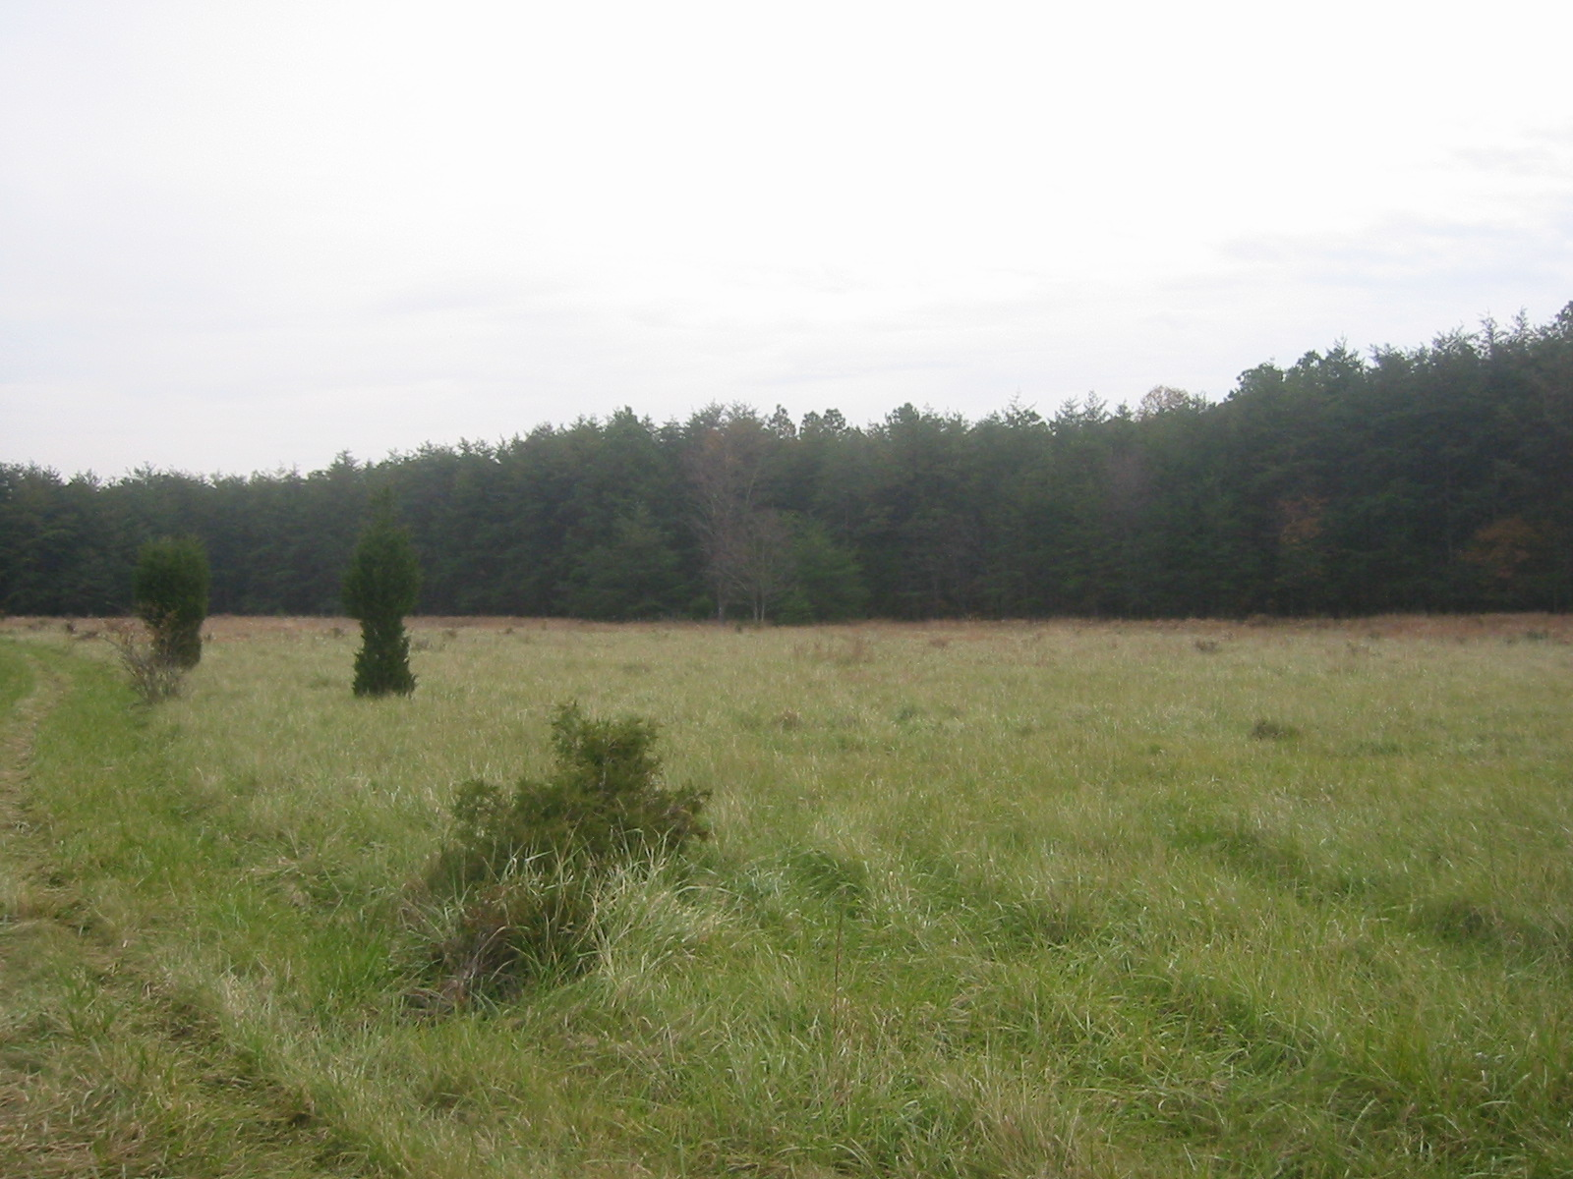
Atmospheric Mercury
Measurements and Modeling:
NOAA Air Resources Laboratory
Mark Cohen, Winston Luke, Xinrong Ren,
Paul Kelley, Roland Draxler, Richard Artz
NOAA Air Resources Laboratory (ARL)
College Park, MD, USA
Toxic Contaminants Full Workgroup Meeting
May 13, 2015, Annapolis MD
Notes:
Mark Cohen participated in the mercury portion of the discussion remotely…

Slide 2
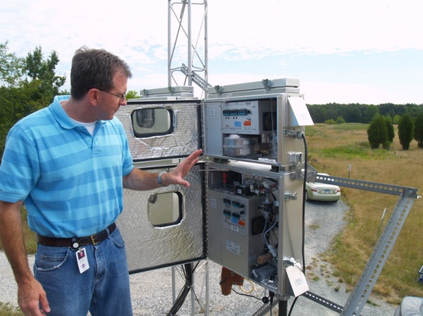
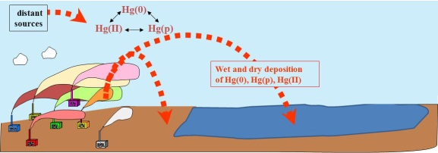
Mercury: Measurements and Modeling
MEASUREMENTS
speciated atmospheric mercury
Modeling used to aid in data interpretation and measurement planning
other air pollutants, e.g., SO₂, O₃, CO
wet deposition
air-surface exchange
MODELING
back trajectories
Measurements used for model evaluation and improvement
comprehensive fate and transport
source-attribution for deposition
Notes:
We have two basic approaches in our mercury research program at ARL – measurements and modeling. They are independent and also integrated. One key objective is to produce policy-relevant results, and to work towards reducing the uncertainties in these results. Another key objective is determining and understanding spatial and temporal trends.
The picture shows Winston Luke and the Tekran speciated mercury samplers (reactive gaseous mercury and fine particulate mercury) and the tower at Beltsville, MD, a comprehensive monitoring site representing a long-term collaboration between EPA and NOAA
One example of how the measurements are being used to aid in modeling is an ongoing model evaluation program in which the HYSPLIT-Hg model is being run for specific episodes at our Grand Bay and Beltsville sites, and the model predictions are being compared against the measurements. High resolution met data (e.g., 4 km) is being generated at ARL to support and enhance this analysis.
One example of how the modeling helps the measurements is the forecasting work done to aid in scientific mission planning. This is illustrated by the daily HYSPLIT-Hg model forecasts of anthropogenic mercury plumes to inform daily decisions about flight planning in the Grand Bay Mercury Intensive (1st phase was carried out summer 2010 and 2nd phase is going on right now (April 15-May 15).

Slide 3

Different “forms” of mercury in the atmosphere
Elemental Mercury -- Hg(0)
most of total Hg in atmosphere
doesn’t easily dry or wet deposit
globally distributed
Elemental Mercury -- Hg(0)
most of total Hg in atmosphere
doesn’t easily dry or wet deposit
globally distributed
?
Reactive Gaseous Mercury -- RGM
a few % of total atmos. Hg
oxidized Hg (HgCl₂, others)
very water soluble and “sticky”
bioavailable
Reactive Gaseous Mercury -- RGM
a few % of total atmos. Hg
oxidized Hg (HgCl₂, others)
very water soluble and “sticky”
bioavailable
Particulate Mercury -- Hg(p)
a few % of total atmos. Hg
Hg in/on atmos. particles
atmos. lifetime 1~ 2 weeks
bioavailability?
Particulate Mercury -- Hg(p)
a few % of total atmos. Hg
Hg in/on atmos. particles
atmos. lifetime 1~ 2 weeks
bioavailability?
?
Notes:
There are three kinds of mercury in the atmosphere. They behave very differently and have different ecological and public health impacts. The forms can inter-covert… Measuring and modeling each of these forms is challenging, but is critical to understand the atmospheric behavior and impacts of mercury. There are many uncertainties in the scientific knowledge regarding atmospheric mercury, e.g., what is RGM? Have we identified all of the significant chemical reactions? Are the currently used reaction rates accurate? The importance of atmospheric methly-mercury as well as its fate and transport is uncertain.
Elemental Mercury -- Hg(0)
most of total Hg in atmosphere
not very water soluble
doesn’t easily dry or wet deposit
upward evasion vs. deposition
atmos. lifetime approx ~ 0.5-1 yr
globally distributed
Reactive Gaseous Mercury -- RGM
a few percent of total atmos Hg
oxidized Hg (HgCl2, others)
operationally defined
very water soluble and “sticky”
atmos. lifetime <= 1 week
local and regional effects
bioavailable
Particulate Mercury -- Hg(p)
a few percent of total atmos Hg
not pure particles of mercury
Hg compounds in/on atmos particles
species largely unknown (HgO?)
atmos. lifetime approx 1~ 2 weeks
local and regional effects
bioavailability?

Slide 4
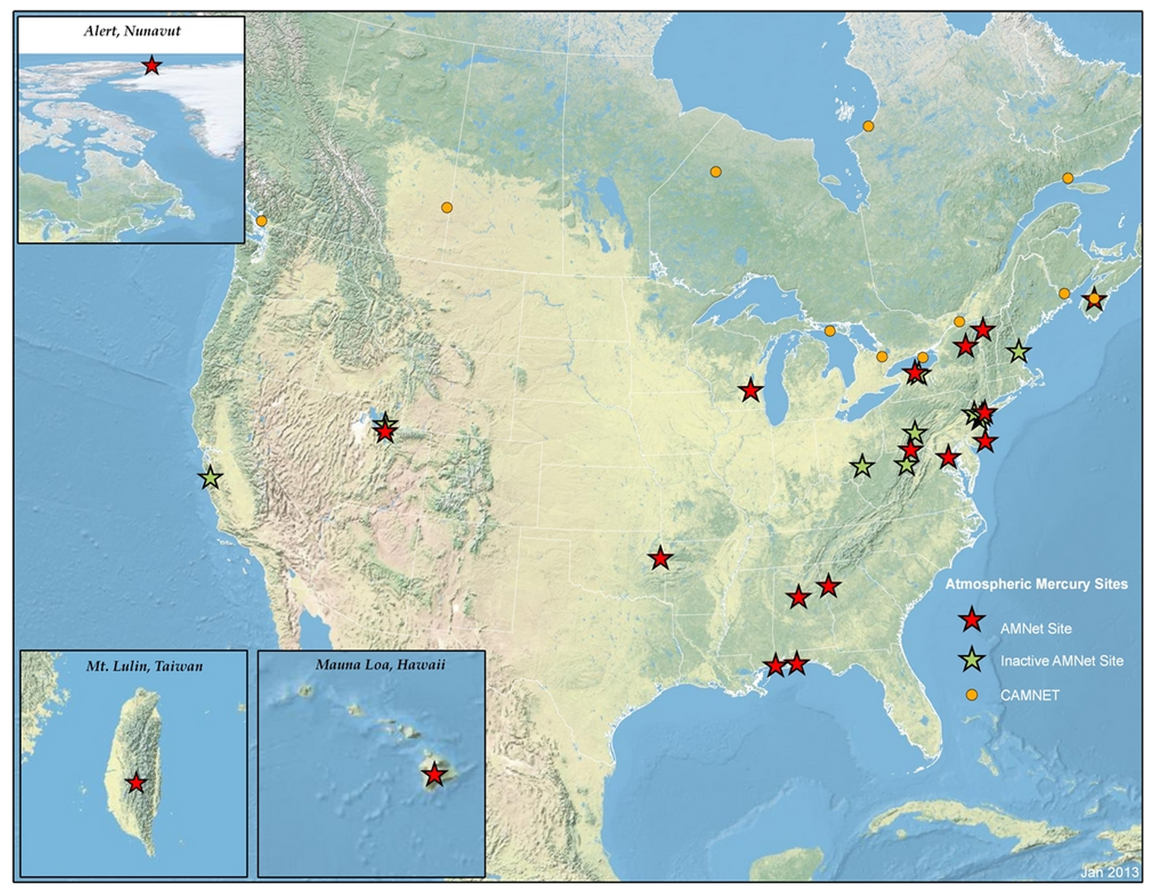
Atmospheric Mercury Concentration Measurement Network (AMNet)
(measuring speciated ambient mercury concentrations)
Piney Reservoir
Mark Castro
Beltsville
NOAA ARL
Grand Bay
NOAA ARL
Mauna Loa
NOAA ARL

Slide 5
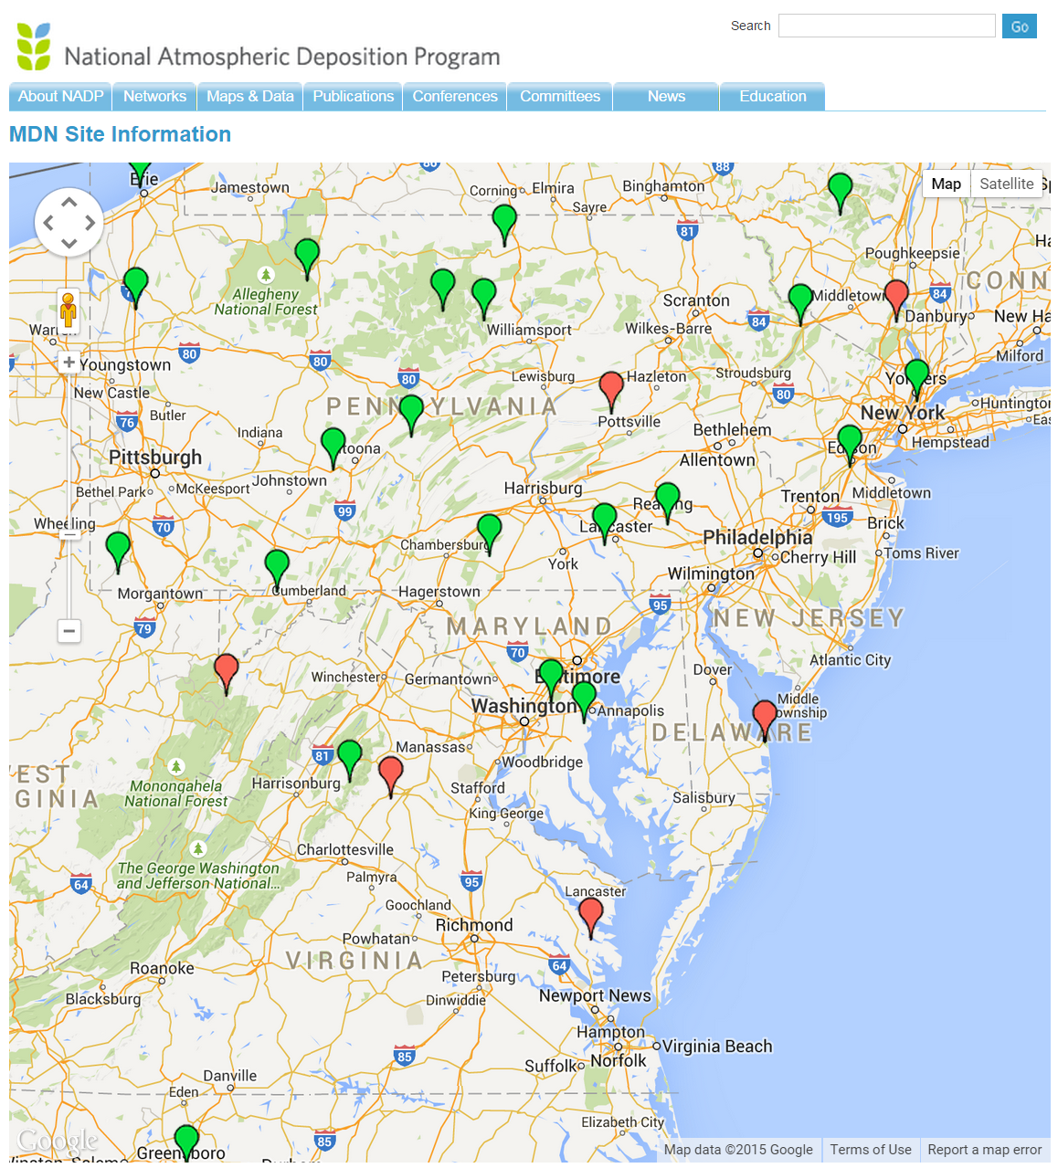
NADP
Mercury Deposition Network
(MDN) sites
in the region
(measuring
wet deposition of mercury)
Piney Reservoir
Beltsville
Red symbols indicate discontinued sites
SERC
Notes:
http://nadp.sws.uiuc.edu/data/sites/map/?net=MDN

Slide 6
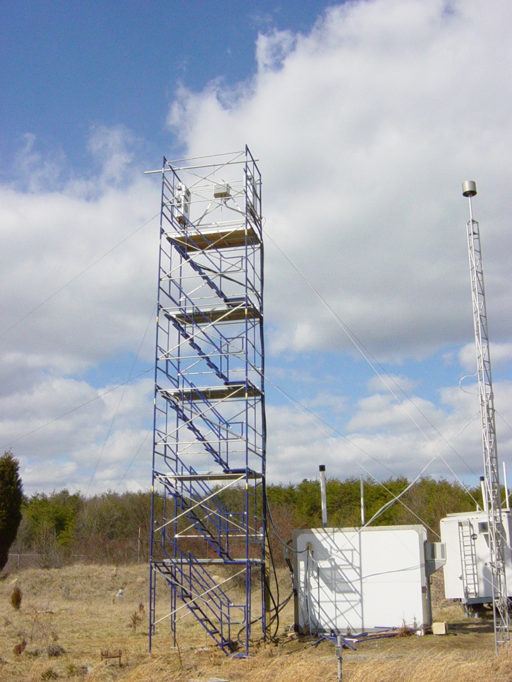
Beltsville Mercury Monitoring Site
Measurements at the site:
Speciated Hg (GEM, GOM, and PBM)
CASTNet measurements (O₃, SO₂, CO, NO, NOy, wind, T, RH, and precipitation)
Weekly NADP/NTN measurements (major ions in precipitation)
MDN (mercury wet deposition).

Slide 7
Mercury Measurements at Beltsville

Slide 8
Atmospheric Mercury Fate Processes
Elemental Mercury [Hg(0)]
Hg(II), ionic mercury, RGM, “GOM”
cloud
Particulate Mercury [Hg(p)]
CLOUD DROPLET
Hg(II)
Hg(II) reduced to Hg(0)
by SO₂ and sunlight
Vapor phase:
Hg(0) oxidized to Hg(II) [and maybe Hg(p)?] by
O₃, H₂0₂, Cl₂, OH, HCl, Br
Adsorption/
desorption
of Hg(II) to
/from soot
Hg(0)
In-plume reduction
of Hg(II) to Hg(0)?
Hg(0) oxidized to dissolved
Hg(II) species by O₃, OH,
HOCl, OCl⁻
Wet deposition
Anthropogenic Emissions
Natural
emissions
Re-emission of previously deposited anthropogenic and natural mercury
Dry deposition
Notes:
Could mention Marine Boundary Layer issues as well... rapid oxidation, deposition, but then some reduction and re-emission, so, potential “churning”

Slide 9

Lagrangian (plume) Modeling with HYSPLIT-Hg
When puffs grow to sizes large relative to the meteorological data grid, they split, horizontally and/or vertically
To simulate the global transport of mercury, puffs are transferred to Eulerian grid after a specified time downwind (~3 weeks), and the mercury is simulated on that grid from then on…
This is how we model the local & regional impacts.
But for global modeling,
puff splitting overwhelms
computational resources
Puffs of pollutant are emitted and dispersed downwind
Atmospheric chemistry and deposition simulated for each puff
9
Notes:
Incorporation of the mercury modeling algorithms into the new GEM-HYSPLIT code was a large scientific programming task.

Slide 10
Eulerian (gridded) Modeling with HYSPLIT-Hg
To simulate the global transport of mercury, puffs are transferred to Eulerian grid after a specified time downwind (~3 weeks), and the mercury is simulated on that grid from then on…
Puffs of pollutant are emitted and dispersed downwind
10
Notes:
Incorporation of the mercury modeling algorithms into the new GEM-HYSPLIT code was a large scientific programming task.

Slide 11
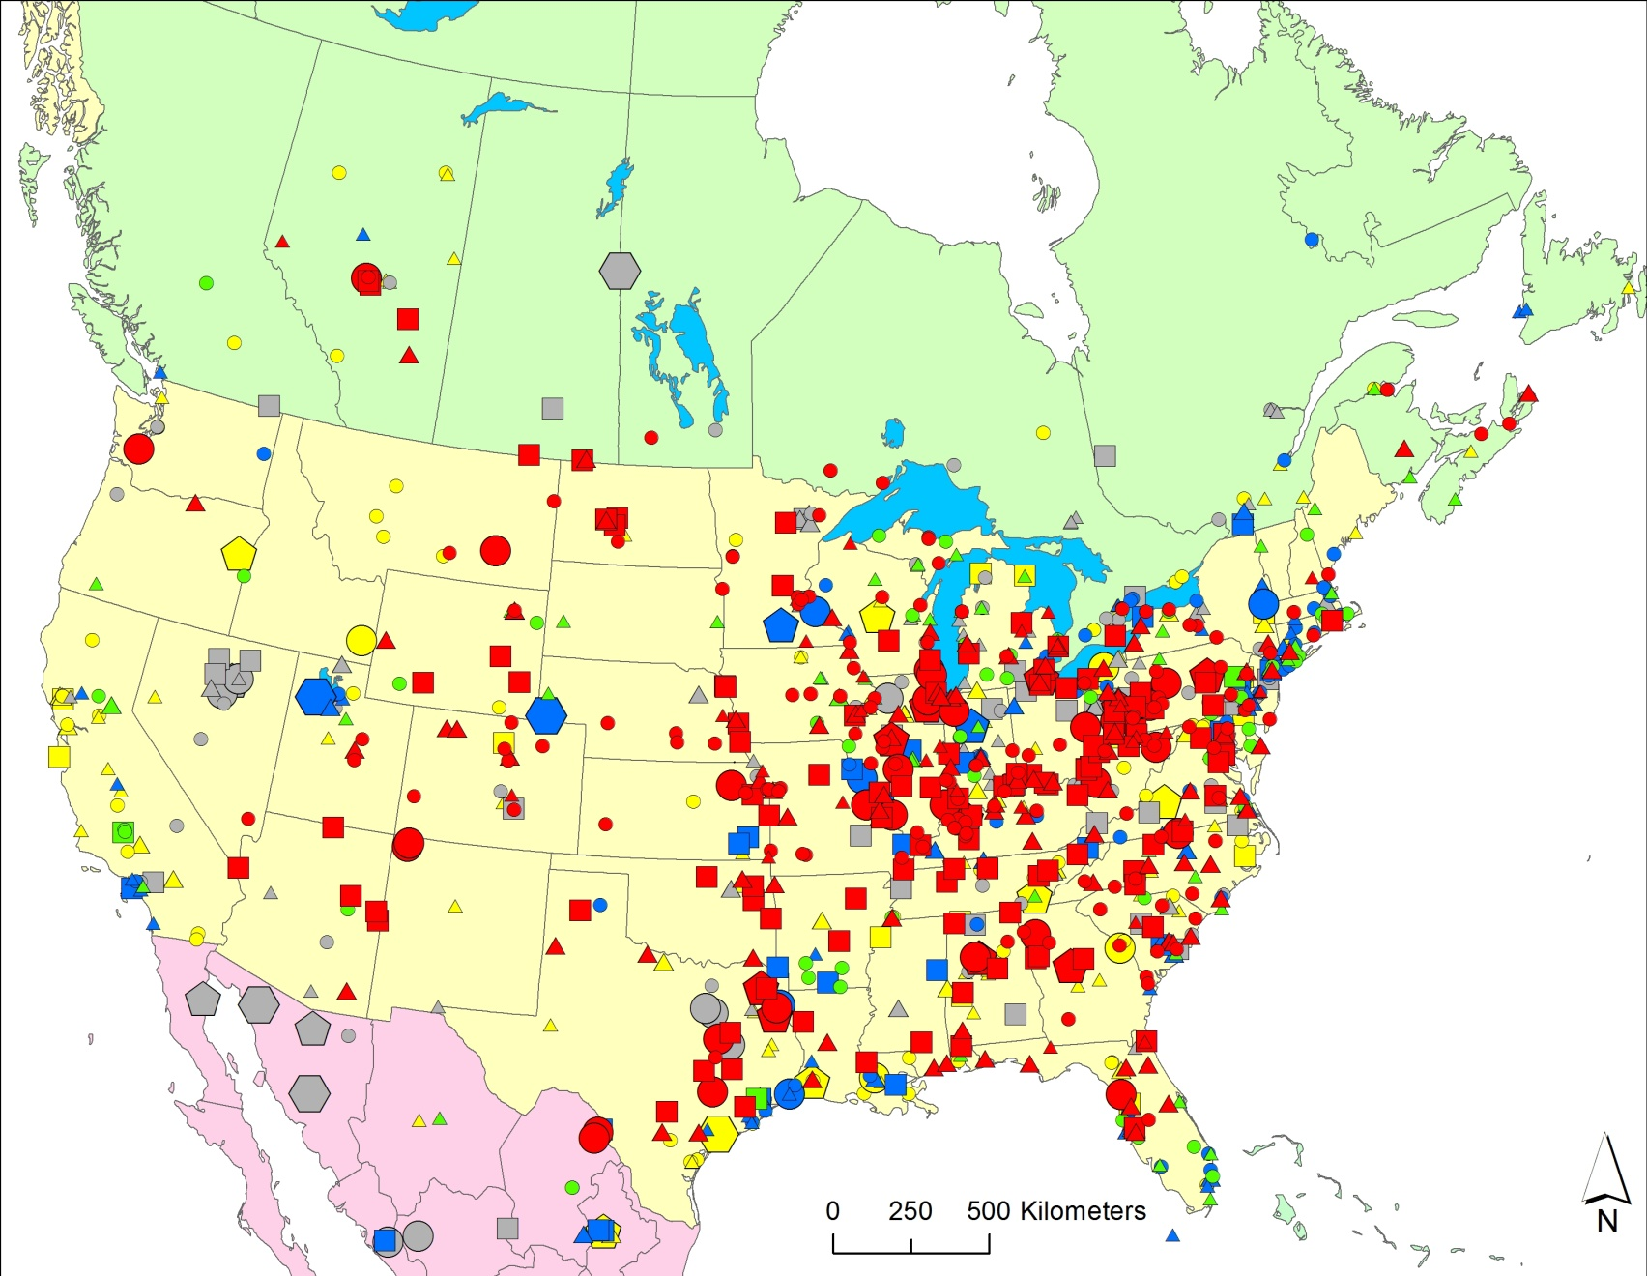
2005 Atmospheric Mercury Emissions from Large Point Sources
Emissions
(kg/yr)
5-10
10-50
50-100
100–300
300–500
500–1000
1000–3000
Type of Emissions Source
coal-fired power plants
other fuel combustion
waste incineration
metallurgical
manufacturing & other

Slide 12
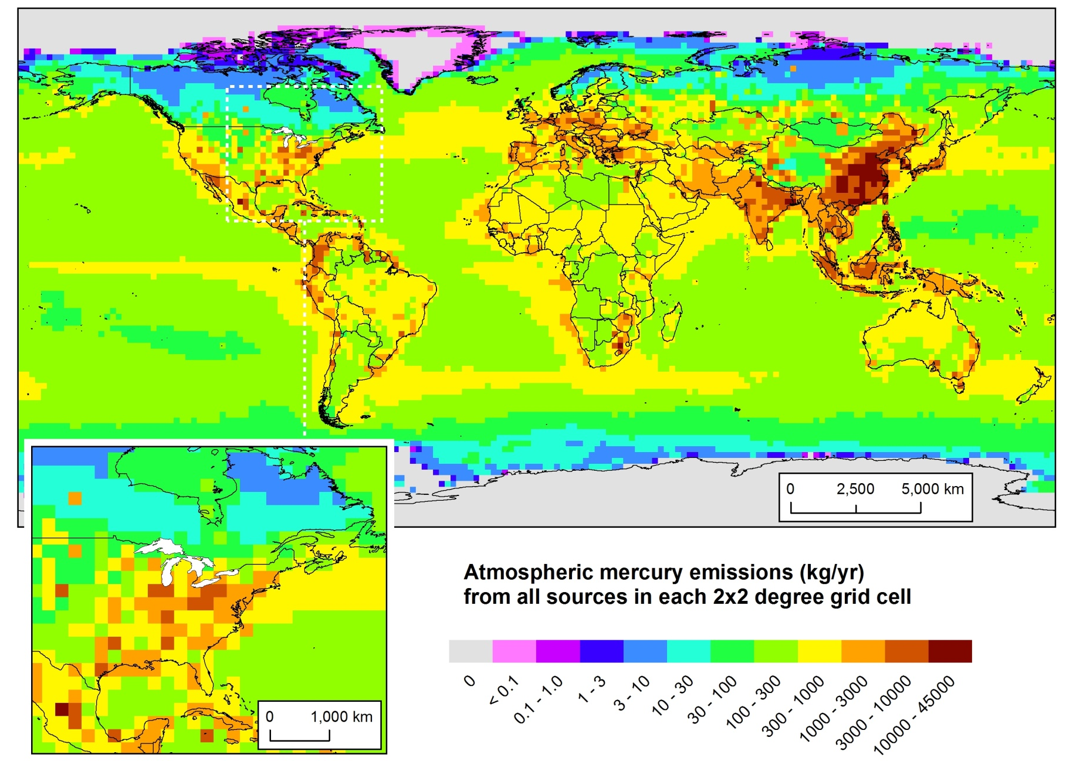
2005 Atmospheric Mercury Emissions
(Direct Anthropogenic + Re-emit + Natural)
Policy-Relevant
Scenario Analysis
Notes:
Here’s where the mercury is emitted from... But what is the relative importance of different source regions to atmospheric deposition of mercury to sensitive U.S. ecosystems, e.g., the Great Lakes? Does most of it come from China?
Data for 2005, from USEPA, Environment Canada, NILU (Norway), and others. Assembled for the GLRI FY2010 modeling project.
Looking at this emissions map, its easy to think that the dominant contributor to Great Lakes mercury might be emissions from China.

Slide 13
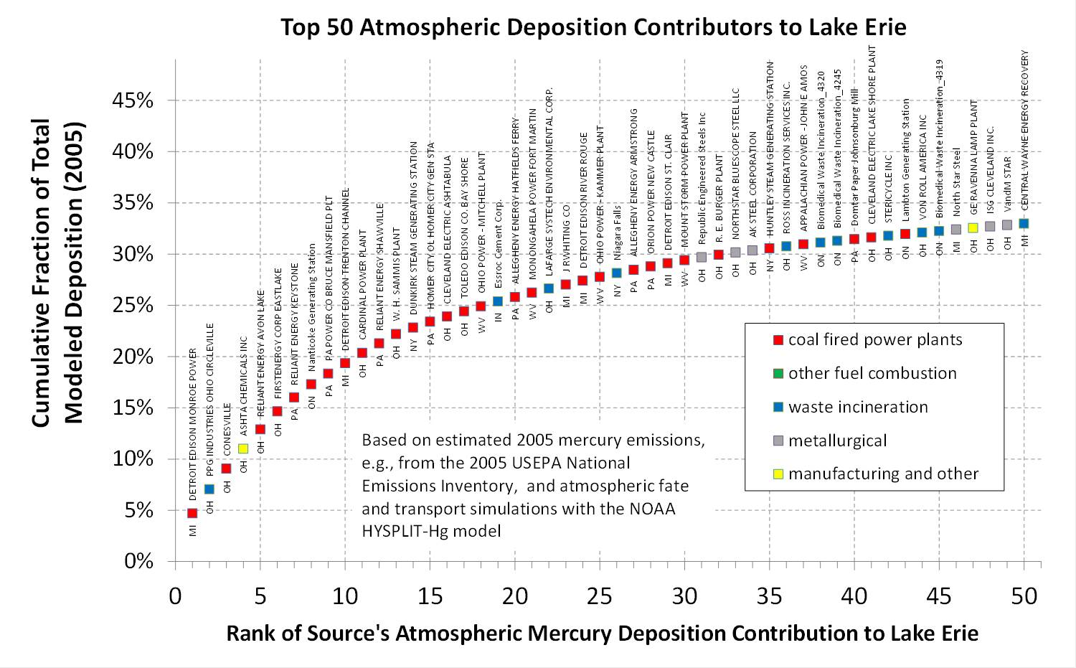

Slide 15
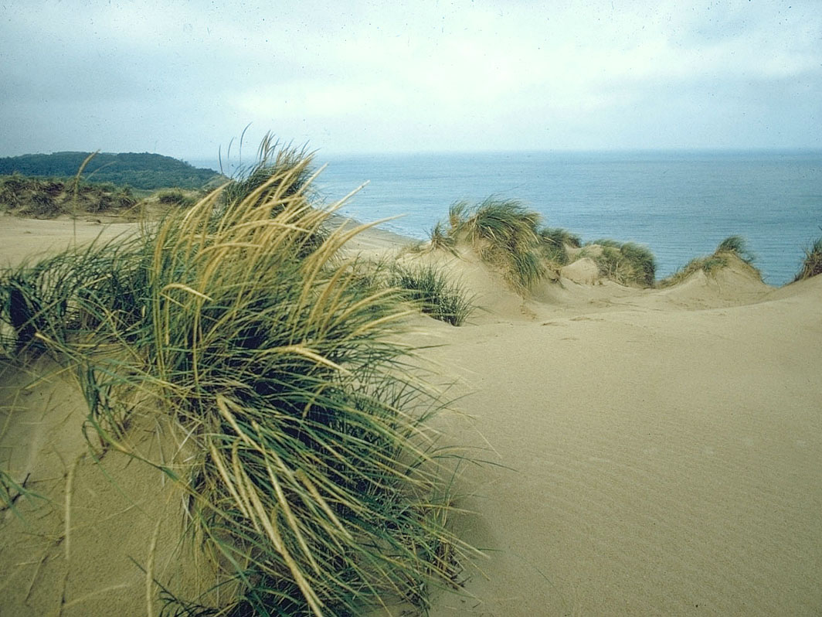

Thanks!
This work was partially funded through the Great Lakes Restoration Initiative

Slide 16
EXTRA
SLIDES

Slide 17
Mercury
Emissions

Slide 18
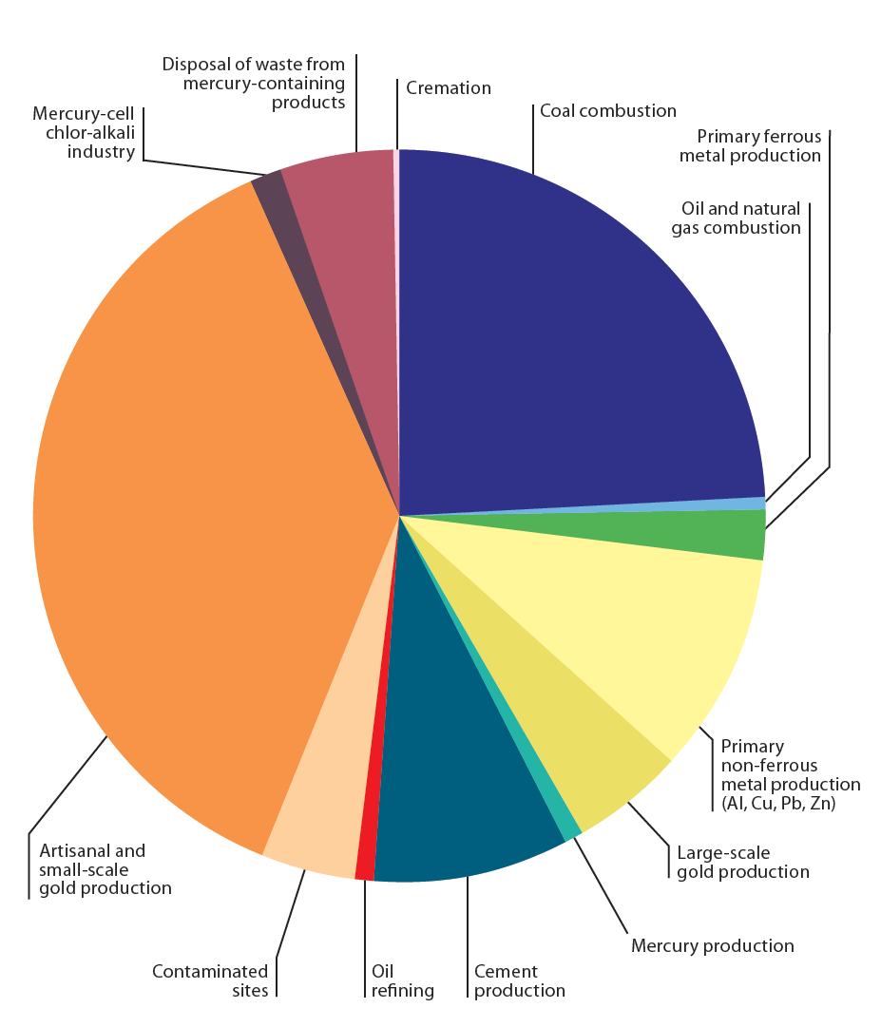
Proportions of
global anthropogenic mercury emissions to air in 2010 from different sectors
AMAP/UNEP, 2013. Technical Background Report for the Global Mercury Assessment 2013. Arctic Monitoring and Assessment Programme, Oslo, Norway/UNEP Chemicals Branch, Geneva, Switzerland. vi + 263 pp.
Available at: http://www.amap.no/documents/doc/technical-background-report-for-the-global-mercury-assessment-2013/848

Slide 19
Atmospheric Mercury Emissions in and around Maryland

Slide 20
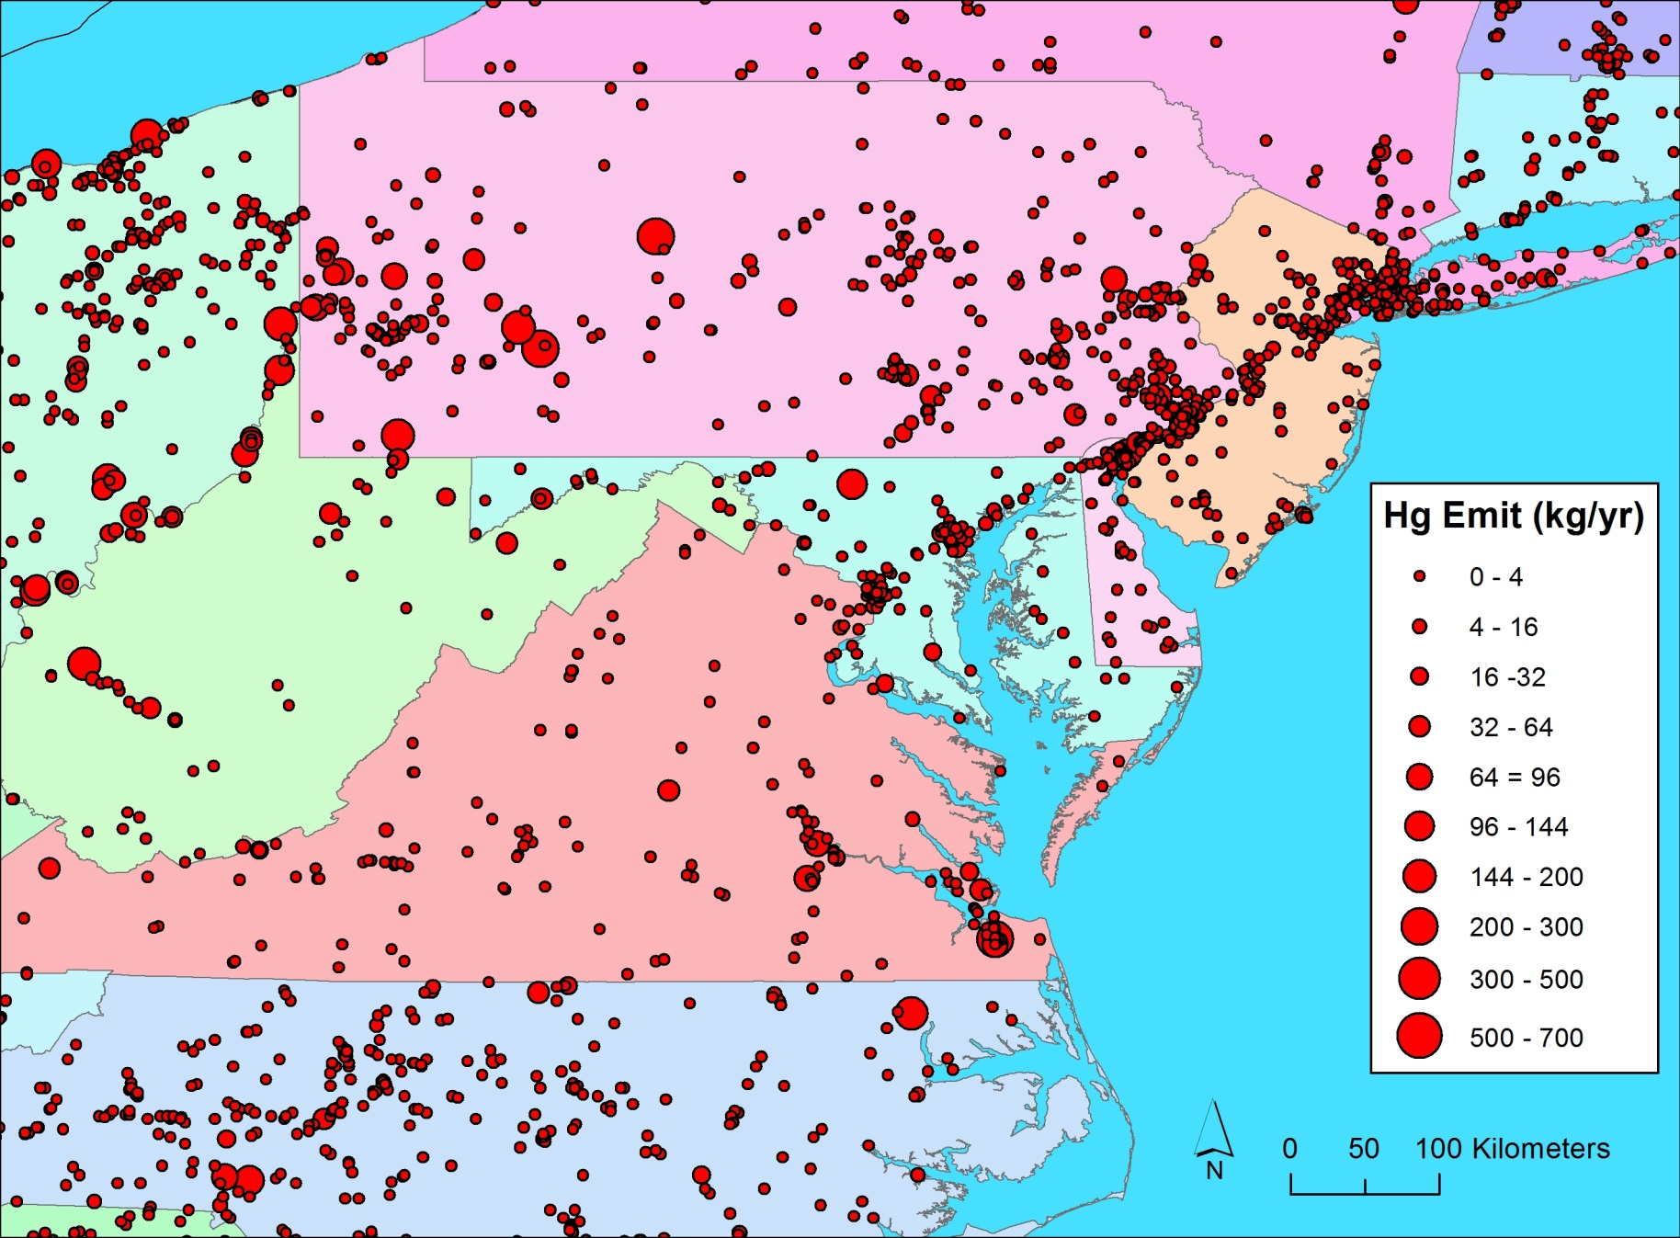
Total Point-Source Facility Mercury Emissions, 2011 USEPA NEI
Notes:
Large source in MD is Lehigh Cement (102.6 kg/yr)

Slide 21
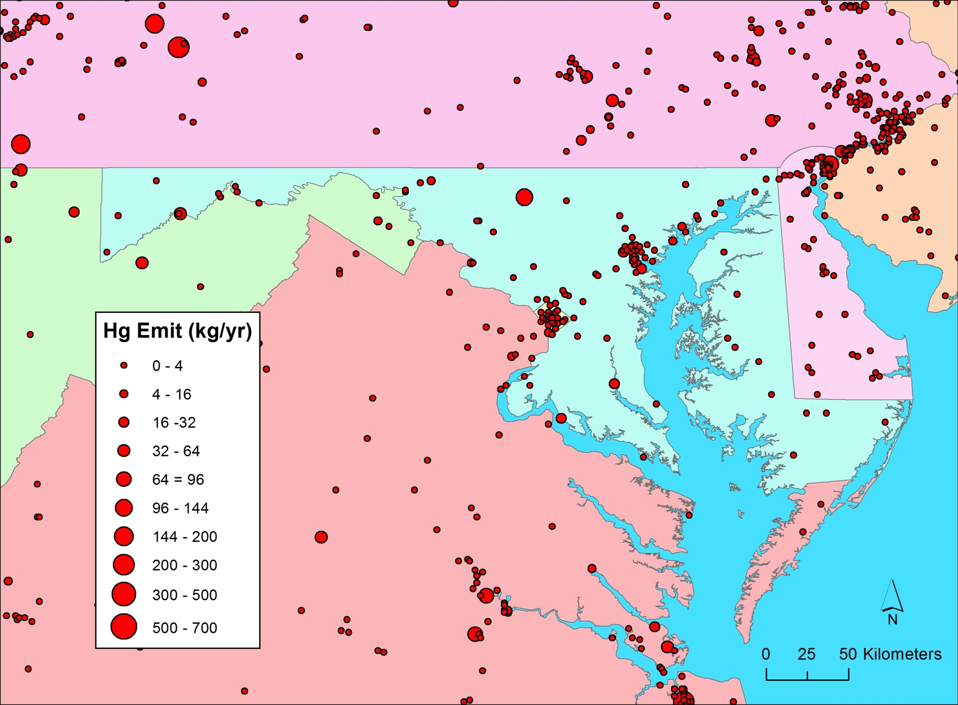
Total Point-Source Facility Mercury Emissions, 2011 USEPA NEI

Slide 22
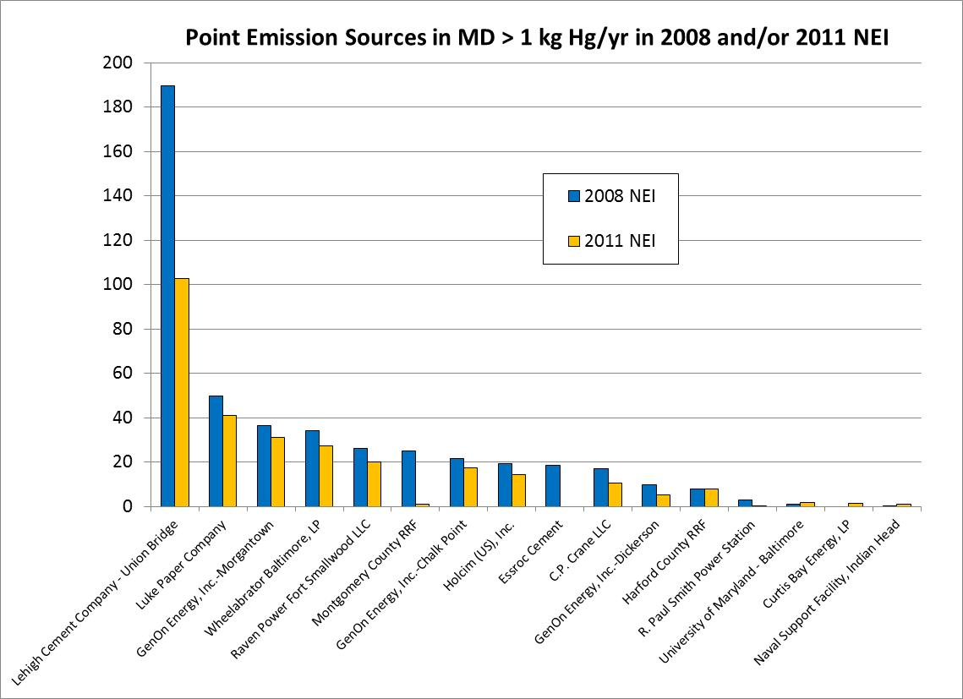

Slide 23
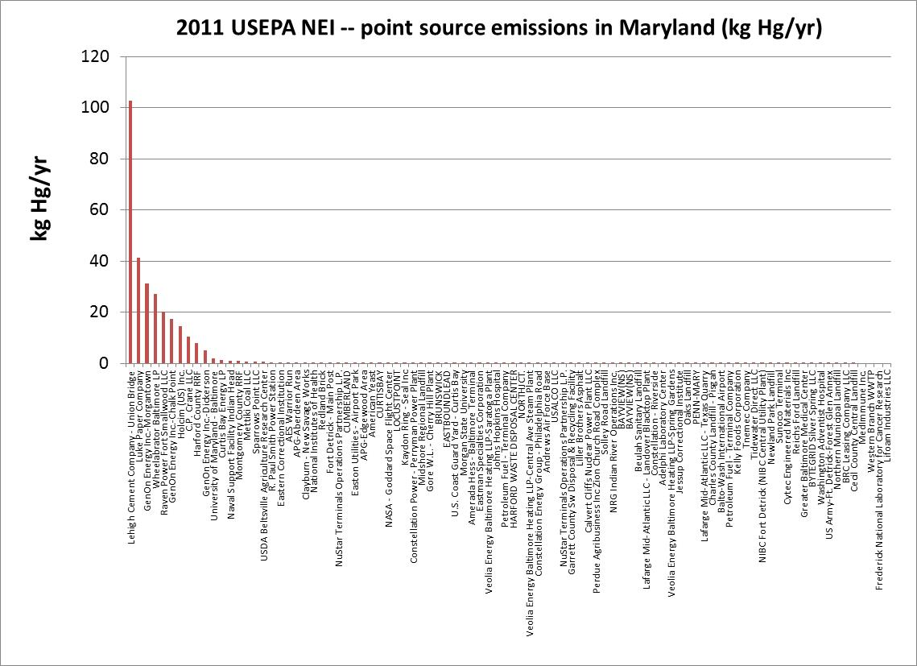

Slide 24
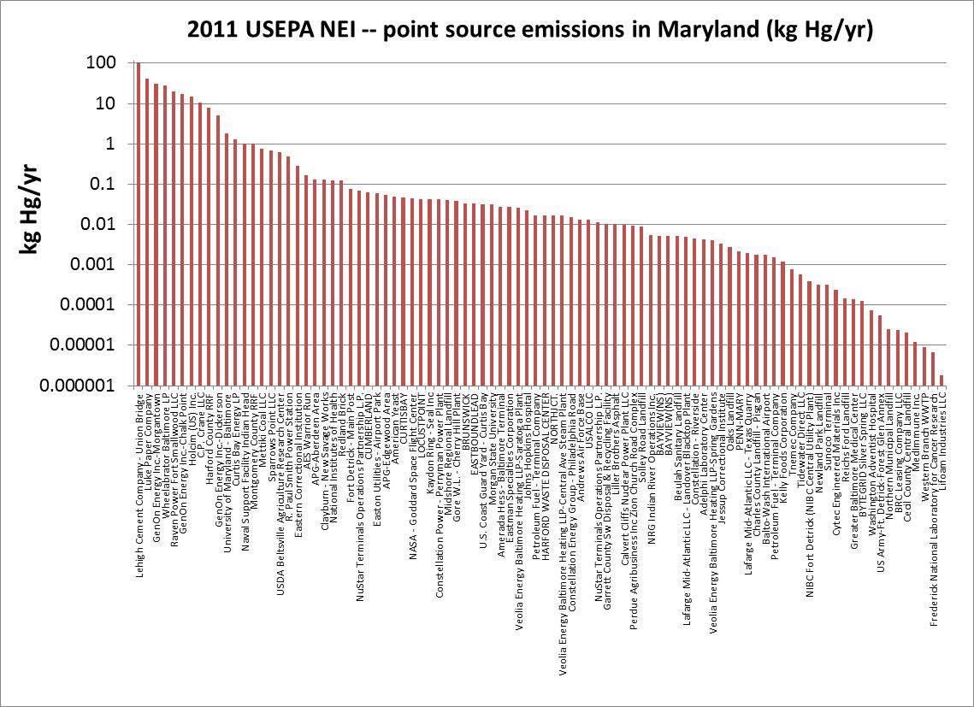

Slide 25
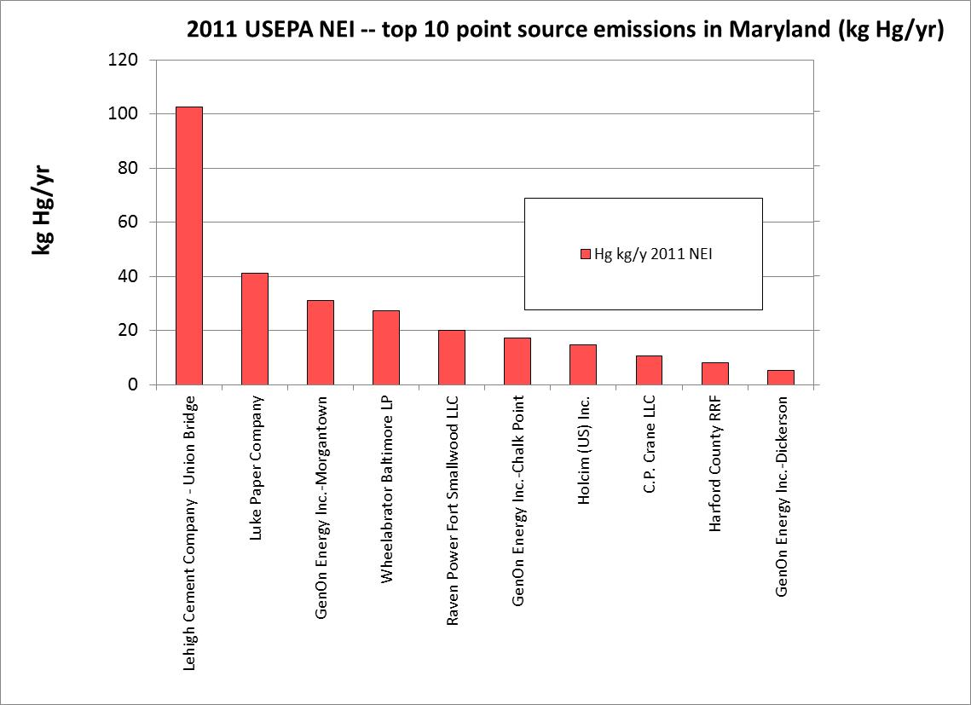

Slide 26
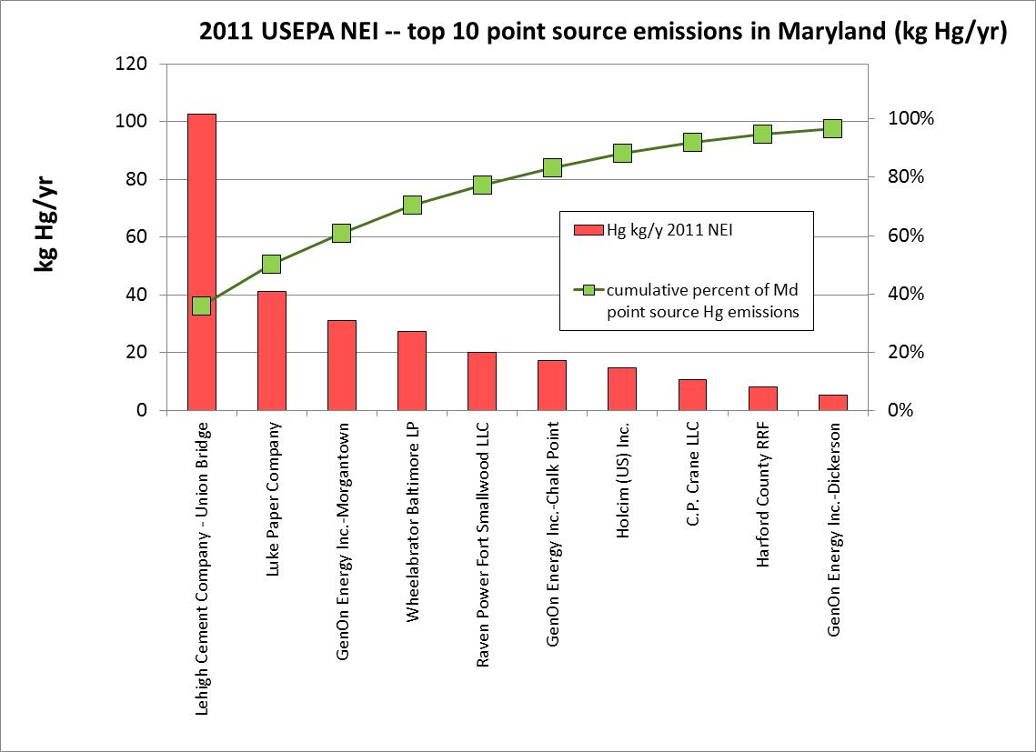

Slide 27
Regional Hg Emission Inventory
MD99

Slide 28
NOx Emissions
Significant NOx emission reduction especially during 2009/2010.
Notes:
Significant emission reduction in both NOx in the areas near the Beltsville site from 2005 to 2013, especially the significant reduction during 2009/2010.

Slide 29
SO₂ Emissions
Significant SO₂ emission reduction during the last 10 years.
Notes:
Significant emission reduction in SO₂ in the areas near the Beltsville site from 2005 to 2013, especially the significant reduction during 2009/2010.

Slide 30
Ambient Mercury Air Concentration Measurements at Beltsville

Slide 31
Measurement Statistics
Statistics of measured hourly concentrations of GEM, GOM, and PBM at the Beltsville site in Maryland. Minimum concentrations for GOM and PBM were zero (not shown).
Notes:
Here is one example by Lyman et al. which show

Slide 32
Seasonal Variations
GEM: relative constant in winter/spring/summer, lower in fall
GOM: higher in spring, lower in summer/fall
PBM: higher in winter, lower in summer/fall

Slide 33
Diurnal Variations
GEM: max. in mid-AM and min. in late PM/early evening
GOM: higher in mid-day, lower at night (close to zero)
PBM: higher in the morning, lower at night.

Slide 34
GEM Trend
A slight decreasing trend: ~0.01 ng m⁻³ per year

Slide 35
GOM Trend
A slight decreasing trend: ~0.6 pg m⁻³ per year

Slide 36
PBM Trend
A slight increasing trend: ~0.5 pg m⁻³ per year

Slide 37
Summary
Eight years of continuous measurements of mercury speciation with current measurements still on-going.
GEM: a slight decreasing trend of ~0.01 ng m⁻³ yr⁻¹, minimum in fall, peak in the morning and low in the early evening.
GOM: a slight decreasing trend (0.6 pg m⁻³ yr⁻¹), high in spring and peak in mid-day.
PBM: a slight increasing trend (0.5 pg m⁻³ yr⁻¹), peak in the early morning probably due to morning rush hour.
Significant emissions in SO₂ and NOx esp. after 2009, but only slight reduction in GOM and GEM with slight increasing in PBM, indicating that either mercury concentrations are affected more by “global pool” than by regional emissions, or the reduction of mercury emissions may not be as much as the reduction of SO₂ and NOx emissions.

Slide 38
Mercury Measurement Challenges
“While there is relative confidence in GEM measurements, GOM and PBM are less well understood.”
“…the methods to measure GOM and PBM are impacted by analytical interferences that vary with environmental setting (e.g., ozone, relative humidity)…”
“Priorities include GOM and PBM calibration systems, identification of GOM compounds in ambient air, and identification of redox mechanisms and associated rate coefficients.”

Slide 39
Modeling

Slide 40
Atmospheric Mercury Chemistry
Oxidation of Hg(0) by O₃ and OH
Reaction rates?
Reaction products?
Do reactions even occur?
Oxidation of Hg(0) by Br
Global 3-D atmospheric concentrations of Br?
Reaction rates?
Other halogens?
Reduction of Hg(II)
How fast? What phases?
How much happens in plumes?
What is mechanism?

Slide 43
Model evaluation summary for one recent set of model runs

Slide 44
In recent years, have been focusing on the Great Lakes, and have been modeling the year 2005.
Primary model evaluation sites were atmospheric concentration and wet deposition measurement sites in the Great Lakes region with data for 2005
Am now transitioning the analysis to more recent year(s) (e.g., 2011) with focus on additional receptors, e.g., Maryland TMDL receptors, etc.
So, now sites in other regions and with more recent data are of great interest…
Beltsville, Grand Bay, Mauna Loa
Piney Reservoir, …

Slide 45
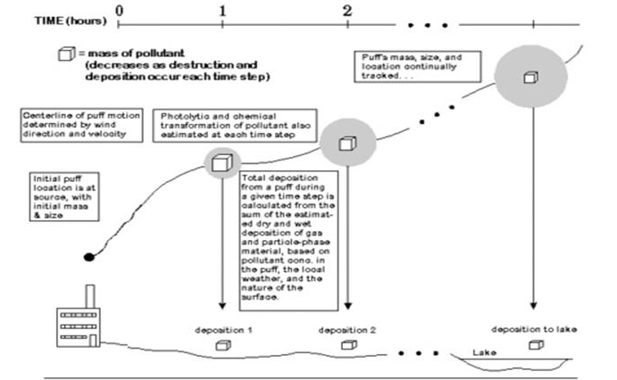
HYSPLIT-Hg Atmospheric Fate & Transport Model:
Lagrangian Component
0
1
2
TIME (hours)
= mass of pollutant
(changes due to chemical transformations and deposition that occur at each time step)
The puff’s mass, size, and location are continuously tracked…
Phase partitioning and chemical transformations of pollutants within the puff are estimated at each time step
Initial puff location is at source, with mass depending on emissions rate
Centerline of puff motion determined by wind direction and velocity
Dry and wet deposition of the pollutants in the puff are estimated at each time step.
deposition 1
deposition 2
deposition to receptor
lake
Notes:
45

Slide 46
(Evolving) Atmospheric Chemical Reaction Scheme for Mercury
Reaction | Rate |  | Units | Reference
GAS PHASE REACTIONS
Hg⁰ + O₃ → Hg(p) | 3.0E-20 | cm³/molec-sec |  | Hall (1995)
Hg⁰ + HCl → HgCl₂ | 1.0E-19 | cm³/molec-sec |  | Hall and Bloom (1993)
Hg⁰ + H₂O₂ → Hg(p) | 8.5E-19 | cm³/molec-sec |  | Tokos et al. (1998) (upper limit based on experiments)
Hg⁰ + Cl₂ → HgCl₂ | 4.0E-18 | cm³/molec-sec |  | Calhoun and Prestbo (2001)
Hg⁰ +OH → Hg(p) | 8.7E-14 | cm³/molec-sec |  | Sommar et al. (2001)
Hg⁰ + Br → HgBr₂
AQUEOUS PHASE REACTIONS
Hg⁰ + O₃ → Hg⁺² | 4.7E+7 | (molar-sec)⁻¹ |  | Munthe (1992)
Hg⁰ + OH → Hg⁺² | 2.0E+9 | (molar-sec)⁻¹ |  | Lin and Pehkonen(1997)
HgSO₃ → Hg⁰ | T*e^{((31.971*T)-12595.0)/T)} sec⁻¹ [T = temperature (K)] |  |  | Van Loon et al. (2002)
Hg(II) + HO₂ → Hg⁰ | ~ 0 | (molar-sec)⁻¹ |  | Gardfeldt & Jonnson (2003)
Hg⁰ + HOCl → Hg⁺² | 2.1E+6 | (molar-sec)⁻¹ |  | Lin and Pehkonen(1998)
Hg⁰ + OCl⁻¹ → Hg⁺² | 2.0E+6 | (molar-sec)⁻¹ |  | Lin and Pehkonen(1998)
Hg(II) ↔ Hg(II) _{(soot)} | 9.0E+2 | liters/gram; t = 1/hour |  | eqlbrm: Seigneur et al. (1998) rate: Bullock & Brehme (2002).
Hg⁺² + hv → Hg⁰ | 6.0E-7 | (sec)⁻¹ (maximum) |  | Xiao et al. (1994); Bullock and Brehme (2002)
?
?
new
?

Slide 47
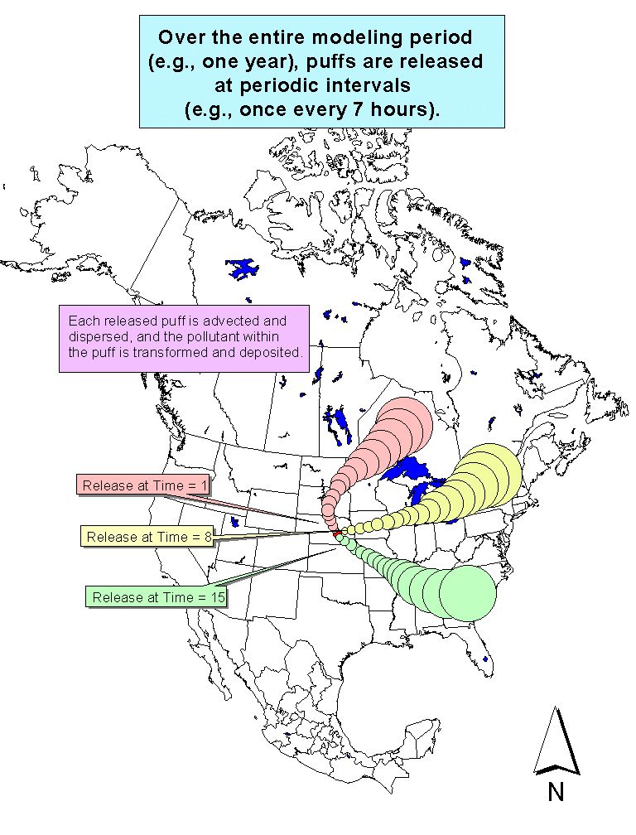
Notes:
47
This is way we typically run the HYSPLIT model. We do a run for one particular source location, and we release puffs periodically throughout the year (e.g., once every 7 hours). We follow each puff and keep track of the dispersion and the fate processes (deposition, transformation, etc.). The model uses the physical-chemical properties of the pollutant we are modeling, of course. By the end of the year, we have a good idea of the average impact that a source in this location would have on the receptors of interest (e.g., the Great Lakes).

Slide 48
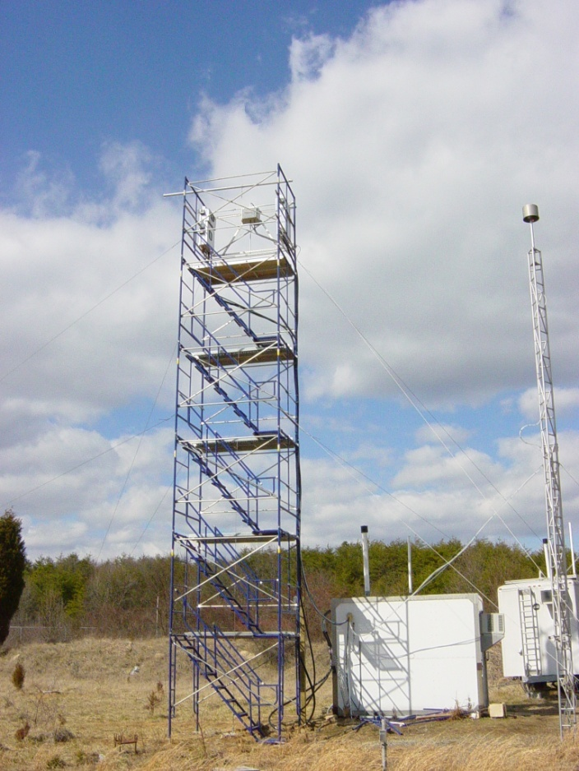
Back Trajectory Analysis – Episodes
Beltsville, Maryland
mercury site
Reactive Gaseous Mercury episode
Notes:
Sometimes we see high peaks of RGM and/or other mercury compounds.
Can we explain what is happening during these episodes? Why was the concentration so high?
Ultimately we want and need to be able to explain the continuous record of measurements at the site, but sometimes it is useful to focus on episodes.

Slide 49
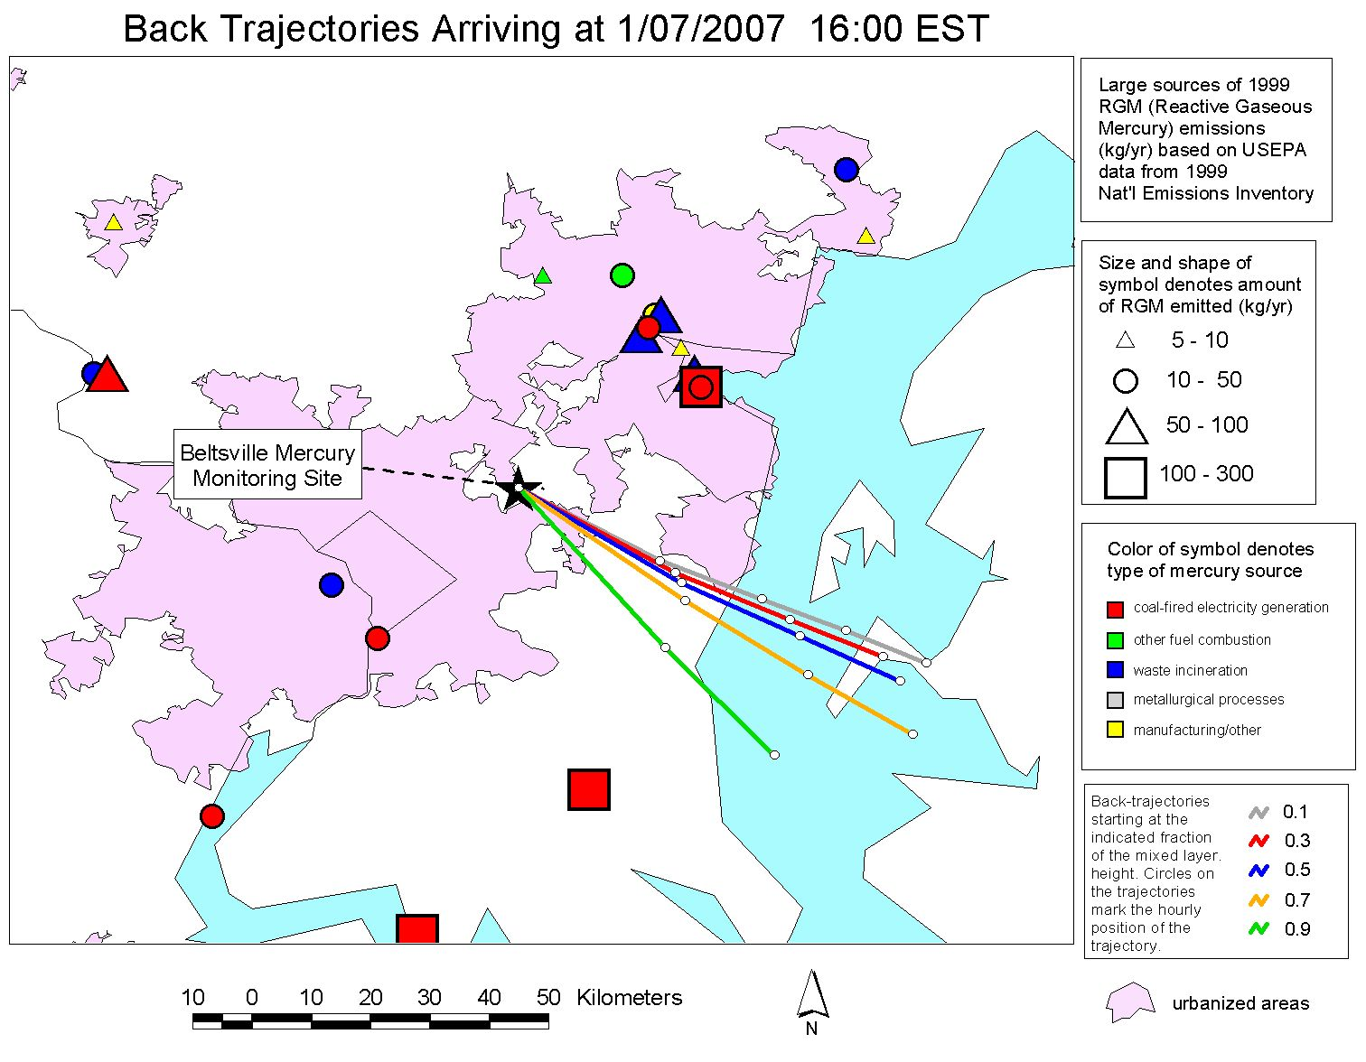
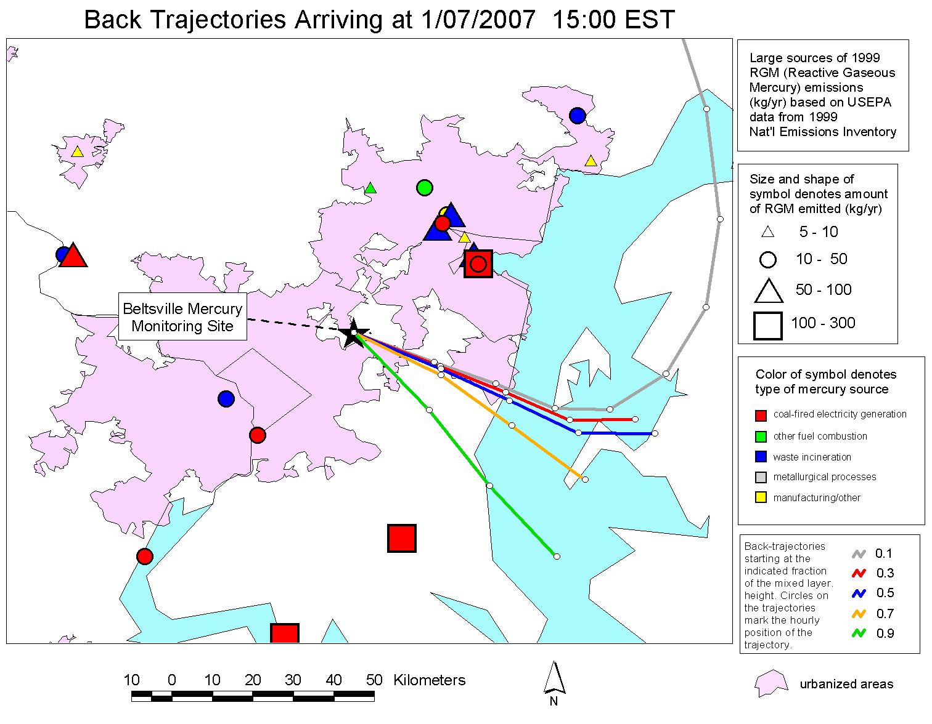
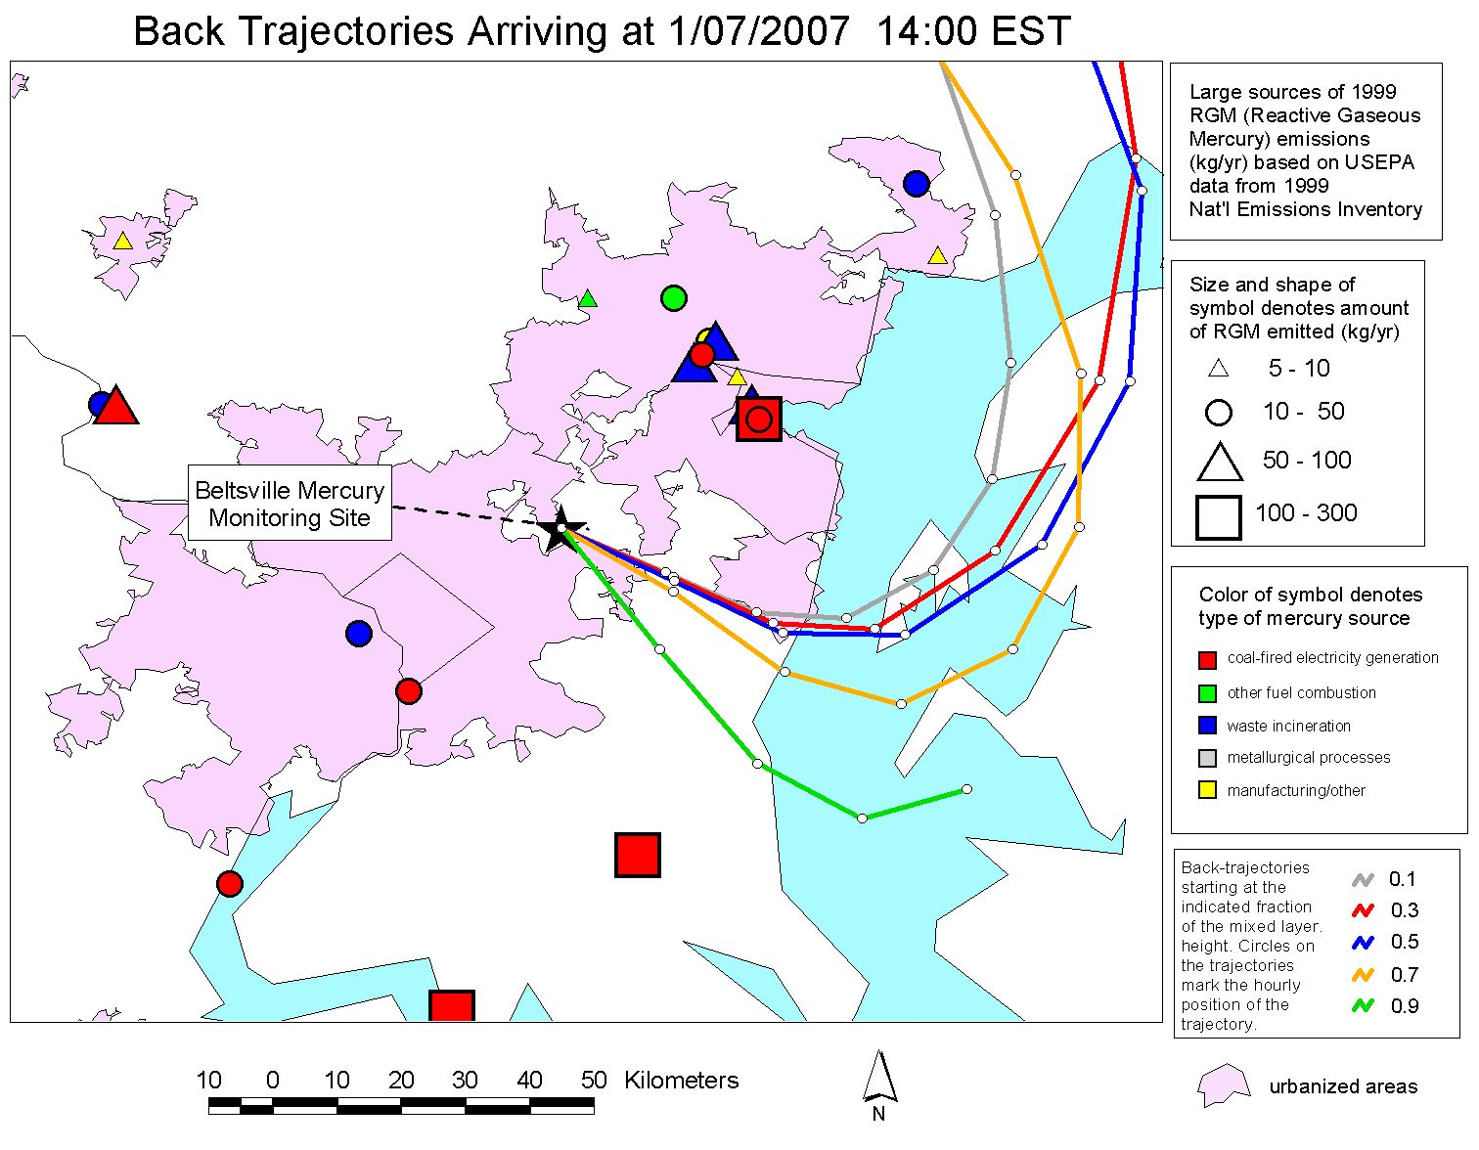
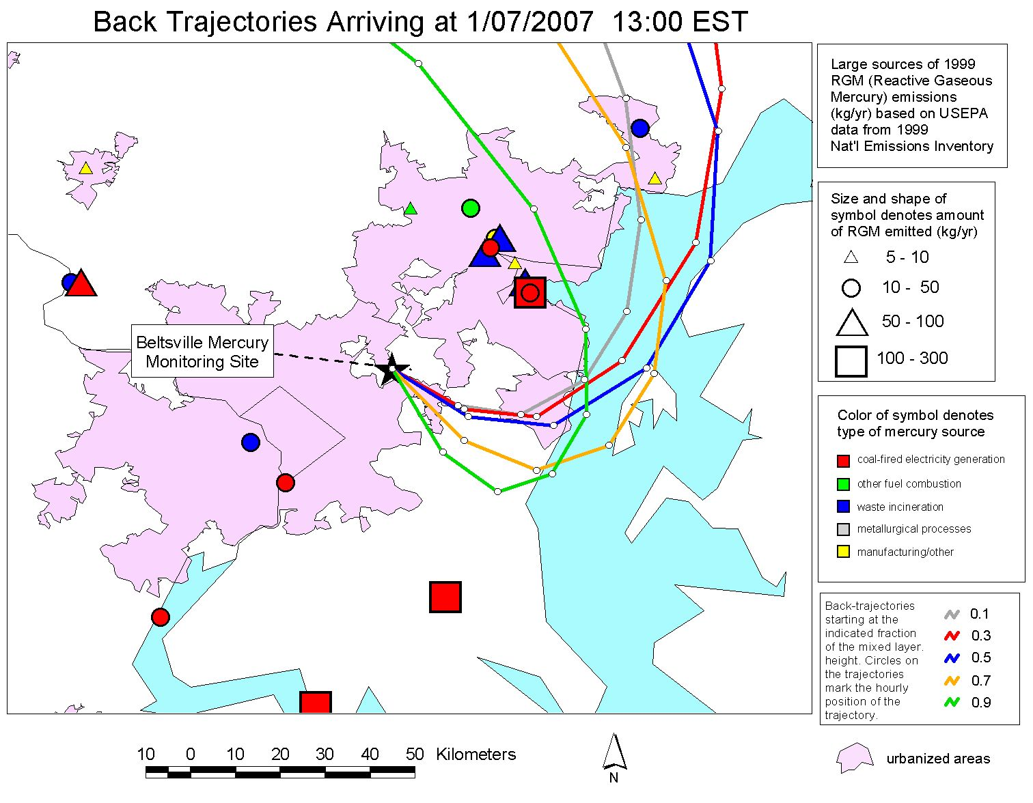
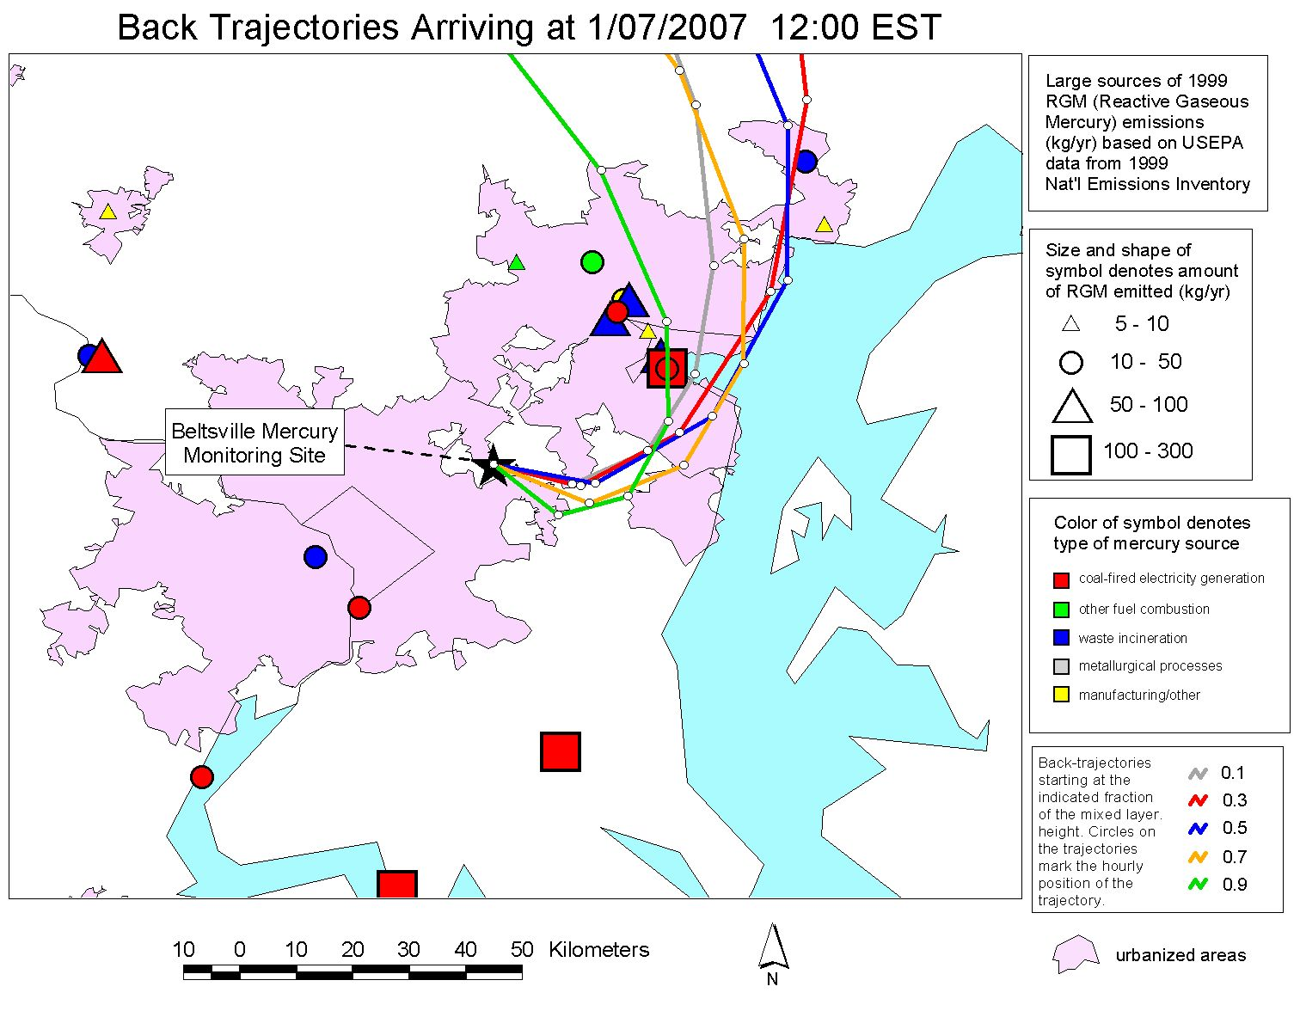
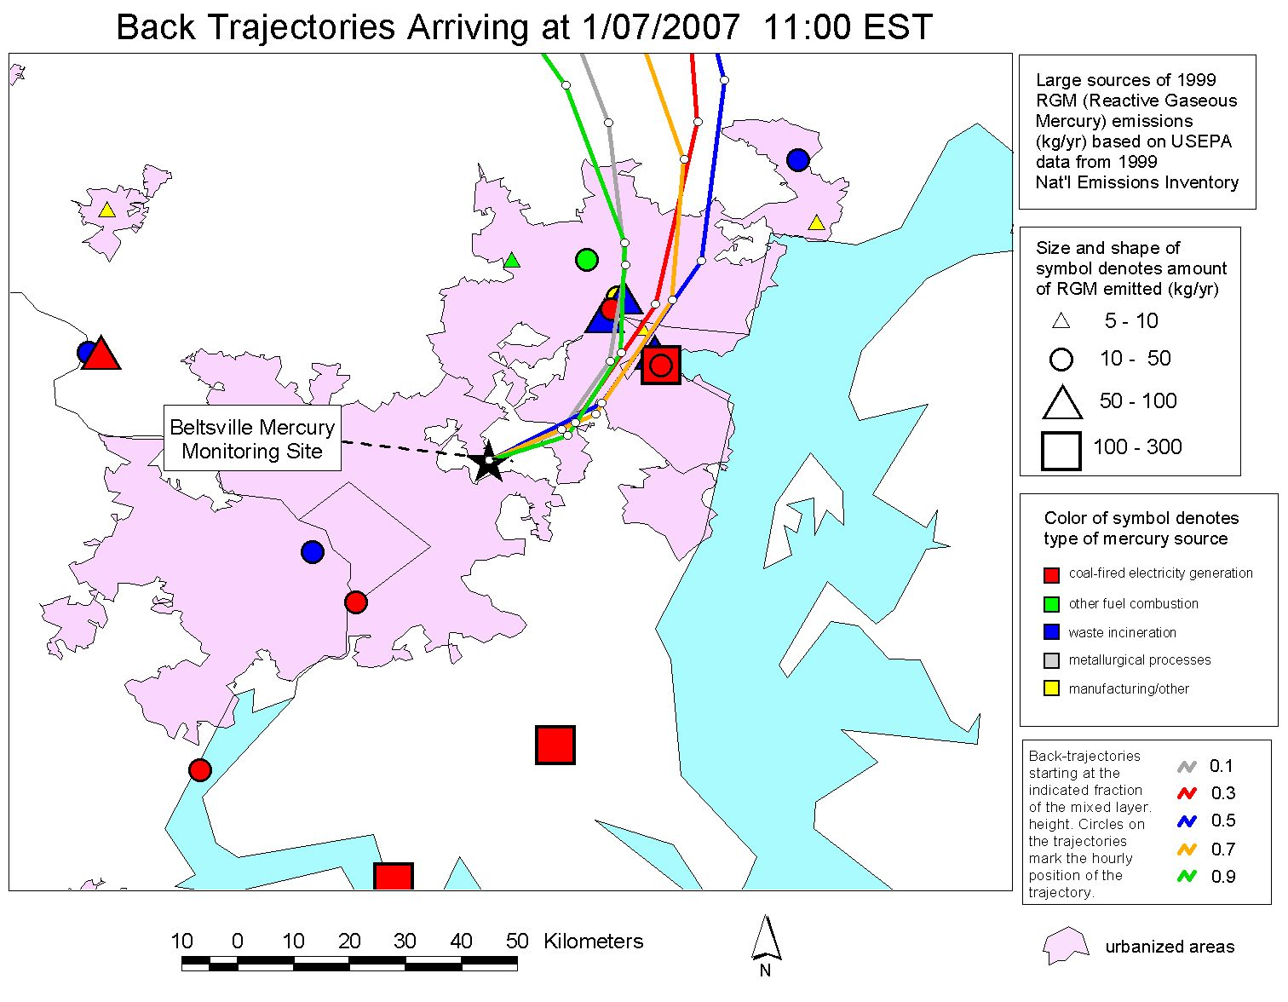

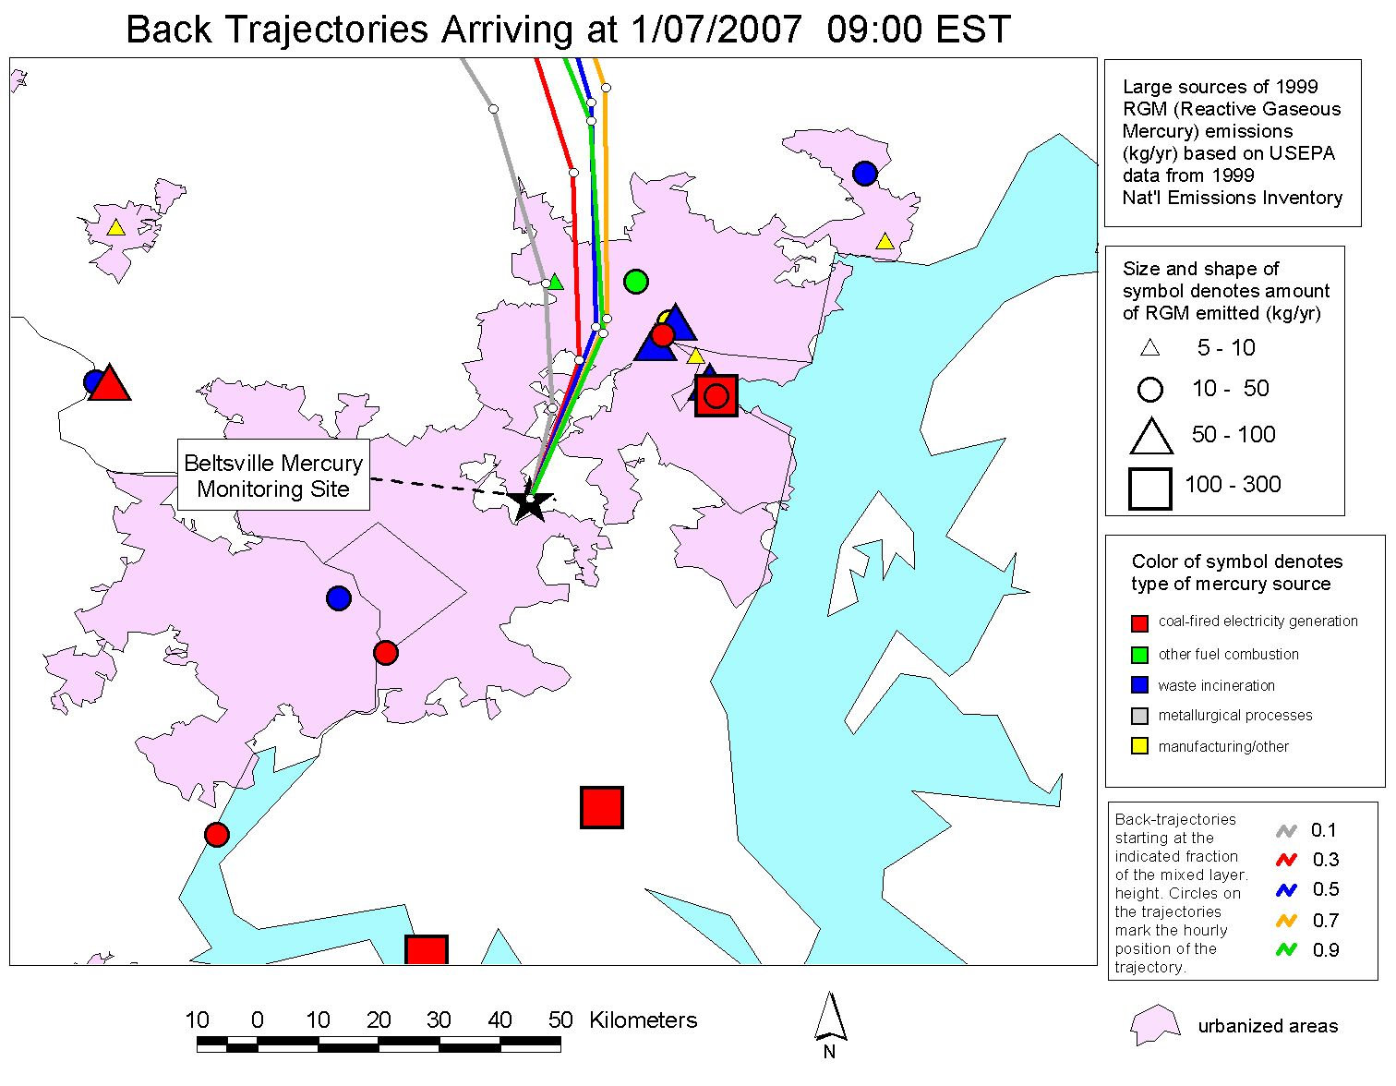
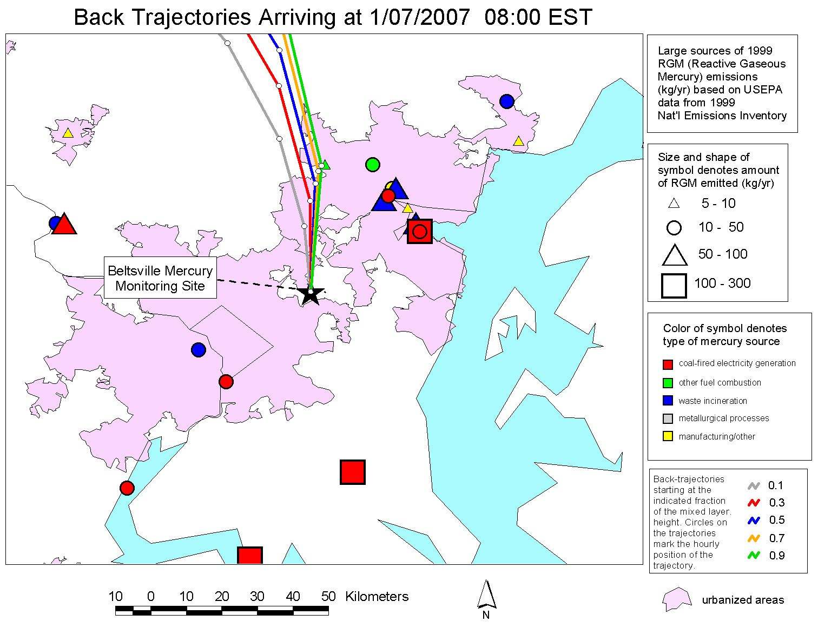
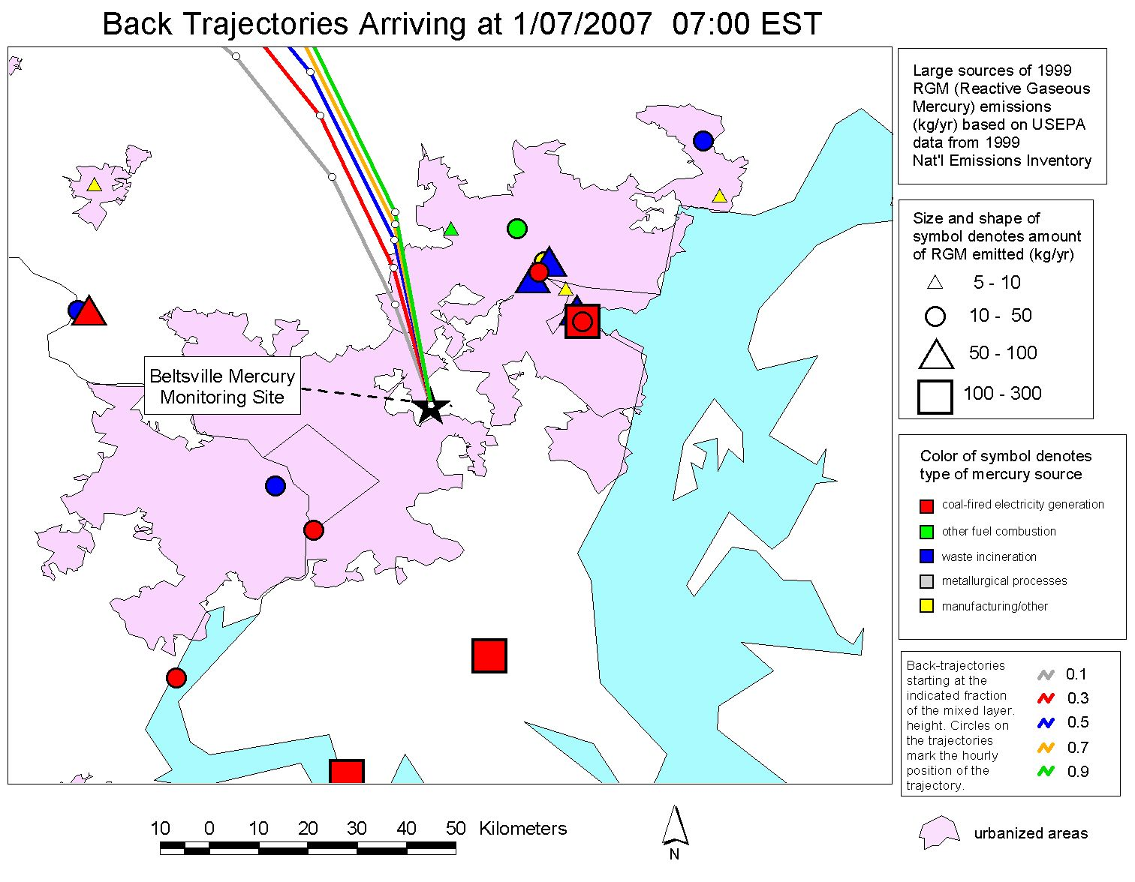
Baltimore
Chesapeake Bay
Washington D.C.
Notes:
When the concentration was high, the air masses appeared to be from a group of significant sources in the Baltimore region northeast of the site.
We have MANY examples of this kind of analysis.
This kind of analysis does not prove that the sources impacted the site and caused the episode, but it is suggestive.
Coupled with other information, this can contribute to a weight-of-evidence approach.

Slide 50
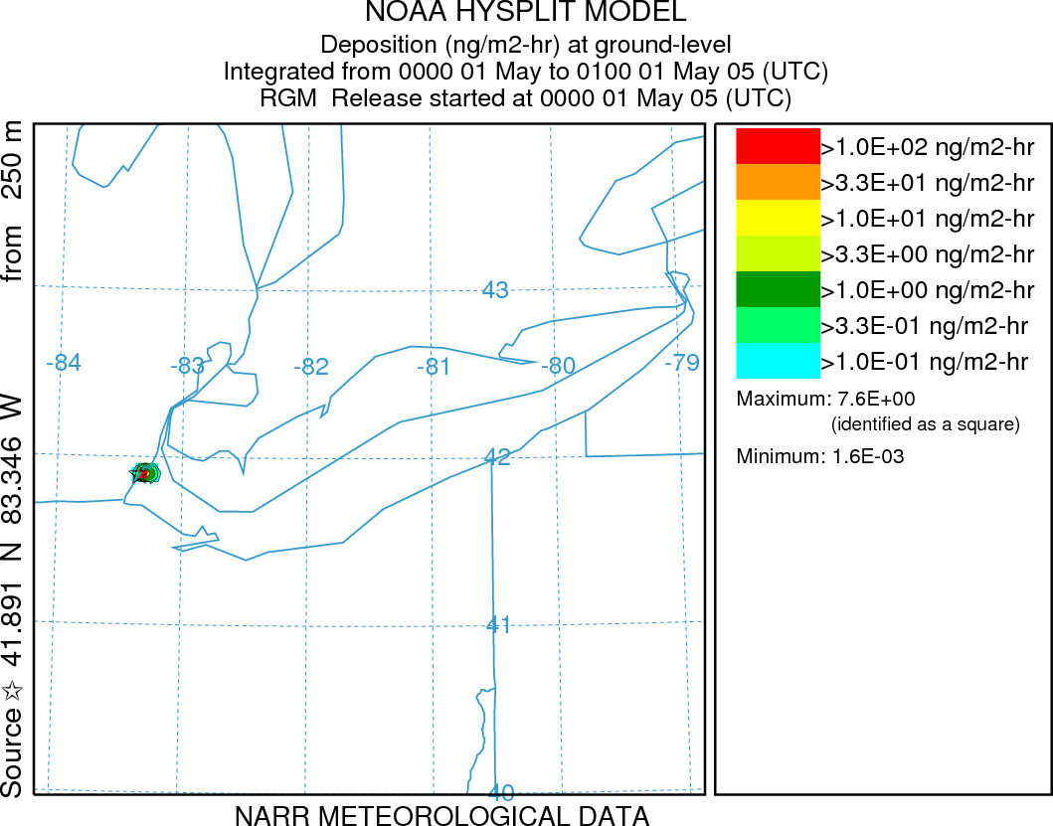
Simulation of Gaseous Oxidized Mercury (GOM)
emissions from one power plant on the shore of Lake Erie:
hourly deposition estimates for the first two weeks in May 2005
Lake Erie
Results scaled to actual GOM emissions of 43.6 g/hr
1 ng/m2-hr = 8.8 ug/m2-yr
(if it persisted the entire year)
Total deposition to Lake Erie is ~20 ug/m2-yr
Notes:
RGM emissions from Monroe plant are 43.61 g/hr according to the 2005 NEI
Elem emissions are 16.44 g/hr, Hgpt emissions are 3.9 g/hr, and total emissions are 64.04 g/hr
Monroe 2005 NEI:
Elem 144.00 kg/yr
RGM 382.00 kg/yr
Hgpt 34.20 kg/yr
Total Hg 561.00 kg/yr

