Slide 1
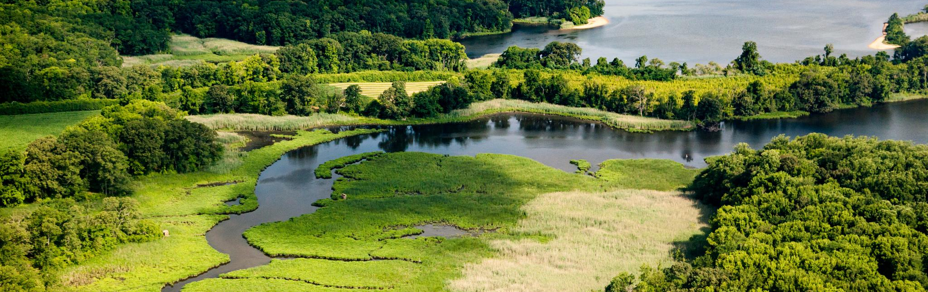


~Day One~ February 24, 2022
Photo Credit: Will Parson/Chesapeake Bay Program

Slide 2
Meeting Goal & Objectives
Meeting Goal
Continue to build community among CAC members and learn more about a key priority of the CAC Water Quality Subcommittee.
Meeting Objectives
Day One: (1) Affirm CAC purpose and identity; (2) Gather insights to refine member engagement and effectiveness and (3) review proposed bylaws revisions.
Day Two: Understand the implications of the Conowingo Dam’s impact and options to address it.

Slide 3
Day 1: Agenda Outline
CAC Business Meeting
Member Spotlights
Communications Products
One Hour Lunch Break
Committee Tune-up and Small Group Sessions (request on camera)

Slide 4
Committee Tune-up: Why are we doing this?
Continue to build community among CAC members
Promote structured time for the full membership to share ideas
improvements to operations
bylaws revisions

Slide 5
Committee Tune-Up: What do we hope to achieve?
Affirm CAC purpose and identity
Promote agreement and ownership of CAC mission
Confirm the boundaries of CAC work
Collect insights to refine member engagement
Daylight ideas to improve CAC operations
Identify internal topics for a future deeper dive
Highlight areas for proposed CAC bylaws revisions
Revisions to Principles
Values and Code of Ethics Additions

Slide 6
Committee Tune-up: How will we take this journey?
Part 1: Where We Are
Recent Operational Changes
Review Charter and Purpose
Review proposed bylaws revisions
Pose questions to “take the temperature” on some issues
No final decisions or voting today
Part 2: Where We Are Headed
Small group discussion
Collect ideas and future internal topics

Slide 7
Questions about the process?

Slide 8
Recent CAC Operational Changes
Intentional recruitment
New member onboarding
Subcommittee structure and function
Virtual and Hybrid meetings
Virtual learning session
More time for small group discussion
Member Spotlights at each quarterly meeting

Slide 9
Constants of the Committee
CAC Charter and Purpose
Specific EPA focus tied to the CAC Grant
Who appoints the members and how many
16 members appointed by Governors/DC Mayor
12 members appointed by Alliance Board
3 designated for Headwater States
Minimum four quarterly meetings a year

Slide 10
CAC Charter & Purpose
6 Tasks in the Bylaws
The Unchanging Foundation:
First and Foremost: You are Advisors
you represent you and your experience
together you are a sample of watershed stakeholders
Your audience is the leadership of the Bay Program
The elected and appointed state/federal officials responsible for meeting the Watershed Agreement goals, including the TMDL
Your advice holds the CBP accountable
you speak truth to power
no other group like this in the CBP

Slide 11
CAC Charter & Purpose
The other 5 functions in the CAC bylaws
flow from and are extensions of your role as advisor…
provide input…
endeavor to understand…
share information…
participate in CBP work…
inform elected officials/decision makers…
CAC is not responsible for nor funded to conduct:
community engagement, project implementation, lobbying

Slide 12
Specific Requirements from EPA
In the CAC Support Grant:
Particular focus on two Outcomes in Chesapeake Watershed Agreement:
Stewardship
Diversity

Slide 13
CAC Bylaws
Proposed Changes
Revisions to Principles
Additions
Value Statement
Code of Ethics
Clarity on:
Reasonable expenses for travel reimbursements
Overnight Accomodations
Volunteer Hours

Slide 14
Bylaws
Article VI: Principles
10 Key Principles- red are proposed changes from the 2019 review
Statements of common goals
How the committee will work
How the members will interact

Slide 15
Bylaws
Principles: Proposed Revisions
Statements of common goals:
The health and restoration of the Bay watershed is the primary goal and motivation for CAC actions and comes before special or jurisdictional interests.
Above all, CAC exists to advise the members of the EC on matters of concern to citizen representatives to the Bay Program…includes advising the PSC….make it clear when representing the CAC or own opinion.
Members bring a variety of valuable perspectives to the work of CAC, all members are expected to We will act on the basis of their best information and understanding to help achieve CAC goals.

Slide 16
Bylaws
Principles: Proposed Revisions
How the committee will work:
focus our collective efforts to strategically and proactively to achieve the greatest contribution to watershed restoration and protection that is possible
comment as a Committee constructively and always with appropriate suggestions and offers of help
collaborate with other Bay advisory committees
As a Committee, we shall adhere to the prudent use of Bay Program funds essential for conduct of our business operations.

Slide 17
Bylaws
Principles: Proposed Revisions
How the members will interact
strive to achieve a Committee consensus on CAC initiatives that recognize diverse views to yield actions / recommendations important to the Bay restoration
As individual members of the CAC we shall:
listen to each other
feel free to express our views openly
be objective
work toward benefiting the restoration rather than special or self interests
take on responsibility/commitments for the CAC, and
contribute beyond quarterly meeting attendance

Slide 18
CAC Bylaws
Proposed Addition
Values
We believe a broad base of participation and partners reflecting all of society is needed to be successful in the restoration and protection of the Chesapeake Bay watershed.
Therefore, we embrace all backgrounds regardless of race, religion, age, culture, political affiliation, disability, socio-economic status, gender/gender variance and sexual identity.
To this end, we treat each other, our partners, and our guests with respect, courtesy and dignity.

Slide 19
CAC Bylaws
Proposed Addition
Code of Ethics
All CAC activities are to be conducted with professionalism.
We foster a forum for fair and open dialogue, a culture of inclusion, and endeavor to hear from all members who wish to share their insights and opinions.
We share our perspectives in a language that is accurate and respectful.
We respect the Committee’s leadership and staff, honor the meeting ground rules and the aspiration of consensus.
We conduct our mission as an advisory committee with positive leadership exemplified by open communication, creativity, dedication and compassion.

Slide 20
Questions about Process of Bylaws Revisions?

Slide 21
Zoom Poll Questions
Intention
“Take the temperature” on a few issues
See if you want to explore these topics for future discussion
If we find a lot of disagreement, then we know where to spend time on follow-up
Not intended as a vote
No final decisions will be made today

Slide 22
Zoom Poll Questions
Instructions
3 Questions
Each slide will
Introduce the Topic
Context
Pros / Cons
Ask for brief Perspectives (other pros/cons) for the benefit of the whole group
Initiate the poll with multiple choice answers

Slide 23
Minimum Qualifications for Appointments
Bylaws State:
“Has knowledge or experience in the development of water quality, habitat and living resource, land conservation, or natural resource management policy, and some knowledge of the Chesapeake Bay program”
Pros - There is less of a learning curve on watershed topics.
Cons - Membership might be skewed to primarily environmental professionals.

Slide 24
CAC Name Change
All watershed residents can adopt individual behaviors to protect their local waterways regardless of their citizenship status. The Chesapeake Bay Program’s Management Board agreed it is more inclusive to remove the word ‘citizen’ from the Stewardship Outcome.
Pros- The Committee name does not inadvertently convey exclusion of residents who are not citizens.
Cons- ‘Citizen’ has been in the CAC name since its inception and it is difficult to find an appropriate alternative.

Slide 25
Small Group Sessions
Instructions
Four Groups
Leaders & Scribes already assigned
One-hour
No need to come to consensus
Share perspectives
Generate ideas

Slide 26
Small Group Sessions
Instructions
Discuss and Answer Questions around three themes (Questions will be displayed in your break-out room and are on your agenda):
Bylaws
Guidance and Insights about your membership
Ideas on additional operational topics

Slide 27
Small Group Sessions
Instructions
Return from your small groups at 3pm
Snapshot on a few questions using chat box
Observations and next steps
Meeting Recess at 3:15pm
Tomorrow morning: time for more reflections on discussion

Slide 28
Questions about small group discussion?

