Slide 1
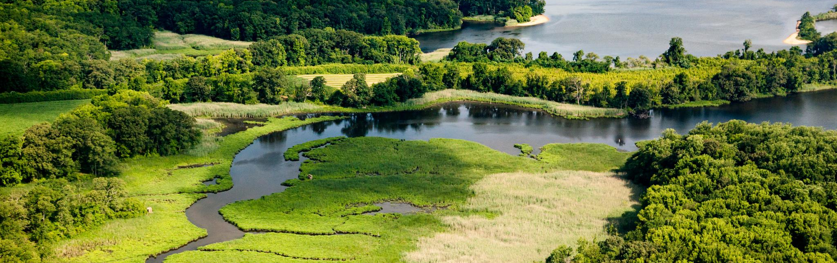
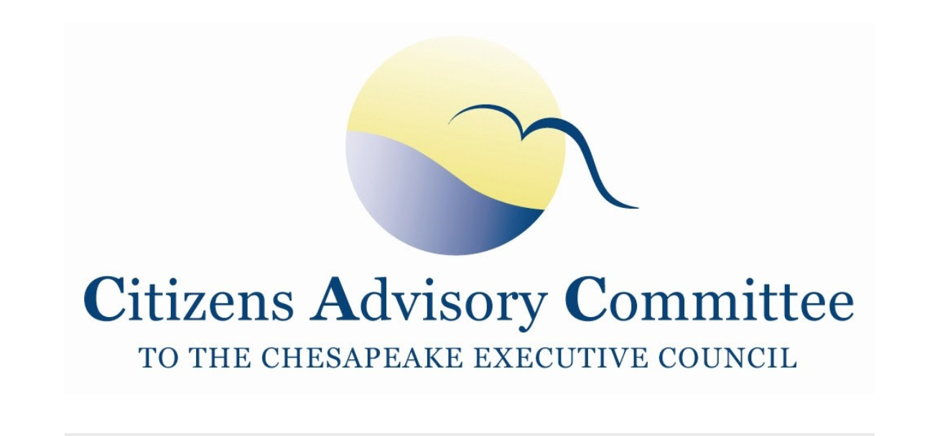

~Day Two~
February 25, 2022
Photo Credit: Will Parson/Chesapeake Bay Program

Slide 2
Meeting Objectives
Meeting Objectives
CAC Water Quality Subcommittee Panel
Understand the implications of the dam’s impact and options to address it.

Slide 3
Agenda Outline
Reflections
CBP Updates
15-minute Break
Water Quality Subcommittee Panel on the Conowingo Dam
  Part 1: Science and Policy
45-minute Lunch Break
  Part 2: Perspectives on addressing Conowingo impacts
  Panel Q&A
10-minute break
CAC Discussion
Adjourn at 3:15pm
4:30pm- optional virtual reception

Slide 4
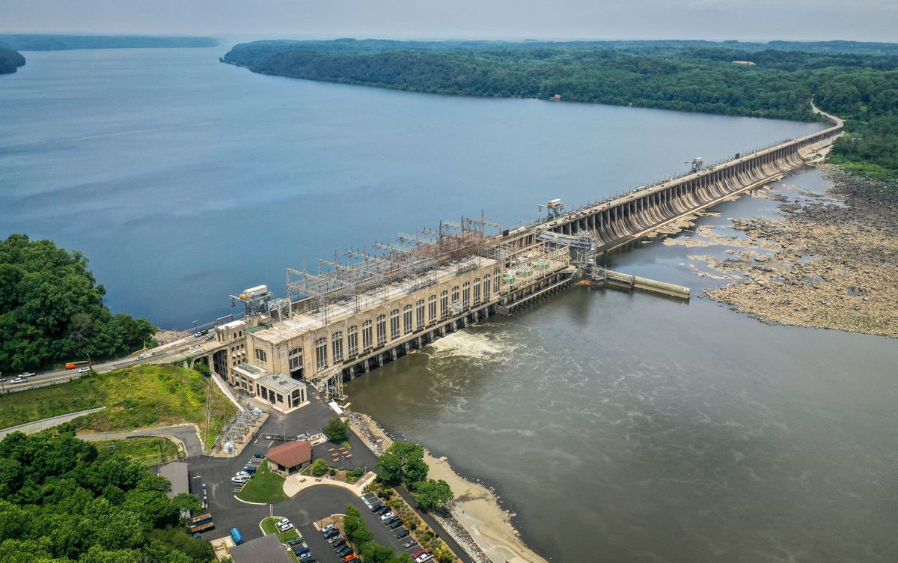
Why does the Conowingo Dam matter?

Slide 5
Why does the Conowingo Dam matter?
“Pollution Gate” 80+ years of trapping capacity near full
Heavy rain events pulse pollution downstream when floodgates are opened to release water
Impacts the TMDL: Additional nitrogen loads not accounted for when the plan was developed
Impacts locally: Sediment released downstream

Slide 6
Background: Interstate Policy Conundrum
Challenge: How do we address the Conowingo Dam impact since it is not included in the TMDL?
State Solution: Create a separate Conowingo Watershed Implementation Plan (CWIP)
  States will pool resources to fund
  Develop innovative financing approaches
  approved by PSC in 2021
States concurrently implement their WIPs

Slide 7
What did CAC say about the CWIP?
Funding
  no money assigned to pay for the implementation
Feasibility
  competition with the State WIPs
Sediment
  CWIP primary focus on nitrogen pollution (6 M lbs)
  Sediment pulses downstream in heavy rain?

Slide 8
What did EPA say about the CWIP?
No money = No confidence in the CWIP
If the States don’t commit funding, the nitrogen pollution will be reallocated to the States
estimated 89% of the reduction will come from Ag BMPs

Slide 9
The Question of Sediment
Lower Susquehanna River Watershed Assessment (2015)
  concludes better “bang for the buck” to target funds and effort on the land upstream in PA and NY
MD pilot project (2021)
  mechanically dredged and explored reuse of the dredge material

Slide 10
Conowingo Dam Panel:
What to we hope to uncover?
Dam’s impact of nitrogen and sediment on the Bay System
Best Path forward to address that impact
  To dredge or not to dredge
  Focus BMPs upstream
Who should pay
Ideas on the best approach

Slide 11
Panel Overview
Part 1: Science and Policy
PA DEP
U of MD and STAC
Part 2: Mitigation Approaches and Funding Ideas
MD DNR
CBF
Restoration Systems
Waterkeepers Chesapeake
Q&A with Panelists

