Slide 1
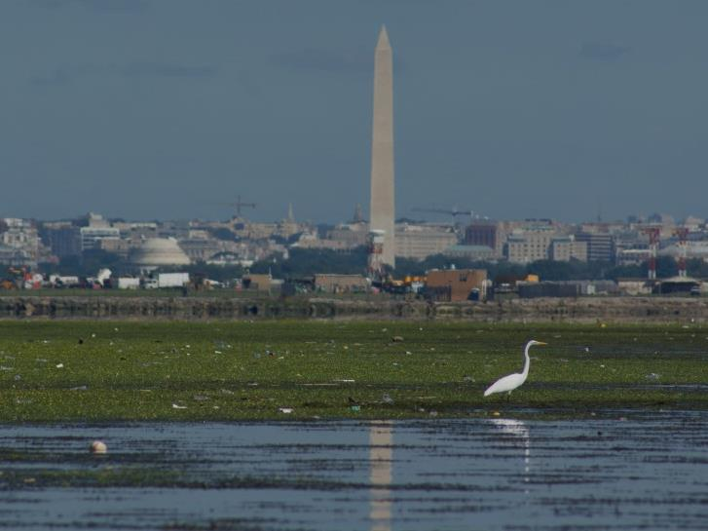
DC’s Phase III WIP:
Targeting, Engaging and Leveraging
Katherine Antos, Chief
Partnering and Environmental Conservation Branch
District Department of Energy and Environment
November 29, 2017
Notes:
Please enter jurisdiction name (and agency logo/s)

Slide 2
District-Specific Considerations
DC is a State and a City
Most load permitted; over 90% wastewater
2
Notes:
Dual function of city and state
Over 90% load from wastewater
Virtually all load covered by BP and MS4 permits
Largely built out. CBP estimates 89% of growth by 2025 will be infill; we think it’s higher
Growth improves water quality
TREE CANOPY:
Mayoral mandate for 40% Canopy Cover by 2032,
- 2011: 35%. currently 39%
New MS4 permit: 33,525 trees in MS4 in next 5 years (6,705 per year)
DDOT is primary tree planting agency (~80%), DOEE awards & manages tree-planting grants (non-profits)
What are the unique characteristics of your jurisdiction as it relates to the challenge of effectively engaging local governments in your Phase III WIP development? For example,
What is the relative importance of local government in achieving pollutant reduction targets in your jurisdiction?
What do you need from local governments during WIP development and implementation?
What information do local government officials and staff need to be effective partners in WIP development? Implementation?
What is your timeline for communication and engagement?
Enter jurisdiction name

Slide 3
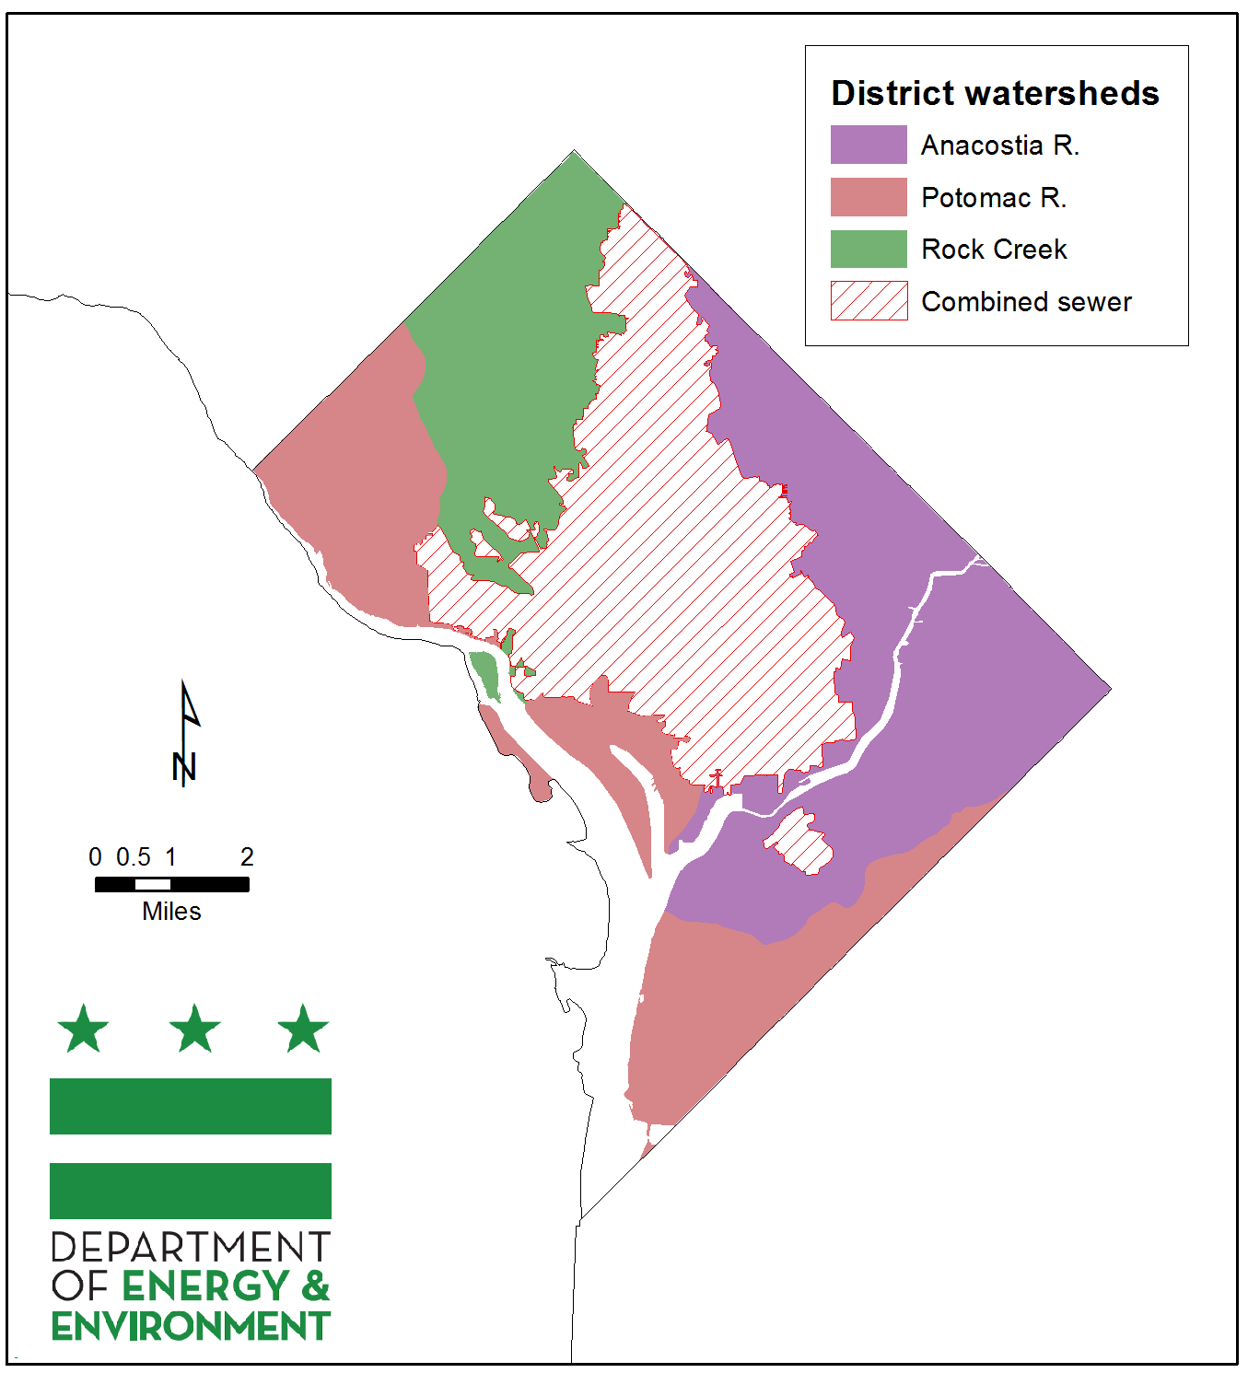
Geographic Targeting
Notes:
Bay L-R segs align with coarse target areas.
Clean Rivers Project addressing CSO
MS4 target areas of Potomac, Rock Creek, Anacostia. Specific stormwater management and tree planting targets for each.
We have more specific planning goals for subwatersheds based on local TMDLs and stream restoration efforts
Challenge is 2-fold: Implementing more, and maintaining what we’ve done

Slide 4
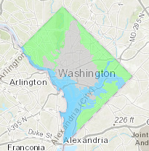
Meeting MS4 Requirements
Stormwater Management Regulations
Stormwater Retention Credit Trading Program
Incentive-Based Programs
Tree Planting
Stream Restoration
4
Notes:
The District’s stormwater management regulations require large construction and redevelopment projects to install green infrastructure (GI)
SRC: A project can meet 50% of its requirement off-site, including through the purchase of Stormwater Retention Credits (SRCs) on the market
Incentive-Based: RiverSmart Homes, Communities, Schools.
Tree canopy: 40% by 2032

Slide 5
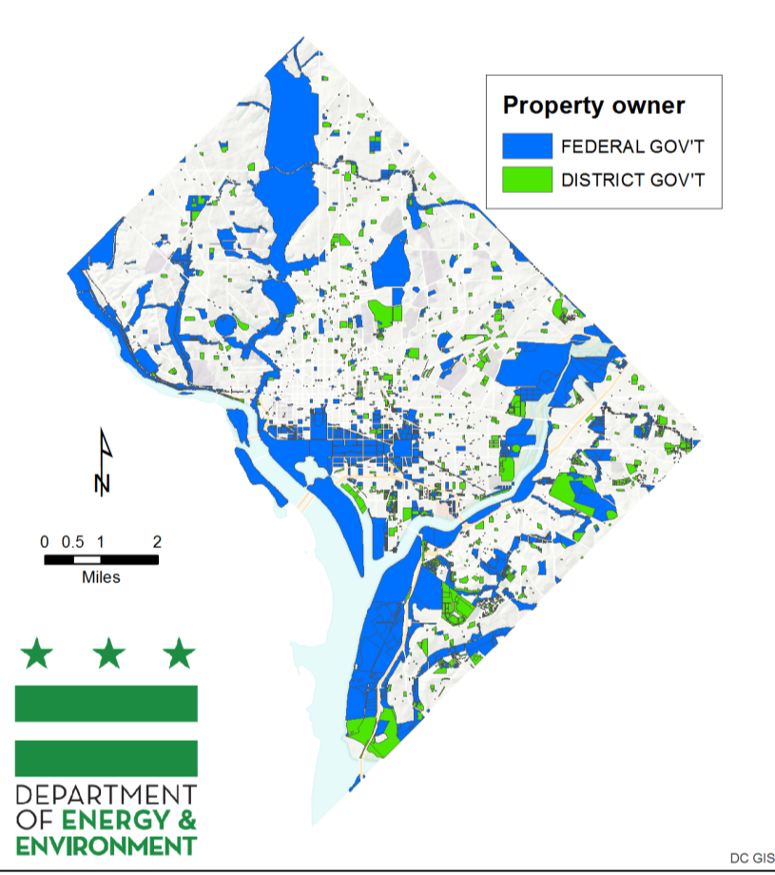
Target Audiences
DC Water
Federal facilities
Sister agencies
Property owners/ managers
Communities near priority restoration areas
Notes:
DDOT/UFD is the primary tree-planting and maintenance agency. We use the UFAC (Urban Forestry Advisory Council) to coordinate with UFD, other District gov agencies, Federal agencies (like NPS), non-profits, utilities, and District resident groups.
- Topics considered by UFAC include: overlap of solar policy and tree canopy; street tree maintenance; workforce training.

Slide 6
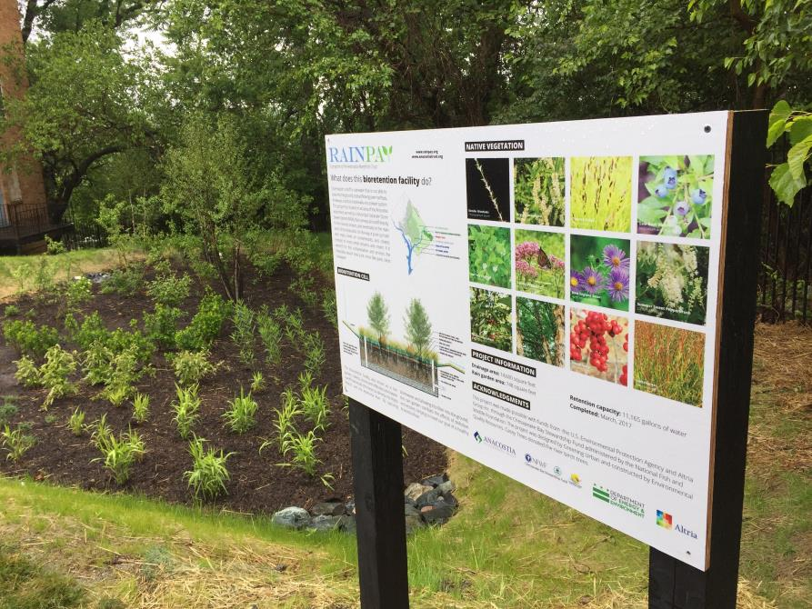
Stormwater Retention Credit Program
Price Lock Program
Aggregator Startup Grant Program
Site Evaluation Program
6
Notes:
Estimate that compliance with stormwater management regs onsite and off will achieve order of magnituted more stormwater management than incentive-based programs
SRCs are generated by sites that install GI voluntarily or in excess of a regulatory requirement – way to further leverage regs to drive projects where greatest benefits.
The opportunity to sell SRCs helps to incentivize GI on properties where it is not otherwise required.
Through the Stormwater Retention Credit (SRC) Price Lock Program, DOEE purchases SRCs at fixed prices in MS4; premium for SRCs with greater benefit (non-tidal MSr). Participants also have the option to sell on the market.
The SRC Price Lock Program provides confidence about the revenue from selling SRCs and creates demand for new, voluntary green infrastructure (GI) projects in areas that drain to waterbodies without treatment.
Through SRC trading and the SRC Price Lock Program, DOEE expects to shift private funding for GI from regulated properties to new GI in areas where it has the greatest environmental benefit.
Aggregator Startup Grant Program supports technical and outreach work to identify potential -generating green infrastructure projects in the MS4 across multiple sites
Site Evaluation Program: property owners can request an evaluation of potential -generating green infrastructure projects on your property (you must have at least .5 acres available and be located within the MS4

Slide 7
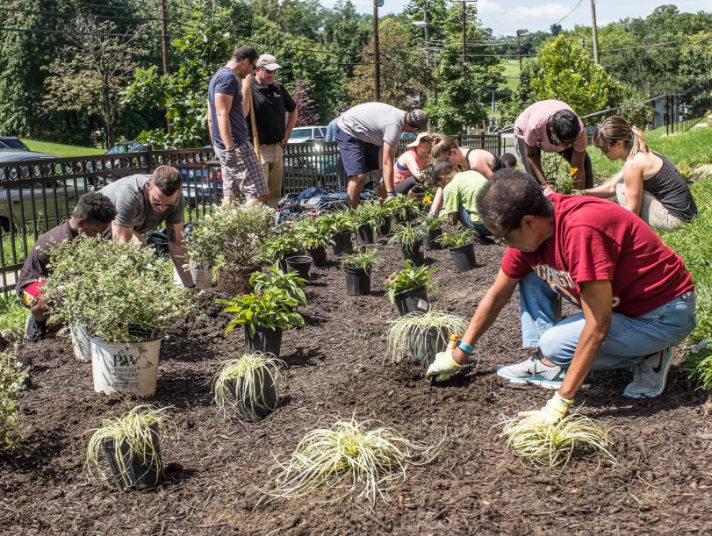
Incentive-Based Programs
Growing RiverSmart
Engaging new partners: Community Stormwater Solutions
Fostering stewardship
Comprehensive outreach
7
Notes:
RiverSmart: Continue to grow # of homes (4500?). Re-launched RiverSmart Communities for larger sites (nonprofits, churches). RiverSmart Schools.
CSS: Bringing in new partners. Gateway to other programs. Plan to do listening sessions with target audiences in 2018 to better understand how to engage in stormwater management
Fostering: WSA. Better network of alum. Enviro Ed – better integrating with curriculum
Outreach across all NRA programs

Slide 8
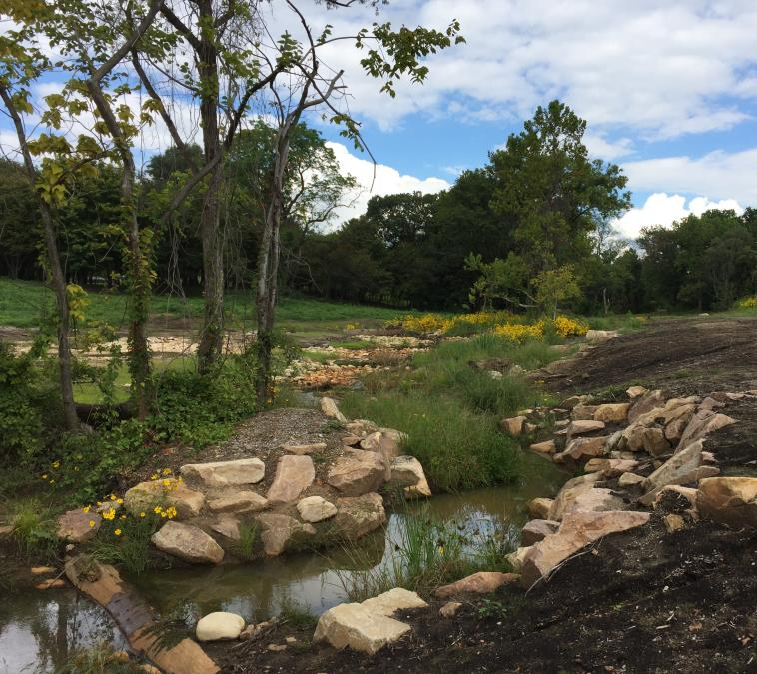
Stream Restoration
In-depth engagement with surrounding communities
Increasingly working with federal agencies
8
Notes:
Watts Branch, Nash Run: In-depth, door-to-door engagement
Feds: running out of streams not on fed land. permitting takes longer

Slide 9
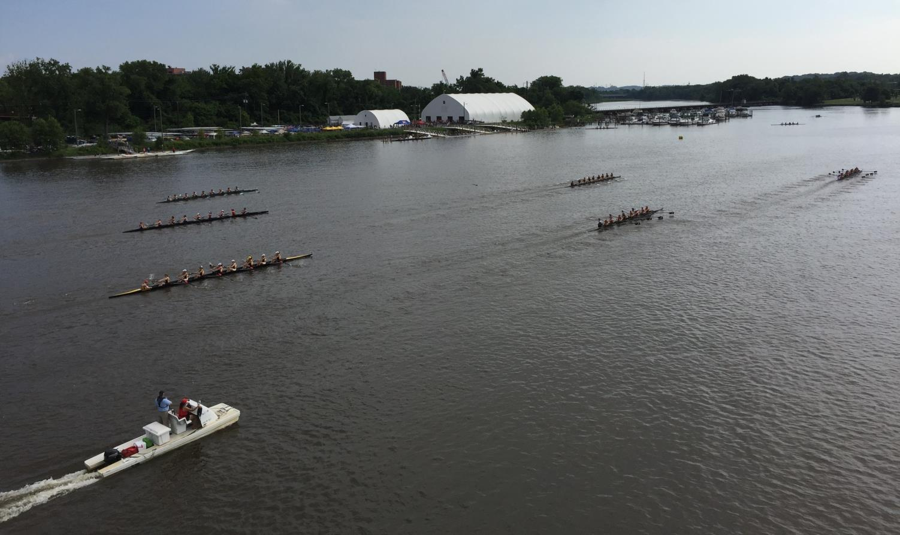
2018: Year of the Anacostia
9
Notes:
Celebrate our waterways. Commemorate past, envision future. More events to draw ppl to river.
A lot happening: Park centennial, Clean Rivers Project coming online, moving forward with cleanup plan for sediment project. Greater monitoring to understand whether river swimmable. Working with NPS, nonprofits

Slide 10
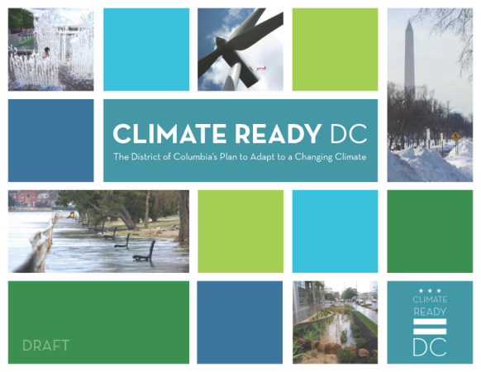
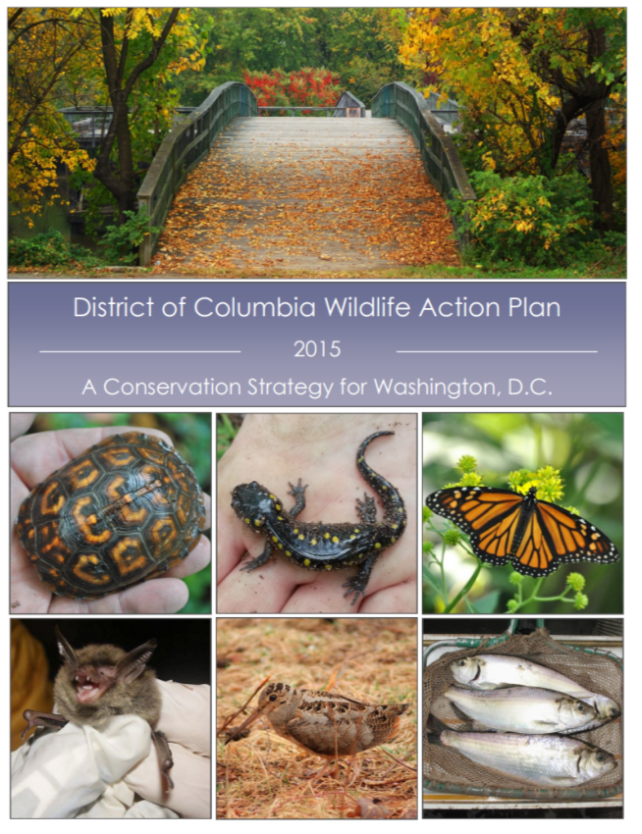
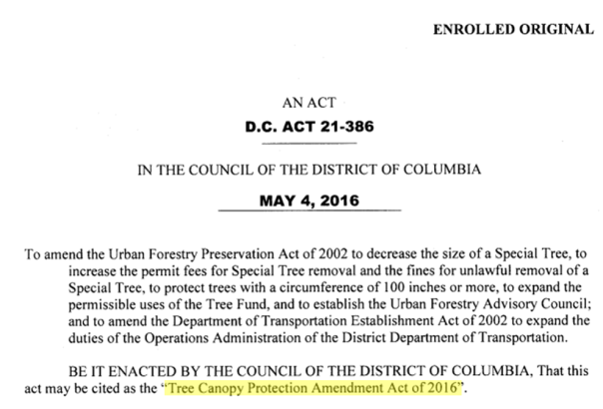
Leveraging Other Efforts
Notes:
Choose strategies help address other priority needs, such as:
Climate Resilience
Public Access
Pathways to Middle Class
Wildlife
CLIMATE READY DC:
- Actions to increase resilience to heat emergencies and reduce urban heat island, flood risk also good for waterways
WILDLIFE ACTION PLAN AND FISHERIES OMNIBUS ACT: Increasing focus on actions to protect, restore habitat. Calls for critical area regulations that will address upland and shoreline restoration, flooding, habitat.
Sustainable DC: TREE CANOPY:
Mayoral mandate for 40% Canopy Cover by 2032,
- 2011: 35%. currently 39%
DDOT is primary tree planting agency (~80%), DOEE awards & manages tree-planting grants (non-profits). Almost all tree boxes full, shifting to plantings on larger parcels
JOBS PROGRAMS: RiverCorps, GZEP, what other opportunities exist with BMP maintenance.

Slide 11
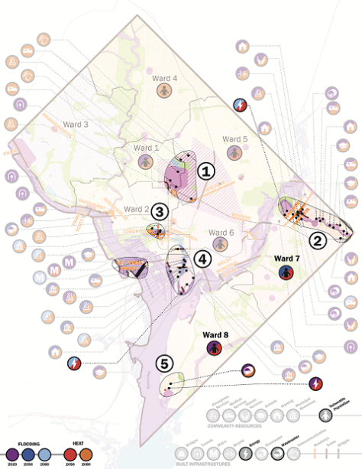
Empower Community
Watts Branch Equity Advisory Group
Equity Consultant (Skeo Solutions) and Equity Auditor (Raben Group)
Technical Support: Georgetown Climate Center
Notes:
The Team
We hired Skeo Solutions to be our main engagement consultant. Vernice Miller-Travis, who has been active in DC and Prince George’s County, is a lead on the team.
Francella Chinchilla with the Raben Group will be the equity auditor.
Progress
EAG: We are currently recruiting and interviewing potential advisory group members. We’re planning to have the first meeting in late December or more likely early January.
Equity training: Skeo will be holding a training for the project team (Georgetown Climate Center, the consultants, and a larger group of DOEE staff) to build a shared language and give the team tools to be successful in working with the advisory group.
Equitable engagement model: Skeo is getting ready to take what they’ve learned during initial organization and recruitment to start creating the model.

Slide 12
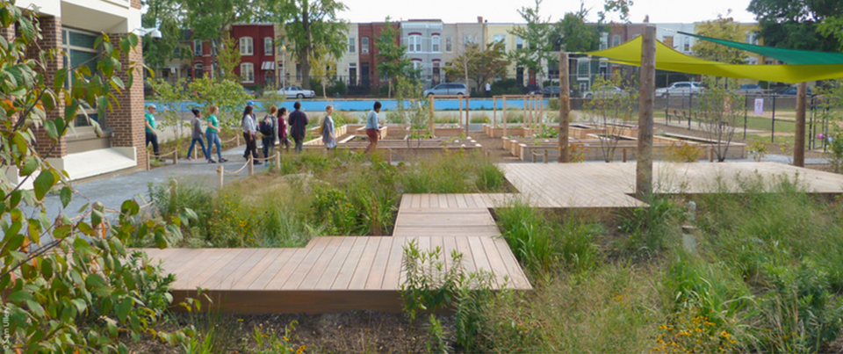
Key Messages
Healthy waters support healthy communities, and vice-versa
Will further refine based on stakeholder input:
  Regulatory compliance
  Access/recreation
  Public health/safety
  Cost savings
  Reduce risk
  Jobs

Slide 13
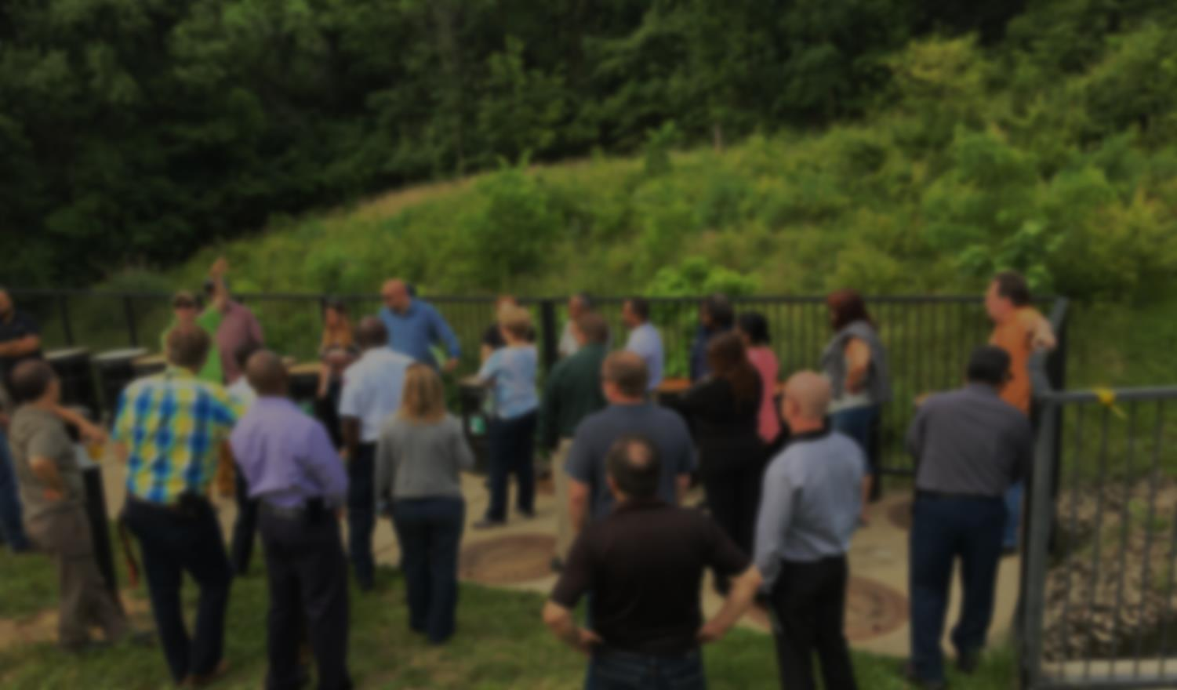
Key Messengers
Federal Facilities Workgroup
Sister Agency Forums
Industry Groups, Trade Associations, Contractors
ANCs, Civic Associations, Community-Based Organizations
Houses of Worship

Slide 14
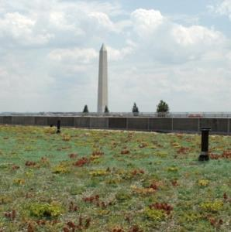
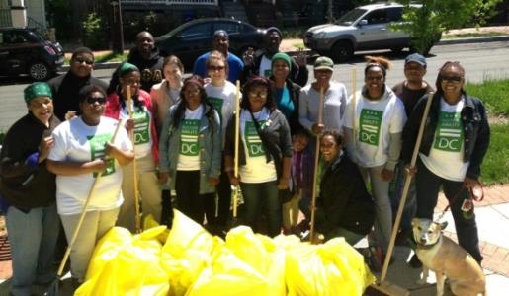
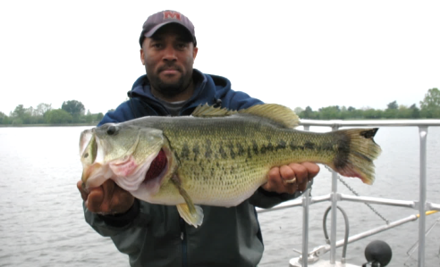
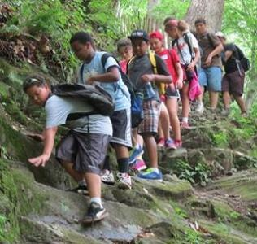
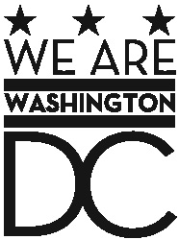

Questions?
Katherine Antos, Chief
Partnering and Environmental Conservation Branch
Katherine.Antos@dc.gov
202-574-7606
doee.dc.gov

