Slide 1
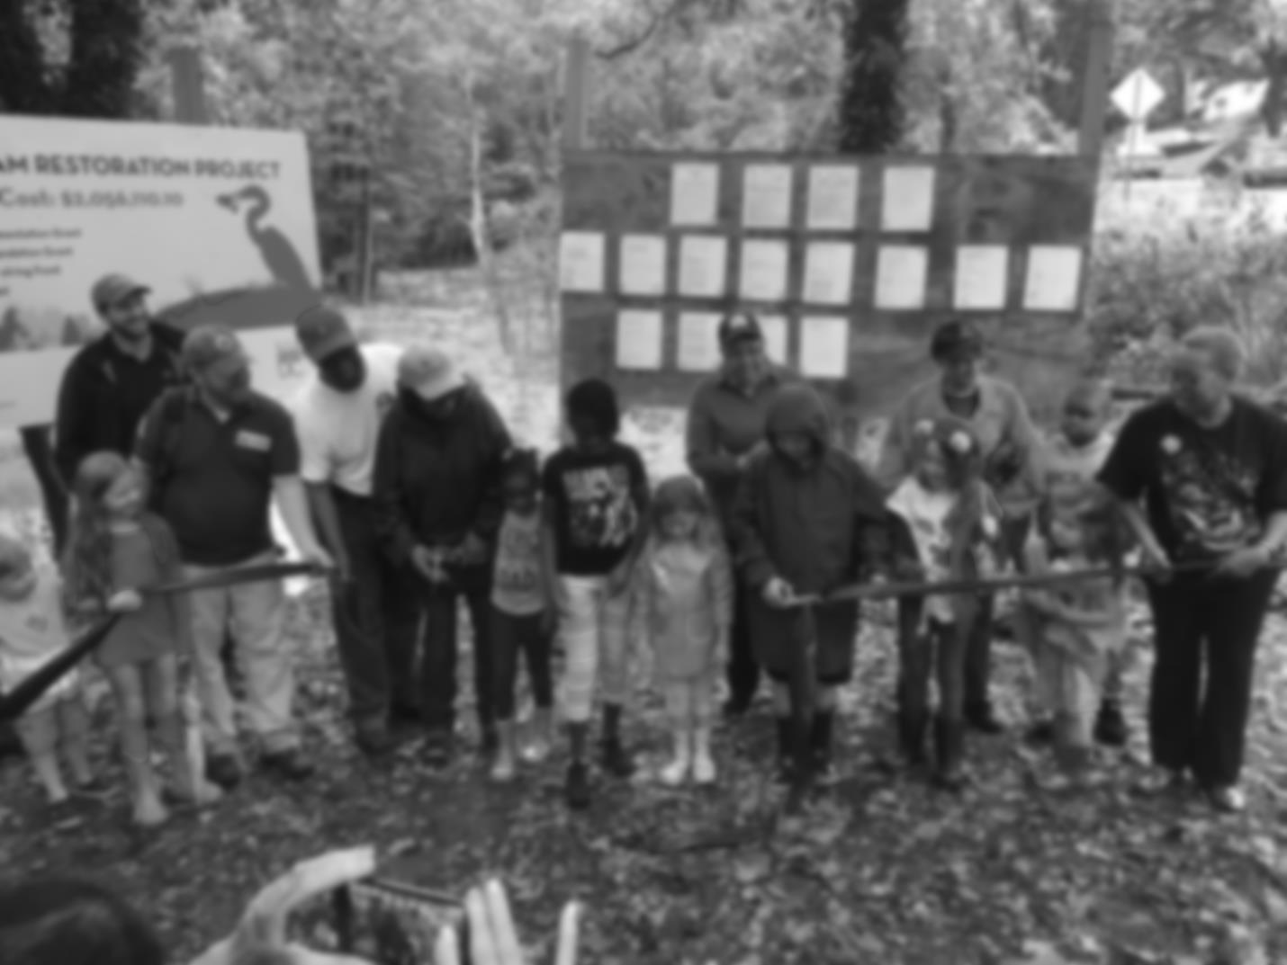


Federal Facilities and the District’s Phase III WIP
Introductory Webinar for Federal Facilities Located in the District of Columbia
May 24, 2018

Slide 2

Chesapeake Bay TMDL, WIPs and Federal Facilities
Katherine Antos
Branch Chief
Partnering & Environmental Conservation Branch
Department of Energy & Environment
@DOEE_DC

Slide 3
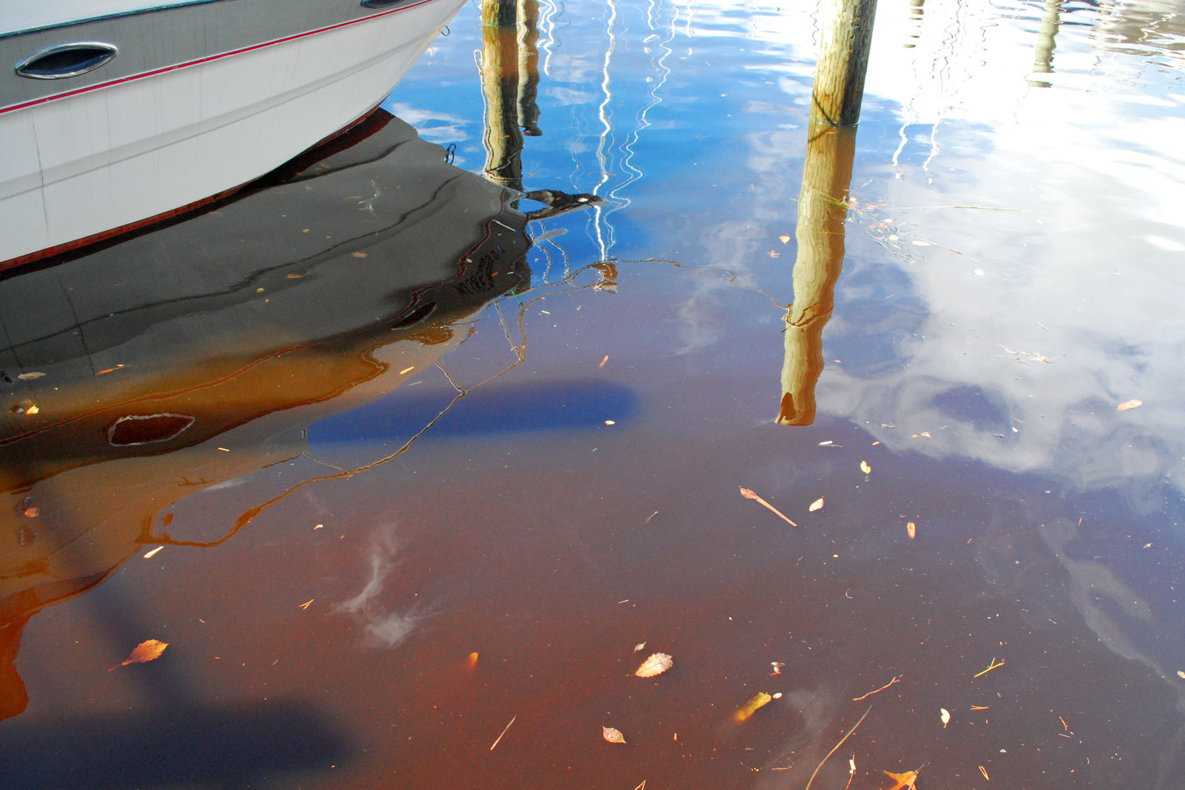

Source: Chesapeake Bay Program Office
3
@DOEE_DC

Slide 4
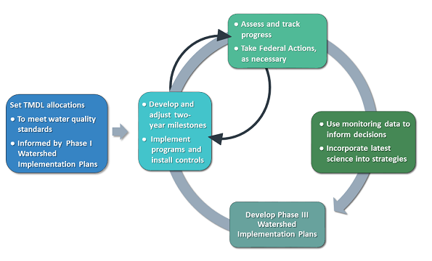
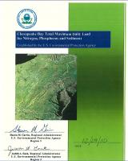
Bay TMDL Adaptive Management Framework
Source: U.S. Environmental Protection Agency
4
@DOEE_DC

Slide 5
Nitrogen
~90% load wastewater
Approaching E3
Wastewater flow and load will increase over time
Phosphorus
5
@DOEE_DC
Notes:
Dual function of city and state
Over 90% load from wastewater
Virtually all load covered by BP and MS4 permits
Largely built out. CBP estimates 89% of growth by 2025 will be infill; we think it’s higher
Growth improves water quality
TREE CANOPY:
Mayoral mandate for 40% Canopy Cover by 2032,
- 2011: 35%. currently 39%
New MS4 permit: 33,525 trees in MS4 in next 5 years (6,705 per year)
DDOT is primary tree planting agency (~80%), DOEE awards & manages tree-planting grants (non-profits)
What are the unique characteristics of your jurisdiction as it relates to the challenge of effectively engaging local governments in your Phase III WIP development? For example,
What is the relative importance of local government in achieving pollutant reduction targets in your jurisdiction?
What do you need from local governments during WIP development and implementation?
What information do local government officials and staff need to be effective partners in WIP development? Implementation?
What is your timeline for communication and engagement?
Enter jurisdiction name

Slide 6
Nitrogen
~90% load wastewater
Approaching E3
Wastewater flow and load will increase over time
Phosphorus
6
@DOEE_DC
Notes:
Dual function of city and state
Over 90% load from wastewater
Virtually all load covered by BP and MS4 permits
Largely built out. CBP estimates 89% of growth by 2025 will be infill; we think it’s higher
Growth improves water quality
TREE CANOPY:
Mayoral mandate for 40% Canopy Cover by 2032,
- 2011: 35%. currently 39%
New MS4 permit: 33,525 trees in MS4 in next 5 years (6,705 per year)
DDOT is primary tree planting agency (~80%), DOEE awards & manages tree-planting grants (non-profits)
What are the unique characteristics of your jurisdiction as it relates to the challenge of effectively engaging local governments in your Phase III WIP development? For example,
What is the relative importance of local government in achieving pollutant reduction targets in your jurisdiction?
What do you need from local governments during WIP development and implementation?
What information do local government officials and staff need to be effective partners in WIP development? Implementation?
What is your timeline for communication and engagement?
Enter jurisdiction name

Slide 7
Nitrogen
~90% load wastewater
Approaching E3
Wastewater flow and load will increase over time
Phosphorus
7
@DOEE_DC
Notes:
Dual function of city and state
Over 90% load from wastewater
Virtually all load covered by BP and MS4 permits
Largely built out. CBP estimates 89% of growth by 2025 will be infill; we think it’s higher
Growth improves water quality
TREE CANOPY:
Mayoral mandate for 40% Canopy Cover by 2032,
- 2011: 35%. currently 39%
New MS4 permit: 33,525 trees in MS4 in next 5 years (6,705 per year)
DDOT is primary tree planting agency (~80%), DOEE awards & manages tree-planting grants (non-profits)
What are the unique characteristics of your jurisdiction as it relates to the challenge of effectively engaging local governments in your Phase III WIP development? For example,
What is the relative importance of local government in achieving pollutant reduction targets in your jurisdiction?
What do you need from local governments during WIP development and implementation?
What information do local government officials and staff need to be effective partners in WIP development? Implementation?
What is your timeline for communication and engagement?
Enter jurisdiction name

Slide 8
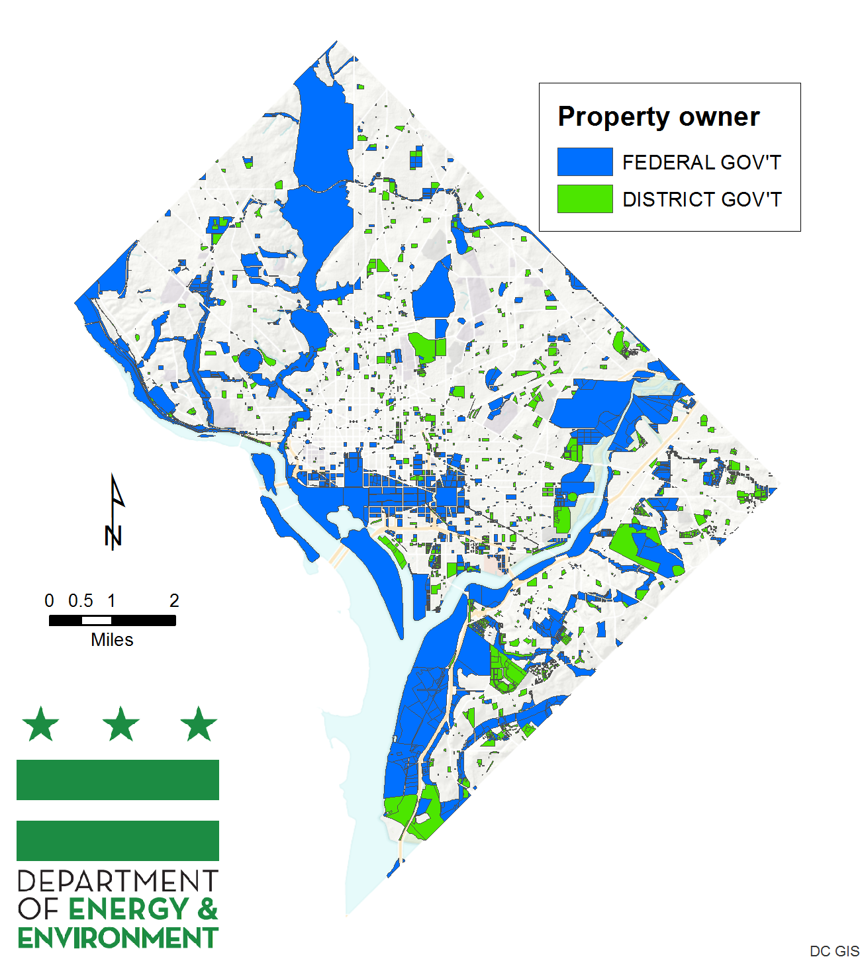
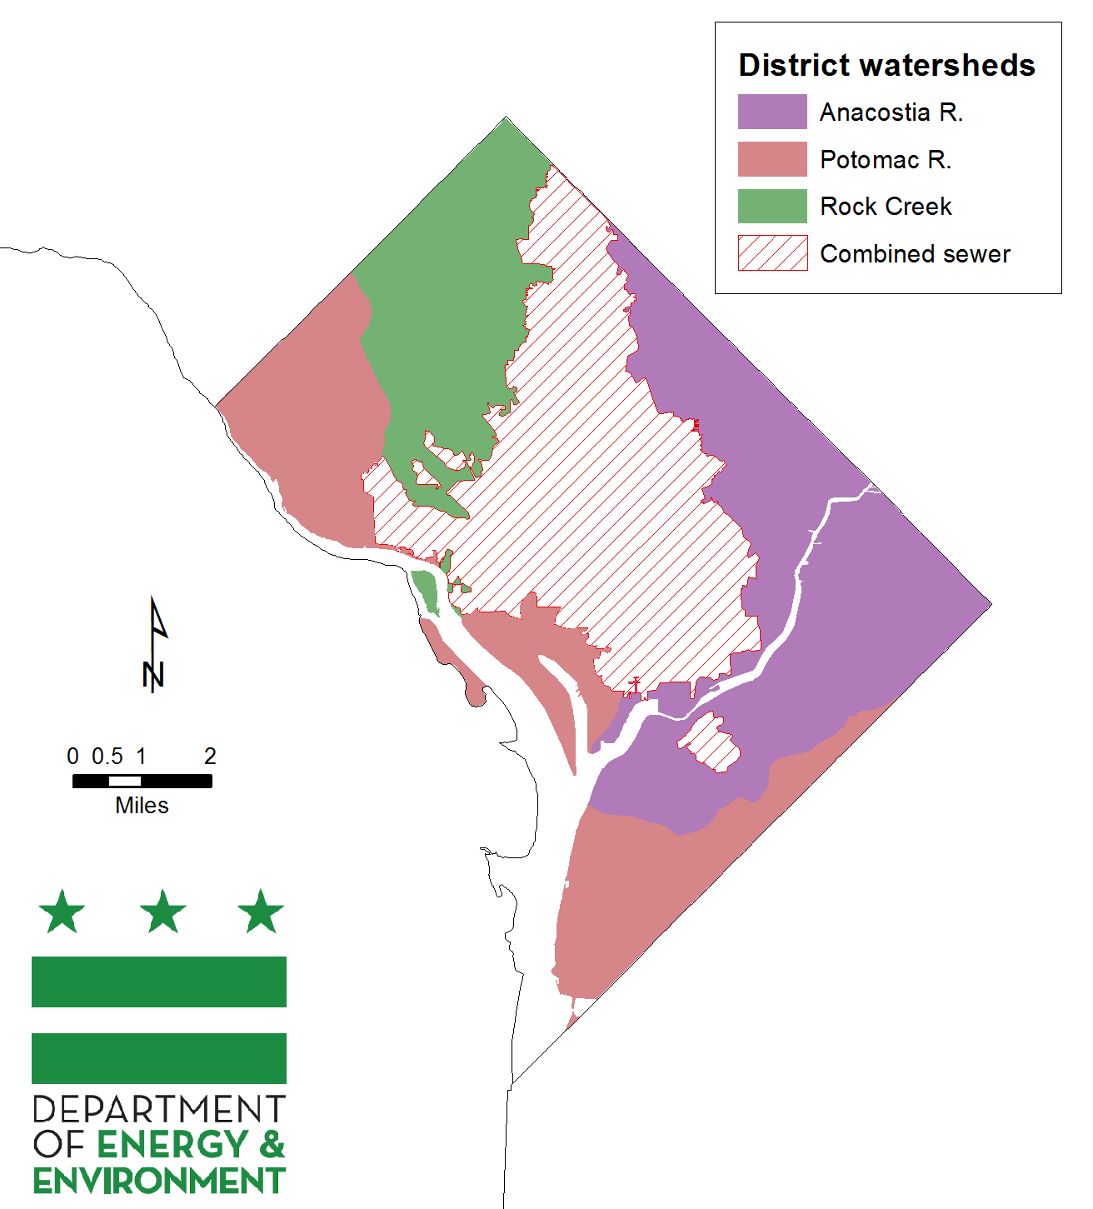
8
@DOEE_DC

Slide 9
Bottom Line
District cannot achieve planning targets without federal facilities
EPA expects federal facilities to participate in Phase III WIP development
Today’s webinar and May 31 training kickoff process for coordination between DOEE and federal facilities within the District to develop Phase III WIP by March 1, 2019 (draft) and June 28, 2019 (final)
9
@DOEE_DC

Slide 10
Expectations for Federal Facilities
Greg Allen
Chesapeake Bay Program Office
@DOEE_DC

Slide 11
Federal Facility Planning Targets
Jeff Sweeney
Chesapeake Bay Program Office
@DOEE_DC

Slide 12
What is C.A.S.T.?
Jeff Sweeney (CBPO)
Aaron Waters (DOEE)
@DOEE_DC

Slide 13
Chesapeake Assessment Scenario Tool (CAST) is a web-based nitrogen, phosphorus and sediment load estimator tool that streamlines environmental planning.
Users specify a geographical area, and then select Best Management Practices (BMPs) to apply on that area.
CAST builds the scenario and provides estimates of nitrogen, phosphorus, and sediment load reductions.
13
@DOEE_DC

Slide 14
Step One
Step Two
Source: cast.chesapeakebay.net
14
@DOEE_DC

Slide 15
The District of Columbia’s Stormwater Database (SWDB)
Matthew Espie
SWDB Administrator
Department of Energy & Environment
@DOEE_DC

Slide 16
Stormwater Database
The Stormwater Database (http://doee.dc.gov/swdb) is the District’s tool to track and report on BMPs in the District
All regulated and voluntary BMPs should be submitted to the Stormwater Database
DOEE exports NEIEN-compliant XML to report all BMPs in the District, and can filter for federal BMPs
16
@DOEE_DC

Slide 17
Process to submit to the Stormwater Database
Regulated BMPs
Project Engineer Submit Stormwater Management Plan, including BMP data
Person Responsible for Maintenance Signs Agreement to maintain the project
DOEE approves Stormwater Management Plan
Project is built. DOEE Final Construction Inspection “activates” BMPs within the database for reporting
Voluntary BMPs
Stormwater Management Plan may be submitted for approval prior to construction
BMP is built
BMP data is submitted to DOEE on spreadsheet template (unless a Stormwater Management Plan was submitted)
DOEE uploads data to the database (unless a Stormwater Management Plan was submitted)
17
@DOEE_DC

Slide 18
When is a BMP regulated?
Major Land Disturbing Activity:
At least 5,000 square feet of land disturbance
Major Substantial Improvement Activity:
Renovation for which the cost is at 50% of the pre-project assessed value
Combined footprint of structure and land disturbance is at least 5,000 square feet
18
@DOEE_DC

Slide 19
Next Steps
Aaron Waters
@DOEE_DC

Slide 20
Important Dates
Register for CAST (cast.chesapeakebay.net)
Register for SWDB (http://doee.dc.gov/swdb)
Attend Training on May 31st, 2018 at DOEE
Comments on Planning Targets due by June 29th, 2018
Check-ins with DOEE:
August 31st, 2018: Review 1st draft scenario
November 30th, 2018: Review 2nd Draft of Scenario
January 15th, 2019: Review Final Draft of Scenario
20
@DOEE_DC

Slide 21
Questions?
Katherine Antos
Branch Chief
katherine.antos@dc.gov
(202) 574-7606
Aaron Waters
Chesapeake Bay and Regulatory Program Specialist
aaron.waters@dc.gov
(202)535-2239
Luke Cole
Chesapeake Bay Data Coordinator
luke.cole@dc.gov
(202) 724-5348
Matthew Espie
SWDB Administrator
Matthew.Espie@dc.gov
(202) 715-7644
Greg Allen, Ph.D.
allen.greg@epa.gov
410-267-5746
Jeff Sweeney
jsweeney@chesapeakebay.net
410-267-9844
Renee Thompson
rthompso@chesapeakebay.net
Olivia Devereaux
olivia@devereuxconsulting.com
301-325-7449

Slide 22
Preliminary Federal Facility Planning Targets
22
@DOEE_DC

