Slide 1

2016 Chesapeake Executive Council Planning Team Powerpoint
Conference Call info: 1-866-299-3188 Conference Code: 267-5715
Online via Adobe Connect: https://epawebconferencing.acms.com/ec
EC PRIVATE/Briefing book page: http://www.chesapeakebay.net/ecbrief/2016_executive_council_briefing_book
Planning Team Chairs: Carin Bisland 410-267-5732 bisland.carin@epa.gov
Russ Baxter (804)786-0044 russ.baxter@governor.Virginia.gov

Slide 2
Today’s Agenda
Intro
Roll Call – Carin Bisland
EC Attendance update – All
Agenda
Change in Time
EC Member Briefings – All
Issues or Concerns
Challenges and Solutions
Logistics – Rachel Felver
Seating
Catering
Product Development timeline progress

Slide 3
Table of Contents Executive Council Planning Areas | CBP | Adv Com |  | DC | CBC | MD | PA | VA | EPA | DE | NY | WV
Planning
Planning Meeting Schedule
Logistics
Location and Date
EC Chair Invitations
EC Member Confirmation
Content
Theme/Focus Areas
Agenda
Agenda - Annotated
State of the Program Package
Advisory Committee Reports
Other Briefing materials
Communications
Media Plan
Media Schedule/deadlines
News Conference – staffing & Qs&As
Execution
Internal Website/Shared Directory
Briefing Materials (bios)
Meeting Day Logistics – Staffing, Security
Physical Layouts
Pending
Past Due
Task Complete

Slide 4
Schedule of Meetings for 2016
Wednesday afternoons 3-4pm
Biweekly until 1 month out
Weekly within a month of the EC meeting
September 14 – Logistics/confirmations/bios/prepping for MB/PSC
September 21 – All Briefing materials should be in/media materials begun
September 28 – Finalized media materials/Any last minute issues

Slide 5
Logistics - Formal Invitations
Status
Invitation sent July 21, 2016
Posting pdf on EC briefing page
Will NOT be sending out new invitations for change in date. Please make sure your EC member is aware of the change

Slide 6
EC Member RSVP status
Attendance Confirmed
Unable to Attend
VA Terry McAuliffe, Governor (EC Chair)
CBC Thomas McLain “Mac” Middleton (MD) CBC Chair
DE Jack Markell, Governor
Kara Coats, Deputy Secretary
DC Muriel Bowser, Mayor
Lt Mayor?
EPA Gina McCarthy, Administrator
MD Larry Hogan, Governor
Jeannie Haddaway Riccio, Deputy Chief of Staff
NY Andrew Cuomo, Governor
James Tierney, Assistant Commissioner
PA Tom Wolf, Governor
WV Earl Ray Tomblin, Governor
USDA Under Secretary Robert Bonnie
USACE Brigadier General William H. Graham
Advisory Committees
CAC Chair – Charlie Stek STAC Chair – Lisa Wainger
LGAC Vice Chair – Bruce Williams
October 4 Sept. 27

Slide 7
Content - Theme/Focus Areas
We want to:
Recognize Our Successes
Show we can be more successful when we work together at all levels (federal, state, local)
Identify significant challenges ahead for which we are committed to finding solutions
Recognize Successes
Collaborate for Progress
Commit to Finding Solutions
Notes:
Recognize successes through posters – WWTP upgrades. Indicators of improvement in water and air quality, SAV, Blue Crab, oysters
Working together – ACE Ches. Comp. plan, local govt. initiative, Choptank initiative
Challenges – env. Finance. Independent evaluator, public EC member talks

Slide 8
Content - Theme/Focus Areas
Status
Document needed
PRIVATE LUNCH: 10:00 a.m.
EC Members + 1, Advisory Committee Chairs.
Lunch actions:
Update on last year’s EC Decision Implementation
EC Informed that the environmental finance symposium took place and report/recommendations prepared.
Advisory Committee Reports and Recommendations. (Each 5 minutes)
Resolution on Local Government Outreach Initiative
Elect 2016-2017 Chair
Transition to Public Meeting (10 minutes)

Slide 9
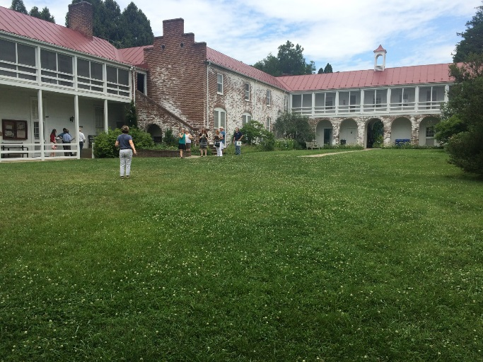
Content – Public Lunch hour
Status
10:00 a.m. – 11:00 a.m.
Posters showing resiliency or high achievement including:
water quality trends and analysis (2)
Wastewater
Air reductions
SAV
Oysters
Crabs

Slide 10
Content – Public Meeting
PUBLIC MEETING: 11:05 a.m.
Welcome to Arboretum – Director, David Carr (2 mins)
Governor McAuliffe – Opening Remarks, Welcome and Introductions, report on private meeting actions (5 min)
Highlights of the Program Report including focus on signs of resiliency and ecosystem improvement and new tools (land cover data for example) that will help us better marshal limited resources (DiPasquale – 5 mins)
USACE presentation on Chesapeake Bay Comp. Plan (5 mins)
Key issues moving forward (each of the signatories representatives highlight a key issue that poses the most difficult challenges in moving forward to the TMDL goals and the strategies and partnerships needed to overcome those challenges) (3 min. each)
Chairman concluding remarks (3 min)
Open to Press Questions (10 minutes)
Adjourn 12:00 p.m.

Slide 11
Meeting Agenda – initial draft
Status
Note: Advisory Committees will meet w/ EC Chair & other EC members independently of this mtg
-------------------------------------
9:45-10:00 EC members arriving
10:00-11:00 Private Breakfast (EC members & +1s; & AC Chairs)
10:00-10:55 Discussion – Topics (20 min AC issues/40mins other)
10:55-10:57 Briefing for press event – Rachel
10:57-11:02 Group photo & Transition to Press Conference
11:05-12:00 Public Session & Press Conference
11:05-11:07 Welcome to Arboretum – Director of the Arboretum
11:07-11:12 EC Welcome, Purpose, and Lunch Actions (directives, letters, etc) – EC Chair
11:12-11:17 State of the Program – CBP Director
11:17-11:22 USACE presentation on Ches. Bay Comprehensive Plan
11:22-11:47 EC member discussion – key issues moving forward/remarks on private lunch actions
11:47-1:50 Closing remarks/open Press Conf. – EC Chair
11:50-12:00 EC Panel for media Q&A

Slide 12
EC member discussion
11:22-11:47 EC member discussion – key issues moving forward/remarks on private lunch actions
11:22-11:25 VA
11:28-11:31 PA
11:31-11:34 EPA
11:44-11:47 USDA
11:37-11:40 CBC
11:25-11:28 MD
11:34-11:37 DC
11:40-11:42 DE
11:42-11:44 NY
* - Random order at this point. Placement on the timeline will be a point of discussion

Slide 13
Execution - Briefing Materials
Status
What | Due for PSC | Due for EC | Status / Response
EC Member Bios | n/a | Sept. 13 | Planning Team members
LGAC Report | n/a | Sept 16 | Mary Gattis
CAC Report | n/a | Sept. 13 | Jessica Blackburn
STAC Report | n/a | Sept. 13 | Rachel Dixon
State of the Program | na | Sept. 23 | Rachel Felver
E. Finance Recommendations | Aug. 8/ Sept 1 | NA | Dan Nees
Independent Evaluator Nomination | MB 9/15 PSC 9/19 | Sept. 20 | Carin Bisland

Slide 14
Execution - Briefing Materials (cont)
Status
What | Due for PSC | Due for EC | Status / Response
Resolution on local engagement | EC Planning 9/6 MB 9/15 PSC 9/19 | Sept. 20 | Mary Gattis
Posters | EC Planning 9/14, SME 9/22 | Sept. 23 | Comm. Team/SMEs
Backgrounders on:
LWCF update |  | Sept. 20 | Amy Handen
RFB update |  | Sept 23 | Sally Claggett
Stream Exclusion |  | Sept. 23 | Tim Garcia
Env. Finance Sym |  | Sept. 23 | Greg Barranco

Slide 15
Communications - Schedule
Thurs, Sept. 15 | Posting to CBP website homepage - Complete
^{Thurs, Sept. 22} | CBP Bay Brief distributed with EC info - Complete
^{Fri, Sept. 23} | ALL BRIEFING BOOK MATERIALS FINAL/POSTED
Tue, Sept. 27 | CBP Media Advisory sent - Complete Draft Media Release out for review (Planning Team, Comm Wkgp)
Fri, Sept. 30 | Reminder to media Final comments on media release due by NOON
Mon, Oct 3 | Logistics team – advance set up
Mon, Oct. 3 | Deadline: media to confirm attendance
Event day | EC Meeting – staff/volunteers on site by 8:30a.m. Set up complete by 9:45am
Notes on Handling of Media:
Media check-in: Required. There will be a check-in table at a convenient location TBD.
Press Conference: Media should use the microphone when asking questions and identify themselves and their news organization during the news conference.
Interviews with EC members: Requests to interview specific EC members will be referred to
the partner’s communications lead and take place after the news conference concludes.

Slide 16
Logistics – Location
Status
State Arboretum of Virginia, Boyce VA
Please see attachment detailing logistics.
First site visit completed -- July 7, 2016.

Slide 17
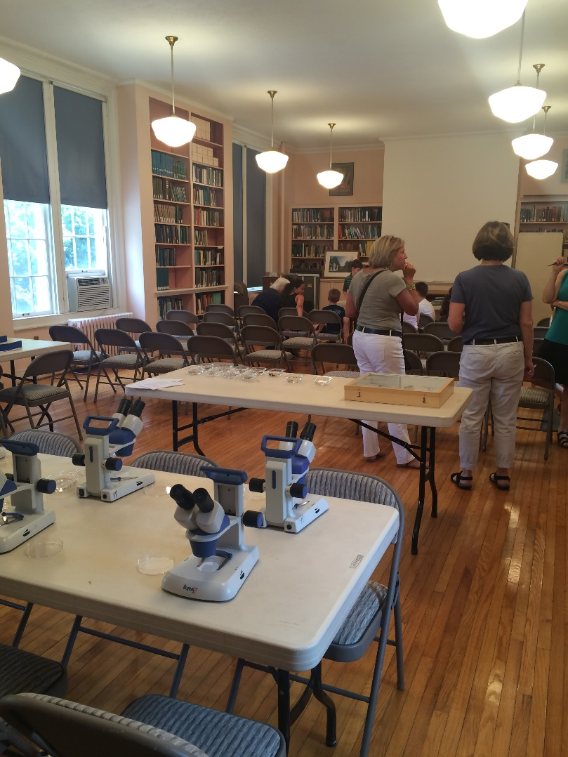
Private Lunch Room

Slide 18
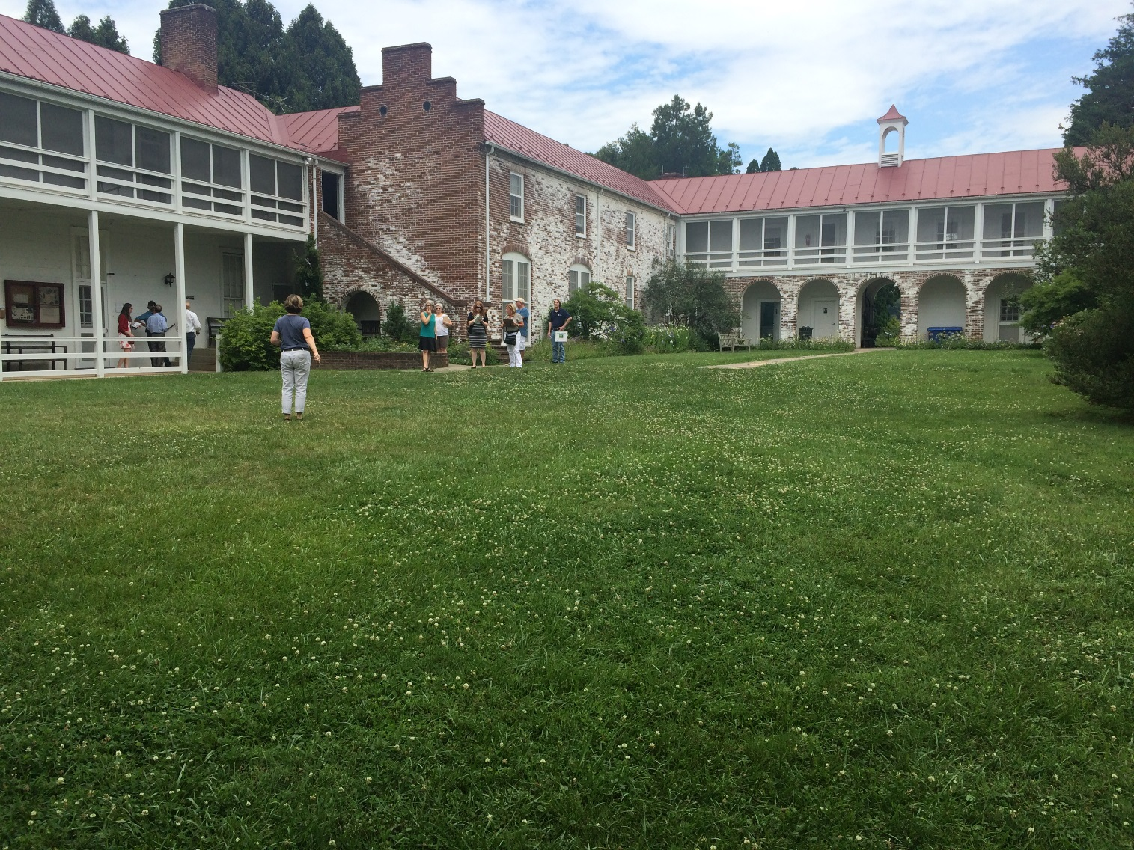
Location for Tent

Slide 19
Logistics / Set up – DRAFT – v. 1
Library
2x6’ table, 4 chairs
DiPasquale
Bisland, Felver, Christophe
Breakfast
CAC LGAC STAC
Notes:
ARBORETUM TO SUPPLY
Main table set up
Seating for 22
10 2x6’ tables
22 chairs
2- 2x6’ tables/back of room and drinks
Use of kitchen for meal prep
CBP TO SUPPLY
Linens for tables (rented)
Place settings (napkins, plates, glasses, utensils)
Nameplates
Food (catered)
Beverages
OTHER
- No a/v in this room required
Lunch will be on table when members arrive
Drinks located on side table
PROPOSED MENU
Greek Salad
Chicken Marbella
Curried Cous Cous
Assorted Desserts
OR
Greek Salad
Roasted Vegetable Savory Tart
Assorted Desserts
DE+1
DE
MD+1
MD
USDA
PA
PA+1
NY
USACE+1
USACE
DC + 1
DC
CBC + 1
CBC
Entrance
EPA +1 EPA VA VA+1
Drinks, 2x6’
Contact: Lori Mackey
Mackey.lori@epa.gov 410-267-5715
© 443-223-5708

Slide 20
Logistics / Set up – DRAFT – v. 2
Library
2x6’ table, 4 chairs
DiPasquale
Bisland, Felver, Toulou
Breakfast
CAC LGAC STAC
Notes:
ARBORETUM TO SUPPLY
Main table set up
Seating for 22
10 2x6’ tables
22 chairs
2- 2x6’ tables/back of room and drinks
Use of kitchen for meal prep
CBP TO SUPPLY
Linens for tables (rented)
Place settings (napkins, plates, glasses, utensils)
Nameplates
Food (catered)
Beverages
OTHER
- No a/v in this room required
Lunch will be on table when members arrive
Drinks located on side table
PROPOSED MENU
Greek Salad
Chicken Marbella
Curried Cous Cous
Assorted Desserts
OR
Greek Salad
Roasted Vegetable Savory Tart
Assorted Desserts
DE+1
DE
MD+1
MD
USDA
PA
PA+1
USACE+1
USACE
NY
DC
CBC + 1
CBC
Entrance
EPA +1 EPA VA VA+1
Drinks, 2x6’
Contact: Lori Mackey
Mackey.lori@epa.gov 410-267-5715
© 443-223-5708

Slide 21
Logistics / Set up DRAFT
Public session & News Conference
NOTES:
Tent
ARBORETUM TO PROVIDE
49 Chairs for guests
Head table set up
4 6ft tables
11 chairs
1- 6ft tables for:
Press and public materials (entrance of tent)
CBP TO PROVIDE
Nameplates
Gavel/strike plate
Flags (except USDA & USACE)
Logo
Linens
Glasses/pitchers/water
Easels (10)
Audio (rented)
Sound system
Table mics
Audience mic
Mult box
Podium w/mic
Battery powered
Tech on site for day
Podium & mic, logo
Posters on Easels
Flags
Door
(Oysters, Blue Crabs & SAV Posters)
NY DE DC
1 Mic
25 Chairs
Press Table
GIT Chairs
MD PA
24 Chairs
VA EPA CBC
Press
Aisle
tables w/ chairs
and water
3 – mics
No chairs; t.v. media section
+1s & AC Chairs
1 Mic
USDA USACE
(WQS, Wastewater & Air Posters)
Flags
Contact: Lori Mackey
Mackey.lori@epa.gov 410-267-5715
© 443-223-5708
Posters on Easels

Slide 22
Hotels near State Arboretum
Candlewood Suites Winchester
1135 Millwood Pike Winchester, VA
(540) 667-22602 ‎ · ihg.com
Fairfield Inn & Suites
250 Front Royal Pike Winchester, VA
(540) 665-8881 – marriott.com
Holiday Inn Winchester SE – Historic Gateway
333 Front Royal Pike Winchester, VA
(540) 667-3300 ‎ · ihg.com
A Loft Winchester
1055 Millwood Pike Winchester, VA
(540) 678-8899 - aloftwinchester.com

Slide 23
EC Members | Security Contact | Public Affairs Contact | +1 (at lunch) | Notes (Dietary restrict?)
CBC – Thomas McLain "Mac" Middleton, CBC Chair | N/A | Contact Ann Swanson on cell, 410-507-0857 | Ann Swanson, CBC Executive Director | None
DC -
DE – Kara Coats, Deputy Secretary, Department of Natural Resources and Environmental Control, State of Delaware | N/A | Carol Riggs Carol.Riggs@state.de.us | Bob Palmer, Acting Director Delaware Department of Natural Resources and Environmental Control | None
EPA – Gina McCarthy, Administrator |  | Monica Lee, Press Secretary Lee.monica@epa.gov 202-564-0645/(c) 202-713-6902 | Shawn Garvin, Region 3 Administrator | None
MD – Jeannie Haddaway Riccio, Deputy Chief of Staff | (410) 974-2991 trooper.delta@maryland.gov |  | Ben Grumbles, Secretary MD Department of the Environment | None
NY – James Tierney, Assistant Commissioner for Water Resources |  |  | N/A | Vegetarian
PA –Tom Wolf, Governor |  |  | Patrick McDonnell, Acting Secretary PA Department of Environmental Protection | None
VA – Terry McAuliffe, Governor (CHAIR) | Marc Wiley, First Sergeant, Virginia State Police, Executive Protective Unit 804-786-8414 | Brian Coy Communications Director 804-225-4260 brian.coy@governor.virginia.gov | Molly Ward – Secretary of Natural Resources cell: 757-771-2211 | None.
USDA – Robert Bonnie Under Secretary Natural Resources and Environment | N/A | Michael Illenberg Mike.Illenberg@oc.usda.gov | N/A | None
US ACE –Brigadier General William Graham | Antonio Santiago-Rios Chief, Security Office antonio.santiago-rios@usace.army.mil (410)962-4112 | Christopher Augsburger Chief, Corporate Communications (410) 962-2809 christopher.augsburger@usace.army.mil | N/A | None

