Slide 1
Enriching educational experiences through partnerships
Jon Wickert, Ed.D.
Amy Green
Notes:
Mention there will be a time in the middle for questions during the activity as well as at the end if time allows.

Slide 2
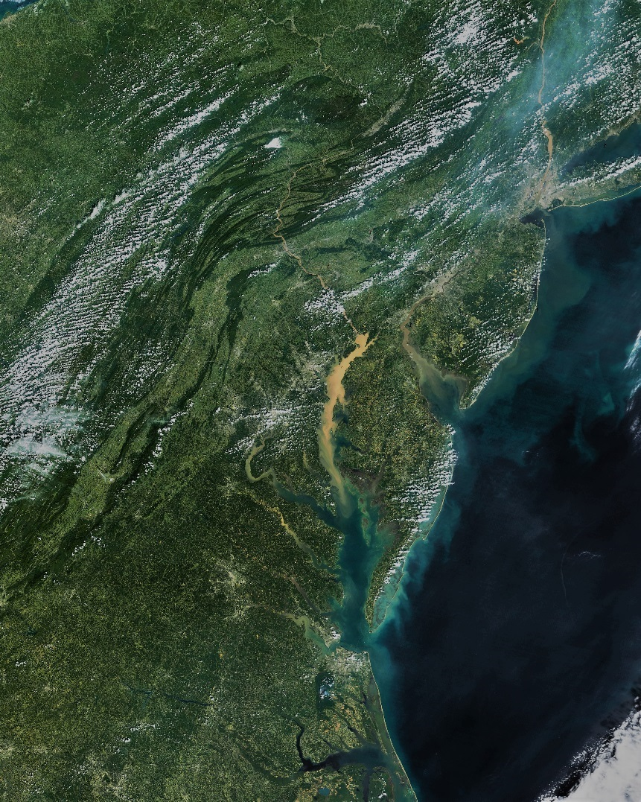

A multi-state commitment for tomorrow
Notes:
7 minutes or less!!!!
Look at the image. What do you see? Take a second to share with a neighbor. *Brief* share out.
Did you want to point out the cities/human impact on the landscape to get them to see that we are looking beyond the bay for this conversation?
In 2014, governors of all states signed an agreement to commit to advance the restoration and protection of the Bay watershed. Each goal of the agreement is linked to a set of outcomes, or time-bound and measurable targets that will directly contribute to its achievement.
These goals are interrelated: improvements in water quality can mean healthier fish and shellfish; the conservation of land can mean more habitat for wildlife; and a boost in environmental literacy can mean a rise in stewards of the Bay’s resources.
Our environment is a system, and these goals will support public health, the health of the watershed as a whole, and improved economic opportunities for today’s students.
In this session, we are specifically going to focus on the education goals that support this vision of the future.
Picture taken Sept. 13, 2011 after tropical storm Lee. NASA is what I use for the credit.

Slide 3
Environmentally & Economically Sustainable Chesapeake Bay Watershed
Environmental Literacy
Engaged Communities
Environmental & Economic Sustainability
Meaningful Watershed Educational Experiences
Notes:
Engaged Communities
The long-term success of the Chesapeake Bay restoration effort depends on the work of individuals and communities living throughout the watershed.
Environmental literacy --for all students and all citizens is essential for maintaining engaged communities
The MWEE is one way that we can support and strengthen the environmental literacy of all students.
Goal: Enable ALL students in the region to graduate with the knowledge and skills to
make informed decisions concerning their local watershed,
to act on these decisions to improve the well-being of other individuals, societies, and the global environment;.
to participate in civic life,
and successfully join in the 21st century job market ( We are seeing significant increases in high-paid environmentally-based careers).
I do think you want to include the job outlook specifically as well as something on potential larger economic impact.
Environmentally based careers
11% increase 2014-2024
Median Pay: $67,460+
Source: www.bls.gov

Slide 4
Meaningful Watershed Educational Experiences
Academic Achievement
Outdoor field investigations & informed action
MWEE
Essential Elements | Issue Definition
 | Outdoor Field Experiences
 | Synthesis and Conclusions
 | Action Projects
Supporting Practices | Active Teacher Support
 | Classroom Integration
 | Local Context
 | Sustained Activity
Notes:
So, what is a MWEE.
A MWEE is an pedagogical approach—it is a method and practice of teaching for meaningful learning
MWEEs seek to seamlessly connect standards-based classroom learning with outdoor field investigations and informed action to create a deeper understanding of our relationship with the natural environment.
Are additive to curricular effectiveness, not additional

Slide 5
Recognizing the MWEE as a Powerful Educational Tool
MWEEs
Student engagement & enthusiasm for learning
Critical thinking, reasoning, problem-solving
Post-secondary and/or job readiness
Intrinsically motivated stewardship and civic engagement
Notes:
For more information about the power of the MWEE as an educational tool, check out the guide and feel free to ask me or our team any questions- (later?)
So we just sold you on why this is good for learning and why it’s good for the BAY. We are encouraging you to take it beyond the bay and we are going to help you do that. We’re ok with a larger perspective and are supportive of this changed conversation. Sell them on the benefits. So now Jon is going to talk about 3 important pieces of MWEEs and how these sound practices enable you to incorporate MWEEs in and across jurisdictions.

Slide 6
Important pieces of a mwee
Partnerships
Curricular Integration & Professional Development
Outdoor Field Experiences
Notes:
The partnerships cultivated help support the implementation of OFEs, curricular integration, and PD. Flipping the traditional PD model on its head and looking to partners to provide support through network of specialists and sharing of resources. ED agency provides direction and works collaboratively through regular structured discussion and common objectives.

Slide 7
Partnerships
FY16 School Programs Delivered by State Parks
 | # Programs | # Students | Contact Hours
Pennsylvania | 3,373 | 129,761 | 196,636
Virginia | 2,457 | 185,695 | 371,390
Delaware | 1,592 | 41,828 | 62,742
 | 7,422 | 357,284 | 630,768
Notes:
Consider what is illustrated here only refers to State Park student programming. It does not include public programming nor the other relationships that exist in these states to support students and communities. Imagine the power if this work was even more closely coordinated and collaboration was taking place across jurisdictions as well. Similar work is happening in other states as well.

Slide 8
Classroom Integration & PD
Pennsylvania State Parks Teacher Institute
  PD for current and pre-service educators aligned to state standards
  Approved provider for PD through PDE
  Trainings from 1-5 days in length
  Promote to 15,000 educators
Notes:
Pennsylvania State Parks offer a variety of hands-on, interactive professional development opportunities for formal, non-formal, and pre-service educators. All trainings provide activities and lessons that address PA Department of Education standards & Common Core. Pennsylvania State Parks is an approved provider of Act48 hours through the Pennsylvania Department of Education; allowing participants to gain needed hours toward their teacher recertification requirements. Most trainings are held at state parks and take place over a single day. While others are developed to provide a more immersive experience and may be two – five days in length. Typically, we schedule and promote the trainings ourselves. But many times, through the request of school districts or other organizations we’ll do specially requested trainings for groups of 10 or more. Additionally, we work with PDE and DEP to promote our professional development offerings to 15,000 Pennsylvania educators.

Slide 9
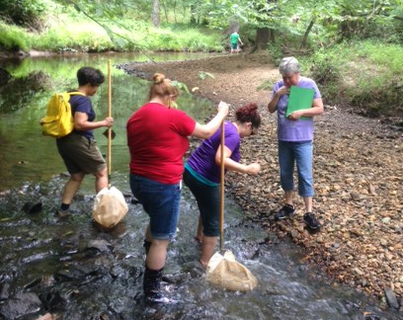
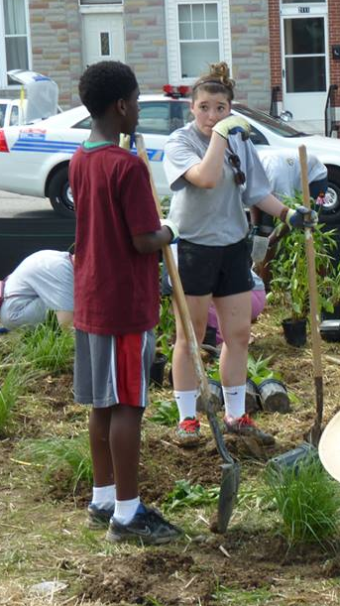
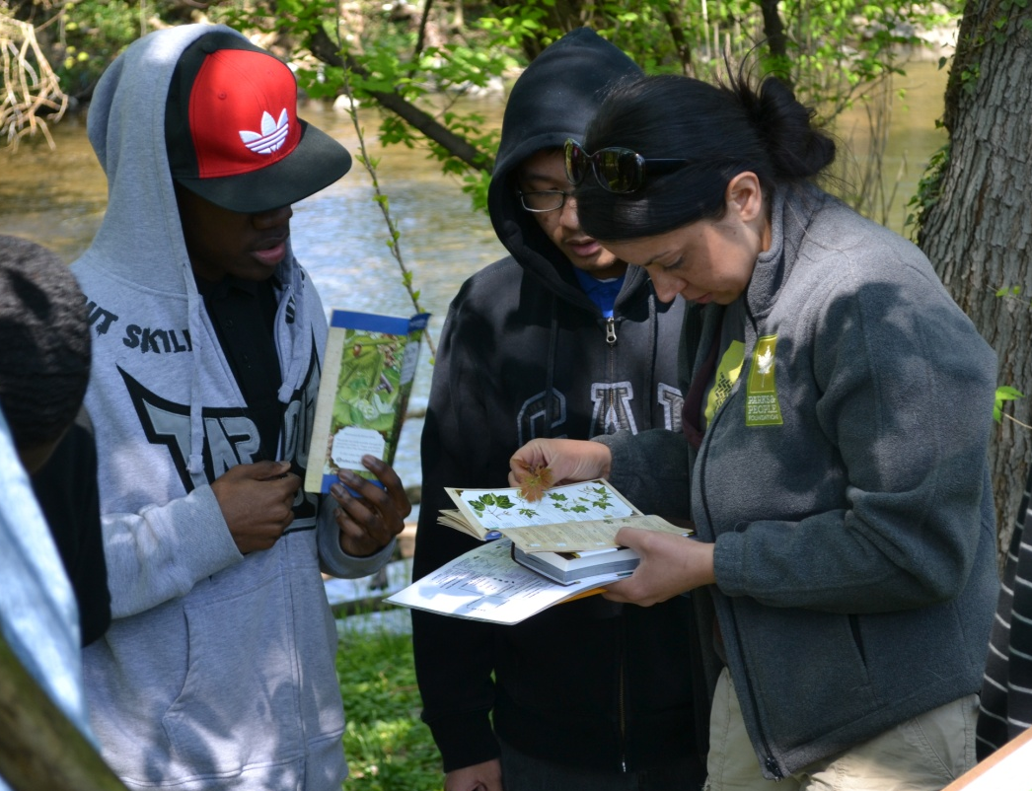
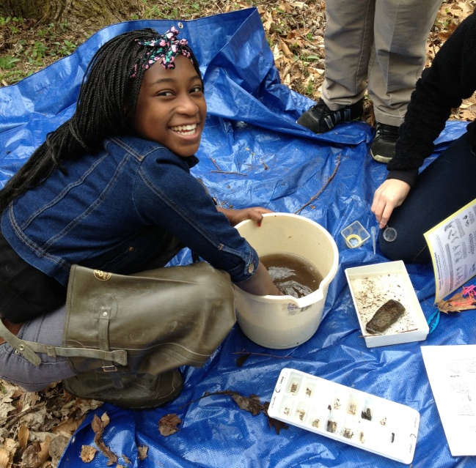
Classroom Integration & PD
Funding as an Opportunity to Integrate Across Disciplines:
Thinking OUTSIDE [of the box]
Maryland DNR’s Explore & Restore Maryland Streams Program
Educational activities using real science
Uses CBIG $ to support E-Lit
Meets multiple CBA goals
Integrates disciplines
Notes:
Existing relationship models -- Supporting classroom integration and professional development –
Maryland is using Chesapeake Bay Implementation Grant funding (CBIG – pronounced “sea-big” – EPA $) to support education that helps weave real science practices using the MWEE model into classrooms through field investigations of streams that mirror the work of stream biologists, and it includes student-led stewardship projects to benefit water quality. The program supports the full MWEE model (all the elements, with extra emphasis on field investigation, collecting/analyzing data, and using it for student-driven stewardship actions)
The funding has provided an opportunity for MD DNR to use a non-traditional source of funds -- and a pairing of education and science practice -- to support ELit and MWEEs. We encourage partners to think outside of the box in this way. DNR has rolled it out to schools through teacher workshops, and has developed and provides instructional materials online
Outdoor Field Experiences mention here.

Slide 10
Question Storming
Directions: You will visit a station representing each important piece of a MWEE and brainstorm questions you have about these topics. Any question is a good one and helps us understand your landscape, concerns, and resource needs in order to help you develop that component in your area of influence.
3 rotations of five minutes each
Each jurisdiction has its own color marker
ONLY QUESTIONS!
No explanations other than to help clarify your question

Slide 11
Fun with stickers
Directions: Using your state-specific colors, visit each of the three pieces again. Use the next 5 minutes to:
  “Q” stickers: Place these stickers next to a question you also have but didn’t ask
  “A” stickers: Place these stickers next to a question someone asked that you could help address/overcome
  Write down on your slide handout any thoughts or big questions that resonate with you as you walk around!

Slide 12
debrief
Take 5 minutes within your group to discuss what resonated with you. Consider what actionable items you commit to explore or enact moving forward.

Slide 13
Wrap up
Outdoor field experiences, curricular integration, and professional development that is driven and supported through agency partnerships lead to richer educational experiences and improved outcomes for students and communities.
The natural environment is a learning tool best leveraged through MWEEs.
Think beyond the geographic boundaries of the bay!
Most importantly, don’t forget…
  What’s best for the Bay is BEST for everyone!
Notes:
This slide starts with Jon on the first bullet.
Amy takes bullets 2 & 3.
Slide 4 appears on click. Amy and Jon will attempt to say together.

