Slide 1
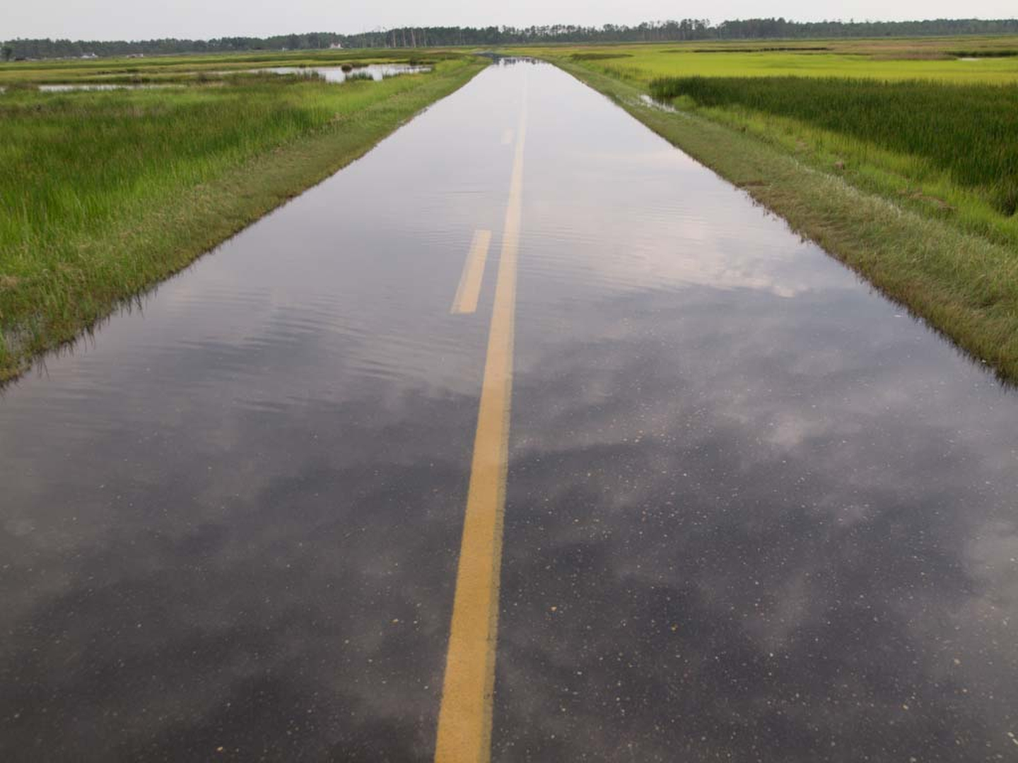

Local Approaches to Climate Resilience & Adaptation on the Eastern Shore
November 16, 2016
Citizens Advisory Committee
Brian Ambrette
Photo: David Harp

Slide 2
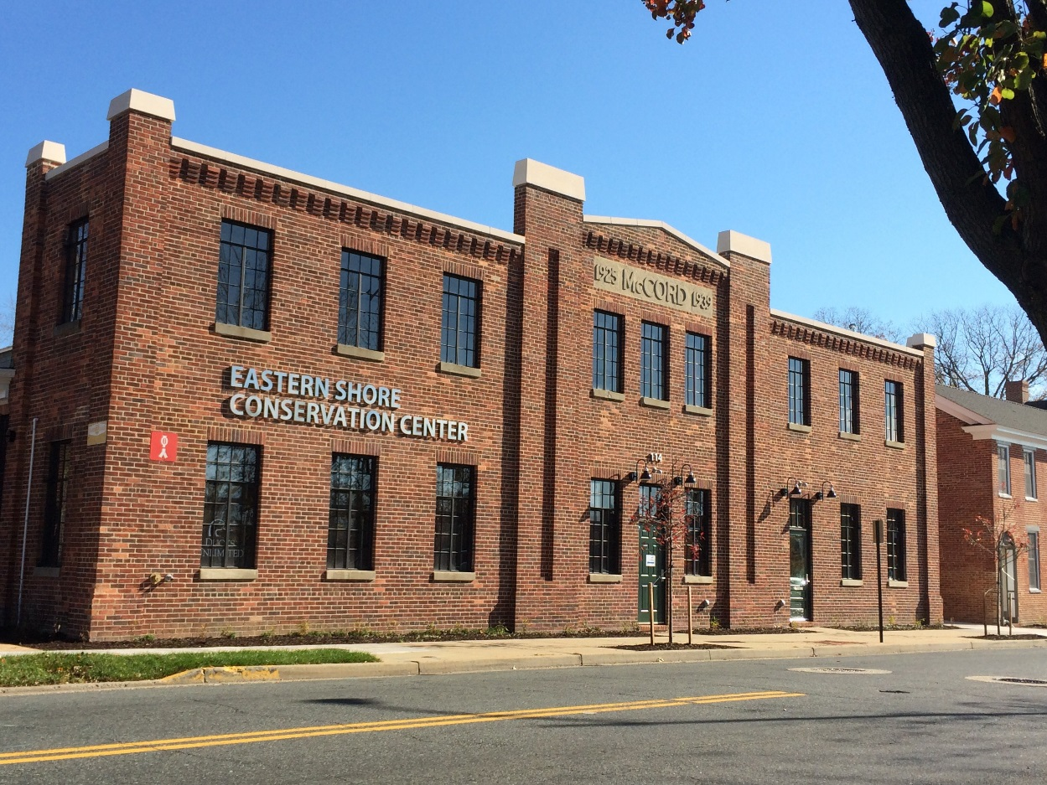

ESLC: What we do
Land Preservation & Stewardship
Center for Towns
Coastal Resilience Program
Policy Advocacy
Eastern Shore Conservation Center
Where we work
C&D Canal to the Nanticoke River
Caroline, Cecil, Dorchester, Kent, Queen Anne’s, Talbot counties
Photo: Brian Ambrette
EASTERN SHORE LAND CONSERVANCY

Slide 3
Coastal Resilience Program Goals
1. Provide Leadership & Capacity
2. Focus Public Support & Political Will
3. Create Products & Services
Lower barriers to local action
Create new
opportunities
Demonstrate
progress
EASTERN SHORE LAND CONSERVANCY

Slide 4
Projects and Initiatives
Kent County climate vulnerability study (completed September 2016)
Eastern Shore regional climate adaptation collaborative (launched March 2016)
Coastal Resilience Chapter for comprehensive plans (Cambridge - November kickoff)
Outreach(ongoing)
1. Provide Leadership & Capacity
2. Focus Public Support & Political Will
3. Create Products & Services
Lower barriers to local action
Create new
opportunities
Demonstrate
progress
EASTERN SHORE LAND CONSERVANCY

Slide 5
Kent County Climate & Sea Level Rise Vulnerability Study
Goal 1 – Identify the natural hazards that will be exacerbated by climate change and sea level rise and understand how those impacts will affect the residents, economy, and natural resources of the county.
Goal 2 – Engage stakeholders in dialogue about natural hazards, the effects of climate change, and potential actions for mitigation or adaptation.
Goal 3 – Communicate the study’s findings and recommendations to the public.
Goal 4 – Train a team in Maryland on the “VCAPS” method for assessing vulnerabilities.
EASTERN SHORE LAND CONSERVANCY

Slide 6
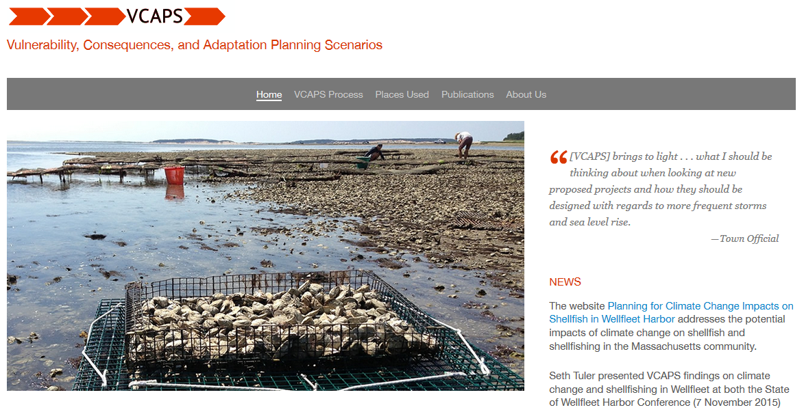
The VCAPS Method
Vulnerability, Consequences, and Adaptation Planning Scenarios
Benefits
A participatory process
Uncovers data needs, responsibility gaps, and planning requirements
Strengthens collaboration across departments
Improves public awareness and participation
www.vcapsforplanning.org
EASTERN SHORE LAND CONSERVANCY
Notes:
There is urgency to address the greenhouse gas emissions that are causing climate change. That, however, was not the focus of this study.

Slide 7
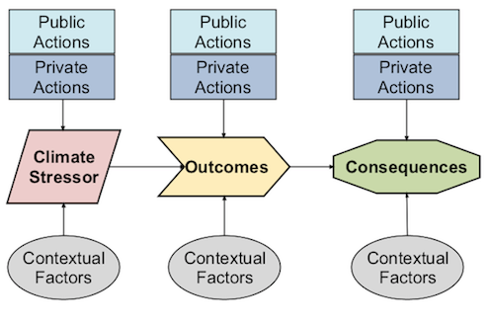
The VCAPS Workshops
How it works
A facilitated conversation
Aided by real-time “conversation mapping”
Produces cause-and-effect linkages between natural hazards and community impacts
Integrates science with local context and experiences
Causal diagramming
EASTERN SHORE LAND CONSERVANCY
Notes:
There is urgency to address the greenhouse gas emissions that are causing climate change. That, however, was not the focus of this study.

Slide 8
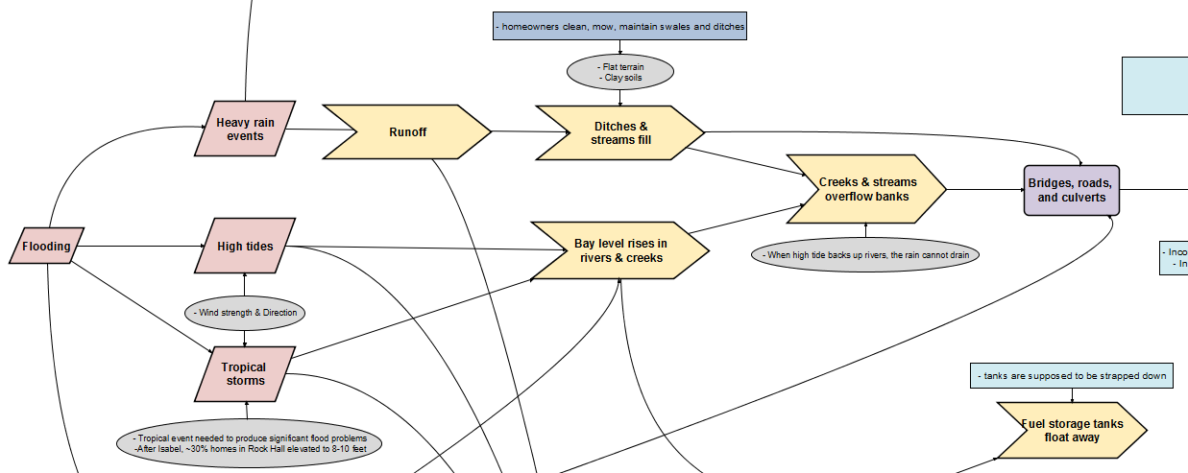
The VCAPS Process
EASTERN SHORE LAND CONSERVANCY
Notes:
There is urgency to address the greenhouse gas emissions that are causing climate change. That, however, was not the focus of this study.

Slide 9
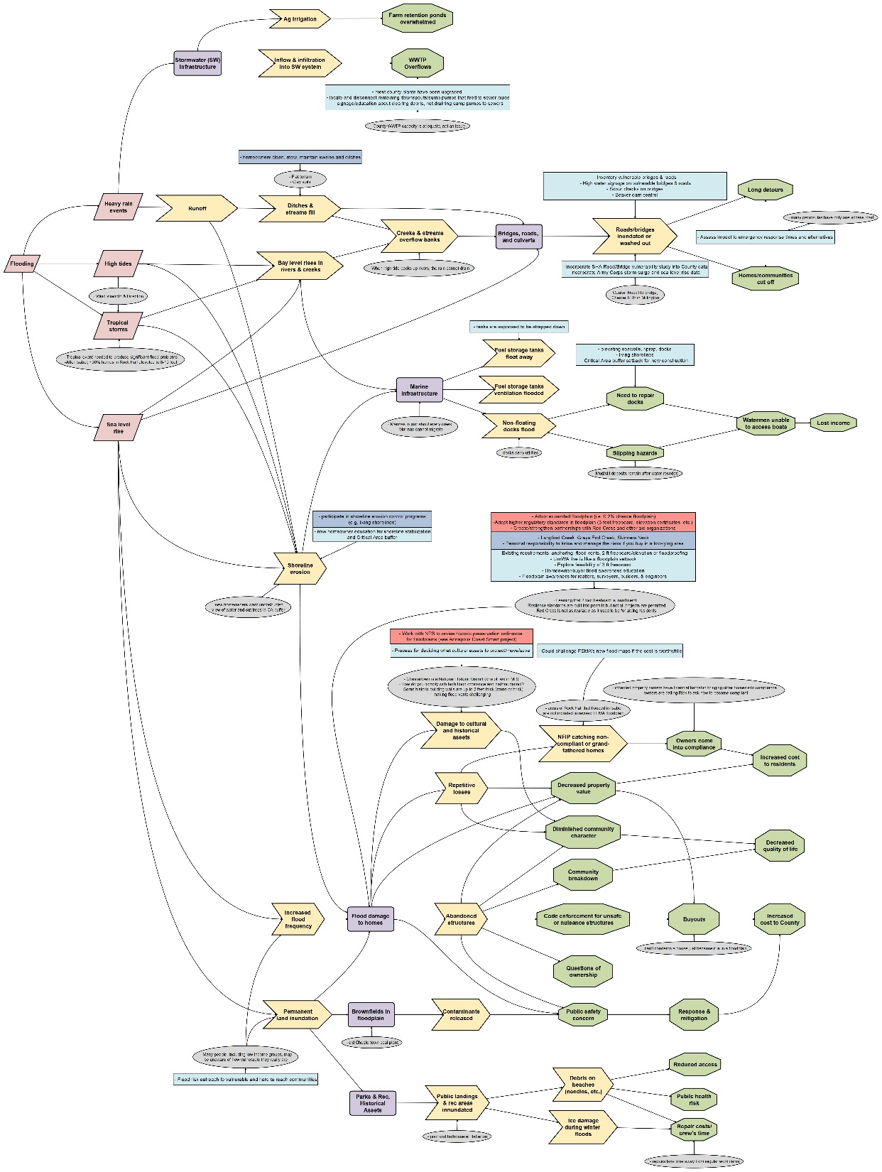
EASTERN SHORE LAND CONSERVANCY
Notes:
There is urgency to address the greenhouse gas emissions that are causing climate change. That, however, was not the focus of this study.

Slide 10
Recommendations
Cooperation & Collaboration
Community Resilience
Education, Information, and Outreach
Emergency Management
Infrastructure & Maintenance
Planning & Decision-making
Land Use & Land Management
Research & Data
8 categories
21 recommendations
48 actions recommended by stakeholders
17 additional actions
EASTERN SHORE LAND CONSERVANCY

Slide 11
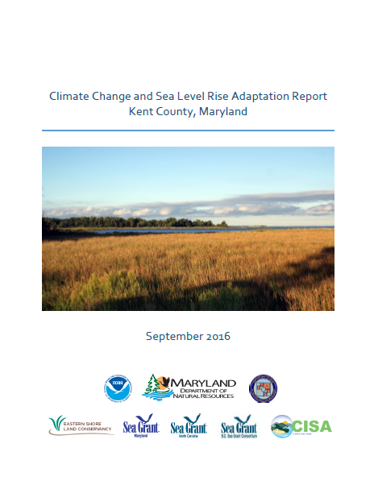
Outcomes
Report adopted by County Commissioners and Planning Commission in September
Influencing the concurrent Comprehensive Plan update
2019 Hazard Mitigation Plan update
Options for strengthening floodplain ordinance
Common language and shared understanding of climate impacts across county government
EASTERN SHORE LAND CONSERVANCY

Slide 12
Voices from Kent County
“The 2 to 4 inch rainstorms are more common.”
“It seems like all we have now is 100-year events.”
“The 100-year event is much more frequent and unrelated to growth or development.”
“The Chester River floods more frequently at high tide, particularly in the summer.”
“Now every storm is a serious concern for life and property.”
“It doesn’t freeze like it used to. There’s no more skating on the ponds.”
“Summers are becoming like Florida.”
“As a teen I remember being hired to work in dry fields during school vacation in March. Now we’re not able to work in the fields until April because they stay wet longer.”
EASTERN SHORE LAND CONSERVANCY

Slide 13
Projects and Initiatives
Kent County climate vulnerability study (completed September 2016)
Eastern Shore regional climate adaptation collaborative (launched March 2016)
Coastal Resilience Chapter for comprehensive plans (Cambridge - November kickoff)
Outreach (ongoing)
1. Provide Leadership & Capacity
2. Focus Public Support & Political Will
3. Create Products & Services
Lower barriers to local action
Create new
opportunities
Demonstrate
progress
EASTERN SHORE LAND CONSERVANCY

Slide 14
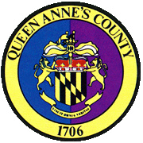




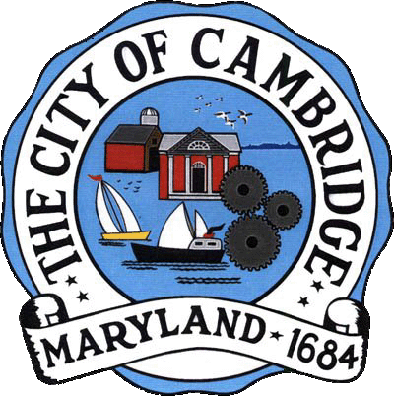

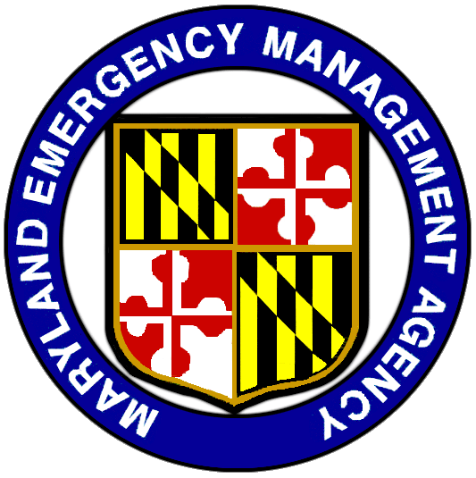



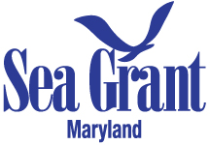



Eastern Shore Climate Adaptation Partnership
5 counties – Caroline, Dorchester, Kent, Queen Anne’s, Talbot
2 towns – Cambridge, Oxford
3 state agencies – DNR, MDE, MEMA
4 academic institutions – UMCES, UMD Sea Grant Extension, Chesapeake College CLEEn, Washington College Shore Power Project
1 nonprofit - ESLC
EASTERN SHORE LAND CONSERVANCY

Slide 15
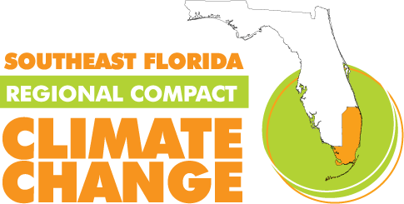



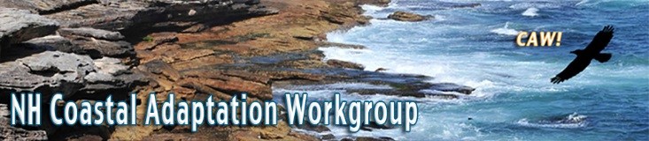

Why regional collaboration?
Professional support community
Shared risks and vulnerabilities
Knowledge sharing, avoid reinventing the wheel
Communication across departmental and jurisdictional lines
Increase regional adaptive capacity
Economies of scale
Greater funding opportunities
Exposure and influence at state and federal levels
EASTERN SHORE LAND CONSERVANCY

Slide 16
Eastern Shore Climate Adaptation Partnership
Vision
Eastern Shore communities are prepared, resilient, and able to adapt to flooding, extreme weather, and changing conditions.
Purpose
The Eastern Shore Climate Adaptation Partnership promotes learning and collaboration among Eastern Shore communities to prepare for changes in weather patterns, flooding, and other environmental conditions. The ESCAP is a venue for partners to provide support, education, technical assistance, and resources to help member communities build resilience.
EASTERN SHORE LAND CONSERVANCY

Slide 17
Eastern Shore Climate Adaptation Partnership
Goals
Assist members in utilizing existing resources, expanding capacities, and locating additional assistance to reduce risk, and prepare and protect their communities’ human, economic, and environmental health.
Collect, house, and share information among members.
Educate members, residents, and elected leaders on changing risks, potential adaptation strategies, and the ESCAP’s work.
EASTERN SHORE LAND CONSERVANCY

Slide 18
Eastern Shore Climate Adaptation Partnership
Work in progress
Adaptation work plans for members
White Paper: The case for local climate adaptation and regional collaboration on the Eastern Shore
Work concepts in development
Extreme Rainfall Study (NOAA grant pending)
FEMA Community Rating System collaboration and assistance
EASTERN SHORE LAND CONSERVANCY

Slide 19
Thank you
Brian Ambrette
Coastal Resilience Program Manager
Eastern Shore Land Conservancy
BAmbrette@eslc.org
410-690-4603 ext. 151
EASTERN SHORE LAND CONSERVANCY

