Slide 1
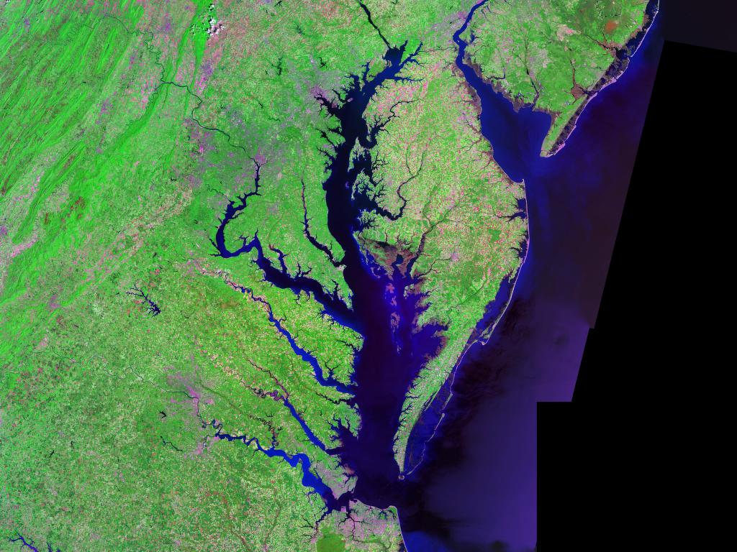
Chesapeake Bay Program
Federal Agencies and Facilities
Welcome and Introduction Training
[[[Draft Slide-deck]]]
January /June 2018
Notes:
Action items: Need EPA and states to provide all POCs for reporting See slides…

Slide 2

Overview
Chesapeake Bay Program
Chesapeake Bay Program Partnership
Federal Lands and Facilities in the Chesapeake Bay Watershed
Introduction and Drivers
Roles and Responsibilities
Reporting Process
Defining BMPs and Milestones
BMP Reporting Due Dates
2017 BMP Reporting Example
Jurisdiction Specific Reporting Slides and Specific Topics
Modeling Tools
Planning Tools
Common Terms
Phase III WIPs
Resources and Team Members
Verification
Accountability
Notes:
Summary of the things the new people need to ready to contribute to. Workplan so that the WG knows what we will be doing this year.

Slide 3
Chesapeake Bay Program
Formed in 1983 due to rapid loss of aquatic life and wildlife
  Excess nitrogen and phosphorus main pollution sources
Regional partnership guiding restoration and protection efforts
  Ex: Fisheries, habitat, water quality, land conservation, stewardship
Authorized through Clean Water Act (CWA) Section 117
Multiple agreements
  2014 Chesapeake Bay Watershed Agreement
Chesapeake Bay total maximum daily load (TMDL)
  Sets targets and allocations for nitrogen, phosphorus and sediment
  Jurisdictions developed plans to reduce specific sources (i.e. wastewater treatment plants, urban stormwater, agriculture)
Notes:
We also have a larger and more regional partnership the guides the management of the restoration and protection efforts. Those efforts for example, include fisheries management, public access, land conservation, wetlands.
It is authorized under the clean water act and establishes a bay program office and executive council, made up of governors of all 7 jurisdictions. From the Executive Council there is an organizational structure the partnership follows, this is located in the back up slides.
Most recent efforts of the partnership include the signing of the 2014 Agreement, Management Strategies and development of 2016-2017 work plans.
Much of the partnership focus is on the Chesapeake Bay total maximum daily load or TMDL. The partnership agreed that nitrogen, phosphorus and sediment are the main pollutants of concern for the bay and the jurisdictions developed plans to reduce pollution from specific sources, such as wastewater treatment plants, urban stormwater and agriculture.
And so before we get into the details of the CB TMDL, the next slide provides the key players of the partnership.

Slide 4

Chesapeake Bay Program Partnership
EPA (represents U.S. Government)
Jurisdictions (VA, MD, D.C., PA, DE, WV, NY)
Chesapeake Bay Commission
Federal agencies
Academic institutions
Non-governmental organizations
  Chesapeake Bay Foundation, Nature Conservancy
Advisory Committees
  Scientific, Local Government, Citizen
Agreement Signatories

Slide 5
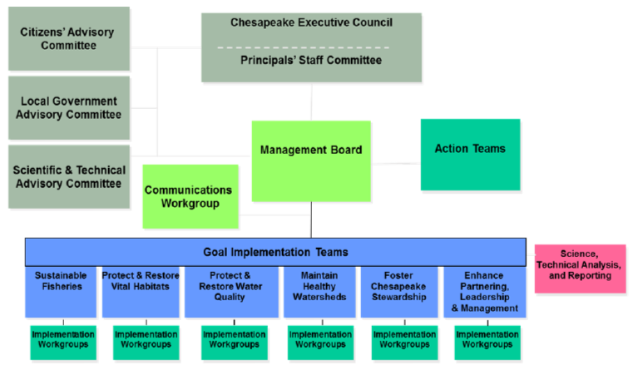
Chesapeake Bay Program Partnership
Federal Facility Workgroup
5

Slide 6

Other Goal Teams and Workgroups Applicable to the FFWG
Water Quality Goal Implementation Team
Watershed Technical Workgroup
Milestones Workgroup
Urban Stormwater Workgroup
Wastewater Workgroup

Slide 7
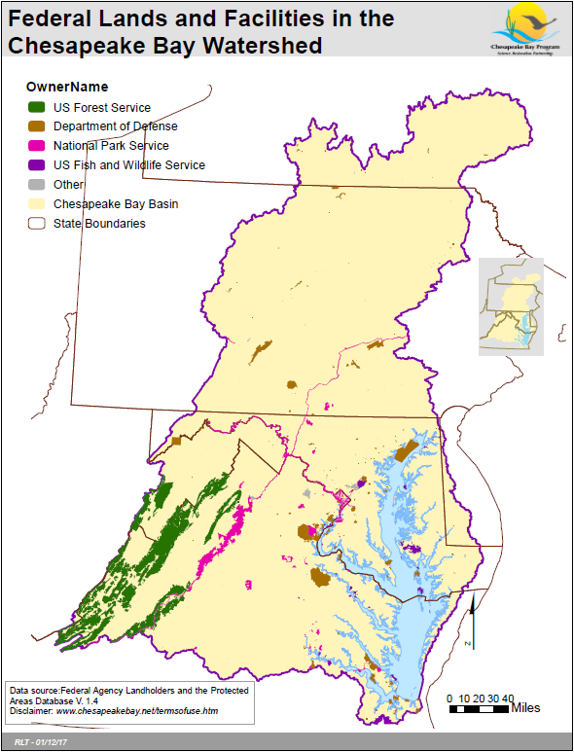
Federal Department | Total Acres
FS | 2,543,167.69
DoD | 484,631.74
NPS | 410,635.97
FWS | 223,288.95
Other | 23,834.87
ARS | 6,949.81
SI | 3,966.73
GSA | 2,596.51
NASA | 2,000.17

Slide 8
Federal Agency Policy and Regulatory Drivers
CWA Section 117: “Chesapeake Bay”
  117 (f)(1): Federal agencies that own or operate a facility within the Ches. Bay watershed “shall participate in regional and sub-watershed planning and restoration programs”
  117 (f)(2): Requires that federal agencies that own property in the Ches. Bay watershed comply with the Ches. Bay agreement and any subsequent agreements and plans
    2014 Chesapeake Bay Watershed Agreement signed June 2014
  117 (g): EPA is empowered (“shall ensure”) that management plans “are developed and implementation is begun by signatories of the Ches. Bay agreement to achieve broad nutrient goals, water quality requirements, and habitat restoration”

Slide 9
Federal Agency Policy and Regulatory Drivers
2014 Chesapeake Bay Watershed Agreement
  Re-affirms protection/restoration goals since Chesapeake 2000 Agreement
  Signatories include EPA (for US govt.), VA, MD, D.C., PA, DE, WV, NY, CBC
  Clear and concise goals (10) and outcomes (31)
  Science and ecosystem management approaches
  Integrates Chesapeake Bay Program and Executive Order 13508 goals
  Increased accountability
    Management strategies and two-year work plans
  Participation
    Water Quality: 2017 and 2025 Outcomes
Notes:
Include hyperlink to Agreement

Slide 10
Executive Order 13508
“Recognizes the Chesapeake Bay as a national treasure”
Federal government “should lead the effort”
  DoD, DHS, DOT, DOI (FWS/NPS/USGS), DOC (NOAA), USDA (NRCS/FS)
Renews federal commitment to control pollution for all sources as well as protecting and restoring habitat and living resources, conserving lands and improving water quality and ecosystem health
Establishes Federal Leadership Committee (FLC)
The FLC developed a strategy for the restoration of the Chesapeake Bay
Requires reports on key challenges to protecting and restoring the Chesapeake Bay
Agencies must implement land best practices “as expeditiously as possible and to the extent permitted by law”
Must balance “leading the effort” and fair implementation of CWA
Notes:
Include hyperlink to EO and Strategy
Mention FOD

Slide 11
Executive Order 13508 Strategy
Restore Clean Water Goal and Strategy Actions
  Federal agencies will contribute to Watershed Implementation Plans (WIPs)
    Estimate nutrient and sediment loads: providing property boundaries, land use, land cover, and implementation of best management practices
    Identify pollution reductions from point and non-point sources
    Commit to actions, programs, policies and resources
  States develop targets or Feds develop implementation plans
    Consider all source sectors: agriculture; forest; urban; onsite
  Implementation and Accountability
    Submit two-year water quality milestones (i.e. planned implementation)
    Report annual implementation
Notes:
FFWG agreed to keep it in.

Slide 12
Chesapeake Bay Total Maximum Daily Load
  “Pollution diet” sets limits on nitrogen, phosphorus and sediment
    Largest EPA TMDL
    Max allowed to meet water quality standards (i.e. dissolved oxygen, chlorophyll)
    Assigned limits are based on modeled data
    Each state developed plan
    Implementation via permits
    EPA/VA/MD issued federal pollution targets in 2015
  Goals and 2017 Mid-point Assessment
    60% reductions by 2017 for all sources (i.e. wastewater, agriculture, stormwater)
    100% BMPs in place by 2025
  Challenges
    Reviewing/commenting on changing state requirements
    Funding implementation and maintenance of BMPs
    Reporting/tracking progress

Slide 13
Watershed Implementation Plans
Watershed Implementation Plans (WIPs) formulate jurisdictional strategies to meet the CB TMDL goals of 60% reductions by 2017 and 100% practices in place by 2025
Phases I & II complete
  County level/federal agency loads assigned in MD for all sources
  Federal agency loads assigned in DC
  County level implementation targets attempted in VA and PA
Calibration of model in 2017 will inform Phase III WIPs due June 2019
  EPA expects jurisdictions to develop local area planning goals
  Federal facility targets revised

Slide 14
NPDES Permitting Compliance
Watershed

Slide 15
Roles and Responsibilities
Watershed
Notes:
Greg to help; see discussion about FOD, FLC, and FFWG.

Slide 16
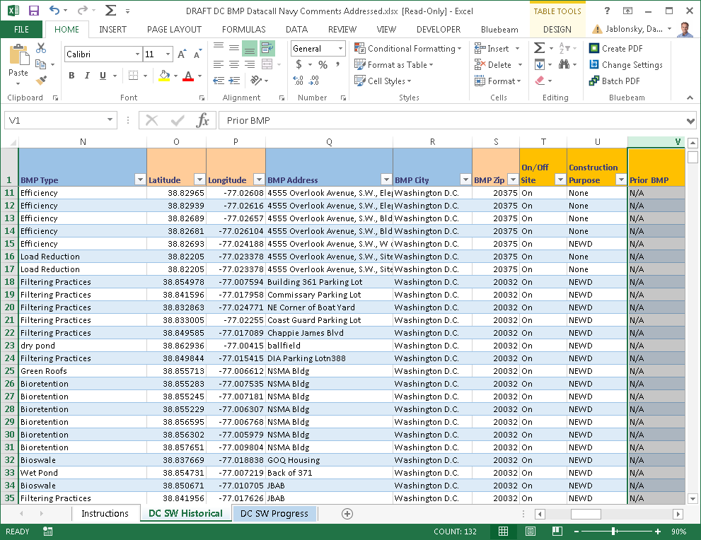
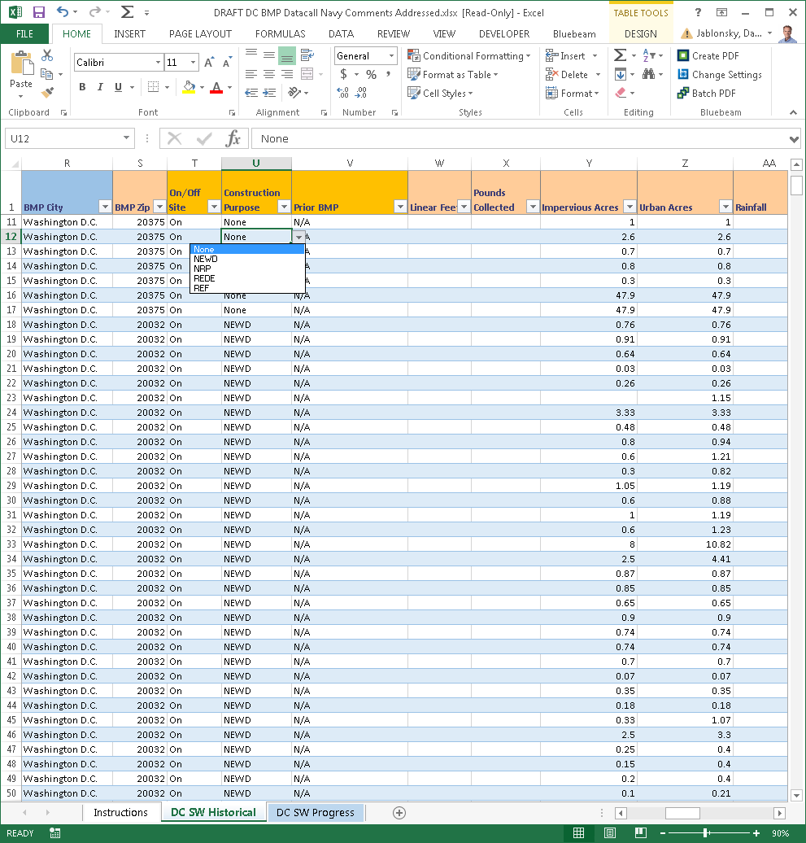
Federal Agency and Facilities Reporting Process
EPA sends request in August to Federal Office Directors and FFWG members
Requests BMP data be submitted to Jurisdictions
Unique templates are
provided by each Jurisdiction to report Progress
CAST is used to report planned BMPs

Slide 17
Defining BMPs and Milestones
Progress BMPs
Constructed, installed and functioning
Federal data submitted to Jurisdictions
Planned BMPs
To be installed using best available info in STATE fiscal year
Facility level information submitted using CAST. Scenarios shared with Jurisdictions
Jurisdictions enter data into NEIEN
Federal data is consolidated with Jurisdiction submittal to EPA
Jurisdiction specific reporting templates used
Programmatic Milestones
Two year cycle requested every ODD year
Agency level actions to support Water Quality
Two-year cycle, requested every ODD year
Submitted to EPA
Historical BMPs
Practices installed in the past and already reported
Revisions and updates based on new information
Verification of inspection and maintenance required to maintain credit
Federal data submitted to Jurisdictions for update in NEIEN
Reported in STATE fiscal year 07/01 through 6/30
Reported in CALENDAR YEARS
Notes:
Programmatic milestones:
Most come from the FOD
Add some language: If a FF Representative they think is a programmatic milestone with a fcility focus that will help BMPs go in the ground later, that type has not bbeen real well defined and has only happened. Examples of each one.

Slide 18
BMP Reporting Due Dates
Progress BMPs
OCT 1 every year
Planned BMPs
NOV 1 every odd year
Programmatic Milestones
NOV 1 every odd year
Historical BMPs
OCT 1 every year with updates

Slide 19
2017 BMP Reporting Example
Progress BMPs
BMPs installed from 07/01/2016 through 6/30/2017
Planned BMPs
BMPs to be installed between 7/1/2017 through 6/30/2019
Programmatic Milestones
Agency level actions to be completed in calendar years 2018 and 2019
Historical BMPs
Updates to BMPs installed from 1984 to 6/30/2016

Slide 20
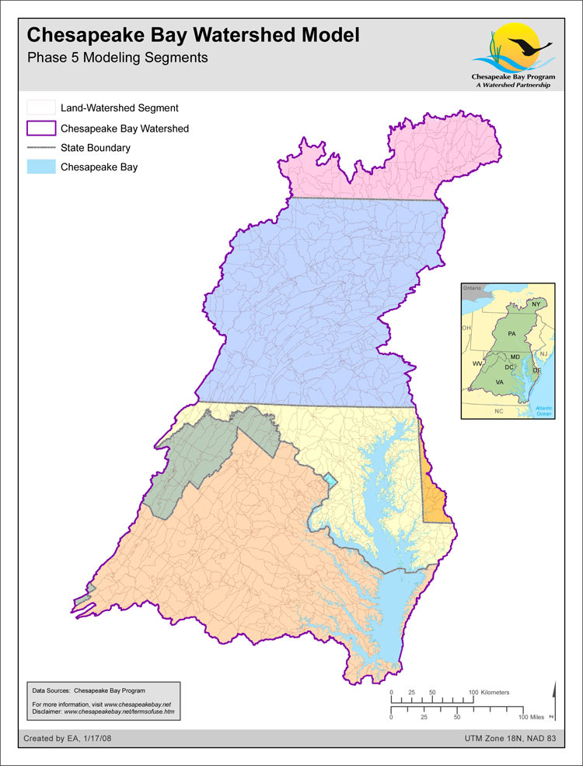
Jurisdiction Specific Reporting Slides

Slide 21
Jurisdiction Specific Slides: Virginia
Jurisdiction POC
Bill Keeling
Non-point Source Analyst
EMAIL and Phone
William.keeling@deq.virginia.gov
804-698-4342
Template Used
Online: Virginia BMP Warehouse
Specific Coordination
Uses online database for reporting progress

Slide 22
Jurisdiction Specific Slides: Maryland
Jurisdiction POC
Gregorio Sandi
Natural Resources Planner
EMAIL and Phone
Gregorio.sandi@maryland.gov
410-537-3742
Template Used
Excel Spreadsheet
Specific Coordination
Multiple sheets require duplicate info for various MDE departments
Notes:
There may be more than one person to report to on the States.

Slide 23
Jurisdiction Specific Slides: Pennsylvania
Jurisdiction POC
Ted Tesler
EMAIL and Phone
thtesler@pa.gov
Template Used
Excel Spreadsheet
Specific Coordination
Limited staff—ensure follow-up

Slide 24
Jurisdiction Specific Slides: District of Columbia
Jurisdiction POC
Luke Cole
Tree Policy Coordinator
EMAIL and Phone
luke.cole@dc.gov
(desk) 202-724-5348 (cell) 202-281-7634
Reporting Template Used
Excel Spreadsheet
Specific Coordination
DDOE emails Federal Facility leads to verify stormwater practices extracted from database to minimize duplicative reporting.

Slide 25
Jurisdiction Specific Slides: West Virginia
Jurisdiction POC
Alana Hartman
Basin Coordinator
EMAIL and Phone
Alana.c.hartman@wv.gov
304-822-7266 x 3623
Template Used
Excel
Specific Coordination

Slide 26
Jurisdiction Specific Slides: New York
Jurisdiction POC
Alana Hartman
Basin Coordinator
EMAIL and Phone
Alana.c.hartman@wv.gov
304-822-7266 x 3623
Template Used
Excel
Specific Coordination

Slide 27
Copy EPA for All Jurisdictional Submittals
Jurisdiction POC
Basin Coordinator
EMAIL and Phone
Alana.c.hartman@wv.gov
304-822-7266 x 3623
Template Used
Excel
Specific Coordination

Slide 28
Modeling Tools
Need Graphic from EPA on how data submittals feed into the tools.
Notes:
Need a schematic that discusses our process/cycle: Greg will take that back to see
Start with federal lands (federal data layer), used to then develop estimated loads, and then we have our targets coordinated with LAPG, BMPs, Report progress, new tools to assess progress; cycle to revise plans and go forward. Two-year milestones.

Slide 29
Modeling and Planning Tools
Need information from EPA on how federal input feeds the model
Need input from EPA on NEIEN, CAST
General information
Get websites
Notes:
Greg will check with the data folks (Jeff/Matt…they may have something we can use) . Get a few slides that get into the depth of this. Ask the modeling workgroup.

Slide 30
Common Terms and Definitions
Chesapeake Bay Program Glossary includes terms used to describe the Chesapeake Bay, its ecosystem and restoration efforts: https://www.chesapeakebay.net/discover/glossary#
Ask EPA for graphic on the: Key Years in the Bay Program Model (i.e.1985, 2010)
Federal data layer: Federal lands and facilities ownership, boundary, acreage information located in an ArcGIS Online map viewer for the Chesapeake Bay watershed. http://gis.chesapeakebay.net/fedfacs/
High-resolution data: One-meter resolution land cover dataset for the Chesapeake Bay watershed. Prior data was at the 30-meter resolution. Gives more accurate look at what’s really on the landscape. http://chesapeakeconservancy.org/conservation-innovation-center/high-resolution-data/land-cover-data-project/
Federal Land Use: Most federal land use data is captured within the high-resolution dataset. Land uses assigned to federal lands include: forest, natural, turf, developed,. Agricultural land uses were extracted from federal lands due to data gaps and uncertainty.
Allocation Air: Portion of nitrogen, phosphorus and sediment load under the oversight of EPA. Load reductions are accounted for through the CAA.
Hydrologic Unit Code (HUC): A hierarchal sequence of numbers or letters that identify a hydrologic feature like a river, river reach, lake or watershed. Longer the number sequence the smaller the average size or scale.
Scenario: Forecasted condition for planning purposes to compare against target or goal.
Calibrated model: Phase 6 model uses monitoring data to ensure model outputs mimic conditions from observed monitoring stations.
Construction General Permit Database:
Regulated versus unregulated lands: Permitted versus non-permitted. Most of the implementation necessary to meet the CB TMDL will come from lands are not permitted/non-regulated.
Notes:
Reviewed glossary of terms and deleted ones that were

Slide 31
Phase III WIP Expectations for Federal Agencies and Facilities
More information to come
Notes:
Integrating Federal Facility Targets and integrating Local Area Planning Goals; because they are new—not sure how the FFTs will be coordinated with. Good clarity that the FFT is a portion of those LAPGs that the jurisdictions base their WIPs around.

Slide 32
CB TMDL N, P, and S Federal Facility Targets
EPA/Jurisdictions defined approach to establish federal 2017/2025 targets for nitrogen, phosphorus and sediment
  Federal Facilities Targets Action Team (FFTAT) lead by EPA with VA (co-chair), PA, MD, GSA, DHS, NPS, USDA, and DoD
‘Protocol for Setting Targets, Planning BMPs, and Reporting Progress’
  Process document for setting federal targets / outlines methodologies to develop loads and pollutant reductions
    VA, MD developed methods / EPA developed default method for PA, DC, NY, DE
  Promotes the use of facility assessment and scenario tool (BayFAST) for EPA to assess federal agency progress toward CB TMDL

Slide 33
CB TMDL N, P, and S Federal Facility Targets
2017/2025 Target encompass permitted and non-permitted facilities and regulated and unregulated sources
Targets consistent with WIP strategies and NPDES permits
2010 baseline condition (i.e. “no-action”)
Targets posted on BayFAST
Supported Efforts
  Comprehensive list of properties
  Updated land use
    VA set targets for agriculture and urban land use classes
    MD set targets based on 20% retrofit of any untreated impervious acreage
    EPA set targets for DC/PA/WV/NY/DE urban based on 60% equivalent reduction
  Historical BMPs
  Panned implementation for 18/19 two-year water quality milestones

Slide 34
Local Area Planning Goals
Jurisdictions will be developing LAPGs
Notes:
What is a LAPG…
Don’t have a sense on how they will be developed by the Jurisdiction.

Slide 35
Resources and Team Members
FFWG Page
Federal Facility Viewer Tool
Resources Links
Source Data
Federal Facilities Guide
Protocol
BMP Field Guide: Jeremy Hansen
Webinars/Trainings: CAST
Any others?

Slide 36
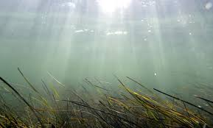
Contacts
Add here

