Slide 1


Slide 2
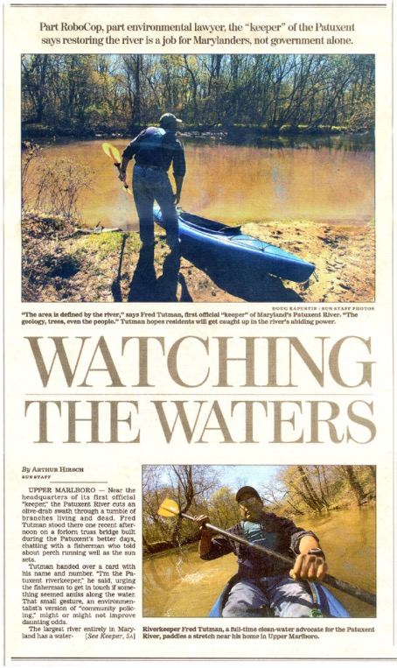
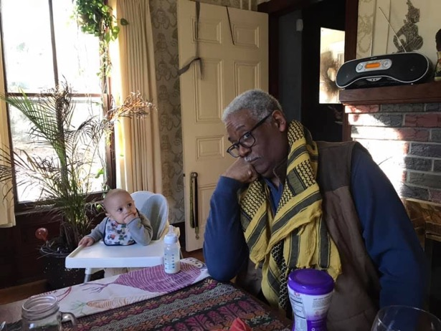
FRED TUTMAN
FRED@PAXRIVERKEEPER.ORG

Slide 3
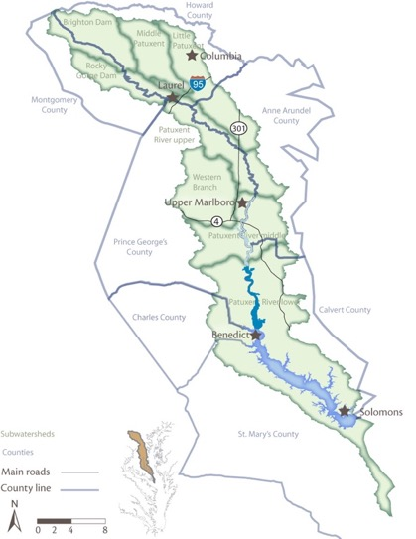
PATUXENT IN NUTSHELL
Patuxent Research refuge
Deepest water in the Chesapeake Bay
Drinking water reservoirs
Longest, deepest intrastate river
The only River Commission in the State
Morgan State Estuarine Research Labs
Patuxent River State Park
Jug Bay
Chesapeake Biological Labs
Fort Meade
Patuxent River Naval Air Station
War of 1812 Historic Site
The only Maryland river to get substantially cleaned up……..and then

Slide 4
Watershed area (acres) and percent distribution among counties.
Anne Arundel | 80,526 | 13.81%
Calvert | 102,632 | 17.60%
Charles | 18,086 | 3.10%
Howard | 121,712 | 20.87%
Montgomery | 39,238 | 6.73%
Prince Georges | 159,202 | 27.30%
St. Mary’s | 61,687 | 10.58%

Slide 5
….the watershed’s human population more than doubled between 1970 and 2000. State Planning projects a growth of some 25.7% from the year 2000 population (estimated at 601,800) to 756,929 by 2020. Currently, the watershed population is growing at about 1.44 % per year, implying a doubling time of 48 years. This growth, plus smaller households, is projected to increase developed land from ca. 187,439 acres (33 % of the watershed in year 2000) to ca. 255,945 acres (44 % of the watershed) in year 2020.

Slide 6
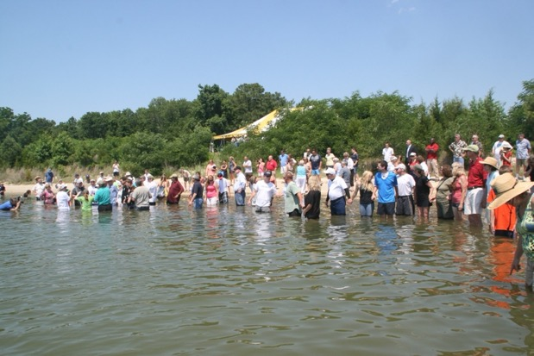
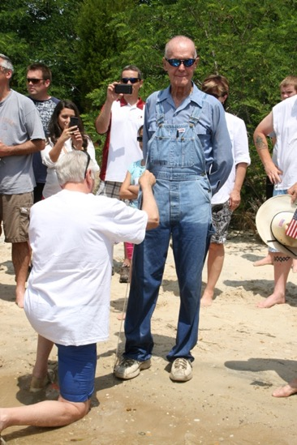
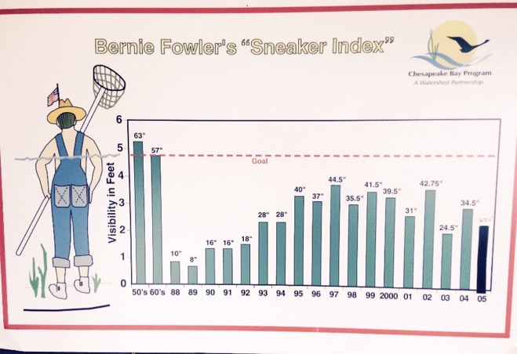
The Patuxent/Bernie Fowler Movement

Slide 7
…Get thee to a nunnery, go. Farewell. Or, if thou wilt needs marry, marry a fool; wise men know well enough what monsters you make of them…
Hamlet
Act 3 Scene 1

Slide 8
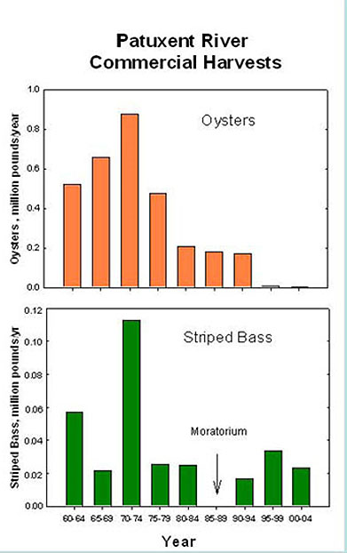
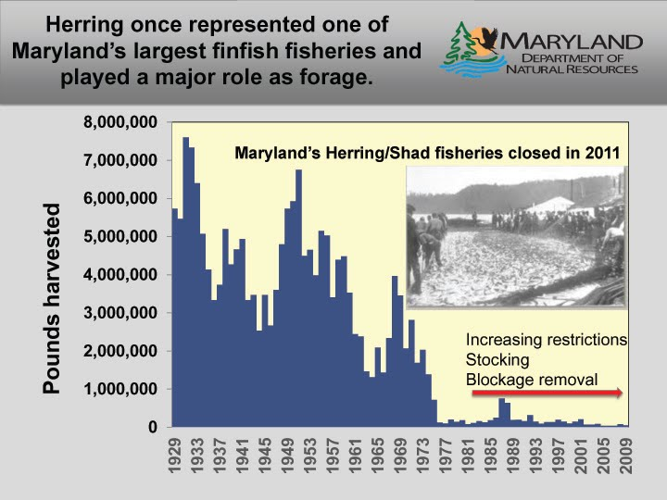
Notes:
The “system” is dying.

Slide 9
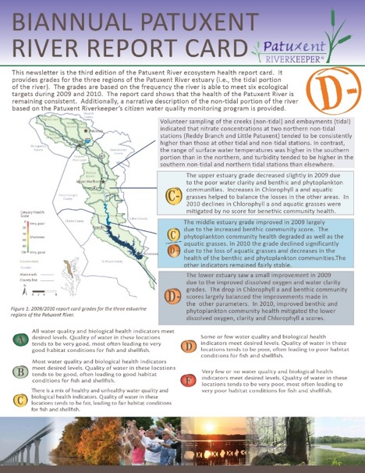
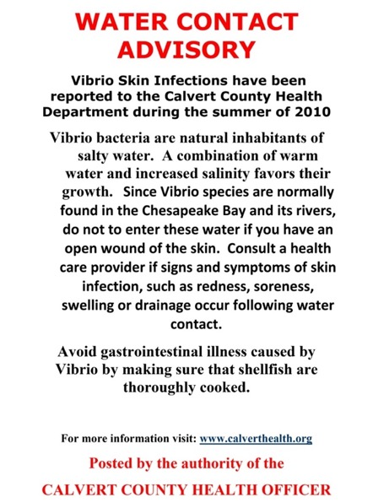
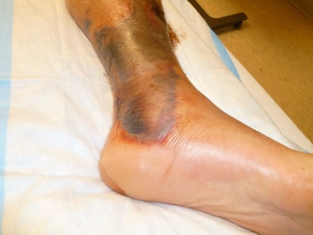

Slide 10
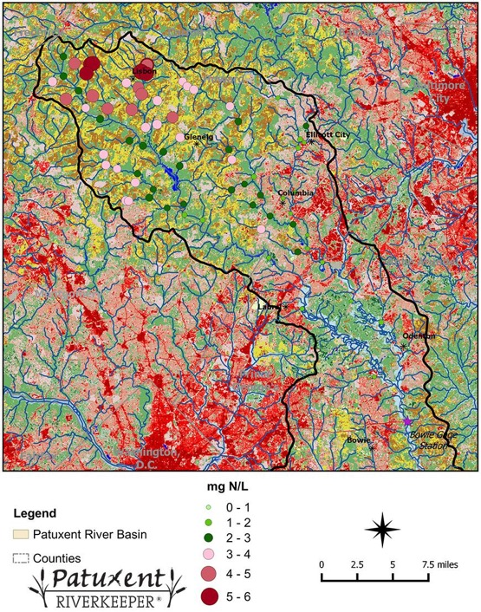
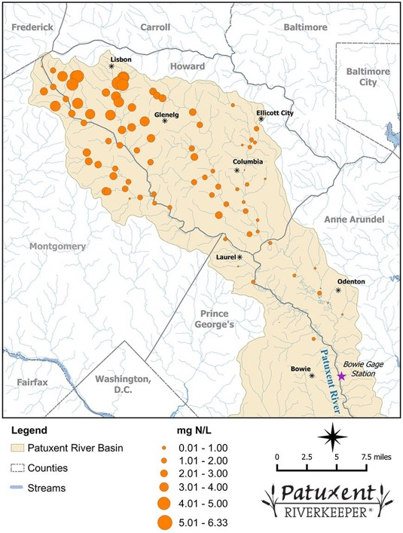
High Nutrient Levels in the North of the Patuxent

Slide 11
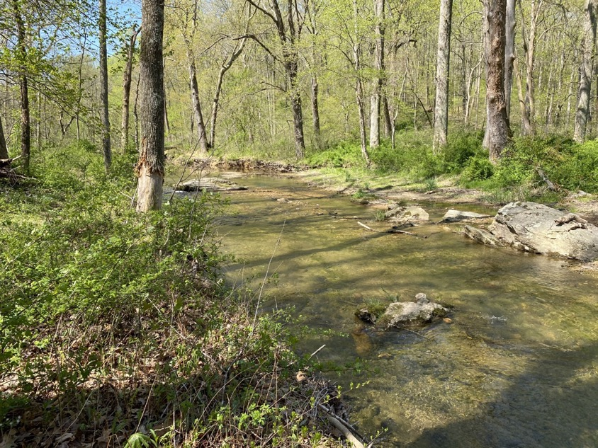
ALGAE BLOOMS
IN PATUXENT RIVER STATE PARK

Slide 12
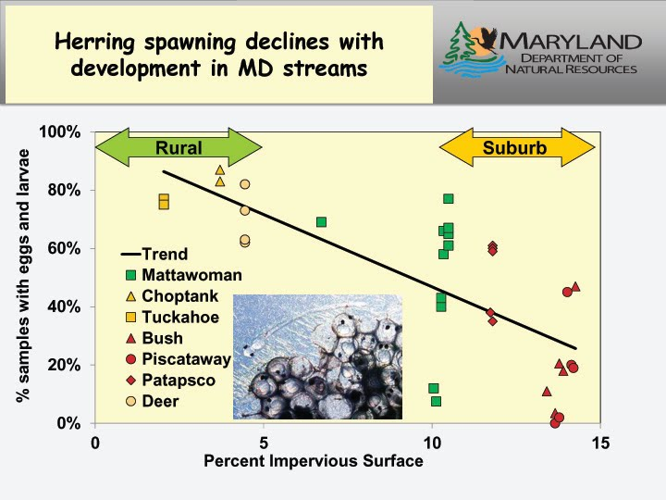
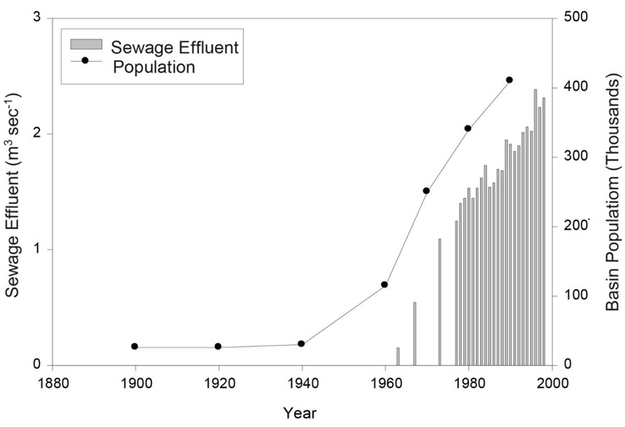

Slide 13
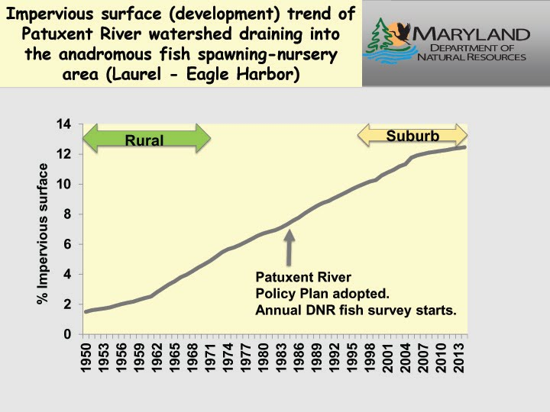

Slide 14
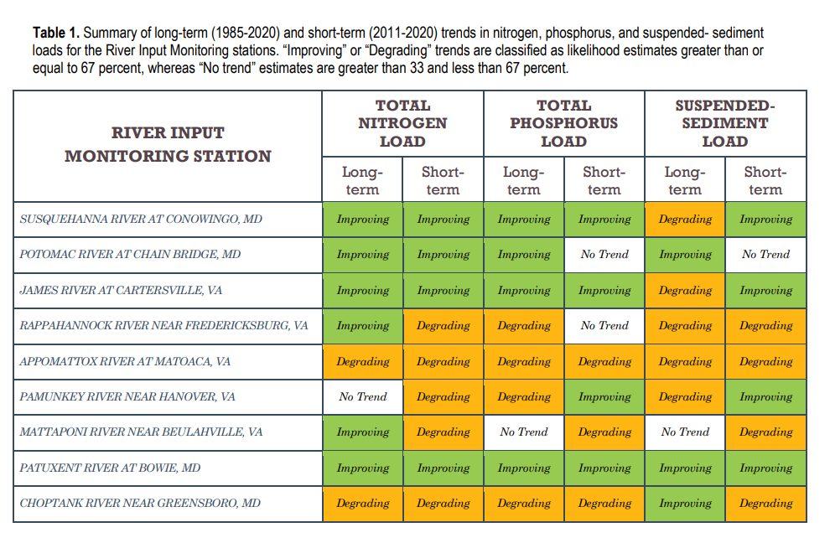

Slide 15
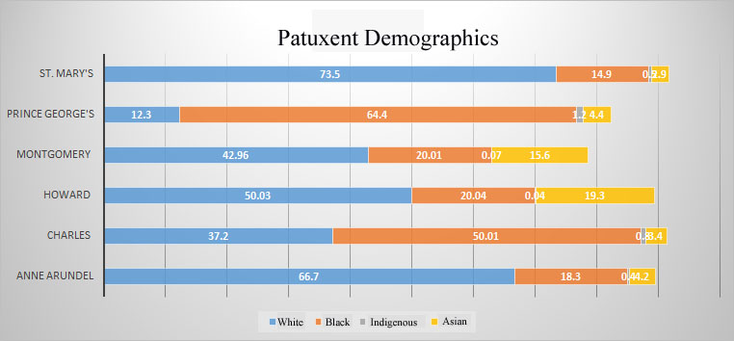

Slide 16

The Fifth Wall
Notes:
It would be a mistake to assume that black and brown people don’t care about the environment simply because they do not rank clean air and water above most other concerns in their daily lives the truth is that we know full well that in a fair and equitable society that we would have clean air water and land inherently. That the deferral of civil rights reflects the deferral of a decent and healthy environment for our children and our communities. No sense of proportionality: Local funders will gladly offer the exact same restoration and stewardship programs to a poor black neighborhood that they will offer to a rich white one.
The fact remains that environmental quality is in part the product of your income, social expectations and economic power. The environmentalism of under served communities is all but invisible to outsiders with a different perspective and vantage point. EJ is eh fifth Wall of environmentalism.

Slide 17
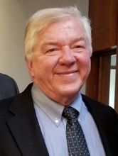
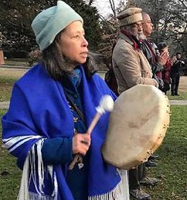
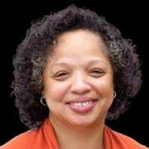
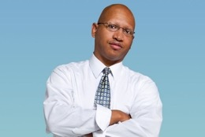
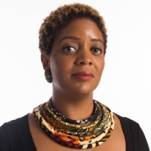
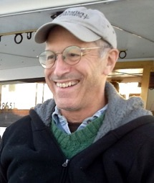
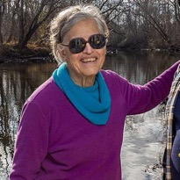

Patuxent Riverkeeper, Board of Directors
Richard Dolesh
Vernice Miller-Travis
Rabiah Nur
Dr. Sacoby Wilson
Tracy McCurty, Esq
Will Biddle
Dr. Barbara Sollner-Webb
Dr. Henry Cole

Slide 18
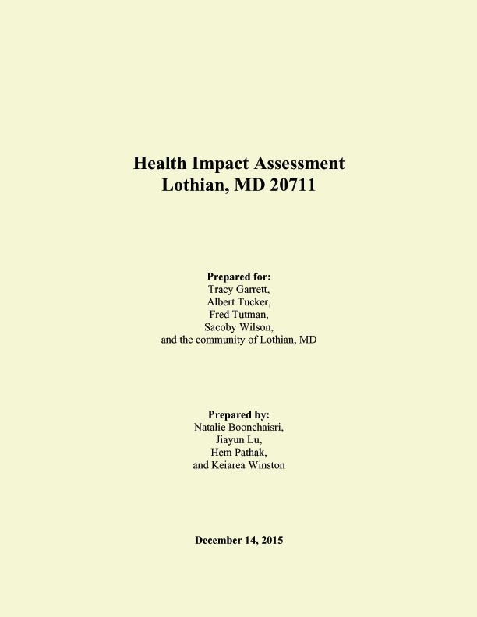
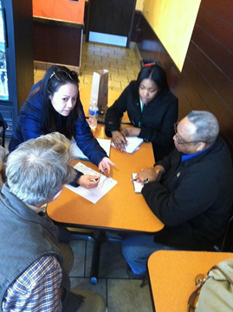
In 2015 a Student team from University of Maryland collaborated with Patuxent Riverkeeper and local citizens to survey, research and write a Public Health Assessment that details some of the health burdens facing the community.

Slide 19
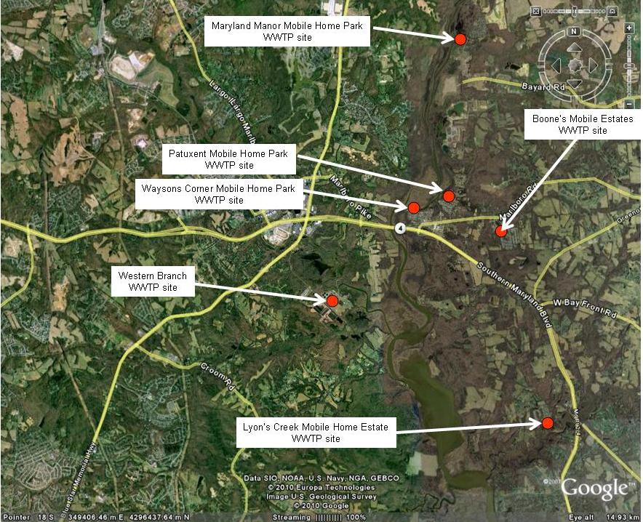
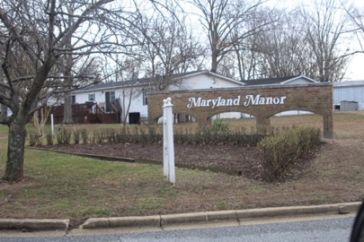
Multiple waste water treatment packet plants are in the area of Lothian. Nearly all have compliance, reporting and violation issues and problems…

Slide 20
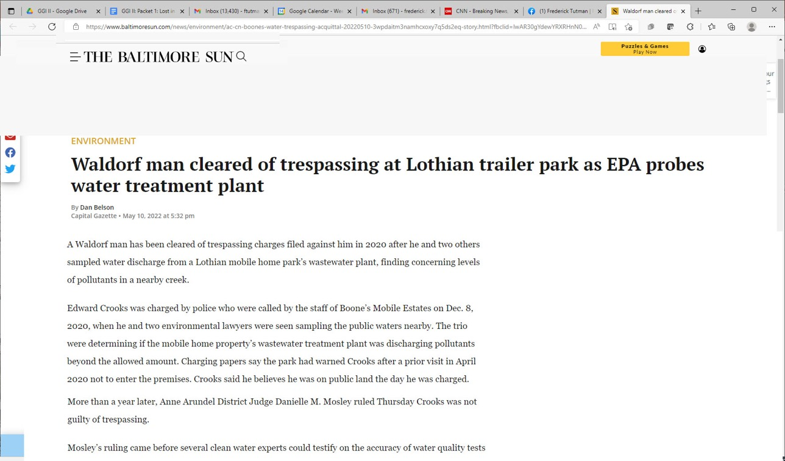

Slide 21
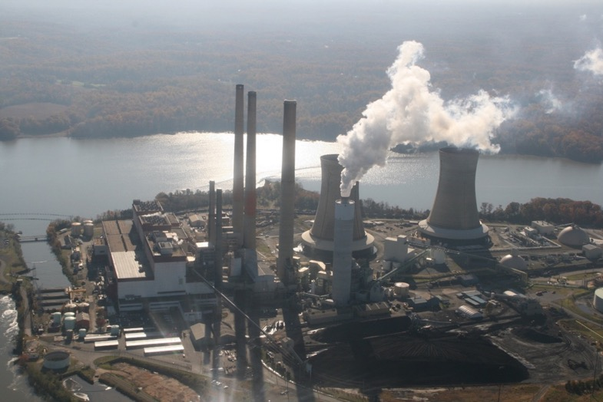
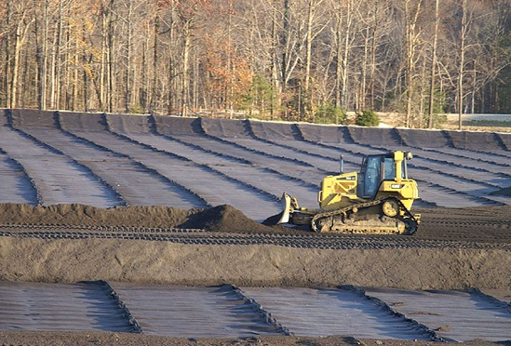
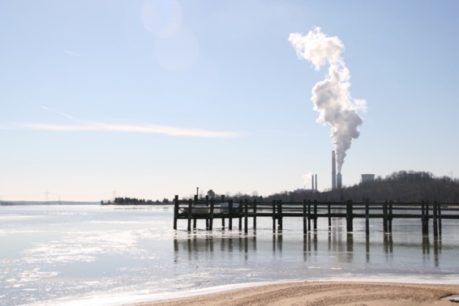
Chalk Point Power Generating Station
Notes:
Communities such as Eagle Harbor are quite frankly voiceless or at least uniformed about the rising toxic burdens that are being consigned to their communities while the public health and the economic beneficiaries are elsewhere. The trading in principles makes environmental compliance the subject of a private transaction between those with credits to sell and those with money to buy them. It sidesteps the public interest significance of zealously enforcing and protecting public trust resources. To be clear, it confers a private profit interest in resources that can never be owned by the parties. It stands for ownership and privatization of water, air and the commons instead of stewardship of these priceless things. Pollution trading offers corporate incentives to externalize and/or pass-on the costs of disposing of waste streams. Underserved communities get the liabilities caused by deferred environmental compliance while more empowered and better off communities reap the extended benefits of reduced pollution, cash from the trades all while evading one of the worst stigmas of race and poverty in our society: Pollution zones ratified by profit incentives—that are always more compelling than compliance incentives. The reality according to countless EPA studies is that the poor and people of color are exponentially more likely to live near a toxic dump or a pollution hazard created by corporate profiteering and lack of regulatory diligence.

Slide 22
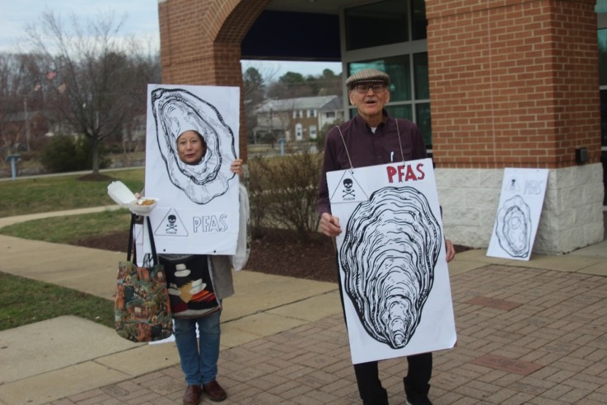
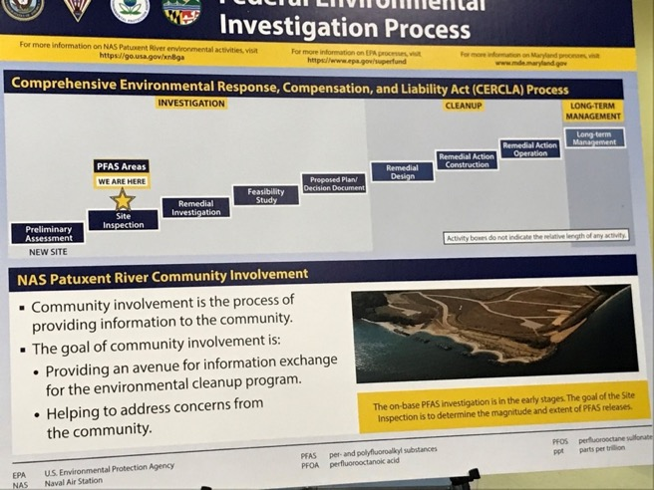
PFAS/PFOS

Slide 23
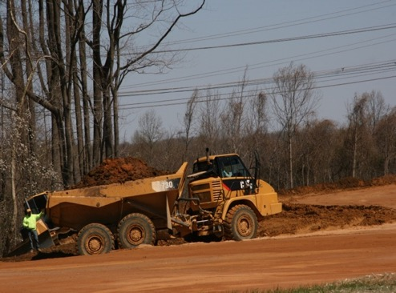
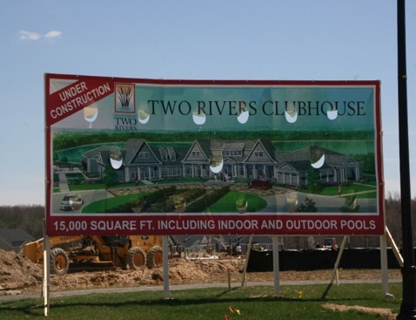
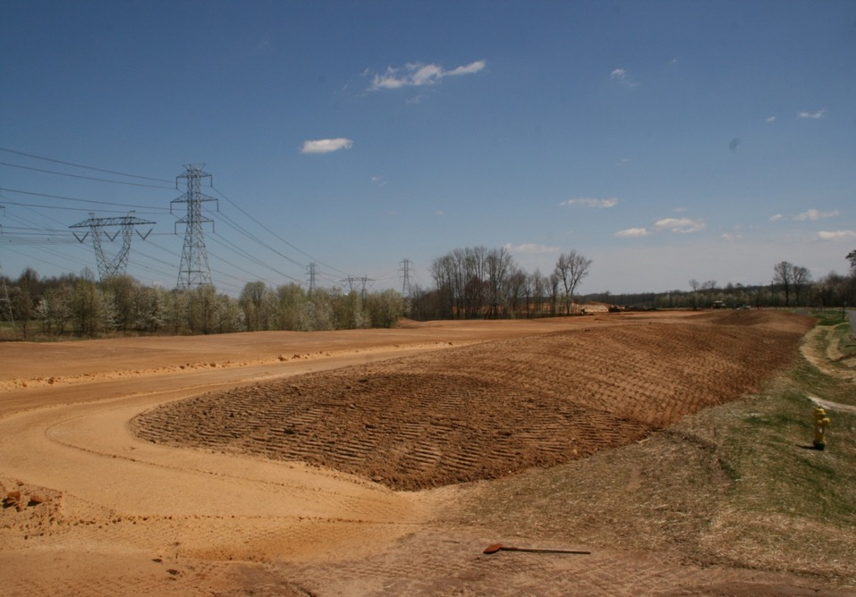
Intensive Growth in BRAC Areas

Slide 24

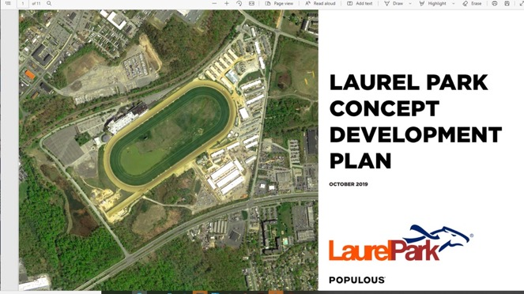


Slide 25
TO REALLY CLEAN UP THESE WATERS..
Set a deadline and stick to it
Create a plausible plan for conservation and implement it
Deeply regulate discharge polluters
Regulate polluting facilities into upgrades
Intensify enforcement actions
Set firm pollution limits
Raise fines for persistent violators
Mentor and promote citizen activism to attack local pollution

Slide 26
Advocacy & Mentoring
Outreach
Clearinghouse
Water monitoring and citizen science
Litigation
State Policy change
Visitor’s Center & Water Trail
Practical collaborations

Slide 27
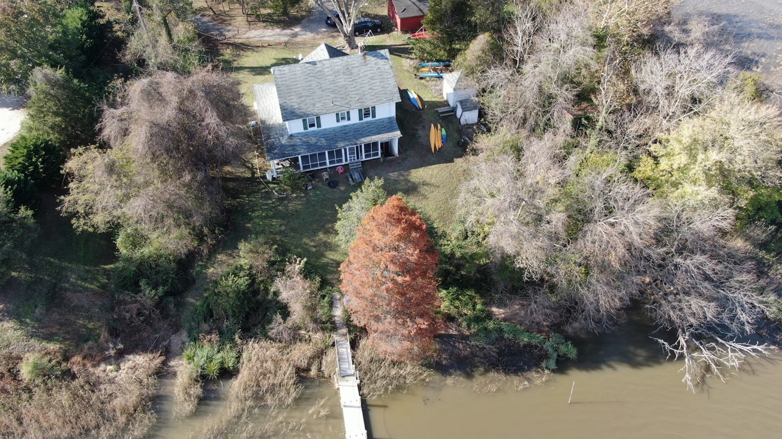

Slide 28
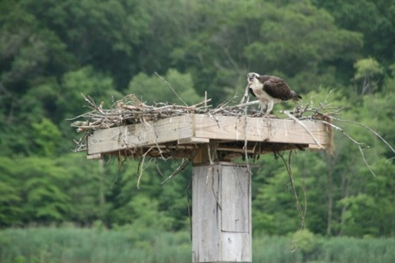
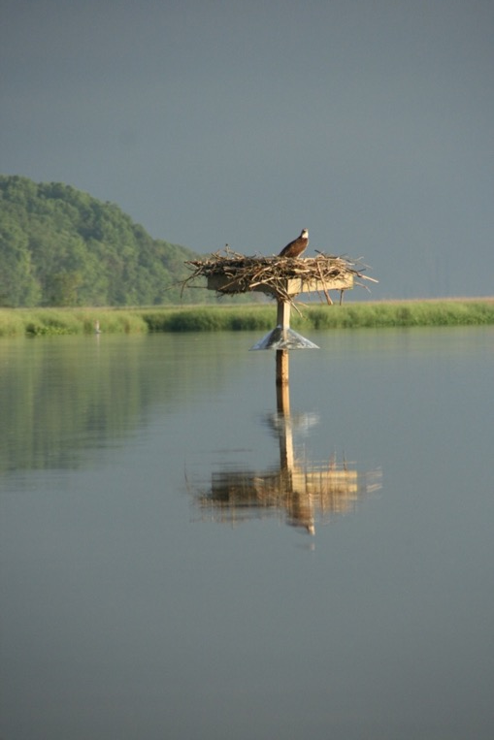
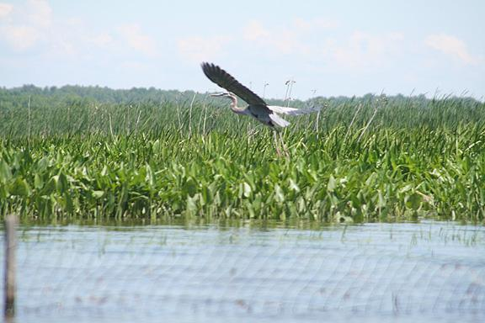

Slide 29
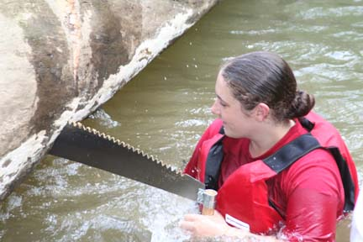
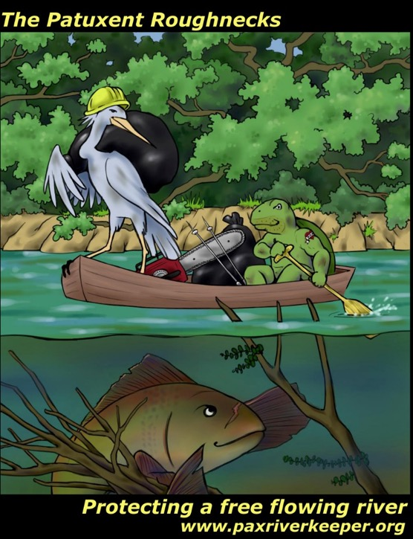
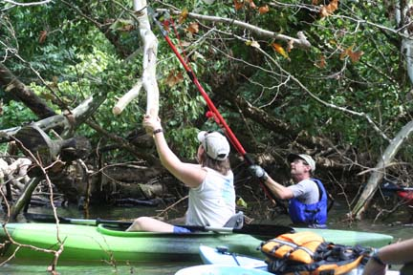

Slide 30
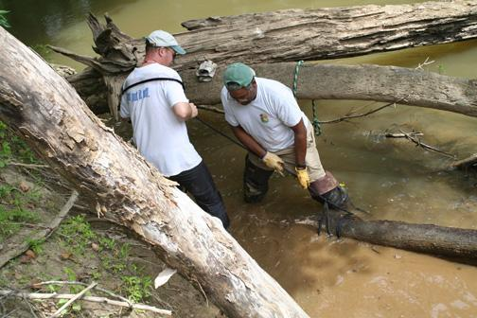
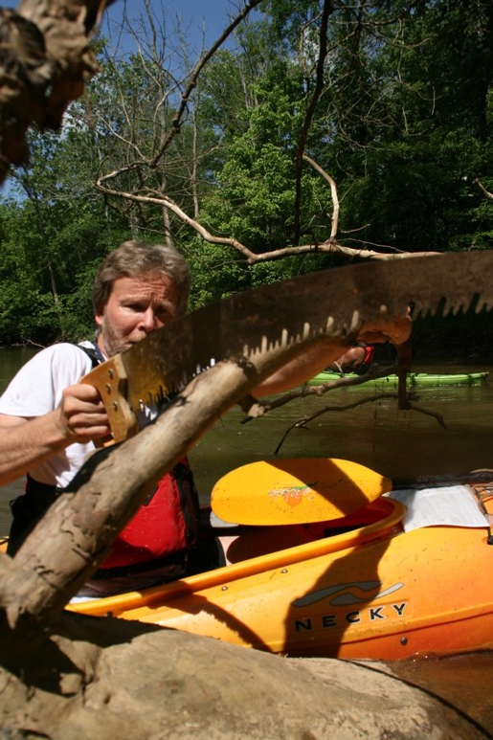
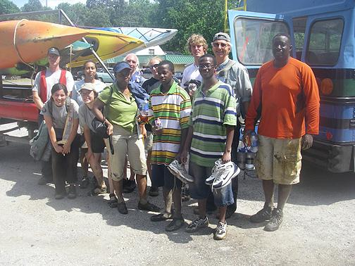

Slide 31



Slide 32




Slide 33



Slide 34

So I decided to test the waters and go public….
Notes:
So I decided to embark on a different kind of environmentalist., Not so much about bossing people around but rather helping them actualize their own environmental goals. I saw this as the soul of diversity. The chance for people to connect to the environment on their own terms. I wrote and it was syndicated around the country and said exactly what I thought. Two board members quit the next day.

Slide 35



Slide 36



Slide 37




Slide 38


Notes:
Eagle Harbor is also the smallest municipality in MD with a seasonal population of about 100. Like the power generating plant, the Brandywine coal waste location is surrounded by a predominantly African-American rural community that has struggled for years to make the operators of the Chalk Plant accountable for problems ranging from well-water draw down issues, traffic, air quality, fugitive dust and local surface water contamination. Citizens have been stymied by lack of political power, as well as a pattern of willful distortions by the plant officials about the safety issues related to the plant and its waste products.

Slide 39


Slide 40


Howard Conservancy
Patuxent River Park
Calvert Mediation Center

Slide 41

Thank you for Listening & Watching!

Slide 42



Patuxent Riverkeeper Center
17412 Nottingham Road
Upper Marlboro,MD 20772
301-276-7913

