Slide 1
Land Use, Hydrography, and Healthy Watersheds Peter Claggett¹, Labeeb Ahmed², Fred Irani¹, Michaella Kuykendall³, Sarah McDonald¹, Renee Thompson¹, Allie Wagner³ ¹ U.S. Geological Survey ² Attain Corporation ³ Chesapeake Research Consortium June 6, 2019 CBP Healthy Watersheds Goal Implementation Team

Slide 2
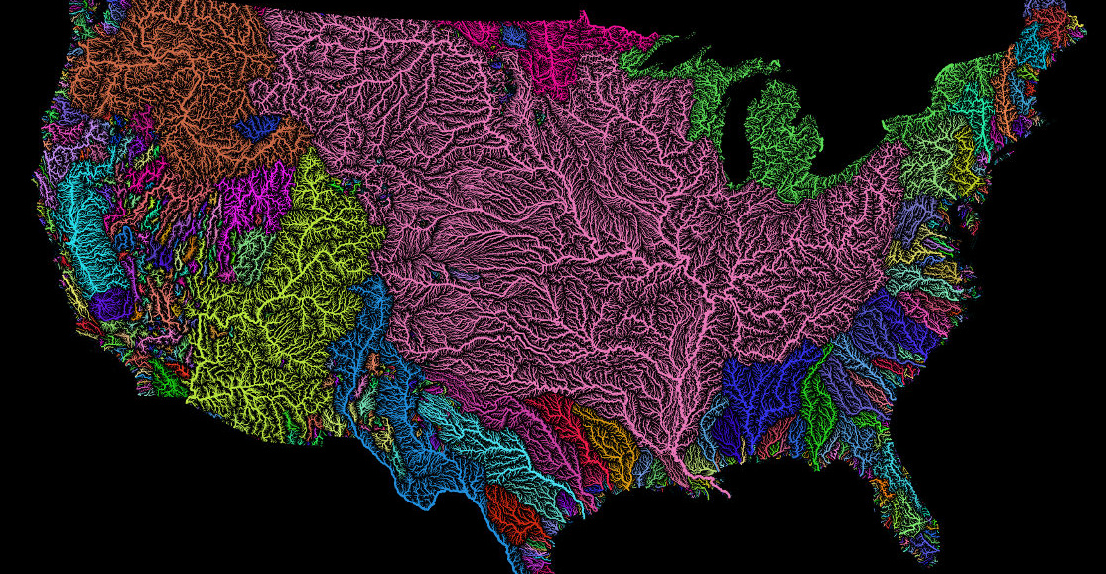
Watershed Health
Risk Factors
Diagnostic Measures
Population density
Impervious cover (%)
Tree cover (%)
Hydric soils (%)
Road x stream crossing density
Probability of land conversion
Stream flow
Stream temperature
Stream incision / floodplain connectivity
Aquatic community composition
Toxics
Nutrients
Sediment

Slide 3
Watershed Health Classification
Healthy
Unhealthy
Secure
Moderately stressed / threatened
Highly stressed / threatened
Vulnerable or Resilient?

Slide 4
Watershed and Stream Health,
Vulnerability, and Resilience
Fish Health, Habitat, and Aquatic Conditions
Coastal Habitats and Waterfowl
Watershed and
Vital Lands
Characteristics
Water Chemistry
Physical Structure of Aquatic Habitats
Flow Regime
Toxics and Emerging Contaminants
Shoreline Erosion and Accretion
Wildlife
Habitat and SAV
Past, Present, and Future
Sediment
Fluxes
Aquatic
Communities
Water Temperature
Fish Health and Disease
Avian
Disease and Pathogens
Food Resources
and
Energetics
Adaptive Management
Landscape Change and Climate Variability
Human Decisions and Actions
Conservation, Restoration, and Land Use Planning
Climate Variability
Precipitation and Temperature
Hydrography
Stream Corridor and Waterbody Characteristics
Land Sub-surface Characteristics
Geology and Soils
Land Surface Characteristics
Land Use, Land Cover, and Landforms
Resource
Management
Agricultural, Silvicultural, and Stormwater Management Practices, and Water Use

Slide 5

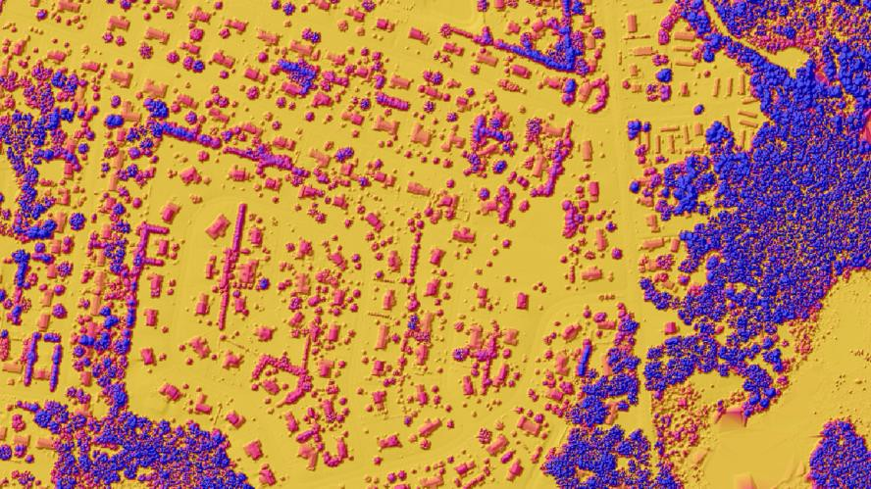
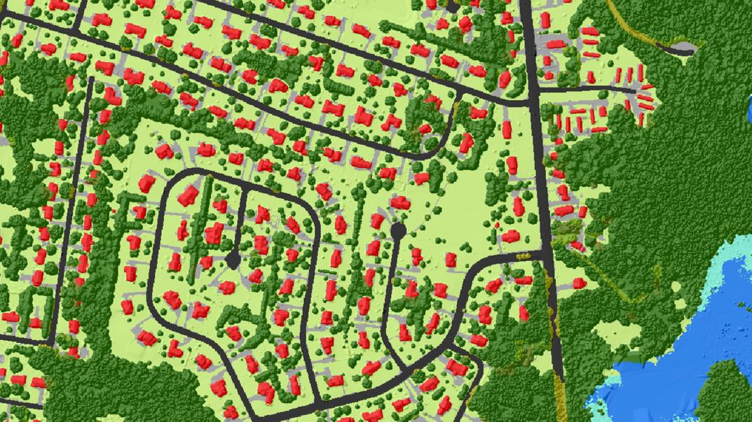
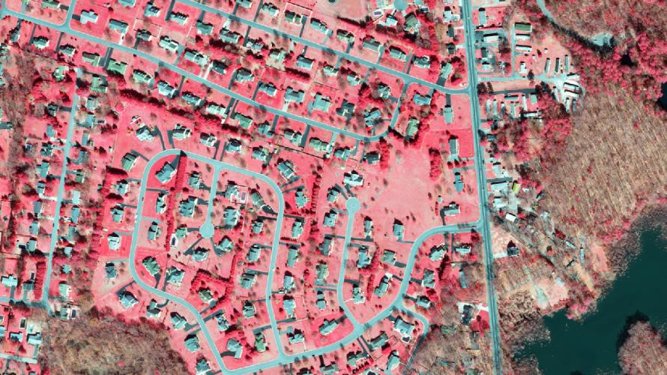
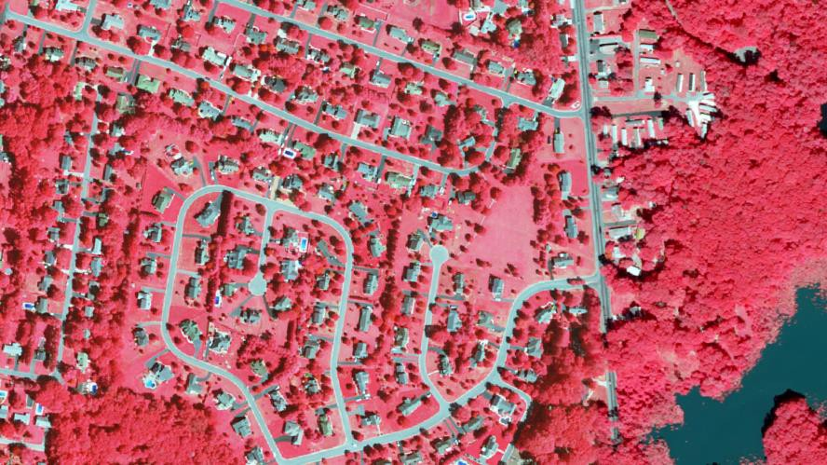
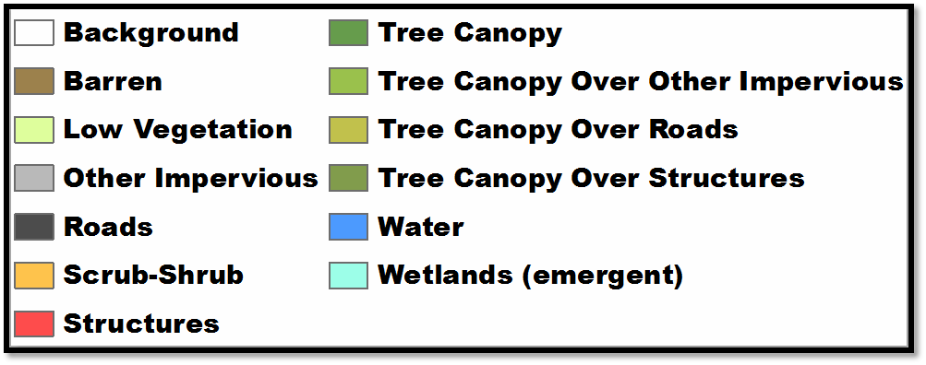
Land Cover Mapping and 4-year Updates
2013 – 2017 - 2021

Slide 6
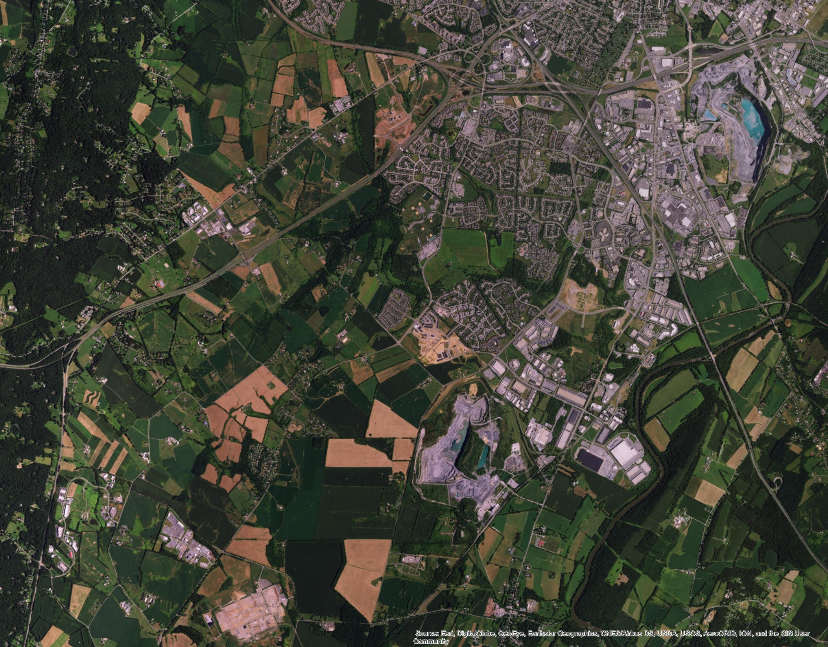
340/85 wedge

Slide 7
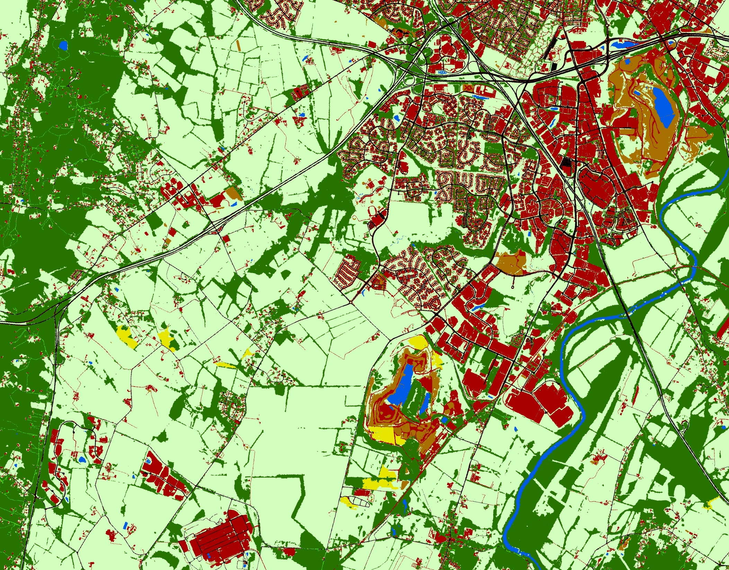
340/85 wedge

Slide 8
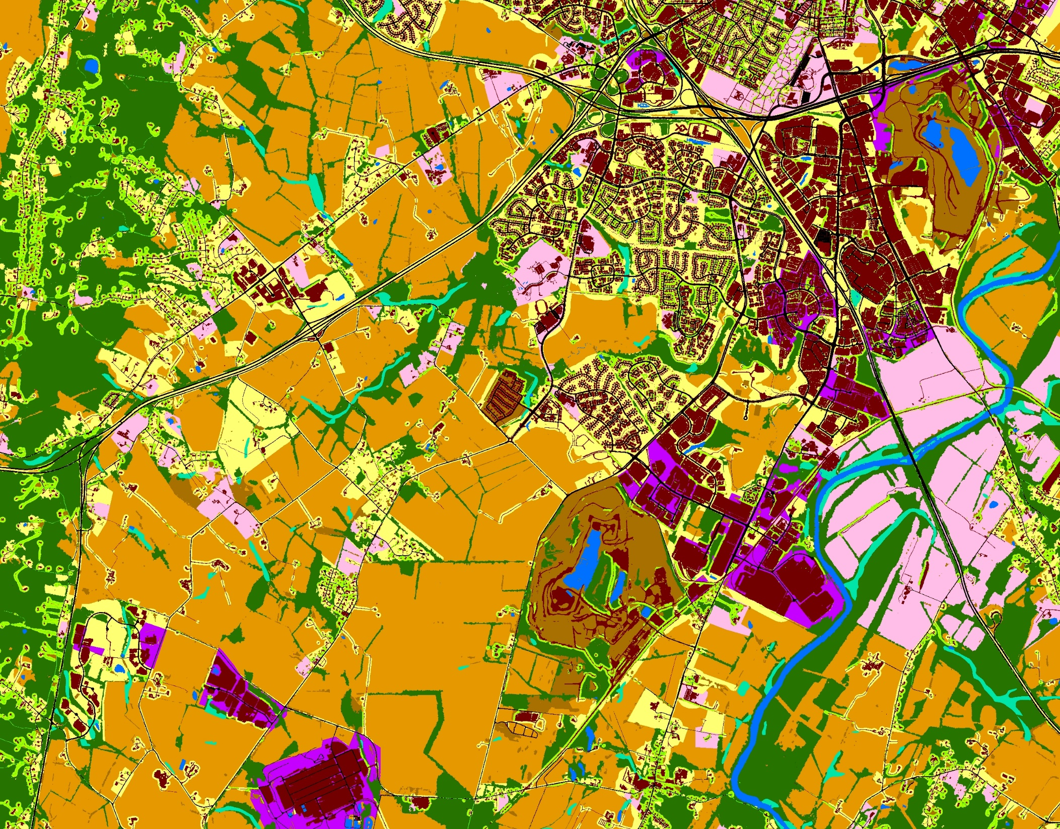
340/85 wedge

Slide 9
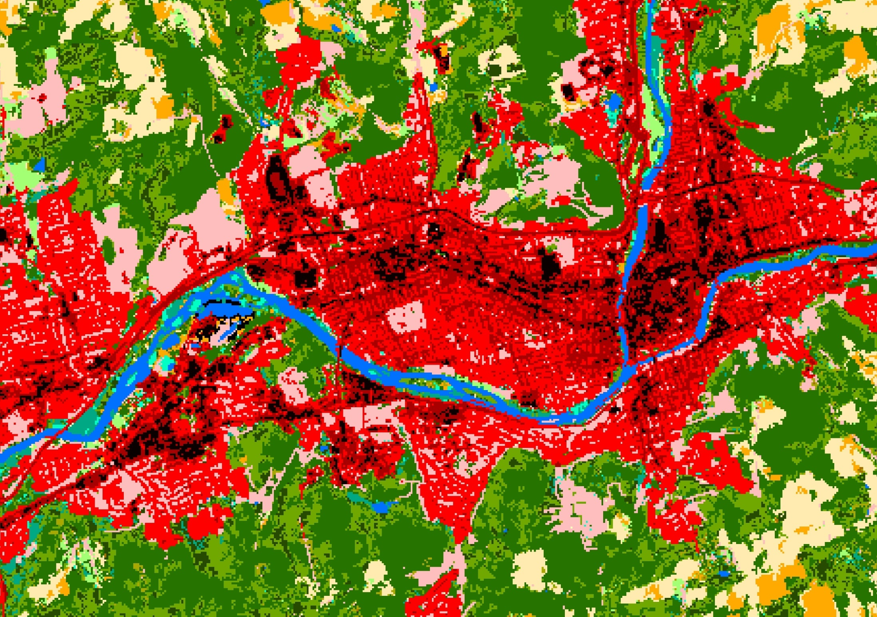
Binghamton, New York
Phase 5.3.2 Land Use/Cover (2006 conditions)

Slide 10
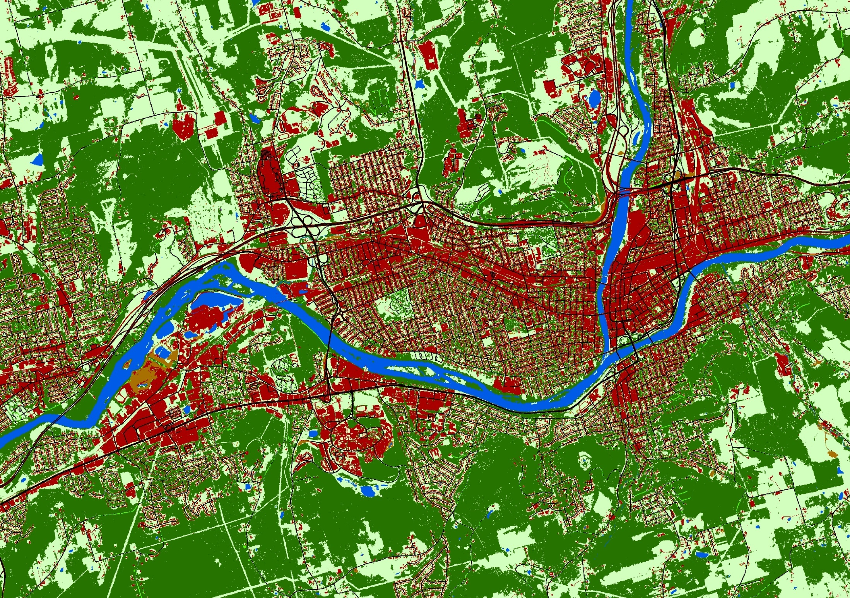
Binghamton, New York
Phase 6 Land Cover (2013 conditions)

Slide 11



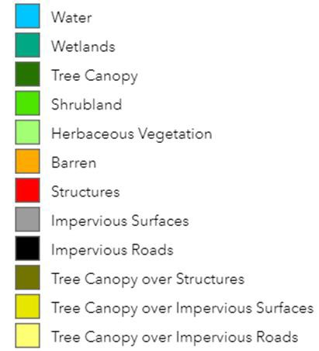
Potential secondary classes:
Aquaculture
Submerged Aquatic Vegetation
Deciduous vs. Evergreen
Nursery
Orchard
Center Pivot
Grass Filter Strips
Vineyard
Pasture
-Greenhouses
-Animal operations
What classes matter to you?
-Wetlands (additional classifications)

Slide 12
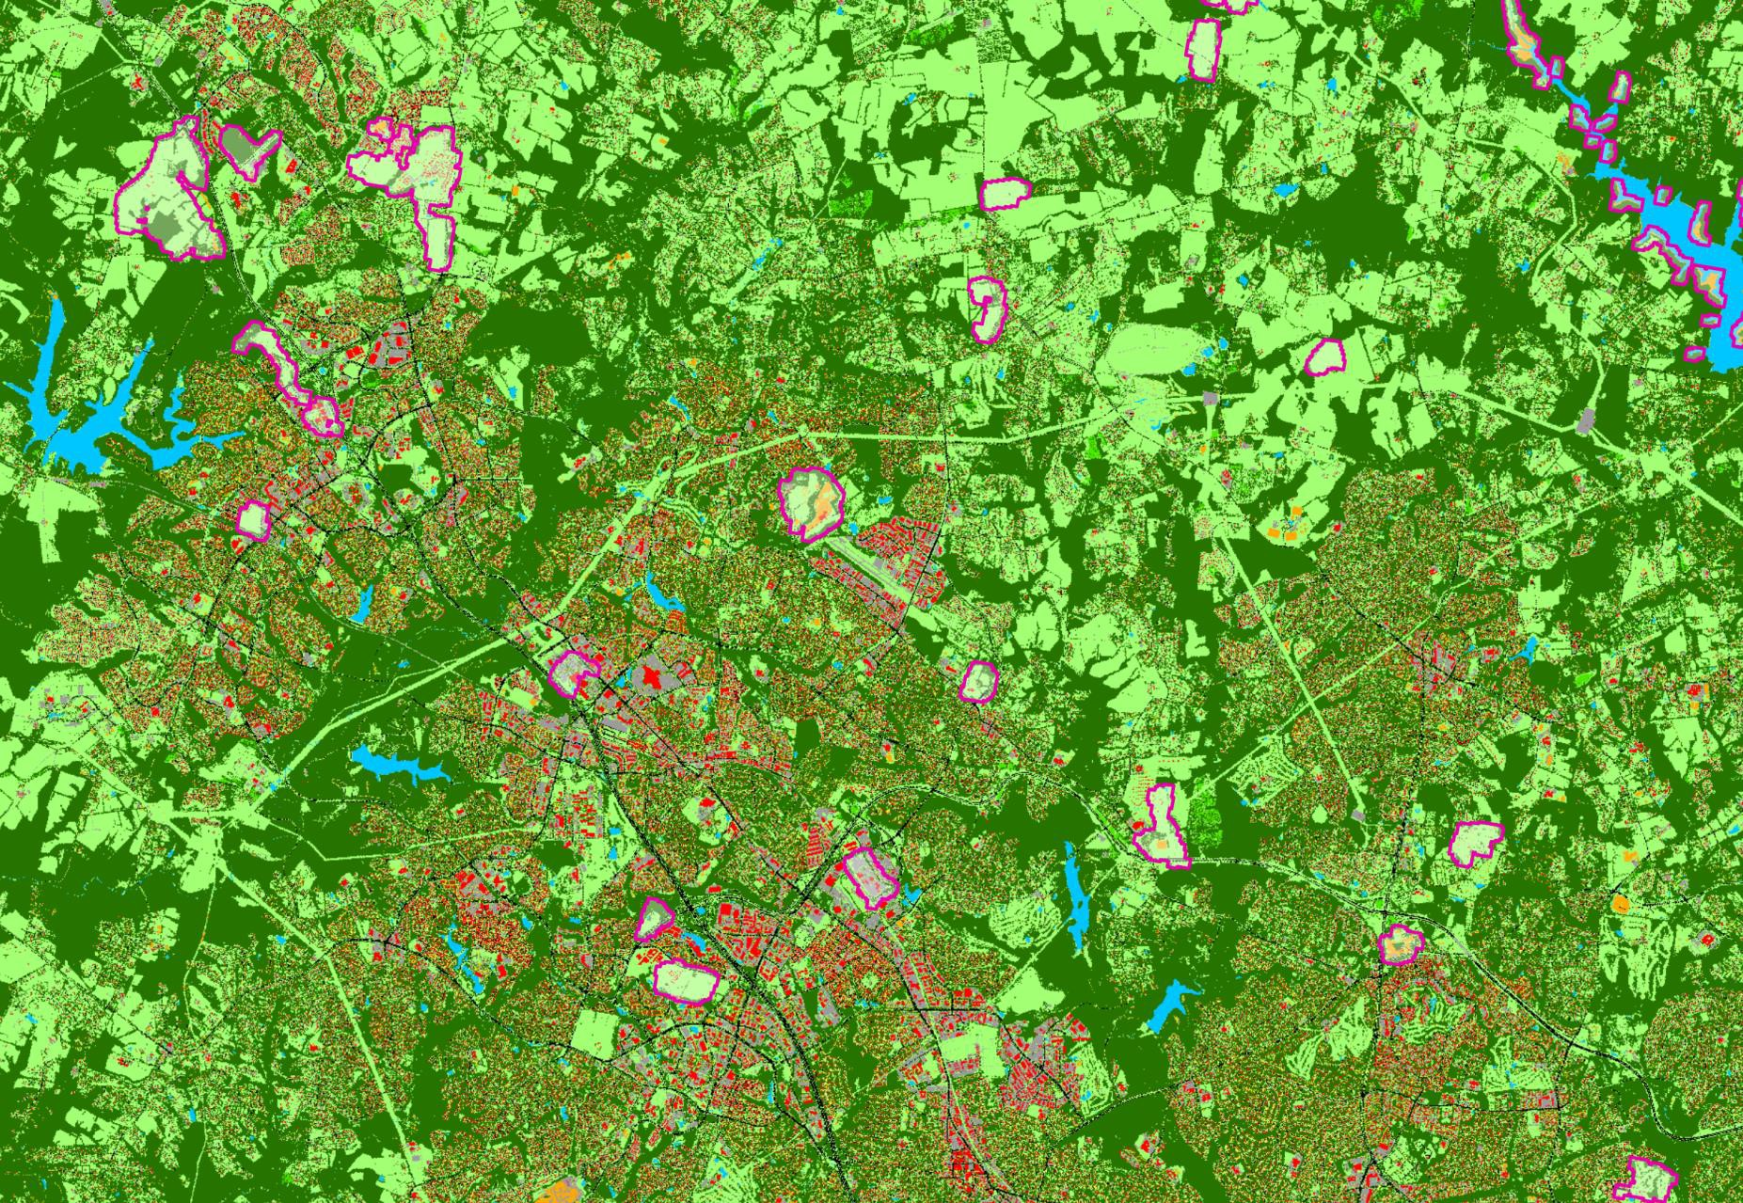
Two-year Hot-Spot Updates: 2013, 2015 (skipped), 2017, 2019, 2021, 2023
What: Full wall-to-wall 2013/14 land cover with hot spots updated for 2017/18, hot spot (filtered LCMAP) boundaries
When: June – August (missing 2018 NAIP for VA and WV)

Slide 13
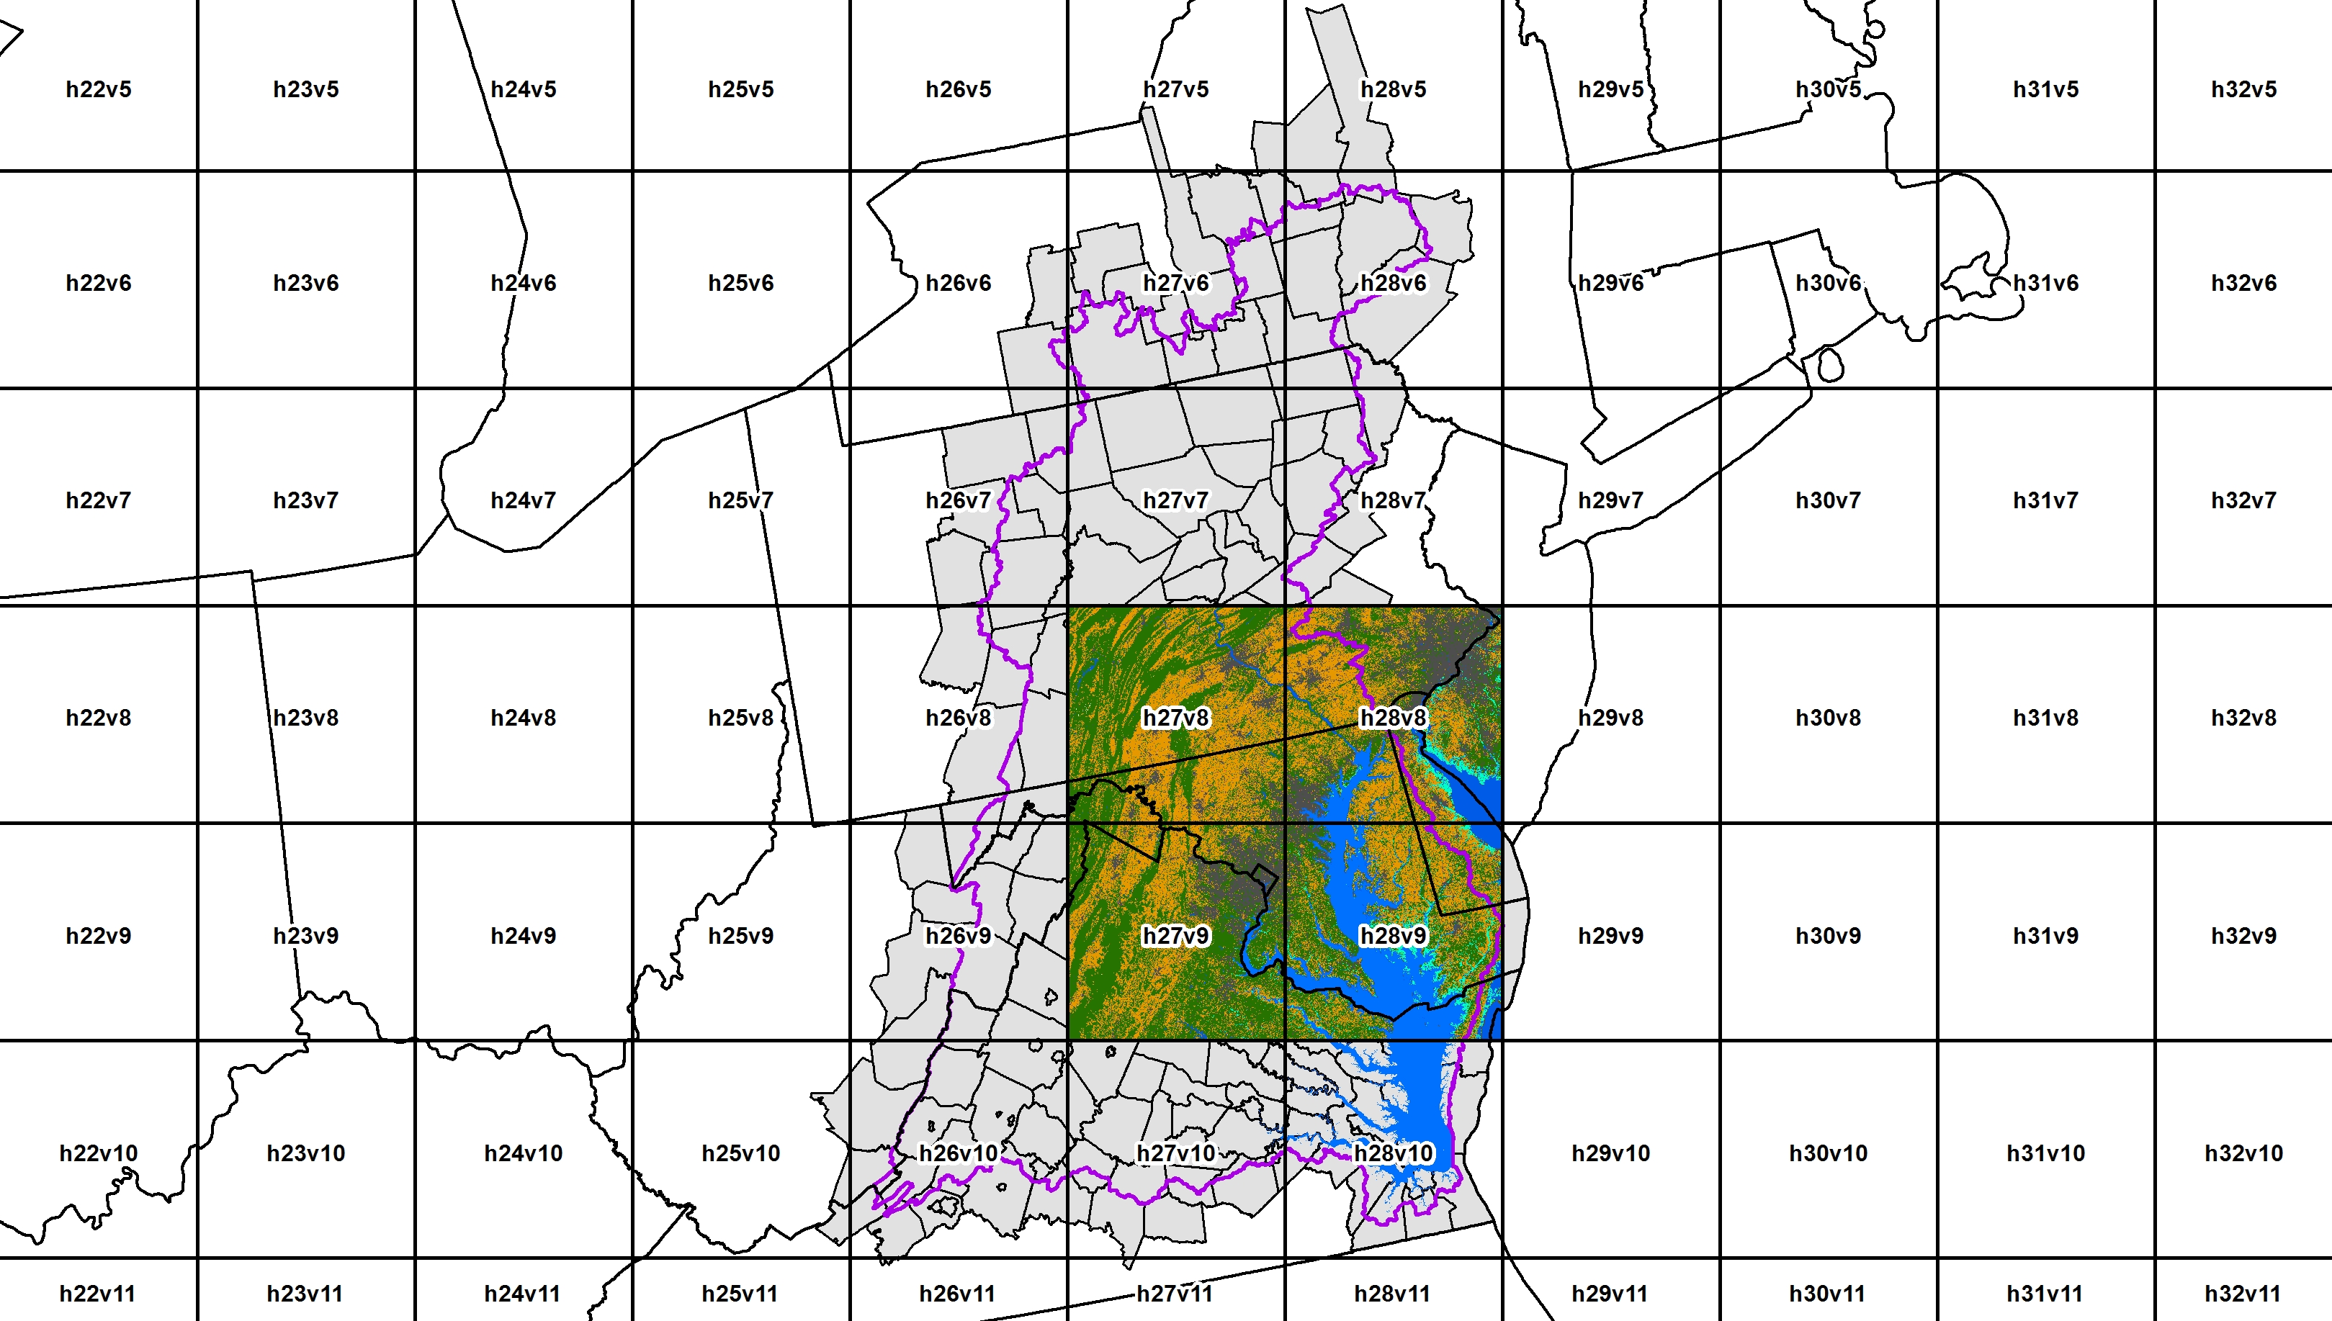
Annual Land Cover Change: 1985 – 2015
(USGS - LCMAP)

Slide 14
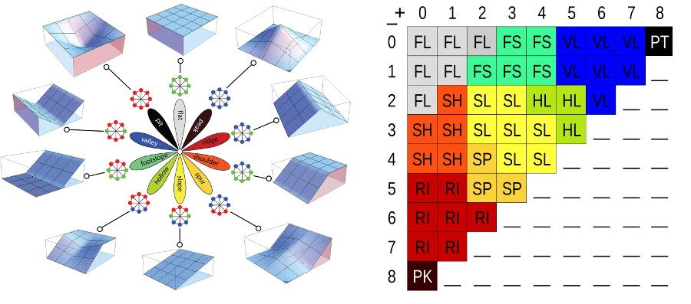
Mapping High-Resolution Streams (1:2K scale)
Using landform analysis
r.geomorphons
Jasiewicz and Stepinski, 2013

Slide 15
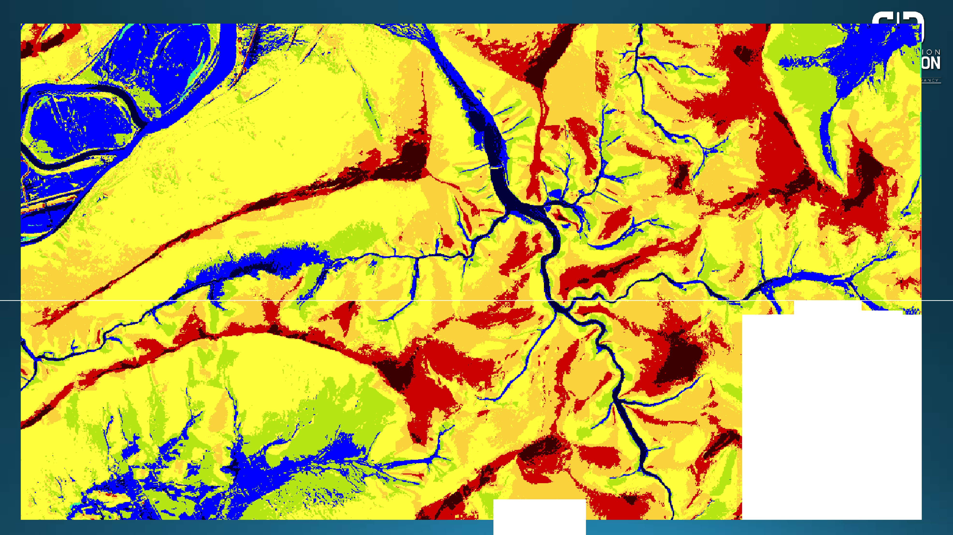
- - '-- -._ ,
0 1) f l o1 t
J) r i dlg, ,e
2 .1 SlllRT11!1^{I· I} II
4) shou l de r
₅₎ s p u 1r
¹6 ) s l op·e
₇₎ ho I low
f oo t. s. I op•e
l■I )
□
□
□
□ 8)
■
10)
vo ll l •e y dep•r •e ss i, on
9)
- ' :-?i _•,
. :, • ,

Slide 18
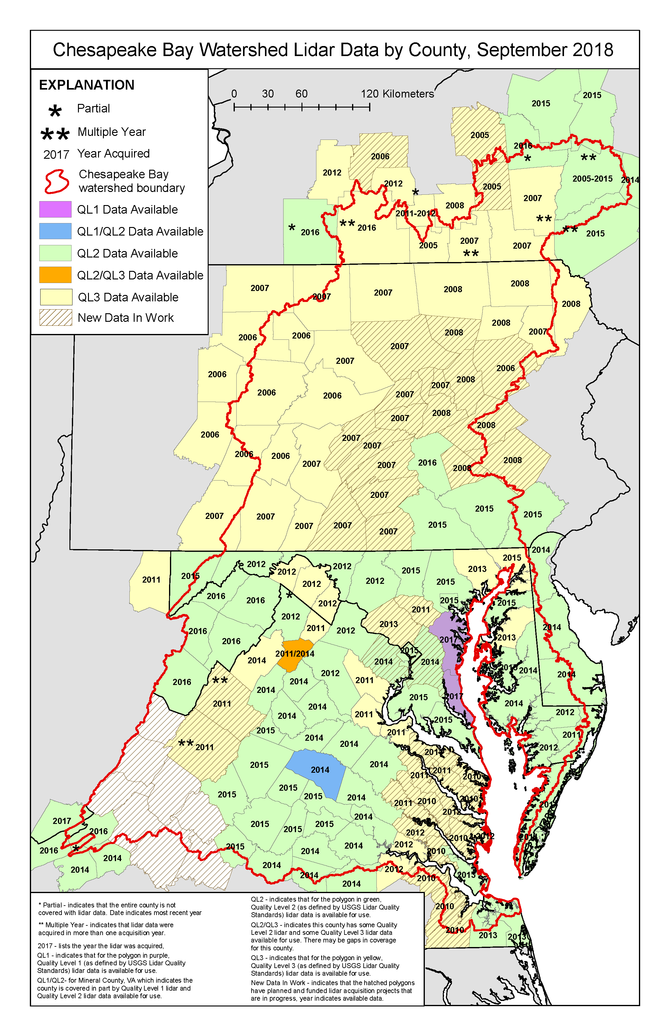
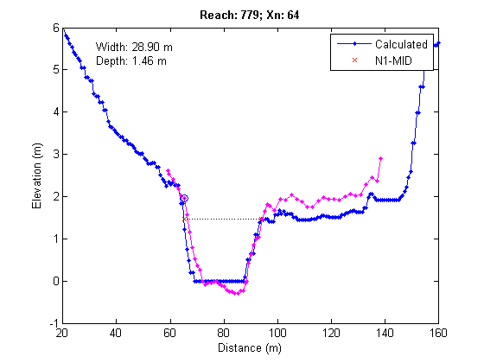
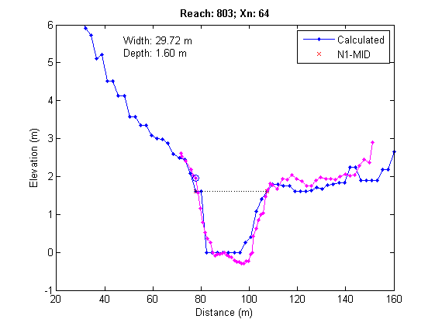
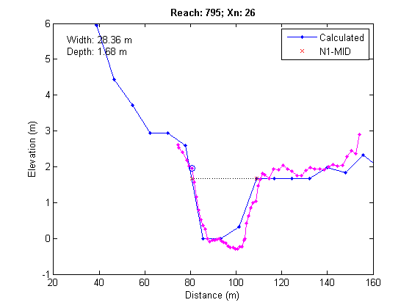
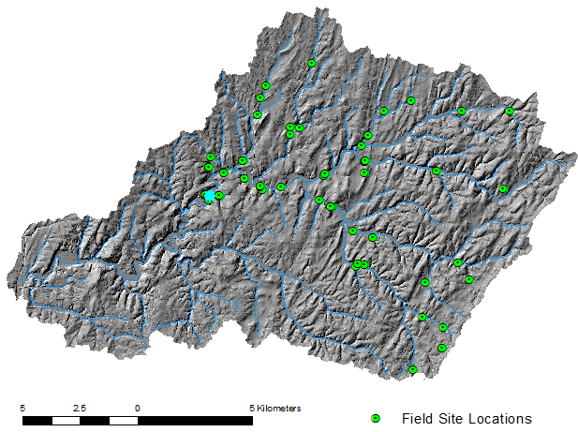
1m DEM
3m DEM
10m DEM
N1-MID

Slide 19
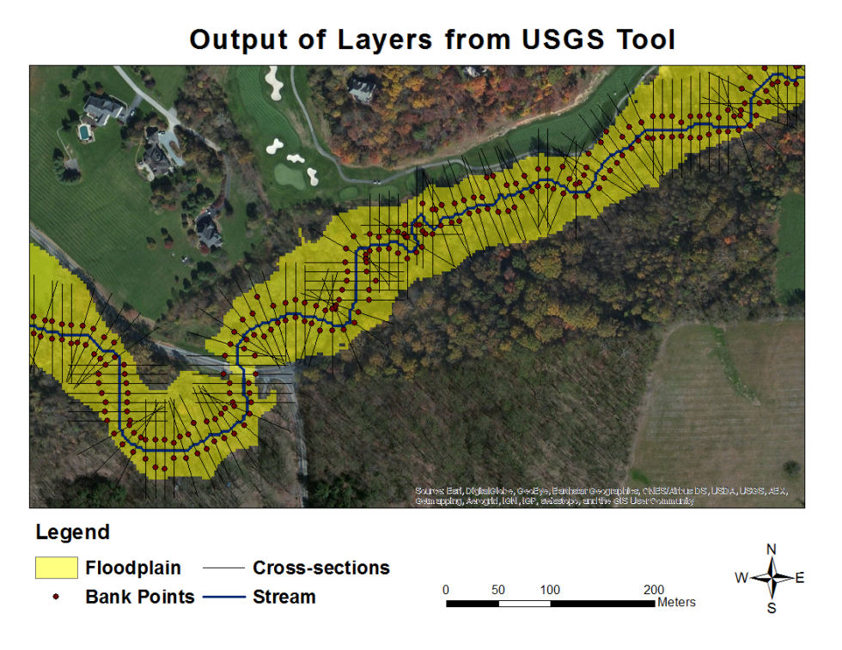
Channel Cross-section Metrics
Bank height (m)
Bank angle, avg (deg)
Bank angle, max (deg)
Channel width (m)
Channel length (m)
Bankfull area (m²)
Floodplain width (m)
Floodplain elevation, range (m)
Floodplain elevation, sd (m)
Stream Reach Metrics
Length (m)
Profile slope (deg)
Order (Strahler)
Magnitude (Shreve)
Upstream and downstream IDs
Drainage area (m²)
Notes:
Bank locations are calculated purely on slope break threshold. Assumes minimum elevation is within channel, increases in intervals searching for some horizontal distance within that vertical distance. This is a parameter!! Here “Depth” = “Bank Height”. And actually “Elevation” on y-axis should be “Depth”

Slide 20

Contact Information (i.e., how to get a copy of the SCFM Toolbox?)
Peter R. Claggett
Research Geographer
pclaggett@usgs.gov
443-370-5724

