Slide 1

Updated Phase 6 Modeling Results for Climate Change Impacts and Climate Allocation Methods
Chesapeake Bay Program
Science, Restoration, Partnership
WQGIT Recommendations to the Management Board
October 15, 2020
James Martin and Ed Dunne, WQGIT Co-Chairs
WQGIT; Gary Shenk, USGS; Lewis Linker, EPA; Richard Tian, UMCES; Gopal Bhatt, Penn State; Isabella Bertani, UMCES; Carl Cerco, Attain; and CBP Modeling Workgroup

Slide 2
Overview
Chesapeake Bay Program
Science, Restoration, Partnership
Policy Issue I: Adoption of refined climate models and targets
Policy Issue II: Year on which to base climate targets (e.g., 2025/2035/2045/2055)
Policy Issue III: Timing options for achieving the climate targets (By 2025? Post-2025? Date certain post-2025?)
Policy Issue IV: Options for allocating climate targets (pollutant loads) amongst the jurisdictions
10 Recommendations from the WQGIT. Seeking Management Board endorsement or approval.
Endorsement = Recommendation supported by MB to advance to PSC for approval
Approval = Recommendation approved by MB. Does not need to advance to PSC.

Slide 3
New Recommendation to the Management Board
Chesapeake Bay Program
Science, Restoration, Partnership
For 2035 climate change estimate, the WQGIT reached a consensus to:
Modify previous decision regarding having a 2035 estimate in a narrative (#7), instead opting for a generic narrative to the effect that “Preliminary estimates for the climate impact through 2035 suggest a doubling of the 2025 load effect, suggesting that the effect of climate change on our ability to meet the Bay’s water quality standards is an ongoing concern.” Specific language for the narrative to be developed by the WQGIT.
This approach alleviates the need to choose an allocation approach for the 2035 climate loads prior to the 2025 reassessment.

Slide 4
WQGIT Recommendations to the Management Board
Chesapeake Bay Program
Science, Restoration, Partnership
Accept updated models for use in re-evaluating climate change for 2025 and 2035.
Exclude model estimated non-attainment in shallow open water from the climate change allocation.
Exclude model estimated non-attainment in open water in CB6 and CB7 from the climate change allocation.
Criteria Assessment Protocol (CAP) Workgroup will evaluate climate change risks to current water quality standard criteria and designated uses, including the open water designated use for CB6MH and CB7MH.
2025 climate change estimate will consider main Bay DW/DC and ensure additional non-attainment returns to 2017 Planning Target levels and within existing variances.
Incorporate the additional nitrogen (N) and phosphorus (P) loads due to 2025 climate change conditions into Programmatic Milestones no later than the 2022-2023 milestones, with all actions to achieve those reductions in place by 2025.
Include a narrative in the Milestones that describe the current estimated jurisdiction-specific nutrient loads due to 2035 climate change conditions.
Include a narrative in the Milestones that describe the current understanding of 2035 climate change conditions, to the effect that “Preliminary estimates for the climate impact through 2035 suggest a doubling of the 2025 load effect, suggesting that the effect of climate change on our ability to meet the Bay’s water quality standards is an ongoing concern.” Specific language for the narrative to be developed by the WQGIT.
Continue efforts to improve understanding of the science and refine estimates of pollutant load changes due to 2035 climate change conditions.
Develop a better understanding of the BMP responses, including new or other emerging BMPs, to climate change conditions.
Compare the current 2025 climate change assumptions with measured climate conditions through 2024.
To include: rainfall volume, intensity and distribution; air temperature, hydrology, water temperature, sea level rise, and changes in bay stratification and circulation.
Consider the efficacy of using projections from measured trends versus downscaled global climate model data for revised 2035 estimates.
In 2025, the Partnership will consider results of updated methods, techniques, and studies and revisit existing estimated loads due to climate change to determine if any updates to those 2035 load estimates are needed.
For 2025 climate change estimate, allocate using the jurisdiction’s watershed loads first option with a 2025 special case for NY.
The NY special case is a policy adjustment to the science-based watershed loads and applies only to the 2025 nitrogen climate allocation.
Reduce NY nitrogen allocation to 0.399 (returning to a value similar to the initial estimate in 2017)
Increase WV nitrogen allocation from -0.054 to 0.000
Increase remaining jurisdictions to 108% of their science-based watershed nitrogen allocation

Slide 5
Management Board Discussion and Approval
Chesapeake Bay Program
Science, Restoration, Partnership
Approval = Recommendation approved by MB. Does not need to advance to PSC.
Accept updated models for use in re-evaluating climate change for 2025 and 2035.
Exclude model estimated non-attainment in shallow open water from the climate change allocation.
Exclude model estimated non-attainment in open water in CB6 and CB7 from the climate change allocation.
Criteria Assessment Protocol (CAP) Workgroup will evaluate climate change risks to current water quality standard criteria and designated uses, including the open water designated use for CB6MH and CB7MH.
2025 climate change estimate will consider main Bay DW/DC and ensure additional non-attainment returns to 2017 Planning Target levels and within existing variances.

Slide 6
Management Board Discussion and Endorsement
Chesapeake Bay Program
Science, Restoration, Partnership
Endorsement = Recommendation supported by MB to advance to PSC for approval
Incorporate the additional nitrogen (N) and phosphorus (P) loads due to 2025 climate change conditions into Programmatic Milestones no later than the 2022-2023 Milestones, with all actions to achieve those reductions in place by 2025.
Include a narrative in the 2022-2023 Milestones that describe the current understanding of 2035 climate change conditions, to the effect that “Preliminary estimates for the climate impact through 2035 suggest a doubling of the 2025 load effect, suggesting that the effect of climate change on our ability to meet the Bay’s water quality standards is an ongoing concern.” Specific language for the narrative to be developed by the WQGIT.
Continue efforts to improve understanding of the science and refine estimates of pollutant load changes due to 2035 climate change conditions.
Develop a better understanding of the BMP responses, including new or other emerging BMPs, to climate change conditions.
Compare the current 2025 climate change assumptions with measured climate conditions through 2024.
To include: rainfall volume, intensity and distribution; air temperature, hydrology, water temperature, sea level rise, and changes in bay stratification and circulation.
Consider the efficacy of using projections from measured trends versus downscaled global climate model data for revised 2035 estimates.
In 2025, the Partnership will consider results of updated methods, techniques, and studies and revisit existing estimated loads due to climate change to determine if any updates to those 2035 load estimates are needed.

Slide 7
Back-up Slides
Chesapeake Bay Program
Science, Restoration, Partnership
The slides that follow were previously presented to the Management Board in September. They are included here for reference or review if needed.

Slide 8
Previous PSC 2025 Climate Change Decisions
Chesapeake Bay Program
Science, Restoration, Partnership
Incorporate Climate Change in the Phase III WIPs
Include a narrative strategy in the Phase III WIPs that describe the jurisdictions current action plans and strategies to address climate change, as well as the jurisdiction-specific nutrient and sediment pollution loadings due to 2025 climate change conditions, while incorporating local priorities and actions to address climate change impacts.
2. Understand the Science
Address the uncertainty by documenting the current understanding of the science and identifying research gaps and needs:
Develop an estimate of pollutant load changes (N, P and Sediment) due to climate change conditions.
Develop a better understanding of the BMP responses, including new or other emerging BMPs, to climate change conditions.
In 2021, the Partnership will consider results of updated methods, techniques, and studies and revisit existing estimated loads due to climate change to determine if any updates to those load estimates are needed.
Jurisdictions will be expected to account for additional nutrient and sediment pollutant loads due to 2025 climate change conditions in a Phase III WIP addendum and/or 2-year milestones beginning in 2022.
3. Incorporate into Milestones
Starting with the 2022-2023 milestones, determine how climate change will impact the BMPs included in the WIPs and address these vulnerabilities in the two-year milestones.

Slide 9
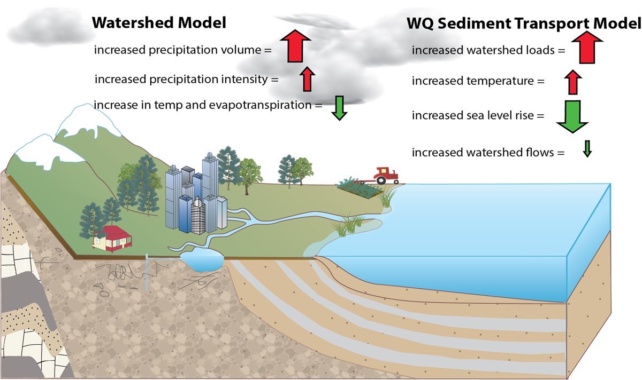
Components of Climate Change – Effect on Tidal Dissolved Oxygen
Chesapeake Bay Program
Science, Restoration, Partnership

Slide 10
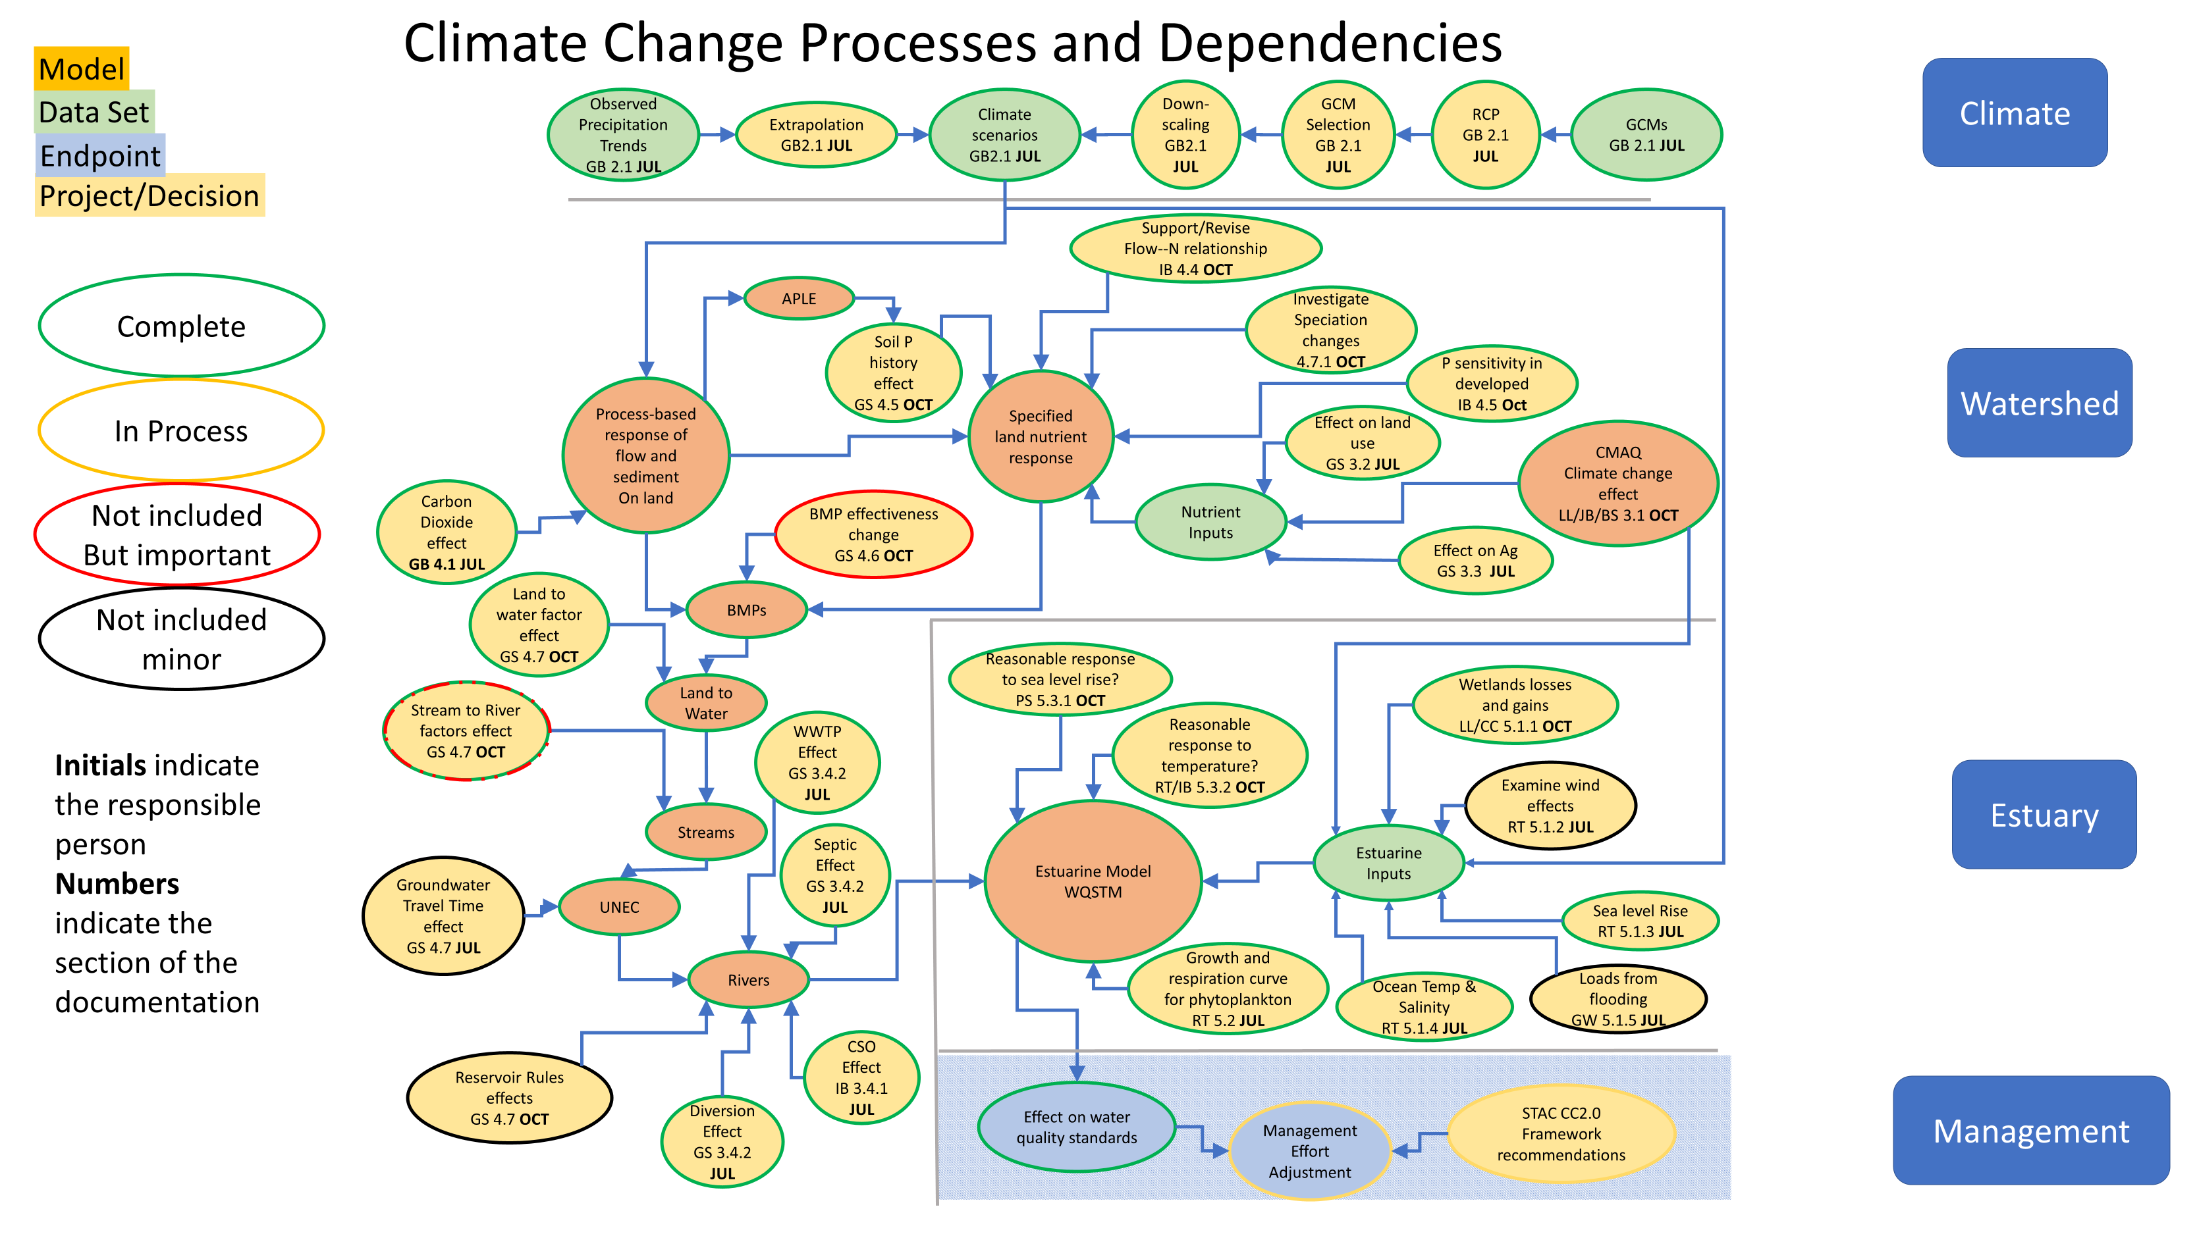
Elements of Chesapeake Water Quality Climate Risk Assessment
Chesapeake Bay Program
Science, Restoration, Partnership

Slide 11
WQGIT Recommendations to the Management Board
Chesapeake Bay Program
Science, Restoration, Partnership
Accept updated models for use in re-evaluating climate change for 2025 and 2035.

Slide 12

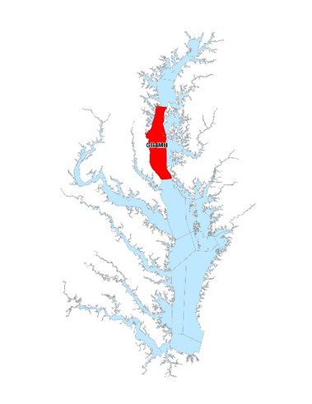
△Achievement of Deep Channel DO Water Quality Standard
Achievement of Deep Channel DO water quality standard (1mg/l instantaneous minimum) expressed
as an incremental increase over the PSC agreed to 2025 planning targets

Slide 13
△Achievement of Deep Water DO Water Quality Standard
Achievement of Deep Water DO water quality standard (3 mg/l 30-day mean) expressed
as an incremental increase over the PSC agreed to 2025 planning targets.

Slide 14
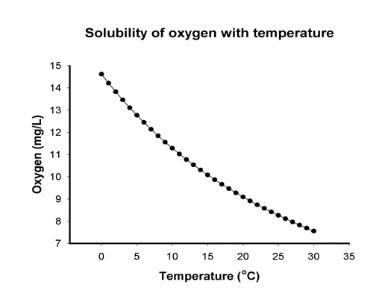
Tidal Fresh Open Water DO Water Quality Standard Violation Rates
Chesapeake Bay Program
Science, Restoration, Partnership
Nonattainment of Tidal Fresh Open Water DO water quality standard
(5.5mg/l 30-day mean)
1995
Climate
2025
Climate
2035
Climate
2045
Climate
2055
Climate
Estimating substantial increases in Open Water DO non-attainment under increased (1ºC) 2025 temperature in shallow waters.

Slide 15
Open Water is Important!
Chesapeake Bay Program
Science, Restoration, Partnership
The Open Water criteria are based on living resource needs for striped bass and other important species.
There is a huge amount of Open Water (2/3 of the Bay) with DO water quality standards in place to protect living resources.
It is the portion of the Bay that we interact with the most.
Shallow Open Water (less than 2 meters deep) may have increased impacts from future estimated temperature increases.
Open Water DO nonattainment in shallow water requires additional investigation. Ultimately, an improved Bay Model simulation of shallow water is needed to better understand the climate effects on Open Water DO water quality standards in Chesapeake’s shallow waters.

Slide 16
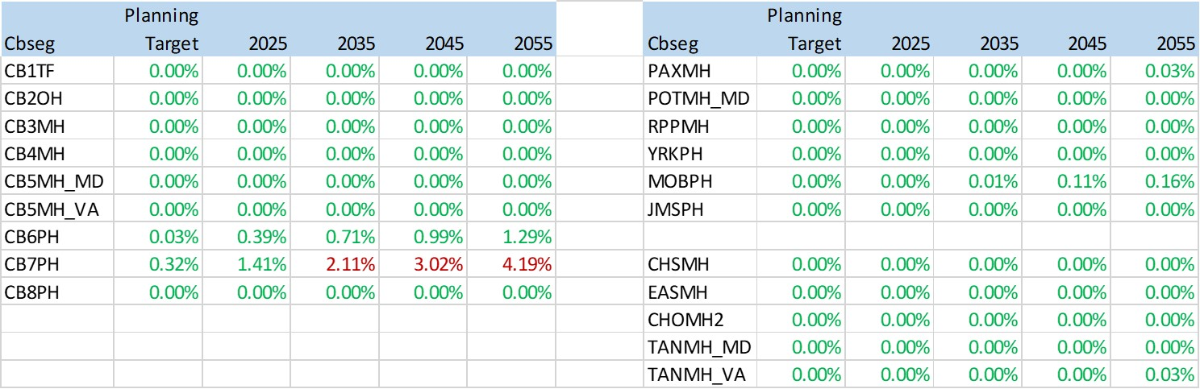
Main Bay and Tributary Open Water Violation Rates
Chesapeake Bay Program
Science, Restoration, Partnership
Non-attainment of Open Water DO water quality standard (5 - 5.5 mg/l 30-day mean)
Most areas do not reach violation, even by 2055
CB6 and CB7 are much more effected

Slide 17
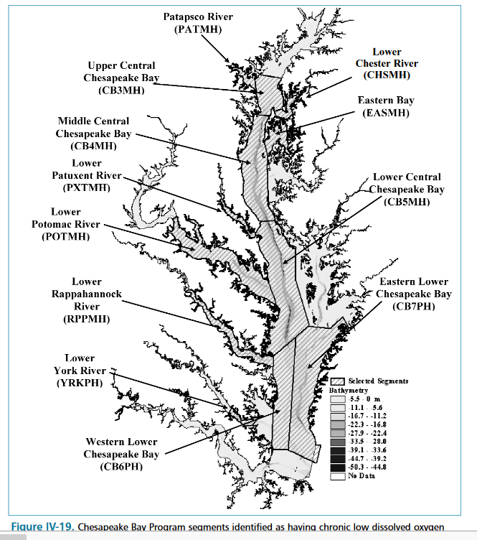
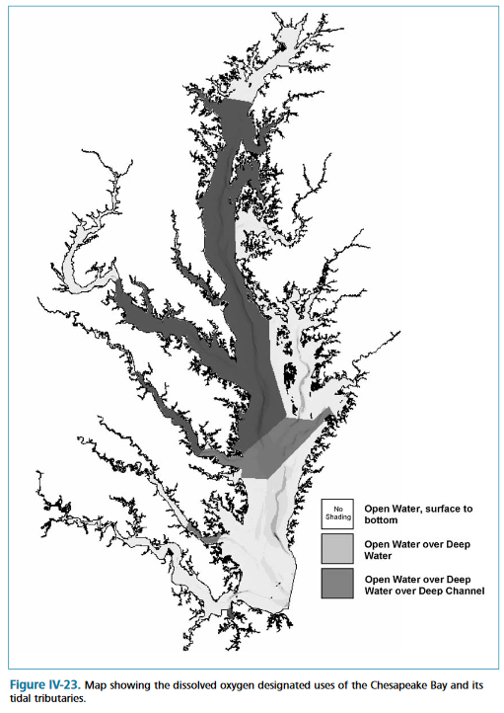
Why are CB6 and CB7 acting so differently?
Chesapeake Bay Program
Science, Restoration, Partnership
2003 Technical Support Document
“The delineation of the boundary was determined by examining maps of contemporary dissolved oxygen concentration distributions and the anecdotal historical dissolved oxygen concentration data record.”
https://www.chesapeakebay.net/content/publications/cbp_13218.pdf

Slide 18
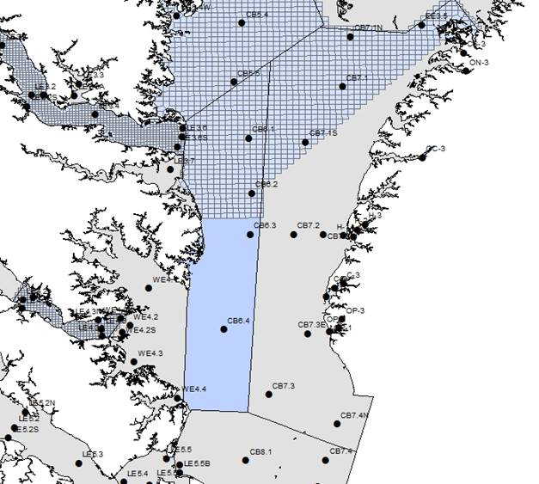
Deep Water Boundary
Chesapeake Bay Program
Science, Restoration, Partnership
CB6 boundary adjusted in 2004 as:
Near the end of the natural channel
The point where non-attainment goes under 1% in the 2003 Cap Load allocations
Modeling Team took a closer look at the Open Water DO nonattainment forecasted in CB6 and CB7
Nonattainment was happening below the pycnocline.
But DO concentrations below the pycnocline would not violate the Deep Water DO standard (> 3 mg/l).
The Modeling Workgroup recommended to the WQGIT that it avoid driving allocations with CB6 and CB7 Open Water DO because:
Attainment is relatively insensitive to load reductions.
No other mainstem segment had Open Water DO violations estimated through 2055.
A more appropriate delineation of the designated uses of Open Water DO and Deep Water DO is needed.
https://www.chesapeakebay.net/content/publications/cbp_13270.pdf

Slide 19
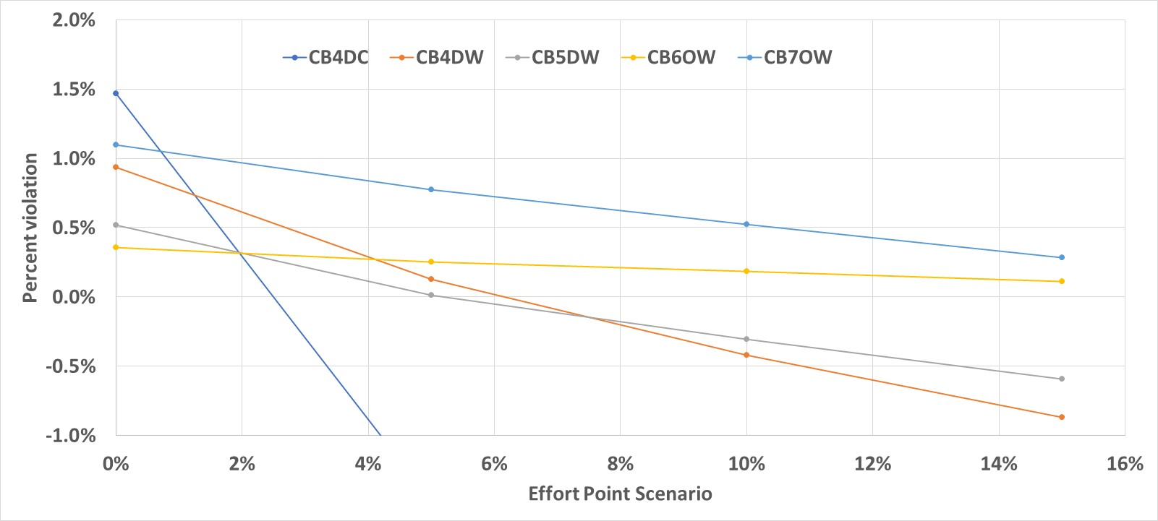
CB6 and CB7 are Less Sensitive to Reductions
Chesapeake Bay Program
Science, Restoration, Partnership
2025 climate and reduction effort applied

Slide 20
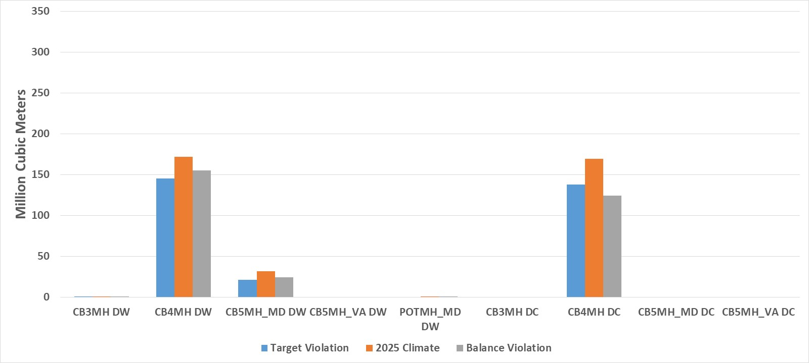
Climate Change Effect on Main Bay DWDC
Chesapeake Bay Program
Science, Restoration, Partnership
1990s climate
305 million cubic meters
2025 climate
375 million cubic meters
2025 reduction
305 million cubic meters
Make sure that variances are not exceeded

Slide 21
WQGIT Recommendations to the Management Board
Chesapeake Bay Program
Science, Restoration, Partnership
Exclude model estimated nonattainment in shallow (or non-main stem segment) Open Water DO from the climate change allocation.
Exclude model estimated nonattainment in Open Water DO in CB6 and CB7 from the climate change allocation.
Criteria Assessment Protocol (CAP) Workgroup will evaluate climate change risks to current water quality standard criteria and designated uses, including the open water designated use for CB6MH and CB7MH.
The 2025 climate change estimate will ensure main Bay Deep Water and Deep Channel DO additional nonattainment under climate change returns to 2017 Planning Target levels and within existing variances.

Slide 22
WQGIT Recommendations to the Management Board
Chesapeake Bay Program
Science, Restoration, Partnership
Incorporate the additional nitrogen (N) and phosphorus (P) loads due to 2025 climate change conditions into Programmatic Milestones no later than the 2022-2023 milestones, with all actions to achieve those reductions in place by 2025.
Include a narrative in the Milestones that describe the current estimated jurisdiction-specific nutrient loads due to 2035 climate change conditions.
Continue efforts to improve understanding of the science and refine estimates of pollutant load changes due to 2035 climate change conditions.
Develop a better understanding of the BMP responses, including new or other emerging BMPs, to climate change conditions.
Compare the current 2025 climate change assumptions with measured climate conditions through 2024.
To include: rainfall volume, intensity and distribution; air temperature, hydrology, water temperature, sea level rise, and changes in bay stratification and circulation.
Consider the efficacy of using projections from measured trends versus downscaled global climate model data for revised 2035 estimates.
In 2025, the Partnership will consider results of updated methods, techniques, and studies and revisit existing estimated loads due to climate change to determine if any updates to those 2035 load estimates are needed.

Slide 23
Climate Allocation Options
Chesapeake Bay Program
Science, Restoration, Partnership
Watershed loads first?
Take out jurisdiction’s watershed load increases due to climate change first, then allocate any remaining reductions using the planning targets method
Allocate all climate change reductions using planning targets method
Adjustments to planning target allocation method?
Only move the non-WWTP sources line (no change)
Move the WWTP and non-WWTP sources lines by the same amount
Set the WWTP source line at 8mg/l and 4mg/l then move the non-WWTP sources line to achieve the remaining reductions
Several other adjustments to the WWTP line were considered and ruled out by the WQGIT

Slide 24
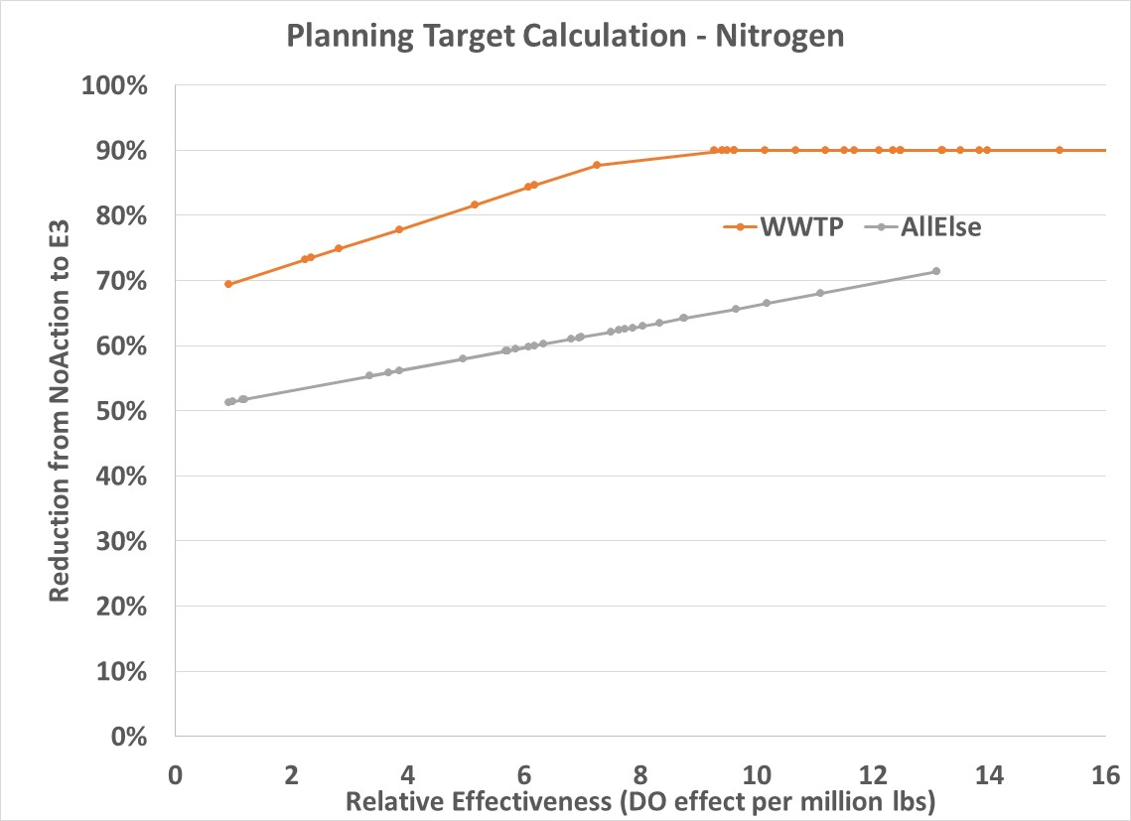
Chesapeake Bay Program
Science, Restoration, Partnership
Wastewater Loads
4.5 mg/l
8 mg/l
Non-WW loads
20 percent slope
Intercept wherever it is needed to be for acceptable water quality
+ adjustments to WV and NY loads

Slide 25
Chesapeake Bay Program
Science, Restoration, Partnership
2025 Climate Allocation Options
Effects from climate changes between 1995 and 2025

Slide 26
Watershed Loads First with 2025 NY Special Case
Chesapeake Bay Program
Science, Restoration, Partnership

Slide 27
WQGIT Recommendations to the Management Board
Chesapeake Bay Program
Science, Restoration, Partnership
For 2025 climate change estimate, allocate using the jurisdiction’s watershed loads first option with a 2025 special case for NY.
The NY special case is a policy adjustment to the science-based watershed loads and applies only to the 2025 nitrogen climate allocation.
Reduce NY nitrogen allocation to 0.399 (returning to a value similar to the initial estimate in 2017)
Increase WV nitrogen allocation from -0.054 to 0.000
Increase remaining jurisdictions to 108% of their science-based nitrogen allocation

Slide 28
Chesapeake Bay Program
Science, Restoration, Partnership
2035 Climate Allocation Options
Effects from climate changes between 1995 and 2035

Slide 29
Pending Recommendation to the Management Board
Chesapeake Bay Program
Science, Restoration, Partnership
For 2035 climate change estimate, the WQGIT has not yet reached a consensus on the allocation approach.
NPS Only (3 ,4, 7, 1, 1)and NPS+PS (4, 3, 7, 1, 1) were similarly preferred in polling of members. 8 and 4 (2, 2, 8, 1, 3) was least favored of the options.
All allocation options (and any possible special cases) should be re-considered in 2025 when the revised 2035 estimates are established. Do not want to set a precedent with this decision.
Revisiting WQGIT Recommendation #7 may be necessary to reach consensus.
(Endorse, Agree w/ Reservations, Stand Aside, Hold, Stop)

Slide 30
WQGIT Recommendations to the Management Board
Chesapeake Bay Program
Science, Restoration, Partnership
Accept updated models for use in re-evaluating climate change for 2025 and 2035.
Exclude model estimated non-attainment in shallow open water from the climate change allocation.
Exclude model estimated non-attainment in open water in CB6 and CB7 from the climate change allocation.
Criteria Assessment Protocol (CAP) Workgroup will evaluate climate change risks to current water quality standard criteria and designated uses, including the open water designated use for CB6MH and CB7MH.
2025 climate change estimate will consider main Bay DW/DC and ensure additional non-attainment returns to 2017 Planning Target levels and within existing variances.
Incorporate the additional nitrogen (N) and phosphorus (P) loads due to 2025 climate change conditions into Programmatic Milestones no later than the 2022-2023 milestones, with all actions to achieve those reductions in place by 2025.
Include a narrative in the Milestones that describe the current estimated jurisdiction-specific nutrient loads due to 2035 climate change conditions.
Continue efforts to improve understanding of the science and refine estimates of pollutant load changes due to 2035 climate change conditions.
Develop a better understanding of the BMP responses, including new or other emerging BMPs, to climate change conditions.
Compare the current 2025 climate change assumptions with measured climate conditions through 2024.
To include: rainfall volume, intensity and distribution; air temperature, hydrology, water temperature, sea level rise, and changes in bay stratification and circulation.
Consider the efficacy of using projections from measured trends versus downscaled global climate model data for revised 2035 estimates.
In 2025, the Partnership will consider results of updated methods, techniques, and studies and revisit existing estimated loads due to climate change to determine if any updates to those 2035 load estimates are needed.
For 2025 climate change estimate, allocate using the jurisdiction’s watershed loads first option with a 2025 special case for NY.
The NY special case is a policy adjustment to the science-based watershed loads and applies only to the 2025 nitrogen climate allocation.
Reduce NY nitrogen allocation to 0.399 (returning to a value similar to the initial estimate in 2017)
Increase WV nitrogen allocation from -0.054 to 0.000
Increase remaining jurisdictions to 108% of their science-based watershed nitrogen allocation

