Slide 1

Updated Phase 6 Modeling Results for Climate Change Impacts
Chesapeake Bay Program
Science, Restoration, Partnership
WQGIT Presentation to the Principals Staff Committee
October 8, 2020
James Martin and Ed Dunne, WQGIT Co-Chairs
WQGIT; Gary Shenk, USGS; Lewis Linker, EPA; Richard Tian, UMCES; Gopal Bhatt, Penn State; Isabella Bertani, UMCES; Carl Cerco, Attain; and CBP Modeling Workgroup

Slide 2
Previous PSC 2025 Climate Change Decisions
Chesapeake Bay Program
Science, Restoration, Partnership
Incorporate Climate Change in the Phase III WIPs
Include a narrative strategy in the Phase III WIPs that describe the jurisdictions current action plans and strategies to address climate change, as well as the jurisdiction-specific nutrient and sediment pollution loadings due to 2025 climate change conditions, while incorporating local priorities and actions to address climate change impacts.
2. Understand the Science
Address the uncertainty by documenting the current understanding of the science and identifying research gaps and needs:
  Develop an estimate of pollutant load changes (N, P and Sediment) due to climate change conditions.
  Develop a better understanding of the BMP responses, including new or other emerging BMPs, to climate change conditions.
  In 2021, the Partnership will consider results of updated methods, techniques, and studies and revisit existing estimated loads due to climate change to determine if any updates to those load estimates are needed.
  Jurisdictions will be expected to account for additional nutrient and sediment pollutant loads due to 2025 climate change conditions in a Phase III WIP addendum and/or 2-year milestones beginning in 2022.
3. Incorporate into Milestones
Starting with the 2022-2023 milestones, determine how climate change will impact the BMPs included in the WIPs and address these vulnerabilities in the two-year milestones.

Slide 3
2017/2018 Climate Change Loads and Planning Targets
Chesapeake Bay Program
Science, Restoration, Partnership
Jurisdiction | Nitrogen Climate Change | Nitrogen Planning Target | Phosphorus Climate Change | Phosphorus Planning Target
NY | 0.400 (3.8%) | 11.59 | 0.014 (2.9%) | 0.606
PA | 4.135 (5.7%) | 73.18 | 0.141 (4.7%) | 3.073
MD | 2.194 (4.8%) | 45.30 | 0.114 (3.2%) | 3.604
WV | 0.236 (3.7%) | 8.35 | 0.019 (3.9%) | 0.456
DC | 0.006 (0.3%) | 2.43 | 0.001 (0.8%) | 0.130
DE | 0.397 (8.5%) | 4.59 | 0.006 (5.1%) | 0.120
VA | 1.722 (3.1%) | 55.82 | 0.193 (3.0%) | 6.186
Basinwide | 9.09 (4.6%) | 201.25 | 0.489 (3.4%) | 14.173
*Units: millions of pounds

Slide 4
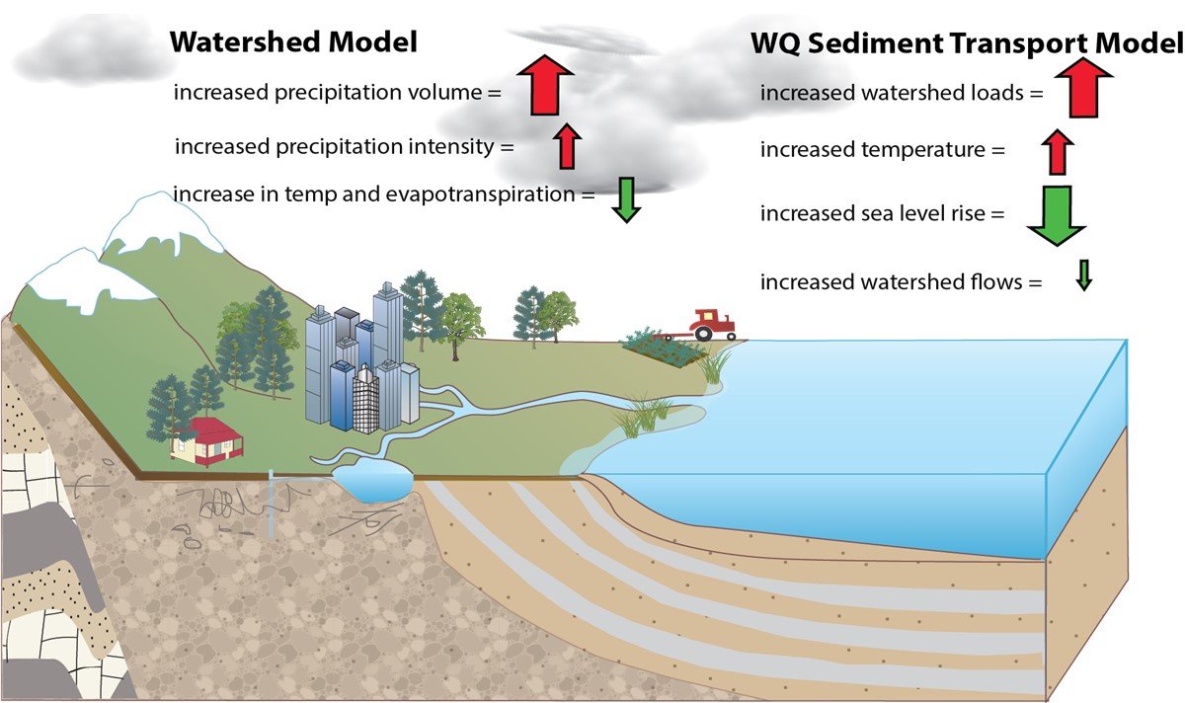
Components of Climate Change –
Effect on Tidal Dissolved Oxygen
Chesapeake Bay Program
Science, Restoration, Partnership

Slide 5
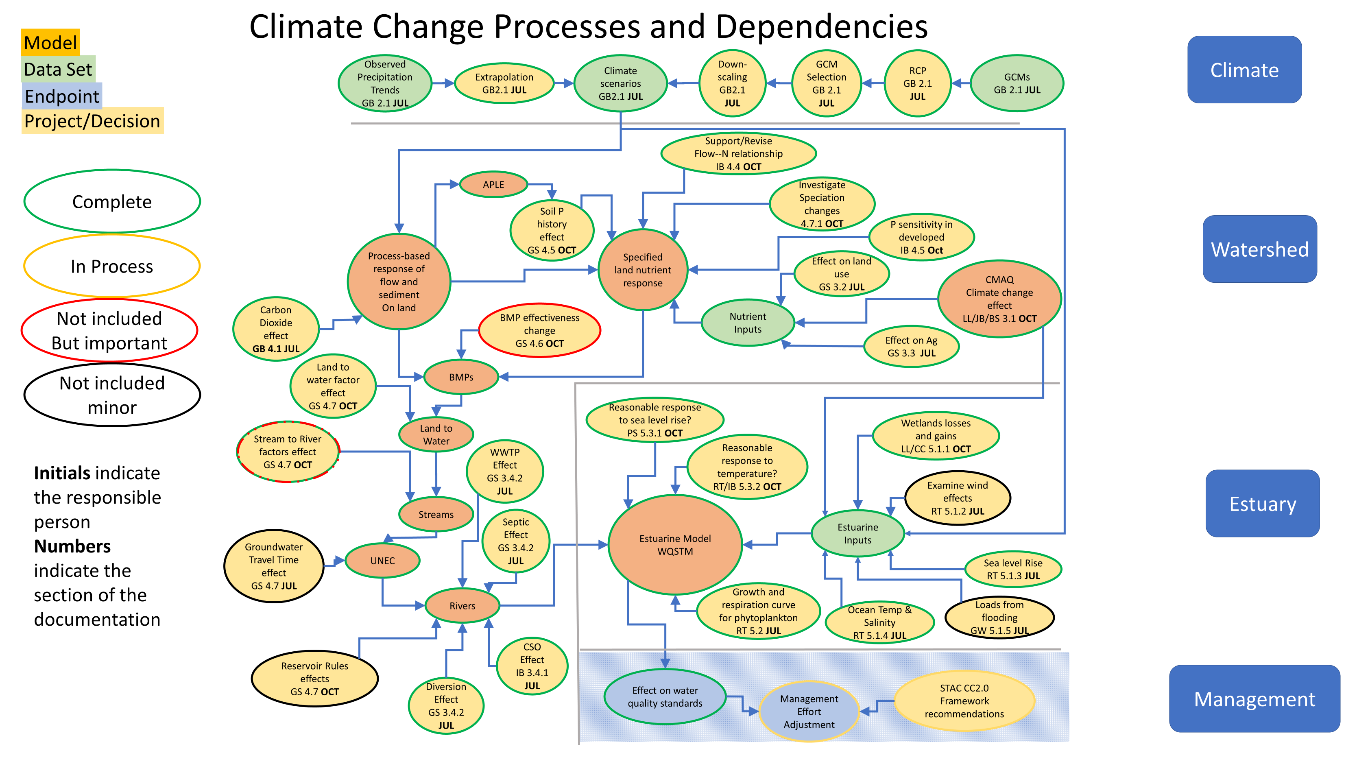
Elements of Chesapeake Water Quality Climate Risk Assessment
Chesapeake Bay Program
Science, Restoration, Partnership

Slide 6
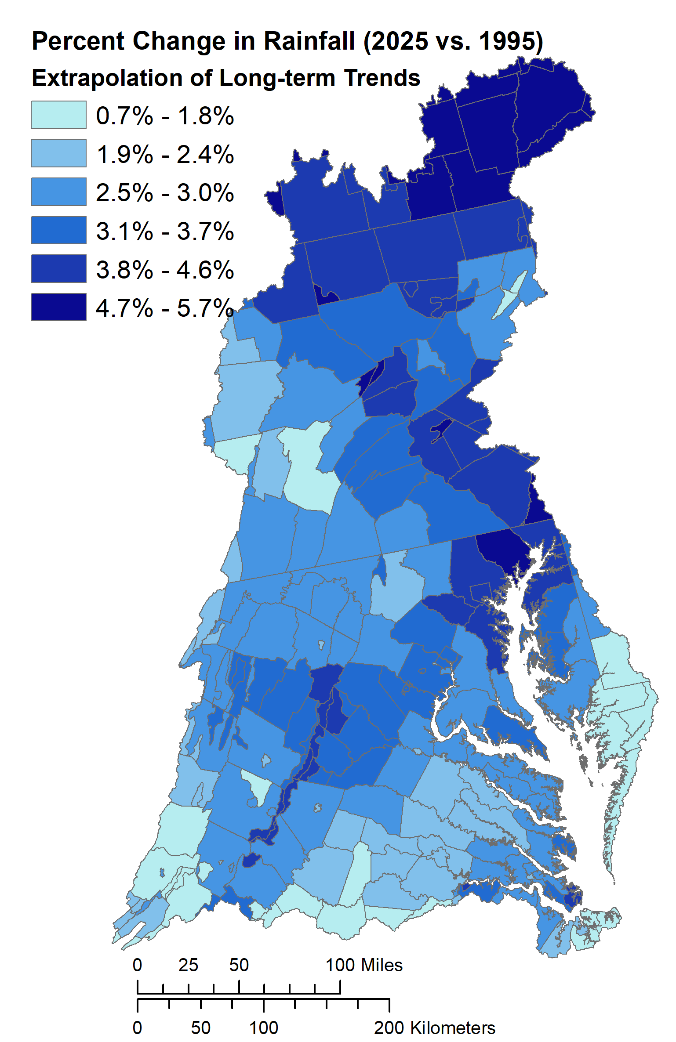
Elements of 2025 Climate Change (1995-2025)
Chesapeake Bay Program
Science, Restoration, Partnership
Air-temperature
increase: 1.06 °C
Flow
2.4% Increase
Nitrogen Load
2.6% Increase
+3.11 % Increase in rainfall
Phosphorus Load
Sea Level Rise: 0.22m
4.5% Increase
Sediment Load
3.8% Increase
Open boundary:
Temperature: +0.95 °C;
Salinity: +0.18 psu
(Thomas et al., 2017)
Phase 6 Watershed Model
Model: CH3D-ICM 400m-1km Resolution

Slide 7
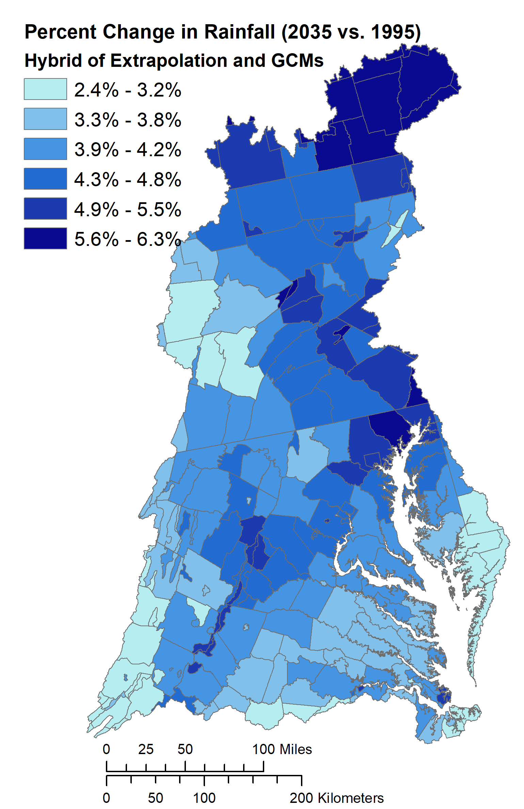
Elements of 2035 Climate Change (1995-2035)
Chesapeake Bay Program
Science, Restoration, Partnership
Air-temperature
increase: 1.39 °C
Flow
3.7% Increase
Nitrogen Load
4.7% Increase
+4.21 % Increase in rainfall
Phosphorus Load
Sea Level Rise: 0.31m
9.9% Increase
Sediment Load
8.5% Increase
Open boundary:
Temperature: +1.32 °C;
Salinity: +0.25 psu
(Thomas et al., 2017)
Phase 6 Watershed Model
Model: CH3D-ICM 400m-1km Resolution

Slide 8
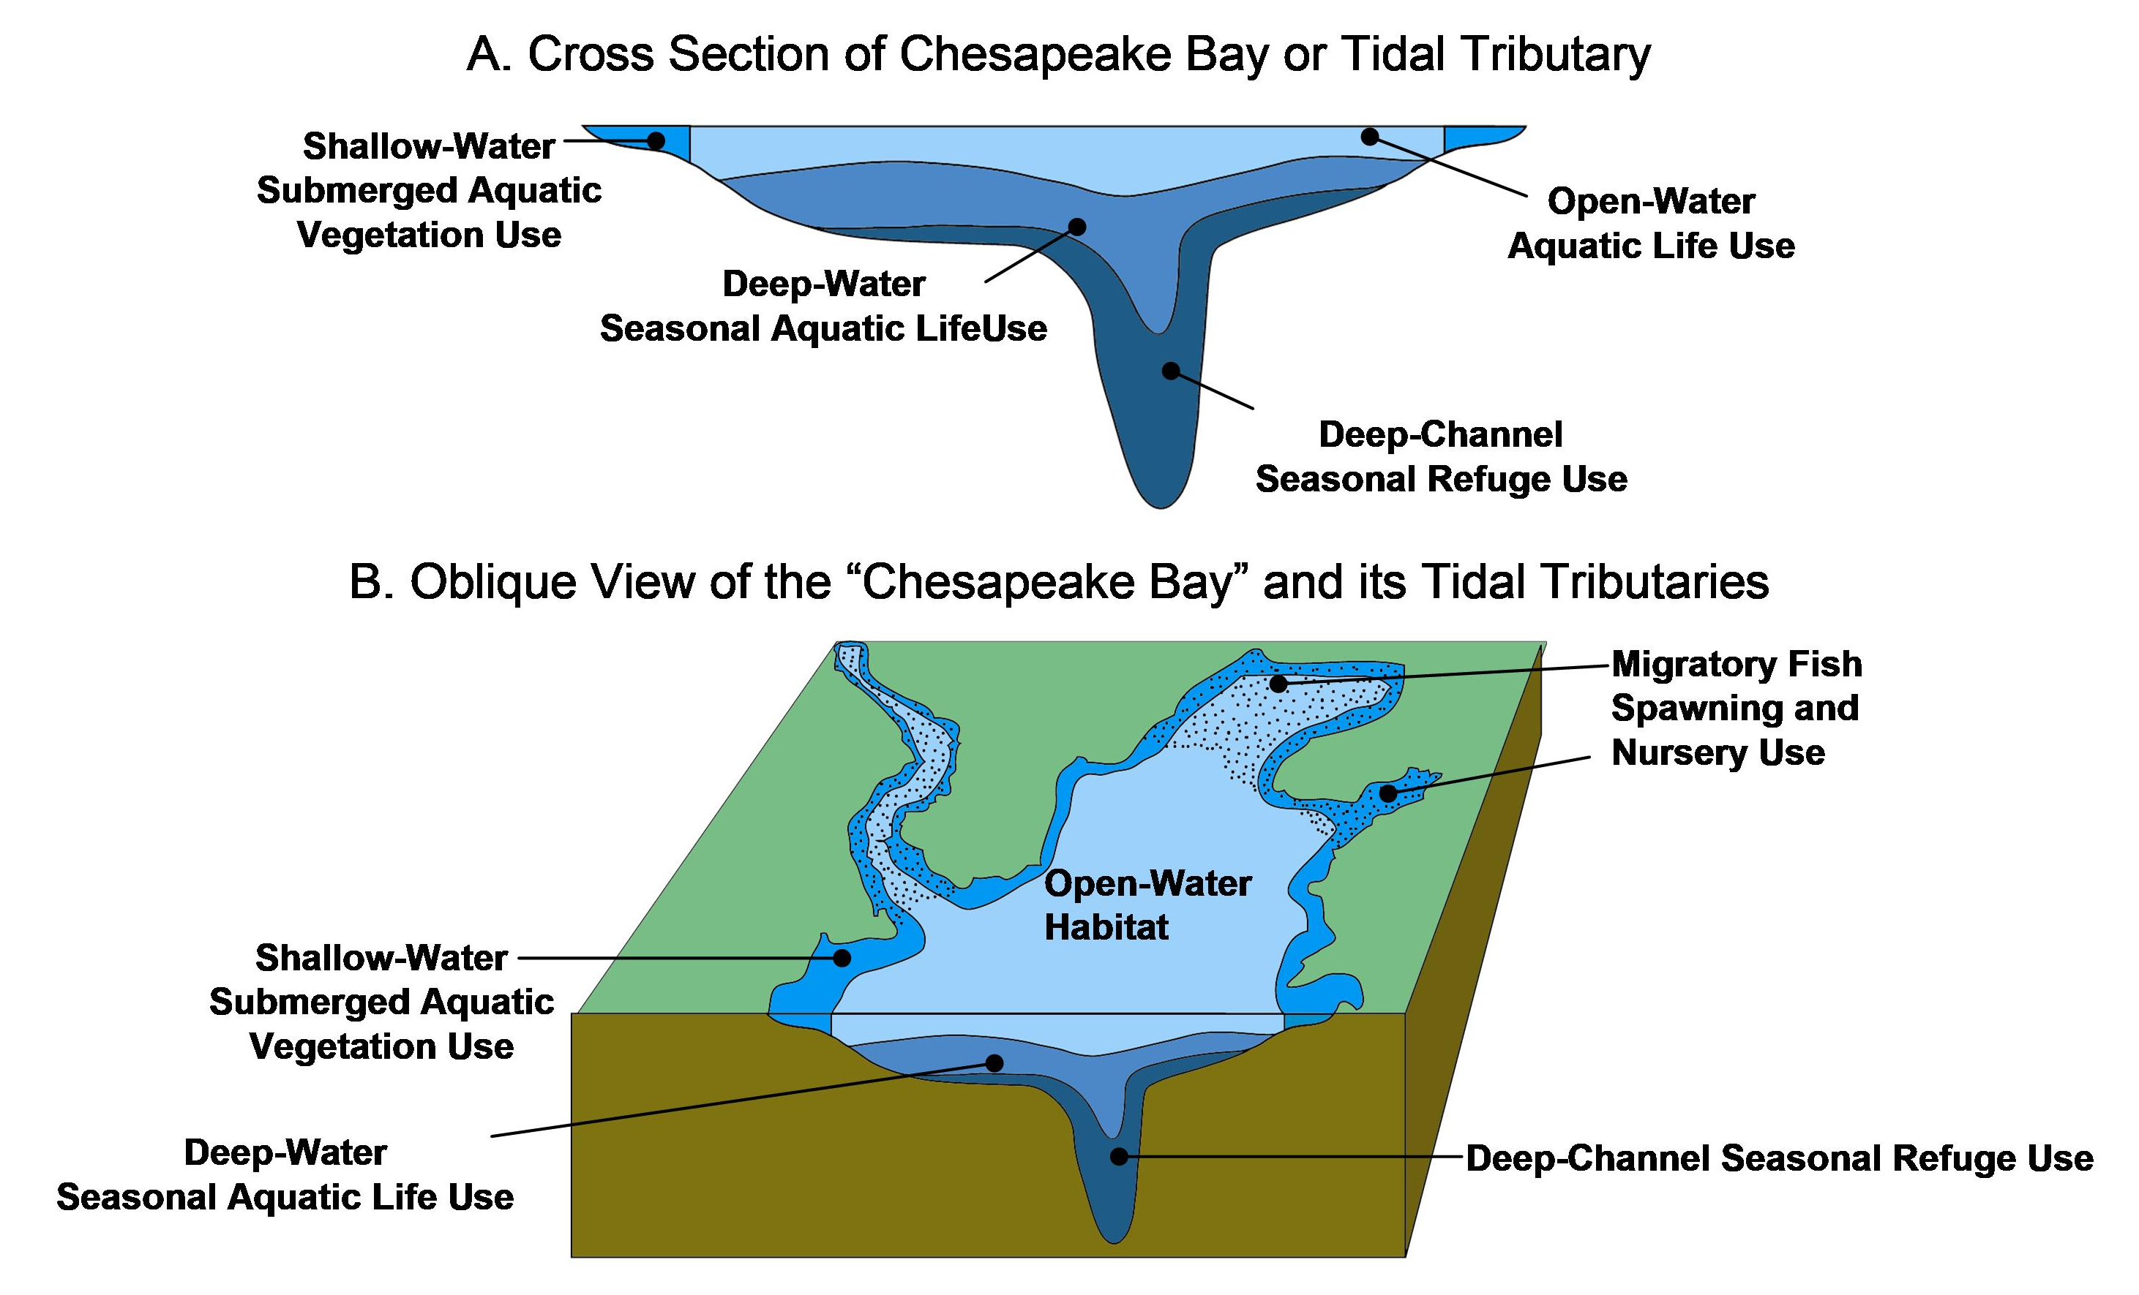
Overview of Bay Designated Uses
Chesapeake Bay Program
Science, Restoration, Partnership

Slide 9

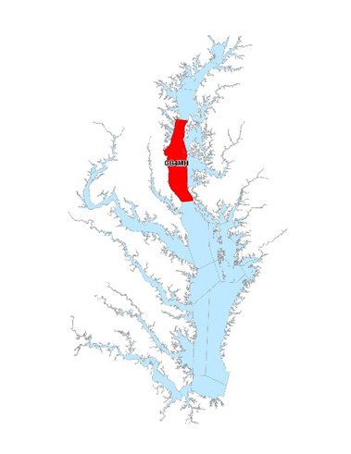
△Achievement of Deep Channel DO Water Quality Standard
Achievement of Deep Channel DO water quality standard (1mg/l instantaneous minimum) expressed
as an incremental increase over the PSC agreed to 2025 planning targets
9

Slide 10
△Achievement of Deep Water DO Water Quality Standard
Achievement of Deep Water DO water quality standard (3 mg/l 30-day mean) expressed
as an incremental increase over the PSC agreed to 2025 planning targets.
10

Slide 11
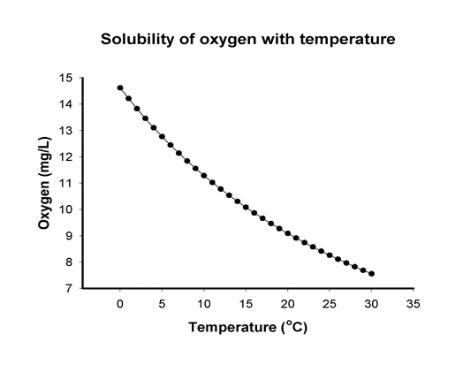
Tidal Fresh Open Water DO Water Quality Standard Violation Rates
Chesapeake Bay Program
Science, Restoration, Partnership
Nonattainment of Tidal Fresh Open Water DO water quality standard
(5.5mg/l 30-day mean)
1995
Climate
2025
Climate
2035
Climate
2045
Climate
2055
Climate
Estimating substantial increases in Open Water DO non-attainment under increased (1ºC) 2025 temperature in shallow waters.

Slide 12
Open Water is Important!
Chesapeake Bay Program
Science, Restoration, Partnership
The Open Water criteria are based on living resource needs for striped bass and other important species.
There is a huge amount of Open Water (2/3 of the Bay) with DO water quality standards in place to protect living resources.
It is the portion of the Bay that we interact with the most.
Shallow Open Water (less than 2 meters deep) may have increased impacts from future estimated temperature increases.
Open Water DO nonattainment in shallow water requires additional investigation. Ultimately, an improved Bay Model simulation of shallow water is needed to better understand the climate effects on Open Water DO water quality standards in Chesapeake’s shallow waters.

Slide 13
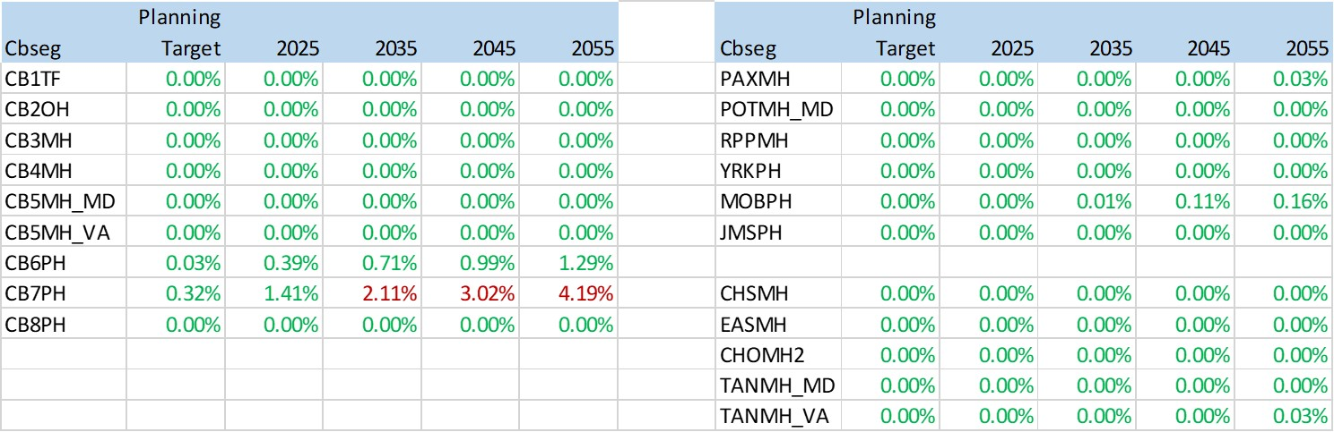
Main Bay and Tributary Open Water Violation Rates
Chesapeake Bay Program
Science, Restoration, Partnership
Non-attainment of Open Water DO water quality standard (5 - 5.5 mg/l 30-day mean)
Most areas do not reach violation, even by 2055
CB6 and CB7 are much more effected

Slide 14
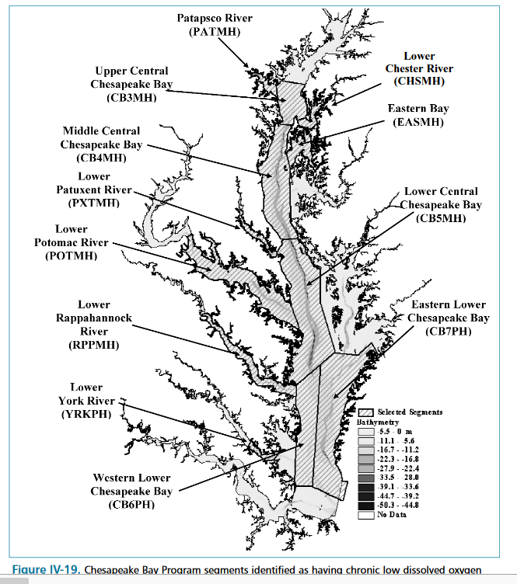
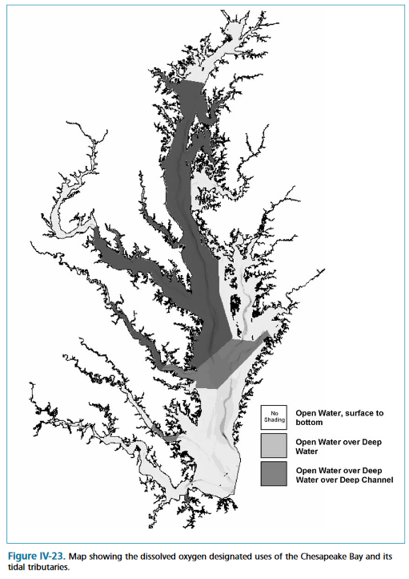
Why are CB6 and CB7 acting so differently?
Chesapeake Bay Program
Science, Restoration, Partnership
2003 Technical Support Document
“The delineation of the boundary was determined by examining maps of contemporary dissolved oxygen concentration distributions and the anecdotal historical dissolved oxygen concentration data record.”
https://www.chesapeakebay.net/content/publications/cbp_13218.pdf

Slide 15
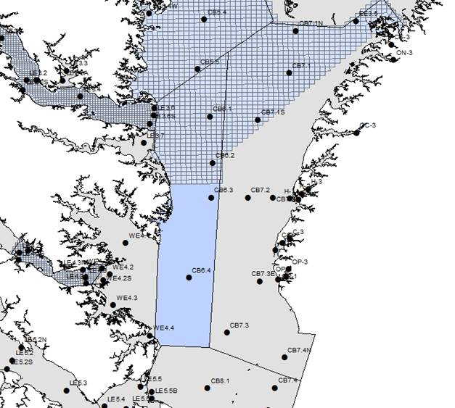
Deep Water Boundary
Chesapeake Bay Program
Science, Restoration, Partnership
CB6 boundary adjusted in 2004 as:
  Near the end of the natural channel
  The point where non-attainment goes under 1% in the 2003 Cap Load allocations
Modeling Team took a closer look at the Open Water DO nonattainment forecasted in CB6 and CB7
  Nonattainment was happening below the pycnocline.
  But DO concentrations below the pycnocline would not violate the Deep Water DO standard (> 3 mg/l).
The Modeling Workgroup recommended to the WQGIT that it avoid driving allocations with CB6 and CB7 Open Water DO because:
  Attainment is relatively insensitive to load reductions.
  No other mainstem segment had Open Water DO violations estimated through 2055.
  A more appropriate delineation of the designated uses of Open Water DO and Deep Water DO is needed.
https://www.chesapeakebay.net/content/publications/cbp_13270.pdf

Slide 16
Chesapeake Bay Program
Science, Restoration, Partnership
Key Points in Assessment of 2025 Climate Change
The efforts since December 2017 to understand the science have produced an improved model with a better understanding of the underlying processes
  Revised load estimates will be focused on the deep water and deep channel designated uses
  Improved model provides ability to consider alternative allocation methods
  Adjustments to the designated uses in CB6 and CB7 are being considered
  More work is needed on the shallow water simulation and understanding climate effects on BMPs
Resulting Climate Change load estimates for 2025 have decreased by about half from the December 2017/March 2018 estimates (about 5M lbs TN)
However, the estimated load reduction to address climate risk for 2035 is about twice that of the estimated 2025 nitrogen load reduction (about 10M lbs TN).
The WQGIT is finalizing its specific recommendations to the Management Board for their consideration. Anticipate those moving forward to PSC at your next meeting (or two).

