Slide 1


New York Local Government Engagement and Communication Strategy
Presented by: Lauren Townley, NYS Department of Environmental Conservation
October 5, 2017

Slide 2
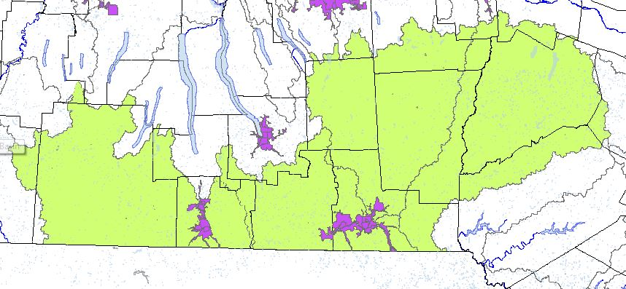
Jurisdiction-specific Considerations
New York has few regulated communities within the watershed
Implementation has been directed at the watershed scale, not at the local scale
Distance from Bay
New York Local Government
Engagement and Communication Strategy

Slide 3
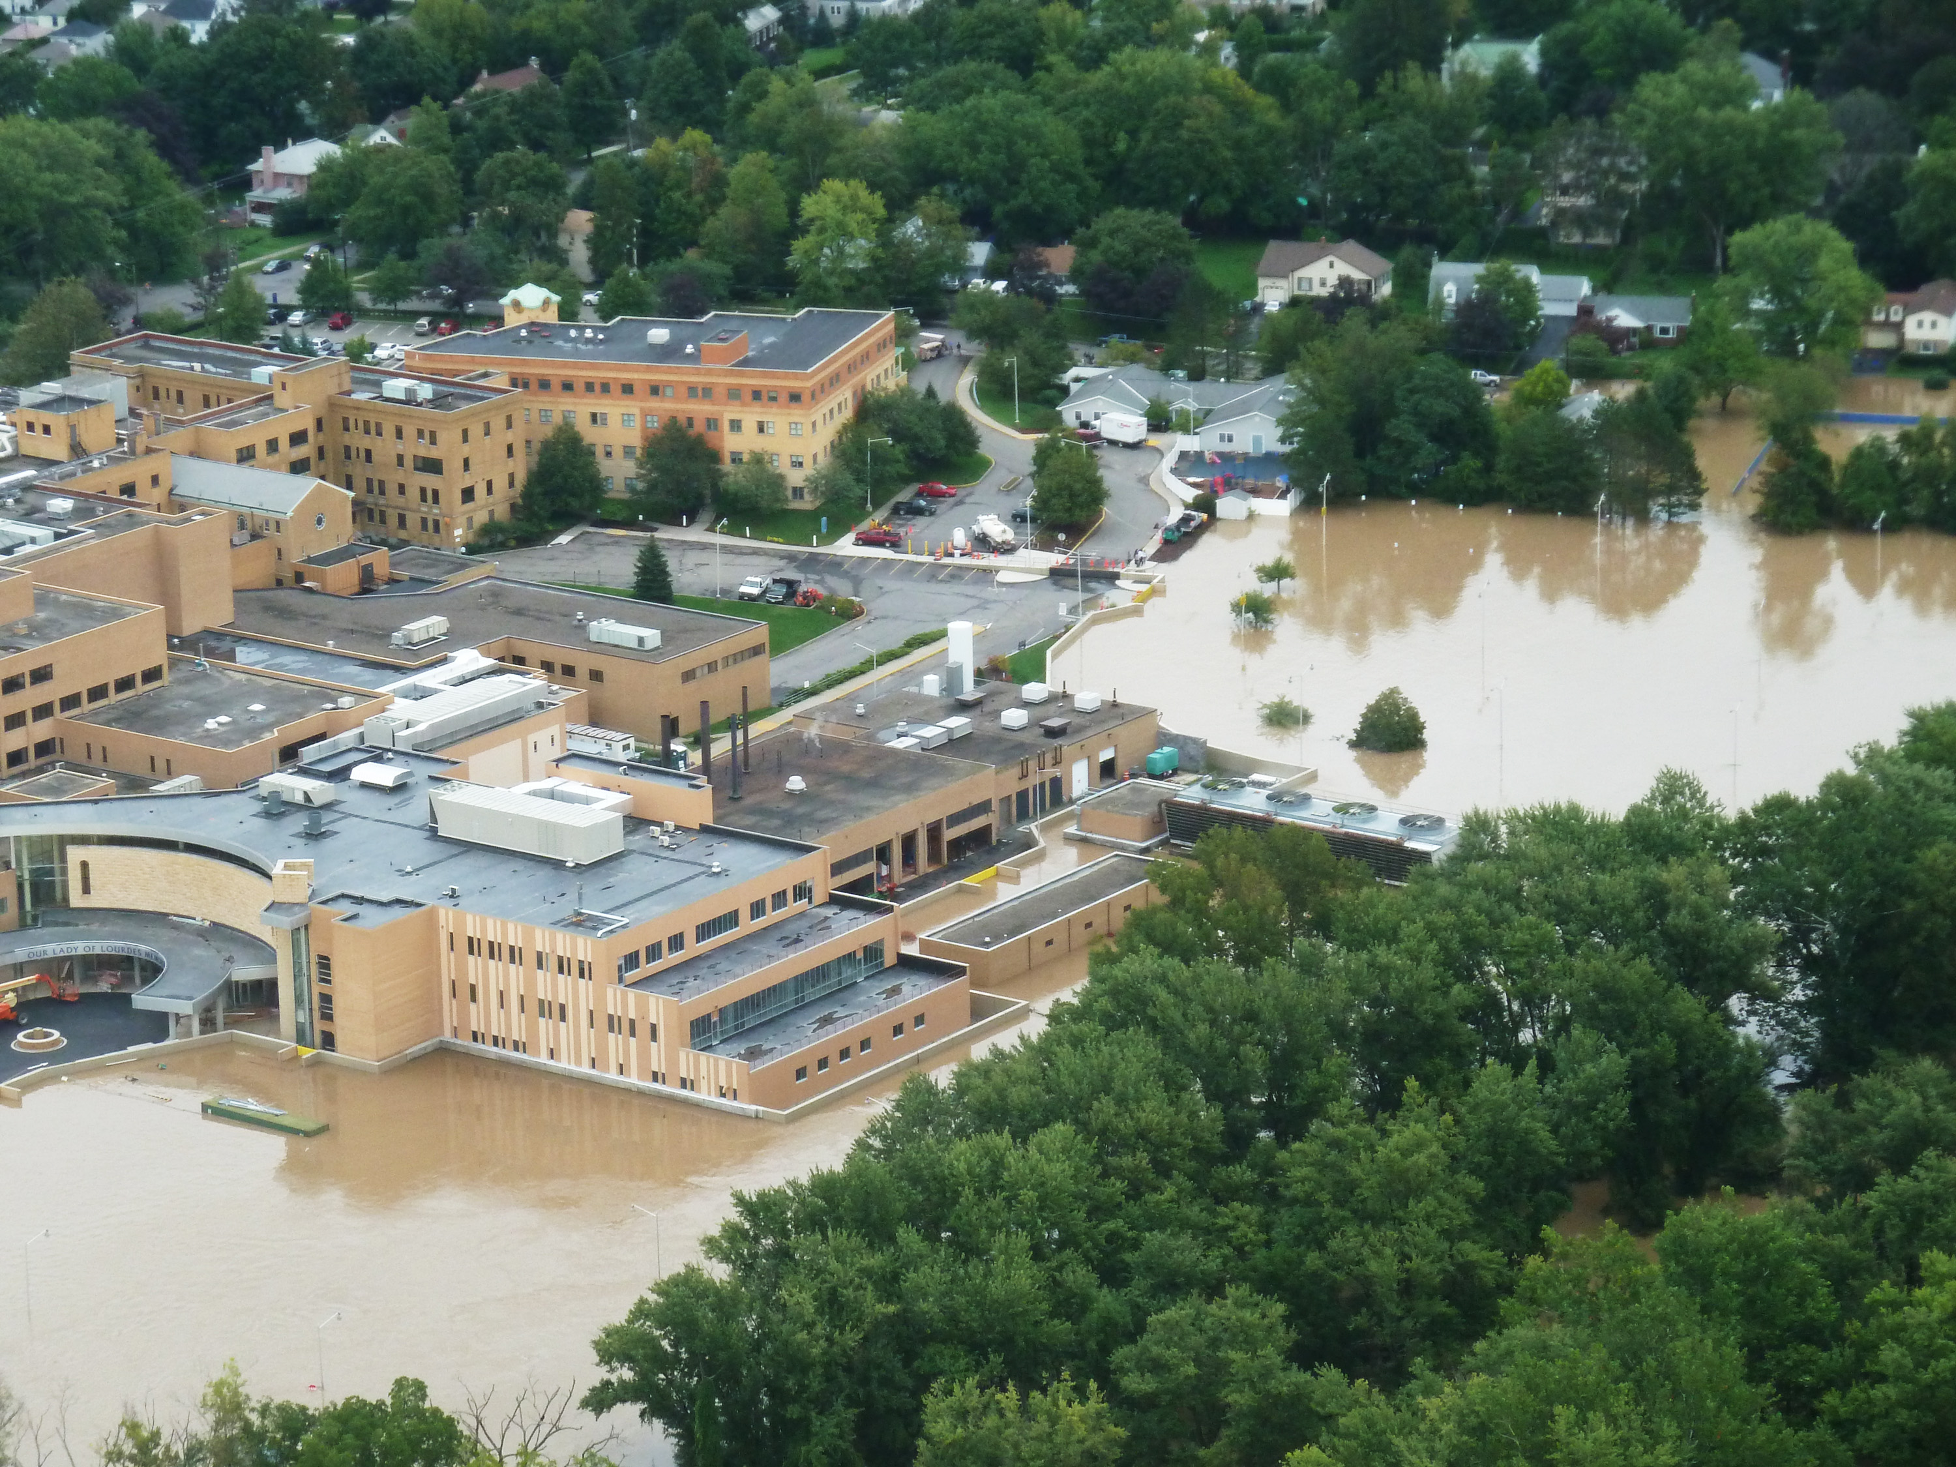
Engagement and Communication Goals
Focus on implementation scenarios that can benefit local concerns
Improve tracking and reporting of work completed by non-regulated entities
Raise awareness of WIP development
New York State Local Government
Engagement and Communication Strategy

Slide 4
Target Audiences
County Water Quality Coordinating Committees (CWQCC)
New York Association of Towns
New York State Association of Regional Councils
Southern Tier East Regional Planning & Development Board
Southern Tier Central Regional Planning & Development Board
Stormwater Coalitions (Chemung Co., Broome/Tioga Co.)
Local government officials
County Planning Departments
New York State Local Government
Engagement and Communication Strategy

Slide 5
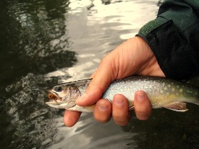
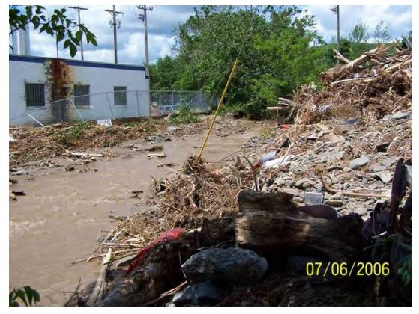
Key Messages
Economic/recreational benefits to improving water quality
Opportunity to address local concerns and receive funding
Training assistance/tools available (local roads, erosion and sediment control, ditch management)
New York State Local Government
Engagement and Communication Strategy

Slide 6
Key Messengers/Trusted Sources
Soil and Water Conservation Districts/Upper Susquehanna Coalition
Regional DEC staff
Regional DEC Communication Specialists
New York State Local Government
Engagement and Communication Strategy

Slide 7


Roles, Resources, and Capacity
State Agencies
NYSDEC and NYSDAM
Local Partners
Upper Susquehanna Coalition/Soil and Water Conservation Districts
New York State Local Government
Engagement and Communication Strategy

