Slide 1
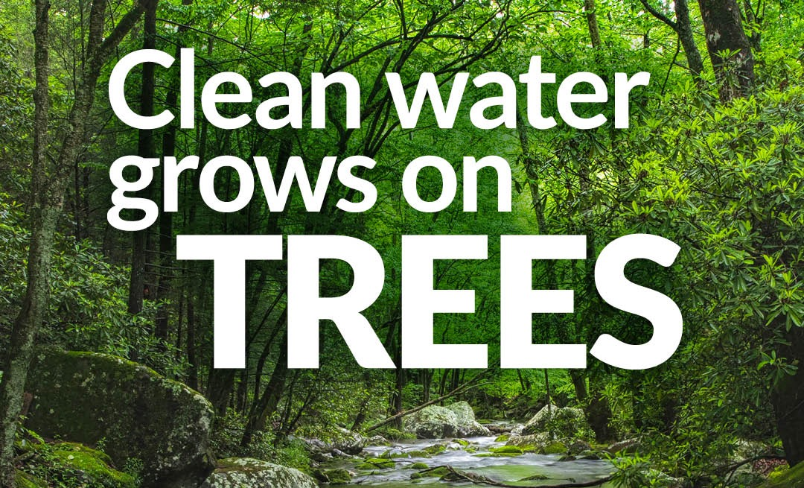
Notes:
Welcome
Name
Title
CBF mention
Location
Thanks for joining me today. My name is Brenda Sieglitz and I am Senior manager of the Keystone 10 Million Trees Partnership. Our Partnership is a collective impact model managed by the Chesapeake Bay Foundation. I work out of our Harrisburg, Pa office – or currently – my home in Lancaster county.

Slide 2
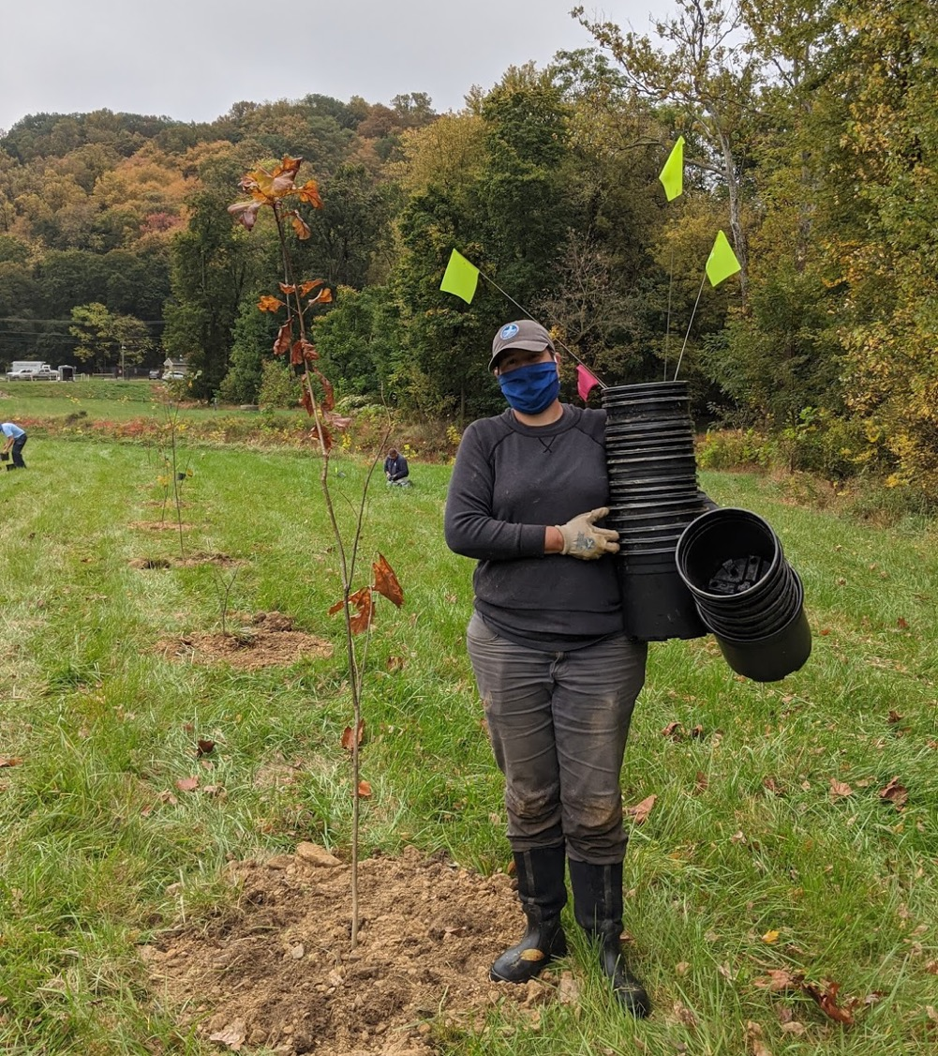
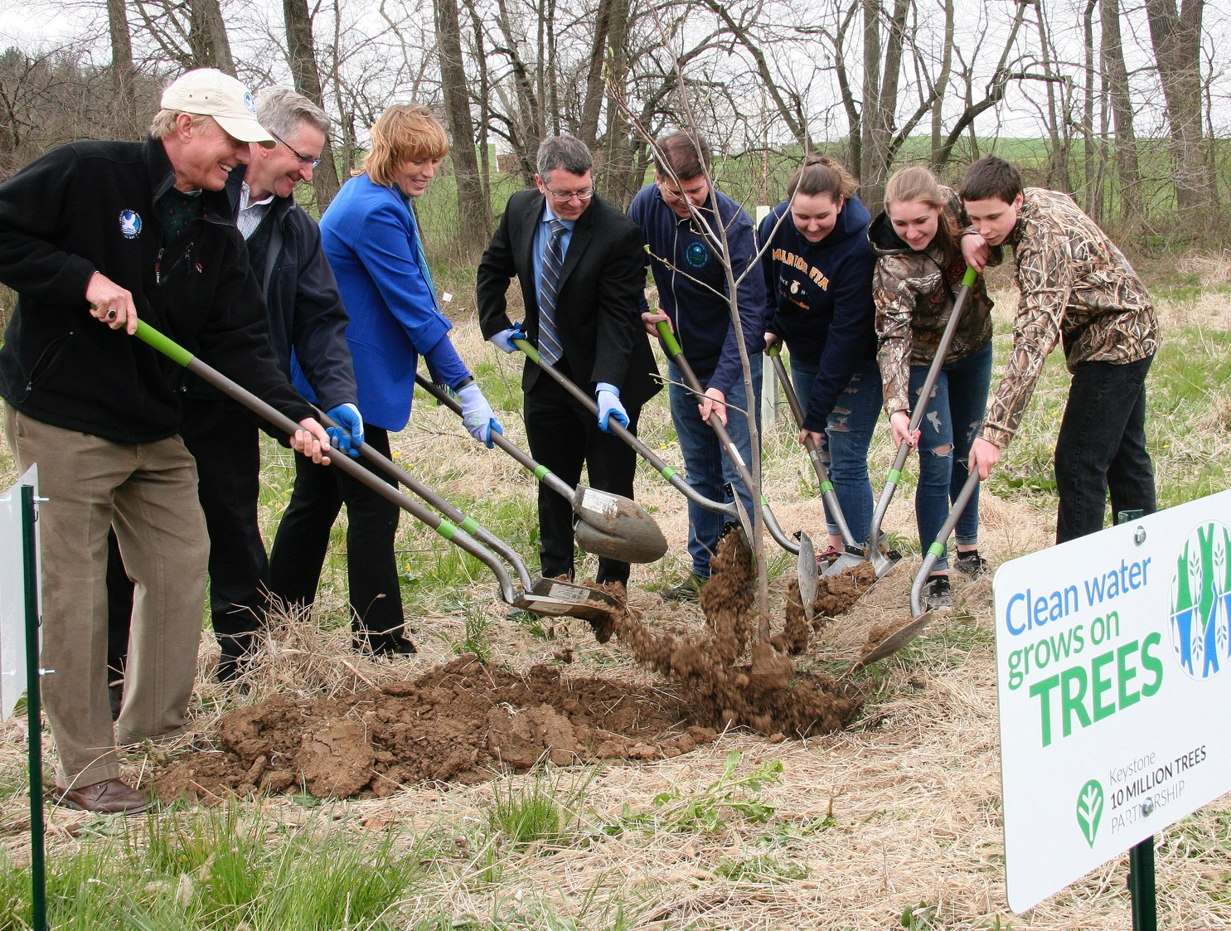
2021
2018
Notes:
2018 Launch
Today
Mission
2025
The partnership launched in April 2018 30 Partners and we now have 203 partners. The partnership is made up of a collection of partners planting trees across the commonwealth – and they have been busy planting their own trees and the trees we provide! It’s our collective mission to plant 10 million trees, together, by 2025.

Slide 3
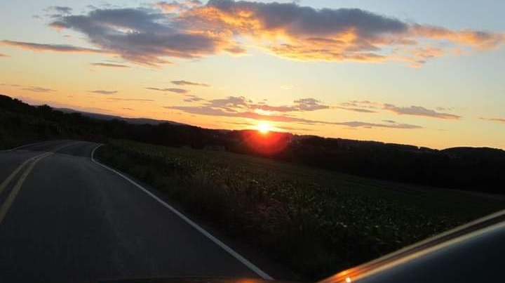
Roadmap to 10 Million
The Roadmap to 10 Million Trees
Direct Investment via Trees, Supplies, and Collaborative Grants* = $
  Exploring Possible Cost-Share Partners 2023-2025
  *Collaborative Grants offered within Chesapeake Watershed
Stimulating Tree Plantings through New Finance Programs + Blueprint Accountability
Support existing tree planting progress with supplies and stewardship
Looking for Cost-Share Partners for Supplies 2023-2025
Work with Industry to create an interface that connects Landowners + Industry
Deploy An Advocacy Campaign to recruit new landowners

Slide 4
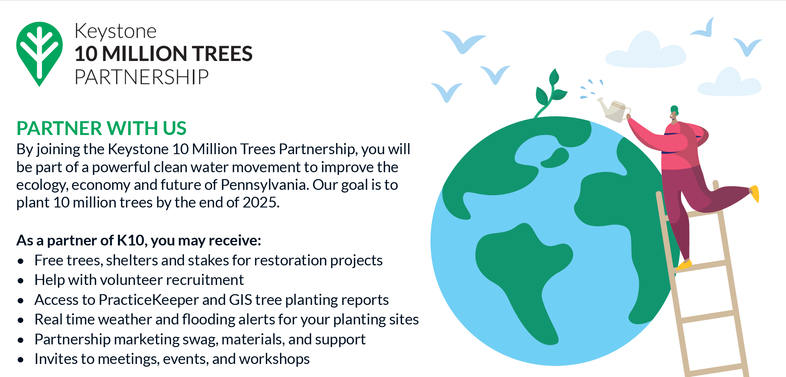
Partner Benefits

Slide 5
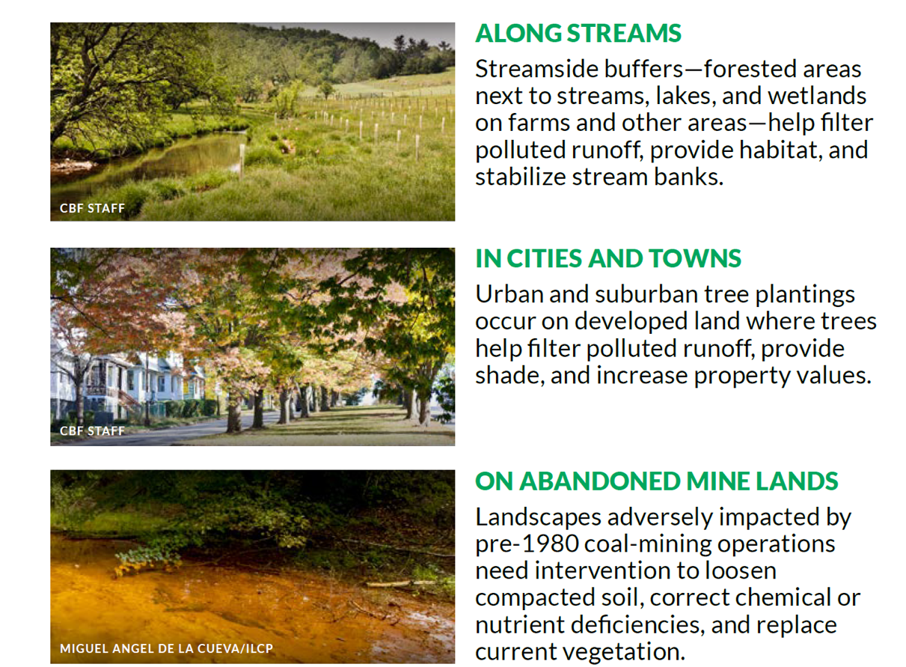
Priority Planting Areas

Slide 6
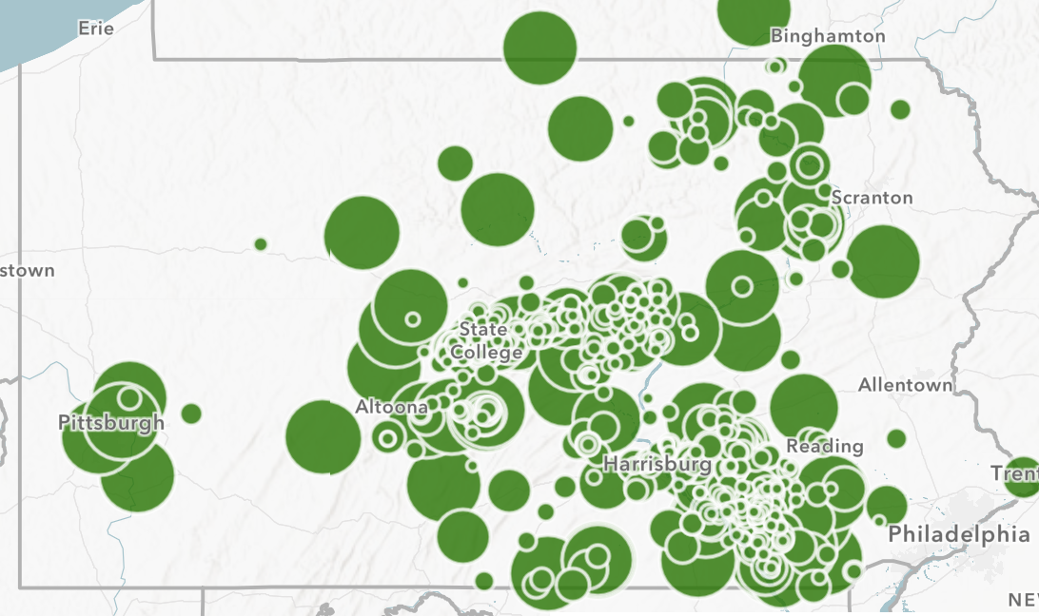
Our Collective Work
Notes:
This is just a snapshot of the work partners are doing across Pennsylvania. You can see much of the work is highly focused in south central Pennsylvania. That is specific to the goals of our backbone organization, the Chesapeake Bay Foundation. The Chesapeake Bay Foundation’s work is tied to the goals of the Chesapeake Bay Foundation Blueprint and reducing the nutrients and sediment flowing into the Chesapeake Bay. And in Pennsylvania that correlates to planting trees along the Susquehanna river and its tributaries to reduce those nutrient and sediment loads. As you can see from this map though – we don’t just plant in the Chesapeake Bay watershed. Why is that?

Slide 7
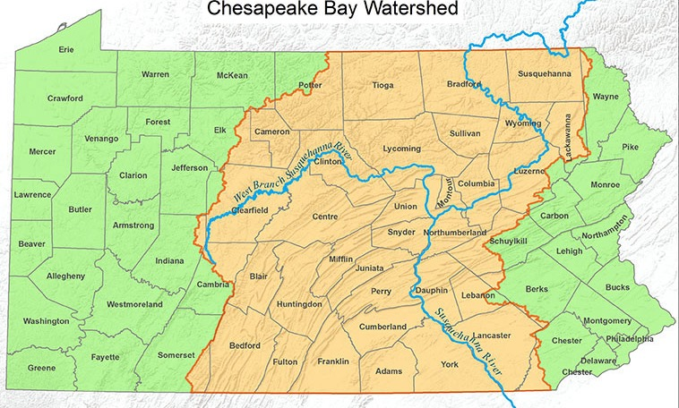
Outside the Watershed
CLEAN WATER LEGISLATION
Photo courtesy of dep.pa.gov
Notes:
Partners outside of the watershed understand the importance of rallying for Clean Water Legislation. They are inviting officials and business leaders to their tree plantings to demonstrate the value of planting trees along streams, in areas where cities and communities are experiencing significant stormwater runoff, and where cities are facing extreme urban tree canopy loss. This isn’t just for partners outside the watershed but is of significant importance outside the watershed because so much of Pennsylvania’s population resides in Pittsburgh and Philadelphia.

Slide 8
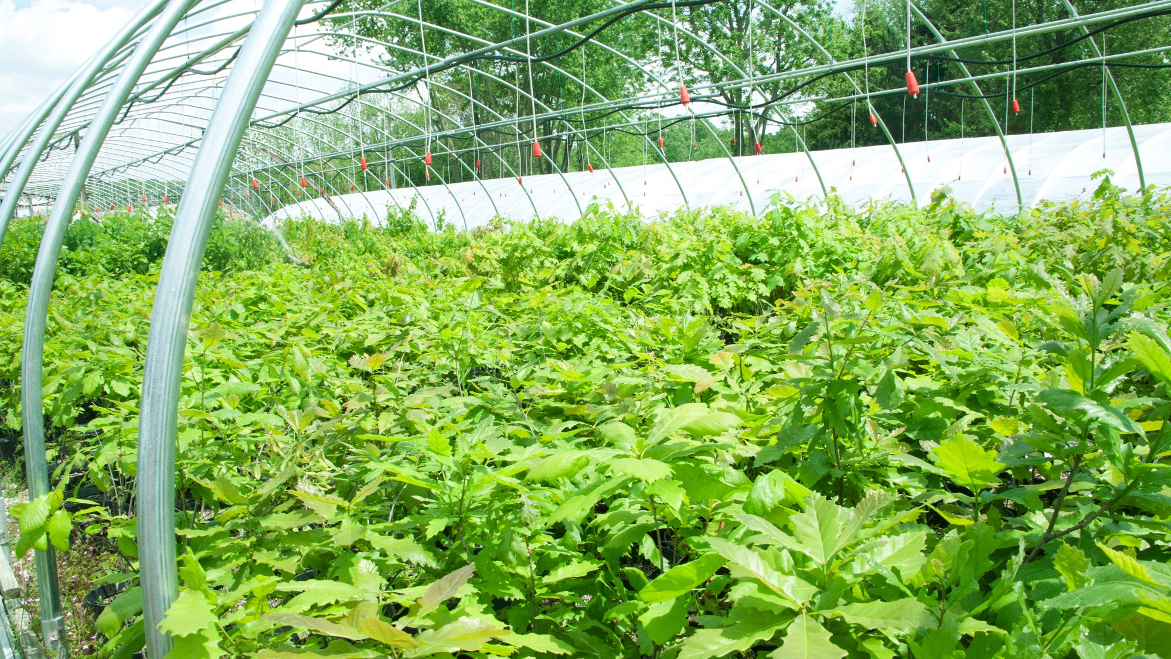
Photo Courtesy of Octoraro Native Plant Nursery
Increase Supply =
+ Economic Impact
Notes:
Our partners rely on us most for 1 thing: TREES! This year we achieved one of our greatest goals in the strategic plan of our partnership: Forward contracting. This allows the Chesapeake Bay Foundation to place a down payment to nurseries to grow native trees specific to our conditions for planting in 2022. This gives us bulk pricing as well as greater controls on species and growing conditions. We have spent much of our time in 2020 working with growers and vendors to source native trees through a rigorous request for proposal process.
We look for growers with a variety of criteria including
They carry current inventory of Native PA trees & shrubs
Trees/Shrubs spend their entire lifecycle in PA and MD
Seeds sourced from regions in PA and Mid-Atlantic
Experience with similar large-scale growing contracts
Whether or not they have a Sustainability/Conservation Plan in Practice at their facility
Ability to comply to Federal Grant/CBF contract requirements
Financial Stability
In collaboration with our partnership’s Grower-Supply workgroup we learned that during the 2008 economic recession many nursery operations who had been around for generations ended up closing due to economic losses. During today’s uncertain economic time, the tree partnership is providing a valuable economic stimulus to an industry that has never fully rebounded from its 2008 losses.

Slide 9
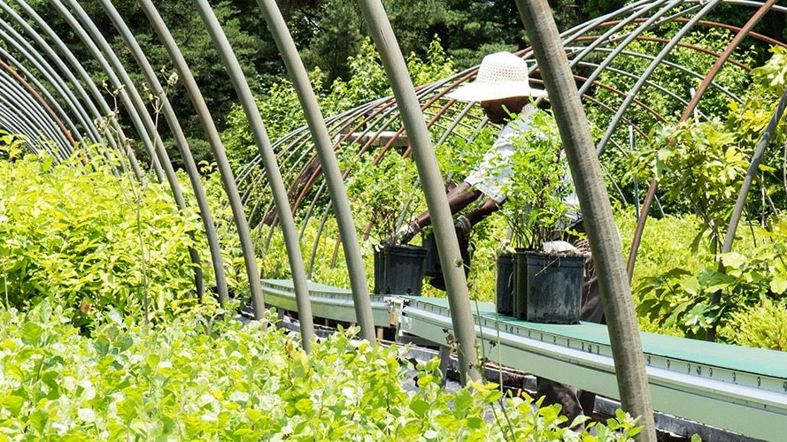
Workforce Development
Photo Courtesy of American Native Plants
Notes:
All growers that are contracting with CBF through the forward contract have expressed that the initial down payment they will receive for growing the 2022 trees will allow them to expand their operations including acquiring the necessary land. Some of that land is from defunct nurseries that have been dormant since the 2008 recession. This down payment also allows them to hire additional workforce to cover the increase in production. We have already seen one of our contracted nurseries, Aquatic Resources in York County, which had a 14.8% unemployment rate in April, post for new jobs on their website since being awarded a big from CBF. Pennsylvania had an unemployment rate of 15.1% in May 2020 so providing contracts to 4 nurseries in Pennsylvania for 2021 and 2022 tree contracts may make a difference.
This impact will have also an economic ripple effect because of supporting contractors who plant trees, maintenance contractors who maintain tree planting sites, logistics companies, and other related companies supporting reforestation in Pennsylvania.
Not to mention it gives us control over the quality of our trees and species selection including restoring the native tree palette of Pennsylvania.

Slide 10
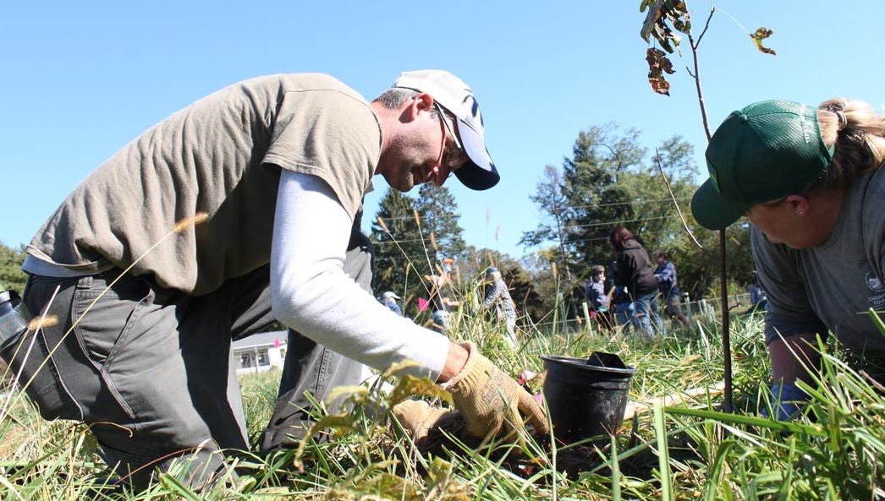
Increase Demand = Legacy Landowners
Notes:
Partners are the gatekeepers to landowners. They are the on the ground experts in their communities. When landowners reach out to the program we connect them with a CBF restoration staff or partner in their region. Their technical expertise is what is growing roots for the partnership to succeed in 2025 and to live on beyond. In each and every county of Pennsylvania landowners have different needs and expectations. Each of their properties may require a different approach and it’s the partners in those regions that know the services, intricacies and opportunities that may be available to these landowners.
We know that the same approach may not be appropriate for every landowner; and that is just some of the best value of the partners. They understand their communities, the issues that landowners face, and the needs they have. The free trees and supplies we provide are just some of the value we can bring to the package of services these partners offer. Sometimes we will offer catch match to grants in south central Pennsylvania towards projects that have a significant impact on the reduction of nutrient and sediment load on the bay, other times the trees and supplies the partnership provides will act as match towards other grants that partners are pursuing.

Slide 11
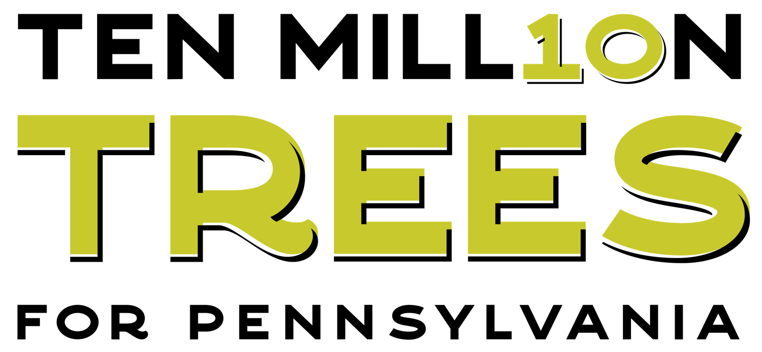

Marketing Campaign
Launching Winter 2021/2022
ANNOUNCING….
Photo Courtesy of https://billboardinsider.com/an-ooh-tribute-smokey-bear-turns-75/
Photo Courtesy of B. Sieglitz - CBF

Slide 12
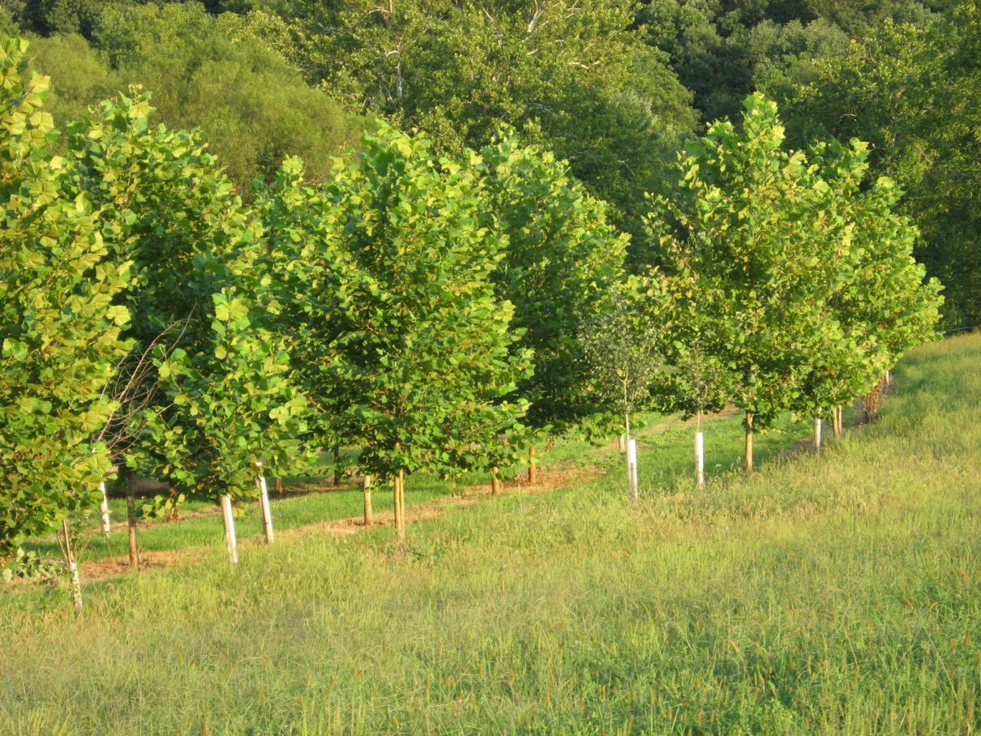

Site Prep, Maintenance = Stewardship
Planting a tree is a commitment;
it needs to be nurtured like any other living thing.
Photo Courtesy of B. Small - CBF
Notes:
Maintenance and stewardship is the number one focus of the partnership. Above and beyond planting 10 million trees we are focused on survival. Our largest investment besides trees continues to be in the tree shelters and stakes to support the trees in their first years planted in their new homes as well as innovative technology and programming that supports maintenance efforts to care for the trees to grow tall and strong decades into the future. That is just one of the reasons that the National Fish and Wildlife Foundation awarded us a grant which provides nearly $2million in investments to plant and maintain 360 acres of new trees in eight PA counties over the next 8 years. One of the key components of this grant is supporting workforce development efforts to train landscape professionals on buffer installation and maintenance. We want to ensure these businesses have the training they need to see these trees into the future.
Beyond this grant we continue to seek out partnerships with groups who have innovative technology to support monitoring tree planting progress and empowering landowners in the field to properly care for their tree planting sites. We know that when we empower landowners with the right tools and resources their tree planting sites can be much more successful. Following the right tree right place model, we also know that must transfer to the right landowner – and part of that model is making sure the landowner has all the resources they need.

Slide 13
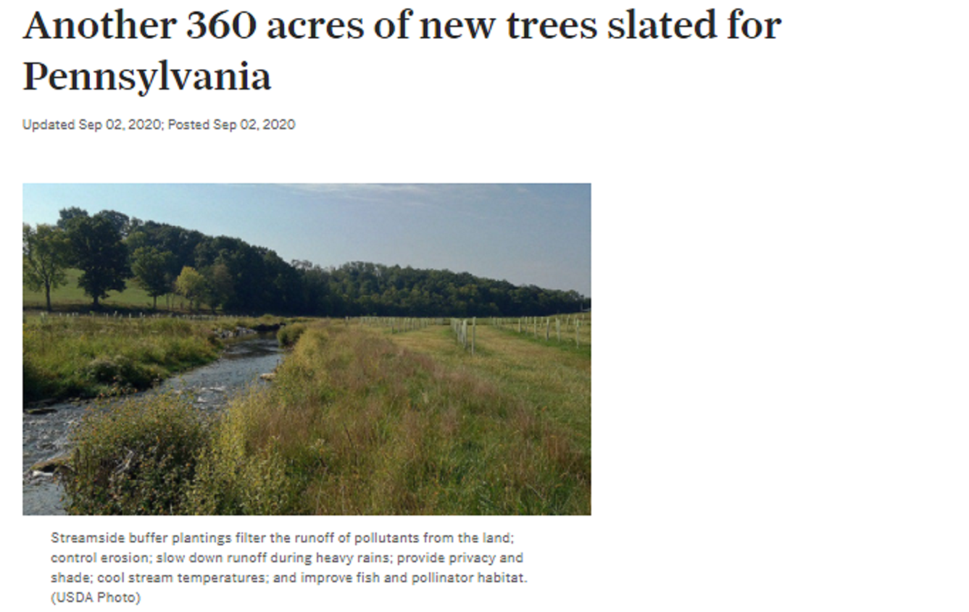
NFWF INSR Grant
Molly Cheatum Mcheatum@CBF.org
NFWF – CBF $2 MILLION INVESTMENT
Plant and maintain trees on 360 new acres
9 trained technicians to support outreach and education to 2400 landowners in Tier 1 + Tier 2 Counties in PA
Engage, train, and certify 15-20 PA based landscape professionals in buffer installation and maintenance
Testing a new buffer incentive with simulated property tax relief for each acre of buffer installed
Engage the Pennsylvania DCNR – DOC, Alliance for the Chesapeake Bay Correctional Conservation Corps in workforce development initiatives within maintenance contracts
Notes:
NFWF received a grant this year totaling $2million work-thanks Molly!

Slide 14
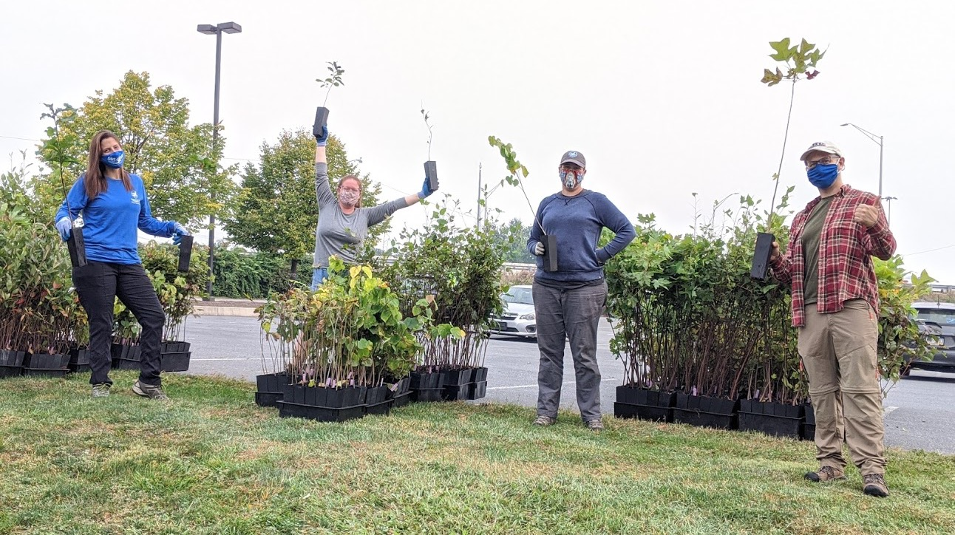

Public Health & Advocacy
Notes:
Penn State Health Patient Tree Giveaway
We know that this picture is our new normal but it’s still not normal. Trees are a core component to public health. We continue to have conversations with groups in the health sector about the intersection between environment and public health because we know, not just from numerous scientific studies, but from today’s pandemic, that environmental degradation is wreaking havoc on human health.
The cost of healthcare is not a small one and it is a cost that not every landowner can manage – particularly farmers. When a farmer plants trees in an approved riparian buffer zone through the partnership could they receive a health savings account to offset their healthcare costs? This is just one of the questions we are asking during our conversations with the health sector as we re-imagine how incentives for planting trees can work in a different structure than the traditional government systems like National Resource Conservation Service’s Conservation Reserve Enhancement Program. Our partners see a vision for landowners that includes these traditional programs but also has other options for landowners that allow for greater flexibility and combine the very things that these trees benefit: public health, air quality, water quality, climate change.
We are excited about exploring future studies with these health advocates. While we know everyone is inundated with the pandemic we also want to be forward thinking about how these trees and the ecosystem services they provide can be a value added as challenges like the pandemic arise in the future.

Slide 15
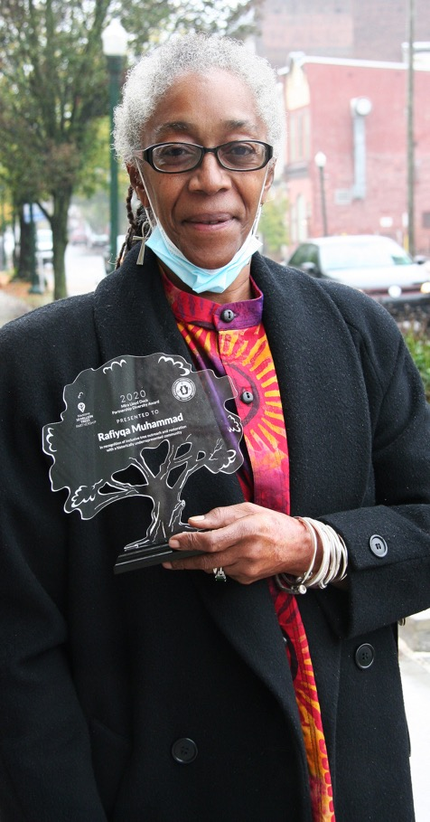
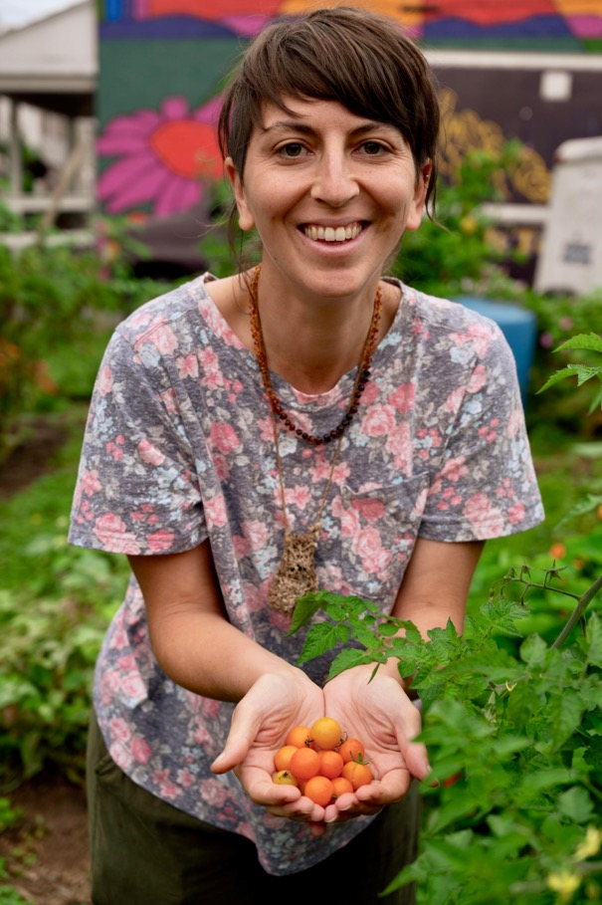
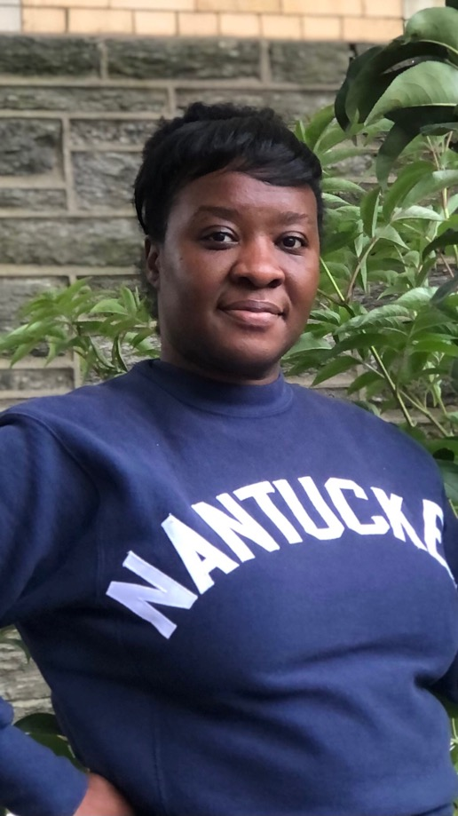
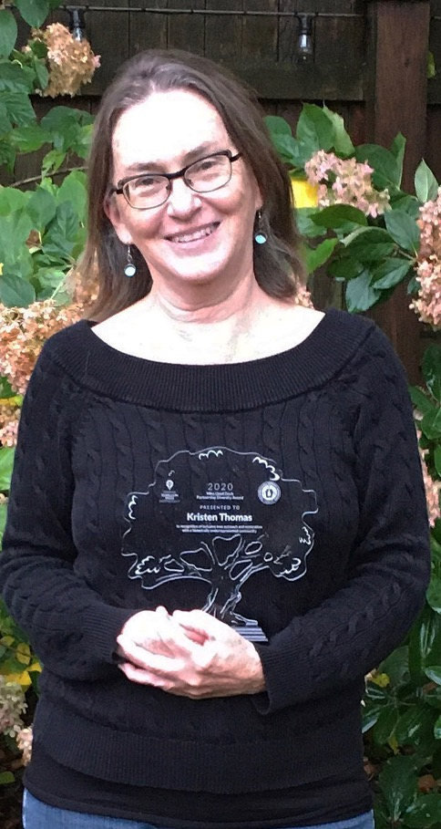
Mira Lloyd Dock Partnership Diversity Award
Notes:
This fall we awarded 2 more Mira Lloyd Dock Partnership Diversity awards – honoring partners working in tree restoration in under-represented areas in honor of the legacy of Mira Lloyd Dock who was a champion for urban beautification and forestry in PA.
2020 Awardees: Rafiyqa Muhammad city of Harrisburg in honor of her work in permaculture and planting rain gardens throughout the city - who will be using the $5,000 in trees and supplies to plant a memorial tree garden to honor victims of violence and covid
Kristen Thomas city of Lancaster in honor of her work through Lancaster Tree tenders and restoring the tree canopy in diverse parts of the city who will be using the funds to plant trees in empty tree wells in the NE section of the city.
2021 Awardees:
Kiasha Huling from UC Green
Shauna Yorty from the City of Lancaster
Thanks to Camera, Carla Johns, Molly Cheatum and Bill Chain who all were part of the committee.

Slide 16
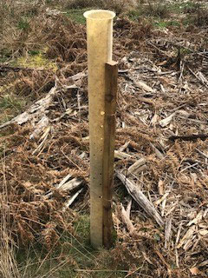

Evergreen Goals
Shelter Recycling/ Returns
Biodegradable Tree Shelters
Tree Container Recollection Program
Stewardship Volunteers
Maintenance Innovation
Healthcare Initiatives
5 – Year Fully Biodegradable Tree Shelter
Photo Courtesy of LCSWMA

Slide 17

Thank You!
Questions
Brenda Lee Sieglitz
Keystone 10 Million Trees Partnership Manager
Chesapeake Bay Foundation
1426 North 3rd Street Harrisburg, PA 17102
Direct: 717.769.4141
Fax: 717.234.9632
http://www.tenmilliontrees.org
Bsieglitz@CBF.org
Photo Courtesy of LCSWMA
Notes:
The partnership is thriving because of its name: partners. We are rooted together in success through our shared goals, holding one another accountable, and we are grateful that we can provide the coordination and financial backing for this effort. We bring together tough, honest, transparent conversations between our partners and landowners in hopes of finding mutual ground to not only plant trees but to grow relationships.
I’m happy to talk through any questions you may have

