Slide 1
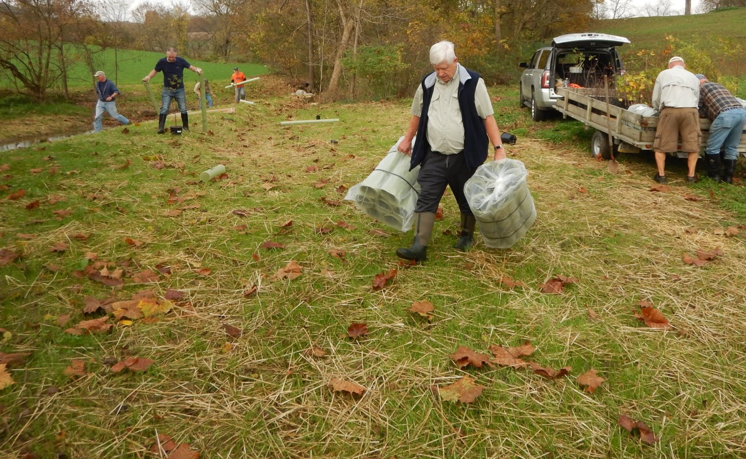

Clean And Clear By 2040
Operating with a bias towards action
Photo: Donegal Trout Unlimited at Clean Water Fund project site

Slide 2
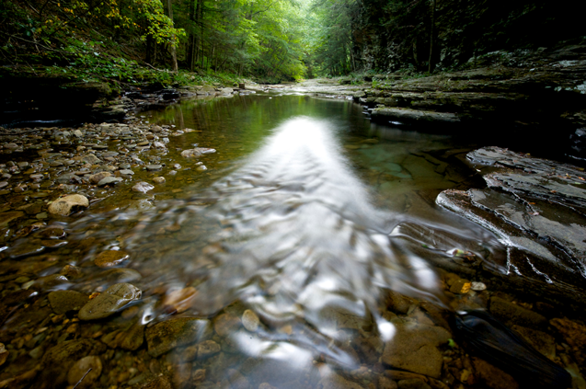

Pennsylvania’s State Constitution states
“the people have the right to clean air, pure water, and to the preservation of the natural, scenic, historic and esthetic values of the environment.”

Slide 3
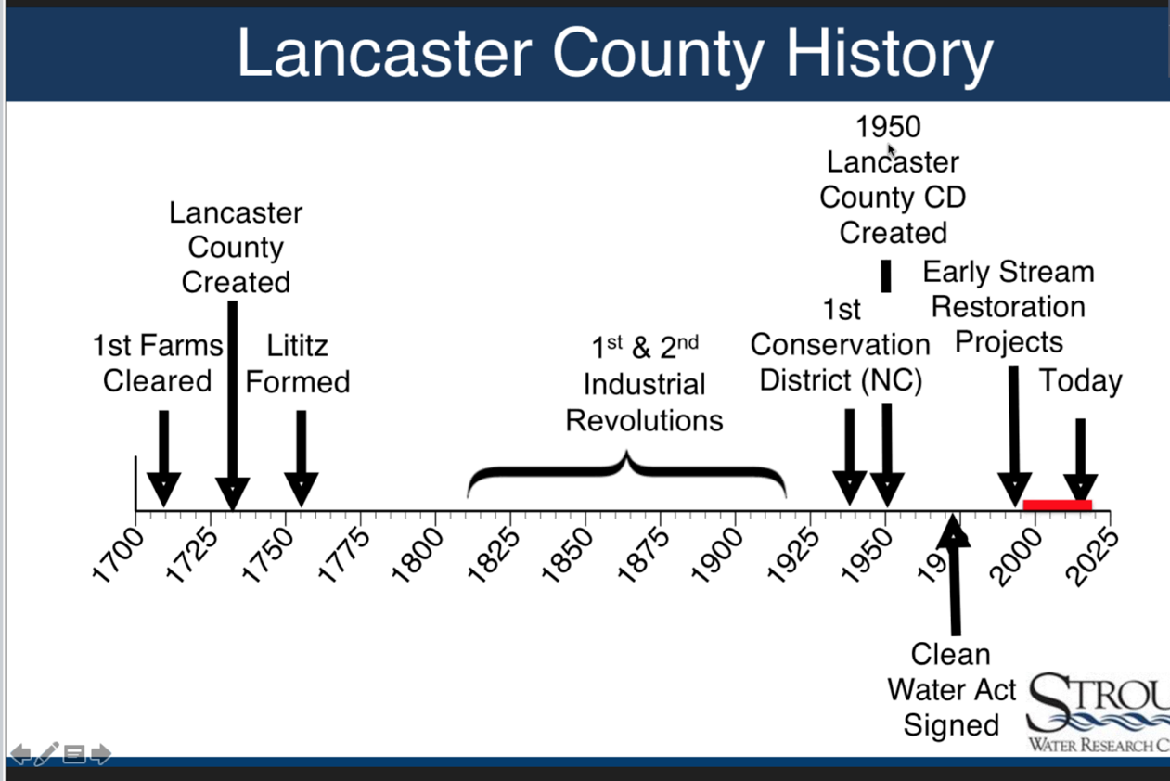


Slide 4
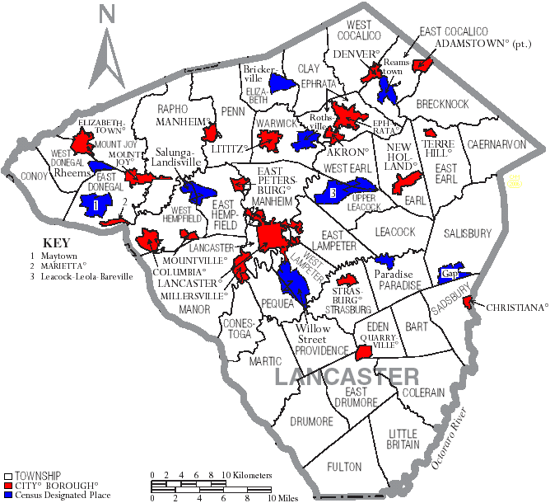
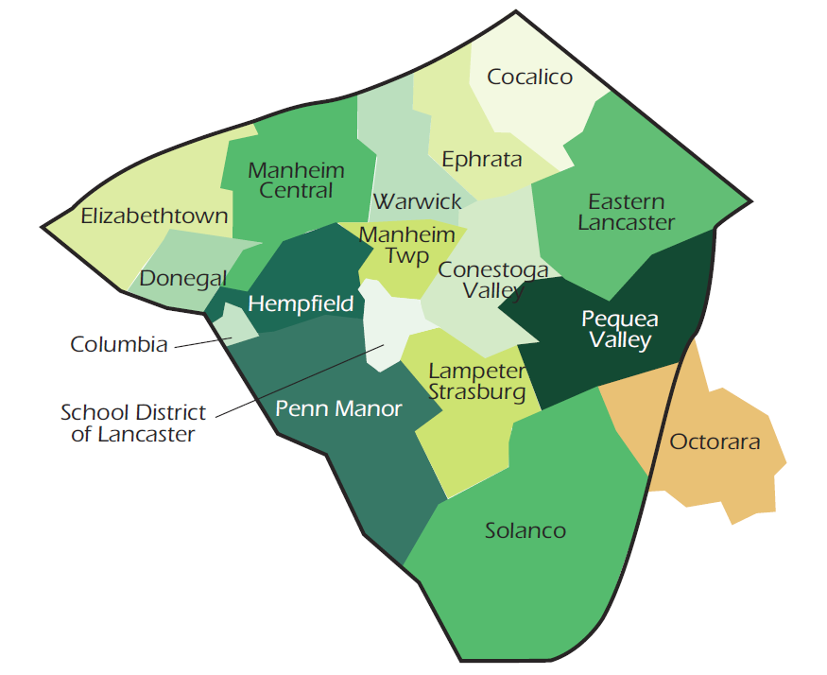
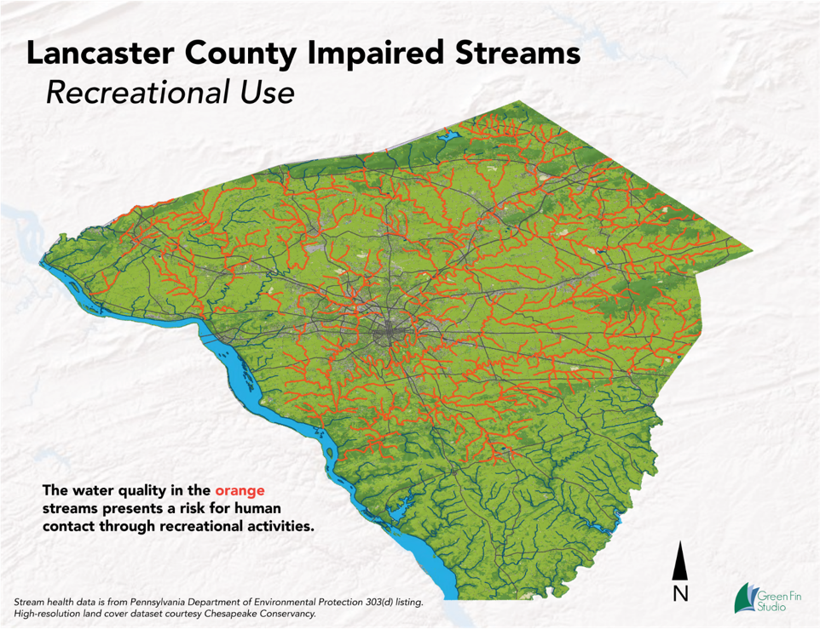

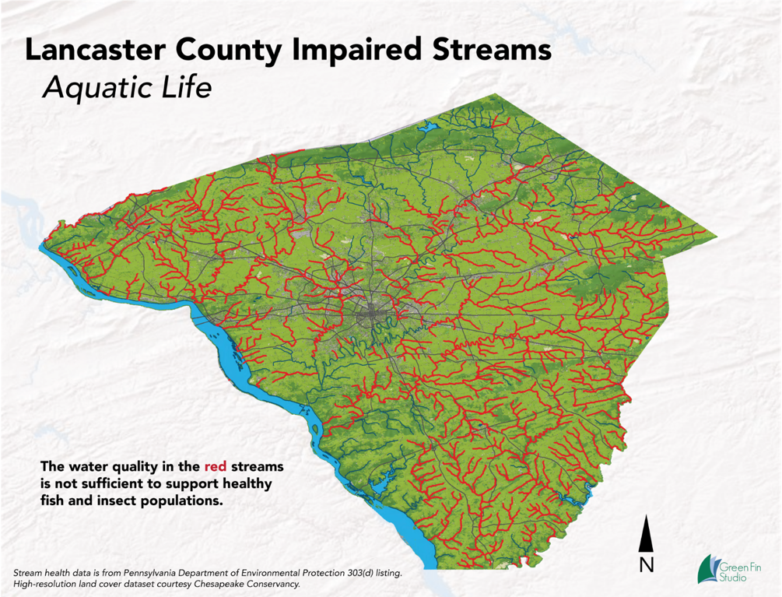
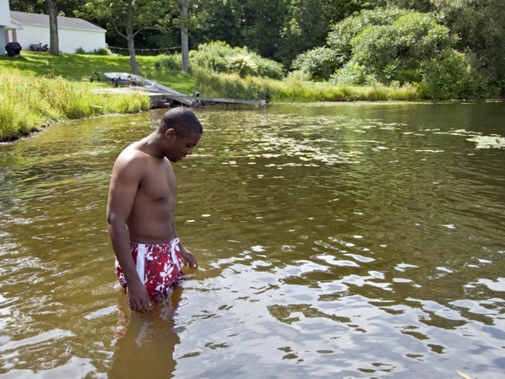

Slide 5

Problem & Solution
Problem
More than half of Lancaster County’s 1,400 miles of streams are impaired.​
Lancaster County streams have the highest amount of nitrogen, phosphorus, and sediment in monitored areas of the Chesapeake Bay Watershed. ​
Solution
Build and sustain a local multi-sector collaboration, supported by a strong backbone organization, to advance a community-led Common Agenda toward a shared result.
Notes:
January 2020 retreat discussions included a need to focus on de-listing streams as a desired outcome. The Bay will benefit but it’s what Lancaster County will notice as a quality of life improvement

Slide 6
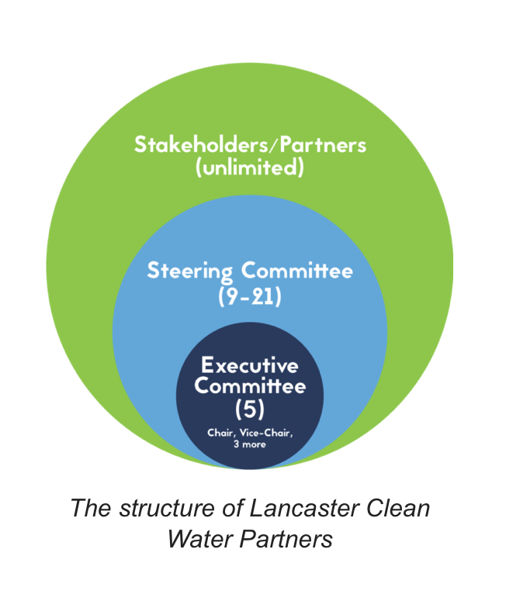
The Lancaster Clean Water Partners
Collective Impact Approach
The commitment of a group of organizations from different sectors to a common agenda for solving a specific social problem, using a structured form of collaboration.
We bring together strong leaders from diverse backgrounds under one common vision:
Clean and clear water in Lancaster County by 2040!

Slide 7
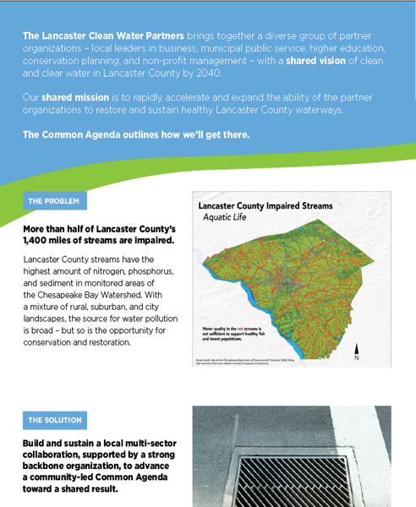

Common Agenda
A shared vision of clean and clear water in Lancaster County by 2040.
Our shared mission is to rapidly accelerate and expand the ability of the partner organizations to restore and sustain healthy Lancaster County waterways.
The Common Agenda outlines how we’ll get there.
Problem
Solution
Priorities
Strategies
Progress indicators
Shared values

Slide 8
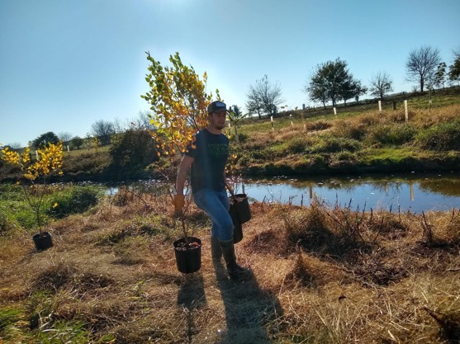
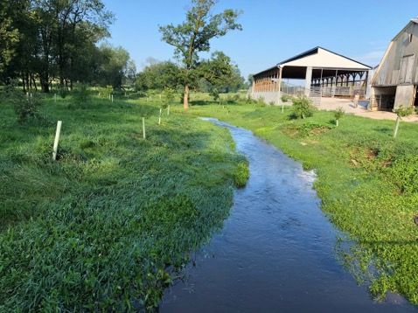
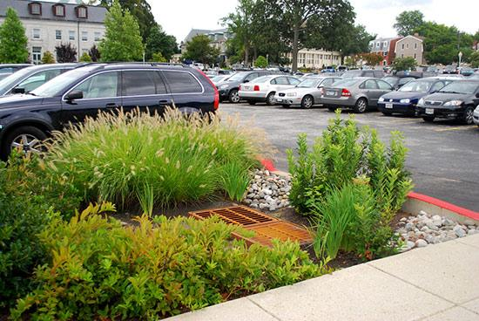
Priorities
Example: Scaled use of sustainable, proven and promising practices (BMPs) at adequate levels for rapid success with the Lancaster Countywide Action Plan (CAP)

Slide 9

So the Progress Indicators Reflect the Revisions
BMPs in place for 7.14 million pounds of nitrogen reduced by 2025
BMPs in place for 540,000 pounds of phosphorus reduced by 2025
BMPs in place for 222.7 million pounds of sediment reduced by 2025
Net reduction of impaired streams to 350 miles by 2030
75% of adult county residents familiar with the issue, supportive, and actively engaged personally

Slide 10
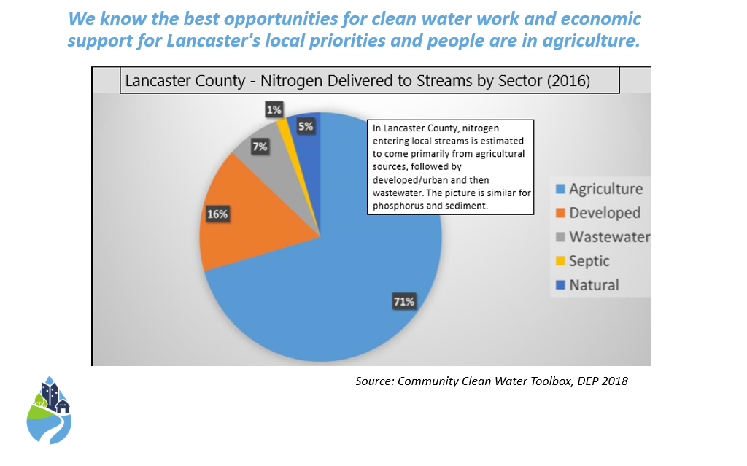
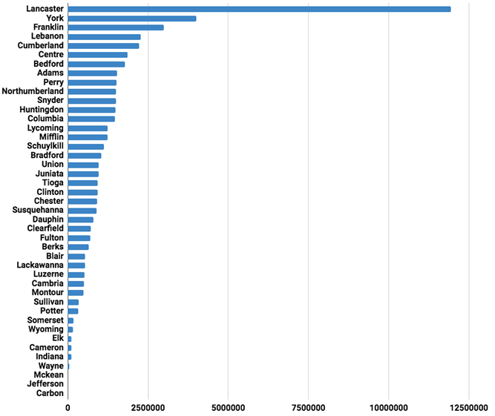
CAP Opportunity

Slide 11



Lancaster County’s CAP Coordinator Team
The Lancaster Clean Water Partners is the lead entity along with the Conservation District.
CAP Coordinator Team includes
Mike LaSala
Laurel Etter Longenecker
Jeff Swinehart
Jeb Musser
Gordon Hoover
Joellyn Warren
Charity Burkholder

Slide 12
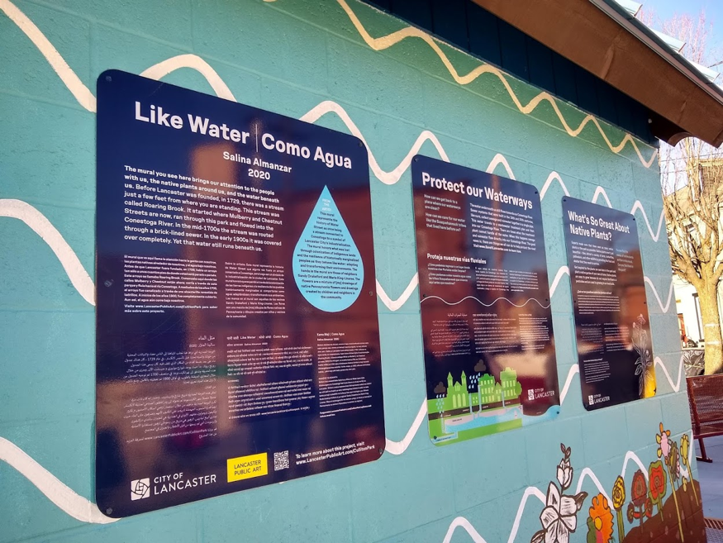
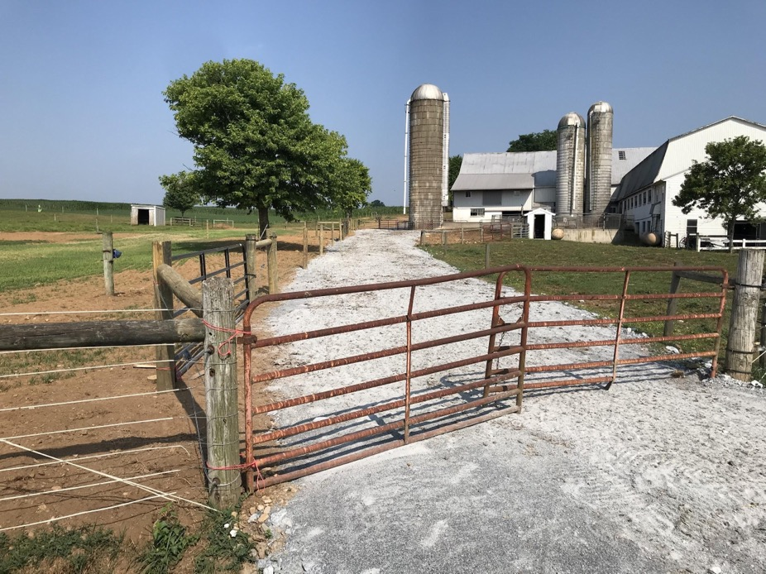
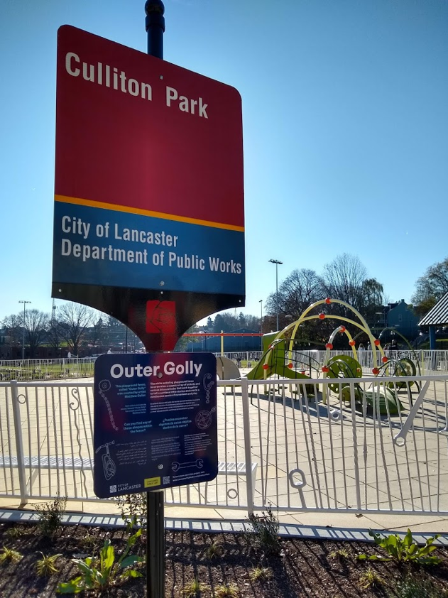
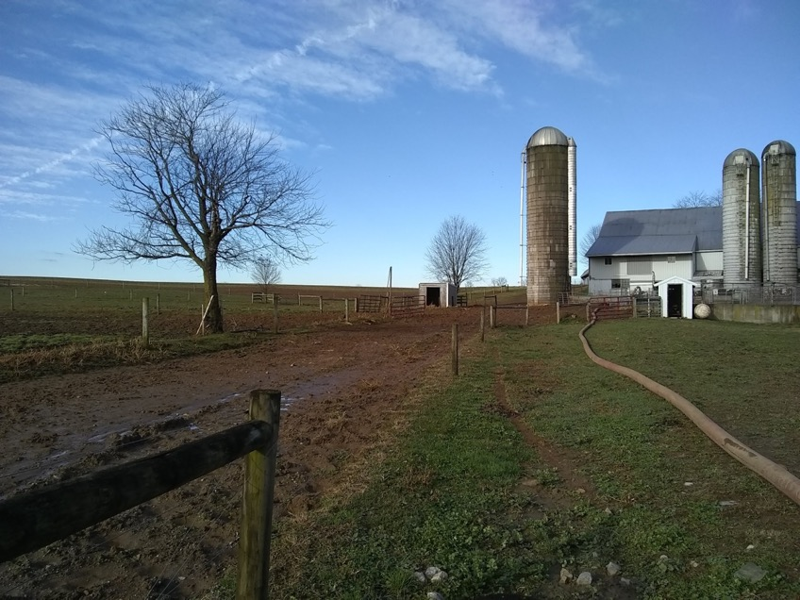
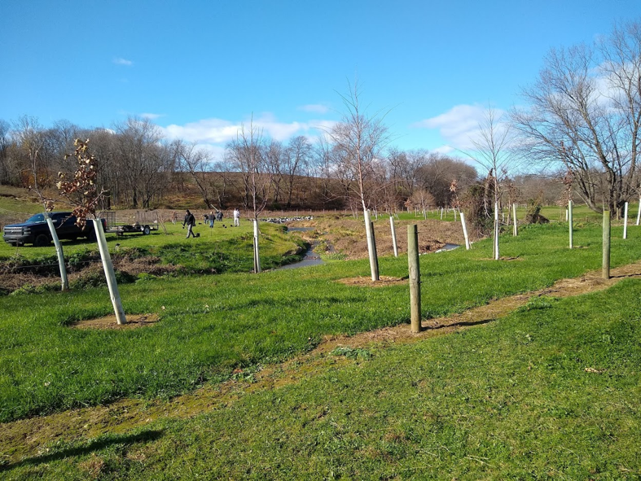
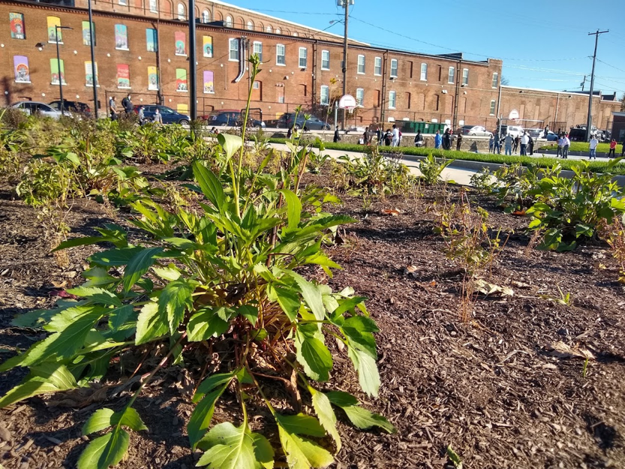
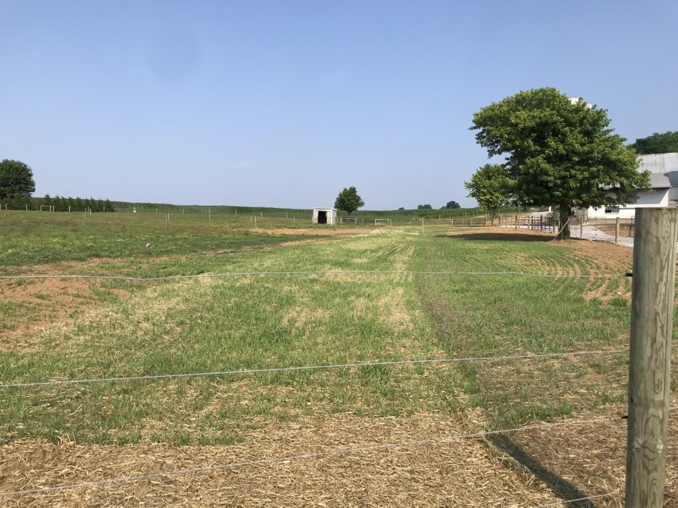

CAP Implementation Projects - $2.7 million
Murry Ridge Park Green Infrastructure Improvements
Paradise Township Vegetated Swale
Maximum Impact: BMP Implementation on a Strategic Farm in East Lampeter Township
Glick/Fishing Creek Stream Tributary Restoration and Buffer Installation
Lancaster City Street Tree Planting
Lancaster City Green Infrastructure Retrofit - Culliton Park
Woerth It Hollow farm
Read these success stories on our website!

Slide 13
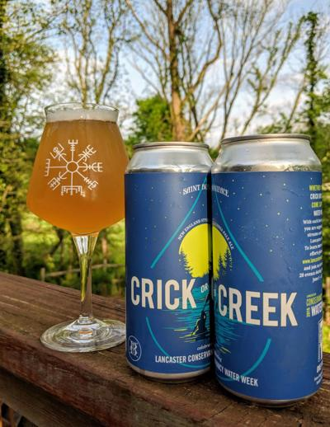
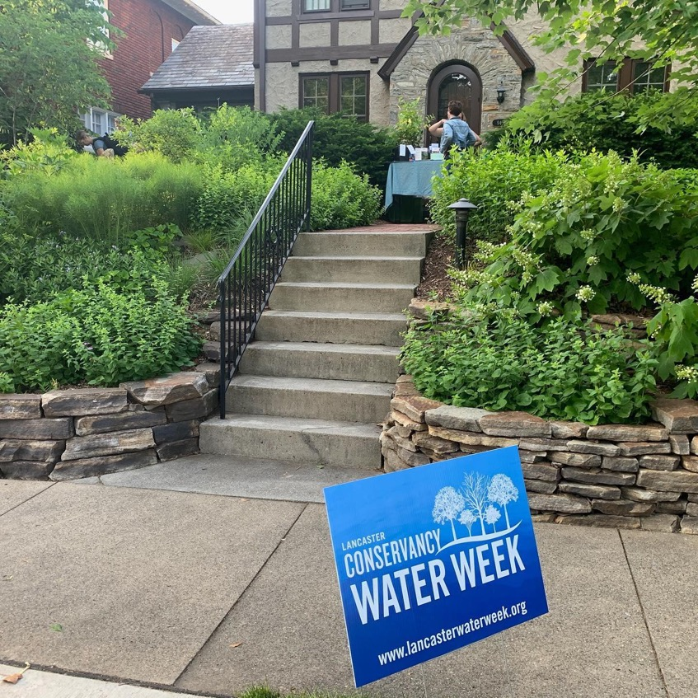

Slide 14
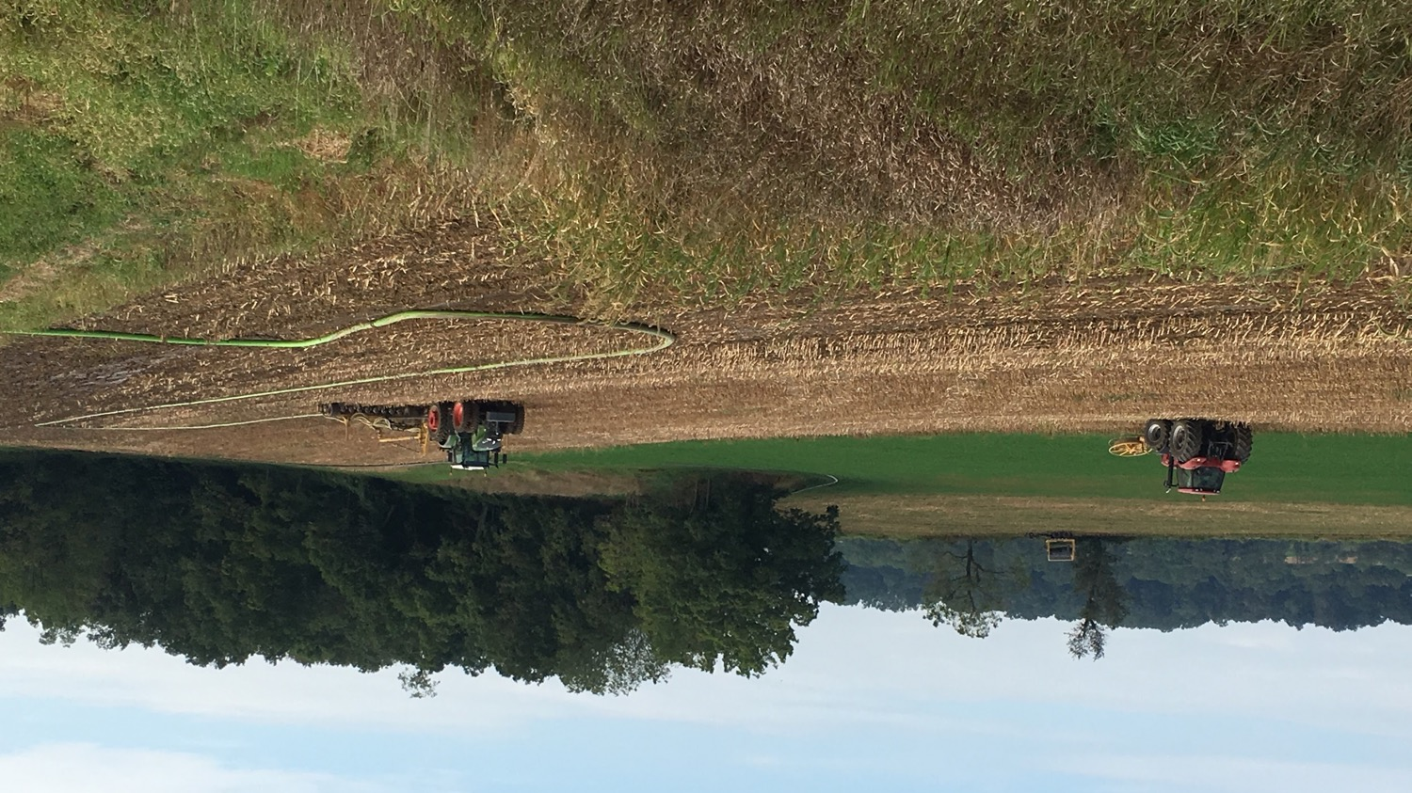
Farmers using a dragline to inject dairy manure after harvest to conserve nutrients. Cover crops are planted after manure is injected to retain nutrients and control soil erosion. Expanding these practices are part of our CAP.

Slide 15
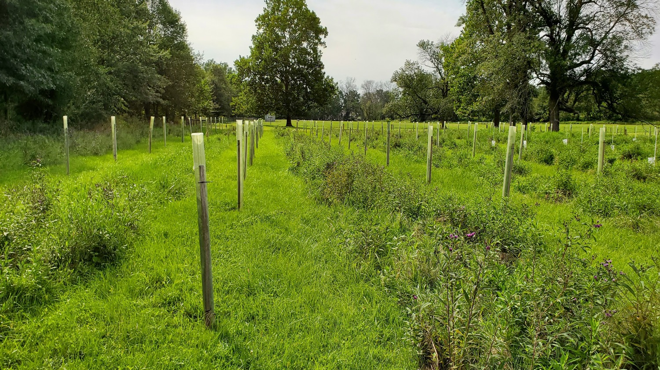
Well-maintained buffer on farmland along Big Beaver Creek.

Slide 16
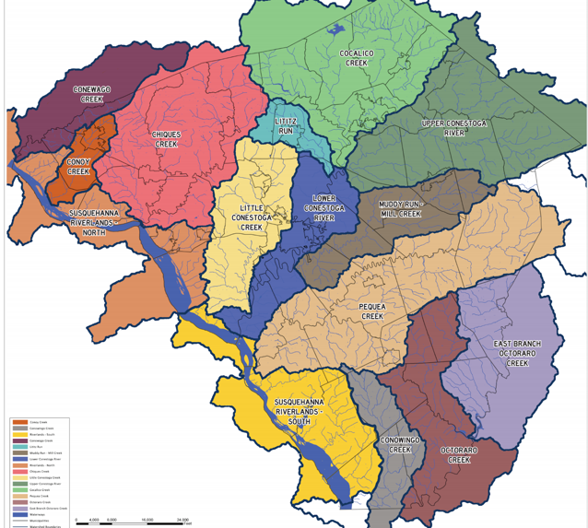
2021 - 2022 Goals
Sustainable restoration of priority streams through regional collaboration and watershed approaches
Stream de-listing strategy serves as anchor
  Operate with an entire catchment in mind
  Pair up the best funding with the most appropriate project so we can have a bigger impact with dollars we have
Track implementation and verify BMP by BMP
Better use of the weekly pre-application meeting
MS4 feedback to shape the next permit
Action Team work overlapping in ways to address monitoring needs, local land use issues, and Places2040 integration

Slide 17
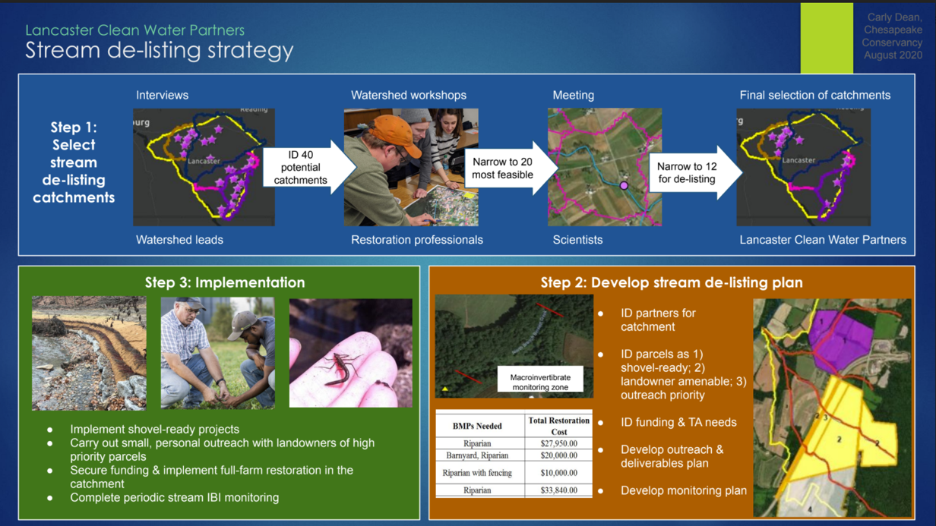
Revised Priorities
Sustainable restoration of priority streams through regional collaboration and watershed approaches
Stream de-listing strategy
Strategy serves as anchor for sustainable funding opportunities

Slide 18
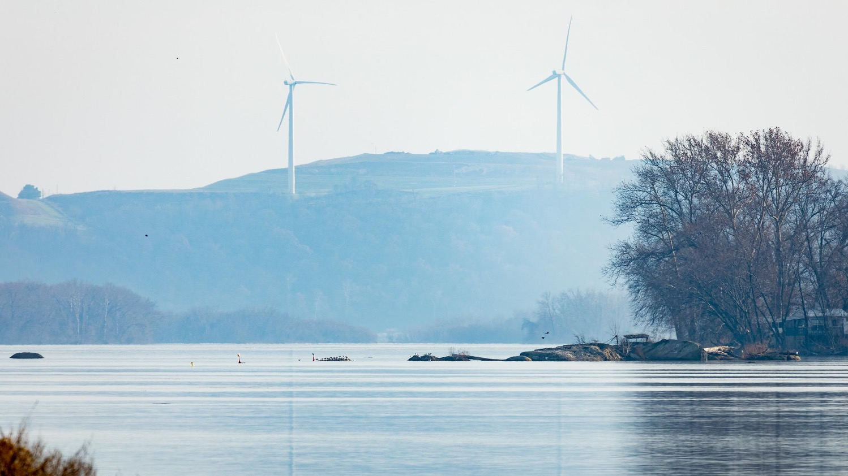
Q&A
Will Parson, Chesapeake Bay Program

