Slide 1

Chris Thompson District Administrator
Turning Red Stream Blue

Slide 2
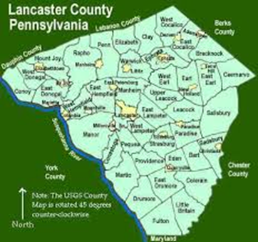
Lancaster County
County Stats:
944 Sq. Miles
Notes:
606,000 acres

Slide 3
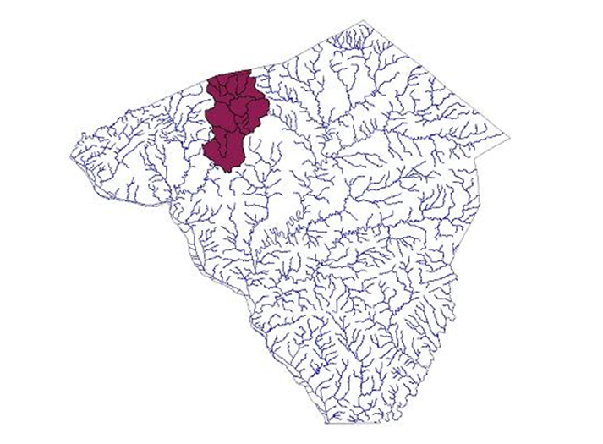
Lancaster County
County Stats:
944 Sq. Miles
1,400 miles of Streams
Notes:
Blessed with ample streams.

Slide 4
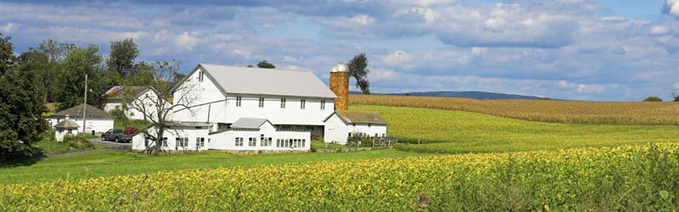
Lancaster County
County Stats:
944 Sq. Miles
1,400 miles of Streams
Notes:
The rich deep soils and abundant access to water is the bedrock of success for agriculture and industry. The diversity of the land of traditional farms and….

Slide 5
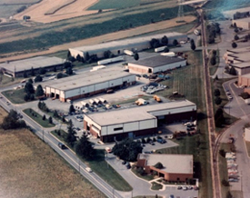
Lancaster County
County Stats:
944 Sq. Miles
1,400 miles of Streams
Notes:
The rich deep soils and abundant access to water is the bedrock of success for agriculture and industry.
The diversity of the land of traditional farms and….

Slide 6
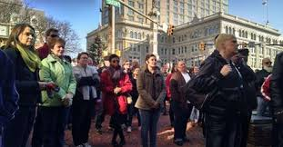
Lancaster County
County Stats:
944 Sq. Miles
1,400 miles of Streams
Population of 530,000
Notes:
That is also a mix of nationalities and cultures.

Slide 7
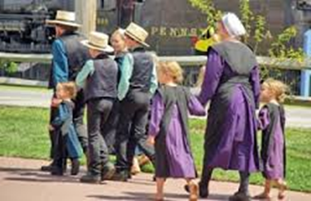
Lancaster County
County Stats:
944 Sq. Miles
1,400 miles of Streams
Population of 530,000
Notes:
That is also a mix of nationalities and cultures.

Slide 8
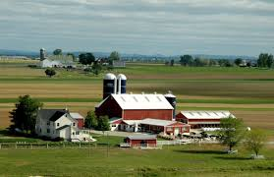
Lancaster County
County Stats:
944 Sq. Miles
1,400 miles of Streams
Population of 530,000
68% of the land or 425,400 acres is farmed.

Slide 9
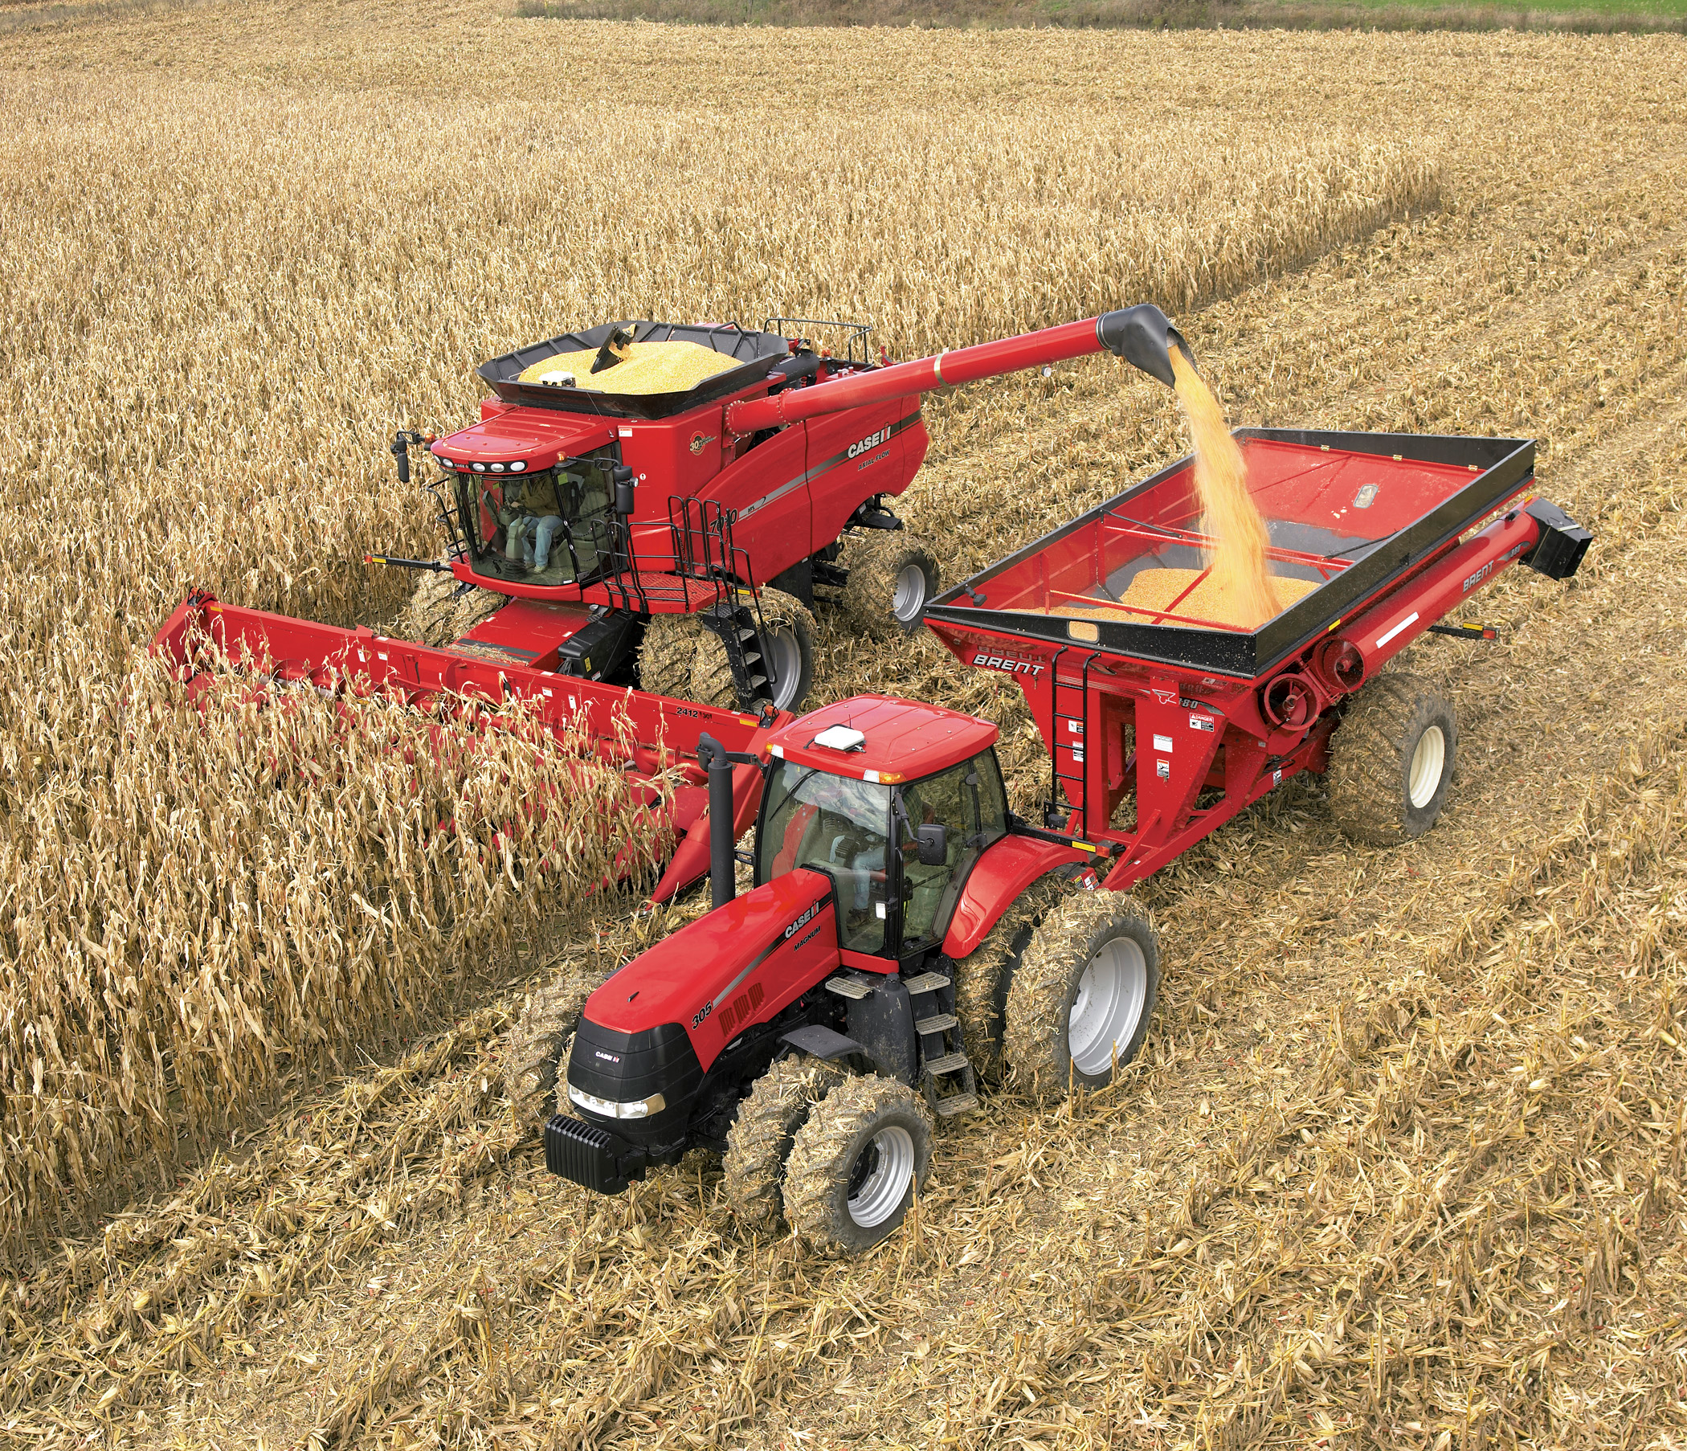
Lancaster County
County Stats:
944 Sq. Miles
1,400 miles of Streams
Population of 530,000
68% of the land or 425,400 acres is farmed.
5,500 Farms
Notes:
* 99% of the farms are family owned.
* Average size is 78 acres vs. state average of 124

Slide 10
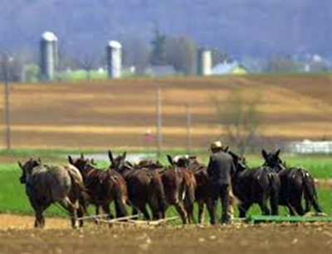
Lancaster County
County Stats:
944 Sq. Miles
1,400 miles of Streams
Population of 530,000
68% of the land or 425,400 acres is farmed.
5,500 Farms
$1.07 Billion
Notes:
½ of the farms in lancaster are owned by the Amish.

Slide 11
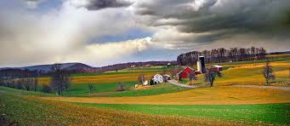
Lancaster County the Land of Opportunity
Notes:
Whether it is the beauty of the land…

Slide 12
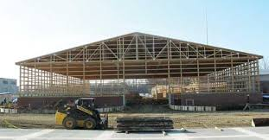
Lancaster County the Land of Opportunity
Notes:
…the business and economic advantages….

Slide 13
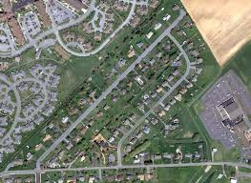
Lancaster County the Land of Opportunity
Notes:
…….This is a place of opportunity where people want to work, live and raise a family.
With that opportunity comes a responsibility…..to take care of the natural resources that have made it all possible.
We need to be good stewards of the county’s natural resources.

Slide 14
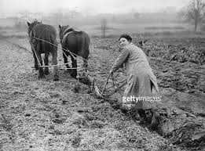
Conservation District 101
Notes:
Back in the turn of the century we learned that past practices don’t always make for a successful future.
Learned from our past.

Slide 15
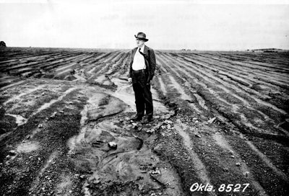
Conservation District 101
Notes:
Back in the turn of the century we learned that past practices don’t always make for a successful future.
Learned from our past.

Slide 16
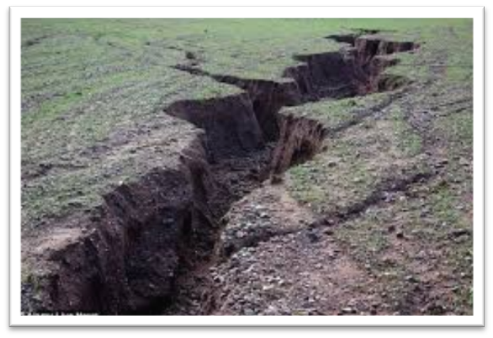
Conservation District 101
Notes:
Back in the turn of the century we learned that past practices don’t always make for a successful future.
Learned from our past.

Slide 17
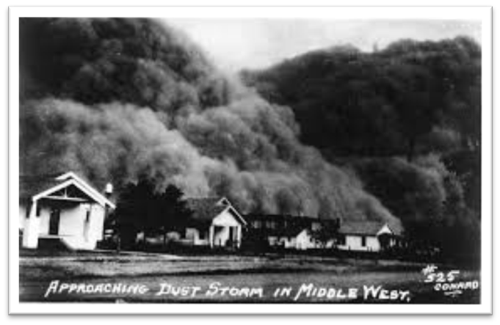
Conservation District 101
Notes:
Back in the turn of the century we learned that past practices don’t always make for a successful future.
Learned from our past.

Slide 18
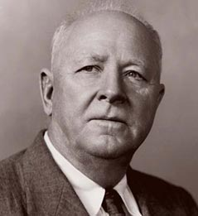
Conservation Districts 101
Hugh Hammond Bennett
April 15, 1881 – July 7, 1960
Notes:
How many of you have ever heard of Hugh Hammond Bennett?
He is the father of Conservation Districts as we know them today.
Bennett possessed the energy and single-mindedness of an evangelist in his promotion of soil conservation.

Slide 19
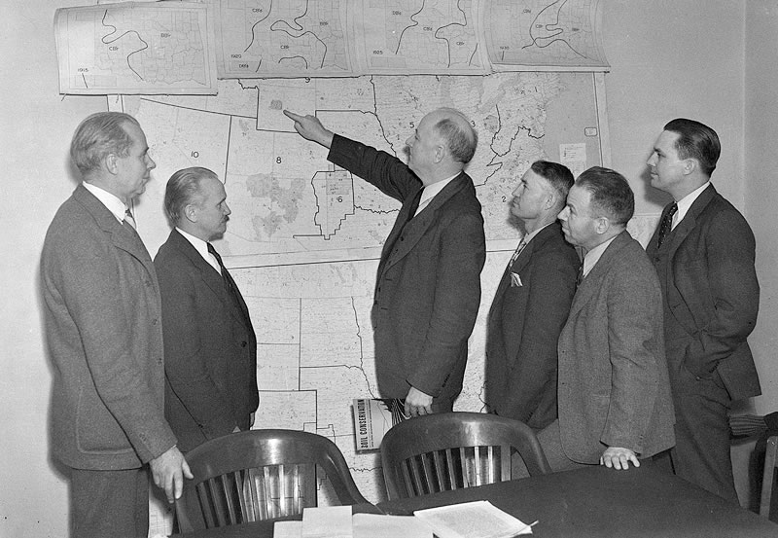
Conservation Districts 101
Hugh Hammond Bennett
April 15, 1881 – July 7, 1960
1928 Wrote: Soil Erosion: A National Menace.
Notes:
As Chief of the newly formed Soil Conservation Service (SCS) Bennett visualized that if the Soil Conservation Service was to be effective, it must be locally lead and have grass roots support.
Bennett laid the foundation for the establishment of the local soil conservation districts with locally elected officials to guide the program and Soil Conservation Service employees to provide the technical support.

Slide 20
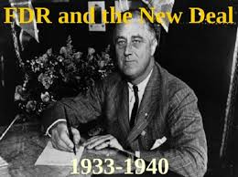
Conservation District 101
In 1933, FDR gave
$5 million to test and prove soil conservation practices could make a difference.
Notes:
During the “Dirty 30s” …… Sever drought had gripped the west and Bennett convinced President Roosevelt that current farming practices were a major cause of the dust storm problems.
In 1933, Using New Deal Funds FDR gave Bennett $5 million to establish Soil Experimental Stations to test and prove soil conservation practices could make a difference.

Slide 21

Conservation District 101
On June 22, 1937
the CLEAN STREAMS LAW was passed seeking to preserve and improve the purity of our local waters.
Notes:
Soon after that PA passed its own laws recognizing the importance of Conservation.
1937 Clean Streams Law not only to prevent further pollution of the waters of the Commonwealth granted the state the powers and duties and the ability to charges fees and permits to complete this mission.
To preserve and improve the purity of the waters of the Commonwealth for the protection of public health, animal and aquatic life, and for industrial consumption, and recreation;

Slide 22
Conservation District 101
On June 22, 1937
the CLEAN STREAMS LAW was passed seeking to preserve and improve the purity of our local waters.
On May15, 1945 Act 217 the CONSERVATION DISTRICT LAW was passed designating Conservation Districts as the primary local governmental unit responsible for the conservation of our natural resources.
Notes:
Soon after that PA passed its own laws recognizing the importance of Conservation.
1937 Clean Streams Law not only to prevent further pollution of the waters of the Commonwealth granted the state the powers and duties and the ability to charges fees and permits to complete this mission.
To preserve and improve the purity of the waters of the Commonwealth for the protection of public health, animal and aquatic life, and for industrial consumption, and recreation;

Slide 23
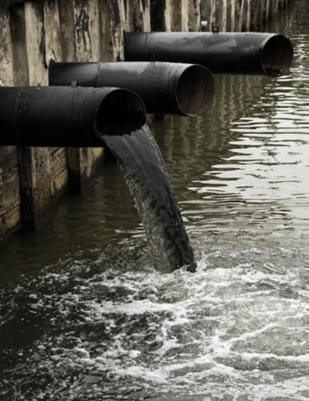
Conservation District 101
Notes:
Industry has also had to learn from the past….

Slide 24
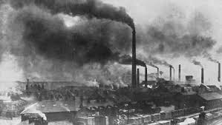
Conservation District 101
Notes:
Air and water pollution generated by our thriving industries led to …

Slide 25
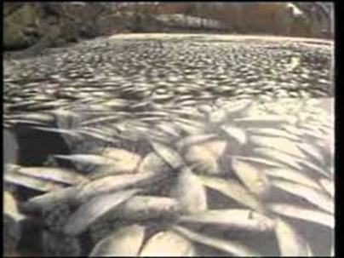
Conservation District 101
Notes:
Massive fish kills and …

Slide 26
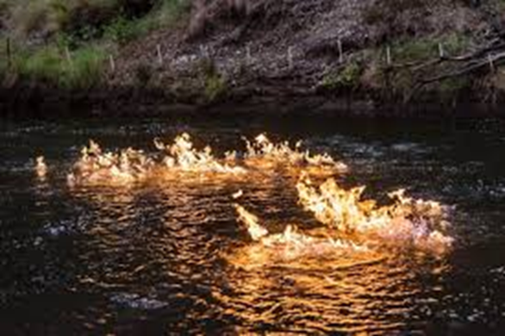
Conservation District 101
Notes:
Rivers on fire…. Cayuga River 1969.
No more will we tolerate the wasteful abuse of our natural resources.

Slide 27
Conservation District 101
May 18, 1971 Article I, Section 27
was added to the Pennsylvania Constitution.
“The people have a right to clean air, pure water, and to the preservation of the natural, scenic, historic and esthetic values of the environment.”
Notes:
In 1971, the Pa legislature added Section 27 to Article 1 Stating that the People have the right to…

Slide 28



PENNSYLVANIA’S STRATEGY
2016 REBOOT
To Enhance Restoration Efforts
Notes:
* Fast forward to today….
* The environment is much better, but there is still a lot of work to be done.
* January of 2016, PA Depts of …launched a Reboot effort to get all of Pennsylvania back on track.
First phase is to ensure that all farms have the required management plans (Ag E&S and a Manure Management Plan)

Slide 29

PENNSYLVANIA’S STRATEGY
5 year plan to verify all farms have the required management tools:
Ag Erosion and
Sedimentation
Control Plan.
Manure Management Plan.
2016 REBOOT
To Enhance Restoration Efforts
Notes:
Subjecting farmers to a law that was in place since 1985.
I support the greater emphasis on cleaning up our creeks streams and waterways, but……
Creating the Culture of Compliance is now being translated that all Farmers are Guilty until proven incent.
We need to change the discussion.

Slide 30

PENNSYLVANIA’S STRATEGY
What does this mean for Lancaster?
Notes:
Lesson from a visit with Amish leadership…..

Slide 31
PENNSYLVANIA’S STRATEGY
What does this mean for Lancaster?
What are the goals?

Slide 32
PENNSYLVANIA’S STRATEGY
What does this mean for Lancaster?
What are the goals?
What are the tools to accomplish the goals?

Slide 33
PENNSYLVANIA’S STRATEGY
What does this mean for Lancaster?
What are the goals?
What are the tools to accomplish the goals?
How do we measure success?

Slide 34
Lancaster County
County Stats:
944 Sq. Miles
1,400 miles of Streams
Notes:
Remember this slide?

Slide 35
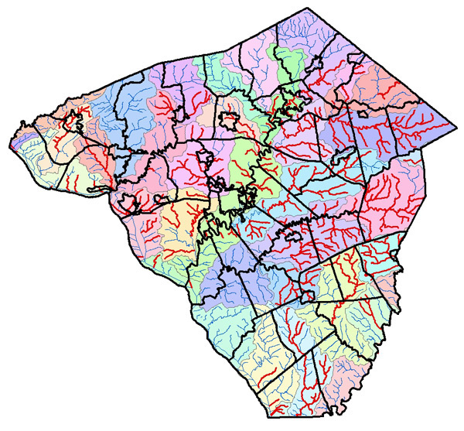
Lancaster County Turning Red Streams Blue
County Stats:
944 Sq. Miles
1,400 miles of Streams.
About ½ impaired.
Notes:
Turning Red Streams Blue

Slide 36
Lancaster County Turning Red Streams Blue
Steps Forward
1. Education and Outreach
Notes:
Turning Red Streams Blue
1. Education and Outreach to communicate the local and regional goals and objectives.
2. Technical & Financial Assistance are the tools to accomplish the goals.
3. Employ Effective Enforcement

Slide 37
Lancaster County Turning Red Streams Blue
Steps Forward
1. Education and Outreach
2. Technical & Financial
Assistance
Notes:
Turning Red Streams Blue
1. Education and Outreach to communicate the local and regional goals and objectives.
2. Technical & Financial Assistance are the tools to accomplish the goals.
3. Employ Effective Enforcement

Slide 38
Lancaster County Turning Red Streams Blue
Steps Forward
1. Education and Outreach
2. Technical & Financial
Assistance
3. Measure Success and Employ
Effective Enforcement
Notes:
Turning Red Streams Blue
1. Education and Outreach to communicate the local and regional goals and objectives.
2. Technical & Financial Assistance are the tools to accomplish the goals.
3. Employ Effective Enforcement

Slide 39

Education & Outreach Changing the Conversation
Notes:
The new strategy focuses on Ag, but we need to expand the message to include all sectors…
In the 1970s, Iron Eyes Cody played an Indian shedding a tear about litter in one of the country's most well-known television PSAs, "Keep America Beautiful"

Slide 40
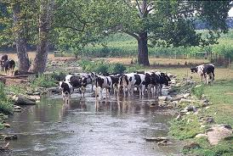
Education & Outreach Changing the Conversation
Notes:
A majority of Lancaster County Farmers are doing a good job!...We need to find a way to lift them up.
We also need to change the way we think about past practices…
Idyllic picture…

Slide 41
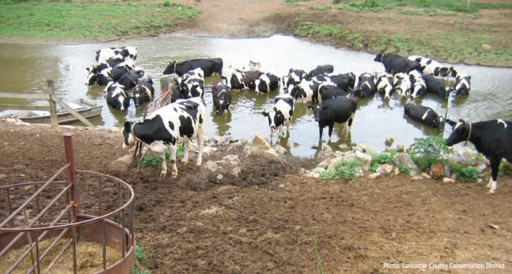
Education & Outreach Changing the Conversation
Notes:
Leads to exposed soil….

Slide 42
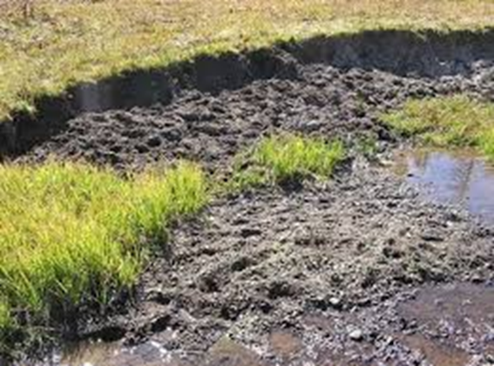
Education & Outreach Changing the Conversation
Notes:
Exposed soil leads to the potential for polution…

Slide 43
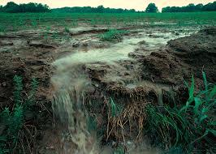
Education & Outreach Changing the Conversation
Notes:
Greater opportunity to pollute our local streams.

Slide 44
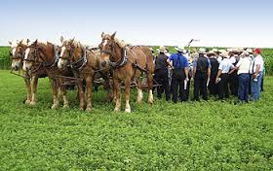
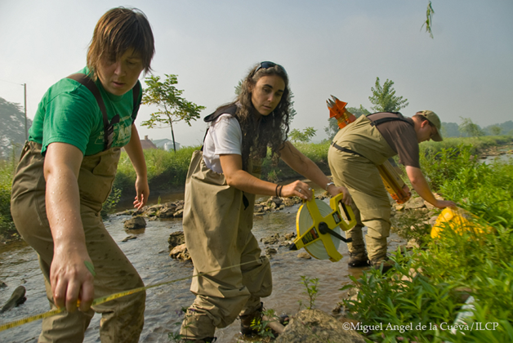
2. Technical & Financial Assistance
* Support Community Based
initiatives.
Notes:
Organized by

Slide 45

2. Technical & Financial Assistance
* Support Community Based
initiatives.
* Build capacity for tech services.
Notes:
Organized by

Slide 46

2. Technical & Financial Assistance
* Support Community Based
initiatives.
* Build capacity for tech services.
* Seek new private & public funds.
Notes:
Seek new private & public funds…..or alternative funding (incentives)

Slide 47

3. Measure Success and Employ Effective Enforcement
Quantify & Communicate current status.
Notes:
Organized by

Slide 48

3. Measure Success and Employ Effective Enforcement
Quantify & Communicate current status.
Utilize Targeting of resources.
Notes:
Organized by

Slide 49

4. Measure Success and Employ Effective Enforcement
Quantify & Communicate current status.
Utilize Targeting of resources.
Measure progress.
Notes:
Organized by

Slide 50

5. Measure Success and Employ Effective Enforcement
Quantify & Communicate current status.
Utilize Targeting of resources.
Measure progress.
Employ Enforcement.
Notes:
Organized by

Slide 51
Lancaster County Turning Red Streams Blue
WHY?
Notes:
Turning Red Streams Blue

Slide 52

Lancaster County Turning Red Streams Blue
WHY?
1. Leadership
Notes:
Turning Red Streams Blue

Slide 53

Lancaster County Turning Red Streams Blue
WHY?
1. Leadership
2. Ownership & Responsibility
Notes:
Turning Red Streams Blue

Slide 54
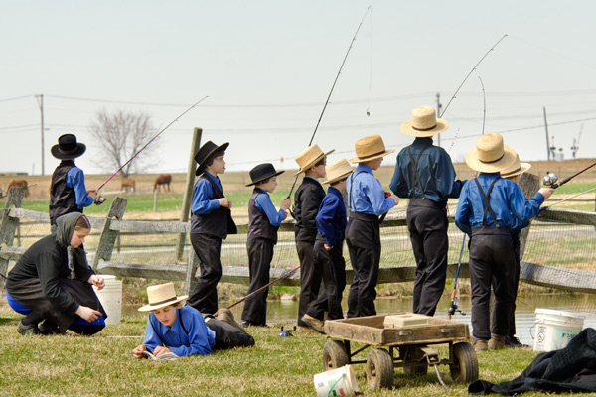
Lancaster County Turning Red Streams Blue
WHY?
1. Leadership
2. Ownership & Responsibility
3. Legacy
Notes:
Turning Red Streams Blue

Slide 55
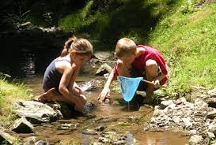
Lancaster County Turning Red Streams Blue
WHY?
1. Leadership
2. Ownership & Responsibility
3. Legacy
Notes:
Turning Red Streams Blue

Slide 56

Lancaster County Turning Red Streams Blue
WHY?
1. Leadership
2. Ownership & Responsibility
3. Legacy
Notes:
Turning Red Streams Blue

