Slide 1
DEQ Use of Volunteer Data
James Beckley

Slide 2
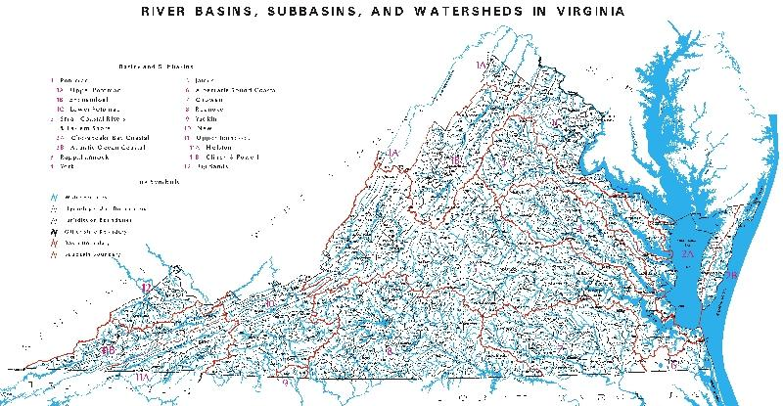
Virginia and DEQ
Virginia has >52,255 miles of rivers and streams
  116,364 acres of significant lakes and reservoirs
  2,684 square miles of estuaries
On average, DEQ monitors ~2,000 stations each year with an monitoring budget of $1 million

Slide 3
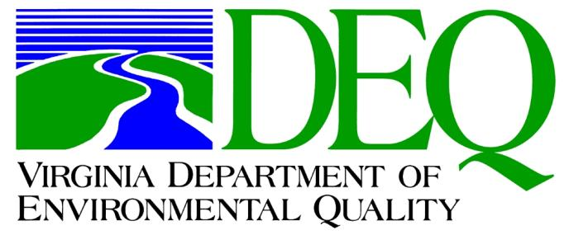
Since 1998 DEQ has actively partnered with citizen volunteer and other non-agency water monitors
In 2003 DEQ developed a QA/QC program to allow the agency to incorporate non-agency data to assess water quality
Continued support by DEQ is resulting in an unprecedented amount of quality data submitted to the agency
Notes:
1993- DEQ was formed from consolidating the much of the duties held by the Virginia Water, Air, and Waste Control Boards
Between 1998 and 2003, DEQ did not have a way to validate data submitted by citizen and other monitoring organizations. This was addressed in 2003 by the agency adopting a standardized protocol to review and validate data

Slide 4
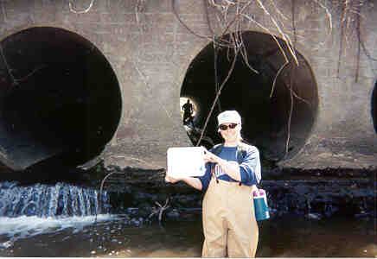
So Where Does This Data Come From?
% Stations Submitted
Citizen Volunteers 75.3%
Non- DEQ Govt.
Agencies 22.5%
Private Industry 1.4%
Academia* 0.8%
*Not already affiliated with a citizen group or under an analysis contract by DEQ
Notes:
Citizen volunteer provide the most data in terms of stations. While most of the data is benthic macroinvertebrate or field parameter (dissolved oxygen, pH, temp), several large groups do perform advanced bacteria and wet chemistry
DEQ is recently seeing increased interest by private industry such as wastewater treatment plants and coal mines to monitor upstream of their discharges and share that information with DEQ.
Colleges and universities are very active in environmental monitoring and often provide their laboratory services to volunteer groups or are under contract to perform specific analysis for DEQ such as fish tissue or PCB testing.

Slide 5
How DEQ Uses Submitted Data
Stream Assessment
Tracking
Rapid Response
Outreach
Education
305(b) assessment of stream health and 303(d) listing
Water quality improvement such as during TMDL implementation
Early detection of pollution events to help alert DEQ
Work with local communities in a positive way
Show the importance of water quality to the public

Slide 6

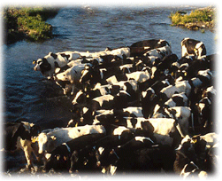
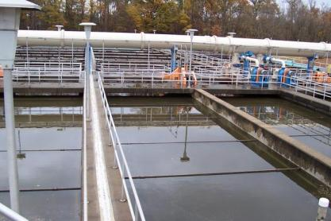
Ways DEQ Does Not Use Submitted Data
Submitted data is not used by DEQ for enforcement or similar “regulatory” actions
Data is not assessed if it was collected in permitted mixing zones or at discharge pipes
Submitted data not used by itself to develop TMDL Implementation Plans
Notes:
This is to protect the data submitter from legal challenges. DEQ always relies on data collected by agency staff using EPA approved protocols when performing enforcement actions or monitoring NPDES permitted discharges. Non-agency data may be combined with DEQ collected data to develop TMDL implementation plans if the data follows DEQ approved protocols (Level III) and agrees with the observations made by DEQ sampling.

Slide 7
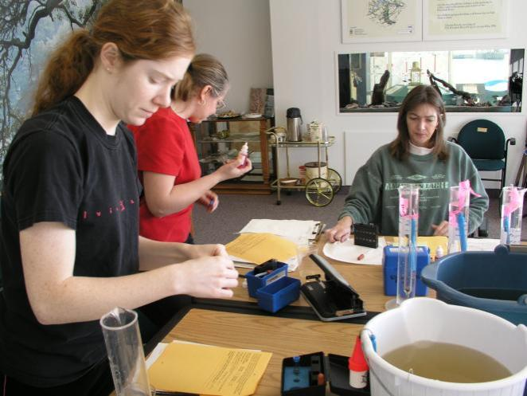
How DEQ Reviews Submitted Data
QA all submitted data
Groups encouraged to use DEQ approved protocols and Quality Assurance Project Plan (QAPP)
Laboratories must pass inspection
Data falls into one of three categories
Alliance for the Chesapeake Bay Member Recertification Event
Notes:
DEQ has two staff members who help perform these tasks.

Slide 8
Level I
QA/QC Protocols
Does not possess a DEQ approved QAPP or SOP
Monitoring and/or laboratory analysis does not follow DEQ protocols
Parameter not associated with a Virginia water quality standard
Uses
Education
Baseline Data
Pollution Red Flags
Local Land Use Decisions
Special Studies
Notes:
Level I data has proven helpful to DEQ. For example, several algae blooms were discovered by citizen volunteers using equipment as simple as a Secchi disk and litmus pH paper.
Virginia has not yet adopted a water quality standard for total nitrogen or total suspended solids in free flowing waters. However, this data is collected by DEQ and non-agency data from a DEQ recognized laboratory is helpful to the agency.

Slide 9
Level II
QA/QC Protocols
DEQ approved QAPP and SOP
Method may deviate from DEQ methods. (e.g. a method with a higher detection limit)
Field and/or laboratory audit required
Uses
All uses as stated in Level I
Assessed in the 305(b) report to determine waters of concern (Category 3C, 3D) to prioritize waters for DEQ follow-up monitoring
Notes:
Most of our non-agency data no longer falls into the Level II criteria anymore as many groups are using more advanced (Level III) protocols. The two exceptions to this is the Virginia Save Our Streams program which monitors for benthic macroinvertebrates by identifying macroinvertebrates to the Order level (DEQ is moving to Genus level). The second exception is the Coliscan Easygel method which is popular with many citizen volunteer groups. Coliscan is considered not as accurate as traditional laboratory methods but is effective in identifying bacteria ‘hot spots’ in TMDL waters.
Category 3C refers to waters that are of concern and are prioritized for DEQ follow-up sampling. This follow-up sampling usually occurs within two years of when the water was placed on the Category 3C list.
Category 3D refers to waters that are not of concern and these are not prioritized for follow-up sampling. However, DEQ is interested in identifying these waters as they may be pristine and the agency may seek protection from degradation.

Slide 10
Level III
QA/QC Protocols
DEQ approved QAPP and SOP
Follow approved methods (EPA, Standard Methods, USGS, etc.)
Field and/or laboratory audit required
Uses
All uses as stated in Level II
Assess water quality in 305(b) report
Impairment listing/delisting in the 303(d) report
Notes:
About 75% of all non-agency data received by DEQ is Level III.
Some streams have been placed on the 303(d) ‘dirty waters’ list based solely on Level III non-agency monitoring. Before a TMDL is developed in these waters, DEQ sampling will first occur to verify the impairment. Data from the Level III group may then be combined with the DEQ results to develop a implementation plan.

Slide 11
3,000 Mile Goal
Virginia House Bill 1859 passed during the 2007 General Assembly and codified in §62.1-44.19:11 of Virginia Code
  “It shall be the goal of the Department to encourage citizen water quality monitoring so that 3,000 stream miles are monitored by volunteer citizens by 2010.”
This bill helped galvanize the need to develop a tracking method to determine the actual mileage contributions that volunteer groups provide to DEQ
Notes:
This bill was only to track citizen volunteer contributions. While developing the tracking tool, DEQ also included a separate metric to track other non-agency data.
DEQ tracks non-agency data by using the 305(b)/303(d) Report as the tracking tool. Each water in Virginia is assigned an Assessment Unit (AU). DEQ codes non-agency data that is included in the assessment report (Level II and III data) by the type of monitoring done (ambient, biological monitoring) and the type of group performing the monitoring (citizen volunteer, local government, etc.). Using GIS, the AU’s where this non-agency data fell into is pulled out and tallied for reporting.

Slide 12
Mileage Tracking
Assessment Cycle | Monitoring Year | Citizen Stations Submitted | Sample Events | Stream Miles | Estuary Mi² | Lake Ac²
2008 | 2001-2006 | 1,002 | 15,605 | 2,371.61 | 73.74 | 9,726.15
2010 | 2003-2008 | 1,485 | 23,420 | 3,499.45 | 37.48 | 30,052.98
2012 | 2005-2010 | 1,774 | 30,829 | 4,124.44 | 40.15 | 27,975.46
2014* | 2007-2012 | 1,825 | 31,871
* Mileage estimates are being calculated and will not be available until the Winter 2014/2015

Slide 13
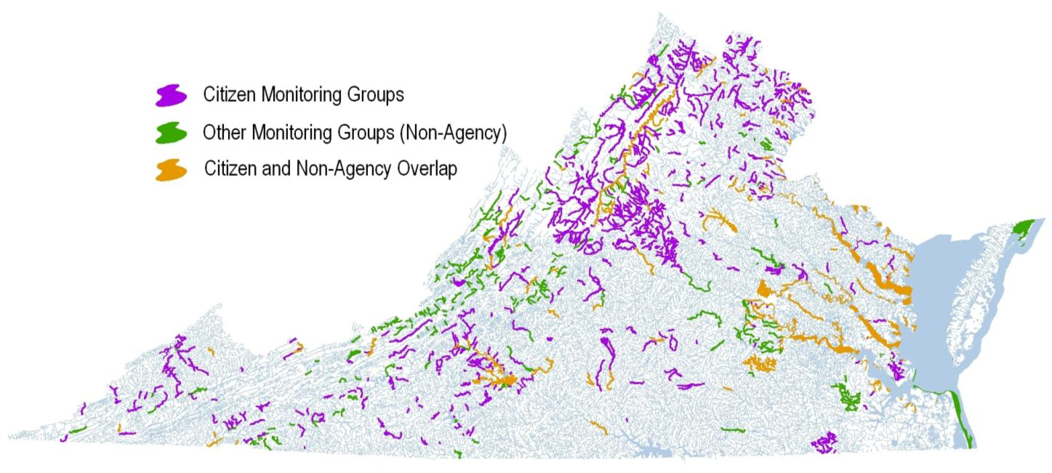
2012 Report: Waters Monitored By Citizen or other Non-DEQ Data

Slide 14
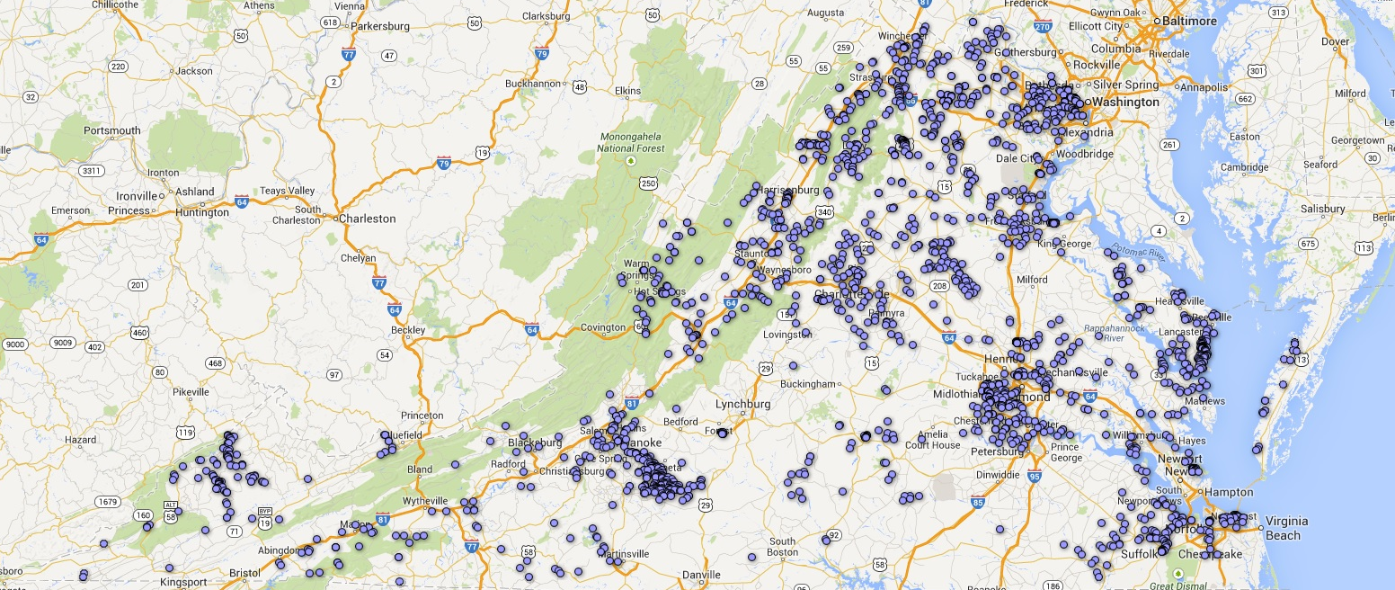
Citizen Data Available Online
DEQ developed an online database for citizens to upload their data- www.deq.virginia.gov/easi/
Google map allows users to click on a station of interest to download data and information.
Map link

Slide 15
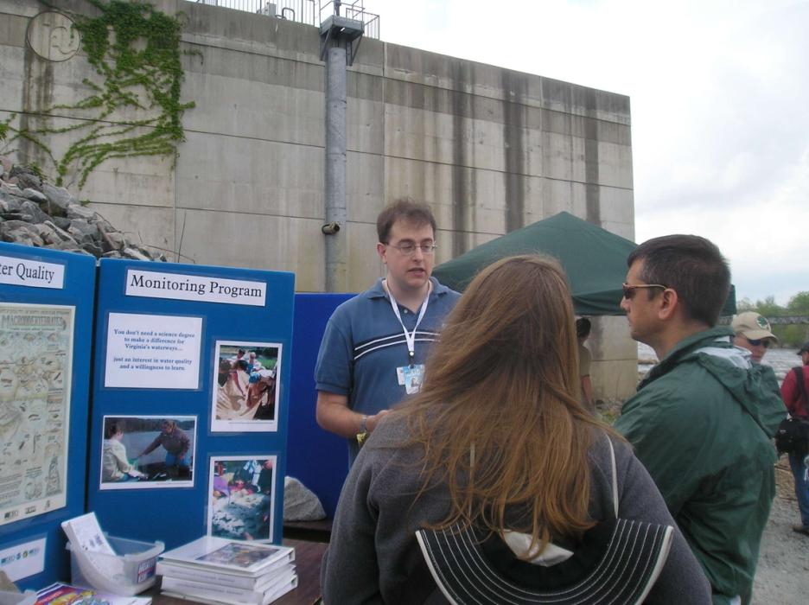
Questions

