Slide 1

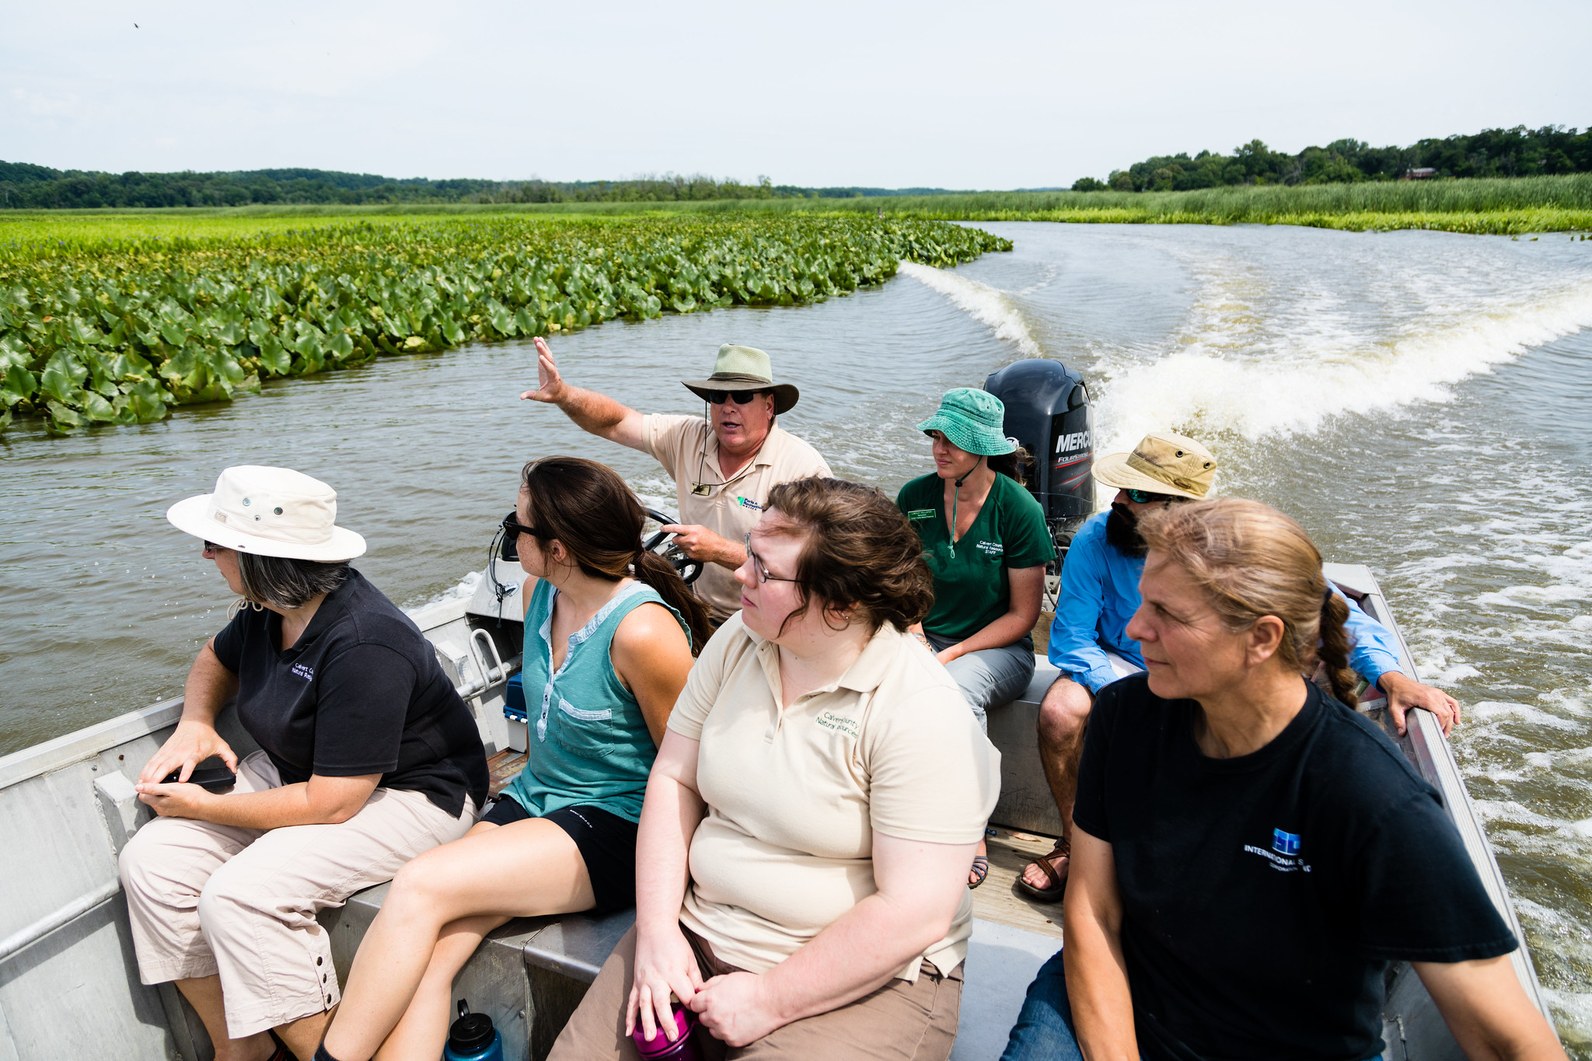
QUARTERLY PROGRESS MEETING – February 2021
Chesapeake Bay Program
Local Leadership
Matt Pennington
Region 9, WV
LLWG Chair 2018 - 2021
Shannon Moore
Frederick County, MD
LLWG Chair 2021 - 2023
Notes:
Find photos on our Flickr site: https://www.flickr.com/photos/29388462@N06/sets/
You can also browse photos by category on our website: http://www.chesapeakebay.net/photos

Slide 2
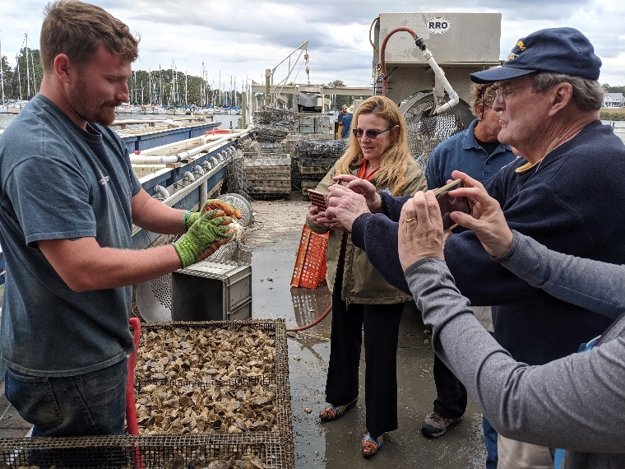
Through the Chesapeake Bay Watershed Agreement, the Chesapeake Bay Program has committed to…
Goal: Stewardship
Outcome:
Continually increase the knowledge and capacity of local officials on issues related to water resources and in the implementation of economic and policy incentives that will support local conservation actions.
Notes:
INSTRUCTIONS:
Add the title of your goal and the language of your outcome from the 2014 Agreement (copy and paste).
Add a relevant photo (if it all fits).
If desired, talking points could include more contextual information, e.g. the importance of the outcome and the historic trends that led to the establishment of the specific target.

Slide 3
What is our Expected and Actual Progress?
A baseline level of knowledge and capacity has not yet been established
Some qualitative information on outputs
        - 32 active workgroup members from 30+ associations
        - 12 workshop/panel sessions have reached 500+ local officials
        - Virtual resources have reached 5,000+ local officials
Notes:
INSTRUCTIONS: Copy and paste the graph or chart you used to answer narrative analysis question #2. The editable graph from the Narrative Analysis template has been included here for your reference.
FROM NARRATIVE ANALYSIS (FOR YOUR REFERENCE ONLY):
“2. Regardless of how successful your short-term progress has been over the past two years, indicate whether we are making progress at a rate that is necessary to achieve the outcome you are working toward.
Use the editable graph or your own chart to illustrate your progress. Explain any gap(s) between our actual progress and our anticipated trajectory.”

Slide 4
Learn
What have we learned in the last two years?
L
Notes:
INSTRUCTIONS: This slide is a transition slide and does not need to be modified.

Slide 5
Successes and Challenges
What worked:
Building Credibility - committed members
Building Relationships - peer to peer, trusted sources
Building Inventory – Association Conferences
What didn’t work: poorly coordinated one-off efforts
Obstacles: A baseline survey and COVID-19 global pandemic
Gaps Filled: Understanding of current training opportunities, newly created educational materials
Notes:
INSTRUCTIONS: This slide should briefly summarize your answer to narrative analysis question #1.
FROM NARRATIVE ANALYSIS (FOR YOUR REFERENCE ONLY):
“1. Examine your red/yellow/green analysis of your management actions. What lessons have you learned over the past two years of implementation?
Summarize what you have learned about what worked and what didn’t. For example, have you identified additional factors to consider or filled an information gap?”

Slide 6
On the Horizon
Fiscal: Impacts of the COVID-19 global pandemic on local governments
Policy: Shift to prioritizing essential services and urgent matters
Diversity, Equity, Inclusion and Justice (DEIJ): advancing these principles is a priority for the CBP and many local governments
Virtual Work: widespread adoption of virtual work has changed local government operations
Climate Change: local governments are acknowledging and addressing the impacts of climate change, especially flooding
Notes:
INSTRUCTIONS: This slide should briefly summarize your answer to narrative analysis question #3.
FROM NARRATIVE ANALYSIS (FOR YOUR REFERENCE ONLY):
“3. What scientific, fiscal and policy-related developments will influence your work over the next two years?
This may include information learned at the previous biennial SRS meeting or more specific information about your outcome such as an increase or decrease in funding, new programs that address gaps, and new scientific data or research. Describe how these developments are likely to impact your recommended measure(s) of progress, the factors you believe impact your ability to succeed, and newly created or filled gaps. These changes should be reflected in the first three columns of your revised logic and action plan after your quarterly progress meeting.”

Slide 7
Adapt
How does all of this impact our work?
A
Notes:
INSTRUCTIONS: This slide is a transition slide and does not need to be modified.

Slide 8
Based on what we learned, we plan to …
Serve as a Broker between trusted sources, our workgroup counterparts, and local leaders
Continue knowledge transfer for newly elected officials
Build relationships and capacity with senior staff and planners at the local government level
Adaptively manage our approach from results of baseline survey
Focus on virtual learning as a significant part of our approach
Notes:
INSTRUCTIONS: This slide should briefly summarize your answer to narrative analysis question #4. As a reminder, question four refers back to the first three questions in the Narrative Analysis.
FROM NARRATIVE ANALYSIS (FOR YOUR REFERENCE ONLY):
“4. Based on your response to the questions above, how will your work change over the next two years?
Describe the adaptations that will be necessary to more efficiently achieve your outcome and explain how these changes will lead you to adjust your management strategy or the actions described in column four of your logic and action plan. Changes that the workgroup, GIT or Management Board consider significant should be reflected in your management strategy.”

Slide 9
Help
How can the Management Board lead the Program to adapt?
H
Notes:
INSTRUCTIONS: This slide is a transition slide and does not need to be modified.

Slide 10
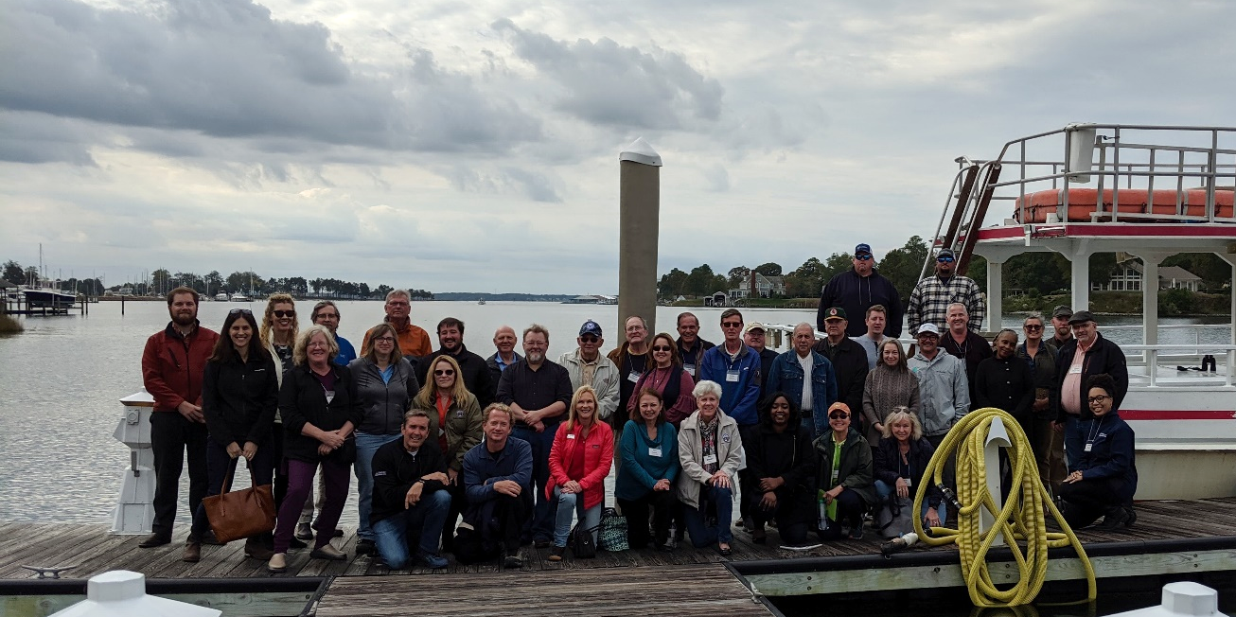
How You Can Help
Help building high-level buy-in, support, and credibility for the LLWG efforts
Notes:
INSTRUCTIONS: This slide is intended to provide context for your presentation.
Summarize your progress and preview your needs without going into detail on either point. If you don’t have a request, identify a few key points you want the to convey to the Management Board.
Replace the provided picture with your own or one selected from the sources identified on the first slide.

Slide 11
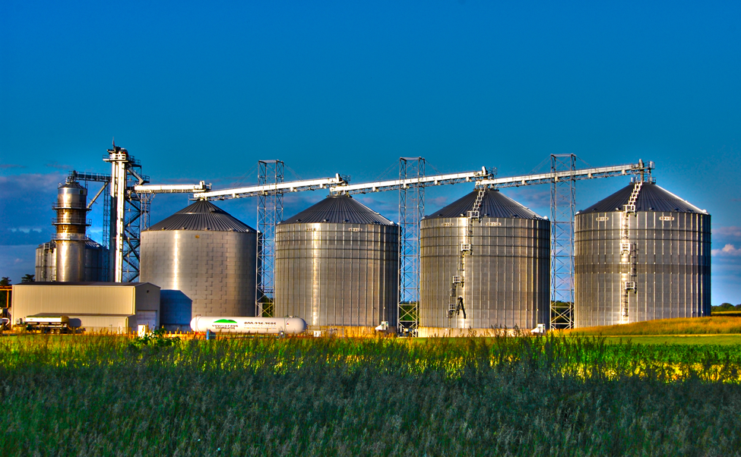
Help Needed
  Accept an invitation from LLWG to attend a meeting with YOUR jurisdictional/regional trusted sources
  At this meeting, identify key strategies/actions for implementation in 2021 – 2023. Examples:
              Identify conferences/possible engagements where having a state presence is beneficial.
            Send letters to trusted sources recommending LLWG for future conferences
Notes:
INSTRUCTIONS: This slide should briefly summarize your answer to narrative analysis question #5.
FROM NARRATIVE ANALYSIS (FOR YOUR REFERENCE ONLY):
“5. What, if any, actions can the Management Board take to help ensure success in achieving your outcome?
Please be as specific as possible. Do you need direct action by the Management Board? Or can the Management Board direct or facilitate action through other groups? Can you describe efforts the workgroup has already taken to address this issue? If this need is not met, how will progress toward your outcome be affected? This assistance may include support from within a Management Board member’s jurisdiction or agency.”

Slide 12
QUARTERLY PROGRESS MEETING
Chesapeake Bay Program
Discussion
Presentation template by SlidesCarnival.
Notes:
[time for discussion at the end of the presentation, before the next outcome presentation]

