Slide 1
Land Use Loading Rates
Urban Stormwater Workgroup
December 16, 2014
Olivia Devereux

Slide 2
Loading Rates and Targets
Loading rates from multiple models and literature are used to inform the targets
Targets are specified loading rates used to calibrate the Phase 6 Watershed Model
Do not include BMPs
Show relative differences among land use loading rates
Subject to modification through calibration
Actual rate adjusted
Relative differences maintained
Loads will vary around the target based on the nutrients applied and management actions
Notes:
Why this matters!!
Loading rates are what come out of the model and also culled from the literature to inform the targets.
Since targets do not include BMPs, literature rates must control for BMPs.

Slide 3
Data Source Characterization
Adapted from BMP Protocol http://www.chesapeakebay.net/documents/Nutrient-Sediment_Control_Review_Protocol_v7.14.2014.pdf
 | High Quality | Medium Quality | Low Quality
Year | Published after 2000 or seminal research | Published prior to 2000 | Published prior to 2000
Applicability | Purpose/scope of research/ publication matches information/data need | Limited application | Does not apply
Study location | Within Chesapeake Bay | Characteristic of CB, but outside of watershed | Outside of CB watershed and characteristics of study location not representative
Data collection & analysis methods | Approved state or federal methods used; statistically relevant | Other approved protocol and methods; analysis done but lacks significance testing | Methods not documented; insufficient data collected
Conclusions | Scientific method evident; conclusions supported by statistical analysis | Conclusions reasonable but not supported by data; inferences based on data | Inconclusive; insufficient evidence
References | Majority peer-review | Some peer-review | Minimal to none peer-review

Slide 4
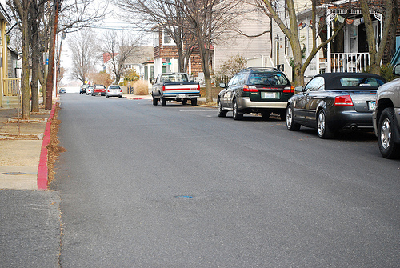
Developed Land Uses
All are also divided by federal, MS4-regulated, and Combined Stormwater Sewer (CSS)
Phase 6 Proposed
Pervious
Turf
Open space
Tree canopy
Impervious
Roads
Buildings, parking lots, etc.
Tree canopy over impervious
Construction
Extractive
Phase 5
Impervious developed
Pervious developed
Construction
Extractive

Slide 5
Pervious and Impervious Developed
Discussed at October USWG meeting
Data from National Stormwater Quality Database (NSQD)
Edge of Field
Mapped NSQD land uses to Phase 6 land uses
Completed
Converted mg/L to Lb/A
Addressed variation across all modeling segments

Slide 6
Pervious and Impervious Land Uses Converting to loading rates
Conversion factors
lb/yr/acre = mg/L * (1,233,482 in/yr) / (12 in/ft) / (453,592 L/ac-ft) * Runoff in/yr for each modeling segment
Runoff
Impervious land uses: surface flow.
Pervious land uses: surface plus interflow
There is one target for all segments, and is expanded to all modeled segments using local hydrology.
Used average from literature review. Will revise to use median because of skewness.
Notes:
So this is essentially multiplying the annual discharge by the concentration.
The annual discharge is the inches per year.
This represents runoff from surface and ground and interflow.

Slide 7
Median Targets across the Ches. Bay
LANDUSE | SCALE | TN (Lbs/A) | TP (Lbs/A) | TSS (Lbs/A)
Construction | EOS | 26.40 | 8.81 | 24,000.00
Barren | EOF | - | - | 17,680.00
Barren | DEL | 3.22 | 0.43 | 4,975.99
Extractive | DEL | 0.99 | 5.66 | 3,255.76
Developed Pervious Open Space | EOF | 4.73 | 1.02 | 339.15
Developed Pervious Turf | EOF | 10.66 | 2.05 | 315.44
Developed Impervious Buildings Parking Lots Etc. | EOF | 19.87 | 2.82 | 792.52
Developed Impervious Roads | EOF | 25.48 | 3.19 | 1,286.10
Notes:
Landfills are identified as developed open space

Slide 8
Construction
The Erosion and Sediment Control BMP Expert Panel recommends:
TSS target = 12 Tons/Acre
Assumes a no BMP condition. The E&S BMP further reduces this load.
Keep the TN and TP targets at the 5.3.2 levels of 26.4 and 8.81 lb/A
Assumes some E&S controls are in place. However, the Expert Panel recommended no E&S BMP nutrient reduction.
Notes:
This means that the nutrient E&S reduction is inherent in the target and the BMP is only for TSS, which does not include an assumption of BMPs in the target.
May be scaled using the cumulative Sparrow rate for each watershed.

Slide 9
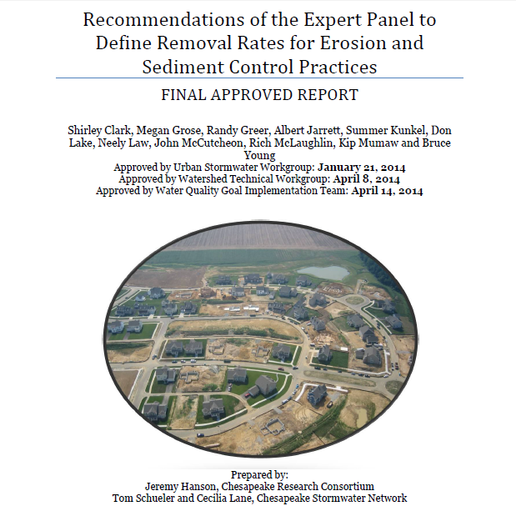
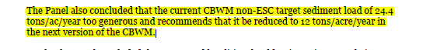
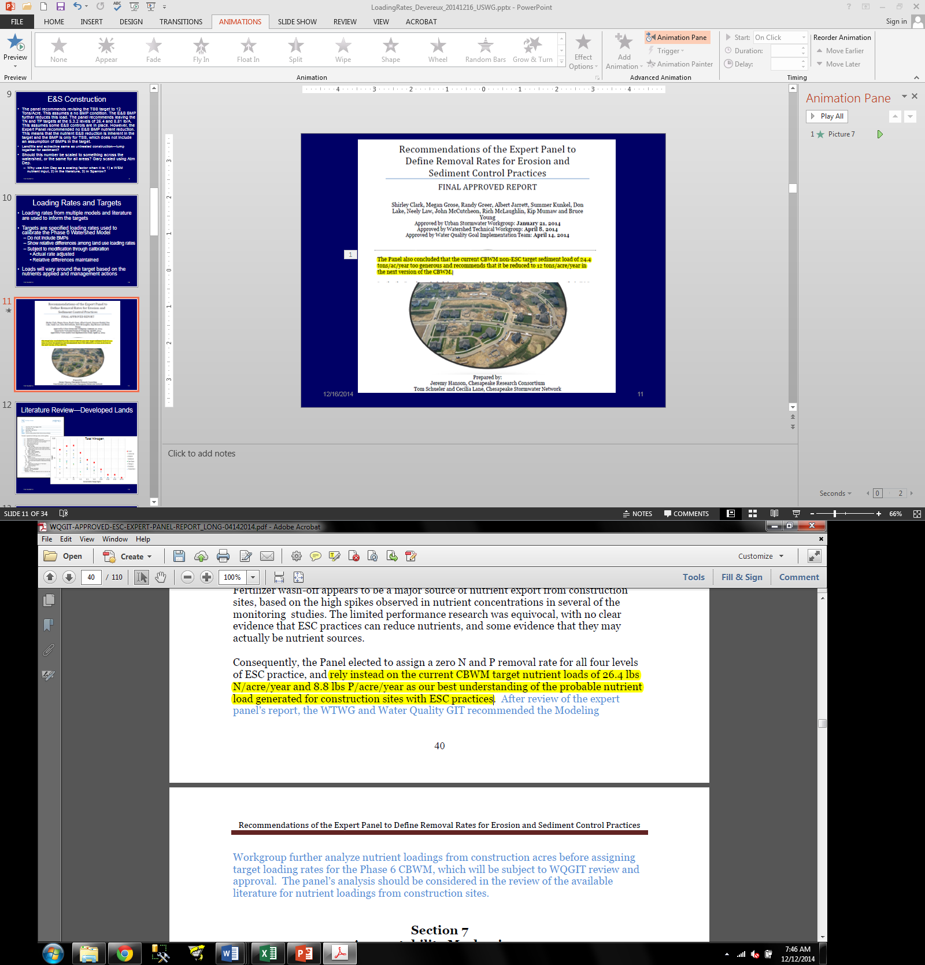

Slide 10
Using Barren from local TMDLs to Inform Construction
Acres are determined by the amount reported by the jurisdictions each year.
Local TMDLs provide data on “barren”
Labeled as “delivered” = delivered to a small watershed
Notes:
only using those records that are as TN, TP, or TSS.
Assuming we will develop rules/assumptions for converting other species to TN and TP. Would pick up 5 more barren values.
The EOF barren records are for only six TMDLs and used NRI erosion rates by county.

Slide 11
Comparing Barren and Construction
LANDUSE | SCALE | TN (Lbs/A) | TP (Lbs/A) | TSS (Lbs/A)
Construction | EOS | 26.40 | 8.81 | 24,000
Barren | EOF | - | - | 17,680
Barren | DEL | 3.22 | 0.43 | 4,976
Extractive | DEL | 0.99 | 5.66 | 3,255.76
Developed Pervious Open Space | EOF | 4.73 | 1.02 | 339.15
Developed Pervious Turf | EOF | 10.66 | 2.05 | 315.44
Developed Impervious Buildings Parking Lots Etc. | EOF | 19.87 | 2.82 | 792.52
Developed Impervious Roads | EOF | 25.48 | 3.19 | 1,286.10
Notes:
NC and Ohio included Diss. N, TP and TSS that were different than the average within the CB. So excluded. TP was higher with NC and OH (1.77 vs. 1.68), TSS was lower (11,561 vs. 12,503).

Slide 12
Extractive
Acres are determined by the amount reported by the jurisdictions each year.
Alternatives:
31 TMDLs listed extractive as a land use
0.5 * construction load (method used for Phase 5.3 target)

Slide 13
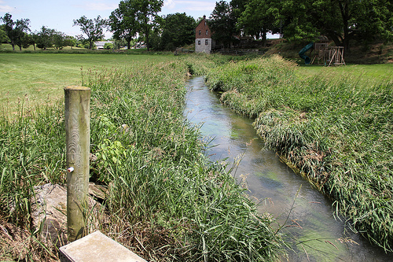
Scale
Goal is to have targets at the smallest scale that also is best informed by data
Field (EOF)
Hillslope
EOS
Small Watersheds or Small Stream Networks
Large Rivers
In the pervious and impervious developed land uses, data sources predominantly are edge-of-pavement
Notes:
Flow: surface vs. subsurface-depths of nutrients and sediment runoff values affect the calibration

Slide 14
Next Steps
Sparrow results (draft) as proportions of loading rate for urban.
Address skewness in pervious and impervious land use literature review results – use median values, not average
Agricultural and natural land uses
Scale

Slide 15
Other Sources of Information
SPARROW—large land use groups
E&S Expert Panel report
MDE MS4 monitoring (in the literature review of NQSD, just a double check)
CBP Sensitivity Work using the multiple model framework
CWP small-scale sediment work
Land data team riparian analyses
Land data team impervious connectedness analysis
STAC recommendations
CBP Partnership Watershed Model Phase 5 documentation (where relevant)
ICPRB calibration work

Slide 16
Land Use Load Decisions – Phase 6
CBP decisions
Relative load between
Large land use classes
Literature
Sparrow
Literature
Further refined land use classifications
Estimated loads in rivers
Segment-specific land use calibration targets
Nutrient inputs
Final calibrated land use loads
⬅-------------------- Modeling workgroup -------------------➔ ⬅----- other CBP groups --➔

Slide 17
Role of Workgroups
Provide critical pieces of information in addition to the full literature review for all source sectors.
Panel, workgroup documents and recommendations, and available literature are critical sources of data for developing the loading rate targets.
Modeling workgroup approves the final Phase 6 model

Slide 18
Timeline
December 31, 2014 - Sparrow and literature review results for draft land uses
February 28, 2015 - draft targets for draft land uses
April 30, 2015 - final targets approved by Modeling Workgroup for draft land uses
Oct 1, 2015 - Once the final land uses are approved, we will finalize targets using a Sparrow update, final sensitivities, and other information.

Slide 19
Keeping Up To Date – Webpages
Land Use Loading Rates http://www.chesapeakebay.net/about/wmp_for_mpa_effort/land_use_loading_rates
Additional information on Mid-Point Assessment http://www.chesapeakebay.net/groups/group/water_quality_goal_implementation_team/wmp_for_the_mpa

