Slide 1

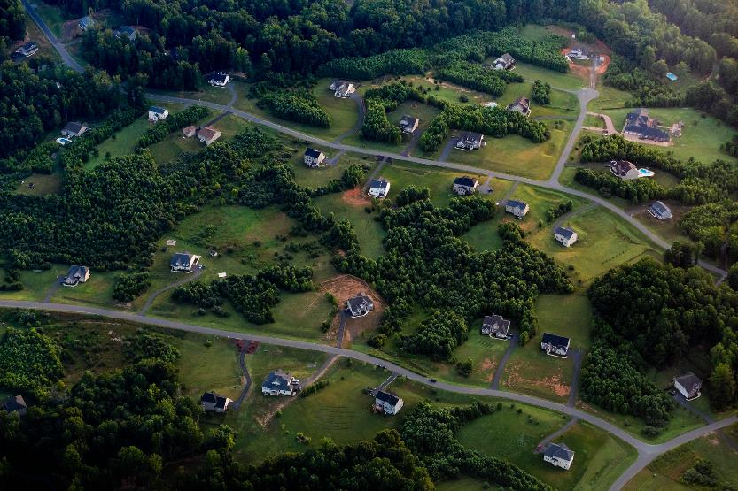
QUARTERLY PROGRESS MEETING – February 2021
Chesapeake Bay Program
Land Use Options
Evaluation
Renee Thompson
Maintain Healthy Watersheds GIT, Coordinator
Notes:
Find photos on our Flickr site: https://www.flickr.com/photos/29388462@N06/sets/
You can also browse photos by category on our website: http://www.chesapeakebay.net/photos

Slide 2
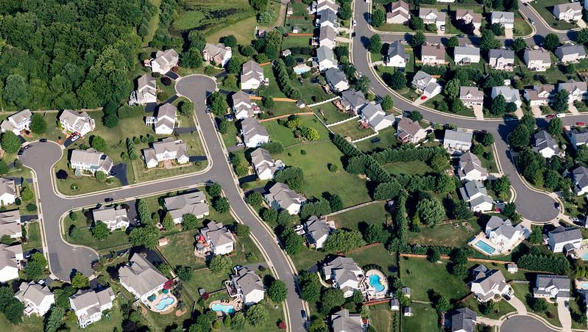
Through the Chesapeake Bay Watershed Agreement, the Chesapeake Bay Program has committed to…
Goal: Land Conservation
Outcome: By the end of 2017, with the direct involvement of local governments or their representatives, evaluate policy options, incentives and planning tools that could assist them in continually improving their capacity to reduce the rate of conversion of agricultural lands, forests and wetlands as well as the rate of changing landscapes from more natural lands that soak up pollutants to those that are paved over, hardscaped or otherwise impervious.
Notes:
INSTRUCTIONS:
Add the title of your goal and the language of your outcome from the 2014 Agreement (copy and paste).
Add a relevant photo (if it all fits).
If desired, talking points could include more contextual information, e.g. the importance of the outcome and the historic trends that led to the establishment of the specific target.
By the end of 2017, with the direct involvement of local governments or their representatives, evaluate policy options, incentives and planning tools that could assist them in continually improving their capacity to reduce the rate of conversion of agricultural lands, forests and wetlands as well as the rate of changing landscapes from more natural lands that soak up pollutants to those that are paved over, hardscaped or otherwise impervious. Strategies should be developed for supporting local governments’ and others’ efforts in reducing these rates by 2025 and beyond.

Slide 3
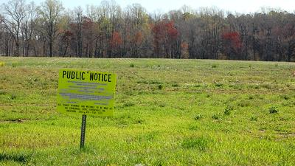
Land Use Options Evaluation - Context
2014 – This outcome was included in the Agreement to provide tools and support to local governments to ensure their capacity to plan for and mitigate land change impact. – source
2014 “Current” condition? – WIP process shed light on the differences between CBP land use and local-scale information
Why this Outcome? – This outcome responds to public comments related to the need to address the extent and impact of land use change (the Land Use Workgroup and the Water Quality GIT were instrumental in this outcome)
Notes:
The notes in this slide were taken directly from a ”factsheet” on the CBP website related to this outcome. These are not my bullets or comments but summarize the document.
I’d like to thank Guy Stevens and the web team for maintaining institutional knowledge on our website as I am not sure how many here would have known this history. I for one did not.

Slide 4
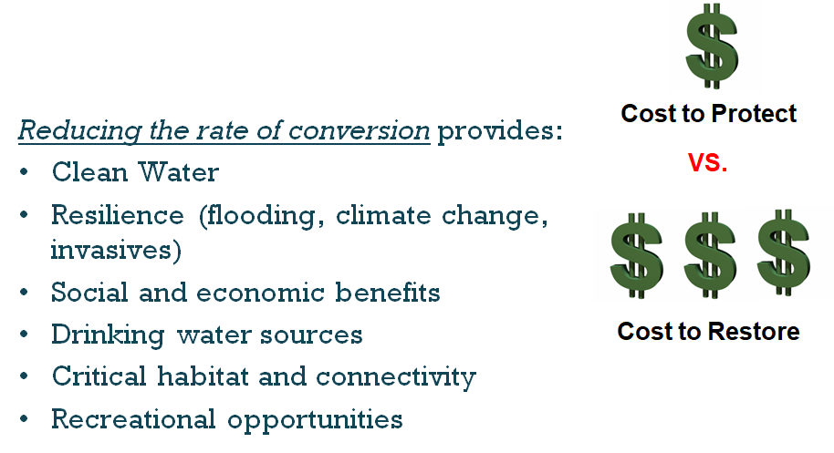
Co-Benefits
Notes:
Reducing farm, forest, and wetland conversion can not only meet restoration and conservation needs but also….

Slide 5
What is our Expected and Actual Progress?
Tie pieces together
Did we meet needs??
High resolution land use/land cover
Developed resources
Need:
Local land use data
Increase capacity to reduce conversion
Increased coordination
Better understanding of local needs/priorities.
Notes:
This outcome is qualitative in nature. Renee worked to mark progress and points of significant progress towards filling multiple needs and gaps.

Slide 6
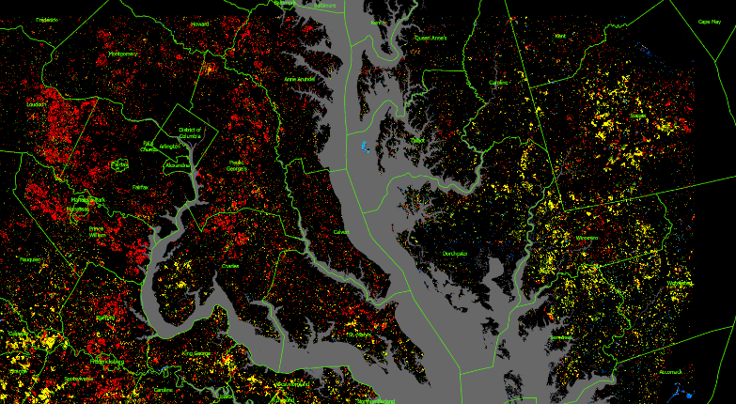
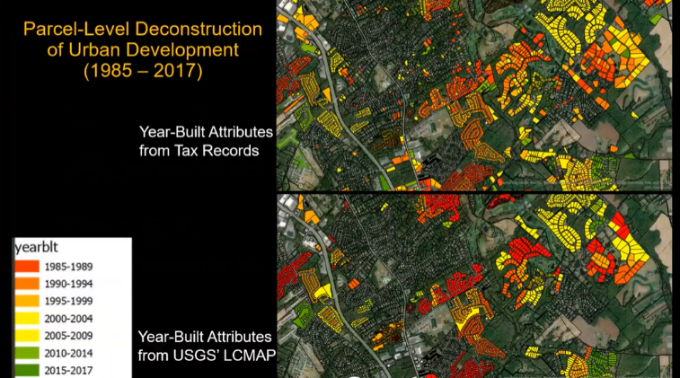
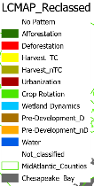
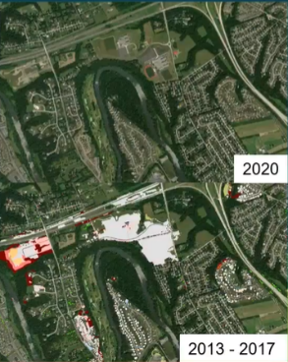
Increasing knowledge at a scale that is locally relevant
USGS Land Change Monitoring, Assessment, and Projection Data
Thirty Years of Change (1985 – 2015)
USGS Land Change Monitoring, Assessment, and Projection Data
Thirty Years of Change (1985 – 2015)
Rates of conversion:
Farmland
Forest
Wetland
Impervious Cover
Slides courtesy of Peter Claggett, USGS CBP
Notes:
Allow for Tax Parcel Scale backcasting.
As Peter reviewed we are currently working with hi-res, locally relevant data.
The USGS LCMAP data combined with the CB hi res land use / land cover allows for a more refined understanding or metrics related to converting natural lands and can be used to measure progress.

Slide 7
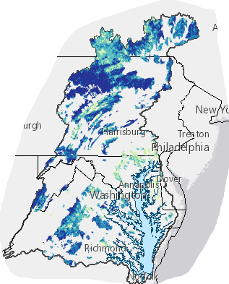
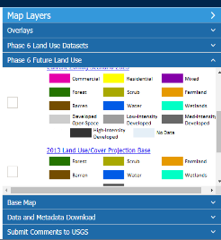
.."Evaluate policy options, incentives and planning tools that could assist in continually improving capacity.."
Data and Tools
  Hi-res land cover
  Phase 6 Land Use Viewer
  Data Dashboard
  Chesapeake Healthy Watersheds Assessment
  Environmental Justice and Equity Dashboard
Notes:
Summary of work/progress
different data/mapping viewers; data dashboard land policy, phase 6 viewer, land policy BMPs,
Resources/communications; resource guide, webinar/presentations. For more details and links see narrative analysis.
NOTE we need a couple more graphics. ..

Slide 8
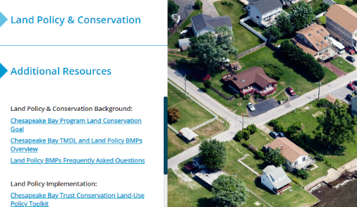
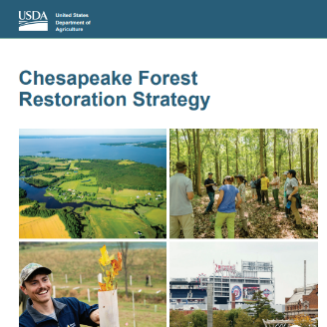
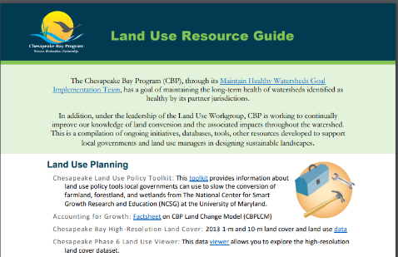
Projects
  Cross-Outcome Watershed Educational Materials
  Conservation of Working Lands-Finance Forum consultants
  Improving Technical Service Delivery for Private Landowners
  Targeted local outreach for green infrastructure in vulnerable areas
  Chesapeake Watershed Finance Intensive Workshop
Communications
  Land Use Resources Guide
  Forest Restoration Strategy
  Land Policy Data Dashboard resources
  Presenter, panelist, speaker
Notes:
Summary of work/progress
different data/mapping viewers; data dashboard land policy, phase 6 viewer, land policy BMPs,
Resources/communications; resource guide, webinar/presentations. For more details and links see narrative analysis.
NOTE we need a couple more graphics. ..

Slide 9
Potential Metrics to measure progress
Land Use Metrics: rate of farm, forest, and wetland conversion through time
  Assess the rate of conversion against key policies (in selected jurisdictions) to determine if the policies, incentives, and planning tools are having the intended effect. (How can the land policy BMPs be utilized?)
Number of projects, presentations tools – total people reached
Survey of key audience needs? / Does what we have developed meet their needs?
Web Analytics: Total downloads, site visits, use of resources, tools and information provided on websites.
Provide a mechanism for feedback directly on the web support tools (to demonstrate direct involvement)
Notes:
There are opportunities to create metrics related to audiences reached, webinars, data downloads, web based, user experience etc.…this list includes examples. It would be good to coordinate with the LLWG as they use related metrics.
Example for bullet 2:
e.g., the Forest Conservation Act in Maryland was implemented in 1990. How has the rate of forest conversion changed since 1990 in Maryland?
The question remains, How to integrate planning into qualitative land use change data to determine success?

Slide 10
Learn
What have we learned in the last two years?
L
Notes:
INSTRUCTIONS: This slide is a transition slide and does not need to be modified.

Slide 11

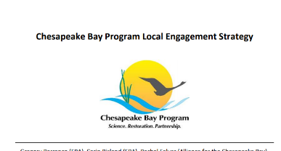
Successes and Challenges
What have we learned?
We are dependent on the participation of related outcomes and workgroups, as well as their work/products
The importance of champions and relationships
Notes:
The success of this outcome is dependent on the work and collective resources across the partnership and effectively engaging locals. Relationships with organizations, champions and decision makers is essential.
For example We were invited to come back to ICPRB (interstate commission on the Potomac river basin) after participating in a panel on land conservation to give a webinar on our Web-based decision support tools.

Slide 12
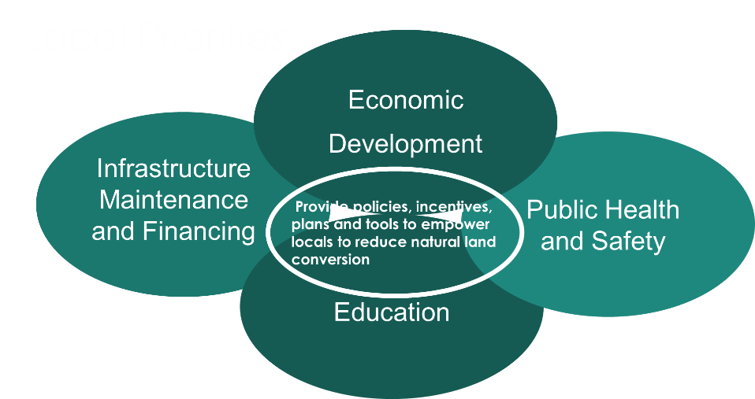
Notes:
The local engagement strategy and the ecologix report has helped us to understand how to frame our outcome and needs in terms of priorities for locals.

Slide 13
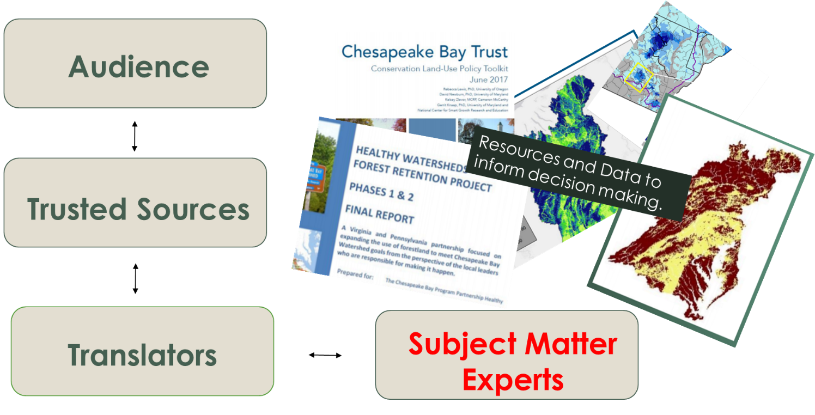
Notes:
local engagement needs and resources assessment
Again you see a version of the local engagement framework here. We have our experts and with the great work of the local leader workgroup we have a good idea of the trusted sources.
What we are missing is translating those resources.

Slide 14
Slide courtesy of CBP Local Engagement Team
Notes:
The local engagement strategy has now evolved into a core internal local engagement group here at CBP. We will continue to work directly with this team as we move forward. This slide was pulled from a recent survey they conducted across staff here at CBPO. The actions listed in this word cloud represent action needs at the local level across outcomes.

Slide 15
Factors Influencing
Management Strategy
    Political and Education Challenges (legislative engagement)
    Sustaining the Ag and Forestry Industries (funding and finances)
    Ability to Engage Local Governments in Conducting the Evaluation (education and outreach)
    Technical Challenges
Current Logic and Action table (STAC factors)
Partner Coordination
Technical understanding
Education and outreach
Local engagement
Legislative engagement / political challenges.
Notes:
There is a disconnect due to some confusion over guidance provided by STAC and the level of grouping in factors. This needs to be updated with current factors and the logic and actions supporting those factors.

Slide 16
Scientific, Fiscal and Policy-related developments
On the Horizon
Scientific:
  High resolution land cover and related metrics (1m, 10m)
  LCMAP – Analysis and distillation by Sarah MacDonald, USGS CBP
      No communication/outreach plan

Slide 17
Policy and other developments
Policy:
  Better incorporate DEIJ and Climate considerations.
Integrate climate and DEIJ metrics
Communication, Translation and Engagement:
Translate, format, package and flow information through to trusted sources.
How to effectively engage locals directly
COVID (future impacts on land use?)

Slide 18
Adapt
How does all of this impact our work?
A
Notes:
INSTRUCTIONS: This slide is a transition slide and does not need to be modified.

Slide 19
Engagement, Coordination and Accounting.
Based on what we learned, we plan to …
Continue to build relationships, share resources and knowledge to meet evolving needs.
  Expand connections beyond CBP internal teams.
      Engage states and regional planning organizations and incorporate resources into land policy BMPs
  What does success mean?
Notes:
Key partners include: HWGIT, LUWG, CCP, FWG, AGWG, Comm, DWG, CRWG, STAC, STAR, LLWG, LGAC as well NGOs and locals.
There is also a need to initiate discussions among state agencies and regional planning organizations
How to revised to achieve a reduction in the rate of land conversion at the local level.
Captured, for example, in the Land Policy BMP scenarios that each state develops, and the CBPC model can forecast how those programs can prevent land conversion.
States and regional planning organizations could benefit from these types of discussions and potentially could result in helpful modifications of existing state-level and regional-level programs and policies affecting local land conversion.
Our goal should be to inform land use planning and conservation decisions with information that will engender more sustainable decisions.
IS the ultimate success would be to have our metrics and materials referenced in policies and legislation? Proof that those who make such decisions are considering the data and info we produce? Or is it ultimately reducing the rate of conversion of farm, forest and wetlands? How do we know if our work is contributing?

Slide 20
Help
How can the Management Board lead the Program to adapt?
H
Notes:
INSTRUCTIONS: This slide is a transition slide and does not need to be modified.

Slide 21
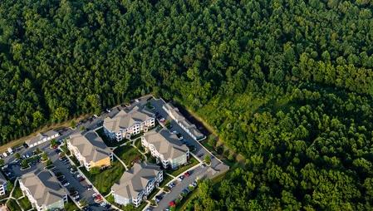
How You Can Help
Renewed engagement land use related outcomes (and Healthy Watersheds GIT)
  Formation of land use action team/work group.
      Resources related to “translation” of CBP resources pursuant to the Local Engagement Strategy.
      Guidance and feedback on how resources will be utnilized at the local level.
Notes:
Formation of a LU outcomes action team/workgroup. (this will allow key entities meeting on a frequent basis so we can accelerate progress on these outcomes.)
Increase resources related for “translation” of CBP resources to inform Local Engagement Strategy. (This will help close gap related to the land-use planning process and how it works at the local level, and for them to use the tools that already exist).
Define direct involvement of locals.
CBP is already moving forward with translating resources, but unless people use it, we won't be able to meet many of the goals and outcomes - slow the rate of conversion or all the investment you are making toward the TMDL will be in vain.
How will MD utilize resources when you engaging locals and what we can do to support you.

Slide 22
QUARTERLY PROGRESS MEETING
Chesapeake Bay Program
Renee Thompson, Geographer
Lower-Mississippi Gulf WSC, USGS,
Chesapeake Bay Program, MD
Coordinator Maintain Healthy Watersheds
Goal Implementation Team
Rthompso@chesapeakebay.net
Rthompson1@usgs.gov
Discussion
Presentation template by SlidesCarnival.
Notes:
[time for discussion at the end of the presentation, before the next outcome presentation]

