Slide 1
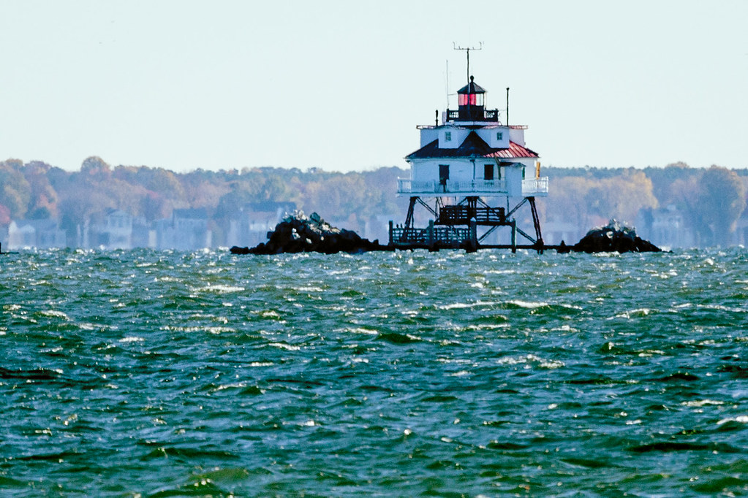


Chesapeake Bay Program Updates Citizens Advisory Committee Quarterly—September 2021
Martha Shimkin
Deputy Director,
EPA Chesapeake Bay Program

Slide 2
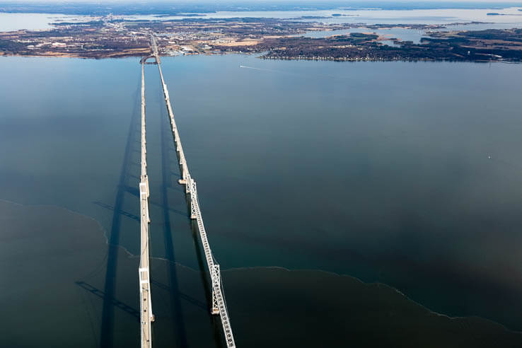
Partnership Updates
FY 2021 Budget Overview
AGENDA
Some Details
Looking Ahead to FY22

Slide 3
Principals’ Staff Committee Meeting –
September 21
Plastics Pollution Action Team Update
Phase I Conowingo WIP Financing Implementation Strategy Update
EC Meeting Planning
DEIJ Implementation Plan Update
Chesapeake Bay Program Budget Overview
Biennial Strategy Review System Report-out and Watershed Agreement Progress
Round Robin: How Federal Funding is Being Used for Bay Needs

Slide 4
Executive Council Meeting – October 1st
Brock Environmental Center, Virginia Beach, Virginia
Agenda
Watershed Education Experience
Ceremonial Signing of Climate Directive
Press Event

Slide 5
Executive Council – December
Next Executive Council meeting to be held in December 2021.
Exact dates TBD.
Meeting will be held in Richmond, Virginia.

Slide 6
FY 2021 Chesapeake Bay Program Budget Funding Categories*
 | FY 2021 Enacted Budget (Dollars in thousands)
Program Operations & Support | $6,958
Partnership & Data Management Support | $10,135
WQ Monitoring Grants | $5,000
TMDL Implementation & Analysis | $1,777
Reporting & Accountability | $1,920
Permit Review and Rule Development, Guidance & Implementation | $3,844
Enforcement | $1,794
Small Watershed Grant Program | $9,625
Innovative Nutrient Sediment Reduction Grants | $9,625
State Implementation Grants | $36,822
Chesapeake Bay Funding Totals | $87,500
AGENDA
*Funding categories used in annual congressional justification

Slide 7
FY 2021 Chesapeake Bay Program Budget
Funding by Category
>70% to Grants
*Dollars in thousands

Slide 8
FY 2021 Partnership and Data Management Support
Funding by Category
Examples of Partnership and Data Management Support
Advisory Committees
CAC/LGAC | ~$300 K each
STAC | ~$400 K
CRC Staffer Support | ~$900 K
Goal Team Funding | ~$900 K
GIT Coordinator Positions | ~$800 K
SAV Monitoring and Analysis | ~$400 K
Technical Program Support (QA, monitoring, modeling, data analysis, GIS, high-resolution land cover, etc.) | ~$3.95 M
Mission Support Contracts (Tetra Tech and ERG) | ~$1.0 M

Slide 9
FY 2021 Chesapeake Bay Program Funding
Funding by Office
(dollars in thousands)
Headquarters
Office of General Counsel, Office of Water, Office of Mission Support, Office of Administration, Office Enforcement and Compliance Assurance.
Region 3
Chesapeake Bay Program Office, Water Division, Office of Regional Counsel, Enforcement and Compliance Assurance Divison, Regional Administrator’s Office.
$82,723
Region 2
$229
Water Division.
FY 2021 CBP: $87,500
*Dollars in thousands

Slide 10
FY 2021 Region 3 Chesapeake Bay Program Funding
Chesapeake Bay Program Office
Region 3
Grants, Contracts, IAs
CBPO
$82,723
$79,004
Operating Funds
*Dollars in thousands

Slide 11

CBIG
CBRAP
Implementation of management mechanisms for all Goals and Outcomes established under the 2014 Chesapeake Bay Watershed Agreement, with emphasis on reduction of nutrient and sediment pollution.
Implementation of regulatory, accountability, assessment, compliance, and enforcement capabilities in support of the Water Quality Goal of the 2014 Watershed Agreement and Bay TMDL.
20%: Pennsylvania, Virginia, Maryland
10%: Delaware, DC, New York, West Virginia
Base: All Bay Agreement signatories receive funds.
Formula: 35% for reductions through 2017. 65% for 2018-2025 N load reduction commitments.
Allocation Formula
$12.6 M
$11.2 M
Funding Amount
Combined Funding Amount approx. $23.8 M

Slide 12
Local Government Implementation Funding
EPA has provided an additional $5 M to States for Local Government Implementation
Intended for use by local entities, including:
Counties, municipalities, cities, towns, townships, federally recognized tribes, local public authorities or districts (including conservation districts or regional planning districts), organizations representing local governments, or watershed organizations that support local government implementation.
Funding is to support WIPs
Allocated using CBRAP grant allocation formula
EPA can also provide this funding directly to local entities through competitive RFAs.

Slide 13
Monitoring Funding
Monitoring grants support jurisdictions and USGS work to monitor and assess water quality, habitat conditions, nutrient and sediment pollution and more, as well as support data analysis and interpretation of trends.
USGS
Non-tidal
$1.17 M
$0.47 M
PA
$400,000
$5 M
MD
$1.69 M
SAV
$1.39 M
VA
WV
$0.21 M

Slide 14
FY 2021 Most Effective Basins (MEB) Funding
Formula is based on cost effectiveness and load effectiveness for nitrogen.
By jurisdiction, the percentage of agricultural sector implementation proposed in each WIP and the resulting MEB funding allocation.
EPA and CBP has focused additional $1.25 in FY21 funds to underrepresented communities.
Jurisdiction | Phase III WIP Ag Nitrogen Commitment (million pounds) | Percent of Total Nitrogen Commitment Proposed | MEB Funding Allocations ($) | Underrepresented Communities Allocation ($)
DC | 0.0 | 0.00% | - | $125,000
DE | 2.2 | 6.08% | $ 364,540 | $125,000
MD | 4.2 | 11.60% | $ 695,940 | $250,000
NY | 0.5 | 1.33% | $ 79,536 | $125,000
PA | 22.3 | 61.59% | $ 3,695,112 | $250,000
VA | 6.7 | 18.50% | $ 1,110,191 | $250,000
WV | 0.3 | 0.91% | $ 54,681 | $125,000
Totals | 36.2 | 100.00% | $ 6,000,000 | $1,250,000

Slide 15
GIT Funding
$900,000 through cooperative agreement with Chesapeake Bay Trust
2020 GIT Funding Project Title
Project 1 - Forage Indicator Development: Using Environmental Drivers to Assess Forage Status
Project 2 - Synthesis of Shoreline, Sea Level Rise, and Marsh Migration Data for Wetland Restoration Targeting
Project 3 - Maintaining forests in stream corridor restoration and sharing lessons learned
Project 4 - Public Access Research - Benefits and Barriers Across the Watershed
Project 5 - Planning for Clean Water: Local Government Workshops
Project 6 - Modeling climate impacts on submerged aquatic grasses (SAV) in Chesapeake Bay
Project 10 - Cultivating and Strengthening Partnerships with Underrepresented Stakeholders
Project 15 - Chesapeake Bay Program Social Science Assessment and Integration Road Map Development
Project 8 - Management Approaches to Reduce Stressors of Stream Health
Project 19 - Developing Standards and Metrics to Target the Conservation of “ Green Spaces “ in Diverse and Low – Income Urban Communities
Project 14 - Methods to integrate co-benefits of toxic contaminant reduction into decision tools
Project 7 - Development of cost-effective methods to measure denitrification rates of Oyster Restoration BMPs
Purpose: The GIT Funding Program undertakes projects that address needs identified in the management strategies and action plans that teams develop to meet the goals of the Chesapeake Bay Watershed Agreement. The program outputs substantially impact team progress on completing planned actions and filling critical knowledge gaps

Slide 16
Innovative Nutrient & Sediment Reduction Grants | Small Watershed Grants
Annual Funding Amounts
2018
2019
2020
2021
$12,000,000
$12,000,000
$18,000,000
$19,250,000
INSR: $6,000,000
SWG: $6,000,000
INSR: $6,00,0000
SWG: $6,000,000
INSR: $9,000,000
SWG: $9,000,000
INSR: $9,625,000
SWG: $9,625,000
Statute: CWA Section 117

Slide 17
Looking Ahead to FY 2022
Fiscal Year 2022 begins on October 1, 2021
Appropriations, Reconciliation, and Infrastructure Bills
Other Federal Agency Bills
ARPA enactment

Slide 18
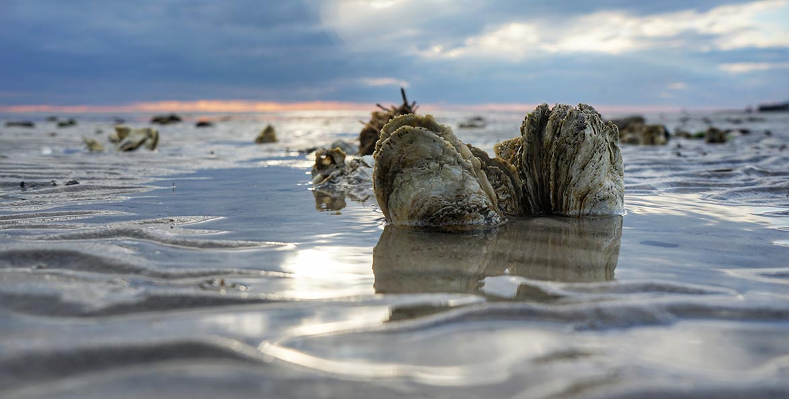
Questions? Martha Shimkin, shimkin.martha@epa.gov

