Slide 1

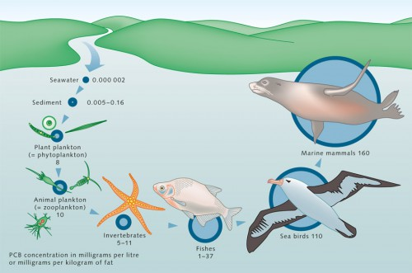
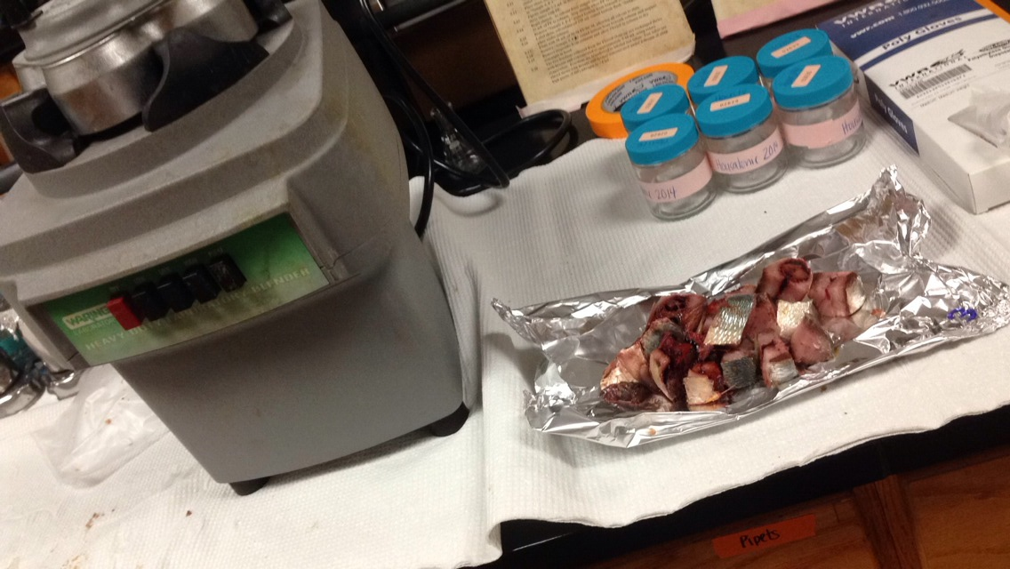
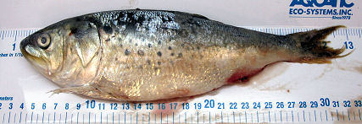
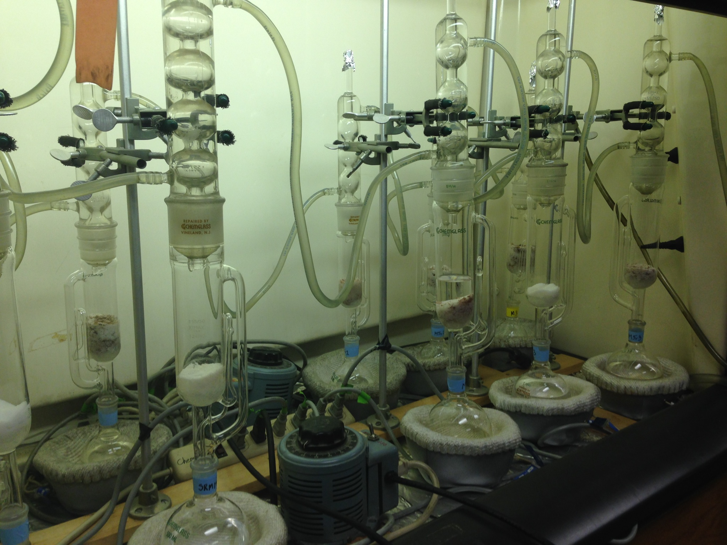
Quantifying Polychlorinated Biphenyl Removal from the Chesapeake Bay by a Commercial Fishery
Rachel Soroka¹, Alexandra Sarno¹, Yarixa Cintron¹, Jeffrey Ashley¹, Linda Zaoudeh²,David Velinsky² and Joel Baker³
¹School of Science, Health and Liberal Arts; Philadelphia University, Philadelphia, PA 19144
²Academy of Natural Sciences of Drexel University; Philadelphia, PA 19103
³Center for Urban Waters; University of Washington at Tacoma, Tacoma, WA 98402
ABSTRACT
PROCEDURE
The Chesapeake Bay is the largest estuary in the United States, receiving high nutrient inputs from various anthropogenic sources which fuel eutrophication within its waters. Concurrently, the estuary receives significant inputs of PCBs, largely from point sources from its industrialized and urbanized tributaries. Phytoplankton provide organic carbon rich sites for absorption/adsorption of PCBs and represent an important vector for PCB bioaccumulation within higher trophic level organisms such as zooplankton and planktivorous fishes. Atlantic menhaden (Brevoortia tyrannus) are pelagic schooling fish found in abundance in the estuary and near coastal regions. As omnivorous filter feeders, juveniles and adults primarily feed on phytoplankton and zooplankton. By filtering vast quantities of planktonic organisms, these fish accumulate polychlorinated biphenyls (PCBs) from this pelagic dietary route. In the past decade, the commercial fishery for Atlantic menhaden landed an annual average of 144 kilotonnes of fish, of which an average of approximately 50% came from fishing efforts within the Chesapeake. This intense reduction fishery processes menhaden into fish oil and meal, high in sought-after omega-3 fatty acids. Using previously, though limited, published concentrations of PCBs for U.S. East Coast-caught menhaden, the annual removal of PCBs from the Chesapeake Bay was estimated to be between 7 and 30 kg/year. In addition to export to the ocean, burial via sedimentation, and volatilization, removal of PBCs by commercial fishing of menhaden may represent a small, but intriguing loss process to the Chesapeake Bay based on mass balance calculations. Future estimates will include other commercial/recreational fisheries of other species, such as blue crab and striped bass, as these may additionally contribute to PCB removal. Additionally, collection and analysis of Chesapeake Bay menhaden will provide increased confidence in these literature-based estimates of annual PCB removal.
Weighed 5g of each homogenized fish sample
Added 10:1 portions of Na₂SO₄ to each sample
Dry fish was transferred to a Soxhlet Extractor and 3 PCB surrogates (14, 65 and 166) were added
Soxhlet Extracted with 50:50 Hexane:Acetone for 24 hours
1 mL aliquot were transferred to a tarred Al pan and the remaining 9 mL were reduced to 2 mL
2 mL of conc. H₂SO₄ were added to hydrolyze lipid
Organic layer was removed and transferred into a clean test tube and reduced to 1 mL
Cleaned up with solid-liquid chromatography (Florisil)
Reduced volume to approximately 1mL
Extracts were transferred to vials and 2 PCB internal standards were added
Extracts were analyzed by Gas Chromatography with an Electron Capture Detector
Roto-Evaporated to 2 mL and diluted to 10 mL with hexane
QUALITY CONTROL
RESULTS and DISCUSSION
INTRODUCTION
We also analyzed a Standard Reference Material® 1946; Lake Superior Fish Tissue and determined the concentration of PCBs. We compared our values with the values presented in the SRM and measured our accuracy. In general, analytical accuracy was satisfactory. We believe that some of our values are higher than the NIST because they present more than one PCB.
In the Chesapeake Bay and US Eastern Seaboard, there is only one commercial fishery that catches menhaden. A report from 2004 to 2013 provided the total number of catches (Chesapeake Bay and Eastern Seaboard) of menhaden. With this information, estimates of the total mass (in Ktonnes/year) caught from Bay were made (Graph 3, right hand y axis).
The Chesapeake Bay is the largest estuary in the U.S., consisting of the Bay, its local rivers and streams, and all the plants and animals it supports (Chesapeake Bay Program). The Chesapeake Bay also receives high nutrient inputs, including toxic PCBs (Velinsky & Baker 1999).
Polychlorinated biphenyls (PCBs) were banned in 1979 for its health and environmental risks, but are currently present in soil, water, and organisms. They enter the Chesapeake Bay through accidental leaks, improper disposal, and “legacy deposits” (Chesapeake Bay Program 2013). Due to their bioaccumulative properties and resistance to degradation, PCBs attach to sediment in aquatic ecosystems and are either buried or accumulated through the food chain (Hudson River Sloop Clearwater 2006). PCBs can be removed from the Bay through volatilization, burial in sediment and export to the ocean (Velinsky & Baker 1999).
  Phytoplankton are the first to absorb PCBs through the water. Zooplankton then consume phytoplankton and the concentration of PCBs magnifies (Sailors of the Sea 2010).
  Both Phytoplankton and Zooplankton are food sources for the Atlantic menhaden (Brevoortia tyrannus) in the Chesapeake Bay, transferring the PCBs to the fish. As Atlantic menhaden age the concentration of PCBs continues to increase due to their diet (Atlantic States Marine Fisheries Commission).
  The Atlantic menhaden are commercially fished for their high fat content – to be processed into fish oil pills and fishmeal. It is also the largest fishery in the Chesapeake Bay with an annual catch limit of 170,800 metric tons, dictated by Atlantic States Marine Fisheries Commission (NOAA 2012).
  We hypothesize that the extensive fishing of menhaden acts as a fourth removal mechanism for PCBs in the Chesapeake Bay
Three Surrogates (PCB 14, 65 and 166) were used to monitor analyte loss through the extraction and clean-up process. The average recoveries for PCB 14, 65 and 166 were (89.00 ± 0.11) %, (86.40 ± 0.10) % and (87.57 ±0.11) % respectively. High surrogate recoveries mean very little loss of analytes (PCB) in the analytical preparation of samples.
Figure 1: Bioaccumulation of PCBs in a marine ecosystem
(World Ocean Review)
Two triplicates were performed for two separate samples to determine precision. The mean and standard deviation were calculate and the values were 84 ± 11 and 92 ± 10. Low standard deviations represent strong precision.
The concentrations of 12 adult menhaden (~ 3 years; average length: 11.3 in) were determined based on the sum of 90 PCBs congeners. The concentration values ranged from 40 to 93 ng t-PCBs/ g fish (Graph 2.), with a mean and standard deviation of 70 ± 17 ng/g. A single sample of processed fish oil from menhaden was also analyzed and had a value of 47.6 ng t-PCBs/g oil.
The average mass of t-PCBs removed from the Bay by the commercial menhaden fishery was estimated using this study’s determination of PCBs (ng PCB/ g fish) and by knowing the total mass of menhaden caught (Figure 3, left hand y-axis). Error bars represent the 25% relative standard deviation observed in our 12 menhaden samples. Because annual data of PCBs removal does no exist, the PCB mass removal was calculated to be 2.6-7.0 kg/year using the 2014 menhaden PCB concentration (this study) and the 2004-2013 annual catch data.
Significance of Commercial Fishery in Removing PCBs from the Chesapeake Bay
Based on the above calculations, an average of 5 Kg of PCBs are removed annually from the Chesapeake Bay. Using a mass balance model and available data from the year 1999 (*Baker and Velinsky, Chesapeake Bay Program Report, 1999), three losses of PCBs from the mainstem Chesapeake Bay were given as:
Our calculations show that the menhaden fishery removes about 0.5% of the PCBs compared to the other removal mechanisms. This indicates that the menhaden fishery in the Chesapeake Bay does not significantly reduce PCB concentrations in the Bay, but this method of analysis can be applied for future mass balance models for other toxins, such as mercury, and different species, such as blue crab and tuna.
Loss by Volatilization 340 Kg/year*
Export to the Ocean 560 Kg/year*
Burial in Sediments 280 Kg/year*
Removal by Menhaden Fishery 5 Kg/year (Estimated from this Study)
Total Mainstem Loss of PCBs 1,185 Kg/year
ACKNOWLEDGEMENTS
Figure 2: Adult Menhaden
(NOAA 2012)
We would like to thank the following:
Ms. Eileen Martinson for funding our research project
Omega Protein Corporation for donating menhaden fish
David Velinsky and Joel Baker for contributing data reports and allowing us to use the Natural Academy of Natural Sciences of Drexel University’s equipment and laboratory.
Dr. Jeffrey Ashley for mentoring and assisting throughout the process of this study.
REFERENCES
Atlantic States Marine Fisheries Commission. (n.d.). Atlantic Menhaden. Retrieved April 21, 2015, from http://www.asmfc.org/species/atlantic-menhaden
Chesapeake Bay Program. (n.d.). The Bay Ecosystem. Retrieved April 21, 2015, from http://www.chesapeakebay.net/discover/bayecosystem
Chesapeake Bay Program. (2013). Chemical contaminants persist across Chesapeake bay watershed. Retrieved April 21, 2015, from http://www.chesapeakebay.net/blog/keyword/PCBs
Hudson River Sloop Clearwater. (2006). What Are The Human Health Effects Of PCBs? Retrieved April 16, 2015, from http://www.clearwater.org/news/pcbhealth.html
NOAA. (2012, January). Menhaden. Retrieved April 16, 2015, from http://chesapeakebay.noaa.gov/fish-facts/menhaden
Sailors for the Sea. (2010, January 1). Bioaccumulation. Retrieved April 21, 2015, from http://sailorsforthesea.org/resources/ocean-watch/bioaccumulation
Velinsky, D.J. and J.E. Baker. 1999. Relative importance of point and non-point sources of chemical contaminants to Chesapeake Bay. Chapter 8. In: Chesapeake Bay Basin Toxics Loading and Release Inventory. EPA 903-R-99-006/ CBP/TRS 222-100, May 1999, Chesapeake Bay Program, Annapolis, MD.
World Ocean Review. (n.d.). Organic pollutants in the marine environment. Retrieved April 21, 2015, from http://worldoceanreview.com/en/wor-1/pollution/organic-pollutants/

