Slide 1

Chesapeake Bay Program Scientific & Technical Advisory Committee “Workshop on Microplastics in the Chesapeake Bay and its Watershed”
BOB MURPHY
CENTER FOR ECOLOGICAL SCIENCES
TETRA TECH
MATT ROBINSON
PARTNERING AND ENVIRONMENTAL CONSERVATION BRANCH
WATERSHED PROTECTION DIVISION
DC DEPARTMENT OF ENERGY AND ENVIRONMENT
J. BROOKE LANDRY
MD DEPT OF NATURAL RESOURCES
CHAIR, CBP’s SAV WORKGROUP
Notes:
This will be a brief overview of DC’s participation in a multi-jurisdictional effort to address trash in the Anacostia River.
Trash is not one of the pollutants that total maximum daily loads, or TMDLs, have been traditionally developed for.
However, given the regulatory framework that a TMDL provides for addressing various sources for trash, I hope to illustrate to everyone here today how it has been used to effectively address trash in local waterways in DC.

Slide 2
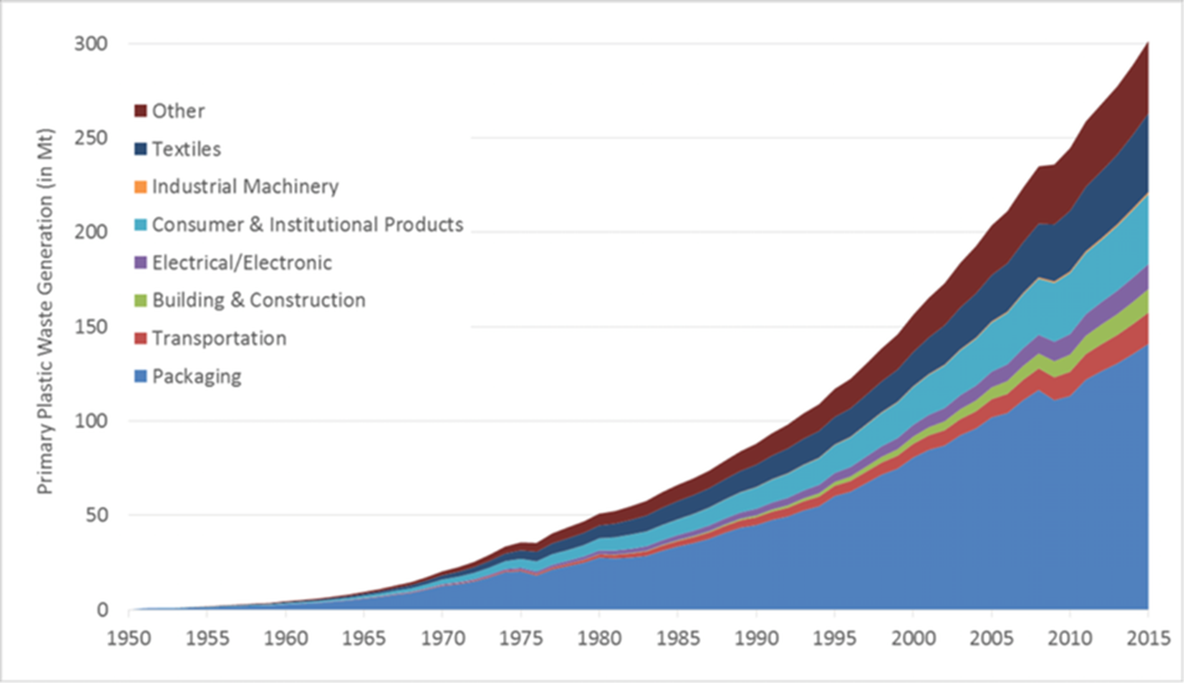
Plastics are a Global Problem
J. Geyer in Science Advances. 2017

Slide 3
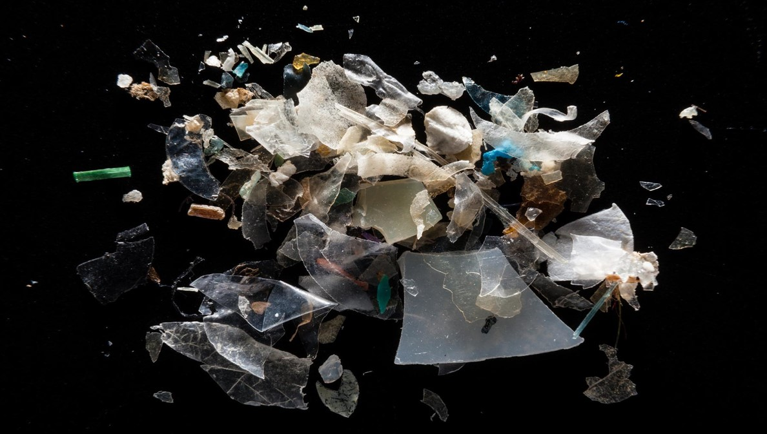
Microplastics
Small plastic fragments, fibers, and granules
How small? Usage of the term “microplastic” in the literature varies from 0.1 um to 10mm – a size range of five orders of magnitude!
Primary Microplastics – manufactured products used in:
-Facial cleansers and cosmetics (microbeads)
-As vectors for drugs
-As air-blasting media for removing rust (often contaminated with heavy metals, e.g. cadmium, chromium, lead)
-Virgin plastic production pellets – Pellets are convenient to ship and are eventually melted down and molded into manufactured products
Secondary Microplastics – pieces that have broken off larger plastic objects through physical, biological, or chemical processes

Slide 4
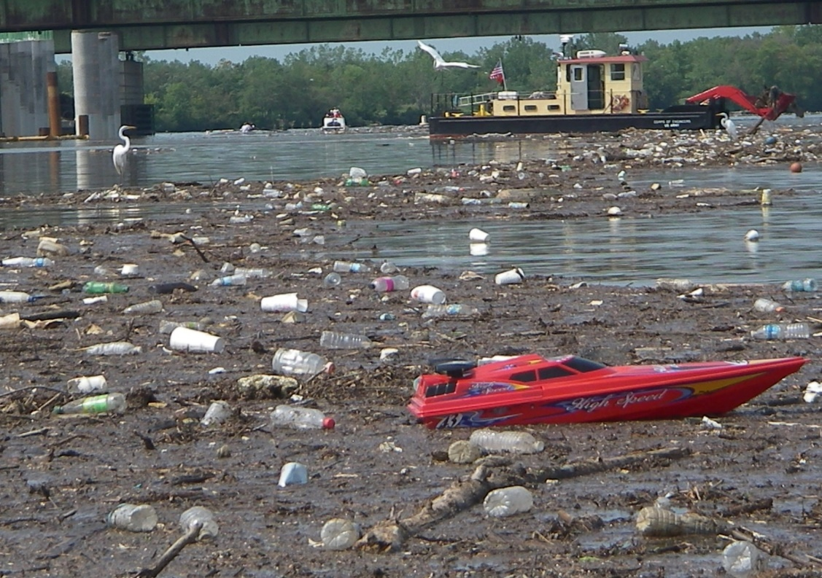
Why Do We Care about Plastics and Microplastics in Chesapeake Bay?
In March 2019, Australian Commonwealth Scientific and Industrial Research Organisation (CSIRO) estimated 95% of all seabird species will ingest some form of plastic by 2050
World Economic Forum projects more plastic in the ocean than fish by 2050
Photo by Masaya Maeda, Anacostia Watershed Society
Notes:
To illustrate for everyone what conditions were like before establishment of the TMDL, here are a few pictures on trash conditions in the Anacostia River and its tributaries.
This is a site in Watts Branch, on the grounds of Kenilworth Park in DC. Watts Branch is DC’s largest tributary to the Anacostia.
In recent years, DOEE has restored an 1,800 linear foot section of Watts Branch with natural stream channel design.
We have also installed two trash traps in Watts Branch: one at the MD/DC line and another at the mouth of Watts Branch before it enters the Anacostia River. I will talk about those best management practices later in the presentation.

Slide 5
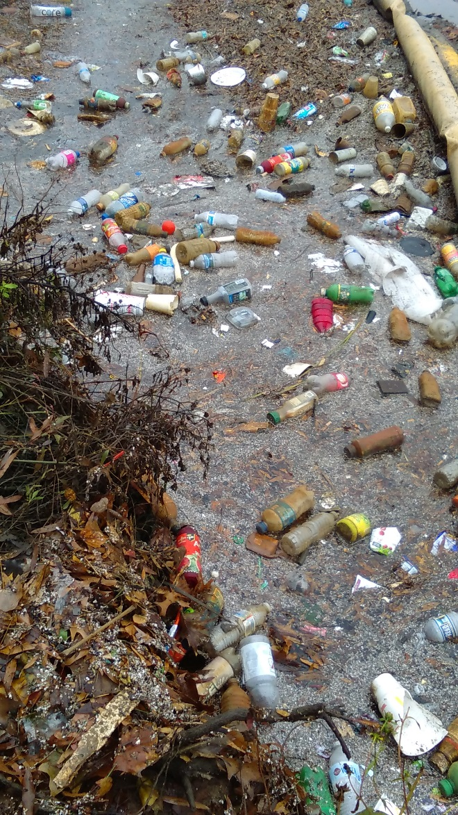
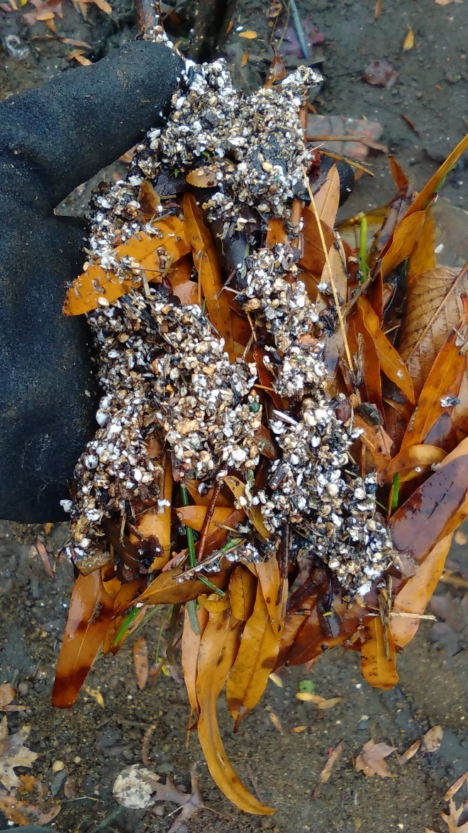
Evidence of Microplastics in the Bay
Photos by Masaya Maeda, Anacostia Watershed Society, 2017

Slide 6
Where are those microplastics likely to accumulate?
Notes:
Following the model for the LA River Trash TMDL, the first of it’s kind in the nation, the jurisdictions decided to assess the baseline load for trash, or the typical annual load.
LA TMDL said that meeting this metric constitutes a zero load of trash to a waterway
To determine this, stream counts of debris were conducted along linear stream transects throughout the District.
In addition, loads of trash were monitored from several outfalls in the Anacostia watershed. Landuse makeup for “sewersheds” to these outfalls and trash loads were correlated with various landuse types.
Landuse became a surrogate for trash loads.

Slide 7
Where are those Microplastics likely to accumulate?
Logical response: SAV beds
Notes:
Following the model for the LA River Trash TMDL, the first of it’s kind in the nation, the jurisdictions decided to assess the baseline load for trash, or the typical annual load.
LA TMDL said that meeting this metric constitutes a zero load of trash to a waterway
To determine this, stream counts of debris were conducted along linear stream transects throughout the District.
In addition, loads of trash were monitored from several outfalls in the Anacostia watershed. Landuse makeup for “sewersheds” to these outfalls and trash loads were correlated with various landuse types.
Landuse became a surrogate for trash loads.

Slide 8
Where are those Microplastics likely to accumulate?
2000% increase in SAV in DC between 2009 and 2017
Surpassed Chesapeake Bay Program goals for SAV restoration
SAV also habitat for larvae of DC state fish, American Shad (A. sapidissima)
Question: could SAV beds be capturing microplastics?
Logical response: SAV beds
Notes:
Following the model for the LA River Trash TMDL, the first of it’s kind in the nation, the jurisdictions decided to assess the baseline load for trash, or the typical annual load.
LA TMDL said that meeting this metric constitutes a zero load of trash to a waterway
To determine this, stream counts of debris were conducted along linear stream transects throughout the District.
In addition, loads of trash were monitored from several outfalls in the Anacostia watershed. Landuse makeup for “sewersheds” to these outfalls and trash loads were correlated with various landuse types.
Landuse became a surrogate for trash loads.

Slide 9
Study of Microplastics in SAV Beds in DC
Figure 1 – Mean microplastic particle concentration (#of particles/volume of sample) in SAV beds vs. unvegetated bottom (n=14, 5 vegetated, 9 unvegetated)
Notes:
Now, how do we implement a trash TMDL?
Well, in DC, two major policy pieces are pushing compliance:
The 2012 iteration of our MS4 permit required the District to have the tools on the ground, by 2017, to capture or remove 103,188 lbs of trash per year from the Anacostia River watershed. That is the equivalent of the MS4 point source load.
Per the NPDES permit for the combined sewer system, DC Water is required to implement a multi-year long term control plan for reducing the frequency of overflows from the combined sewer system. These are commonly known as combined sewer overflows. They are in the process of implementing a multi-year, multi-billion dollar to construct nderground tunnels to capture this overflow and hold it for eventual piping to blue plains for treatment.

Slide 10
Bringing the Issue to Light
How can we bring more attention to this issue regionally?
Notes:
Now, how do we implement a trash TMDL?
Well, in DC, two major policy pieces are pushing compliance:
The 2012 iteration of our MS4 permit required the District to have the tools on the ground, by 2017, to capture or remove 103,188 lbs of trash per year from the Anacostia River watershed. That is the equivalent of the MS4 point source load.
Per the NPDES permit for the combined sewer system, DC Water is required to implement a multi-year long term control plan for reducing the frequency of overflows from the combined sewer system. These are commonly known as combined sewer overflows. They are in the process of implementing a multi-year, multi-billion dollar to construct nderground tunnels to capture this overflow and hold it for eventual piping to blue plains for treatment.

Slide 11
Bringing the Issue to Light
How can we bring more attention to this issue regionally?
The CBP’s SAV Workgroup applied for a Scientific & Technical Advisory Committee (STAC) funding to hold a workshop in 2019 about microplastics in the Bay and watershed
Notes:
Now, how do we implement a trash TMDL?
Well, in DC, two major policy pieces are pushing compliance:
The 2012 iteration of our MS4 permit required the District to have the tools on the ground, by 2017, to capture or remove 103,188 lbs of trash per year from the Anacostia River watershed. That is the equivalent of the MS4 point source load.
Per the NPDES permit for the combined sewer system, DC Water is required to implement a multi-year long term control plan for reducing the frequency of overflows from the combined sewer system. These are commonly known as combined sewer overflows. They are in the process of implementing a multi-year, multi-billion dollar to construct nderground tunnels to capture this overflow and hold it for eventual piping to blue plains for treatment.

Slide 12
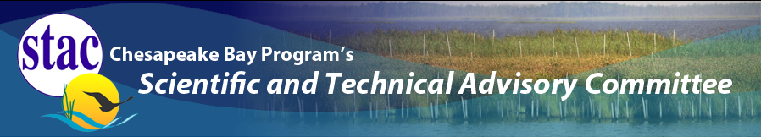
Scientific & Technical Advisory Committee Workshop
“Microplastics in the Chesapeake Bay: State of the Knowledge, Data Gaps, and Relationship to Management”
SAV Workgroup Sponsored
Brooke Landry (MD DNR, SAV WG Chair)
Bob Murphy (TetraTech, SAV Workgroup; Workshop Co-Chair)
Matt Robinson (DC DOEE, SAV Workgroup; Workshop Co-Chair)
Emerging Issues of Concern

Slide 13
Workshop Goals
1. Assess the state of the knowledge on microplastic pollution in the Chesapeake Bay and its tributaries
2. Assess possible effects of microplastics on various habitats and associated living resources
3. Identify existing policy and management tools being used to address plastic pollution in the watershed and beyond, and their effectiveness
4. Identify research gaps moving forward, and develop recommendations for future studies or new tools
Notes:
DC now has 9 trash traps installed.
Pictured here is the installation of a proprietary design, a bandalong trash trap. This was installed in Watts Branch, the District’s largest tributary to the Anacostia River.
The Bandalong is an Australian design. The District was the first jurisdiction in the western hemisphere to install this design. We now have four of these and they typically capture between 8 and 10,000 lbs of trash per year.
This trap was installed and maintained by the Anacostia Riverkeeper, through a grant from DOEE.

Slide 14
Workshop Format
Steering committee decided early on that the workshop should be formatted around conducting an ecological risk assessment (ERA)
The Ecological Risk Framework consists of the following components:
1. Problem Formulation: Determine assessment endpoints and measurement endpoints
2. Risk Analysis: Identify testable linkages between sources, stressors and assessment endpoints
3. Risk Characterization: What are the risk and effects? Ex. LC50 – Lethal concentration to kill 50% of a population
Ecological Risk Framework (EPA, 1992)
Notes:
DC now has 9 trash traps installed.
Pictured here is the installation of a proprietary design, a bandalong trash trap. This was installed in Watts Branch, the District’s largest tributary to the Anacostia River.
The Bandalong is an Australian design. The District was the first jurisdiction in the western hemisphere to install this design. We now have four of these and they typically capture between 8 and 10,000 lbs of trash per year.
This trap was installed and maintained by the Anacostia Riverkeeper, through a grant from DOEE.

Slide 15
Highlights
Yonkos et al. (2014) found microplastics in 59 out of 60 samples in four tidal tributaries to the upper Chesapeake Bay. Concentrations highly correlated with urban/suburban landuse.​
​USGS has found microplastics in every sample taken at five non-tidal stations in the Chesapeake Bay watershed (Fisher, 2019). ​
​In 2018, 95% of smallmouth bass (M. dolomieu) sampled in the central Susquehanna River had microplastics in their guts (Parks, 2019).​
​Brander (2019) found that juvenile Black Seabass (Centropristis striata) fed with fish fed with pre-cleaned microplastics displayed increased oxygen consumption. Juveniles exposed to microfibers in the water column displayed increased oxygen consumption. ​
​Knauss (2019) found that Eastern Oyster (C. virginica) larvae that ingested polystyrene microbeads displayed a significant increase in algal clearance and an increase in carbon –assimilation in a dose dependent manner. ​
​
Notes:
DC now has 9 trash traps installed.
Pictured here is the installation of a proprietary design, a bandalong trash trap. This was installed in Watts Branch, the District’s largest tributary to the Anacostia River.
The Bandalong is an Australian design. The District was the first jurisdiction in the western hemisphere to install this design. We now have four of these and they typically capture between 8 and 10,000 lbs of trash per year.
This trap was installed and maintained by the Anacostia Riverkeeper, through a grant from DOEE.

Slide 16
Conclusions
Studies have shown microplastics are fairly ubiquitous throughout the bay and its tributaries. They have been found in both tidal (Yonkos, 2014; Rochman, 2019) and non-tidal waters (Fisher, 2019).
There is general agreement that plastics represent a widespread, but largely unquantified, threat to the Chesapeake Bay ecosystem.
Need standardization of terminology
There are a number of piecemeal efforts to monitor plastics in the Bay, but no systematic effort and no organized effort directed at micro- and nano-plastics.
The MOST URGENT need is to identify assessment endpoints that represent areas of environmental and human health concern and to characterize the severity of those risks.
Notes:
DC now has 9 trash traps installed.
Pictured here is the installation of a proprietary design, a bandalong trash trap. This was installed in Watts Branch, the District’s largest tributary to the Anacostia River.
The Bandalong is an Australian design. The District was the first jurisdiction in the western hemisphere to install this design. We now have four of these and they typically capture between 8 and 10,000 lbs of trash per year.
This trap was installed and maintained by the Anacostia Riverkeeper, through a grant from DOEE.

Slide 17
Recommendations

Slide 18
Recommendations
1. The CBP should create a cross-GIT Plastic Pollution Action Team to address the growing threat of plastic pollution to the bay and watershed.

Slide 19
Recommendations
1. The CBP should create a cross-GIT Plastic Pollution Action Team to address the growing threat of plastic pollution to the bay and watershed.
2. The Scientific, Technical Assessment and Reporting Team should incorporate development of ERAs of microplastics into the CBP strategic science and research framework, with the development of the ERAs focused on assessment of microplastic pollution on multiple living resource endpoints.

Slide 20
Recommendations
1. The CBP should create a cross-GIT Plastic Pollution Action Team to address the growing threat of plastic pollution to the bay and watershed.
2. The Scientific, Technical Assessment and Reporting Team should incorporate development of ERAs of microplastics into the CBP strategic science and research framework, with the development of the ERAs focused on assessment of microplastic pollution on multiple living resource endpoints.
3. STAC or an appointed ad hoc technical team should undertake a technical review of terminology used in microplastic research, specifically size classification and concentration units, and recommend uniform terminology for the CBP partners to utilize in monitoring and studies focused on plastic pollution in the bay and watershed.

Slide 21
Recommendations
1. The CBP should create a cross-GIT Plastic Pollution Action Team to address the growing threat of plastic pollution to the bay and watershed.
2. The Scientific, Technical Assessment and Reporting Team should incorporate development of ERAs of microplastics into the CBP strategic science and research framework, with the development of the ERAs focused on assessment of microplastic pollution on multiple living resource endpoints.
3. STAC or an appointed ad hoc technical team should undertake a technical review of terminology used in microplastic research, specifically size classification and concentration units, and recommend uniform terminology for the CBP partners to utilize in monitoring and studies focused on plastic pollution in the bay and watershed.
4. The CBP should develop a source reduction strategy to assess and address plastic pollution emanating from point sources, non-point sources, and human behavior.

Slide 22
Recommendations
1. The CBP should create a cross-GIT Plastic Pollution Action Team to address the growing threat of plastic pollution to the bay and watershed.
2. The Scientific, Technical Assessment and Reporting Team should incorporate development of ERAs of microplastics into the CBP strategic science and research framework, with the development of the ERAs focused on assessment of microplastic pollution on multiple living resource endpoints.
3. STAC or an appointed ad hoc technical team should undertake a technical review of terminology used in microplastic research, specifically size classification and concentration units, and recommend uniform terminology for the CBP partners to utilize in monitoring and studies focused on plastic pollution in the bay and watershed.
4. The CBP should develop a source reduction strategy to assess and address plastic pollution emanating from point sources, non-point sources, and human behavior.
5. The CBP should direct the Plastic Pollution Action Team and STAR Team to collaborate on utilizing the existing bay and watershed monitoring networks to monitor for microplastic pollution.

Slide 23
Next Steps
Brief the Principals’ Staff Committee at an upcoming meeting*.
2. Brief LGAC on the STAC Report.
3. Brief Potomac River Fisheries Committee on the STAC Report
Work with STAR on the creation of a Plastic Pollution Action Team which will initially focus on determining the scope of work for conducting a microplastics ecological risk assessment*.
* - Subject to approval of November Management Board Meeting Summary.

Slide 24
Take-Aways for CAC
DC has agreed to be a champion on the Management Board for addressing this issue.
We welcome the opportunity to discuss our successes and failures with other jurisdictions
who are as equally concerned about plastic pollution.
Reducing plastic pollution should be a regional priority.

Slide 25
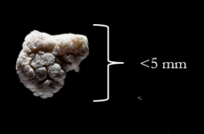
Special Thanks
Matt Robinson, DC DOEE, Workshop co-chair
Brooke Landry (MD DNR), CBP SAV Workgroup Chair and workshop sponsor.
Rachel Dixon, former STAC Coordinator
Annabelle Harvey, STAC Coordinator
Our Host: Dann Sklarew, George Mason University Department of Environmental Science & Policy
Workshop Steering Committee:
Mark Luckenbach, Virginia Institute of Marine Science
Denice Wardrop, Penn State
Lance Yonkos, University of Maryland
Jason Rolfe, NOAA Marine Debris Program
Kelly Somers, EPA Region III
Greg Allen, EPA Chesapeake Bay Program Office
Kim Grubert, MD DNR
Phong Trieu, Metropolitan Washington Council of Governments
Notes:
Following the model for the LA River Trash TMDL, the first of it’s kind in the nation, the jurisdictions decided to assess the baseline load for trash, or the typical annual load.
LA TMDL said that meeting this metric constitutes a zero load of trash to a waterway
To determine this, stream counts of debris were conducted along linear stream transects throughout the District.
In addition, loads of trash were monitored from several outfalls in the Anacostia watershed. Landuse makeup for “sewersheds” to these outfalls and trash loads were correlated with various landuse types.
Landuse became a surrogate for trash loads.

Slide 26

Questions?
Microplastics from the Magothy River at the laboratory of Dr. Lance Yonkos, University of Maryland, College Park

