Slide 1
EPA Evaluation of Chesapeake Bay
Two-Year Milestones
(2012-13 & 2014-15)
December 4, 2014
Suzanne Trevena
EPA Water Protection Division
Chair Milestone Workgroup

Slide 2
Overview
What are the 2-year milestones and evaluation?
How we conducted evaluation
Evaluation results

Slide 3
Milestones Evaluation
Milestones comprise:
  Numeric: translate practices into load reductions and compare to long-term trajectories
  Programmatic: Actions to build capacity to achieve necessary implementation levels
2012-13: Did jurisdictions and federal agencies achieve their 2012-13 commitments set 2 years ago?
2014-15: Are commitments strong enough to keep jurisdictions and federal agencies on track to have:
  All practices in place by 2025 to achieve clean water in Bay
  Practices in place by 2017 to achieve 60% of necessary reductions compared to 2009

Slide 4
The Evaluation Team
State WIP leads
Sector experts
  Agriculture
  Urban/Stormwater
  Wastewater
  Trading/Offsets/Growth
  Modeling
  Local Engagement
Bay Grant project officers
Senior Managers

Slide 5
Overall Programmatic Progress and Goals
Majority of 2012-13 programmatic milestones were achieved
  Some important milestones missed, e.g. permit reissuance
For 2014-15, the trajectory and pace of implementation to meet 2017 goals gets steeper in many instances. There are good commitments, more needs to be done to build necessary capacity
Enhanced implementation rates and new, innovative tools are needed to meet the challenges ahead of us

Slide 6
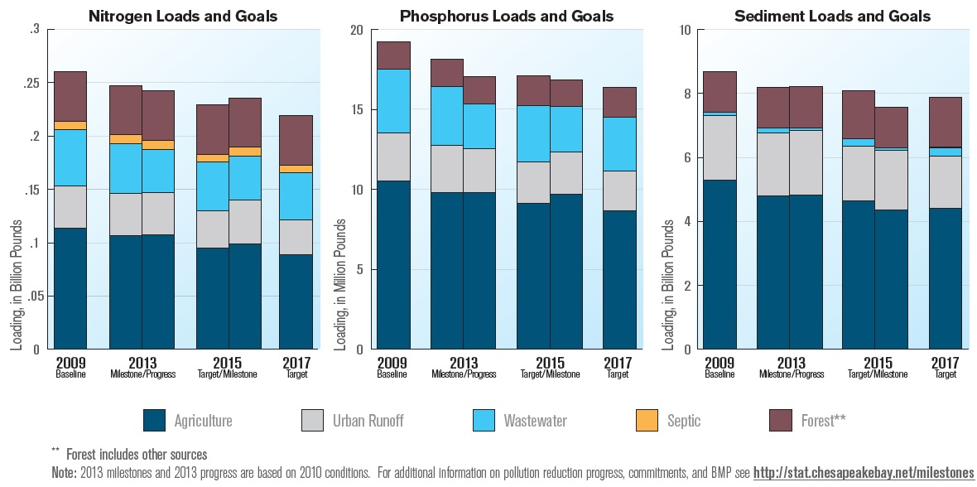
Overall Numeric Progress and Goals
Blue arrows – Milestone targets
Green arrow – actual progress
Orange arrow – reflect being “on track” to 2017

Slide 7
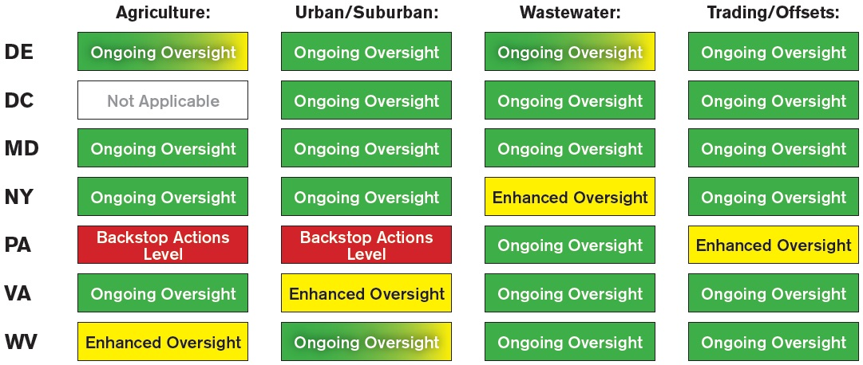
2014 Oversight Status

Slide 8
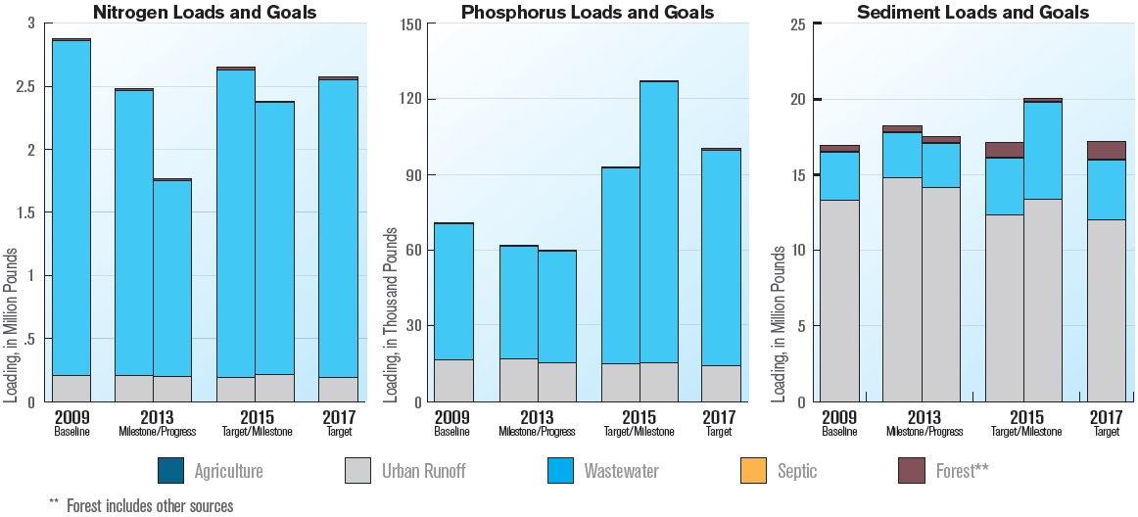
District of Columbia Progress and Goals
Blue arrows – Milestone targets
Green arrow – actual progress
Orange arrow – reflect being “on track” to 2017

Slide 9
District of Columbia Oversight Status
Strengths
  Continued upgrades to Blue Plains WWTP; will have enhanced nutrient removal in place by
  October 2014
Shortfalls
  Did not complete citywide online stormwater tool by 2013
Issues to Address
  Increase implementation of tree plantings and redevelopment projects at 1.2 inch retention standard to meet Urban Stormwater projections

Slide 10
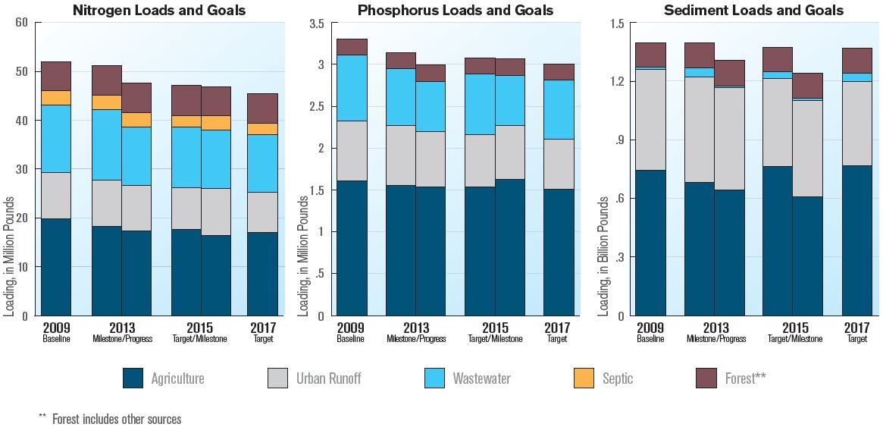
Maryland Progress and Goals
Blue arrows – Milestone targets
Green arrow – actual progress
Orange arrow – reflect being “on track” to 2017

Slide 11
Maryland Oversight Status
Strengths
  Implemented revised agricultural nutrient management regulations and homeowner fertilizer act
  Doubled Bay Restoration Fund fee—funds to complete ENR upgrades at 67 major and 5 to 10 minor wastewater treatment plants by 2017
Shortfalls
  Phosphorus Management Tool regulations not completed as specified; committed to implementing in 2014
Issues to Address
  Issue remaining, expired MS4 permits and construction general permit by agreed upon schedule

Slide 12
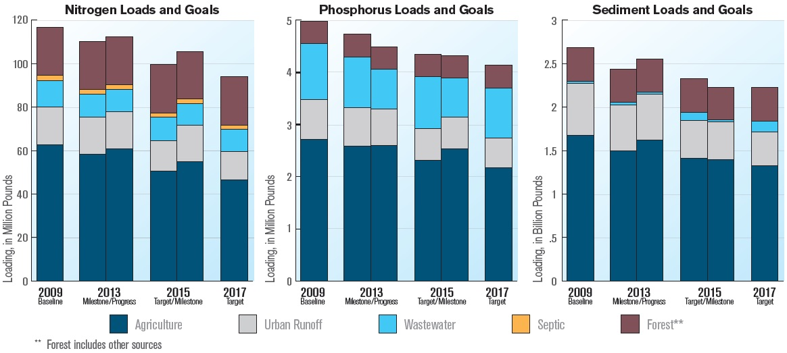
Pennsylvania Progress and Goals
Blue arrows – Milestone targets
Green arrow – actual progress
Orange arrow – reflect being “on track” to 2017

Slide 13
Pennsylvania Oversight Status
Strengths
  Committed to performing 450 agricultural compliance inspections and 100 compliance actions during the 2014-2015 milestone period
Shortfalls
  Did not meet 2013 reduction targets in agriculture and did not meet implementation targets for critical BMPs the Commonwealth is relying on heavily to meet nutrient and sediment reduction targets
Issues to Address
  Increase progress in agriculture and stormwater to get on track to meet nitrogen targets for 2015, with focus on highest priority water quality BMPs

Slide 14
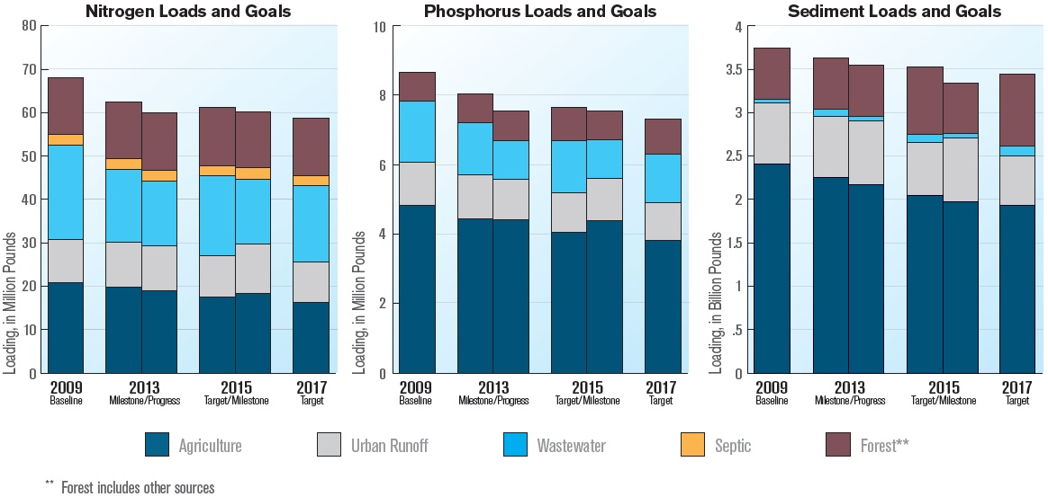
Virginia Progress and Goals
Blue arrows – Milestone targets
Green arrow – actual progress
Orange arrow – reflect being “on track” to 2017

Slide 15
Virginia Oversight Status
Strengths
  Launched the Virginia Enhanced Conservation Initiative; $4.8 million in cost-share funds and reimbursing farmers up to 100% to install stream fencing systems
  Approved bond authorization including $101 million to fund grants for wastewater plant upgrades and up to $75 million for Combined Sewer Overflow control projects
Shortfalls
  Did not issue 10 remaining, expired Phase I MS4 permits—not on track to have practices in place by 2025 to meet TMDL allocations for stormwater within Phase I localities
Issues to Address
  Demonstrate more aggressive implementation of BMPs to manage stormwater, including infiltration and filtration

Slide 16
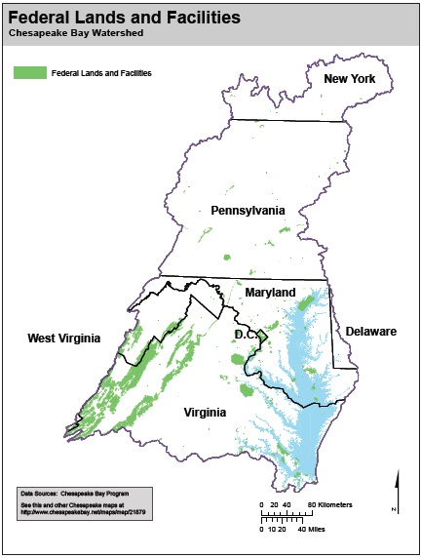
Federal Agencies
Strengths
  Developed the planning tool Bay Facility Assessment Scenario Tool (BayFAST) to allow federal agencies to estimate current loads and pollutant reductions from various BMP scenarios
Shortfalls
  EPA deferred revisions to national stormwater rule; alternatively will develop proposals to strengthen
  stormwater program in 2014-2015
Issues to Address
  Improve BMP progress reporting by federal facilities through BayFAST in 2014

Slide 17
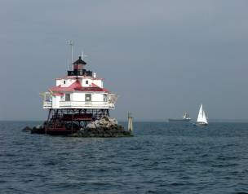
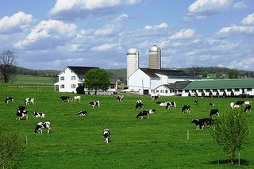

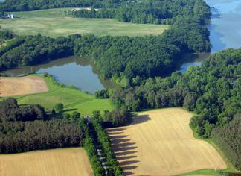
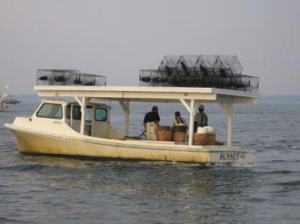
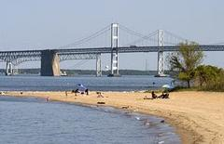
Questions?
www.epa.gov/chesapeakebaytmdl

