Slide 1
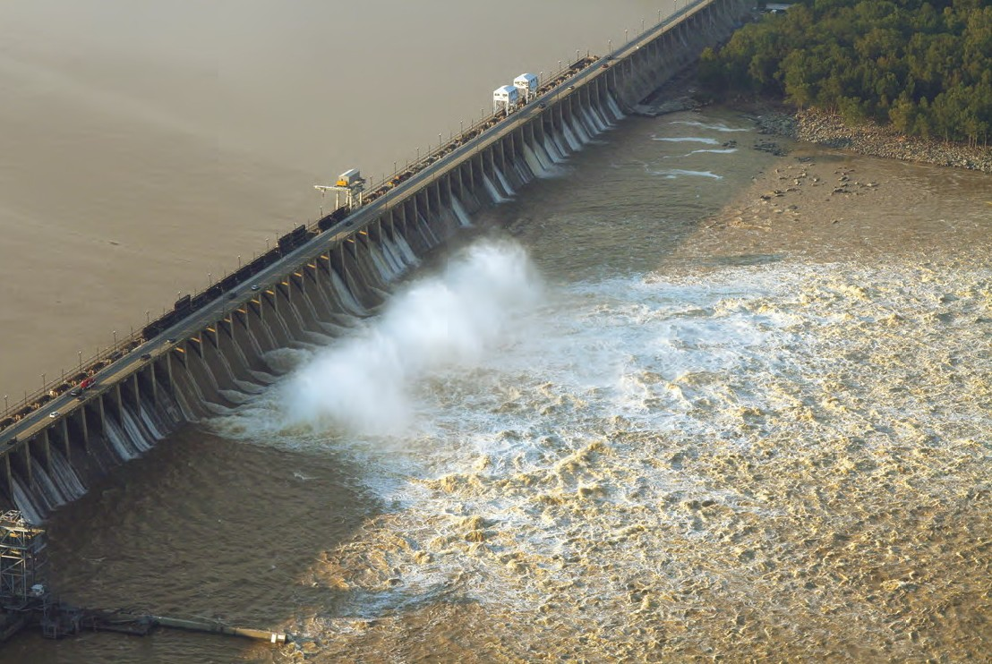
The Lower Susquehanna River reservoir system and Chesapeake Bay: Historical context and current understanding
CAC Conowingo Dam Panel Discussion
February 25, 2022
Andy Miller, UMBC/STAC

Slide 2
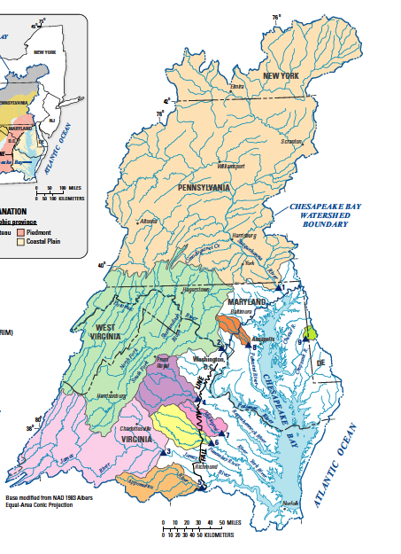
Susquehanna River Has a Major Influence on Chesapeake Bay Water Quality
Susquehanna watershed
43% of Chesapeake Bay watershed
47% of freshwater flow into the Bay
41% of nitrogen loads to the Bay
25% of phosphorus loads to the Bay
27% of sediment loads to the Bay
Influences Bay water quality well
into Virginia’s portion of the Bay
Potomac watershed
Slide from Lee Currey,MDE; Source: Linker (2014)
Notes:
The Susquehanna River contributes almost one-half of the freshwater inflows into the Chesapeake estuary and over 40% of the nitrogen.
Almost half of the nitrogen load to the Bay is from the Susquehanna
Much less of the phosphorus load is from the Susquehanna river, but that is changing
These numbers do not inform the amount of nitrogen and phosphorus that influence the growth of algae
The second largest contributor of nutrients is the Potomac Basin

Slide 3
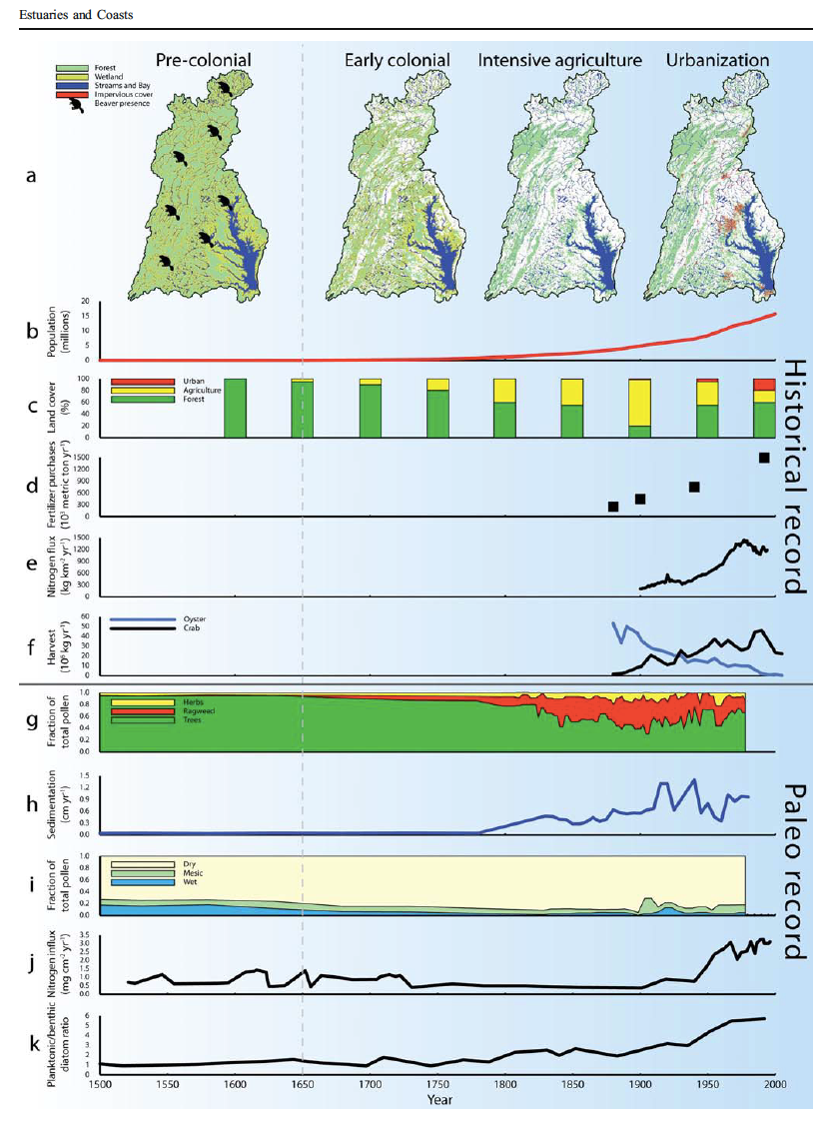
Brush, 2007
Historical land use, nitrogen, and coastal eutrophication: a paleoecological perspective
Time scale extends from 1500-2000
Rapid increase in sedimentation goes back to European settlement and accelerates in 1800’s and 1900’s, rapid increase in nutrient flux is dramatic after WW II
Population
Land cover
Fertilizer purchases
Nitrogen flux
Shellfish harvest
Fraction of total pollen
Sedimentation rate
Fraction of total pollen
Nitrogen influx
Planktonic/benthic

Slide 4
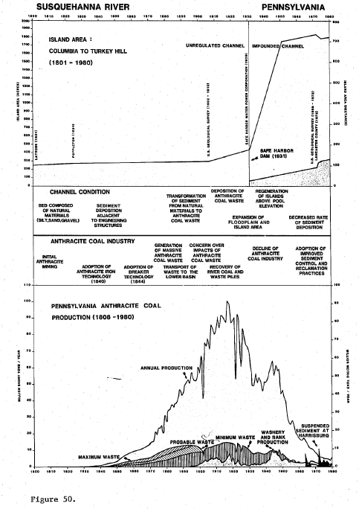
Lintner, S.F., 1983. The Historical Physical Behavior of the Lower Susquehanna River, Pennsylvania, 1801-1976.
The Susquehanna River basin had a history of hydraulic mining for coal beginning in 1840
It took 30-40 years for large volumes of mining-related sediment to begin accumulating in the lower Susquehanna
Net accretion of islands and aggradation on floodplains occurred up through 1929; rates of island growth accelerated after closure of Safe Harbor Dam
Marietta floodplain aggraded 3-7 feet

Slide 5
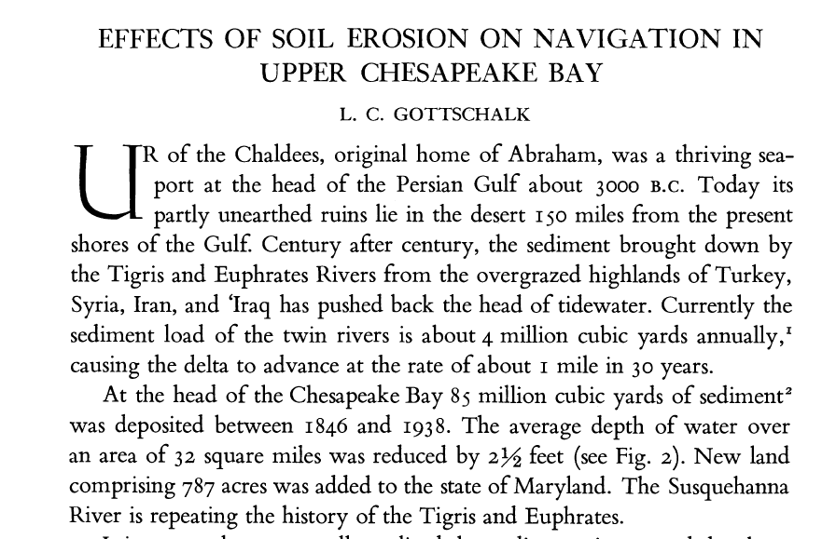
From Gottschalk, 1945
1. Some historical context

Slide 6
Langland, USGS, 2015 – Open File Report 2014-1235
Sediment loads were greater in the early to mid-1900s, averaging approximately 87 million tons per decade (8.7 million tons per year)
In the 1950s, agricultural conservation measures were enacted (Wedin, 2002; Westra, 2003), helping to reduce sediment loads from 87 million tons in previous decades to approximately 60 million tons.
Sediment loads have generally decreased from the 1960s through the 1980s as a result of more land reverting to forest from farm abandonment, a decrease in land disturbance from coal production, and new best-management actions to control sediment.
Loads continued to decline to an average of 3.5 million tons per year over the period 1991–2012

Slide 7
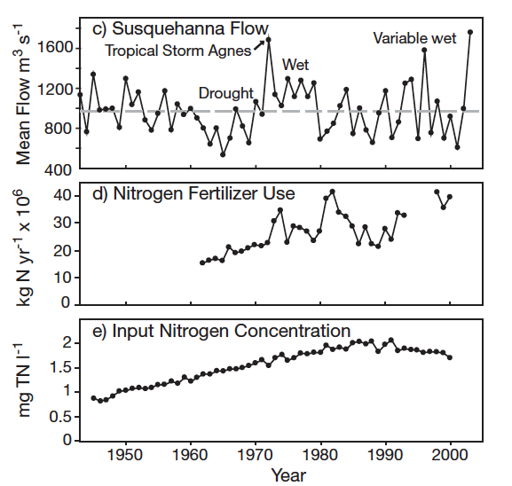
As watershed sediment yield started to decline, nutrient flux was increasing…
This was a global trend but it began to hit Chesapeake Bay particularly hard in the 1970’s and 1980’s
As we now know, nutrients are the bigger problem for the Bay ecosystem
From Kemp et al. 2005

Slide 8
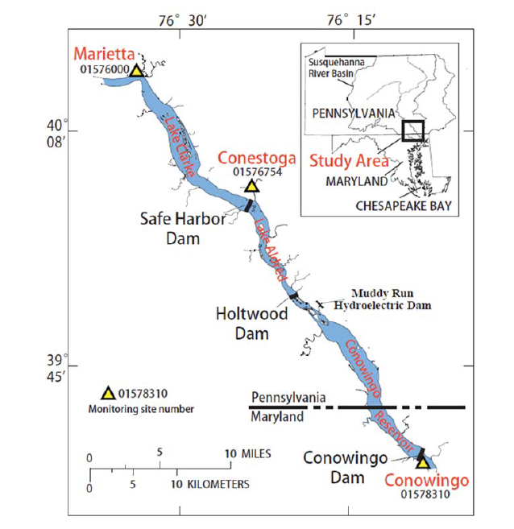
The System of Reservoirs has been filling over time.
Three Reservoirs in the Lower Susquehanna
What do we mean by “equilibrium” or “dynamic equilibrium”?
Safe Harbor Dam
Lake Clark
1950-2015
Holtwood Dam
Lake Aldred
Vertical Exaggeration 264x
1920-2015
Conowingo Dam
Built 1931
Equilibrium - 1950
Built 1910
Equilibrium - 1920
Conowingo Reservoir
Built 1928
Equilibrium – around 2010
(First evidence - late 1970s)
1960
1990
2015
Source: Langland and Blomquist, USGS, personal communication
Notes:
For almost a century, the lower Susquehanna Reservoirs trapped significant amounts of sediment and phosphorus from reaching the Bay.
The reservoir system has been losing their storage capacity over time and since about the mid-1990s, phosphorus and sediment began increasing into the Bay. Please explain why
The major consequence is it may more difficult to meet water-quality goals in the Bay
The modeling tools are not accounting for the recent infill. The model represents a 1990 time periods
history of infill of the three reservoirs and highlight how the recent changes in Conowingo Reservoir could affect water quality at the outflow.
The lower diagram shows sedimentation levels in the three reservoirs and highlights the time period of each measured level. Lake Clark and Aldred are shown to be at equilibrium since 1960. Conowingo shows a growing amount of sediment infill over the period1960-2015, with the vast majority of total sediment infill occurring prior to 1960 for the three-reservoir system.

Slide 9
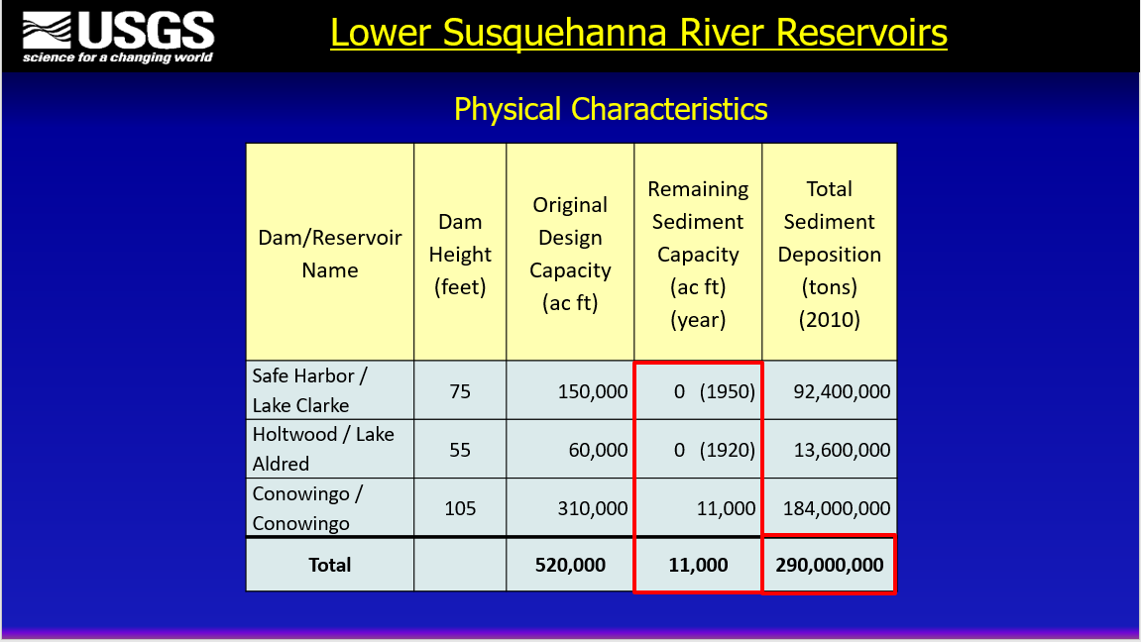
What do we mean by “equilibrium” or “dynamic equilibrium”?
Langland, 2016

Slide 10
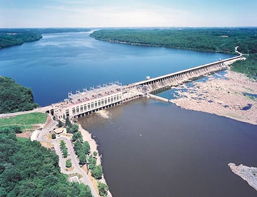
Timeline for Lower Susquehanna River Reservoirs: 1900-2020
1900
1910 – Holtwood Dam constructed
1920
1920 – Holtwood Dam reaches equilibrium
1928 – Conowingo Dam constructed
1931 – Safe Harbor Dam constructed
1940
1950 – Safe Harbor Dam reaches equilibrium
1960
1960s – Historical lowest flows in Susquehanna
1972 – Tropical Storm Agnes
1980
1979 – Systematic water quality monitoring begins on the Susquehanna River at Conowingo Dam
1996 – January “Big Melt” rain on snow flood event
2000
2001 – SRBC convenes “Susquehanna Sediment Task Force” Symposium; publishes report
2010 – Chesapeake Bay TMDL established
2012 – Hirsch 2012 - clear evidence for Conowingo Reservoir at or near dynamic equilibrium
2020
2017 – Bay TMDL Midpoint Assessment
Source: Langland, USGS, Personal Communication

Slide 11
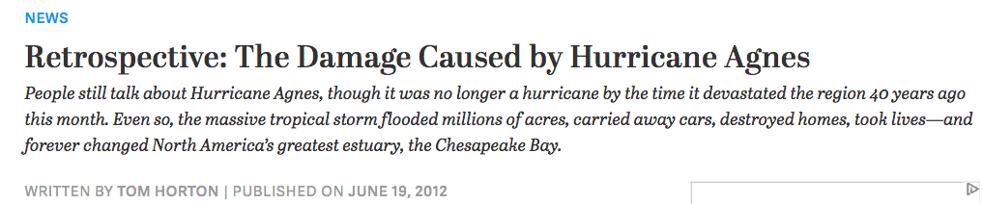
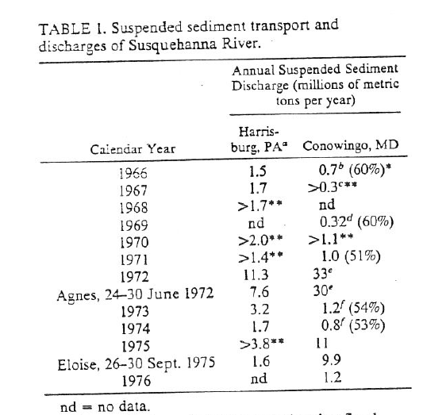
Table from Gross et al., 1978
It has been known for more than 40 years that the reservoir system was trapping large volumes of Susquehanna River sediment and associated contaminants, and could export multiple years’ worth of sediment in a single large flood
The impact of Agnes was due not only to remobilization of stored material, but also to the enormous volume of fresh water changing salinity and current patterns in the Bay, and due to the fact that it occurred in June rather than late summer, fall, or winter
The steep decline in Chesapeake Bay seagrass and oyster beds, water quality, dissolved oxygen, and other measures of environmental quality is commonly dated to the period after 1972 when Tropical Storm Agnes caused a historic flood to inundate the estuary with sediment and pollutants.

Slide 12
What is the truth about Conowingo Dam? Is it undermining Chesapeake Bay restoration efforts? Is dredging the answer?
There has been extensive scientific review of these questions. The Lower Susquehanna River Watershed Assessment (Army Corps of Engineers) was completed in 2014. A STAC review of the report was also published in 2014 and the final LSRWA report was released in 2016.
There was a Chesapeake Bay Scientific and Technical Advisory Committee Workshop on the subject of Conowingo infill and its implications in January 2016.
In summer 2017, research projects investigating the potential of Conowingo sediment to affect water quality in Chesapeake Bay were completed by UMCES scientists under contract to Exelon as part of its bid for relicensing of the Conowingo hydropower dam. A paper summarizing those findings was published in 2019.
The 2017 TMDL Midpoint assessment included analysis of updated modeling results to determine the additional loads that would have to be accounted for as a result of Conowingo infill

Slide 13
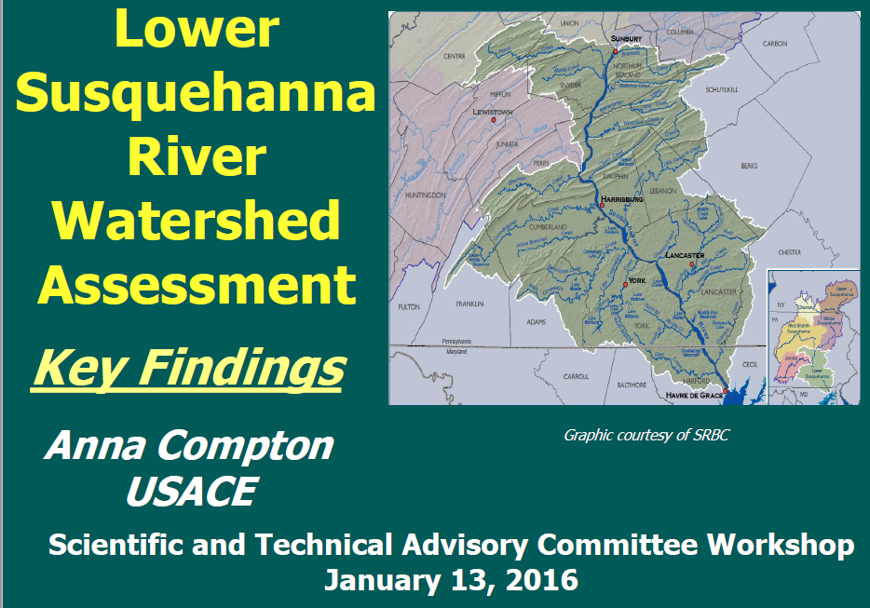
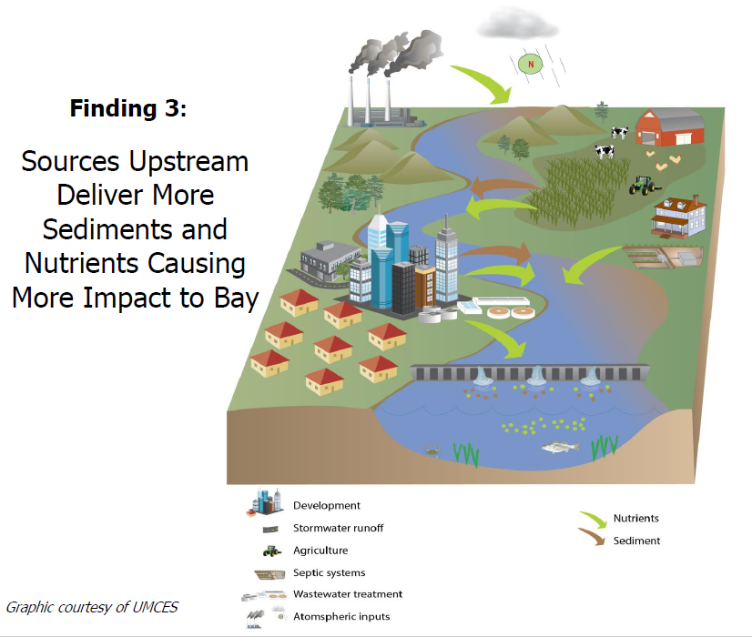
Finding 3 Continued:
Notes:
Finding #3, cont’d- Sources upstream of Conowingo Dam deliver more sediment and nutrients and, therefore, have more impact on the upper Chesapeake Bay ecosystem, than do the scoured sediment and associated nutrients from the reservoir behind Conowingo Dam.
On average during a 4-5 year event, approximately 70-80% of the sediment that empties into Chesapeake Bay from the Susquehanna River is from watershed sources while 20-30% scour of reservoir material (from behind Conowingo).
During lower flow periods, the reservoirs act as a sediment trap aiding in the health of the Bay until the next high flow event.
Watershed contributions of sediment and nutrients during large storm events will have significant effects on the Bay’s living resources with or without a “full” Conowingo reservoir .
-The majority of sediment and nutrients, and their impacts on the upper Chesapeake Bay ecosystem during storm events, originate from the upstream Susquehanna River watershed rather than from being scoured from the reservoirs behind the dams. Conowingo Reservoir and the two upstream reservoirs’ bed sediment scour comprised an average of approximately 30 percent with a range of 20 to 35 percent of the total sediment loads entering Chesapeake Bay during an event up to 800,000 cfs (recurrence interval of less than 40 years); the remaining load was estimated to be from the Susquehanna River watershed. The range of scour to watershed loads is due to variations in sediment-loading conditions from the bed and the watershed. The study data indicate that as flow increases the bed scour load becomes an increasingly higher proportion of the total sediment load. On average, flows above 800,000 cfs produced scour load that comprised about 30 to 50 percent of the total load entering the Bay; however, an event of this magnitude is extremely rare with a recurrence interval of 40 years or more. There will be a point where the sediment transported into the reservoirs will have a limited ability to scour based on the transport capacity and the ability of the reservoir bed to erode. So at some point, the bed will either not erode, or the erosion rate will be very low.
-Under 2011 bathymetry conditions, the bed sediment scour load from Conowingo Reservoir during Tropical Storm Lee comprised about 20 percent of the Tropical Storm Lee total sediment load (about 3.0 million tons of the 14.5 million tons); this load included scour from the two upstream reservoirs and loads from the rest of the Susquehanna River watershed. Similar results were calculated for the “full” Conowingo Reservoir bathymetry. These results imply that the Susquehanna River watershed located above the Conowingo Dam (including the two upstream reservoirs) provided 80 percent of the load during Tropical Storm Lee, with the remaining 20 percent from scoured bed sediment trapped in Conowingo Reservoir behind the dam.
*Storm characteristics are highly variable and variations in track, timing, and duration can alter the amount of sediment entering the system from both the watershed and from the reservoirs behind the dams. Consequently, this percentage of scour and watershed contributions can vary as well, so this concept is not universal to all storms, but it does give a good sense of magnitude. For the entire time period of 2008-2011 under 2011 bathymetry, scour from the Conowingo Reservoir (estimated 3.0 million tons) comprised 13 percent of the total sediment load to the Chesapeake Bay (estimated 22.3 million tons ), with 87 percent of the load originating from the upstream Susquehanna River watershed, including any scour from the two upstream reservoirs.

Slide 14
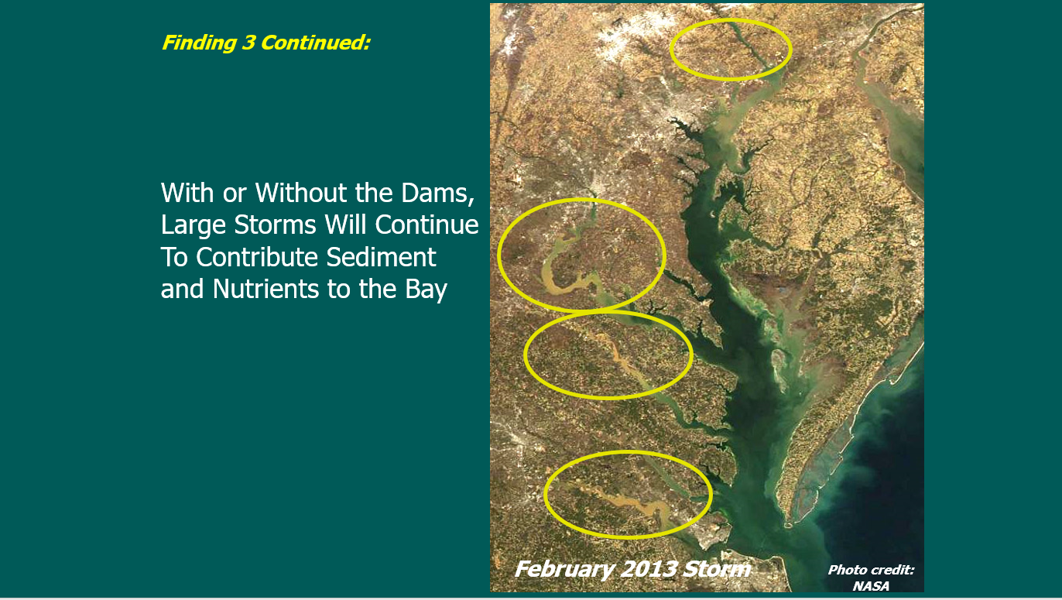

Slide 15
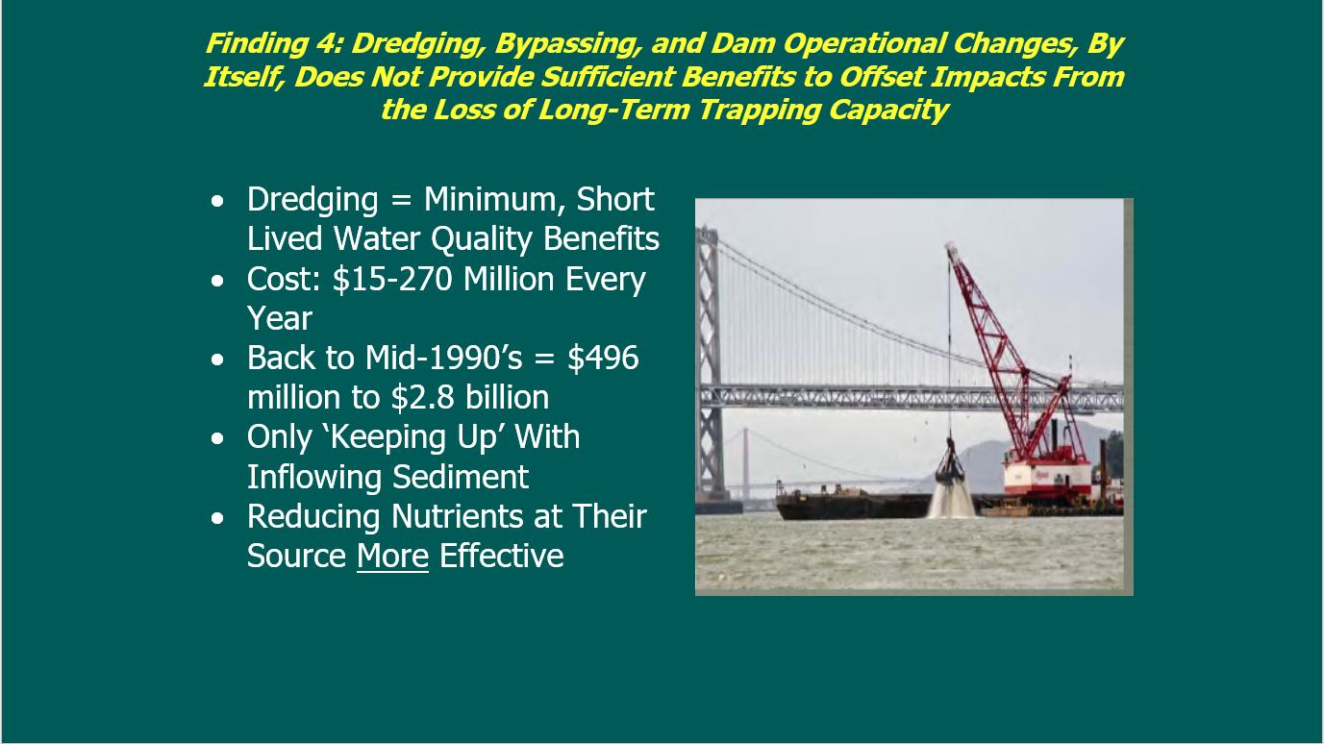

Slide 16
From the 2014 STAC Review of LSRWA report:
As soon as possible, follow-up studies should more fully quantify the impact on Chesapeake Bay water quality from increases in sediment-associated nutrients brought about by reservoir infilling.
There is no compelling reason to reduce sediment loads per se from the Susquehanna watershed to compensate for increased sediment passing out of the Conowingo reservoir. Nutrients are the main problem, not sediments.
Additional particulate phosphorus load reductions from the Susquehanna watershed (beyond present WIPs) should be considered to compensate for changes to the Conowingo.

Slide 17
From the 2016 STAC Workshop on Conowingo Infill
Increases in phosphorus and sediment flux from the Conowingo Reservoir occurred despite observed reductions in the fluxes of sediment and phosphorus from the upriver Marietta, PA gauge as well as other upstream gauges and were therefore attributed to Conowingo infill.
Infilling of the Conowingo Reservoir primarily influences particulate nutrient delivery, with negligible influence on fresh water discharge or dissolved nutrient delivery to the Chesapeake Bay system. Most nitrogen is transported in dissolved form.
Under low to moderately high flow conditions, it is likely most of the sediment loading from the Susquehanna is trapped (and buried) by processes at or before the Estuarine Turbidity Maximum (ETM).
There is significant bypassing of the ETM under very high flow conditions, but when and how much remains to be determined.

Slide 18
Flood waters and sediment passing through Conowingo Dam on the lower Susquehanna following Tropical Storm Lee, Sept. 12, 2011
Flow = 220,000 cfs; peak was 778,000 cfs
Photo by Wendy McPherson,
USGS

Slide 19
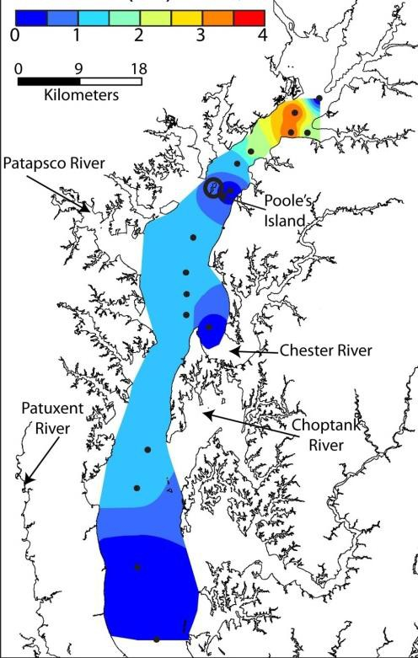
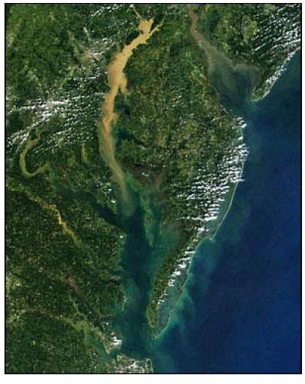
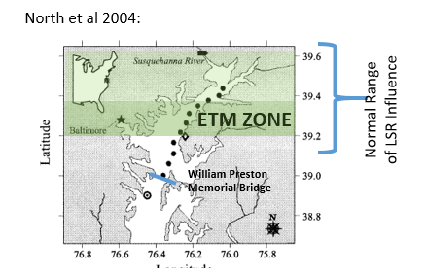
Tropical Storm Lee sediment plume
What the Data Shows
Sediment Deposition (cm)
Much of the environmental impact of large flow events is due to the effects of a large volume of fresh water entering the upper Bay
For most of the upper Bay, Lee deposits were 0-1.5 cm thick
Photo Credit: NASA
Palinkas et al., 2014

Slide 20
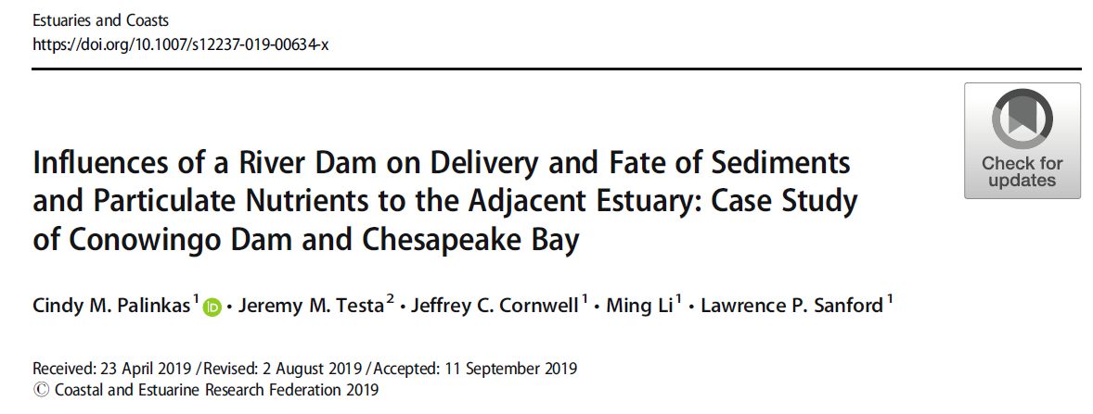
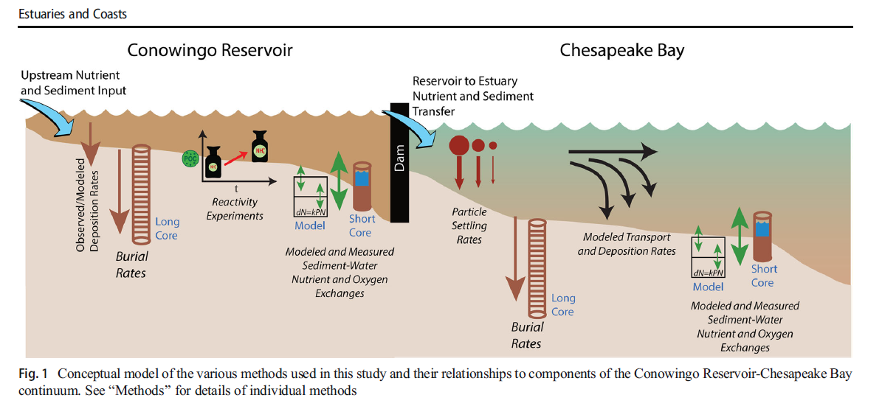
2019 paper summarizing the 2017 UMCES studies conducted to improve understanding in advance of the Exelon relicensing agreement

Slide 21
Conclusions from UMCES 2017 reports and Palinkas et al. 2019
Results show that, for equvalent river discharges, sediment loading has decreased during non-event flows but increased during event flows
The potential biogeochemical impacts of these elevated inputs is limited, because scoured particulate nitrogen (N) and phosphorus (P) loads that do enter the Bay are highly refractory and would contribute a relatively small fraction of loading in an extreme storm like Tropical Storm Lee
These sediments are efficiently retained in the upper Bay due to high sinking rates or trapping in the ETM but can be transported downstream during events
While large precipitation and riverine flow events are significant and can generate a substantial short-term impact on receiving waters in Chesapeake Bay, the estuary is remarkably resilient to storms
The Chesapeake Bay will be negatively influenced by continued infilling of reservoirs and the loss of an unintended watershed BMP, but the scale of the potential impact of elevated particulate nutrient inputs on the mainstem Chesapeake Bay is likely small compared to ongoing reductions in dissolved nitrogen and phosphorus in many regions of the watershed.

Slide 22
Key takeaways :
Loads entering the estuary are largely retained in the upper Bay – but can be transported farther downstream during large events
Reservoir sediments are highly refractory and inputs of reservoir-like organic matter DO NOT enhance modeled sediment-nutrient release in upper Bay sediments
These findings highlight the Bay’s resilience to large sediment loads during events such as Tropical Storm Lee in 2011, likely aided by ongoing restoration efforts
While events can have major short-term impacts, the long-term impact to Bay biogeochemistry is less severe

Slide 23
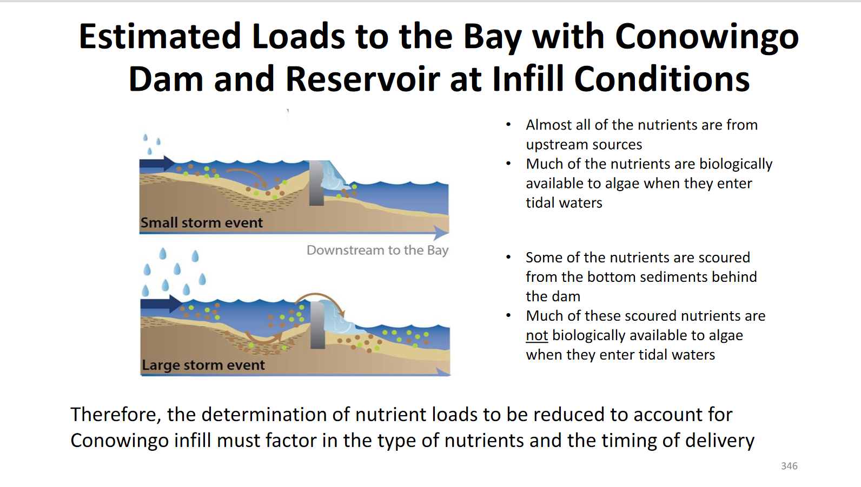
Updates to the modeling framework incorporating findings have led to determination of additional load reductions needed.
Dec. 2017 WQGIT Midpoint assessment

Slide 24
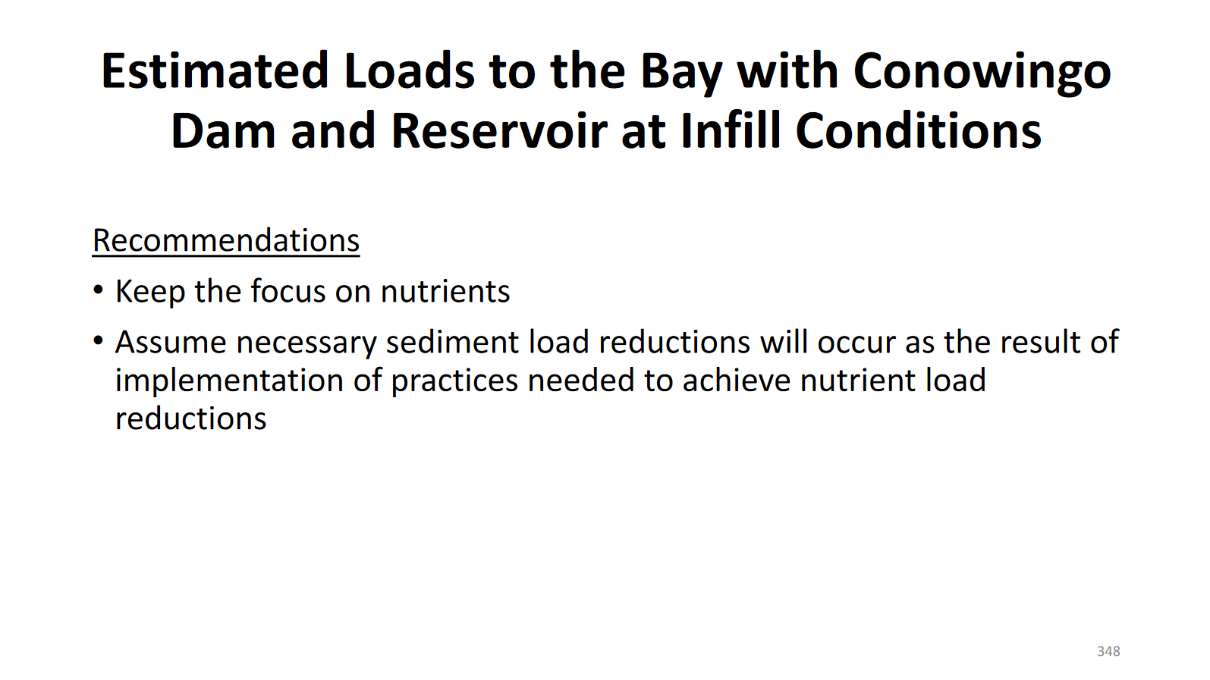

Slide 25
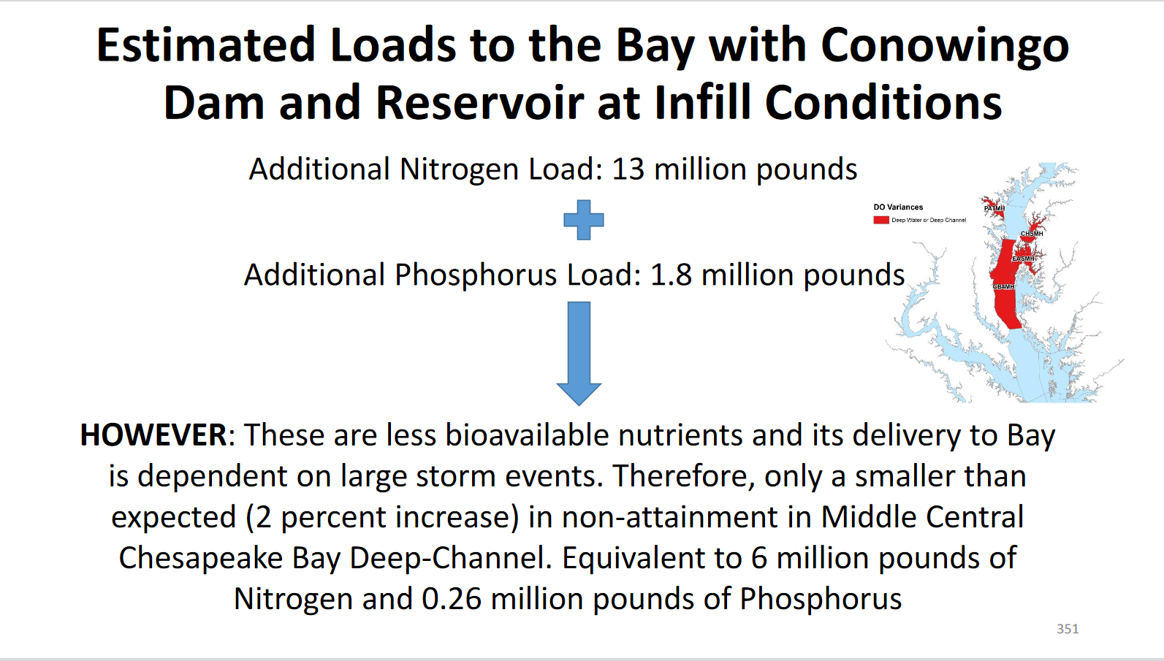

Slide 26
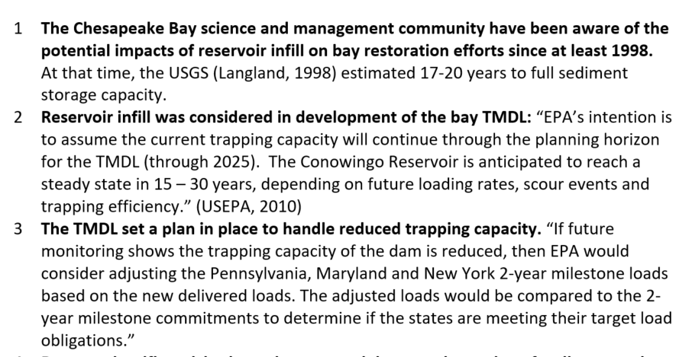
From talking points prepared by Joel Blomquist of USGS to brief Senator Ben Cardin’s staff, July 2020
17-20 years would put you at 2015-2020 – so it happened no more than 10 yrs early

Slide 27
A new problem – reported in 2019
USGS scientists observed increases in dissolved phosphorus loads from Conowingo that appear to be associated with biogeochemical processes within the reservoir sediment and water column, and could have implications for water quality that have not been considered previously by the watershed partnership. The reservoir ecosystem is largely unexamined and poorly understood. This information was not available when the TMDL was written.
Understanding is still evolving, however the statement above remains true.
Exelon and State of Maryland agreed on a relicensing plan in October 2019
STAC submitted a comment in January 2020 recommending funds from the agreement should be committed to study of biogeochemical processes that might lead to release of dissolved orthophosphate from the reservoirs to the upper Bay

Slide 28
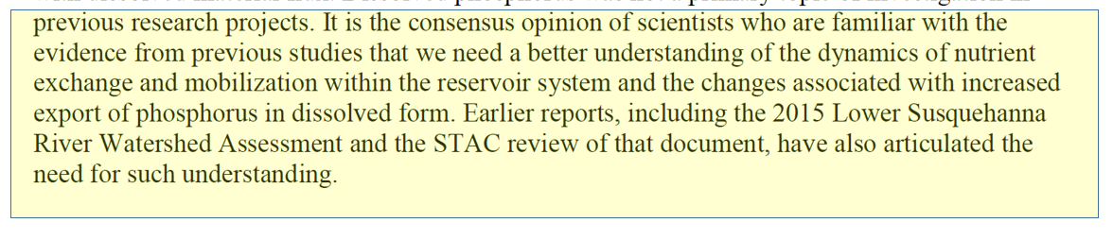
STAC recommends that MDE consider using some of the funds from the Exelon agreement to undertake new programs of monitoring within Conowingo Reservoir and its environs that will allow better understanding of trends affecting the flux of dissolved nutrients, and particularly dissolved phosphorus, to the upper Bay.

Slide 29
There are pilot studies in progress to reevaluate whether an economically feasible dredging option can be developed.
Beyond the question of beneficial use of dredge spoil, it’s not yet clear to what extent these studies will address the conclusion that any increased reservoir storage from dredging would be temporary, and would require permanent annual investments unless and until the upstream sources are reduced to target levels
We do know that sediment is not the main problem, and that most of the nitrogen passes through the reservoir system with the water in dissolved form; particulate organic N and sediment –attached P are the main environmental concern
We don’t know whether or to what extent dredging would impact water quality through exposure and potential resuspension of buried exposed bottom material and possible release of sediment-associated nutrients into the water column

