Slide 1
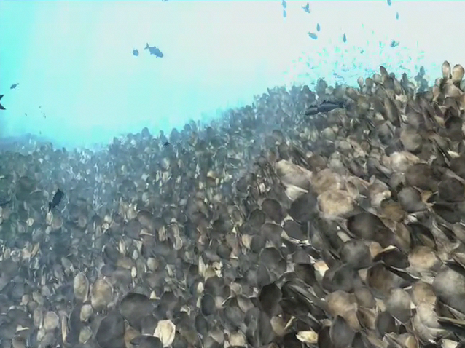


The Chesapeake Atlantis Model:
Visualizing the Effects
of Expected Changes in the Chesapeake
Tom Ihde, ERT, Inc.
for the NMFS Office of Science & Technology
Citizens Advisory Committee, 16 November, 2016

Slide 2
Range of Tools Available
to Understand Climate Effects
Table-based
Maps - overlapping GIS layers
Integrative, over disciplines, space & time
  Capture complex dynamics of an estuary
  Cumulative effects of multiple factors changing the system
Notes:
Table-based
> most common
Maps - overlapping GIS layers
> also commonly used
Both are useful, and instructive, but limited, since effects of multiple factors acting together seldom direct or intuitive
Integrative, over disciplines, space & time
Capture complex dynamics of an estuary
Cumulative effects of multiple factors changing the system
i.e., puts effects in context with all the major changes the system is experiencing, and able to capture non-linearities caused by multiple feedbacks in the system
It is only with integrative models that we can capture more complex dynamics of what is happening in the complicated system
1st example - when a predator decreases, the predation pressure on its prey is reduced, allowing for other competing predators to do better, sometimes allowing the 2nd or 3rd (competing) predator populations to grow & (non-intuitively) deplete the prey species;
2nd example – menhaden -> classic belief is that they eat phytoplankton, so more MUST be better – HOWEVER, they only primarily consume phytoplankton in their first year (they live for about a decade), after that, they primarily consume zooplankton, which eat the phytoplankton; the result is that more menhaden actually = less zooplankton, which allows the phytoplankton to bloom out of control

Slide 3
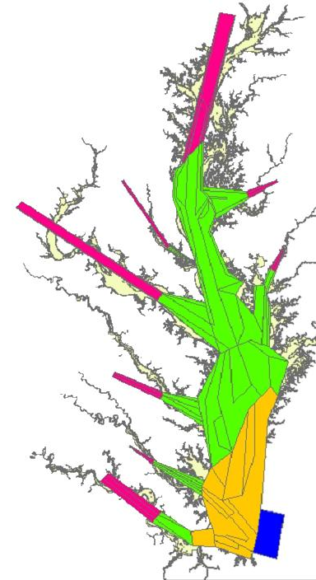
The Chesapeake Atlantis Model (CAM)
“Factors Influencing” Included:
Biological environment
Primary production
Trophic interactions
Recruitment relationships
Age structure
Size structure
Life History
Habitat also refuge
SAV, Marsh, Oysters
Fisheries
Multiple sectors
Gears
Seasons
Spatially explicit
Physical environment
Chemistry
Circulation & currents
Temperature
Salinity
Water clarity (suspended sediment)
Climate change
Nutrient cycling
Currency is Nitrogen
Oxygen
Silica
3 forms of detritus
Bacterial nutrient cycling

Slide 4
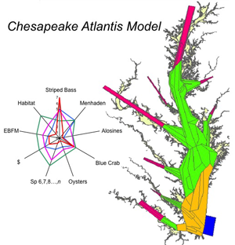
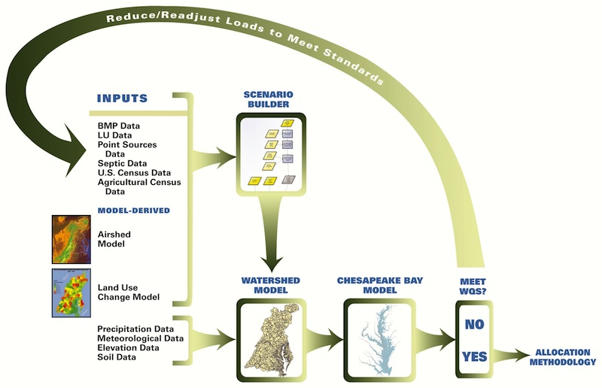
Effects of changing conditions
On our living resources
H-GIT Outcomes
Water quality attainment and
Regulation
WQ-GIT Outcomes
SF-GIT Outcomes
STAR
Key Actions
Climate Resiliency
Key Actions & Outcomes
Notes:
To date, the CBP has been focused on physical and chemical modeling to satisfy TMDL load reduction requirements.
That work satisfies many of the Outcomes and Key Actions, but not all, especially Outcomes that focus on Living Resource effects of changes expected in the Chesapeake
The Chesapeake Atlantis Model (CAM) compliments the current Bay Program modeling by providing strategic information on the trade-offs we should expect to occur in this system with climate change, the TMDL, and habitat loss (or restoration)

Slide 5
Application Outline
  Stressors / system changes:
  Habitat loss:
    - Marsh, SAV
  Water column factors:
  - Nitrogen & Total Suspended Solids
  Climate forcing:
  - Temperature increase
Simulation results
Next Steps
Notes:
I’m going to illustrate the effects of system stressors modeled both individually and in combination
* One of the key strengths of this approach is estimating cumulative effects of multiple stressors simultaneously – the effects of change are not usually linear or additive in a complex environment like an estuary

Slide 6
Habitat Scenario Assumptions
  50% loss of Marsh
  (area & biomass)
    Due to multiple, interacting factors:
      shoreline armoring
      subsidence
      sea level rise
  50% loss of Seagrass
Notes:
Biogenic habitat groups
Marsh loss – not completely arbitrary; Chosen with input from Habitat specialists as “realistic” scale of loss
Marsh [accretion] can not keep up with losses, shallowest areas around most of Bay, so losses are expected to be substantial
Generally for modeling with a complex model like Atlantis, a large change also helpful, so the signal that we see is easier to recognize as being caused by the factor, and not some 2ndary, tertiary, or higher level change
SAV – arbitrary -> same scale of marsh loss

Slide 7
Water Column Habitat Assumptions
  “TMDL” = Total Maximum Daily Loads of Nitrogen & turbidity – full attainment:
  Nitrogen
    - 25% reduction
  Turbidity (total suspended solids)
  - 20% reduction

Slide 8
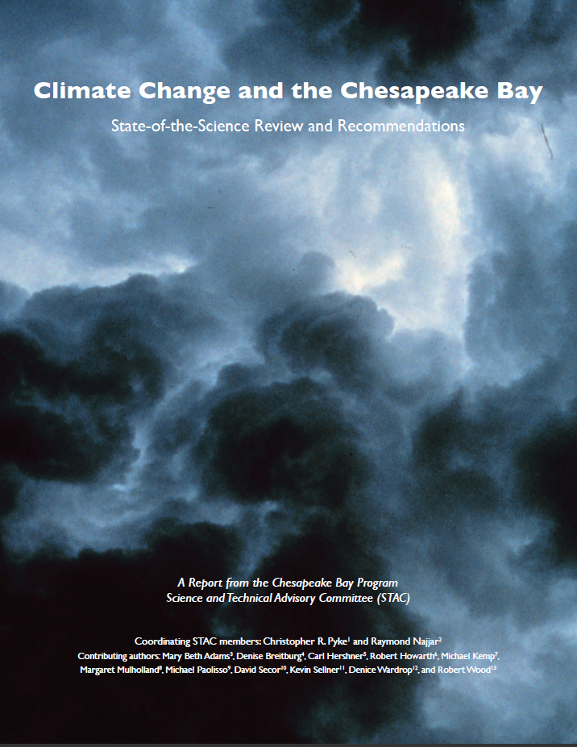
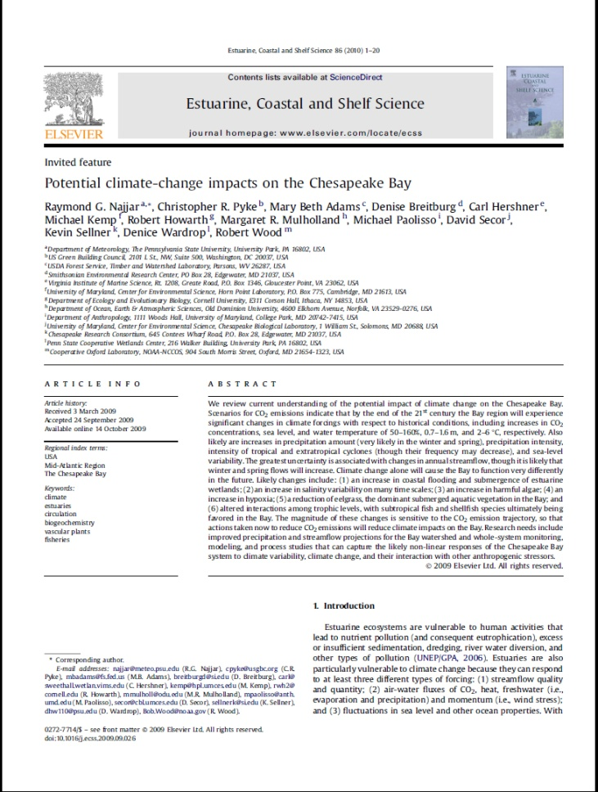
Climate Change Assumptions
Najjar et al. (2010); IPCC AR4 (2007)
50 years from now:
  Increased water temperature (1.5°C)
  Salinity (+/- 2 ppt)
Notes:
Climate Change scenarios based on STAC (Scientific and Technical Advisory Committee, Chesapeake Bay Program) Review
– which, in turn, was based on IPCC (Fourth Assessment Report of the Intergovernmental Panel on Climate Change, AR4, 2007) report,
and a lit review,
- numbers are specific (AR4 downscaled) to the Chesapeake Bay

Slide 9
Effects of Factors Influencing
Selected Group Effects of Interest to Management
Temp Increase with
Marsh Loss,
SAV Loss,
& TMDL
BA
SF
FF
Z
W
BC
Z – Zooplankton
SB
AM
BA – Bay Anchovy
W – Worms (and other
benthic invert. prey)
Temp Increase
with Marsh Loss
& SAV Loss
FF
BC – Blue Crab
BA
SF
Z
BC
W
SB
AM
AM – Atlantic Menhaden
SB – Striped Bass
SF – Summer Flounder
Temperature
Increase (1.5C)
BA
SF
FF
Z
W
BC
FF – All Finfish
SB
AM
Scenarios
TMDL
W
FF
AM
SF
BA
BC
Z
SB
SF
FF
SAV Loss
BC
BA
W
Z
AM
SB
Marsh Loss
BA
SF
FF
W
BC
Z
AM
SB
-15
-15
-15
-15
-15
-15
-10
-10
-10
-10
-10
-10
-5
-5
-5
-5
-5
-5
0
0
0
0
0
0
5
5
5
5
5
5
10
10
10
10
10
10
Percentage Change
Notes:
Orientate to plot axes
-------------------------------------
If we model stressors/factors singly,….
Little variability predicted under Marsh loss, SAV loss, and TMDL scenarios; little consistency between these scenarios
Temp+ => much greater variability / effect of system change; consistent for all scenarios that include Temp+
Interactions also important – and expected to be very non-linear/ multiplicative, not additive

Slide 10
Demonstrated Application of CAM
Needed: a specific application as an example of how the Atlantis approach can support adaptive management – i.e., management strategy adjustment through iterative meetings with a Workgroup or Committee
Most readily applied to Outcomes where an set number had been chosen to start on for the purposes of the New Agreement (e.g., specified acreage)
Example
SAV Outcome – range of attainment
  Acreage benefits
  Water clarity benefits
  Restoration benefits
  (and impacts of losses)

Slide 11





Thanks to:
Marine and Atmospheric Research
11

Slide 12
  Contact:
  Thomas.F.Ihde@gmail.com
  443.975.3736
Notes:
Key need for this work is to hear from your workgroups that you are involved in, that you have interest in applying this approach for
- very flexible tool
- contact me if you are uncertain if CAM can be applied to ?'s you are interested in,
- prioritizing NOW which workgroup to work with first

Slide 13
Extra Slides

Slide 14
The Need
New Bay Program Agreement
  “Use science-based decision-making and seek out innovative technologies and approaches to support sound management decisions in a changing system.”
STAC guidance
Workshop reports suggest need for building capacity for integrating ecosystem modeling to better understand system and the effects of changes to the system:
  Modeling in the Chesapeake Bay Program: 2010 and Beyond (2006): Living resources modeling must be given the same level of attention and support as watershed and water quality modeling, and the programs must be integrated. The next big challenge for CBP modeling is to model not only a restored Chesapeake Bay, but the recovery trajectory to a restored Bay. It is quite likely that CBP models will need to be able to predict ecosystem “tipping points” in order to predict ecosystem recovery trajectories.
  Multiple Models Workshop Report (2014): The Chesapeake Bay Program should implement a multiple modeling strategy for each major decision-making model of the Bay …and analyze the output to quantify skill, advance knowledge, and inform adaptive management.
  Wetlands Workshop report (2014): Regional-scale models that accurately reflect local and landscape-scale patterns and processes (e.g., relative sea level rise, sediment accretion rates, habitat configuration and composition within a landscape), should be applied to make predictions about a changing ecosystem and inform actions at a sub-watershed or local scale. …The CBP must also evaluate trends in habitat suitability related to hydrogeological settings, and specifically model environmental flow requirements that have been found to be particularly crucial in evaluating the resiliency of aquatic systems and organisms.
  Forage Workshop report (2015): Participants recognized the importance of the continuing development of models to integrate information from various data sets to allow modelers and managers to frame management questions in an ecosystem context. Models are needed, for example, to identify and evaluate abundance thresholds or critical habitat levels and to better understand ecosystem effects of large-scale changes to the forage base, especially for conditions and stressors for which data are lacking (e.g., climate change).

Slide 15
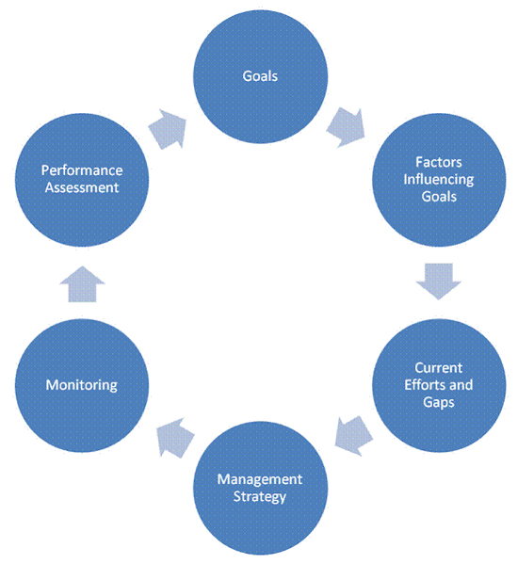

Where Can Atlantis Help?
Atlantis
Factors Influencing Include:
Biological environment
Primary production
Trophic interactions
Recruitment relationships
Age structure
Size structure
Life History
Habitat also refuge
SAV, Marsh, Oysters
Fisheries
Multiple sectors
Gears
Seasons
Spatially explicit
Physical environment
Chemistry
Circulation & currents
Temperature
Salinity
Water clarity
Climate change
Nutrient Inputs
Currency is Nitrogen
Oxygen
Silica
3 forms of detritus
Bacterial nutrient cycling
Develop & test
New indicators
Test sensitivity of Bay system to
Knowledge gaps
→ help prioritize research
Explore tradeoffs – range of possible Workgroup Outcomes of interest
Indicators:

Slide 16
Management Strategy Outcomes & Key Actions
  Habitat-GIT:
  Visualize range of attainment for SAV Outcome: acreage benefits, water clarity benefits
  and restoration benefits
  Fish Passage: Visualize benefits (& ecosystem services) of restored populations
  Wetlands outcome – range of attainment, simulate ecosystem services
STAR:
Development and testing of ecological indicators
Integrative tool for multiple datasets – visualize data trends & effects on common scale
Climate Resiliency & Adaptation:
  Visualize likely impacts of expected temperature increase and salinity change
  Support development of research agenda – identify most critical data or research gaps
  Visualize future realizations for public, stakeholder, and local engagement
  Simulate implementation of priority adaptation actions
  Develop and test climate resilience indicators to assess adaptation action effectiveness
  Water Quality-Goal Implementation Team (GIT):
Visualize, improve understanding of ecosystem services of attainment of TMDL or
a range of levels of attainment
The simulation of all other Outcomes in the context of the TMDL conditions for the Bay
Demonstrate and quantify the benefit of improved monitoring, and filling of data gaps
  Sustainable Fisheries-GIT:
  Blue crab – ecosystem effects of varying abundance; harvest sectors allocation
  Oyster restoration – visualize benefits of restoration
  Fish habitat – visualize effects of loss or gain
  Forage – simulate predator population effects of loss or gain of forage groups
Notes:
Tom went through the Workplans & pulled out:
Outcomes & Key Actions for a wide variety of Workgroups, where Atlantis complements our existing water quality modelling efforts
This is not a complete list, 3 more pages like this, but these are probably the most urgent
Each checkmark – separate set of simulations, & separate effort to support a Workgroup; these will not happen simultaneously without a bigger team (than 1)

Slide 17
Management Strategy Outcomes & Key Actions
Important that any of the scenarios (√ ‘s) developed for Workgroups can also now be visualized in the context of
either or both:
  TMDL attainment and
  Expected Climate Change for Bay waters
  Scenarios can build on previous work – once completed, can be combined with other scenarios of interest (if desired) to estimate cumulative effects of multiple changes to the system
Notes:
It is important to understand that now that I have TMDL (attainment and status quo [i.e., 2010]) and Climate Change scenarios developed, it is a simple matter to plug these conditions in for any other scenario as well, so the effects of those environmental conditions can be considered with whatever other changes a Workgroup/Action Team wants to better understand

Slide 18
Recommendation
Recommendation:
  The EPA should establish an ecosystem modeler position to support Chesapeake Bay Program to efforts to better connect water quality to ecological outcomes.
General Proposal:
    The ecosystem modeler would:
      Lead activities under STAR modeling team to expand modeling to better understand and predict ecosystem response
      Serve as a liaison to respond to STAC guidance on ecosystem modeling
      Identify and coordinate ecosystem modeling efforts across the watershed that support CBP outcomes
      Prioritize and develop practical ecosystem model applications to support GIT management strategies

Slide 19
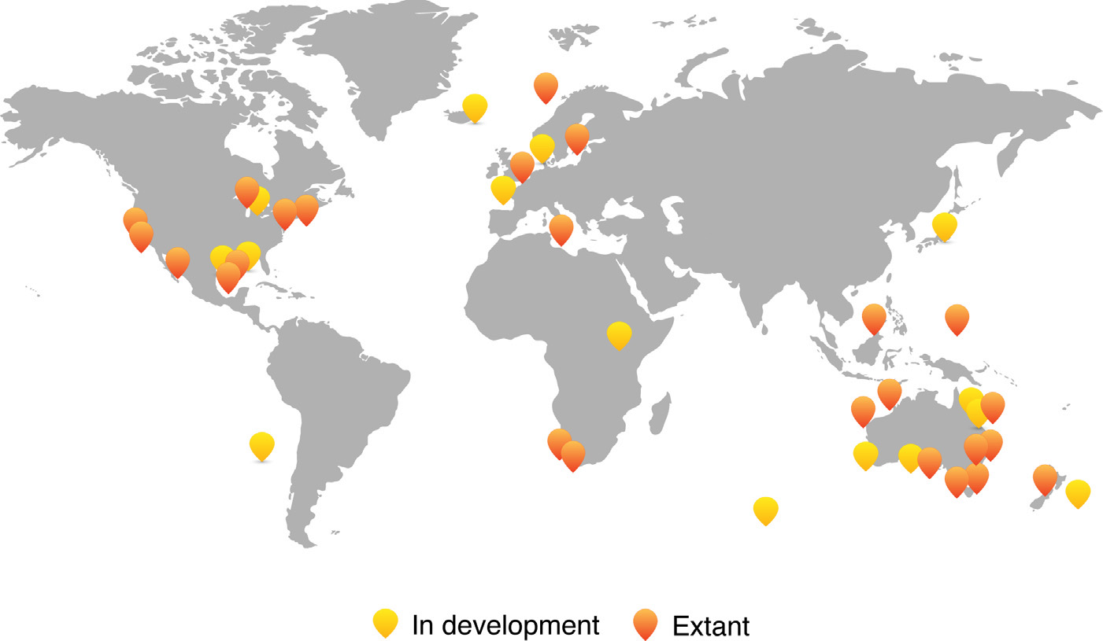
Atlantis Applications
Figure from Weijerman et al., 2016

Slide 20
The Chesapeake Atlantis Model
Design

Slide 21
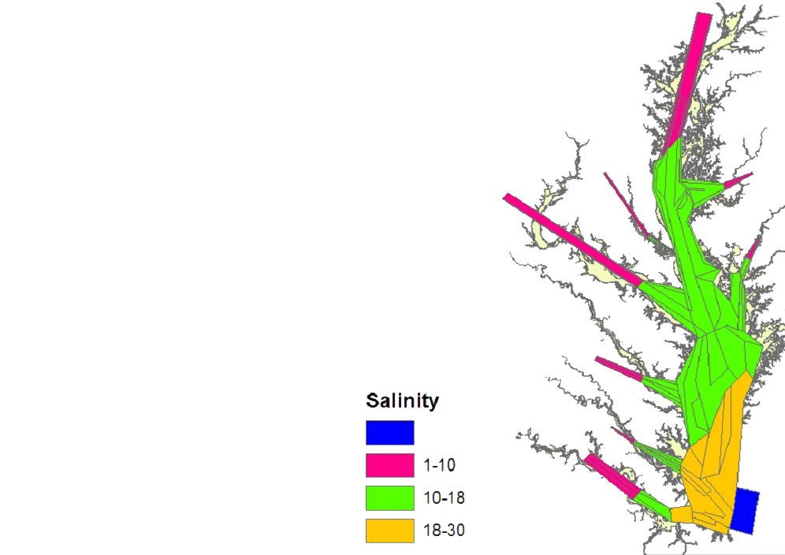
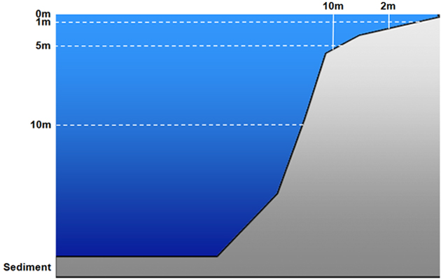
CAM Design: 3-Dimensional Box Model:

Slide 22
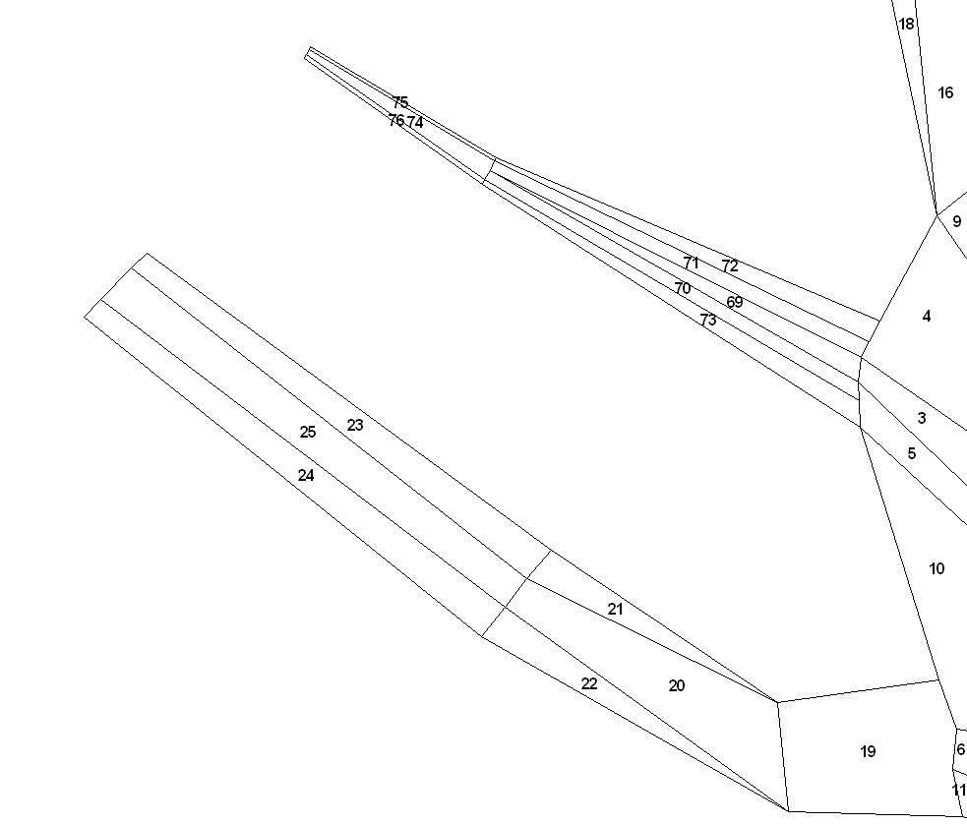
CAM: River Box Structure
Notes:
Tribs all have deeper channel with very shallow, narrow boxes that allow for conditions favorable for marsh grasses or SAV to predominate
This structure can accommodate changes in development or water treatment plants, etc.

Slide 23
Ecological Groups: Federal fisheries, Forage, Protected, Habitat
Finfish
- Alosines (Amer.Shad, Hickory Shad, Alewife & Herring)
- Atlantic Croaker
- Bay anchovy
- Black drum
- Bluefish
- Butterfish, harvestfish (“Jellivores”)
- Catfish
- Gizzard shad
- Littoral forage fish: silversides, mummichog
- Menhaden
- Striped bass
- Summer flounder
- Other flatfish (hogchoker, tonguefish, window pane, winter flounder)
- Panfish:
Euryhaline: Spot, silver perch; FW to 10ppt: yellow perch, bluegill
- Reef assoc. fish: spadefish, tautog, black seabass, toadfish
- Spotted hake, lizard fish, northern searobin
- Weakfish
- White perch
Elasmobranchs
- Cownose ray
- Dogfish, smooth
- Dogfish, spiny
- Sandbar shark
Birds
- Bald Eagle
- Piscivorous birds (osprey, great blue heron, brown pelican, cormorant)
- Benthic predators (diving ducks)
- Herbivorous seabirds (mallard, redhead, Canada goose, & swans)
Mammals
- Bottlenose dolphin
Reptiles
- Diamond-back Terrapin
- Seaturtles
Invertebrates
- Benthic feeders: (B-IBI “CO”+”IN”) …,
- Benthic predators: (B-IBI “P”) …,
- Benthic suspension feeders: (B-IBI “SU”)
- Blue crab YOY
- Blue crab adult
- Brief squid
- Macoma clams: (B-IBI)
- Meiofauna: copepods, nematodes, …,
- Oysters
Primary Producers
- Benthic microalgae (“microphytobenthos” benthic diatoms, benthic cyanobacteria,
& flagellates)
- “Grasses:”
SAV – type varies with salinity
- Marsh grass
- Phytoplankton – Large: diatoms & silicoflagellates (2-200um)
- Phytoplankton – Small: nannoplankton, ultraplankton,
aka “picoplankton” or “picoalgae” (0.2-2um),
cyanobacteria included (2um)
- Dinoflagellates (mixotrophs) (5-2,000um)
ZooPlankton
- Ctenophores
- Sea nettles
- Microzooplankton (.02-.2mm): rotifers, ciliates, copepod nauplii
- Mesozooplankton (.2-20mm): copepods, etc.
Detritus
- Carrion
- Carrion (sediment)
- Labile
- Labile (sediment)
- Refractory
- Refractory (sediment)
Bacteria (.2-2 um [.002 mm] - feed microzooplankton food chain)
- Benthic Bacteria (sediment)
- Pelagic Bacteria: (free-living)
Images courtesy of ian.umces.edu/imagelibrary/
Notes:
Full ecosystem function
try to capture dominant / most important features of SYSTEM function

Slide 24
Next…
  Test sensitivities; explore current hypotheses: pred-prey mismatches; shifts in state of system; DO; Verify trends with other models where possible
  Add other effects of climate change:
  - allow movement preferences for changing climate conditions (temperature, salinity)
  - shifts in timing of migration & spawning
  Acidification effects
Notes:
Key need for this work is to hear from your workgroups that you are involved in, that you have interest in applying this approach for
- very flexible tool
- contact me if you are uncertain if CAM can be applied to ?'s you are interested in,
- prioritizing NOW which workgroup to work with first

