Slide 1
Assessing oyster aquaculture impact on water quality in Chesapeake Bay
Richard Tian, Carl Cerco, Lewis Linker
Chesapeake Bay Program Office
Modeling Quarterly Review Meeting
04/11/2018
Annapolis

Slide 2
Oyster Aquaculture Facts
Oyster aquaculture is on a trajectory of exponential expansion in Chesapeake Bay.
Increased by 10 folders from 2012 to 2016 in Maryland waters and more established on VA portion of the Bay.
By 2025, 112 millions oysters harvest projected in MD and 280 millions oyster harvest in VA.
Equivalent to an annual removal of 78x10³ lbs nitrogen, and 8.6x10³ lbs phosphorus.
On top of nutrient removal, oyster filtration can help to clean up the Bay.

Slide 3
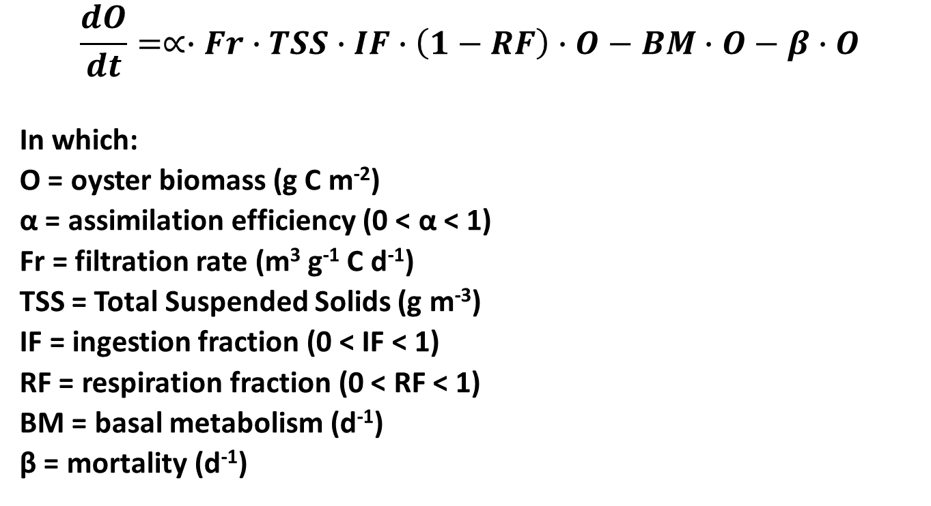
Oyster Basic Equation in Model
$$\frac{dO}{dt}=∝∙Fr∙TSS∙IF∙\left(1−RF\right)∙O−BM∙O−β∙O$$
In which:
O = oyster biomass (g C m⁻²)
α = assimilation efficiency (0 < α < 1)
Fr = filtration rate (m³ g⁻¹ C d⁻¹)
TSS = Total Suspended Solids (g m⁻³)
IF = ingestion fraction (0 < IF < 1)
RF = respiration fraction (0 < RF < 1)
BM = basal metabolism (d⁻¹)
β = mortality (d⁻¹)
Carl Cerco; modified

Slide 4
Fluxes generated by oyster
Bottom water
Cyanobacteria
Diatom
Green
L-RPOC
L-RPON
L-RPOP
ISS
PIP
Respiration
Nutrient
OYSTER
L-RPOC
L-RPON
L-RPON
ISS
PIP
Sediment

Slide 5
Diagenesis Model with Benthos (Carl Cerco; Modified)
transport
Particulate
Organic
Matter
respiration
filtration
excretion
Dissolved
Nutrients
Dissolved
Oxygen
settling
Water
Column
Filter
Feeders
Sediments
sediment-water
exchange
Denitrification
biodeposits
sediment-oxygen
demand
Particulate
Organic
Matter
diagenesis
Dissolved
Nutrients
Oxygen
Demand
diagenesis
Burial

Slide 6
Oyster Aquaculture sites
MD: Salinity ≥7 ppt, depth ≤ 12 ft.
VA: Lease sites
Sufficient phytoplankton and suspended solids
Model setup
392 million oysters harvest in 2025, equivalent to 468k lbs C in biomass.
78k lbs N and 8k lbs P reduction in nutrient loads.
Oyster biomass in the water column is 1.5 times the annual harvest for aquaculture in cages (20% in MD and 80% in VA).
Oyster biomass on the bottom is twice the annual harvest for bottom culture (80% in MD and 20% in VA).

Slide 7
Deep Channel criteria assessment
Impact on deep water and deep channel: non-attainment decreased from 6.00 to 5.24%, to 1.2 million pounds of nitrogen and 22 thousand pounds of phosphorus removal from the watershed
No significant difference between base and WIP scenarios.

Slide 8
Open water criteria assessment
(Examples with oyster aquaculture)
Local open water seems less impacted

Slide 9
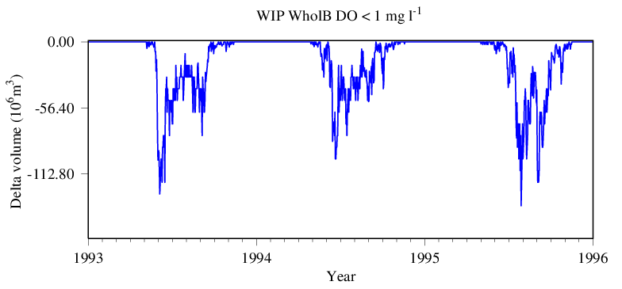
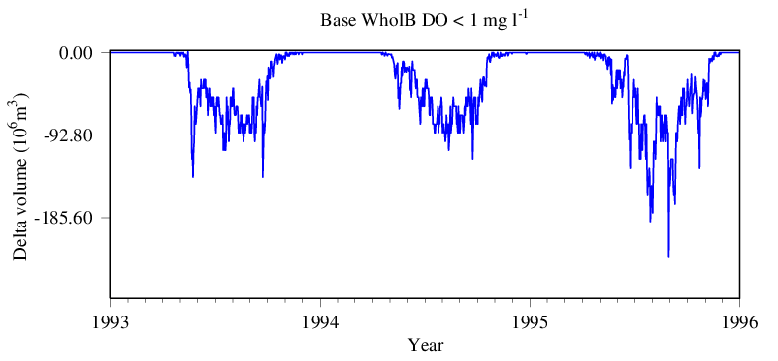
Difference in Hypoxia volume in the whole Bay
(DO< 1 mg/l)
Slightly higher in the base case (lower panel) then in the WIP case

Slide 10
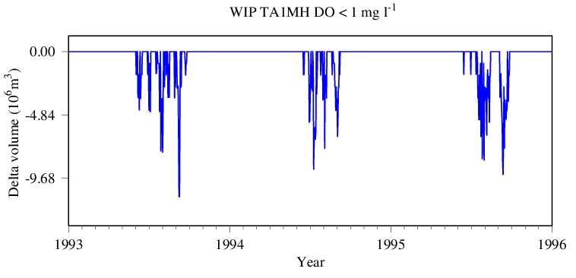
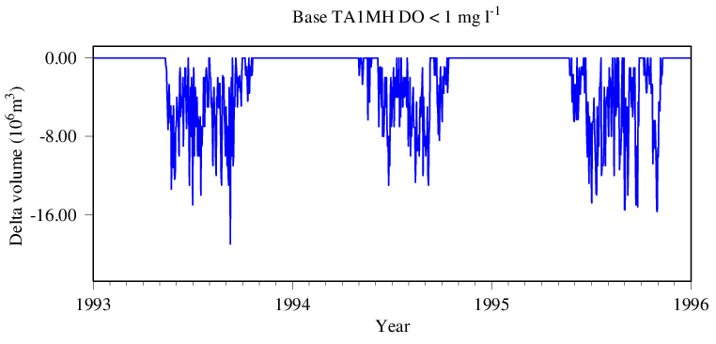
Difference in Hypoxia volume Tangier Sound
(an aquaculture segment)
Slightly higher in the base case (lower panel) then in the WIP case

Slide 11
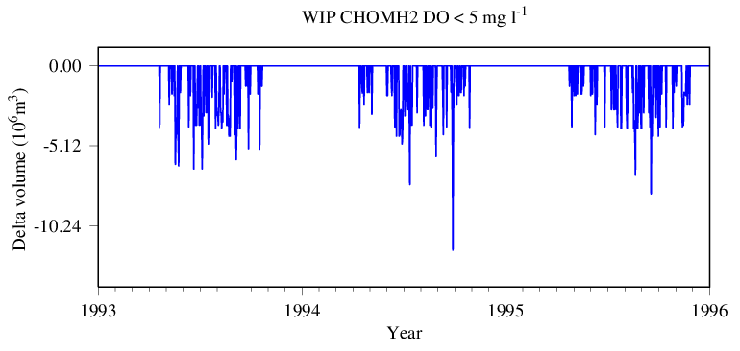
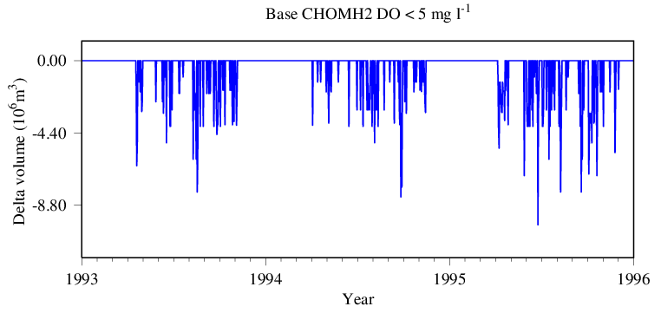
Difference in Hypoxia volume Choptank Estuary
(an aquaculture segment)
High frequency variation

Slide 12
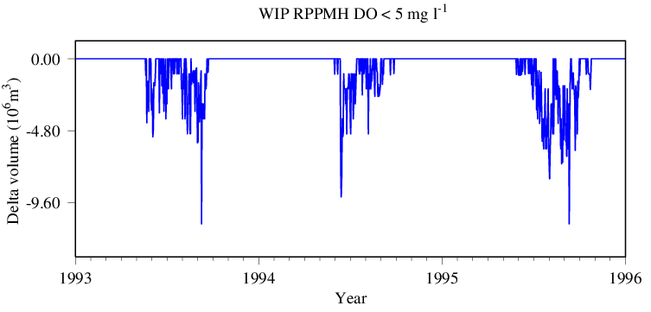
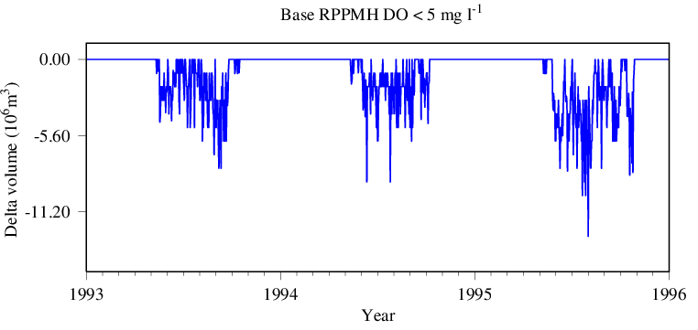
Difference in Hypoxia volume Rappahannock Estuary
(an aquaculture segment)
Slightly higher in the base case (lower panel) then in the WIP case

Slide 13
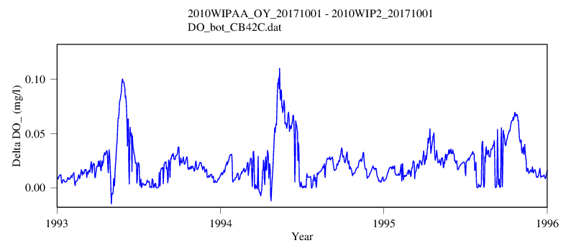
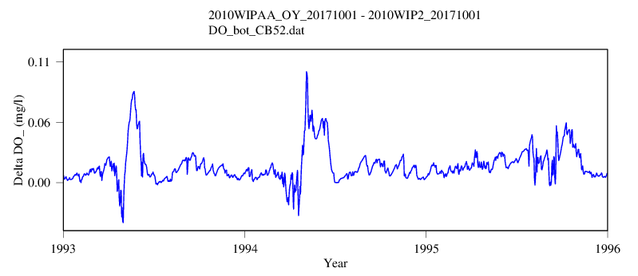
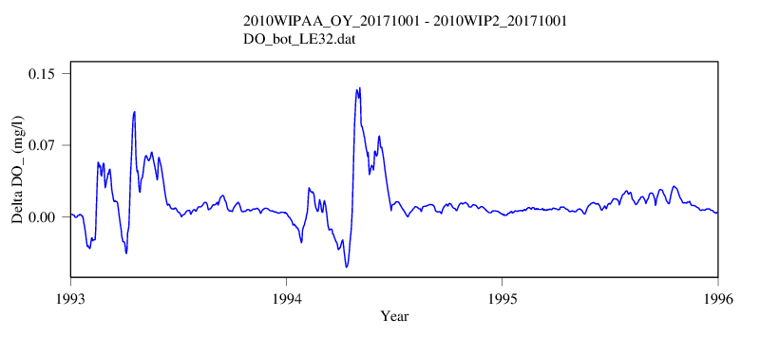
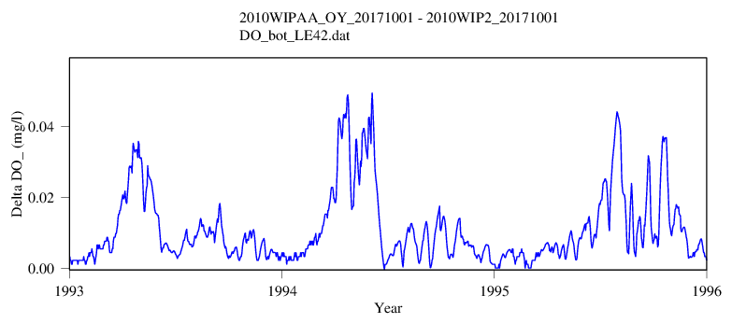
DO improvement across deep channel and local waters with projected oyster aquaculture in 2025 under the WIP condition
CB4.2C Bottom
CB5.2 Bottom
EE3.2 (Tangier Sound)
LE4.2 (York River)

Slide 14
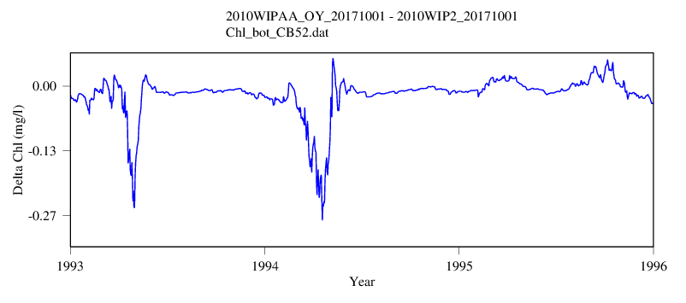
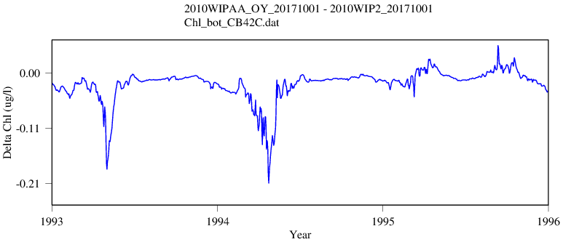
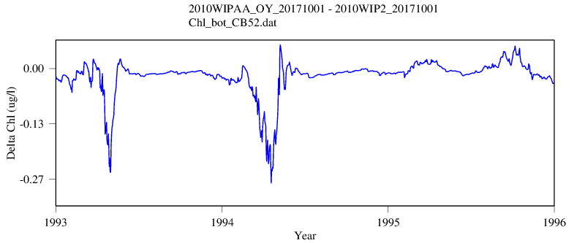
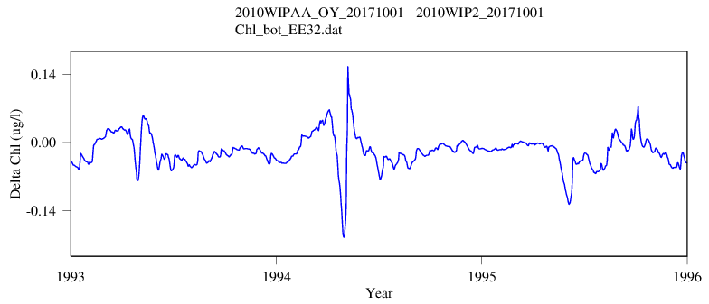
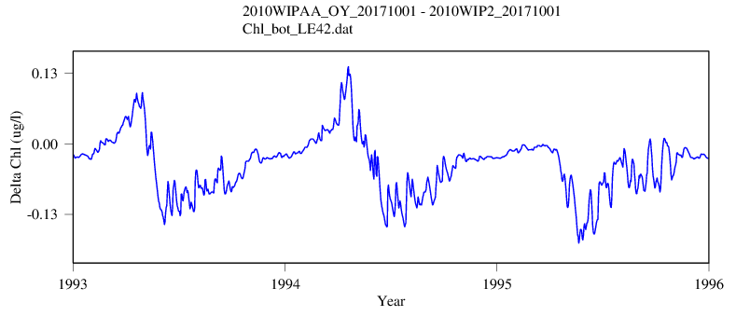
Chl changes with projected oyster aquaculture in 2025 under the WIP condition
CB4.2C Bottom
CB5.2 Bottom
EE3.2 (Tangier Sound)
LE4.2 (York River)

Slide 15
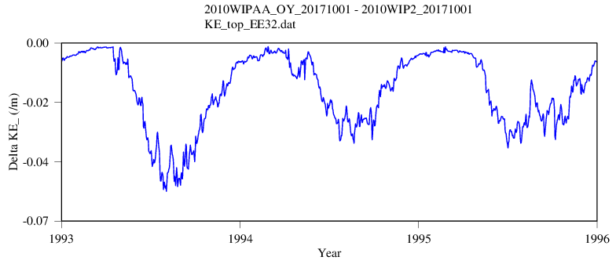
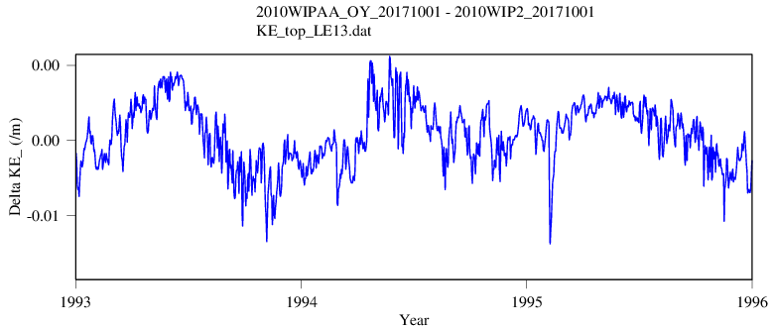
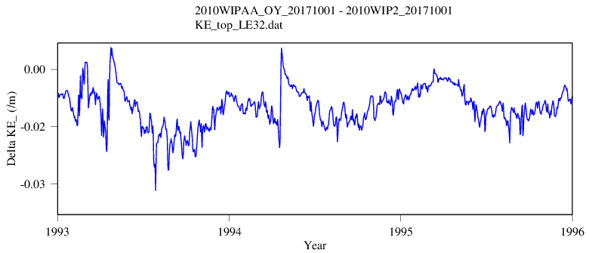
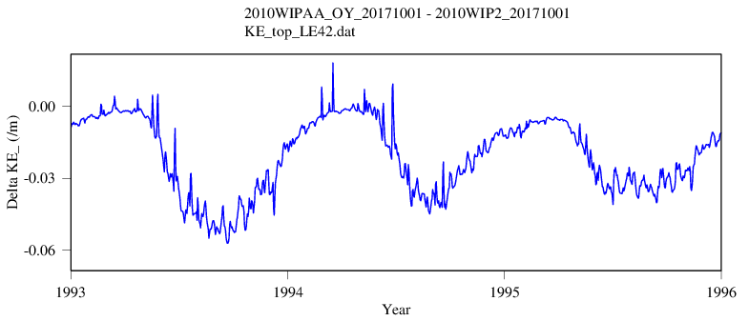
KD improvement with projected oyster aquaculture in 2025 under the WIP condition
EE3.2 (Tangier Sound)
LE1.3 (Patuxent)
LE3.2 (Rappahannock)
LE4.2 (York River)

Slide 16
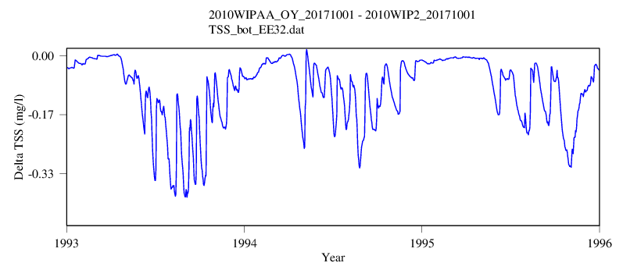
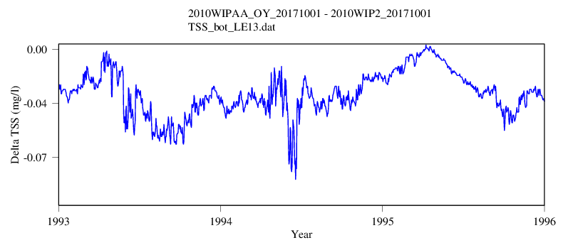
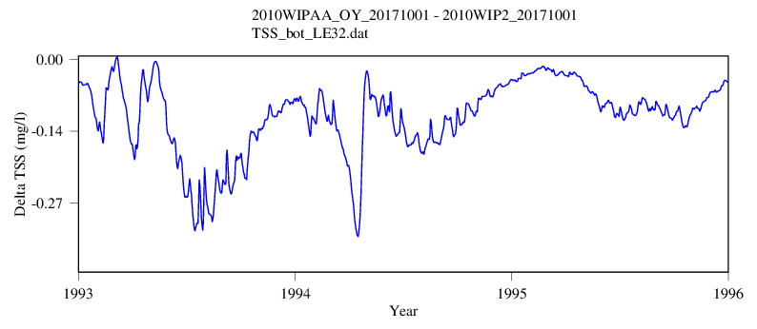
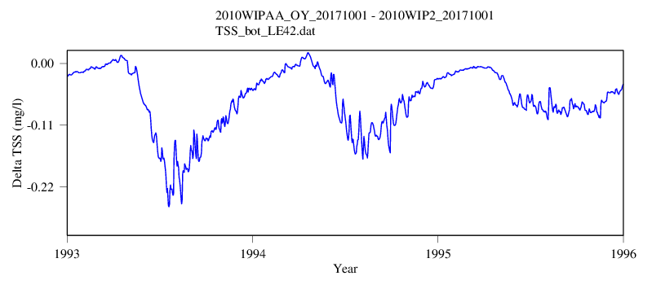
TSS changes with projected oyster aquaculture in 2025 under the WIP condition
EE3.2 (Tangier Sound)
LE1.3 (Patuxent)
LE3.2 (Rappahannock)
LE4.2 (York River)

Slide 17
Summary
Full oyster aquaculture buildout is estimated to improve water quality attainment in the Chesapeake locally and in deep hypoxic water.
Signal of impact on an array of water quality variables: DO, Chlorophyll, KD, and TSS.
The simulated biogeochemical nutrient reductions are about twice as effective at improving CB4MH Deep Channel DO attainment than nutrient reductions from oyster ingestion.

