Slide 1

Pennsylvania’s Phase 3 WIP Progress:
Focusing and Expanding on Local Action
Chesapeake Bay Citizens Advisory Committee
December 1, 2021
Tom Wolf, Governor
Patrick McDonnell, Secretary

Slide 2
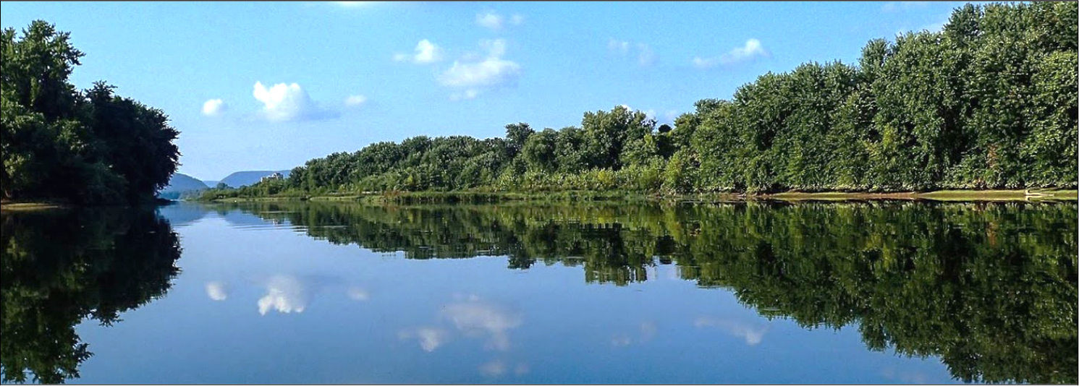
Phase 3 Watershed Implementation Plan
Update on PA’s Phase 3 WIP implementation progress.
Agenda
Journey to Success
Building Partnerships and Working Together
County and State Progress
Accelerating Implementation through Funding
Challenges and Solutions and the Future

Slide 3

PA’s Phase 3 WIP: Journey to Success
2017: Seven active WIP Workgroups:
Agriculture, Communications & Engagement, Forestry, Funding, Local Area Goals, Stormwater, Wastewater
2017: Bi-monthly meetings of 20-member, multi-sector, public/private WIP Steering Committee (lead by 3 Cabinet Secretaries)
2017-2019: Monthly meetings of WIP Workgroups
June 2017: WIP Kickoff & Listening Summit -
240 people from diverse backgrounds working together on shared goals
2018 - 2019: Adams, Franklin, Lancaster, York Countywide Action Plan (CAP) pilot: 4 counties develop and implement first CAPs
April – June 2018: Draft WIP Public Comment Period
April 2018: Local Area Planning and Community Toolbox Summit: share proposed local planning process with 200 participants
August 2018: Best Management Practice Verification Program Planning Summit
August 2019: PA submits Phase 3 WIP to EPA
Fall 2020: Outreach to Tier 3 and 4 counties and Tier 2 Counties complete CAP Development
Spring 2020: Tier 2 counties begin county planning
Winter 2020-2021 – Tier 3 and 4 counties begin county planning
Fall 2021 – Tier 3& 4 Counties complete CAPs and begin implementing – all 34 counties implementing CAPs
October – December 2021 – All CAPs incorporated into revised Phase 3 WIP due to EPA December 31, 2021

Slide 4
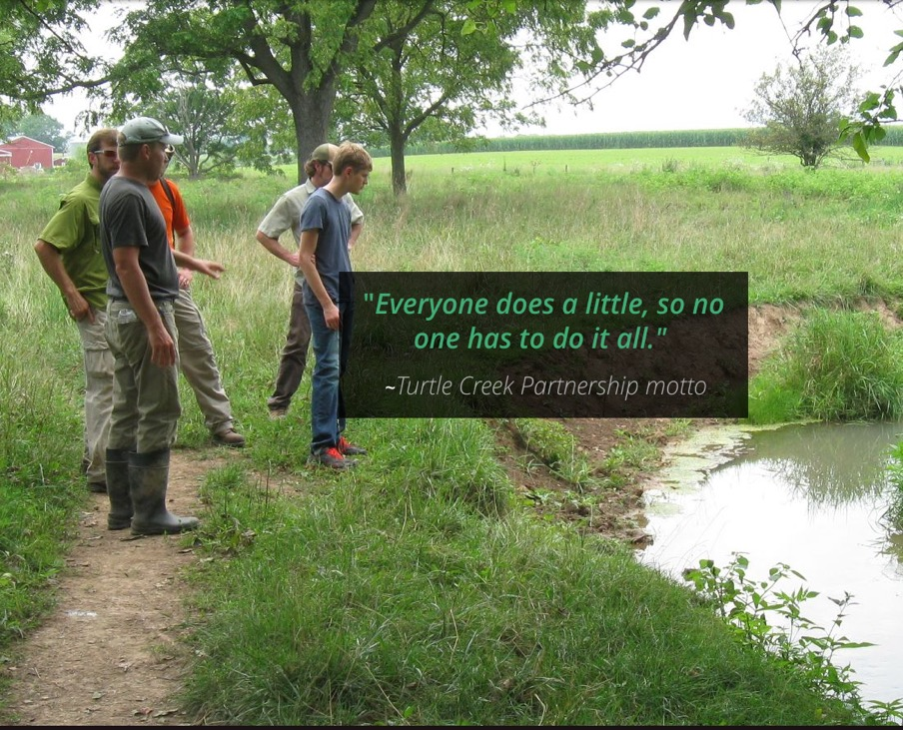
Building on Partnerships: Agencies
Fish and Boat Commission:
  Expansion of a Stream Restoration Model in Northcentral PA
PennDOT:
  Reporting almost 1,000 additional stormwater BMP records toward 2020 WIP progress
National Fish and Wildlife Foundation (NFWF):
  Local Government Implementation
  grant administration on behalf of DEP
  Chesapeake Bay INSR and Small Watersheds grant funding
  PA Most Effective Basin (MEB) Agricultural Implementation grant funding

Slide 5
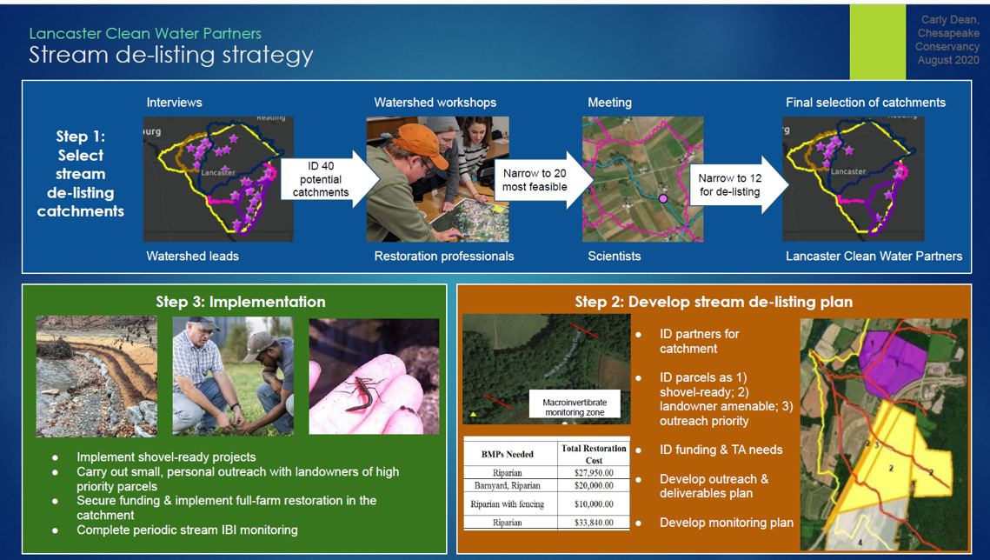
Building New Partnerships: Local Watersheds
Rapid Stream De-Listing Strategies – New Partnerships Using Data and Mapping Tools
Counties – including Lancaster, Huntingdon, Union, Centre and others -- are working with Chesapeake Conservancy to identify and prioritize small ag-impaired watersheds to restore in a short period of time using DEP water quality data, maximizing technical assistance and reporting progress.

Slide 6
2021 County CAP and State WIP Progress
How PADEP Hels Counties Succeed
Pilot Counties, through their CAP Coordinators, completed their second year of CAP Planning and Progress Updates (2021) and updated their two-year CAP Milestone Plans and Goals (2022-2023) and State Programmatic Recommendations (4 counties)
Tier 2 Counties, through their CAP Coordinators, completed their first CAP Planning and Progress Updates (2021) (4 counties)
Tier 3 and 4 County Groupings completed their CAPs and are transitioning to CAP implementation this fall (26 counties/10 groups and CAP Coordinators working together with Chesapeake Bay Office and DEP Regional Office CAP Support Teams)
State WIP Action Leaders provided extensive programmatic and numeric WIP Progress Updates (2021), responded to county Programmatic Recommendations, and updated their two-year WIP Milestone Plans and Goals (2022-2023)
Chesapeake Bay Office worked closely with all counties and EPA, coordinated all CAP and WIP reporting efforts, provided updates to counties on State Programmatic Recommendations, and is incorporating progress into Phase 3 WIP Amendment due to EPA (12/31/2021).

Slide 7
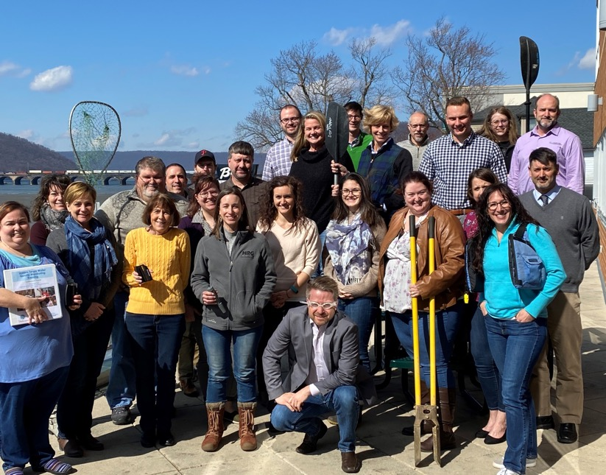

How We’re Working Together to Succeed
How PADEP Hels Counties Succeed
CAP Coordinators and Action Teams
Coordinator Training Academy
Webinar Wednesdays
One-on-one County Meetings
Weekly e-newsletters
Clean Water Academy: Web-based training modules
Materials and training to support county teams’ local outreach needs
2020 Coordinator Training Academy

Slide 8
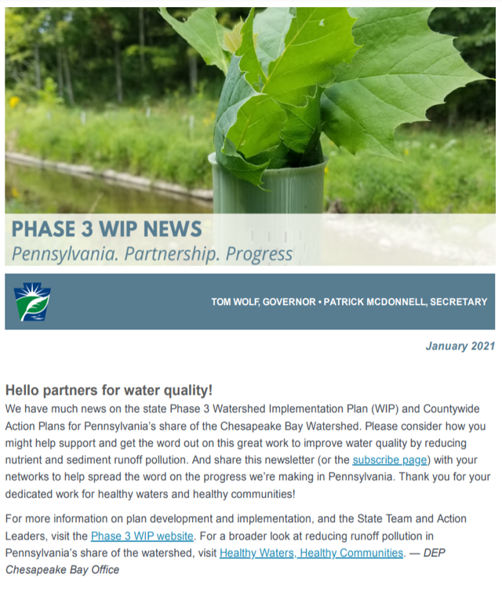
How We’re Working Together to Succeed
How PADEP Hels Counties Succeed
Healthy Watersheds, Healthy Communities
story map: 3,000+ views
Tracking Pennsylvania’s Progress: DEP Bay website adds public transparency for county and state milestone commitments and progress updates
Healthy Waters monthly e-newsletter: Increasing subscribers
Expanding DEP Chesapeake Bay Office and Region CAP Support coordination teams

Slide 9
How We’re Working Together to Succeed
CAP Highlights from County Partners – Creative and Innovative Efforts!
  Prioritize and pursue small restoration areas and stream delisting strategies
    Emphasis on Section 319 projects
  Develop and expand incentive programs
    Buffer Bonus, reporting discounts on equipment, nutrient management,
    cover crop/no-till, streambank fencing
  Create soil sampling programs with a focus on soil health and 4R Nutrient Stewardship
  Increase recreational access to bring awareness of local waters
  Work on more Acid Mine Drainage (AMD) Projects and improve reporting
  Merge CAPs with county hazard mitigation plans - connect with
  special emphasis on buffers and stream restoration to assist with flooding
  Develop urban nutrient and fertilizer planning programs
  Continue discussions around local ordinances to reduce stormwater impacts
  Increase education, engagement and outreach to larger group of stakeholders

Slide 10
How We’re Working Together to Succeed
Trends and Needs identified in CAPs: Funding, People and Reporting
  Culture shift – changing roles and holistic view of CAPs and countywide watershed restoration
  Establish a workforce program to train specialized staff (technical, administrative, grants, etc.) to ensure a pipeline of positions is secured
  Additional dedicated funding for people and projects
  Expand regional technical assistance programs
    (e.g., Bay Engineers and PACD Growing Greener Technical Assistance Grant – TAG Programs)
  Data Management – entering information into reporting tools
  NRCS data privacy confidentiality hurdles need to be overcome
  Cross-grant coordination and timing
  (e.g., DEP Growing Greener and 319, NFWF, DCNR grants)
  Improved CAST/Bay Model documentation of real, on-the-ground reductions
  COVID-19 impacts remain – supply costs are high and backlog of work remains an issue

Slide 11

Accelerate Implementation through Funding
Environmental Stewardship Fund
Community Clean Water Coordinator Grant -- Chesapeake Bay Watershed Only $100,000 per Coordinator, hired or contracted by the county lead entity to coordinate development and implementation of the Countywide Action Plan (CAP) Eight (8) Coordinators for Pilot and Tier 2 Counties Ten (10) Coordinators to share among Tier 3 and 4 Counties (26 counties) CAP Implementation Grant -- Chesapeake Bay Watershed Only Allocate up to 50% of Growing Greener Program funds (approx. $8-16 million) to Bay counties with CAPs based on proportion of total nutrient load (Edge of Stream) to the Bay Funds are to be used to implement local projects and practices identified in the CAP that yield high nutrient reductions

Slide 12
Accelerate Implementation through Funding
Chesapeake Bay Office Funds Provided: October 2020 to October 2021:
  October: Over $1 million in Section 319 Grants awarded to Pilot and Tier 2 counties
  November: Over $6 million in CAP Implementation and CAP Coordinator Grants in Pilot and Tier 2 counties
  December: Growing Greener Plus Grants awarded
    Over $9 million awarded to watershed restoration project implementation in Pilot and Tier 2 counties
    Over $16 million awarded in the Chesapeake Bay Watershed in total
  January: $1 million for 10 CAP Coordinator Grants awarded in Tier 3 & 4 counties
  October: Approximately $4 million in Section 319 non-point source management grants, majority in Bay watershed

Slide 13
Accelerate Implementation through Funding
Chesapeake Bay Office 2022 Funding Opportunities
DEP
  2022 CAP Coordinator and CAP Implementation Grant round for all CAP counties across the watershed.
    Nearly $15 million in state Environmental Stewardship Funds available
    More than $1 million in EPA Chesapeake Bay funds in addition to state funds
NFWF and EPA
  Initial $2.5 million in new grants for 10 projects in PA’s Most Effective Basins (MEB) to accelerate ag BMP implementation in selected regions of PA’s Chesapeake Bay watershed. NFWF works with the DEP Chesapeake Bay Office and State Conservation Commission leadership to ensure that the PA-MEB program effectively aligns with the priority initiatives in Pennsylvania’s Phase 3 WIP.
  Additional funds are allocated to NFWF every year from EPA for Most Effective Basin (MEB).

Slide 14
Accelerate Implementation through Funding
Environmental Stewardship Fund
Conservation District Watershed Specialists – All Conservation Districts DEP provides approximately $2.6 million annually to County Conservation Districts for Watershed Specialists. Enable communities to affect positive change on water quality through collaboration with Watershed Associations and other non-governmental organizations and the impactful use of grant funds to implement water quality restoration projects and provide education and outreach. This funding is used as match toward the Section 319 Nonpoint Source Management Program

Slide 15
Challenges and Solutions
The need for funding and flexibility Dedicated funding source needed Better federal and state cross-grant timing and coordination Address funding programs with required statutory elements that reduce flexibility (e.g. Section 319) DEP’s CAP Implementation Grant allows for more flexibility as it is considered an allocation-based grant program The need for accountability Competitive projects, with modeled reduction outputs, that will lead to water quality improvement Reporting requirements allow for DEP to be accountable to Pennsylvanians PracticeKeeper data reporting system has allowed us to document ag BMPs implemented through multiple funding programs (will be used for Section 319/Growing Greener in future)

Slide 16
Challenges and Solutions
The need for people Typical competitive grant programs generally require up-front effort to line up landowners, identify projects, and provide rationale to ensure a competitive application will be funded with finite amount of resources Not only is technical assistance required, but also grant writers, managers, coordinators and administrators This past year, DEP identified ways to simplify the competitive grant application process for Growing Greener and Section 319 DEP developed sample forms, recorded and posted webinars on the website, and held at least two virtual presentations to help guide applicants

Slide 17
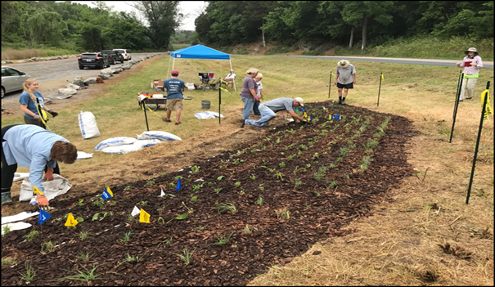
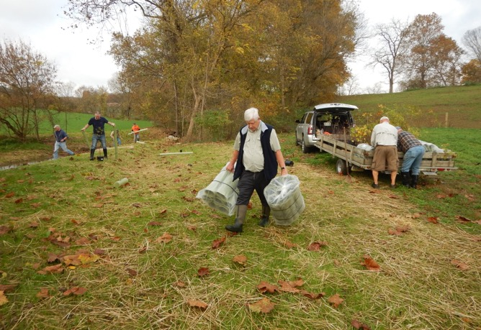
What to Expect in the Future
WIP Amendment: Include all 34 CAPs as part of the Phase 3 WIP and incorporate PA’s progress
Expand collaboration: Continue to expand work with multi-agency programs to increase efficiencies and outcomes.
Implement BMPs: Accelerate BMPs through additional and flexible funds for project implementation and staff.
Expand technical assistance: Focus on building and a trained and ready workforce of technical providers.
Continue to share success stories: Work with state and county partners to share our progress.
Cumberland County –
Installation of Big Spring Native Pollinator Garden.
Lancaster County –
Donegal Trout Unlimited at Clean Water Fund project site

Slide 18
Kristen Wolf
PA Department of Environmental Protection
Chesapeake Bay Program Coordinator
kwolf@pa.gov
(717) 772-1675
Notes:
Open for public comment/questions.

Slide 19
Accelerate Implementation through Funding
Environmental Stewardship Fund
Chesapeake Bay Ag Inspection Program – Phase 2 Pilot Lancaster, Adams, and Chester Conservation Districts; DEP SC and SE Regional Offices $2.5 million available (plus $300,000 EPA Most Effective Basin) to provide cost-share assistance to farmers for plan implementation to come into compliance with regulations Maximum of $20,000 per farmer to implement practices like grassed waterways, terraces, diversions, barnyard runoff control, fence, livestock crossings, etc. Complements other state and federal funding sources (REAP, NRCS EQIP, etc.) Ag Plan Reimbursement Program (COMPLETE) – Chesapeake Bay Watershed Only Instituted in 2016- June 30, 2021 to support the 2016 Chesapeake Bay Restoration Strategy; administered by two private consultant contractors through competitively bid contract Provided nearly $2.4 million in cost-share assistance to farmers who need to develop Ag E&S, NMP, MMPs to meet the regulatory obligations More than 3,200 plans covering more than 515,000 acres were completed

Slide 20
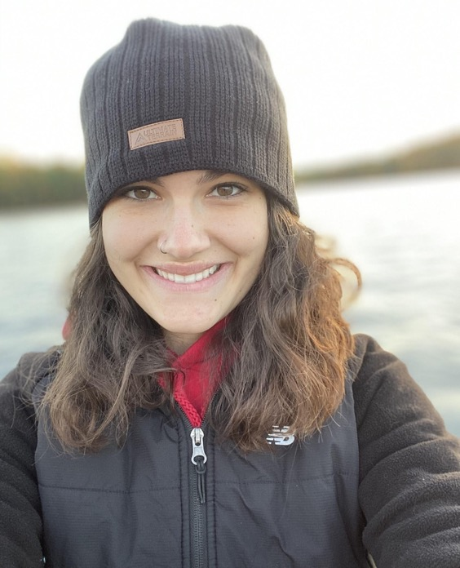
Continue to Build Partnerships
“Our Countywide Action Plan is about 75 percent focused on agriculture, so it is hugely important to have representation from the Farm Bureau and landowners.”
—Caitlin Lucas, Clean Water Action Plan Coordinator
Franklin County Conservation District
Notes:
20

Slide 21
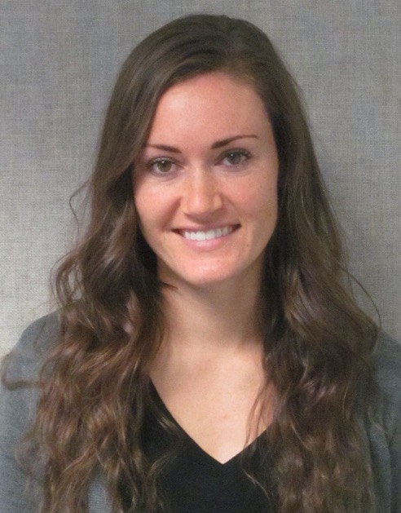
How We’re Working Together to Succeed
How PADEP Hels Counties Succeed
“Every county is different and they are each approaching this task differently. I think it's very beneficial to hear what other people have been doing, to get some ideas on how it works, and what best fit that specific county. Don't recreate the wheel or feel like you have to start from scratch. There are a lot of templates and guidance out there that you can use.”
– Katie Doster, District Manager
Lebanon County Conservation District
2020 Coordinator Training Academy.

Slide 22
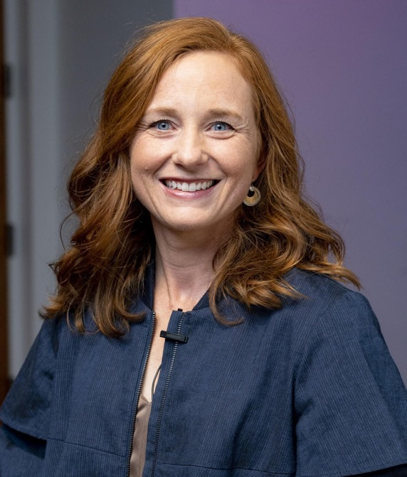
Accelerate Implementation through Funding
How PADEP Hels Counties Succeed
“We've definitely had success already with on-the-ground project implementation.
The funding that DEP gives us for CAP implementation, the flexibility of those dollars has been extremely helpful, and
we appreciate being able to get that to
the projects on the ground quickly and
be responsive to the local decision making.”
— Allyson Gibson, Coordinator
Lancaster Clean Water Partners
Notes:
22

