Slide 1
State Conservation Commission
Chesapeake Bay Program
Citizen Advisory Committee
December 1, 2021

Slide 2
What is the overall progress in getting pollution prevention practices on PA farms?
AG conservation partnership is moving forward despite the challenges of COVID and supply chain disruptions.
Additional funds at the local, state and federal levels continue to increase, slowly and steadily, especially financial assistance (FA) programs. (EQIP, RCPP, CEG, REAP, AgriLink, NFWF, MEB, etc.)
Developing dedicated, predictable and adequate funding is key
Technical assistance capacity needs to grow to keep up with existing and projected demand.
Conservation district, NRCS and private sector staff are critical TA components

Slide 3
What is the overall progress in getting pollution prevention practices on PA farms?
If federal FA increases as hoped (e.g. PA NRCS funding for CB WS doubles), that will place significant stress on TA resources.
If state FA significantly increases in this same time frame, that will place even more stress on TA resources.
Expanding TA is a long-term challenge requiring long-term investments
Chasing the elusive “shovel ready” project takes significant time and resources before any dirt is ready to be turned.
TA resources are the key to “shovel ready.”

Slide 4
USDA NRCS (PA)
Federal Farm Bill funding has remained stable
Proposed funding in Infrastructure and BBB could have significant impact on FA and TA in PA
USDA NRCS has been and will continue to be the “work horse” of agricultural BMP work in Pennsylvania and across the watershed.
Supporting increases in NRCS funding for Bay states, and especially proportional funding for PA is important. (e.g. Climate Smart BMPs, CRFI, etc.)

Slide 5
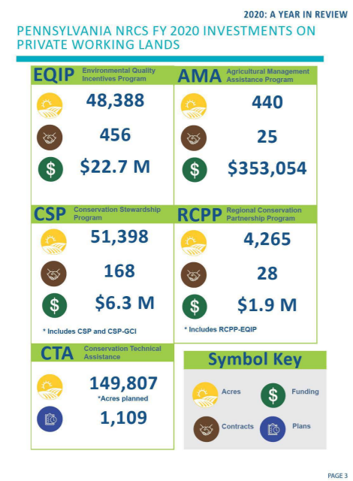
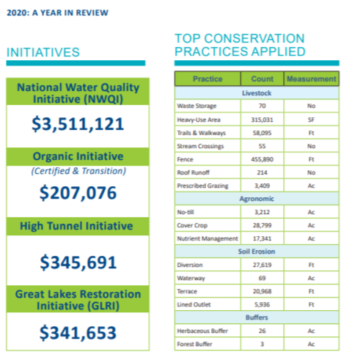
PA NRCS 2020 Report ~ $36 million Statewide ~ $24-25 million in CB WS

Slide 6
PA DEP Programs (Support for state agency staff and CD staff, and AG BMP funding (*))
Chesapeake Bay Agricultural Nonpoint Source Abatement
Conservation District Watershed Specialists
Phase 2 Ag Inspection Pilot (*)
Countywide Action Plan Implementation Grant (*)
Growing Greener (*)
Section 319 (*)
Small Business Advantage Grant Program (*)
Agriculture Plan Reimbursement Program (Complete) (*)

Slide 7
SCC & PDA Programs
Conservation Excellence Grants
REAP Tax Credit Program
AgriLink Low Interest Loan Program
Farmland Preservation & RCPP

Slide 8
Conservation Excellence Grants (CEG)
2019 PA Farm Bill Program
Administered by SCC
Priority Locations & Priority BMPs
Status of TA for Projects
Willingness to Accept Reasonable Mix of Financial Tools
Delegated to County Conservation Districts
Block Grants & Advanced Funding & up to 25% Admin/TA
Must accept application at least quarterly
60-day application turn-around
$250,000 cap and small project component

Slide 9
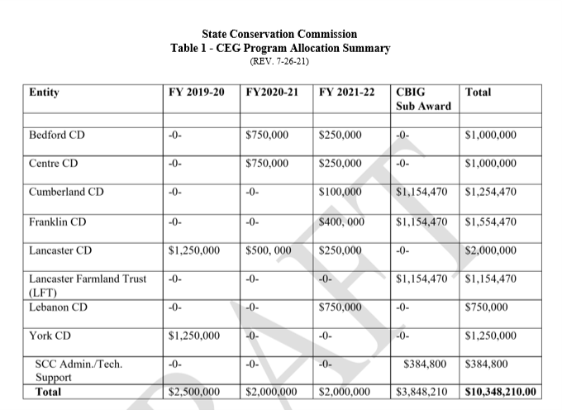

Slide 10
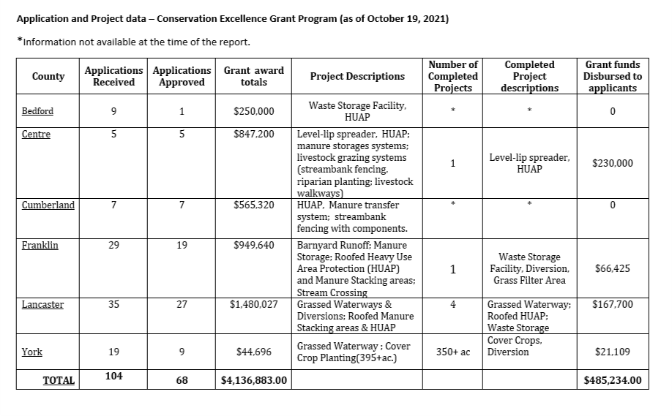

Slide 11
REAP Tax Credit Program
REAP allows farmers, businesses, and landowners to earn state tax credits in exchange for the implementation of SCC approved conservation BMPs or purchase of no-till equipment
The program is administered by SCC in cooperation with PA Department of Revenue.
Requires compliance with agricultural conservation regulations (NM, MM, Ag E&S or conservation plan)
First-come, first-served program with no rankings.
Sponsorship is possible

Slide 12
REAP Tax Credit Program
Eligible applicants can receive up to $250,000 in tax credits in any consecutive 7-year period.
Eligible BMPs can receive 50%, 75% or 90% tax credit
90% REAP tax credit option for certain high-priority BMPs within watersheds covered by an approved TMDL. Those practices include: riparian forest buffers; livestock exclusion from streams and supporting practices; stream crossings; cover crops; soil health BMPs; and other BMPs determined appropriate by the SCC.
2019 PA Farm Bill increased annual REAP allocation from $10 million to $13 million

Slide 13
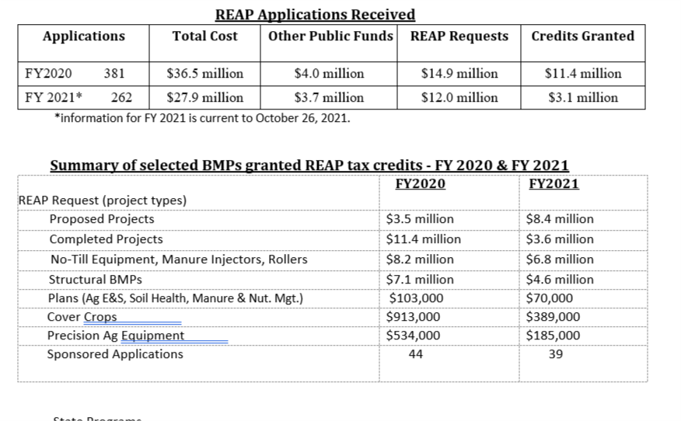

Slide 14
AgriLink Low Interest Loan Program
Low interest loan program administered by SCC in cooperation with PA Treasury
Provides loans through private sector lenders for eligible AG BMPs
2019 PA Farm Bill amendments and funding
Rates subsidized by SCC (3% below market rates)
Up to $250,000 and up to 12-year term
Program launch in mid-December
$2.5 million loan block released at 3% below market rates

Slide 15
PA Farmland Preservation Program
Established in 1988
Top in nation for farms (5,329) and acres (55,702) preserved.
The program guarantees a future food supply, and contributes to a healthier economy and improved environment.
Receives ~ $40 million annually for easements
Two RCPP Grants received
2018 RCPP Implementation of BMPS (6-county target area)- Received $6.3 million in funding ( $5.3M for EQIP projects and $1M for ACEP easements)
Partners: PDA, CDE, and Sustainable Chesapeake
2019 RCPP (22-counties along Kittatinny Ridge mainly focused on easement purchases)-Received $9.98M in funding (All being used mainly for easement purchases Ag and Forest)
Partners: PDA, DCNR, DMVA, PGC, TNC, Berks Nature, TLVC, Manada, CPC

Slide 16
What can CAC do to help
Advocate for … dedicated, predictable and adequate funding
CEG, REAP, AgriLink, CD Line Items, GG, CBP, etc. (existing)
Agricultural Conservation Assistance Program (SB 832)
Clean Streams Fund
RGGI
Growing Greener
Chesapeake Resilient Farms Initiative
EPA (NFWF) Most Effective Basin Funding
Ensure that technical assistance funds are part of any new funding source.

