Slide 1
Crosswalking Local Land-Use Data with the Proposed
Phase 6 Land Uses
Peter Claggett,
U.S. Geological Survey
Land Use Workgroup Meeting
January 30, 2014

Slide 4
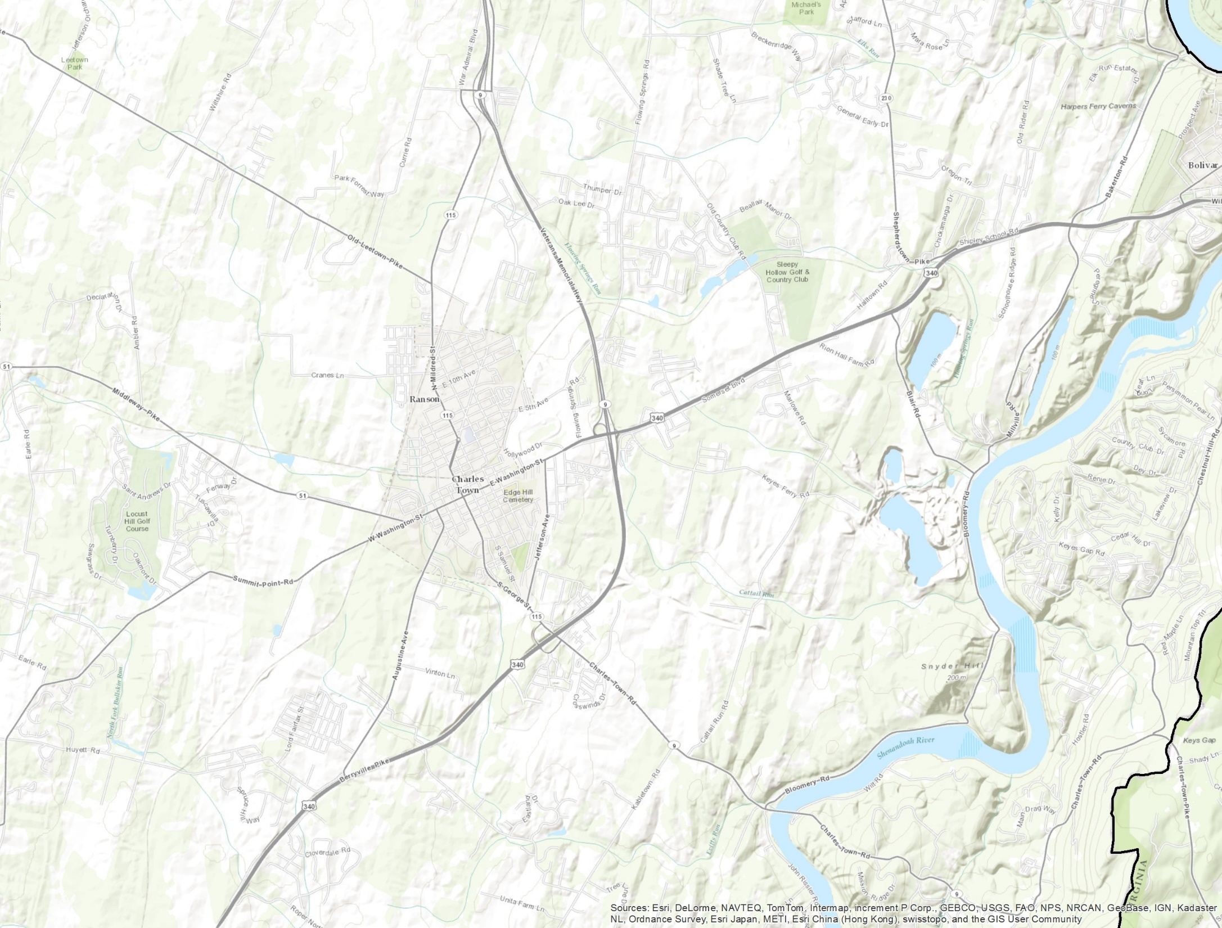
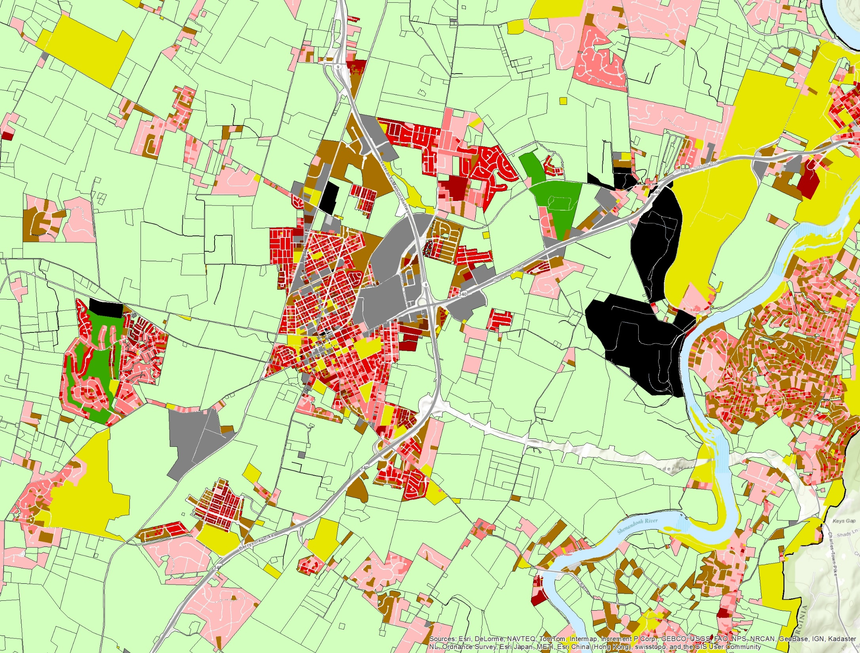
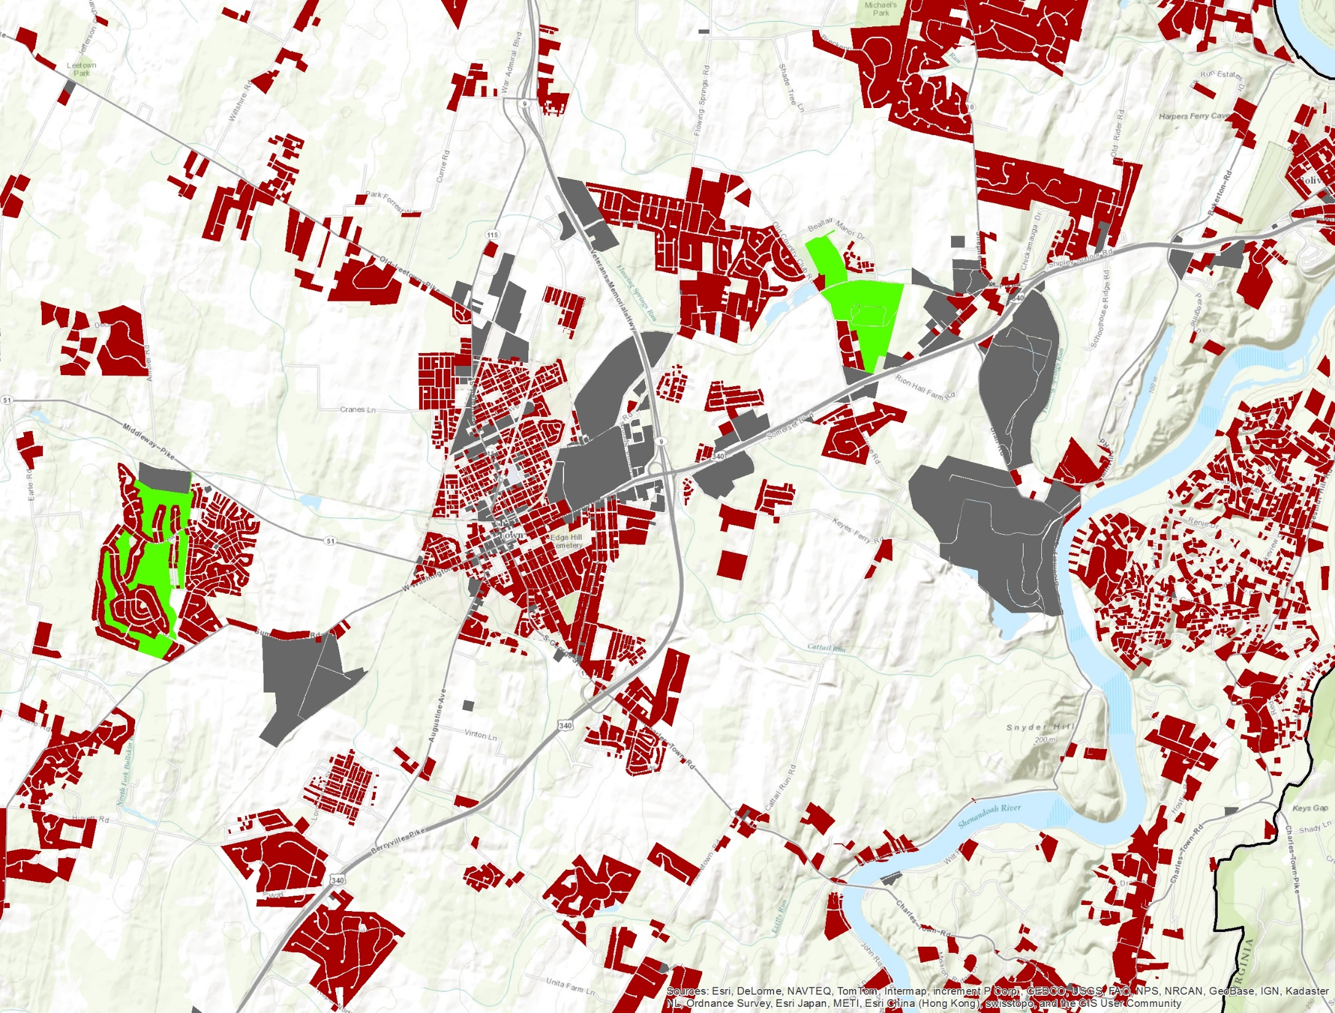
Local Land Use (all classes)
Local Land Use (generalized urban classes)
Charles Town, WV

Slide 5
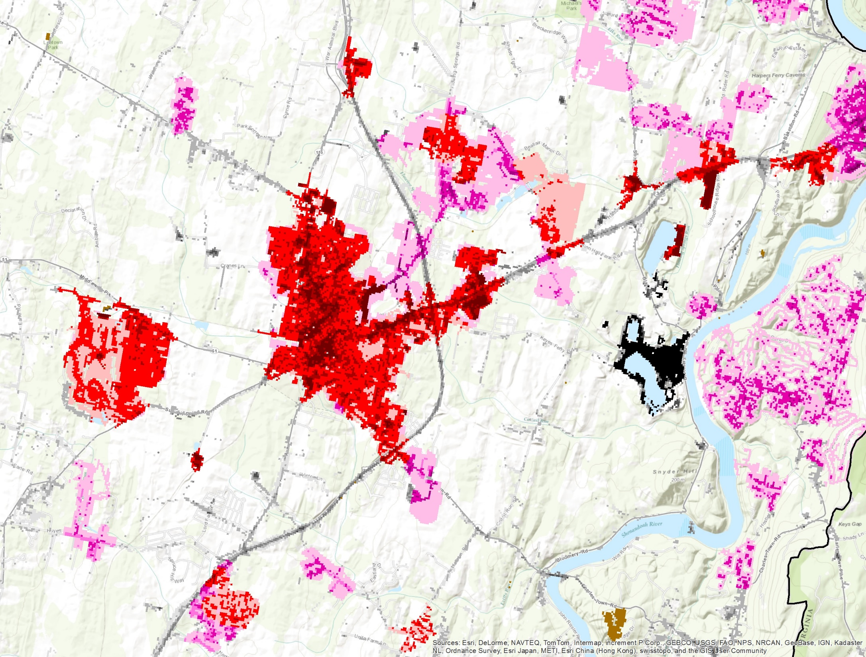
Phase 5.3.2 Land Cover:
Mixture of low and medium intensity development consisting of impervious surface and turf grass.
Charles Town, WV

Slide 6
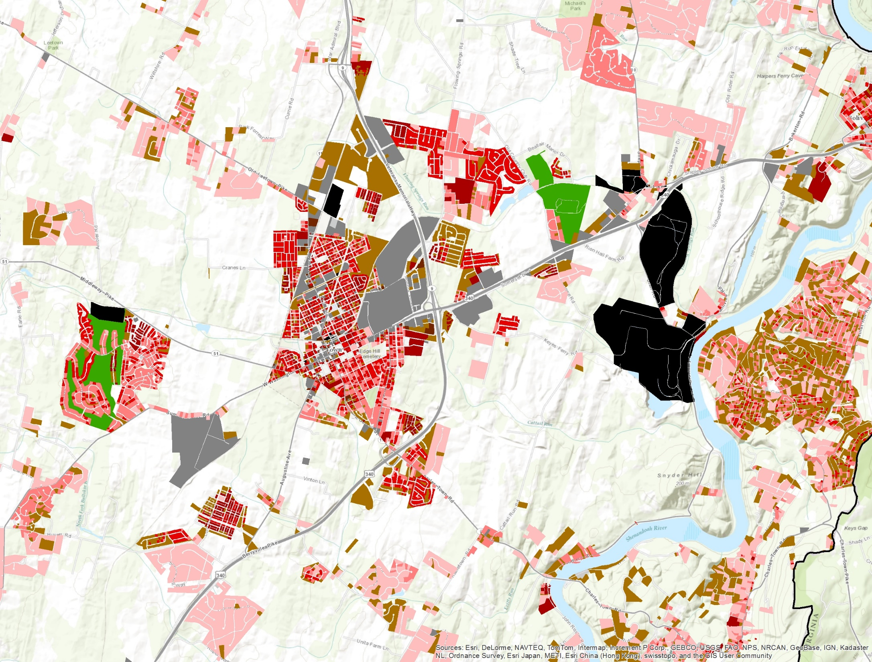
County Land Use:
Golf course coupled with mixture of Low, Medium, and High-density Residential Development (impervious and pervious portions derivable using published coefficients).
Charles Town, WV

Slide 7
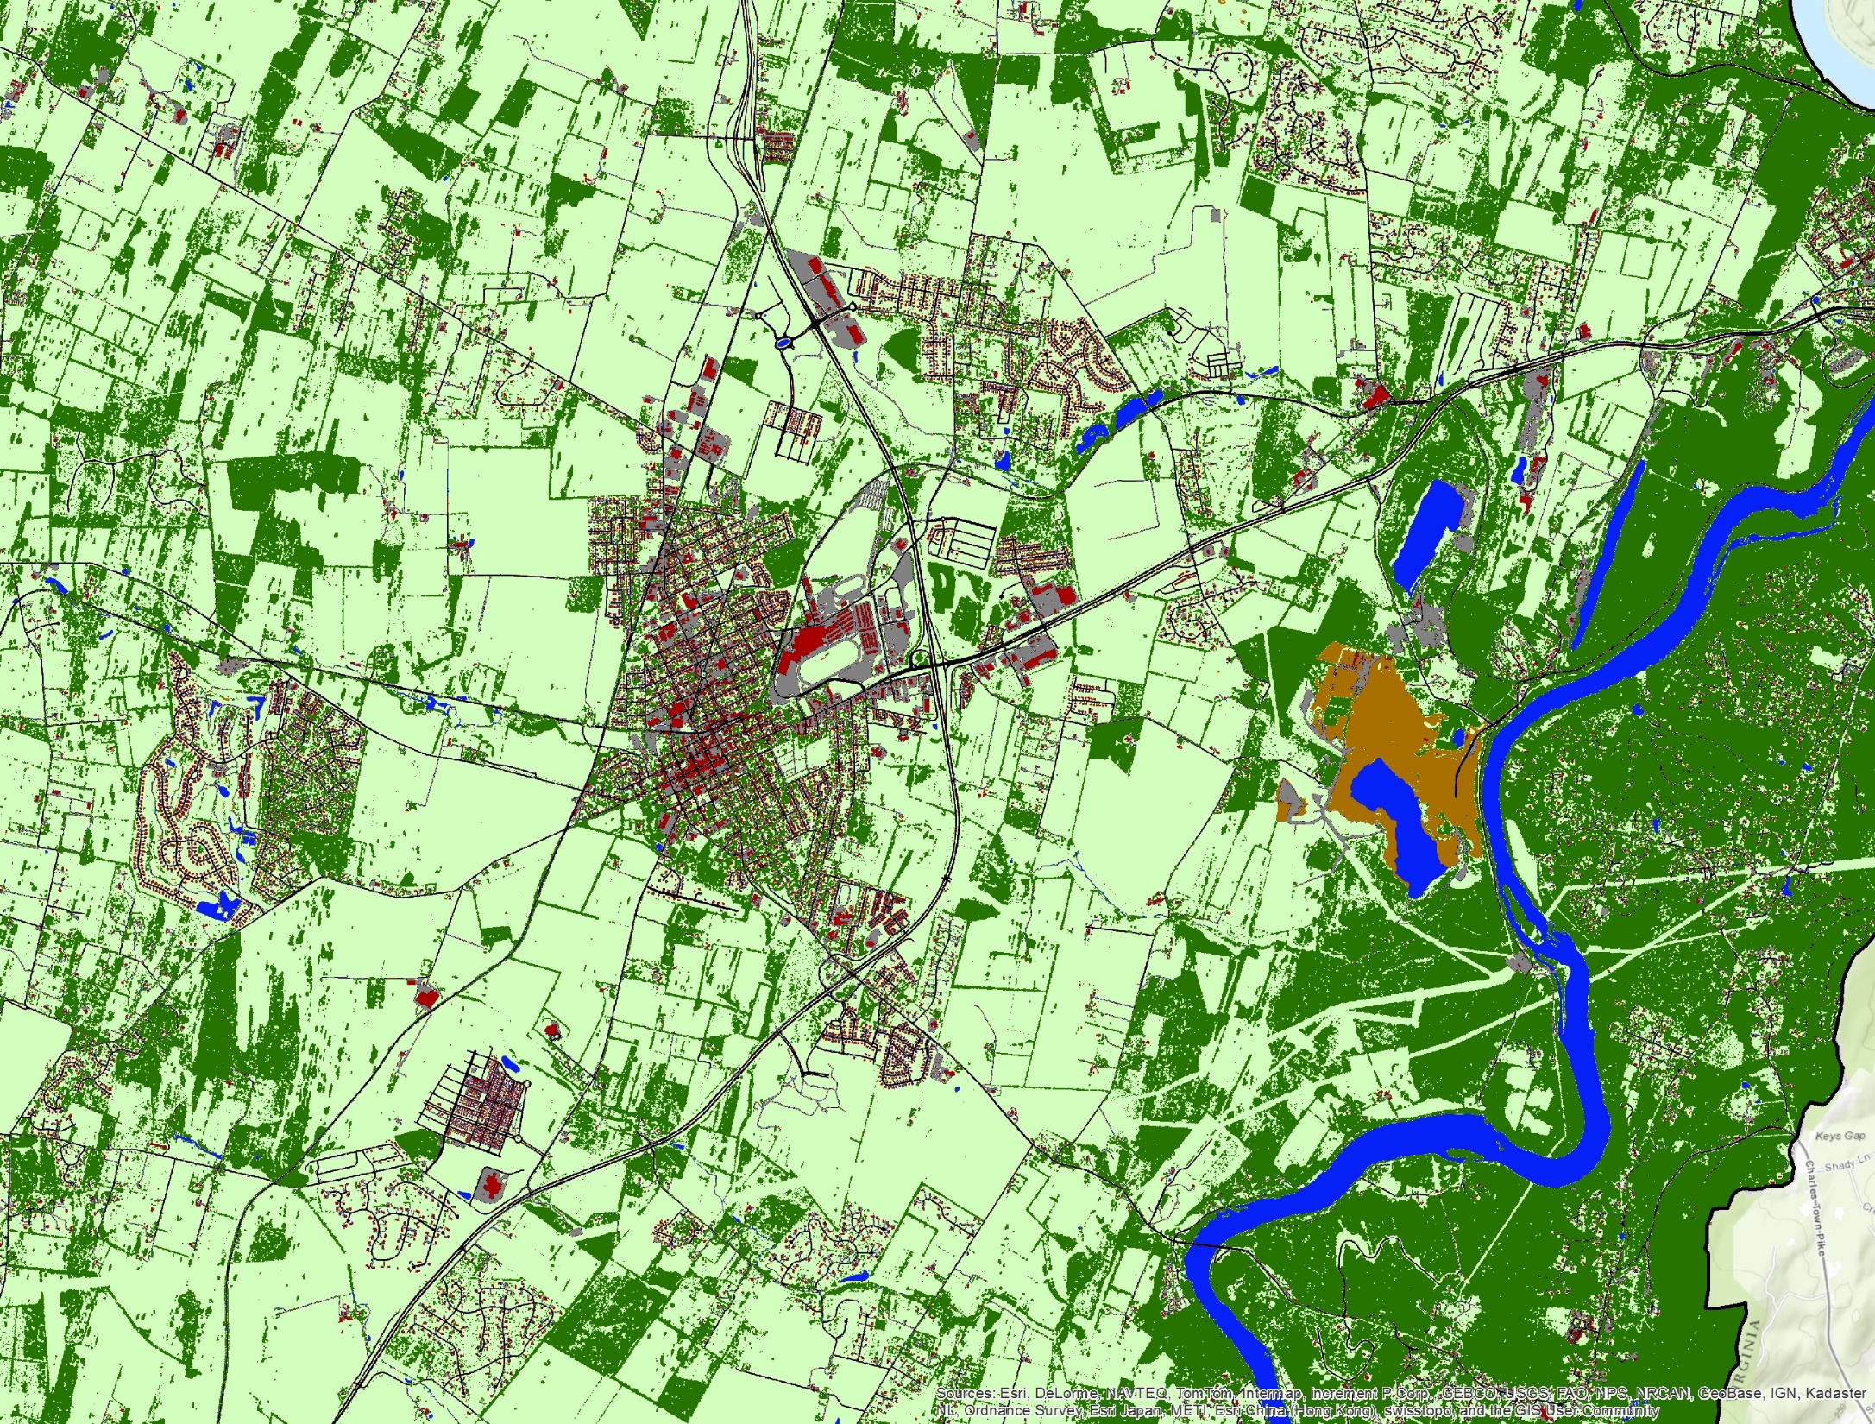
County Land Cover:
Impervious from roads and buildings mixed with grassland and trees.
Charles Town, WV

Slide 8
Land cover enables separation of pervious developed land into tree canopy and grass.

Slide 9
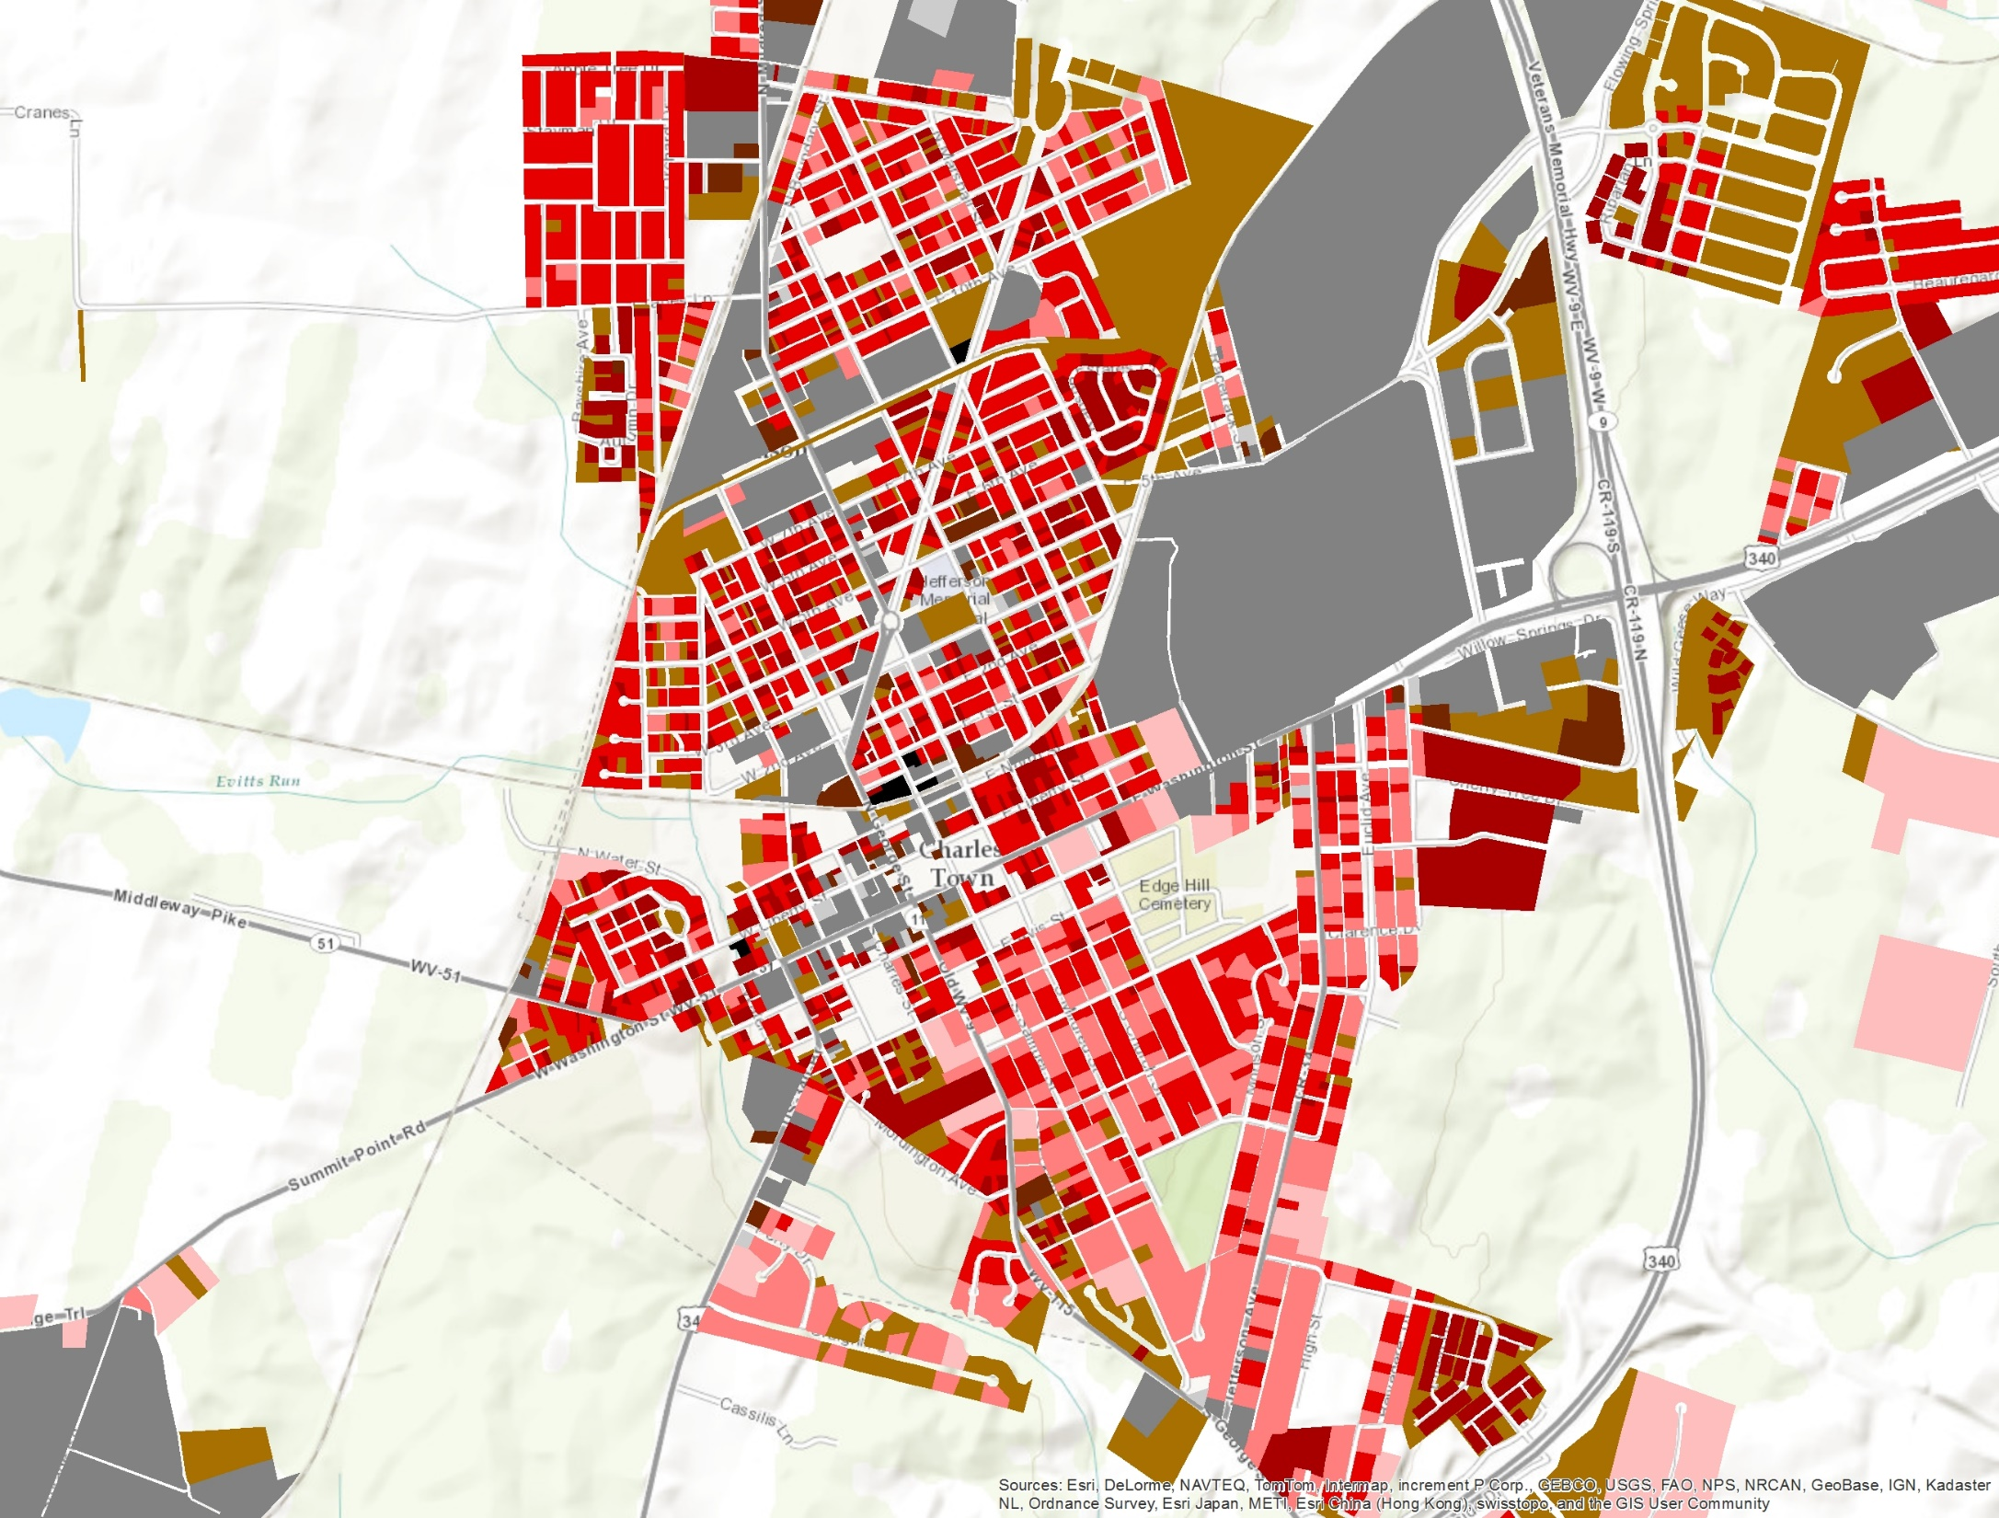
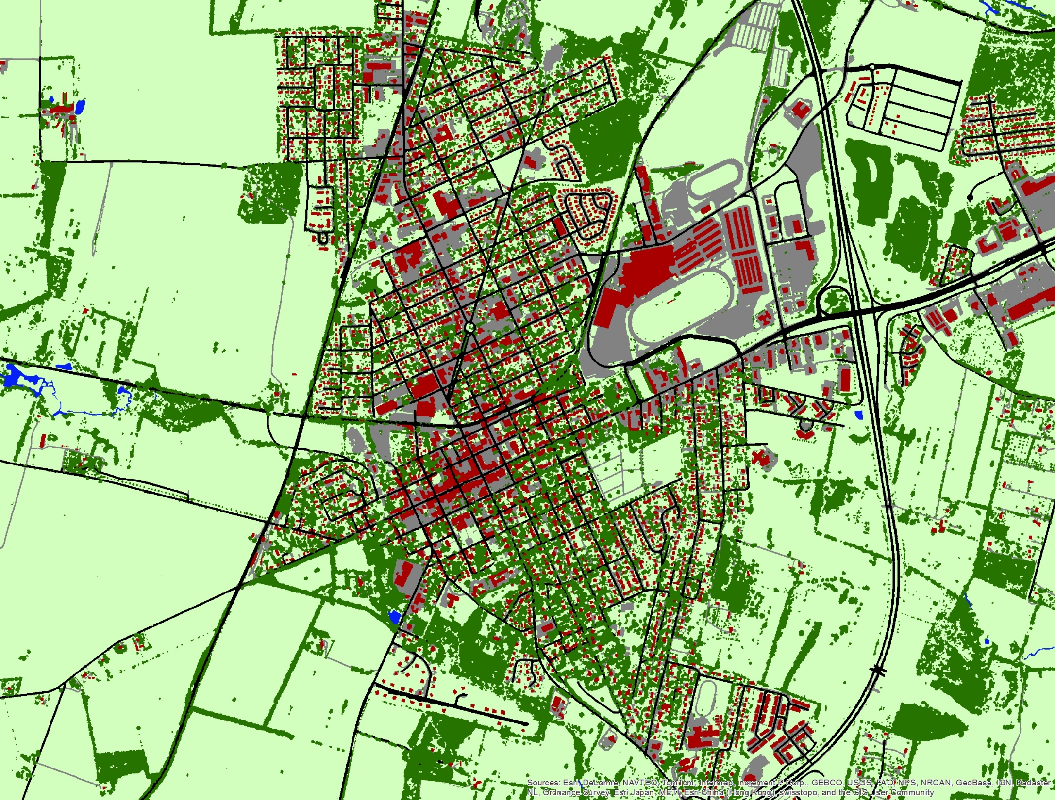
Land cover enables separation of pervious developed land into tree canopy and grass.
Charles Town, WV

Slide 10
Local Land Use (all classes)
Local Land Use (generalized urban classes)
Charles Town, WV

Slide 11
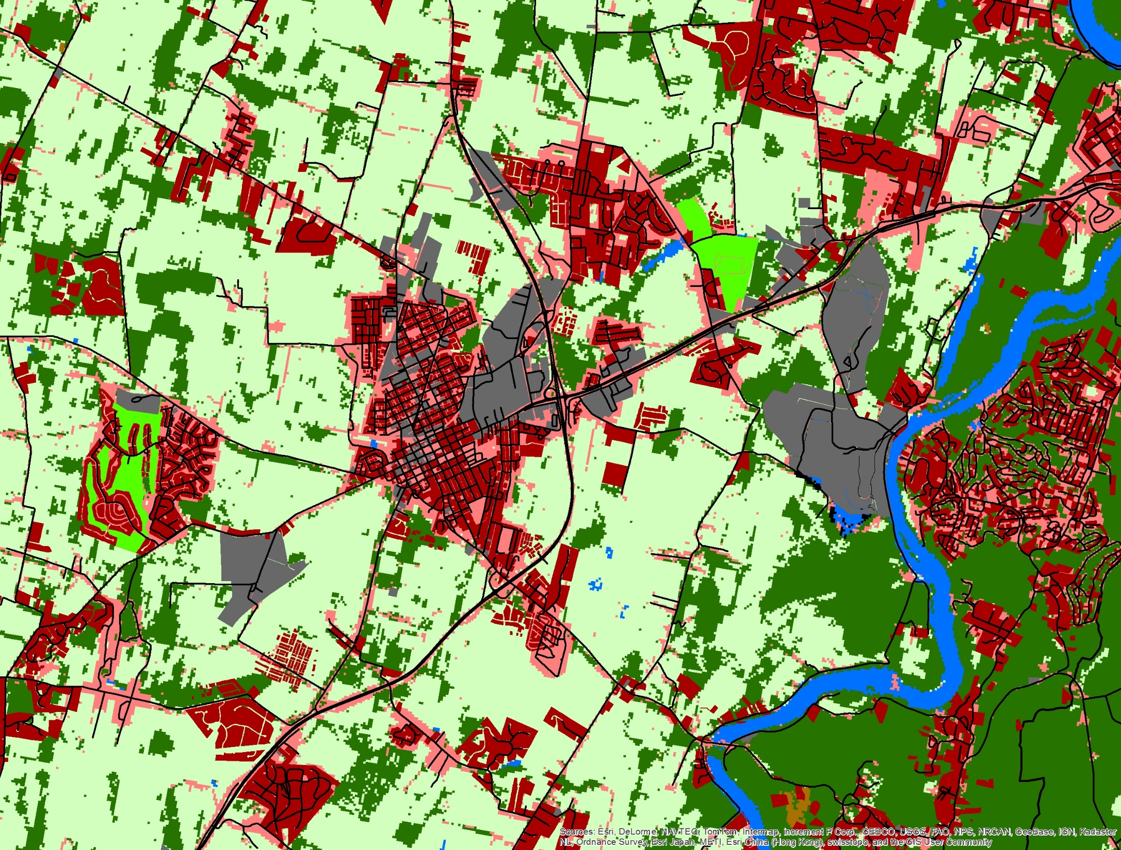
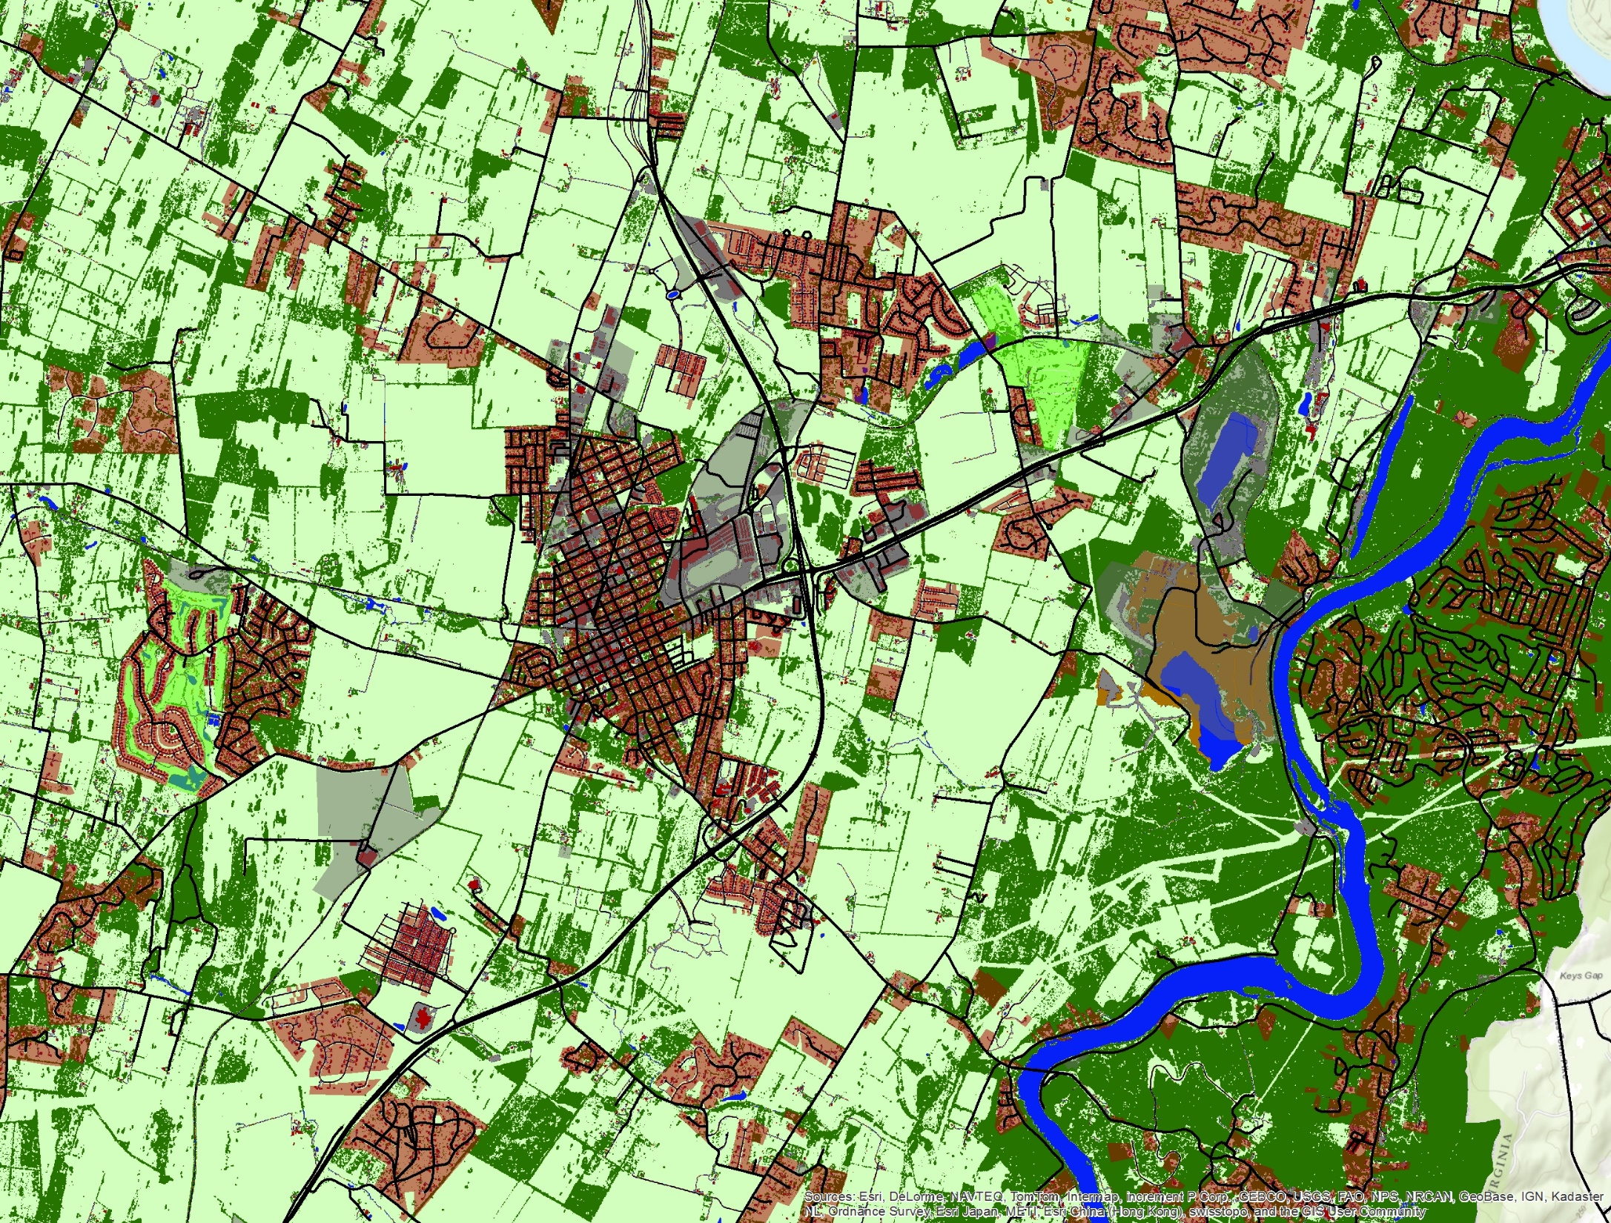
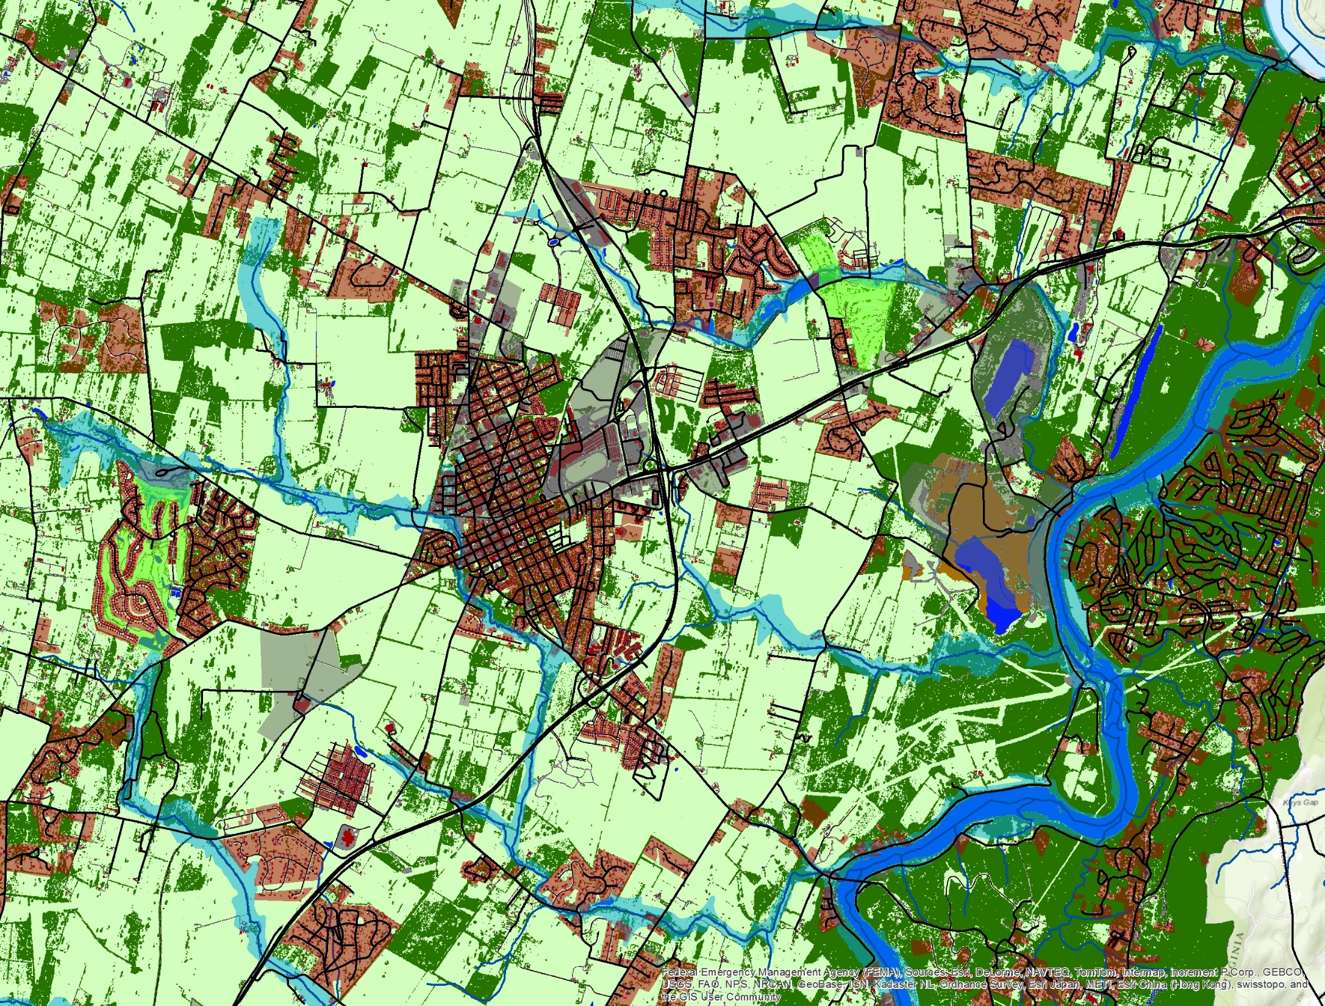
Local Land Use + Phase 5.3.2 Land Cover
Local Land Use + Local Land Cover
NHD-H Flowlines (1:24,000) & FEMA Floodplains
Charles Town, WV

Slide 12
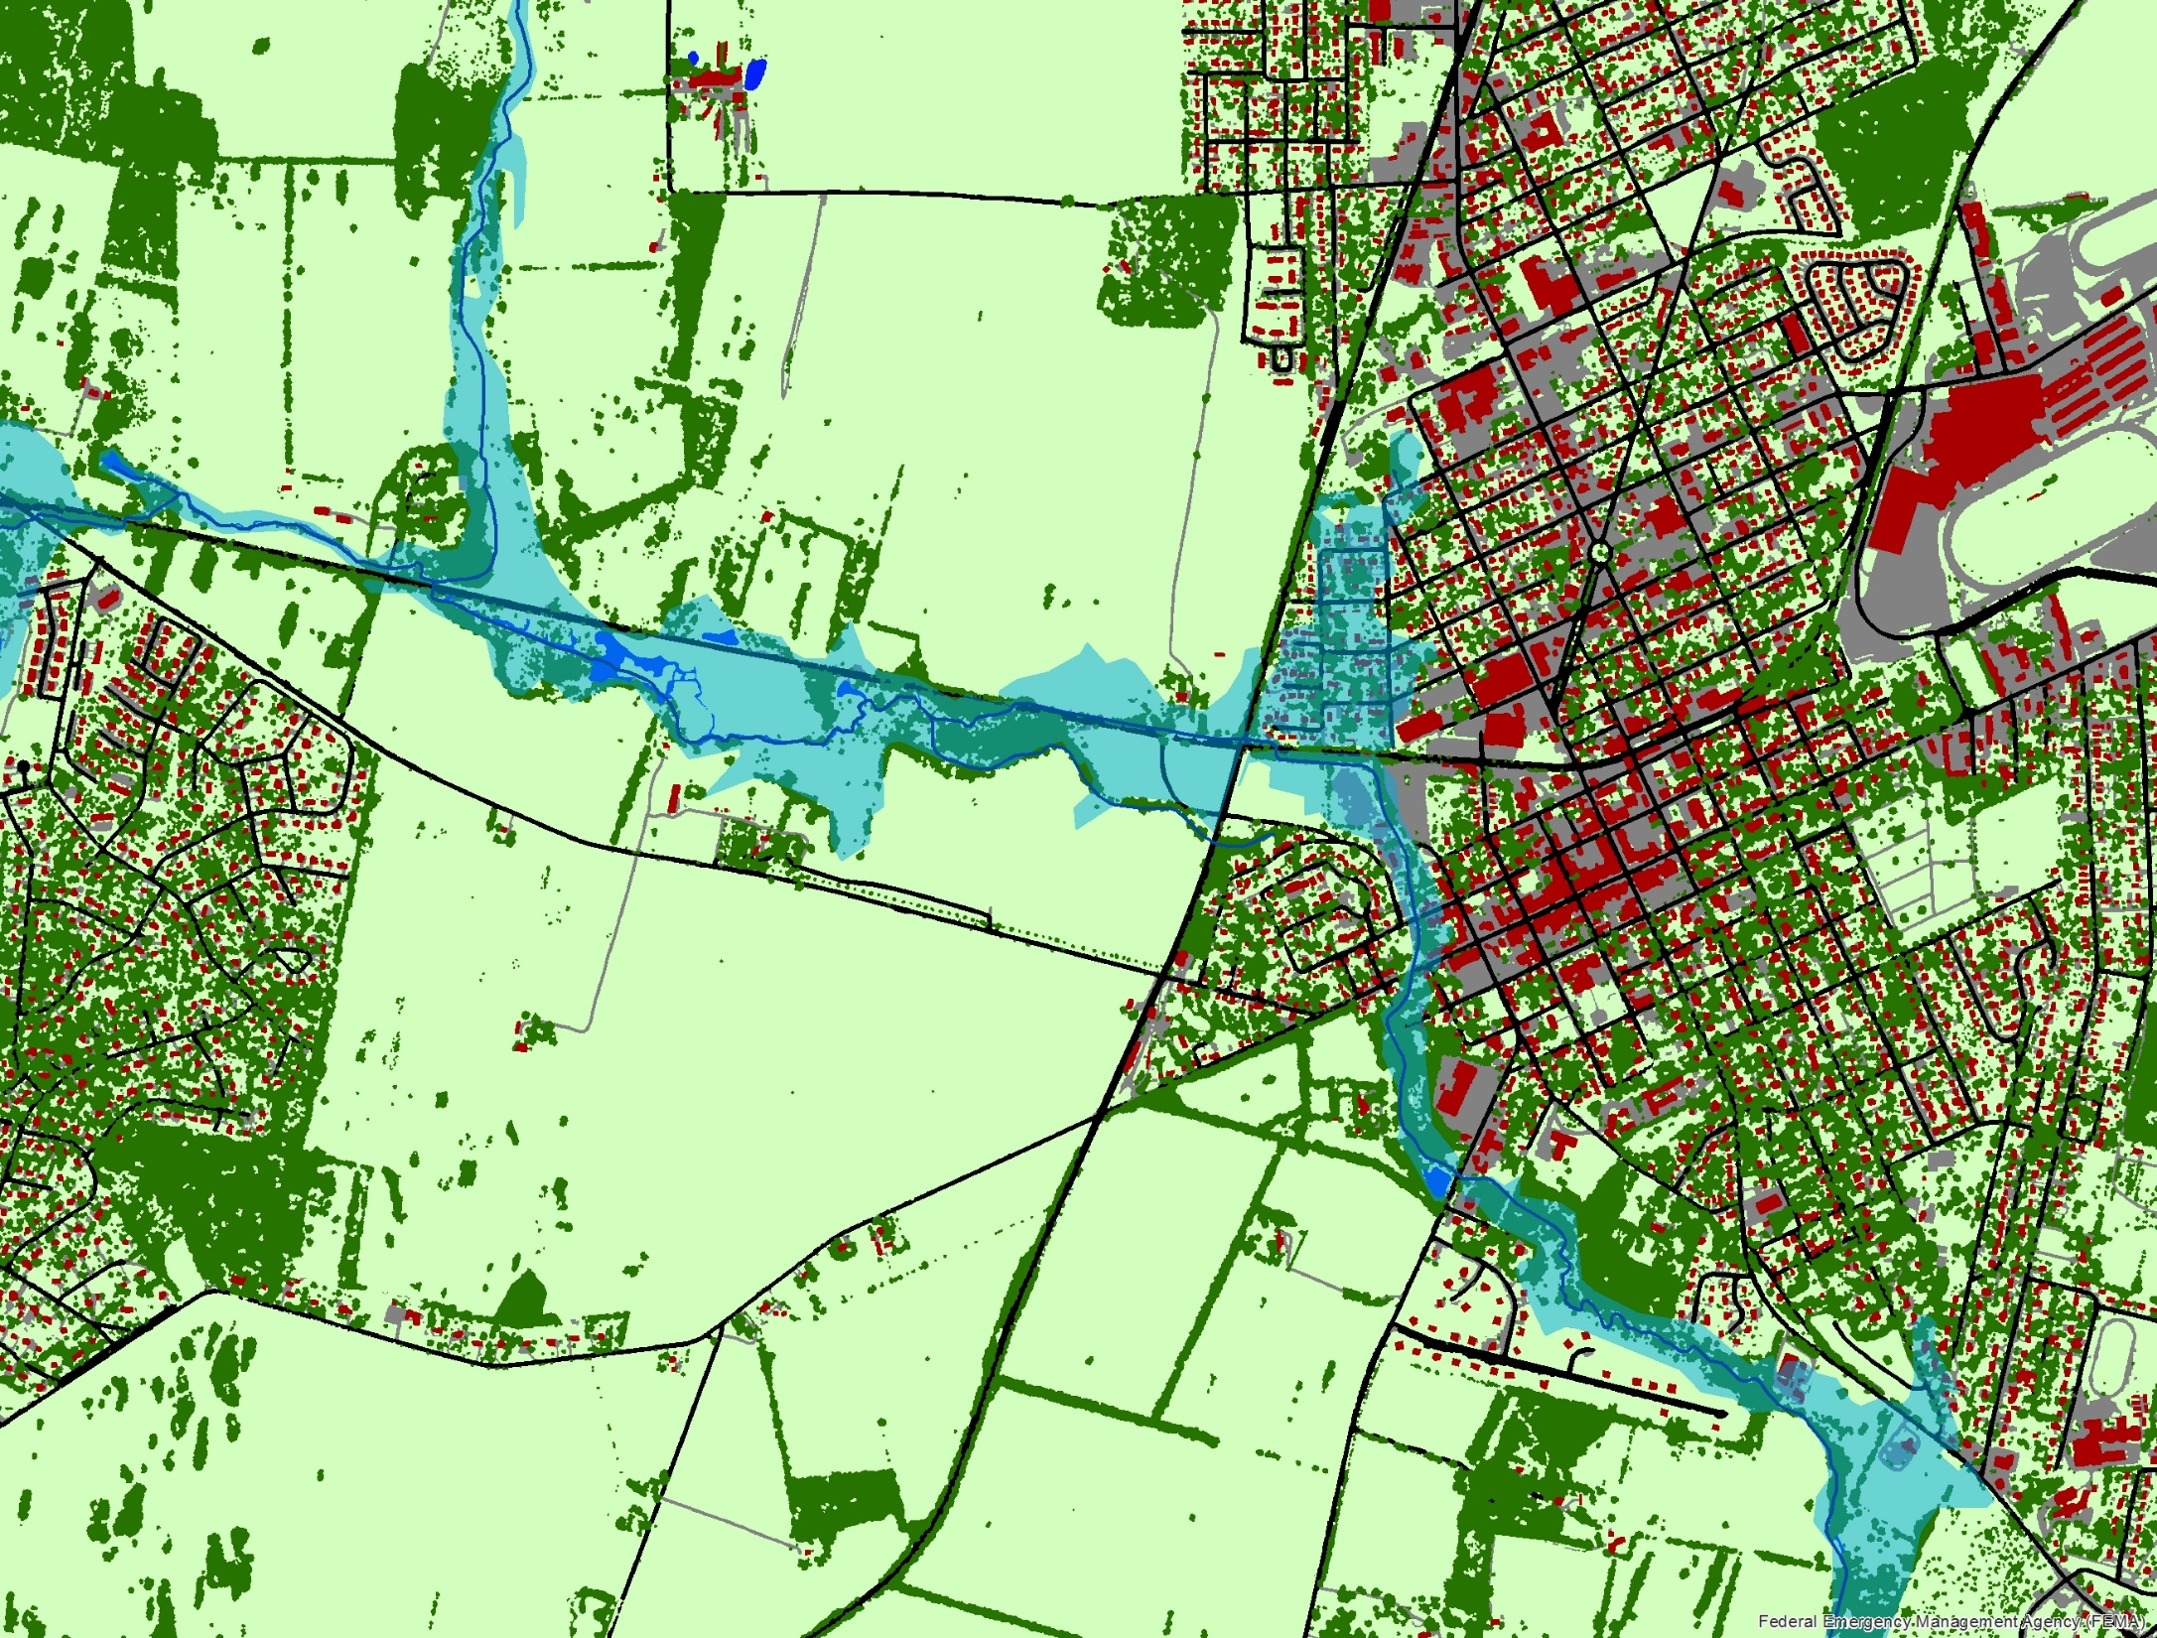
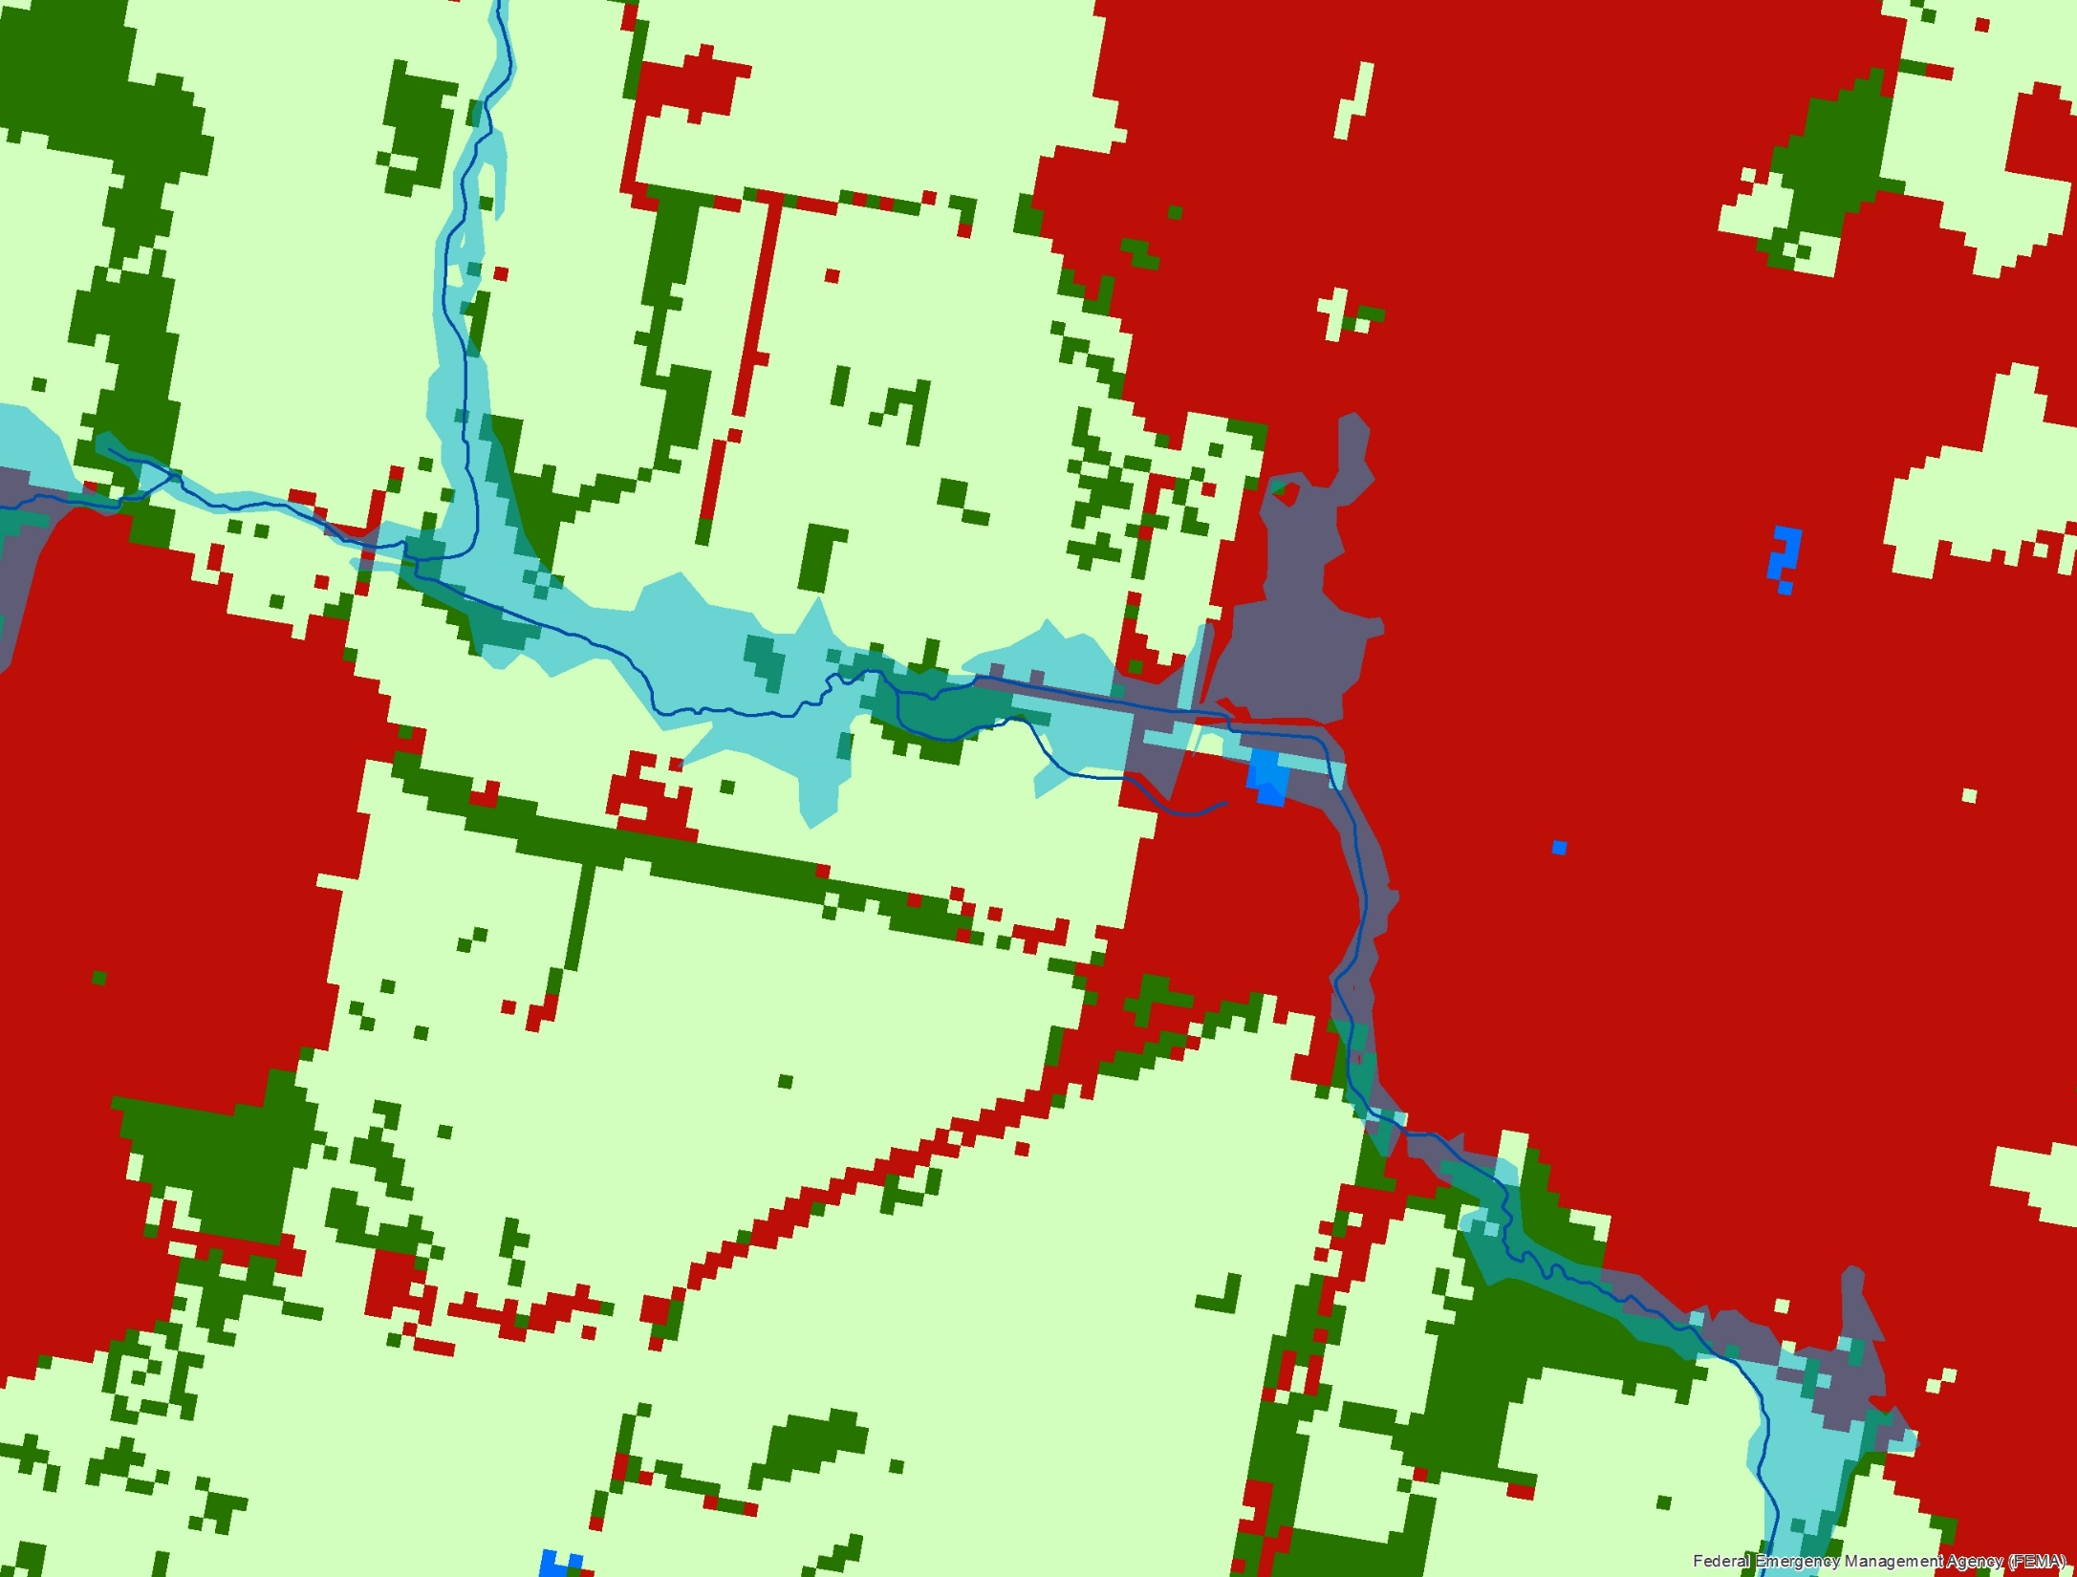
1m-resolution land cover captures narrow forest buffers
30m-resolution land cover does not
Charles Town, WV

Slide 13
Connected Impervious Surfaces?
Charles Town, WV

Slide 14
Disconnected Impervious Surfaces?
Charles Town, WV

Slide 15
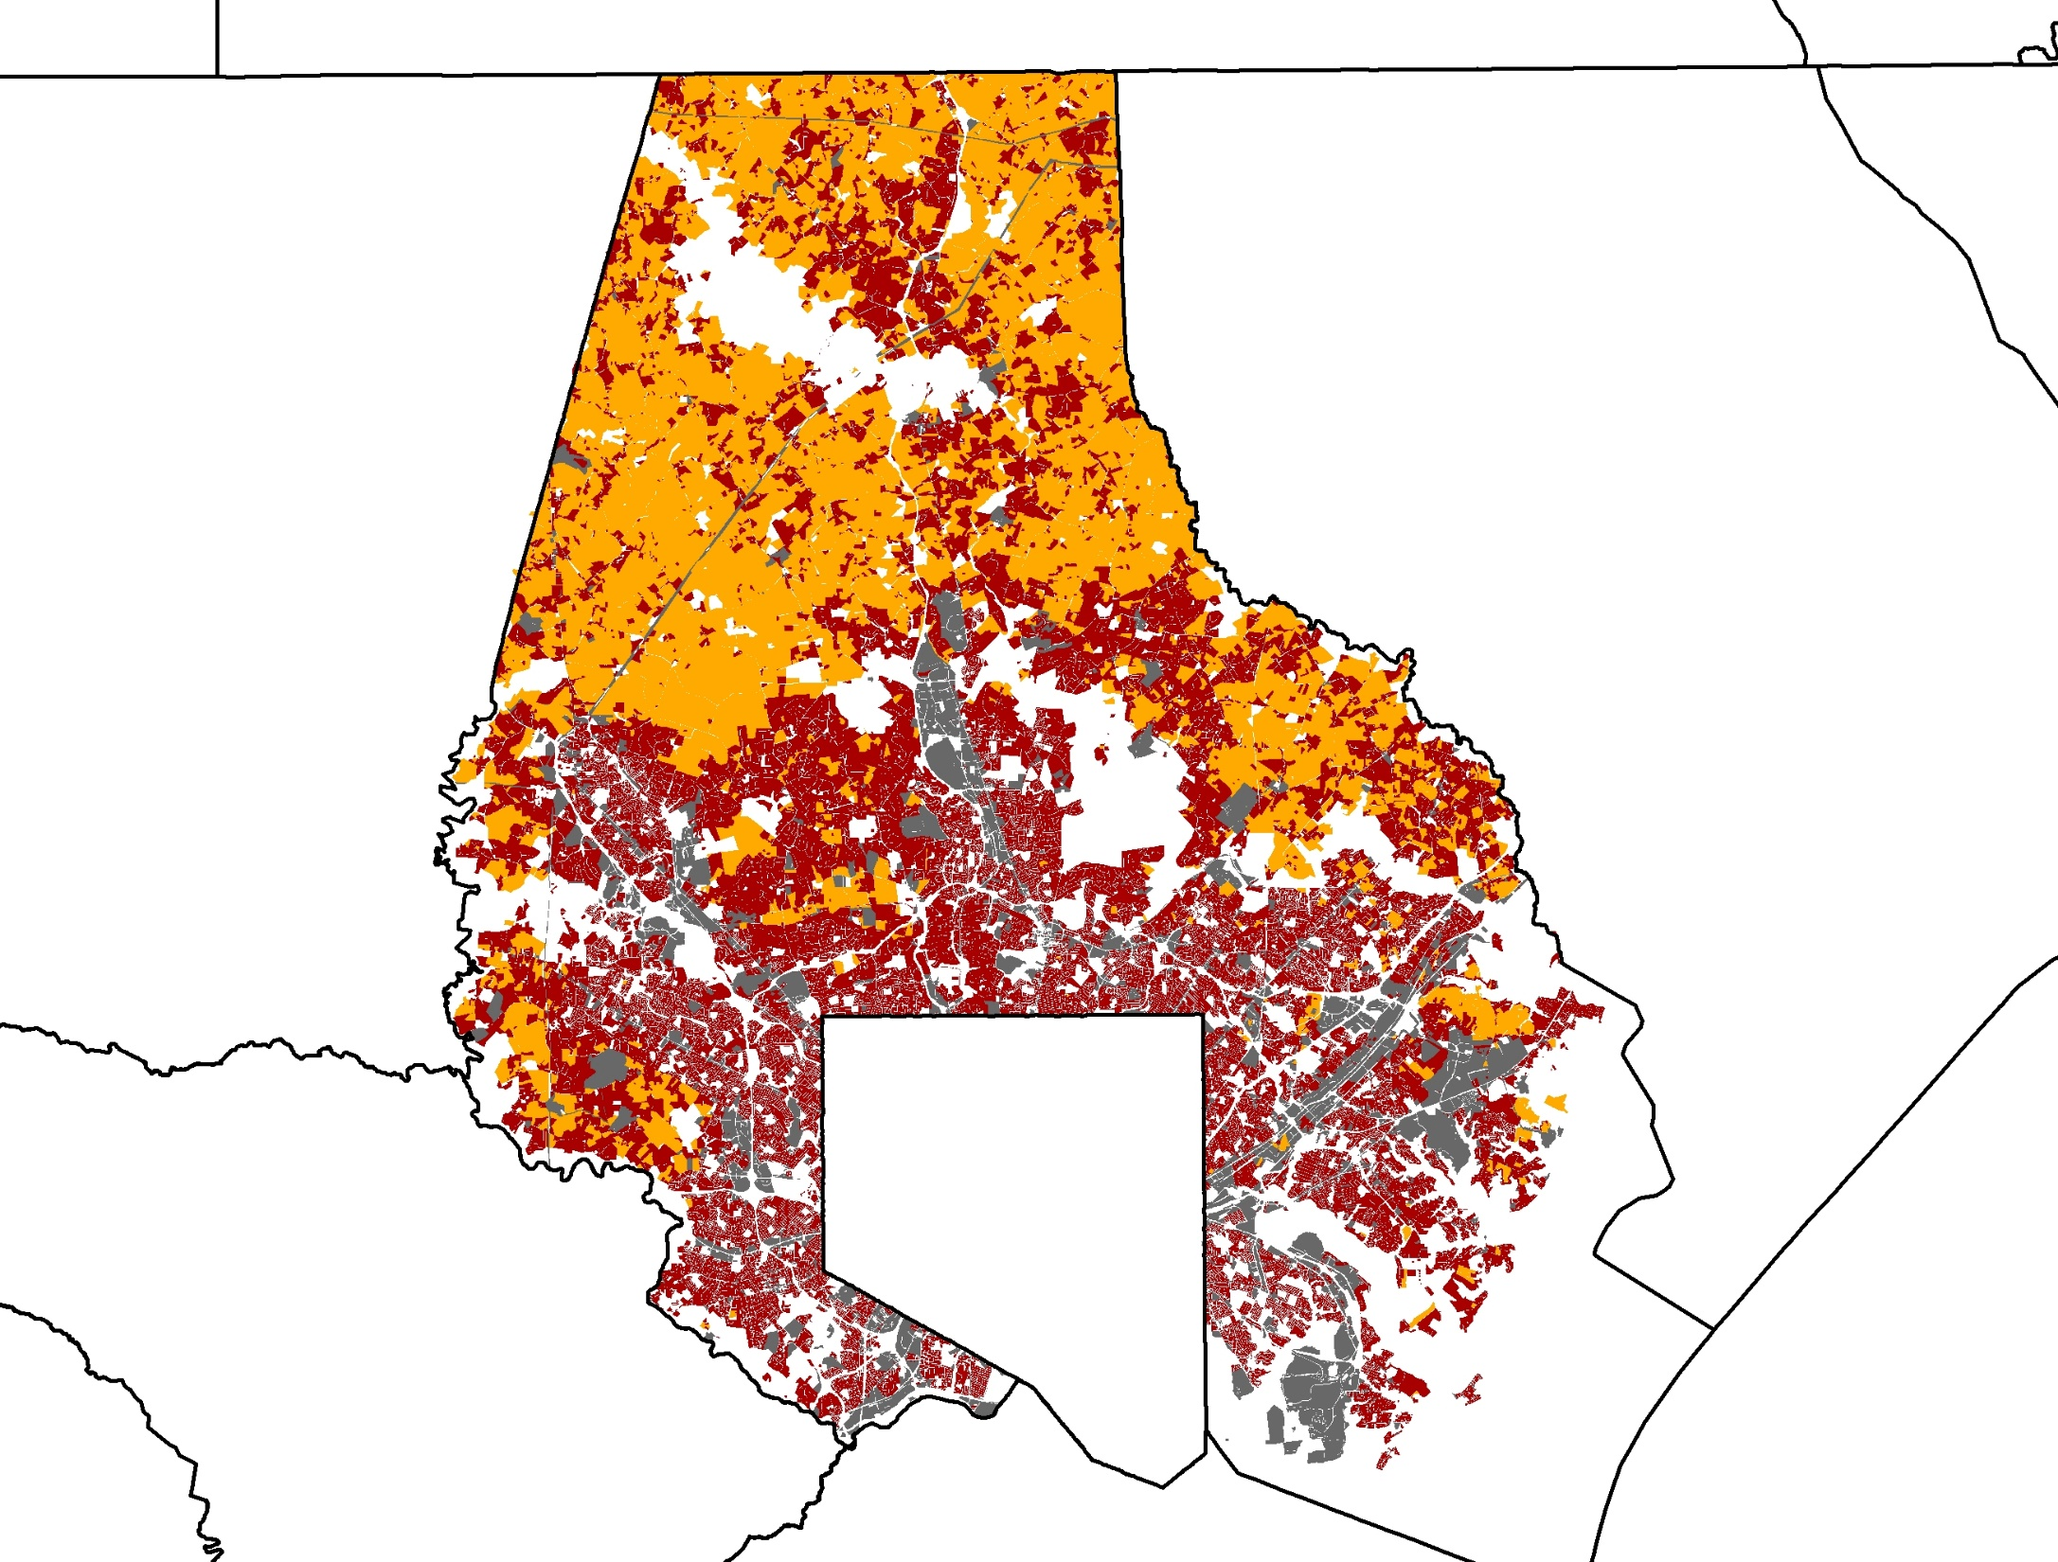
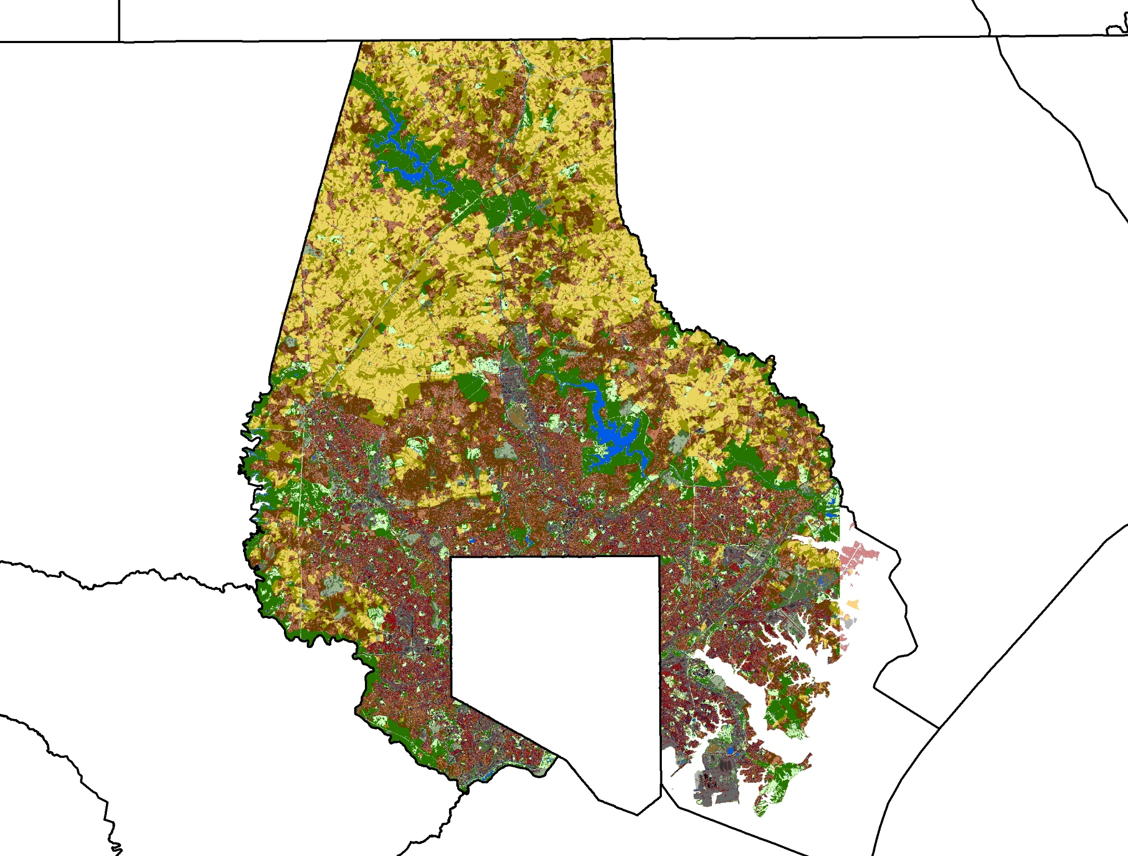
Baltimore County Land Use
Baltimore County Land Use & Land Cover

Slide 16
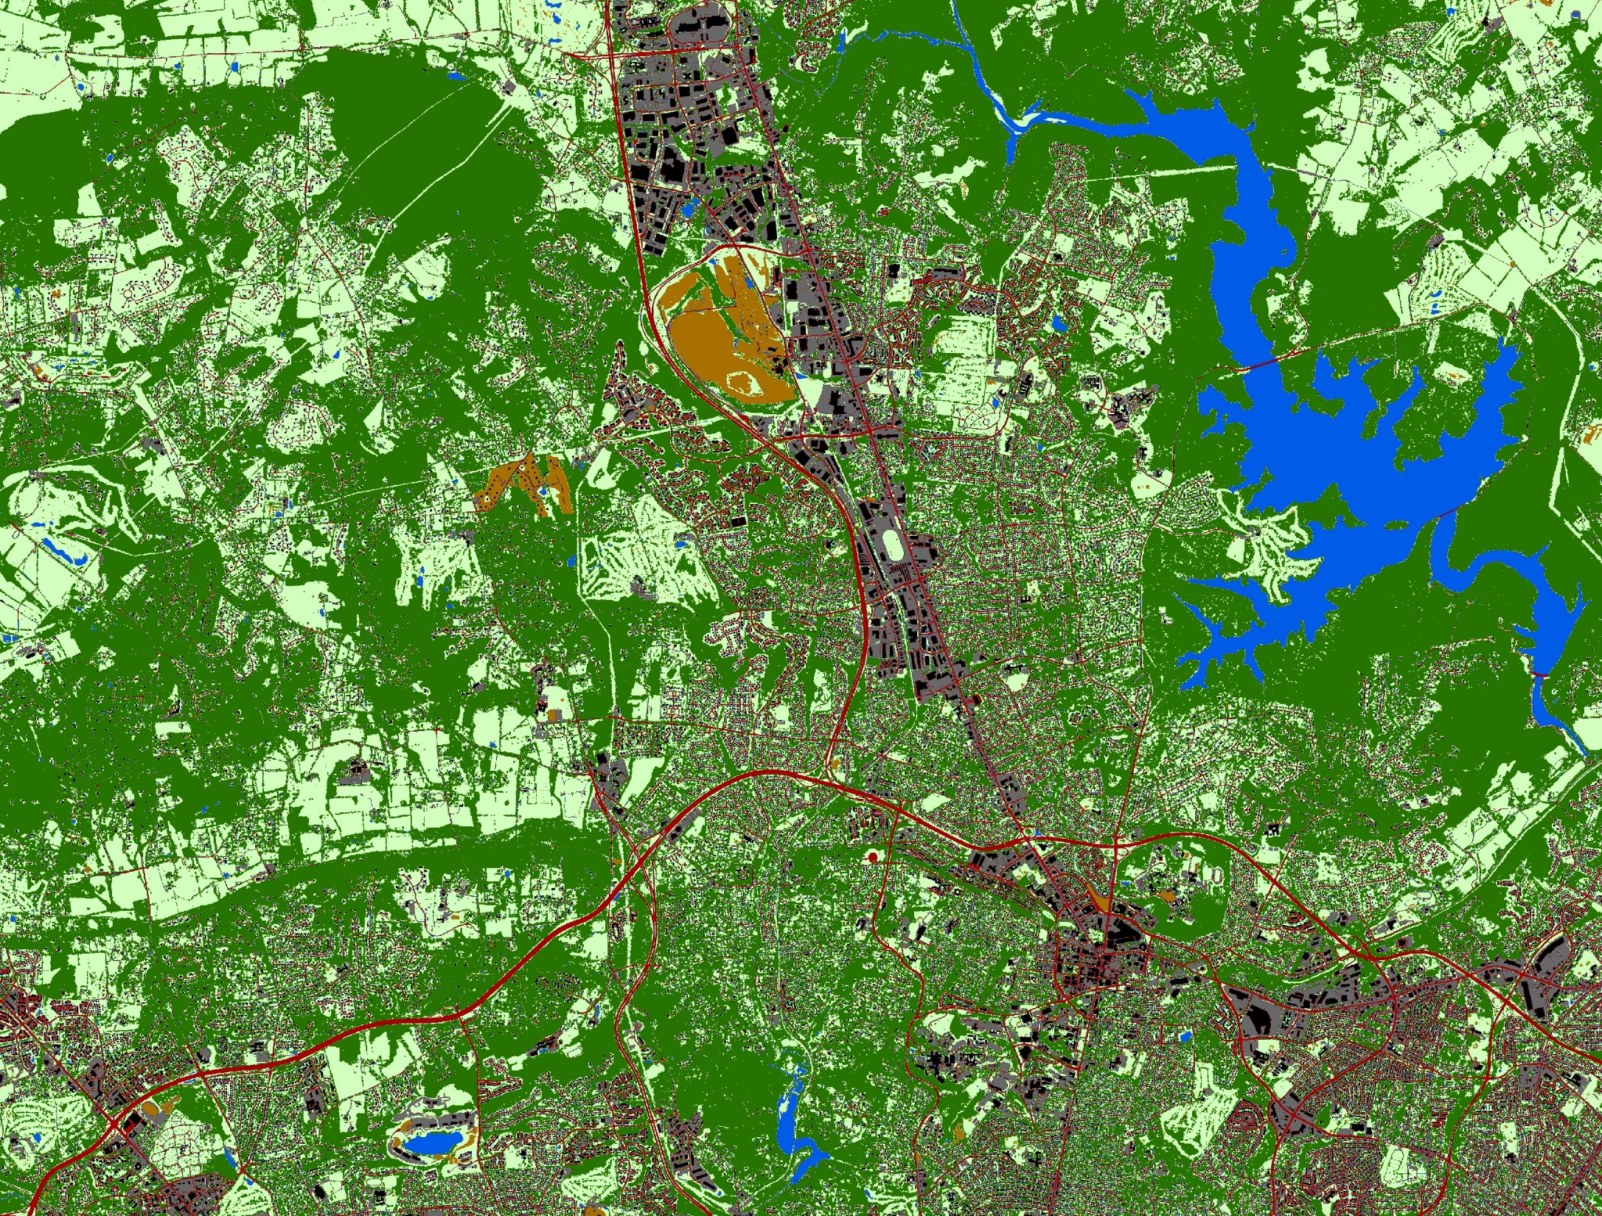
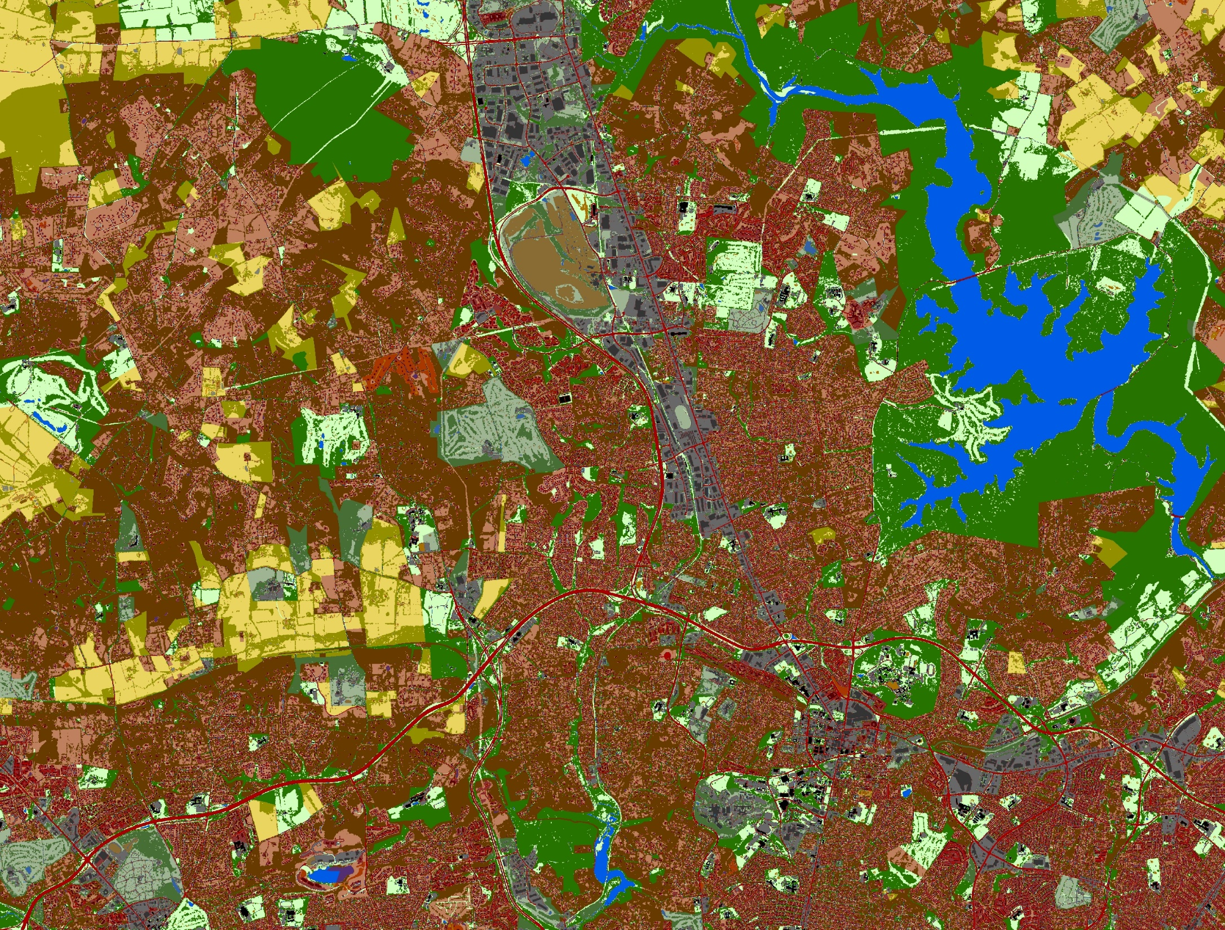
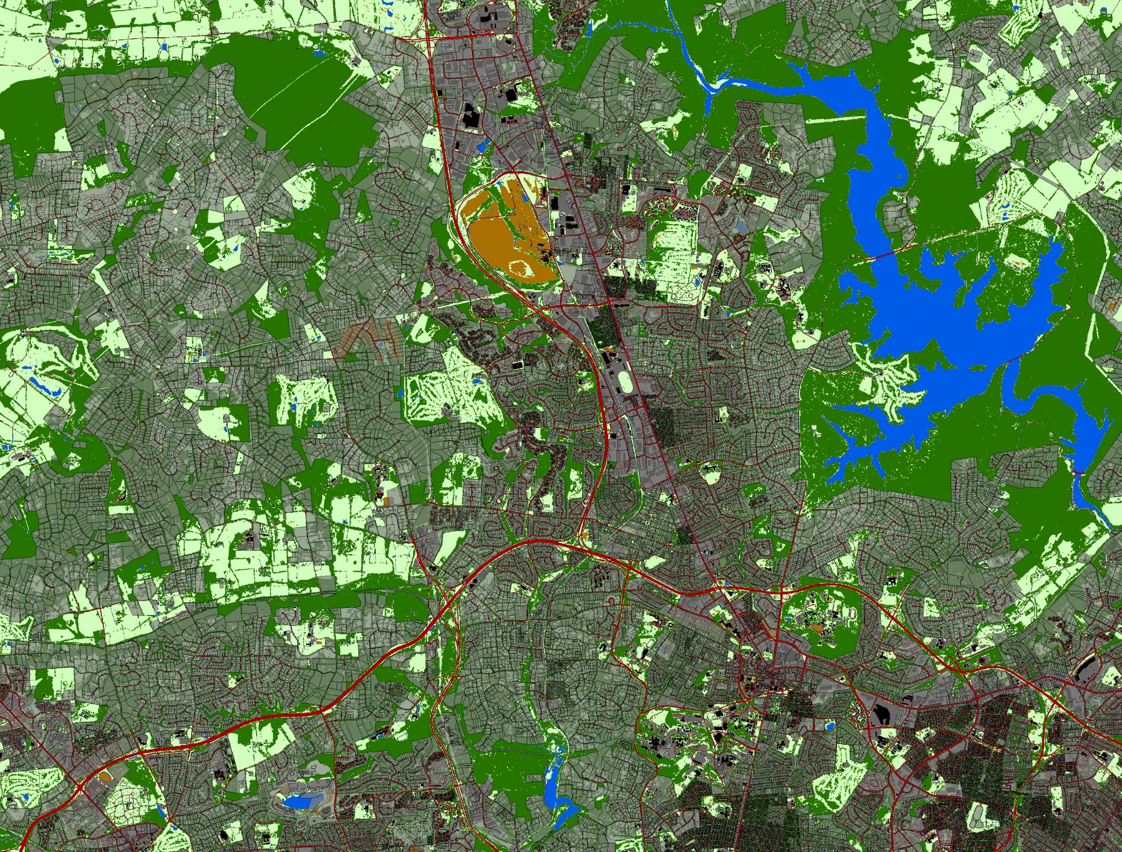

Slide 17
Baltimore land cover vs P532 land use
 | University of Vermont 2007 Land Cover Data (acres)
P532 2006 Land Cover (acres) | NoData | Trees | Grass/Bare | Water | Developed | Total | User's Accuracy | CBLCD Proportions
Trees/Shrub/Wwet | 415 | 41,835 | 16,023 | 1,447 | 3,298 | 63,018 | 66.4% | 21.5%
Grass/Crop/Past/Bare/Extr | 369 | 14,314 | 76,806 | 648 | 3,282 | 95,419 | 80.5% | 32.6%
Water | 908 | 270 | 111 | 3,526 | 26 | 4,840 | 72.8% | 1.7%
Developed | 360 | 40,043 | 44,020 | 471 | 44,551 | 129,446 | 34.4% | 44.2%
Total | 2,053 | 96,462 | 136,960 | 6,092 | 51,156 | 292,724
Producer's Accuracy |  | 43.4% | 56.1% | 57.9% | 87.1%
UVM LC Proportions | 0.7% | 33.0% | 46.8% | 2.1% | 17.5%

Slide 18
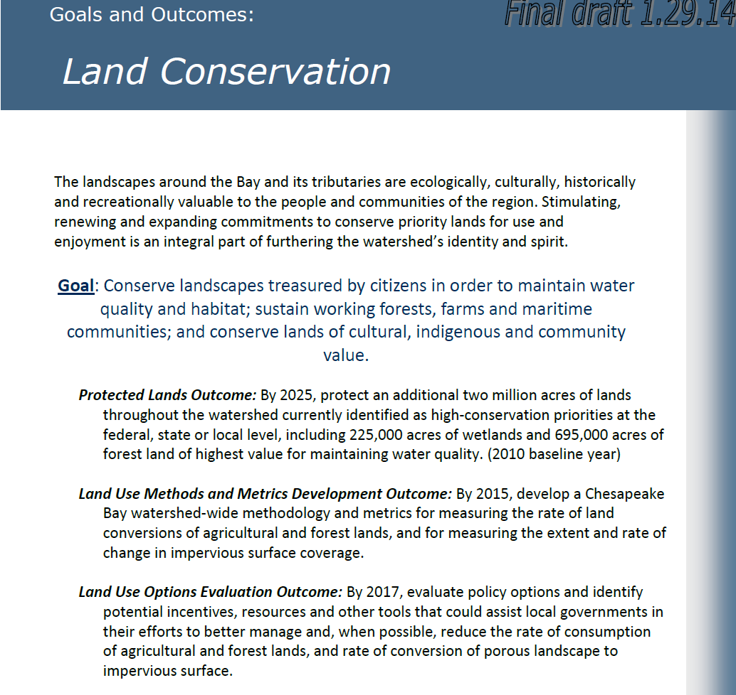
www.chesapeakebay.net/presscenter

