Slide 1


Rising Watershed and Chesapeake Bay Water Temperatures—Ecological Implications and Management Responses
STAC Workshop Draft Findings
Stream Health Workgroup
April 14, 2022
Presented by Katie Brownson, USFS

Slide 2
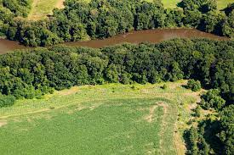
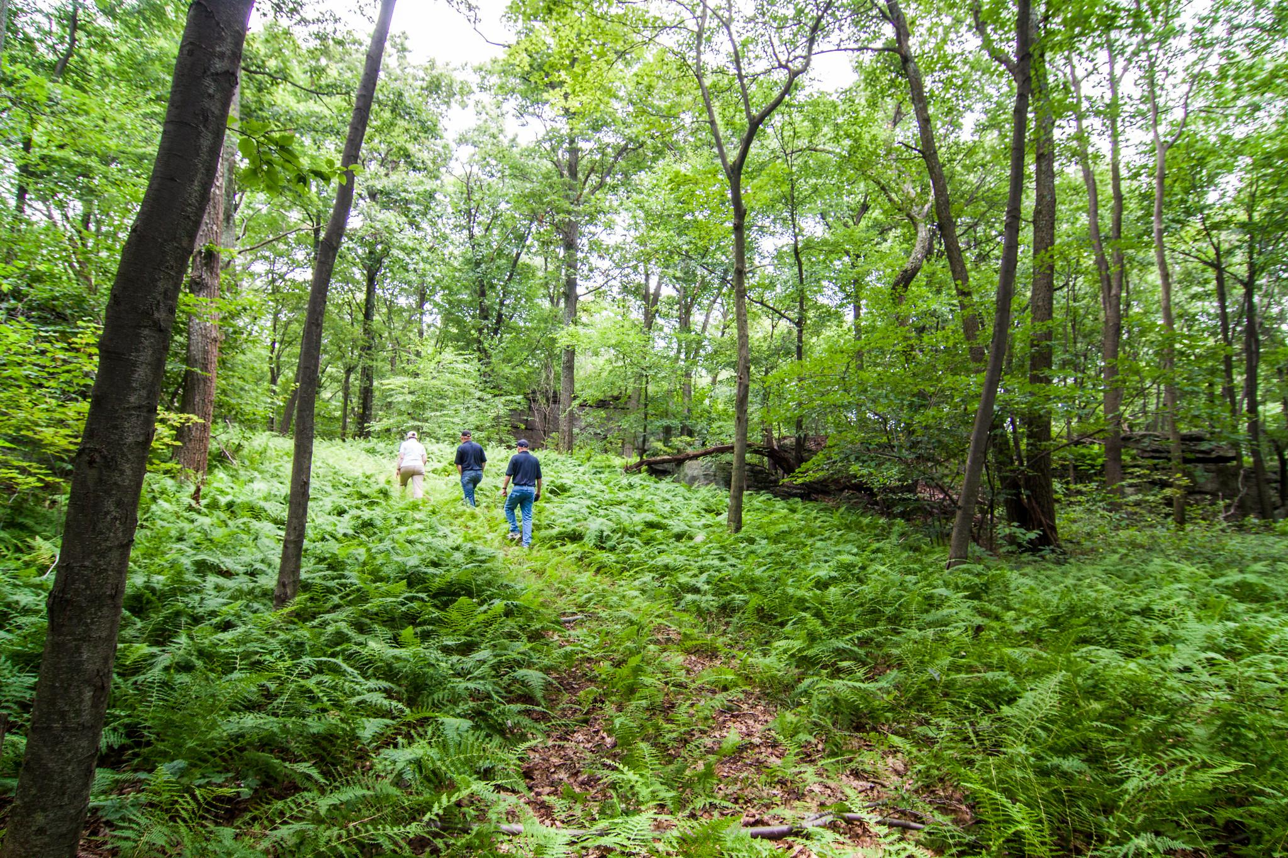
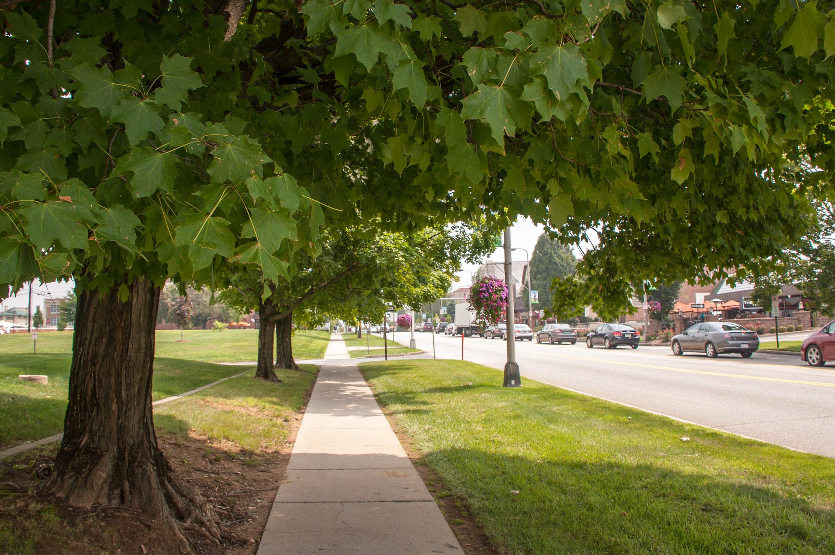
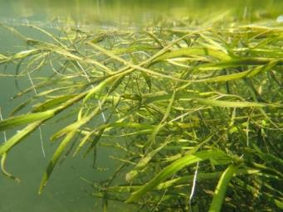
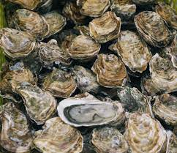
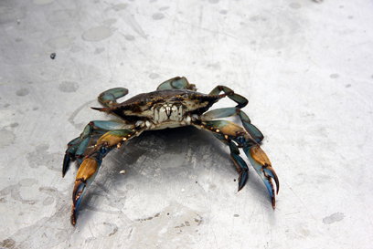
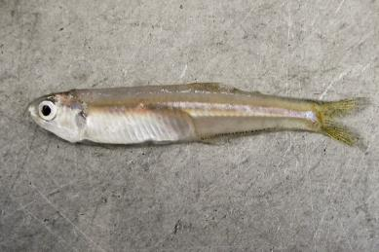
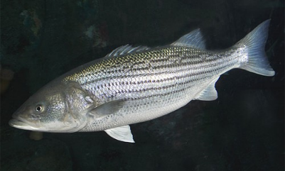
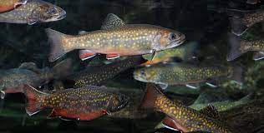
BMPs
Conservation
Land use practices
Mitigation
Lowering of Water Temps
Watershed
Tidal & Watershed
Adaptation
Minimize Impacts & Adjust
Submerged Aquatic Vegetation (SAV)
Oysters
Blue Crabs
Forage
Striped Bass
Brook Trout
(Menhaden, Bay anchovy, benthic invertebrates)

Slide 3
Increasing stream and river temperatures have been driven by rising air temperatures, but other drivers have a strong influence
Heat transfer from channel substrate
Substrate composition (bedrock vs. gravel)
Hyporheic exchange
Residence time in hyporheic zone
Groundwater inputs
Hyporheic exchange
Groundwater temperature
Degree of infiltration
Groundwater residence time
Legacy sediment
Underlying geology
Runoff temperature
Sources of water (farm ponds, municipal, mining and industrial discharge, snowmelt, etc.)
Upstream and riparian land use
Degree of infiltration
Channel temperature buffering capacity
Surface area: volume ratio
Channel form
Large woody debris
Instream vegetation
Water clarity
Stream size
Streamflow
Baseflow
Withdrawals (from surface or groundwater)
Local hydrology (presence of dams, floodplain connectivity, etc.)
Hydraulic resistance
Upstream and riparian land use
Groundwater inputs
Degree of infiltration
Rainfall
Non-tidal water temperature
Air temperature
Direct solar radiation
Canopy cover
Ambient air temperature

Slide 4
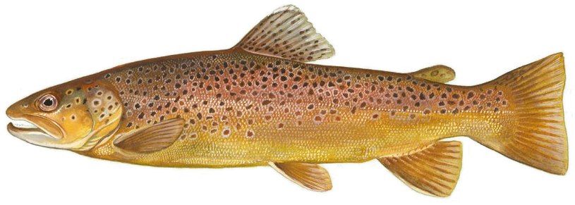
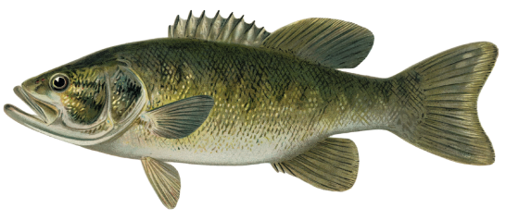
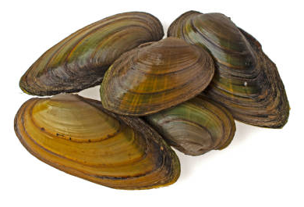
Ecological Impacts - Species
Strongest negative impacts on coldwater species (e.g., trout, sculpin) and their habitats (esp. where streams aren’t driven by groundwater )
Watershed-wide, warmwater aquatic species are most common. Although more tolerant to temperature increases, they are sensitive to extreme temperatures including rapid changes and to indirect effects (e.g., invasives, pathogens) from higher temps.
More study needed of temperature effects on lower foodweb
Algae, biofilms, zooplankton
Macroinvertebrates
Freshwater mussels & host species

Slide 5
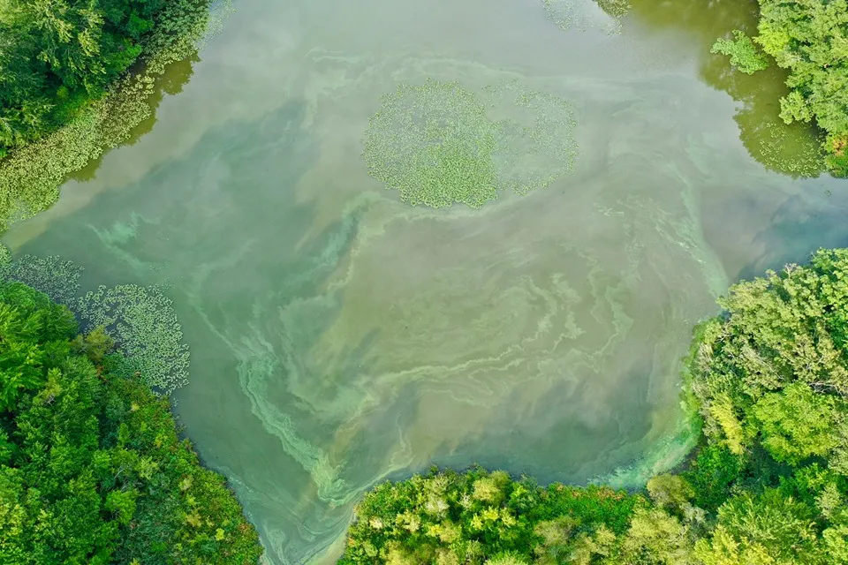
Ecological Impacts - Other Stressors
Co-occurring Stressors
Low dissolved oxygen
Invasive species
Algal blooms
Bacterial/viral outbreaks
Distribution & toxicity of other
pollutants (e.g., heavy metals,
pesticides, ammonia, etc.)
Expansion of invasives
Photo credit: Driscol Drones

Slide 6
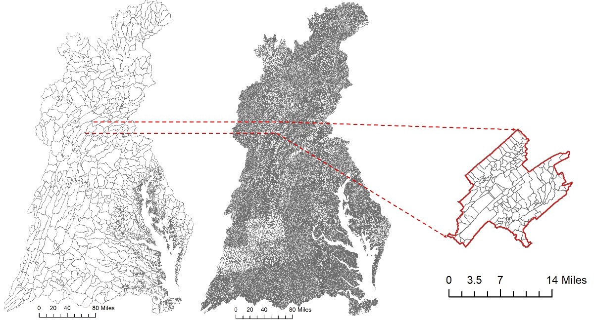
Management implications: Priority information needs
Improved understanding of the relative influence of BMPs and habitat restoration on water temperature, including cost-effectiveness
Additional data/modeling capacity to predict future changes in stream temperature
Additional research to better understand how stream temperature and living resources will respond to management

Slide 7

Day 2 Themes for Discussion
Coldwater fisheries and habitats
Rural waters and habitats
Urban waters and habitats
Cross-watershed topics
State temperature water quality standards (WQS), monitoring and implementation
Monitoring and modeling
Photo credit: Joel Prince, NASF

Slide 8
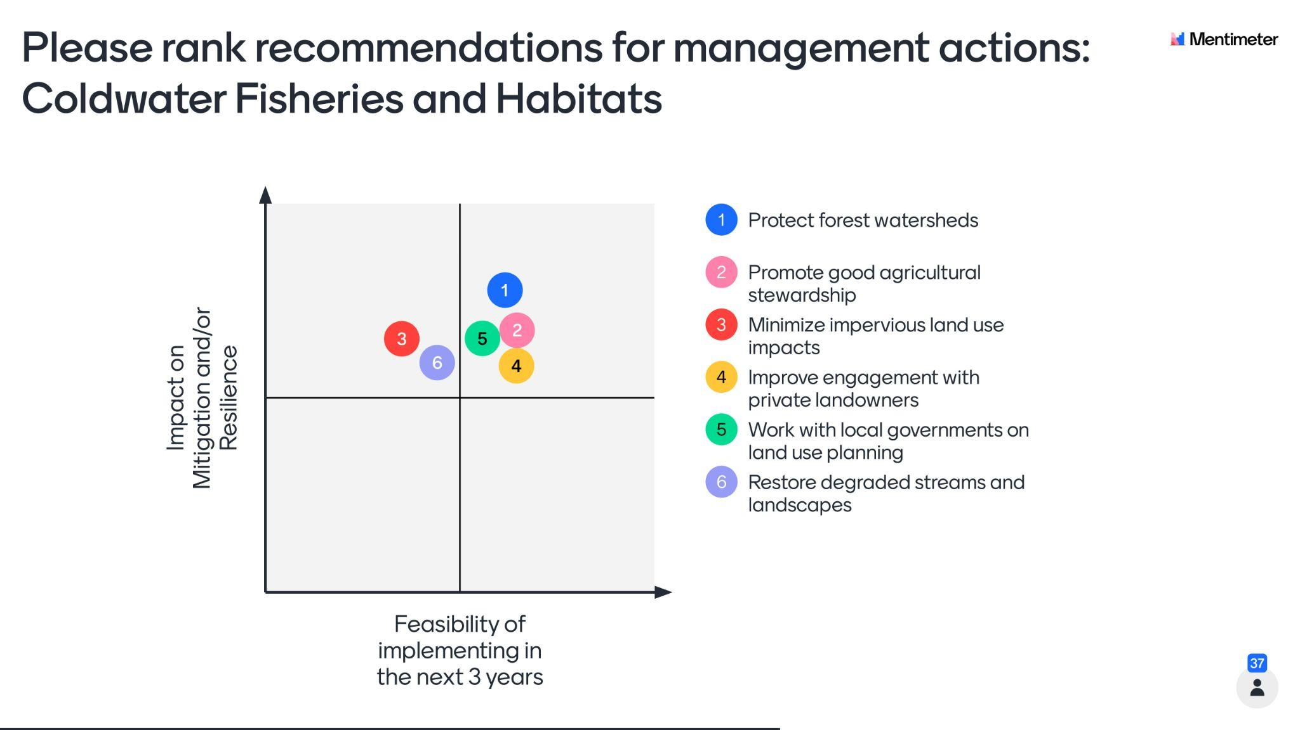

Slide 9
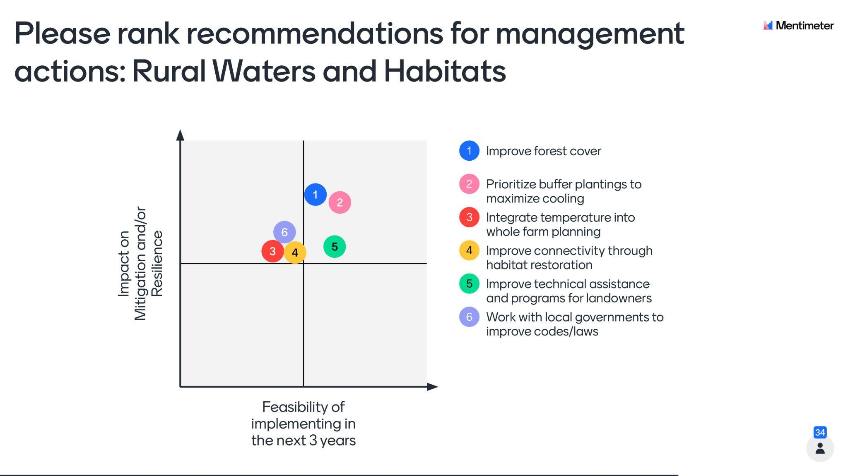

Slide 10
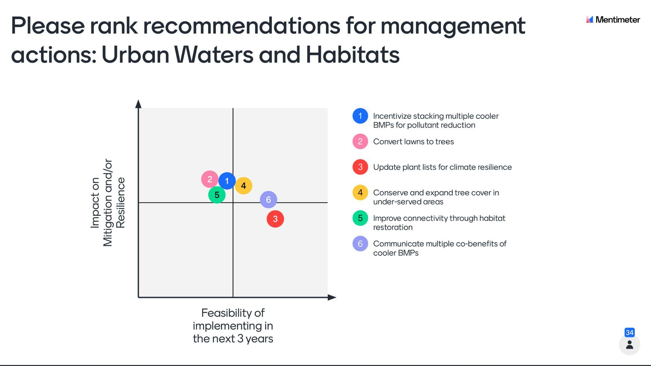

Slide 11
Discussion on Stream Restoration
Stream restoration has the potential to cool or warm waters depending on how a project is designed and implemented
Restoration can help species adapt to warmer temperatures
More research is needed to understand thermal impacts of various restoration approaches in different contexts
What impact do beaver analogue practice have on water temperature?
Where are the greatest opportunities to cool waters by improving hyporheic exchange?
Better design and siting criteria are needed

Slide 12
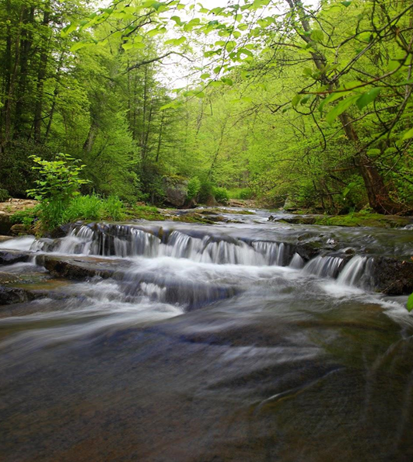
State Temperature Water Quality Standards (WQS)
Modernize WQS to make them more effective to combat rising water temperatures
Improve interstate cooperation through information-sharing, problem solving and monitoring-modeling support
Strengthen anti-degradation measures
Improve criteria to reflect a better understanding of thermal tolerances and ecology for a broader suite of species

Slide 13
Monitoring, Modeling and Science Needs
Better use existing monitoring data, CBP mapping tools and LU/LC data
Improve monitoring networks to better include small streams and incorporate more continuous data collection
Develop integrated monitoring programs that incorporate air, water, sediment and groundwater temperature monitoring
Develop models that better simulate land use and groundwater effects on local steam temperatures
Conduct a vulnerability assessment of how climate and land change may affect stream temperatures
Establish multi-species prioritization tools and science-based targets for restoration and conservation to mitigate rising water temperatures

Slide 14
Next Steps
Steering Committee will review & synthesize information, including management recommendations and associated science needs, from synthesis papers and both workshop days and draft final report
Participant review of draft report (~May-June 2022 timeframe)
Release final report (~summer 2022 timeframe)
Conduct outreach with Bay Program and partners to discuss strategies to implement the report’s recommendations

Slide 15
Watershed Acknowledgements
Synthesis Element #1 Paper (Water Temperature Effects on Fisheries and Stream Health in Nontidal Waters): Stephen Faulkner, Kevin Krause, Rosemary Fanelli, Matthew Cashman, Than Hitt and Benjamin Letcher, USGS; Frank Borsuk and Greg Pond, EPA
Synthesis Element #1 Addendum (Temperature Criteria in CBP Jurisdictions' Water Quality Standards and Information on Warmwater Species): Rebecca Hanmer, EPA-retired; Jonathan Leiman, Maryland Department of the Environment; Daniel Goetz, Maryland Department of Natural Resources; Robert Breeding, Virginia Department of Environmental Quality; and Matthew Robinson, DC Department of Energy and Environment
Synthesis Element #4 Paper (Watershed Characteristics and Landscape Factors Influencing Vulnerability and Resilience to Rising Stream
Temperatures): Renee Thompson, USGS; Nora Jackson, CRC/CBP; Judy Okay, J&J Consulting; Nancy Roth, Tetra Tech; Sally Claggett, USFS
Synthesis Element #5 Paper (Trends): Rich Batiuk, CoastWise Partners; Nora Jackson, CRC/CBP; John Clune, USGS; Kyle Hinson, VIMS; Renee Karrh, Maryland Department of Natural Resources; Mike Lane, Old Dominion University; Rebecca Murphy, University of Maryland Center for Environmental Science/CBP; and Roger Stewart, Virginia Department of Environmental Quality
Synthesis Element #6 Paper (Model Projections): Rich Batiuk, CoastWise Partners; Gopal Bhatt, Pennsylvania State University/CBP; Lewis
Linker, U.S. EPA CBP; Gary Shenk, USGS/CBP; Richard Tian, University of Maryland Center for Environmental Sciences/CBP; and Guido Yactayo, Maryland Department of the Environment
Synthesis Element #7/8 Paper (Impacts of BMPs and Habitat Restoration on Water Temperatures): Katie Brownson and Sally Claggett, USFS; Tom Schueler, CSN; Anne Hairston-Strang and Iris Allen, Maryland Department of Natural Resources-Forestry; Frank Borsuk and Lucinda Power, EPA; Mark Dubin, UMD; Matt Ehrhart, Stroud; Stephen Faulkner, USGS; Jeremy Hanson, VT; Katie Ombalski, Woods & Waters
Consulting
Synthesis Element #10 Paper (Monitoring): Peter Tango, Breck Sullivan, John Clune, and Scott Phillips, USGS

