Slide 1



Reaching Consensus on Midpoint Assessment Policy Decisions
Chesapeake Bay Program Principals’ Staff Committee December 20, 2017

Slide 2
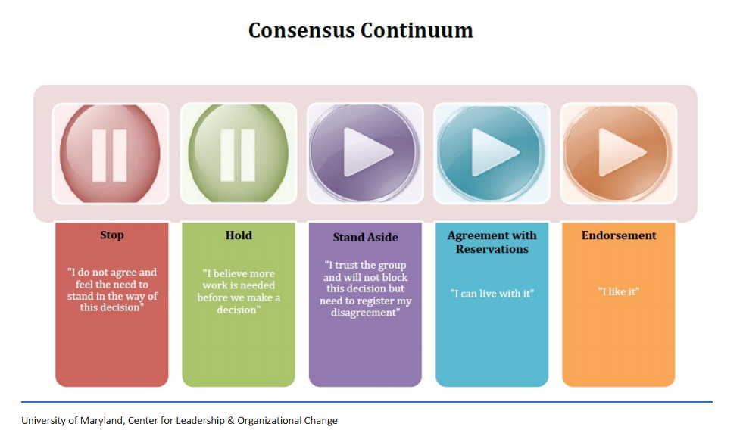

Slide 3
Today’s Requested Policy Decisions
Approval of the approach to account for the additional loads delivered to the Bay due to the Conowingo infill
Approval of how to factor climate change into the Phase III WIPs
Approval of the draft Phase III Planning Targets as the starting point for the 4-month review process

Slide 4
Today’s Meeting Flow
Specific language for each decision will be presented to the PSC
PSC approved modifications to the decision language made in real time
PSC will be asked to approve
Recommended public communication messages for each decision
Specific language to be inserted into the final Phase III WIP expectations document to reflect growth, Conowingo infill, and climate change decisions

Slide 5
Conowingo Dam Infill

Slide 6
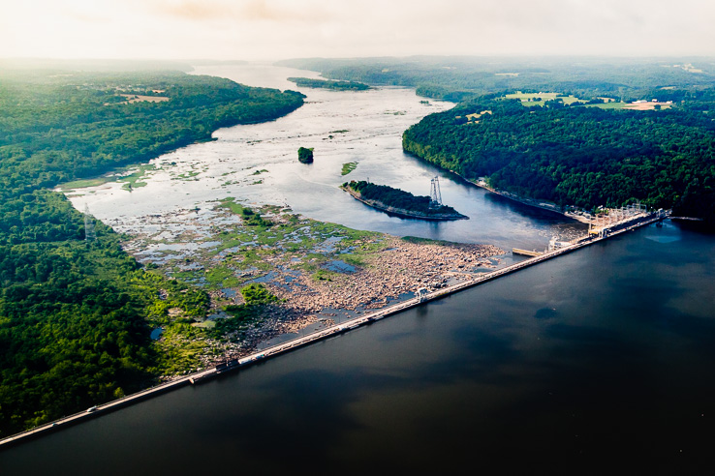
Today’s Requested Policy Decision
Approval of the WQGIT-proposed approach to account for the additional nutrient loads delivered to the Bay due to the Conowingo infill
www.chesapeakebay.net

Slide 7
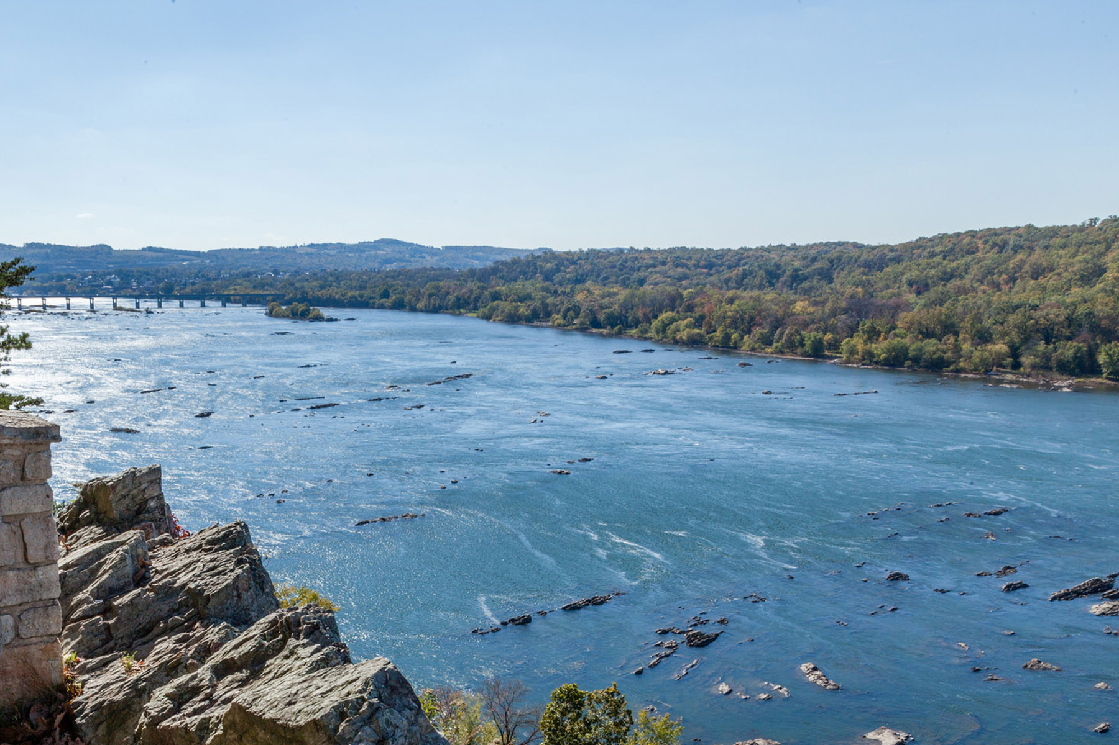
Today’s Requested Policy Decision
Approval of the timeframe by which the jurisdictions have to address the additional nutrient loads
www.chesapeakebay.net

Slide 8
Key Issues & Questions Addressed From Day One

Slide 9
PSC Policy Decisions

Slide 10
PSC Public Communication Messages

Slide 11
Climate Change Impacts

Slide 12
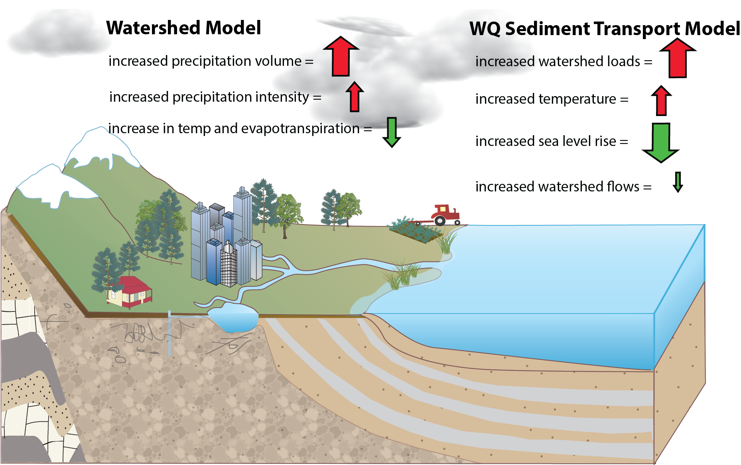
Today’s Requested Policy Decisions
Approval of the WQGIT-proposed dual approach to factor climate change into the Phase III WIPs

Slide 13
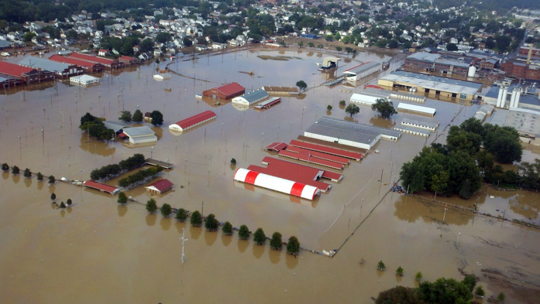
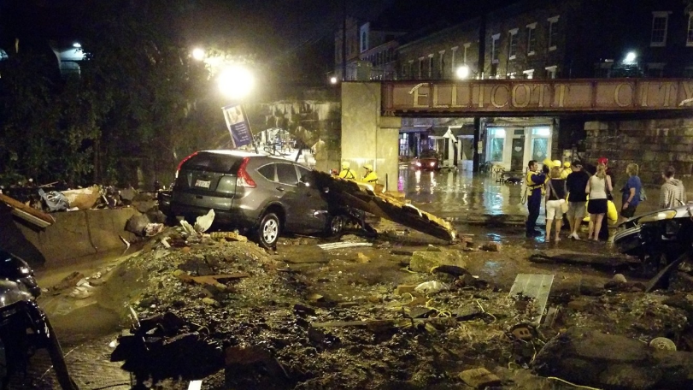
Today’s Requested Policy Decisions
Approval of WQGIT recommendation to provide flexibility among jurisdictions and a commitment for CBP programmatic support (e.g., guidance, data, funding, etc.) for implementation of climate change policies that exceed the Partnership approved policies

Slide 14
Key Issues & Questions Addressed From Day One

Slide 15
PSC Policy Decisions

Slide 16
PSC Public Communication Messages

Slide 17
Draft Phase III Planning Targets

Slide 18
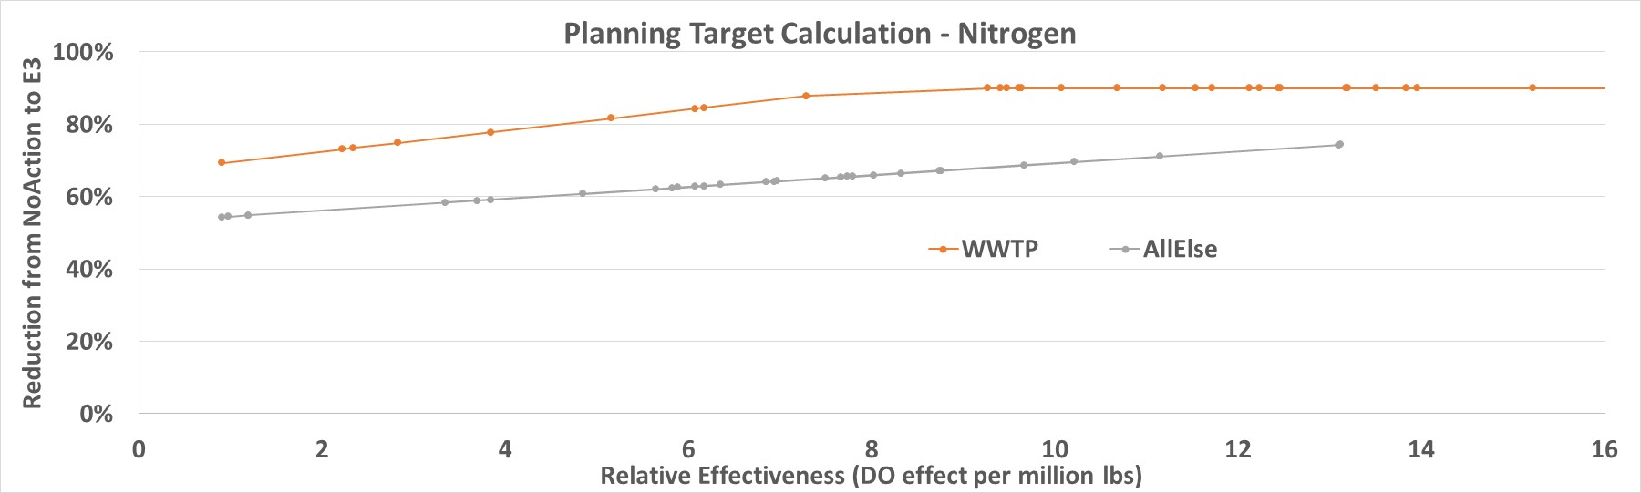
Today’s Requested Policy Decision
Approval of the draft Phase III Planning Targets as the starting point for the Partnership’s 4-month review process

Slide 19
Proposed Draft Phase III Planning Targets: Nitrogen
Jurisdiction | 1985 Baseline | 2013 Progress | Phase III Planning Target
NY | 18.71 | 15.44 | 10.59
PA | 122.41 | 99.28 | 73.18
MD | 83.56 | 55.89 | 45.30
WV | 8.73 | 8.06 | 6.35
DC | 6.48 | 1.75 | 2.43
DE | 6.97 | 6.59 | 4.59
VA | 84.29 | 61.53 | 55.82
Basinwide | 331.15 | 248.54 | 198.25
*Units: millions of pounds

Slide 20
Proposed Draft Phase III Planning Targets: Phosphorus
Jurisdiction | 1985 Baseline | 2013 Progress | Phase III Planning Target
NY | 1.198 | 0.710 | 0.506
PA | 6.115 | 3.696 | 3.073
MD | 7.419 | 3.919 | 3.604
WV | 0.793 | 0.560 | 0.456
DC | 0.090 | 0.062 | 0.130
DE | 0.225 | 0.115 | 0.120
VA | 13.545 | 6.345 | 6.186
Basinwide | 29.384 | 15.408 | 14.073
*Units: millions of pounds

Slide 21
Key Issues & Questions Addressed From Day One

Slide 22
PSC Policy Decision

Slide 23
PSC Public Communication Messages

Slide 24
EPA’s Phase III WIP Expectations
Accounting for Growth:

Slide 25
EPA’s Phase III WIP Expectations
Conowingo Dam infill:

Slide 26
EPA’s Phase III WIP Expectations
Climate Change:

