Slide 1

Effects of recent seagrass species change on habitat structure and function:
Preliminary research proposal
Emily French
Summer 2013

Slide 2
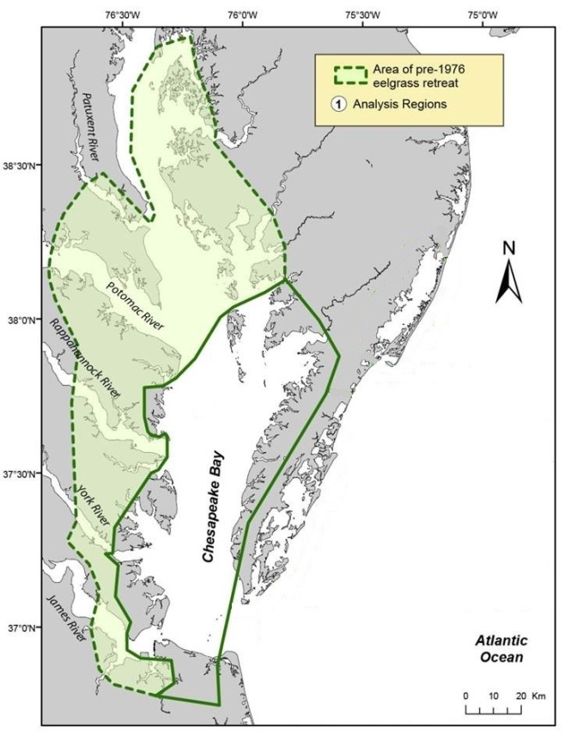
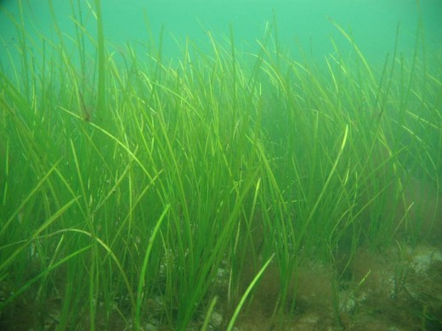
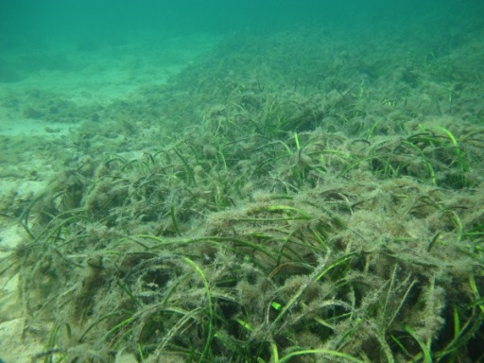
Change in seagrass species in the Chesapeake Bay
Z. marina declining in the Chesapeake Bay, only occupies 65% of area it did 20 years ago
www,helcom.com/fi
Modified from Orth et al. 2001
www.kinrm.sa.gov.au
Notes:
**Note: I should be using eelgrass scientific name, ZM in this presentation but please forgive me if I say eelgrass, since we are so used to using that term**
Since you all are interested in seagrass, you probably know about the saga of eelgrass. Unfortunately it presently only occupies 65% of the area that it occupied 20 years ago. Here is a figure that shows its historical range, the upper shaded polygon, compared to its present range, the lower unshaded polygon.
Eelgrass is dying off because of decreasing WQ conditions. Here you can see an example of an eelgrass bed that is healthy, and below it one that is covered in epiphytic algae. The epiphytic algae takes off when water is warm or there is an increased nutrient input of both. It chokes out the light to the eelgrass since it grows directly on the blades.

Slide 3
Change in seagrass species in the Chesapeake Bay
Deteriorating water quality causing Z. marina to die back
Disturbances can allow opportunistic species to thrive
R. maritima is the second most prevalent grass in the polyhaline Bay, is a good colonizer that thrives when conditions are right
R. maritima could be a potential replacement in areas where grasses co-occur
Notes:
Deteriorating WQ, including sediment and nutrient input and both gradual and episodic warming, causing EG to die back. So deteriorating WQ is a disturbance the ecosystem of the polyhaline chesapeake bay is undergoing. As we know, disturbances can cause opportunistic species to thrive.

Slide 4

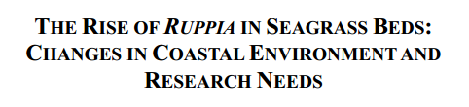
Hot off the press!
Notes:
As you can see from the titles of recent papers, what we think is happening in the Chesapeake bay isn’t an isolated incident.
First paper: paper about how ruppia has expanded in 3 wetlands in northeast Mexico, replacing areas formerly dominated by Z. marina
Second: looks at a couple different case studies and determines that the relative abundance and therefore ecological importance of ruppia is rising and further research is required
Third: experiment about how halodule could possible replace eelgrass in a sound in NC, showed how faunal abundance and diversity was lower in halodule compared to eelgrass

Slide 5

R. Maritima vs. Z. marina
Notes:
Going back to RM and ZM, the two most prevalent grasses in the Chesapeake Bay, this is a cartoon of how the two grasses occupy different areas but also overlap. This diagram shows how they might interact along a depth gradient. Ruppia needs more light than does eelgrass, which is why it occupies shallower water.

Slide 6
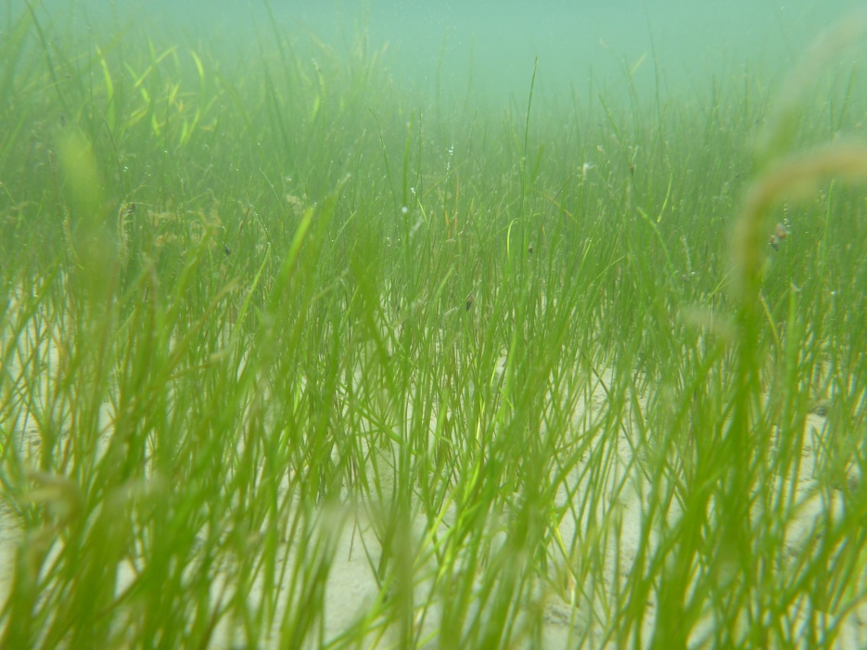
R. Maritima vs. Z. marina
Notes:
Here is Ruppia growing in shoal areas- it has a shorter canopy with thinner blades and a less robust root system.

Slide 7
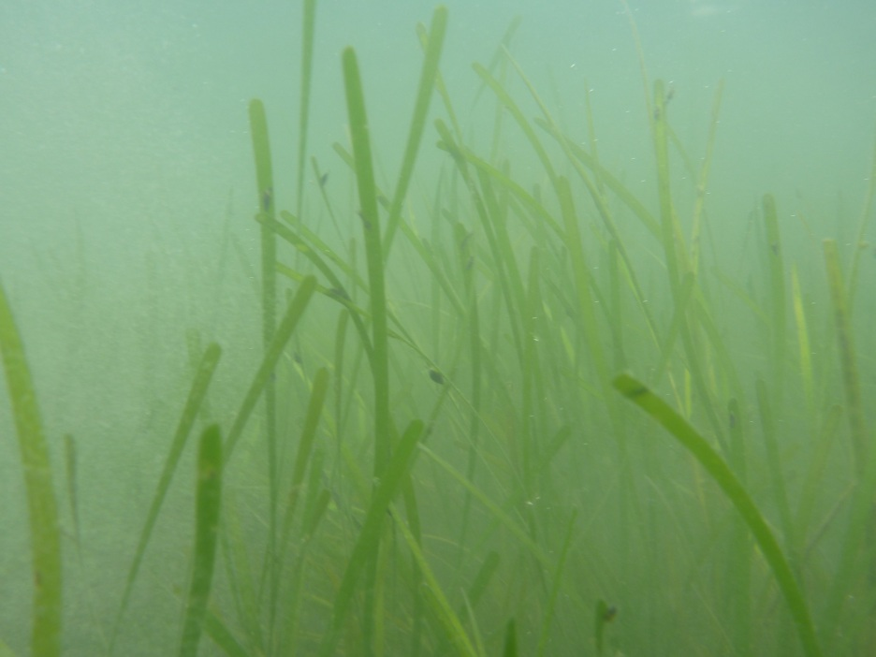
R. Maritima vs. Z. marina
Notes:
Here is eelgrass growing in the deeper edge of the seagrass bed. It has wider, longer blades and a more robust root system.

Slide 8
R. Maritima vs. Z. marina
Notes:
Here is the mixed area where both grasses grow. We believe this area has the potential to see replacement by ruppia if eelgrass dies out.

Slide 9
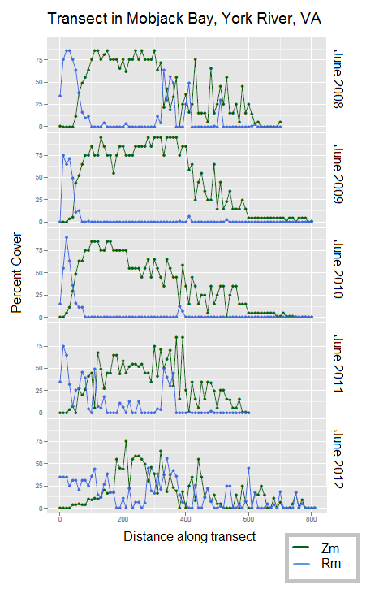
Evidence near the York River, VA
Orth lab 2012, unpublished data
Notes:
We have some data already on what’s going on in right here in the Chesapeake Bay. This plot shows one of many estblished transect that JJ Orth’s lab observes yearly every June. Here is how it changed in cover of the two grasses over a 5 year period. The eelgrass has decreased and there’s a lot more ruppia presently.

Slide 10
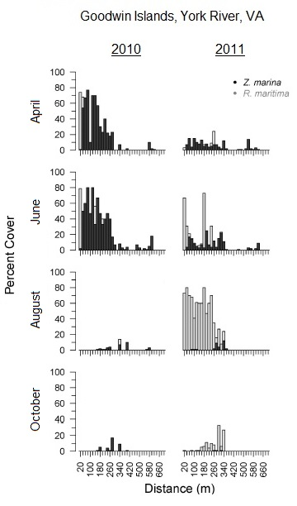
Evidence near the York River, VA
Orth lab 2012, unpublished data
Moore et al. in press
Notes:
This next figure is from a paper by our lab that was recently accepted to E&C. Hard to see, but the darker bars are eelgrass and lighter bars are RM. We can see that after 2010, a record die-off year for eelgrass, ruppia really took over the area. Looking at August 2010 and August 2011, we can see that RM entirely dominates the transect.
**So we have a good example of alteration of seagrass species right here in the Chesapeake Bay, which is why we want to find out how ecosystem functioning will change along with the change in species.**

Slide 11
Research Questions
1. How do the structural components of Z. marina beds compare to those of R. maritima?
2. Does habitat value for associated faunal communities vary between R. maritima- dominated, Z. marina-dominated, and mixed species areas?
3. Are there sediment biogeochemical, microbiological , or erosion potential differences between the R. maritima-dominated, Z. marina-dominated, and mixed species areas?
Notes:
These are the questions I will concentrate on throughout the study

Slide 12
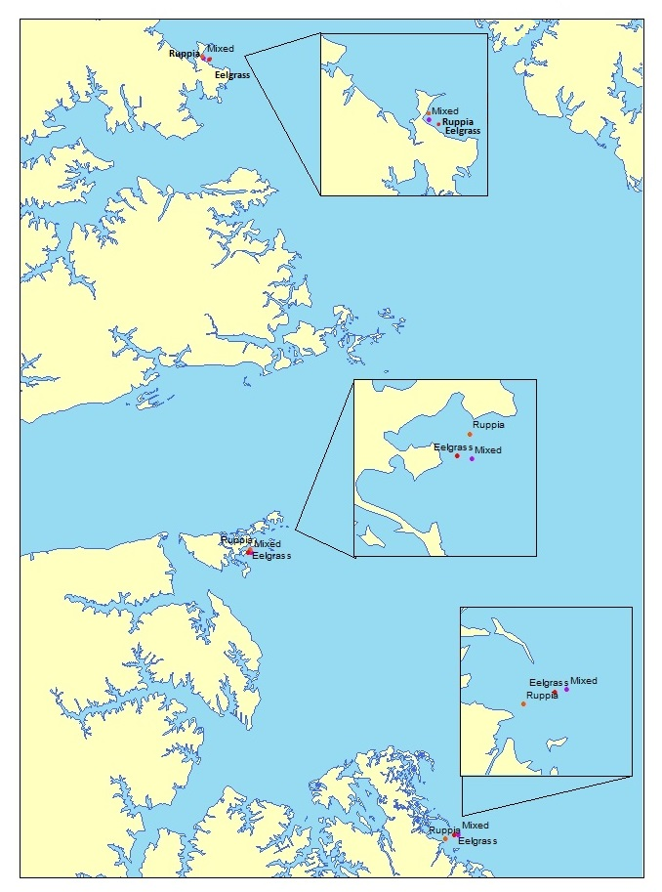
Sites: Lower, polyhaline Chesapeake Bay
Three Sites: Mobjack Bay between the Severn and Ware rivers, Goodwin Islands, Poquoson flats
Three sampling areas within each site: Z. marina- dominated, R. maritima- dominated, mixed
Five replicates within each sampling area (n=5)
Notes:
We used transect data from JJ orth’s lab, like the first plot you just saw, to pick areas were both grasses existed, but it looked like eelgrass was decreasing and RM was increasing.
We also picked these three sites to be representative of the polyhaline Ches. Bay. Each site has some differences, such as the Mobjack Bay site is more protected, and Poquoson probably receives the most flushing.

Slide 13
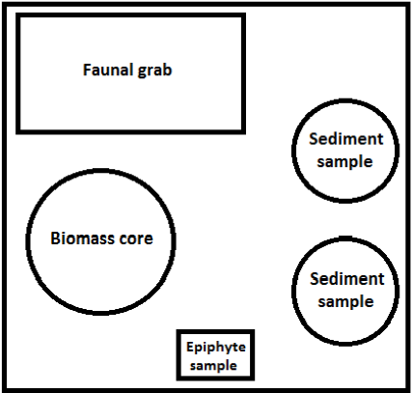
Methods
5 replicates of each of the sample types will be taken within each of the sample areas.
Meter square quadrat will be haphazardly tossed within 10 m of the PVC pole marking the sampling area.
Notes:
So a few things have changed, but this is for the most part still my sample design.

Slide 14
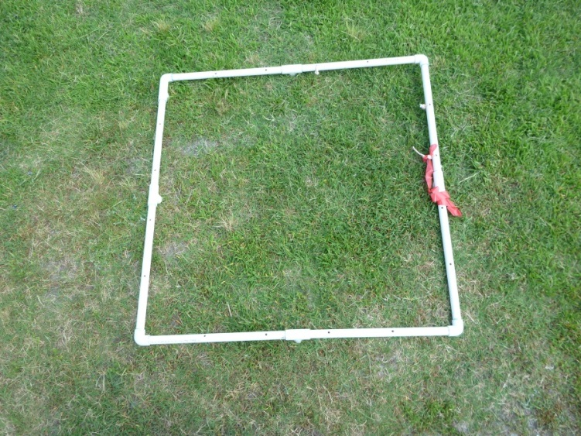
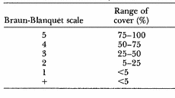
Methods
Sample types:
Percent cover
Biomass core
Sediment core- sediment characteristics
Sediment core- microbial community
Faunal grab
Epiphytes
Erodibility

Slide 15
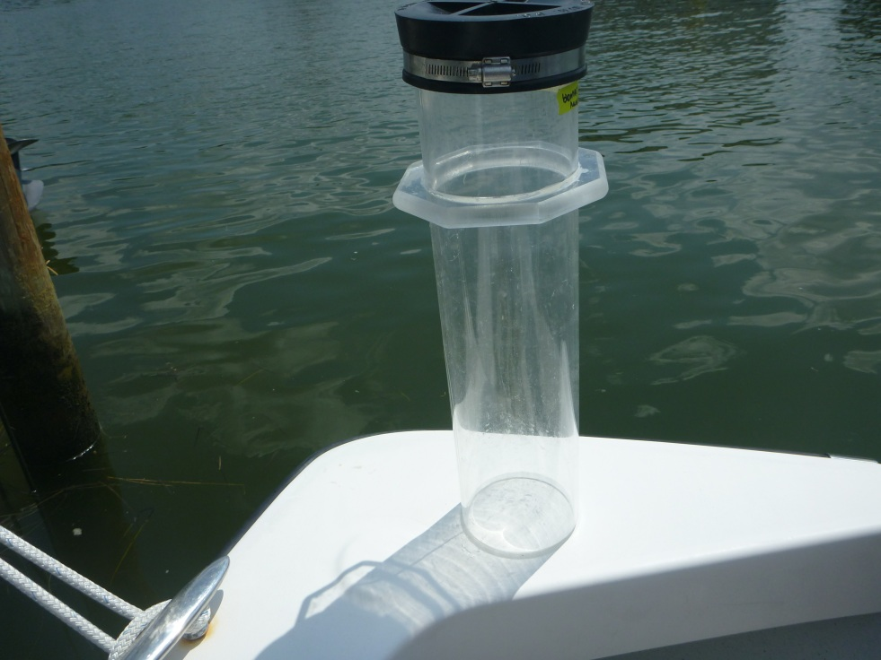
Methods
Sample types:
Percent cover
Biomass core
Sediment core- sediment characteristics
Sediment core- microbial community
Faunal grab
Epiphytes
Erodibility
Notes:
More quantitative measurement than percent cover. Helps get a better idea of the ratios of seagrass where we are sampling and will hopefully show how the ratios of grass change over the summer.

Slide 16
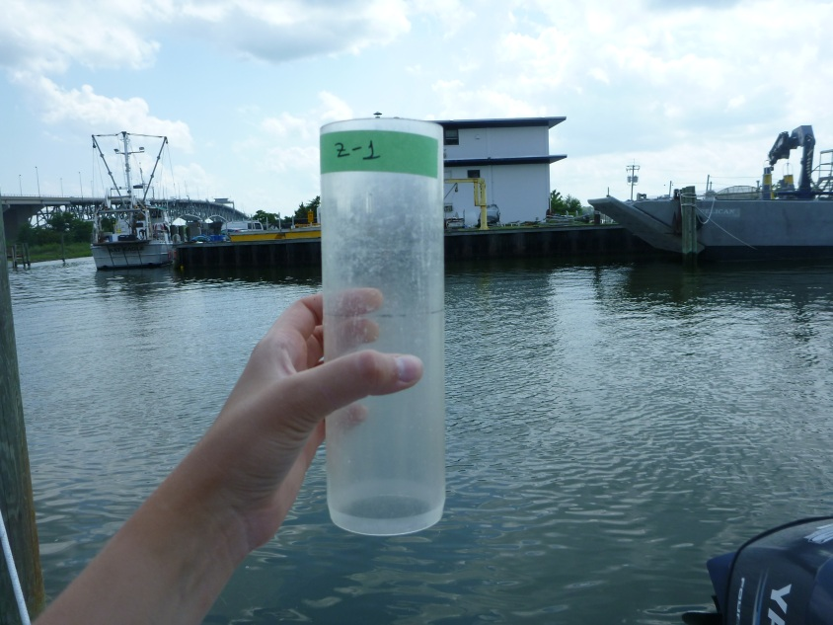
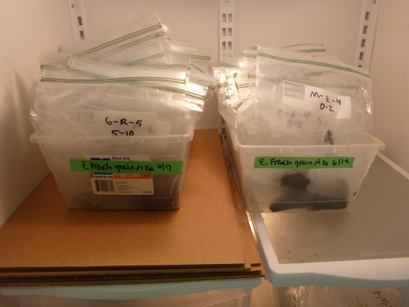
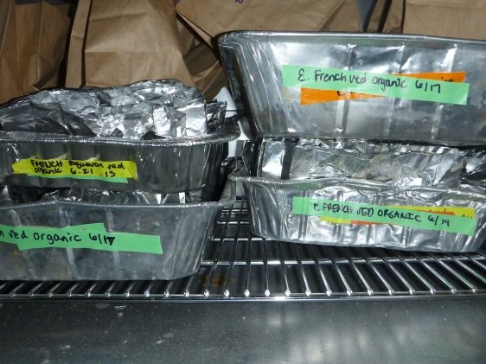
Methods
Sample types:
Percent cover
Biomass core
Sediment core- sediment characteristics
Sediment core- microbial community
Faunal grab
Epiphytes
Erodibility
Notes:
Organic matter, sediment grain size and nutrients (ammonium and phosphate)

Slide 17
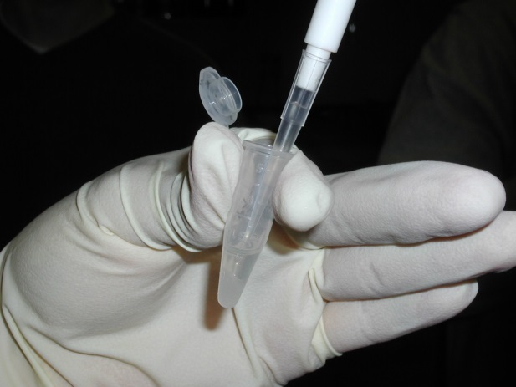
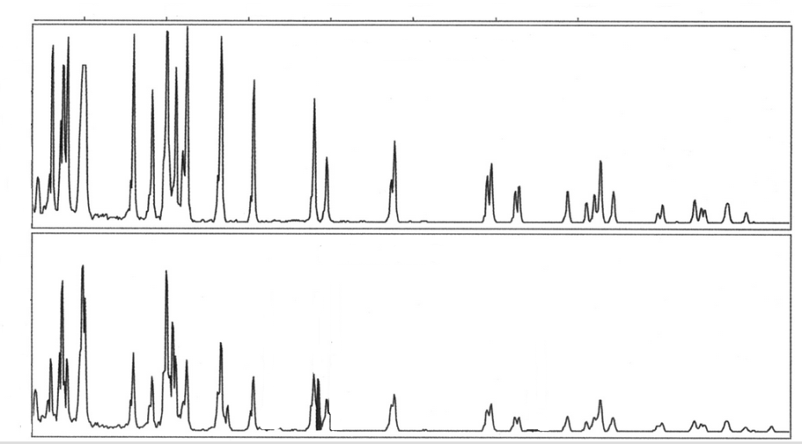
Methods
Sample types:
Percent cover
Biomass core
Sediment core- sediment characteristics
Sediment core- microbial community
Faunal grab
Epiphytes
Erodibility
http://biology.clc.uc.edu/
Community 1
Community 2
Notes:
Using sediment samples to analyze the diversity and abundance of the microbial community. DNA fingerprinting- peaks on this printout correspond to the abundance and diversity of microbial community.

Slide 18
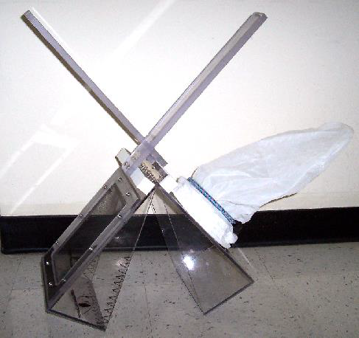
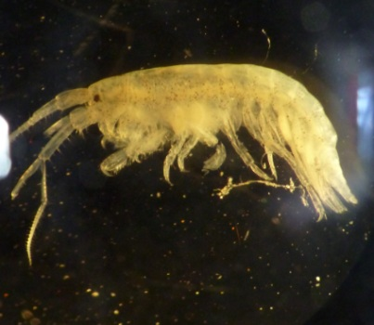
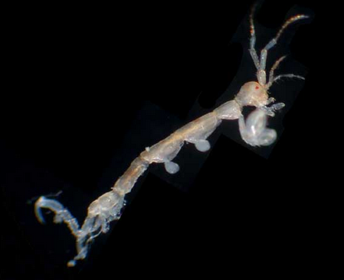
Methods
Sample types:
Percent cover
Biomass core
Sediment core- sediment characteristics
Sediment core- microbial community
Faunal grab
Epiphytes
Erodibility
Notes:
Explain virnstien. We’re mainly looking for crustaceans like isopods and amphipods.

Slide 19
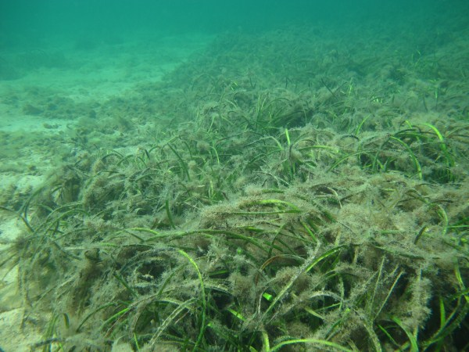
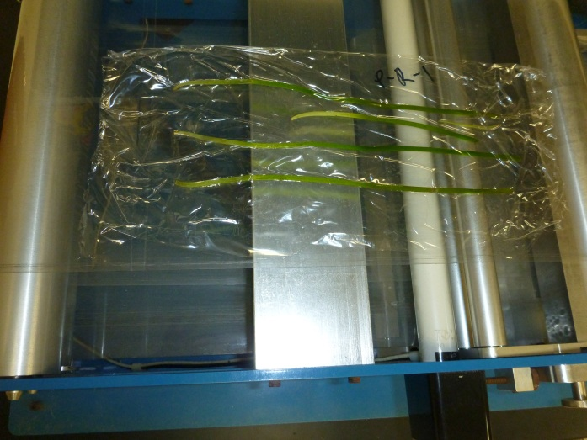
Methods
Sample types:
Percent cover
Faunal grab
Sediment core- sediment characteristics
Sediment core- microbial community
Biomass core
Epiphytes
7. Erodibility
www.kinrm.sa.gov.au

Slide 20
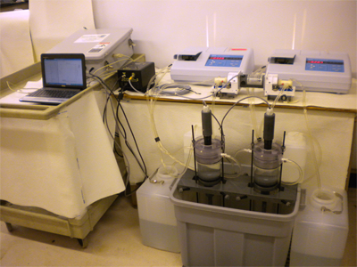
Methods
Sample types:
Percent cover
Faunal grab
Sediment core- sediment characteristics
Sediment core- microbial community
Biomass core
Epiphytes
7. Erodibility
http://gescience.com/UGEMS.html
Notes:
One component we’ve recently added to my project is erodibility measurements. A machine called the Gust will go through a cycle of simulated shear stress in order to test erosion potential of sediments. This sampling and analysis will only include the endmembers, sediment that came from a ruppia bed and sediment that came from an eelgrass bed.
Feel free to ask me about this, however I probs can’t answer!!

Slide 21
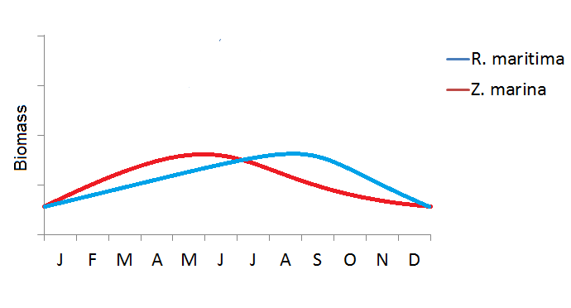
Timeline
June 2013- Preliminary sampling at the height of Z. marina biomass
August 2013- Second sampling at the height of R. maritima biomass
Notes:
We have seen a higher biomass of widgeongrass near the end of the summer which we are hoping to see this summer, since like we said earlier it is subject to variations in conditions we can’t yet predict exactly how it will behave

Slide 22
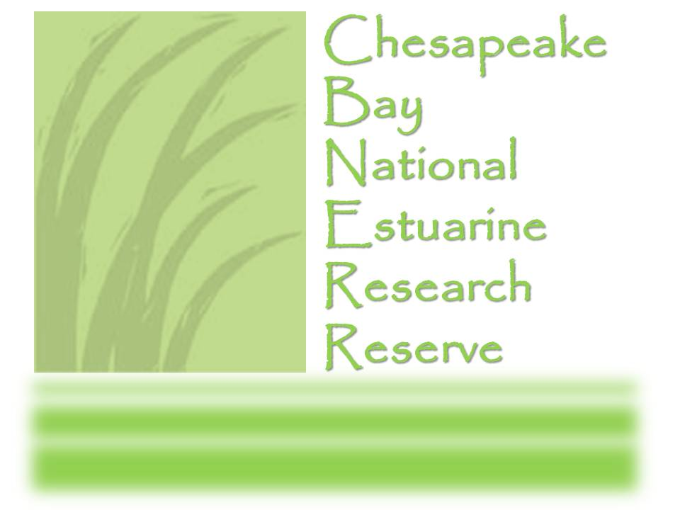

Thanks!
Moore lab: Ken Moore, Erin Shields, Betty Neikirk, Steve Snyder
Orth lab, Song lab, Duffy lab
CB-NERRS WQ lab

Slide 23
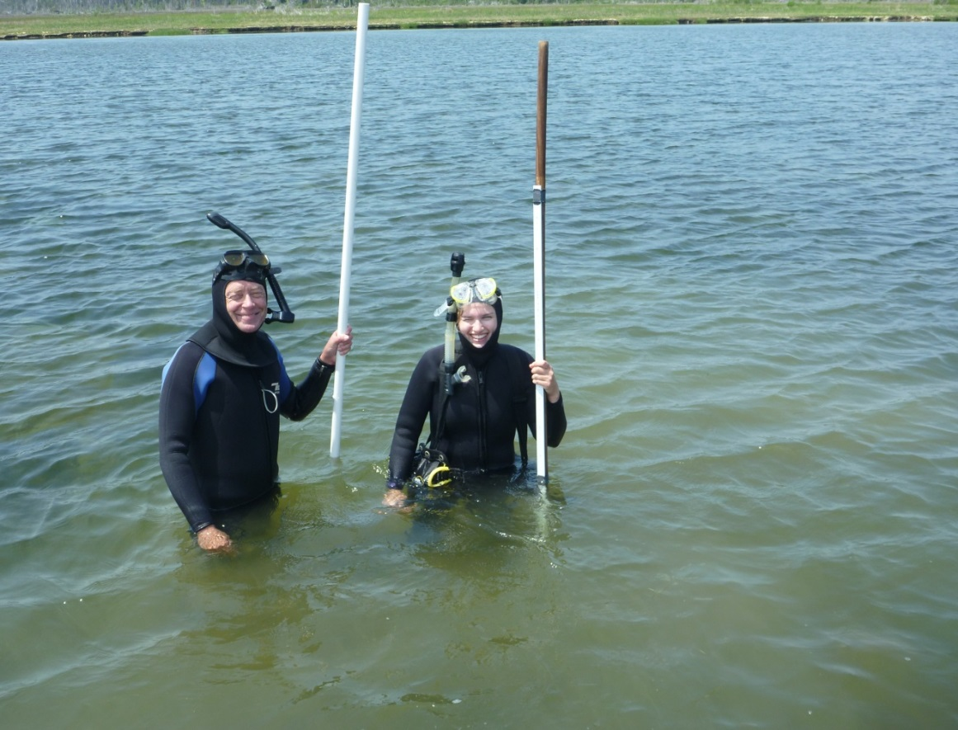
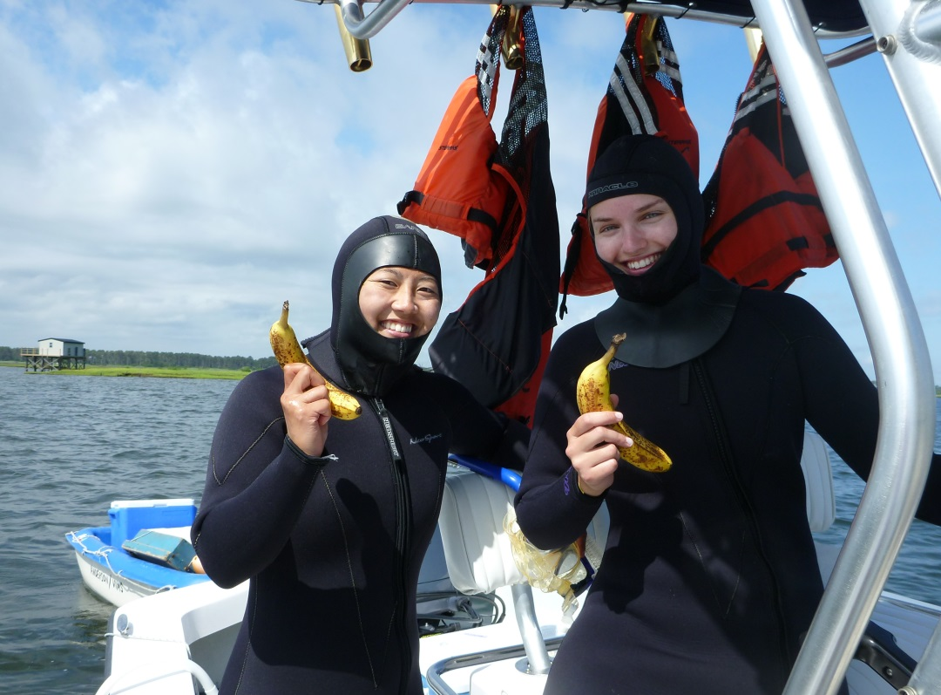
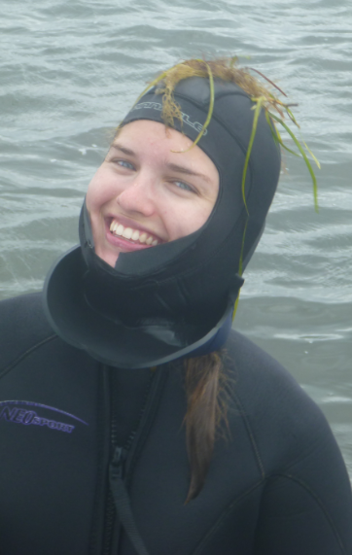
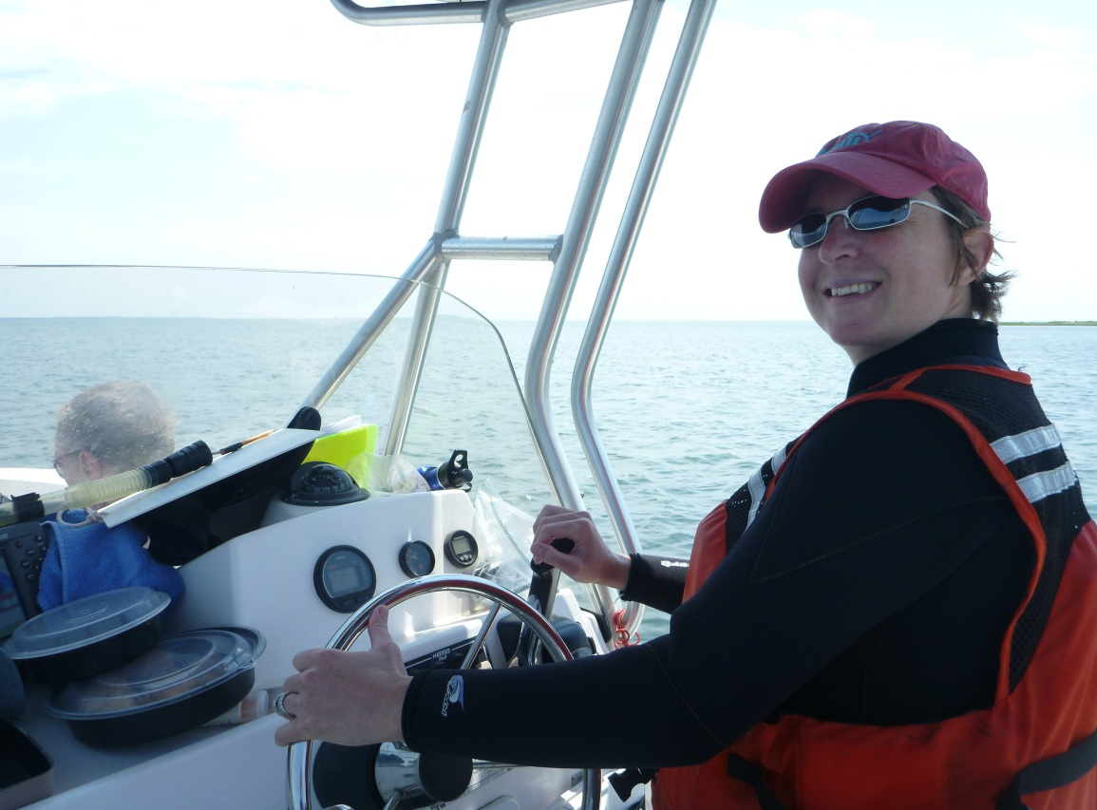
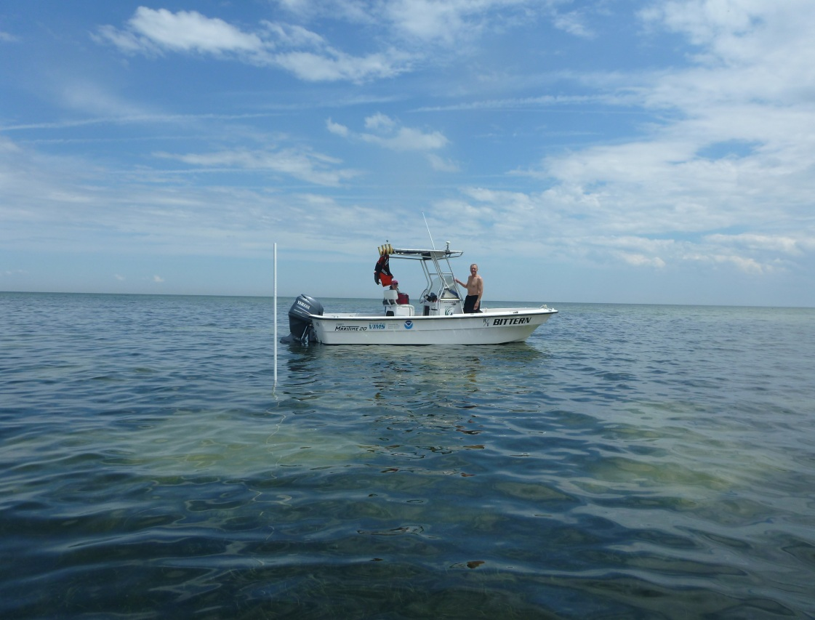
Notes:
As a reminder we just finished up the preliminary sampling yesterday! I have over 900 samples to process from five field days at the three different sites. Now we know the sampling is somewhat manageable and I am open to suggestions for the next sampling, such as erodibility measurements like Carl and I have previously discussed.

Slide 24
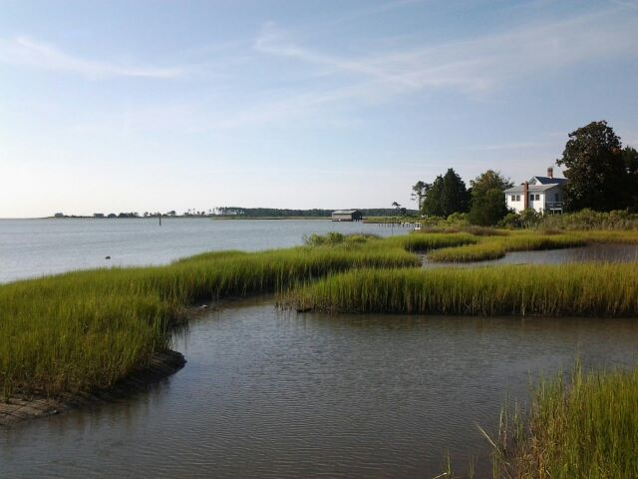
Questions or suggestions?

