Slide 1
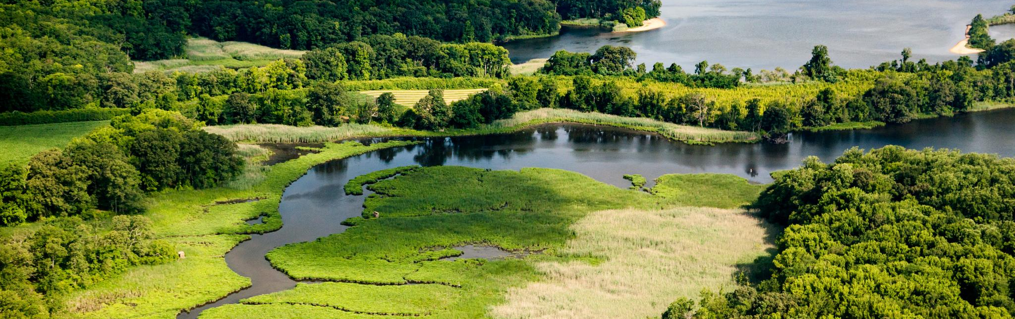


Photo Credit: Will Parson/Chesapeake Bay Program
Part One: CAC 2021 Recommendations
Sept 16, 2021

Slide 2
CAC Annual Recommendations
Issues the full CAC has discussed that year
Topics from quarterly meeting briefings
Limit to 3 topics
Avoid “hidden” or sub-recommendations
Concise
Direct
Detail focused on the advice and stakeholder view of the impact
Actionable
Beyond an expression of appreciation or concern
Not posing another question

Slide 3
Overview of Meetings Sept 2020- Sept 2021
Fall of 2020: strong focus on COVID, public health and the environment, and concerns about financial shortfalls
Panel: Bridging the Gaps Between Environmental Quality and Public Health
Began Chesapeake Bay Program’s DEIJ Strategy and PSC Action Plan

Slide 4
Overview of Meetings Sept 2020- Sept 2021
In Winter: focus on the new Presidential Administration and what changes at EPA might mean for the Bay TMDL 2025 deadline, including the new information becoming publicly available about the Conowingo Watershed Implementation Plan and how to pay for its practices
Panel discussion on Federal Priorities with US Senate staff and the federal advocacy lead from the Choose Clean Water Coalition
Began Briefings on the first draft Conowingo WIP and heard some reactions from stakeholders at watershed organizations

Slide 5
Overview of Meetings Sept 2020- Sept 2021
Spring/Summer 2021: onboarding new members, some of those conversations around water quality, like climate change, started to also bring up questions about social impacts. Conversations were infused with observations and experiences of the intersectionality of environmental issues and community resiliency and engagement.
Updates on progress toward the goals and the challenges ahead, particularly with agriculture
Deep dive on climate change in anticipation of the Executive Council Directive (to be signed next month)
You learned from the Bay Program [and from each other] about approaches to communications, outreach and engagement

Slide 6
Unique Opportunity
Recommendations for this year: unique position to provide specific advice through the lens of residents who collectively know more than the general public about these topics AND go farther and offer advice on:
HOW government might approach solutions
how government should COMMUNICATE to the public about these issues
Make the case: HOW government might best help WHILE providing meaningful support to local champions who can get community buy-in and engagement

Slide 7
CAC EC Topics for Consideration
(1) Accountability on 2025 Deadline to Maintain Public Confidence
Expectation of Backstops
Acceleration of efforts to gain as much progress as possible in remaining 3 years
Targeting for biggest impact
(2) Climate Change
Resiliency for ecological, public health and economy
Opportunity with new state and federal funding
More training for local government officials charged with local land use decisions
(3) Conowingo WIP
Viability of operation and implementation with the State WIPs as competitors
(4) Stewardship and Engagement
A separate topic or woven into each recommendation?

