Slide 1

USGS Chesapeake Bay Watershed EDC Science: The Next Five Years
Kelly Smalling, NJ Water Science Center, Project Lead
Chesapeake Bay TCW Group
April 8, 2015

Slide 2
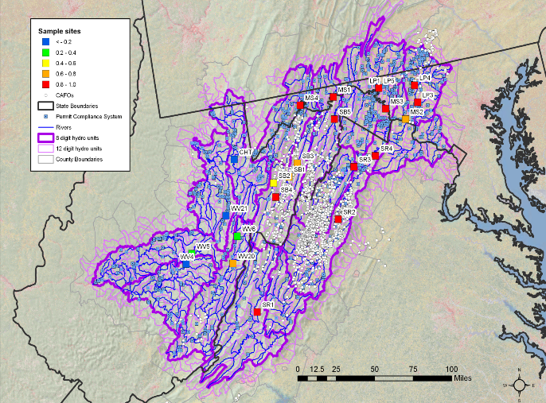
2003 Potomac Watershed: Cause for Concern?
Multiple bacterial pathogens
Parasite/fungal infections
Skin lesions
Largemouth Bass virus
High prevalence of intersex
Immunosuppression
Causes?

Slide 3
Estrogenicity (EEQ) of Water Extracts Smaller Tributaries of Shenandoah Drainage
Agriculture
WWTP Effluent
Ciparis, S. L.R. Iwanowicz and J.R. Voshell. 2012. Effects of watershed densities of animal feeding operations on nutrient concentration and estrogenic activity in agricultural streams. Sci. Total Environ. 414:268-276.

Slide 4
Charge: Ensure that the Bay and its rivers are free of effects of toxic contaminants on living resources and human health.

Slide 5
Broad Strategic Goals
1. Identify and quantify the sources, fate, transport, distribution and exposure of EDCs
2. Evaluate the effects of EDCs on fish and wildlife in the environment
3. Determine the mechanism(s) and threshold for adverse effects on fish and wildlife species
4. Develop appropriate assessment tools and models for risk evaluation of EDCs on natural resources

Slide 6
Major Science Questions
What are the most important sources and exposure pathways of EDCs ?
What are the factors that influence these sources/pathways and can WQ management actions help minimize EDCs ?
What chemical or mixtures are responsible for causing ED?
What is the extent/magnitude of adverse effects on fish and wildlife populations associated with exposure to EDCs
What are the causal agents and mechanisms of ED?
Can a risk assessment model be developed?

Slide 7
Goal 1: Identify and quantify the sources, fate, transport, distribution, and exposure of EDCs to fish and wildlife
1A) Synthesis and analysis of existing USGS field chemical data from the Chesapeake Bay watershed
1B) Chemical analysis of tissues to understand sources and the mechanisms of effects
1C) Sources, transport and distribution of EDCs from agricultural and urban land-uses
1D) Effects-directed analysis (EDA) to identify candidate chemicals or chemical classes causing endocrine disruption
Notes:
4 projects associated with this goal
Development of integrated database for chemical and biological data collected in the Chesapeake Bay Watershed

Slide 8
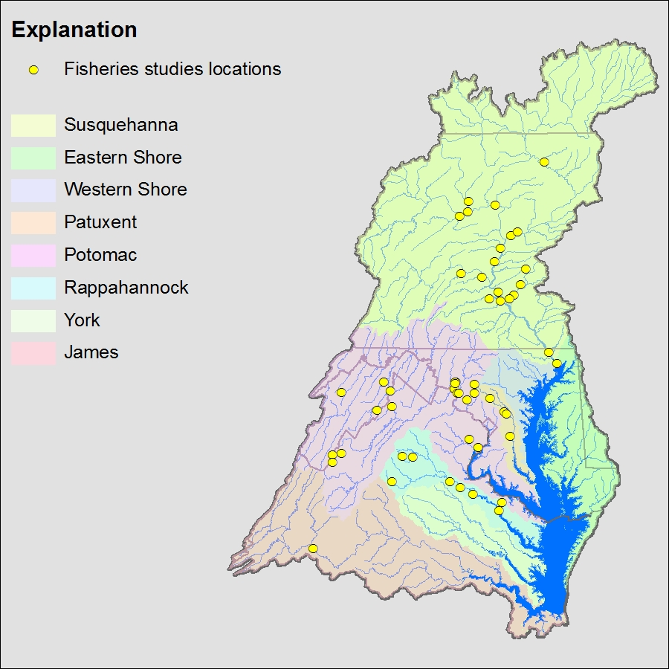
Synthesis and Analysis of Chemical Data
Objectives:
Synthesize/archive environmental chemistry data collected over last 10 years
determine if chemicals are accumulating in key tissues to understand the mechanisms of exposure/effects
characterize the concentrations of a variety of EDCs in water and sediment

Slide 9
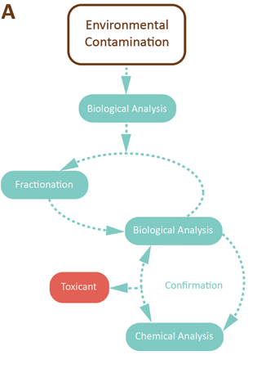
Effects-Directed Analysis
EDA is designed to determine the endocrine disruption potency (based on bioassay responses) in fractions of an environmental sample
Objective: to identify the chemical(s) or chemical classes responsible for causing ED in fishes
Burgess et al. Environ Toxicol Chem 32(2013)1935-1945

Slide 10
Goal 2 Evaluate the effects of EDCs on fish and wildlife in the environment
2A) Synthesis of existing USGS biological effects data generated over the past decade
2B) Biological effects monitoring of fishes
2C) Occurrence and potential effects of EDCs in amphibians
2D) Evaluating the influence of mercury bioaccumulation on endocrine disruption in fishes in relation to other EDCs
2E) Endocrine-related effects in wildlife
2F) Assessment of potential endocrine disruptive effects on birds and/or other aquatic associated vertebrates

Slide 11
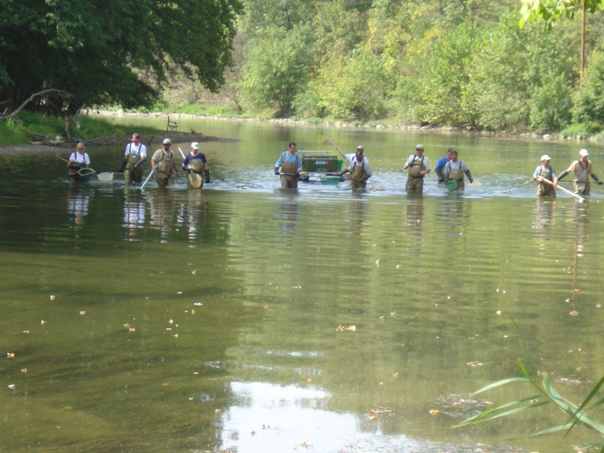
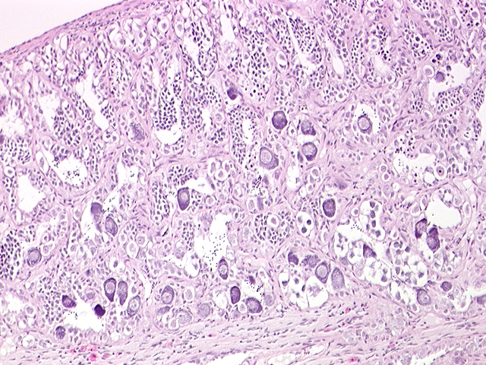
Biological Effects Synthesis and Monitoring
Objectives:
synthesize the biological effects data on the incidence of endocrine-related effects data on fish
assess ED in fish at agricultural and urban sites
examine the relation between fish Hg concentrations and ED in relation to other EDCs

Slide 12
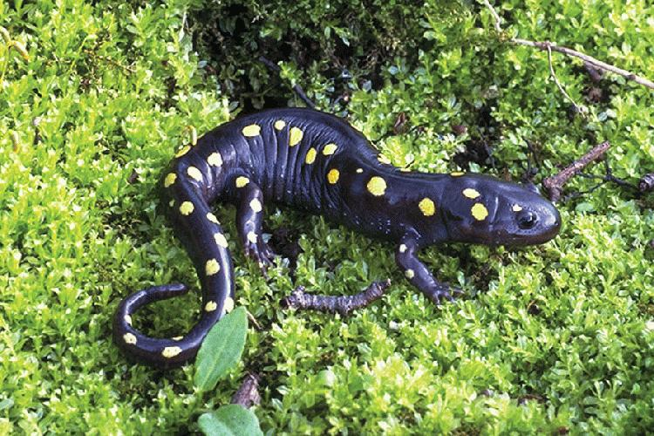
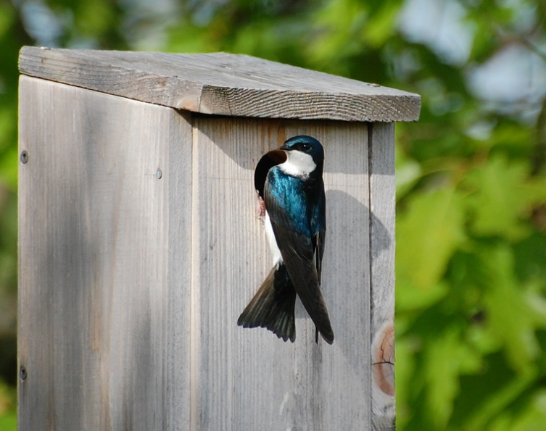
Effects on Wildlife
Objectives:
conduct a review of the available data/literature on endocrine-related effects in wildlife species.
identify potential effects of EDCs to amphibians and assess the health of individuals and populations
characterize the potential impacts on endocrine-related processes to aquatic associated vertebrates (tree swallows?)

Slide 13
Goal 3: Determine the mechanism(s) and thresholds for adverse effects of EDCs on fish and wildlife species
3A) ED caused by chemicals or mixtures: controlled lab and mesocosm fish exposure-effects studies
3B) Identifying mechanisms of effect in wild fishes
3C) Landscape-based experimental approach to assess sources of EDCs and ED in fish
3D) ED effects on turtle embryonic development from exposure to field collected water
3E) Assessment of avian embryonic effects of potential EDCs

Slide 14
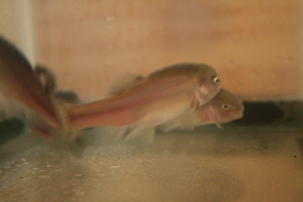
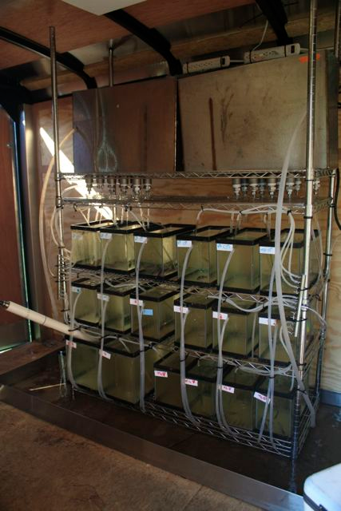
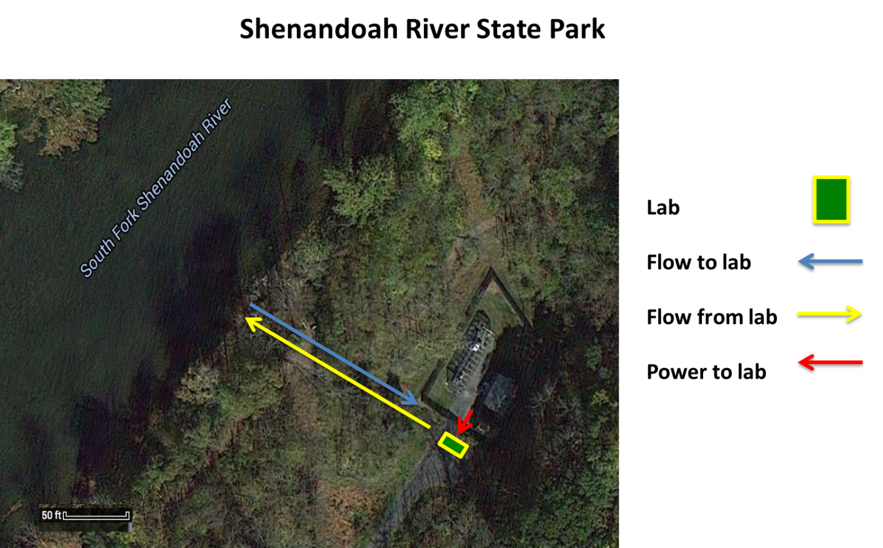
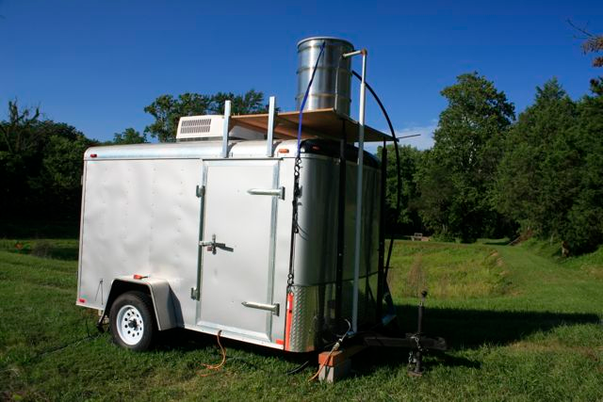
Mobile Labs
The objective of this study is to provide detailed characterization of the occurrence of EDCs in water and associated effects on the model aquatic organism, the fathead minnow.

Slide 15
Goal 4: Develop appropriate assessment tools and models for risk evaluation of EDCs on fish and wildlife populations.
4A) Establishing a plan to assess risk of EDCs to aquatic and terrestrial organisms.
Objective: develop a plan for assessing the risk of EDCs to fish and wildlife populations that (1) explicitly incorporates uncertainty and expert opinion, (2) is transparent with regards to known or hypothesized causal relationships in systems of interest, and (3) develops a probabilistic representation of variability observed in nature.

Slide 16
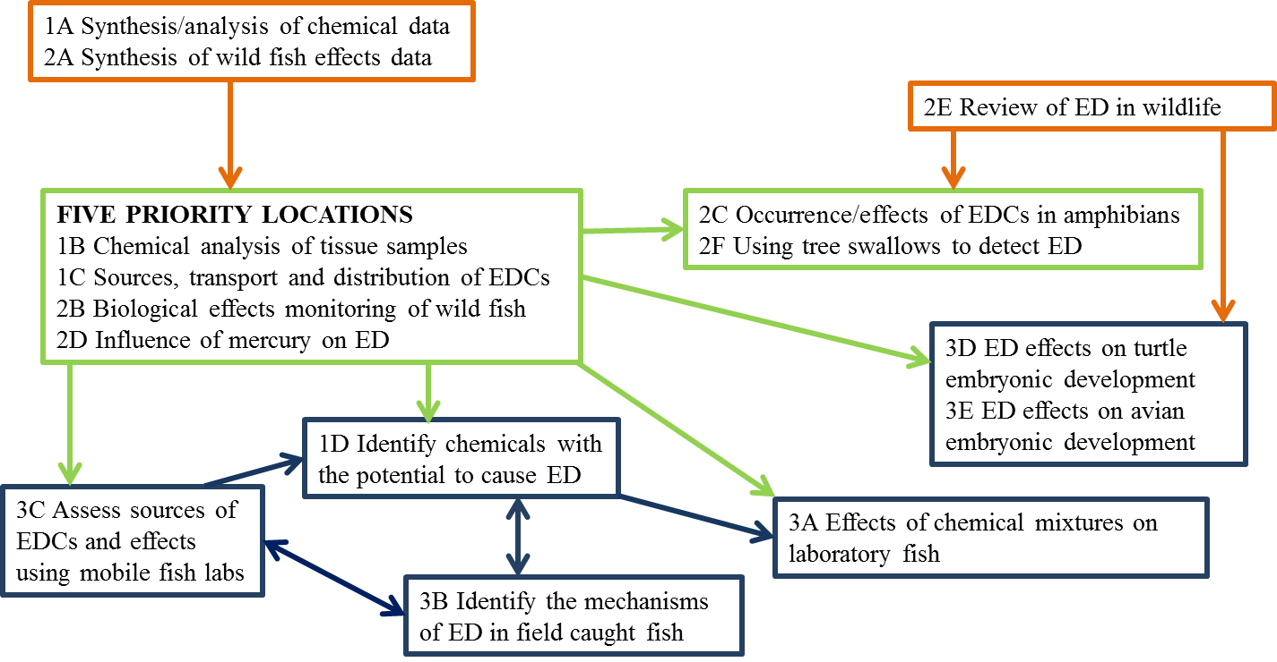
Integration Across Goals

Slide 17
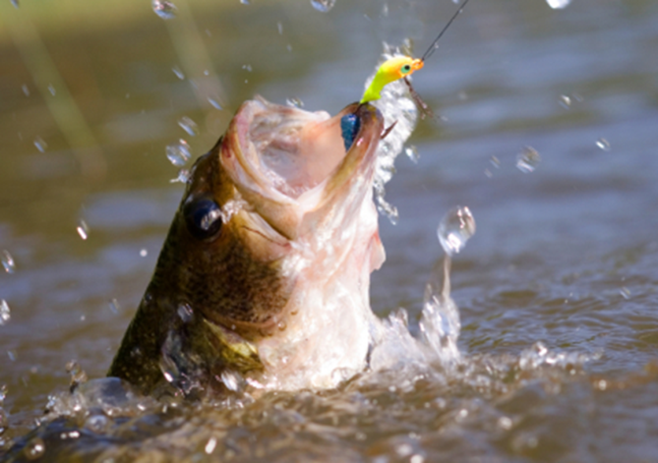
Outcomes
Synthesis of historical information into a comprehensive database and summary products
Comprehensive review of EDC effects on wildlife
Understand the chemical or mixtures responsible for impacts to fish and wildlife
Understand the mechanisms of ED
Develop a risk assessment strategy/model for fish and wildlife
All to inform management actions to improve WQ and the health of fish and wildlife in the Chesapeake Bay watershed

Slide 18
Identified Science Gaps
assessment of ED in important invertebrate species;
identification of other aquatic and terrestrial species that might be affected and the sources and mechanisms of these effects, and
identification of food web effects – i.e. sediment to benthic invertebrates or plants to fish, amphibian, reptiles and birds.
It is the hope of the team that some of these studies will be conducted within the team and associated collaborators, should funding become available.

Slide 19
Chesapeake Bay Watershed EDC Research Team
David Alvarez, CERC, Research Chemist
Larry Barber, NRP, Research Geologist
Vicki Blazer, LSC, Research Fish Biologist
Collin Eagles-Smith, FRESC, Research Ecologist
Luke Iwanowicz, LSC, Research Fish Biologist
Dana Kolpin, IA WSC, Research Hydrologist
Julia Lankton, NWHC, Veterinary Pathologist
Natalie Karouna- Renier, PWRC, Research Ecologist
Patrick Phillips, NY WSC, Hydrologist
Donald Tillitt, CERC, Research Toxicologist
James Winton, WRFC, Research Microbiologist

