Slide 1

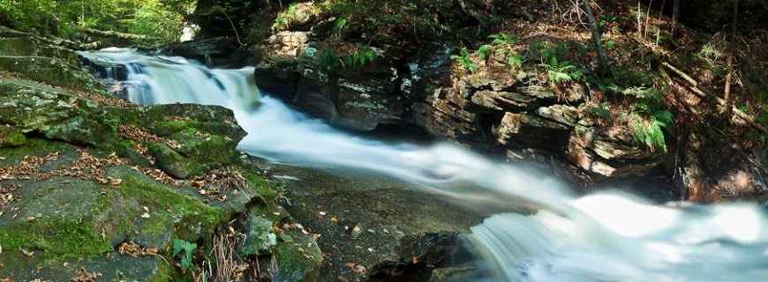


Healthy Watersheds Consortium
Research & Tools
Demonstrating Stream Health Improvement from
Healthy Watershed Actions in Maryland
Mark Southerland
Carlos Lozano
Andrea Fortman
April 17, 2018

Slide 2
Outline
Research Question
Methods
Results
Conclusions

Slide 3
Research Question
General question:
What is the effect of healthy watershed actions on stream condition?
Specific question:
What is the condition of Maryland streams in protected vs. non-protected areas from 1995-2016?
Notes:
Site condition = condition of stream network that site is in

Slide 4

Methods
Stream Data
  Maryland Biological Stream Survey
Protected Lands
  MD iMAP
  Chesapeake Bay Program
Statistical Analysis
  Logistic Regression Mixed Model
  Generalized Linear Mixed Model

Slide 5
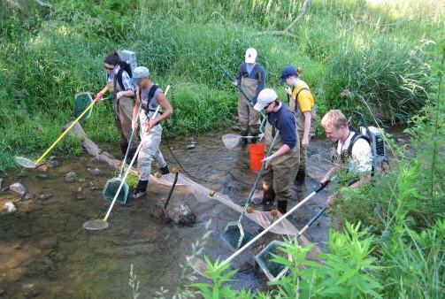
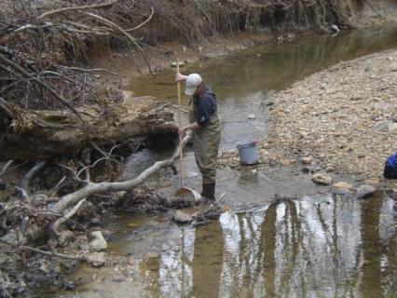
Stream Data
Maryland Biological Stream Survey
  5,000 sites sampled over 20 years
  Fish IBI and Benthic invertebrate IBI as indicators
  of stream condition
  IBI ≥ 3 is healthy (non-impaired) on scale 1-5

Slide 6
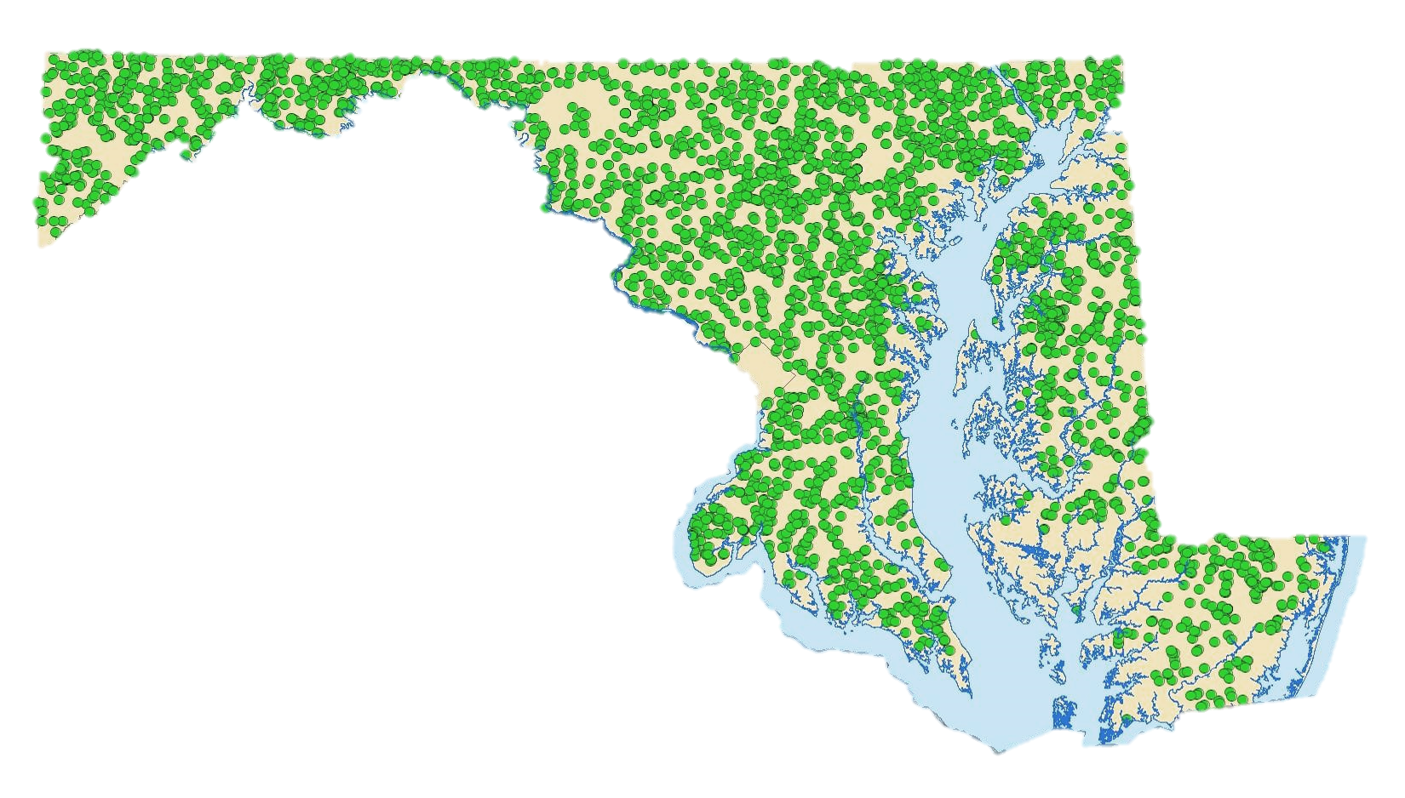
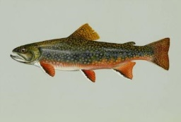

MBSS Sites

Slide 7
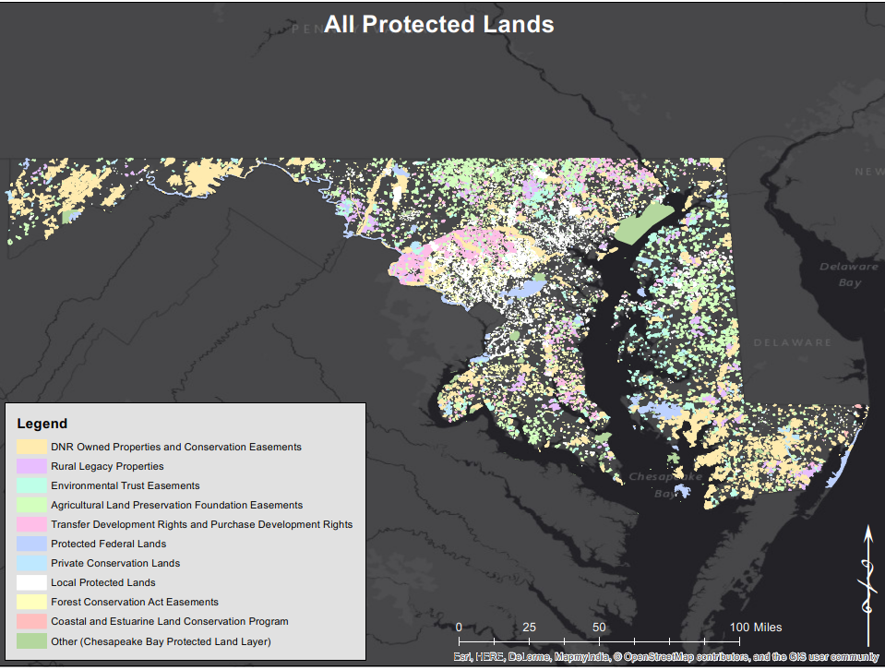
Protected Lands

Slide 8
Protected Lands
Types of protected areas
  Coastal and Estuarine Land Conservation Program
  DNR Owned Properties and Conservation Easements
  Forest Conservation Act Easements
  Protected Federal Lands
  Local Protected Lands
  Private Conservation Lands
  Maryland Environmental Trust Easements
  Maryland Agricultural Land Preservation Foundation Easements
  Rural Legacy Properties
  Transfer Development and Purchase Development Rights

Slide 9

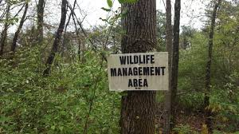
Protected Land Types
Consolidated categories of protected areas
  All protected areas
  DNR-owned lands and easements
  100-acre minimum areas
  100-acre minimum DNR areas

Slide 10
DNR Lands
State Parks
Natural Resources Management Areas
Natural Environmental Areas
State Battlefields
Rail Trails
State Forests
Demonstration Forests
John S. Ayton Tree Nursery
Chesapeake Forest Lands
Forest Fire Tower sites
Wildlife Management Areas
Fishery Management Propagation Areas
Fishery Management Public Fishing Areas
State Wildlands
Heritage Conservation Sites
Marine/Communication Facilities
Undesignated lands

Slide 11
Statistical Analyses
Logistic Regression Mixed Model
  Binomial distribution: Probability of IBI ≥ 3
    IBI = 3 is the threshold for “healthy” condition
  Random slope and MDE8 watershed factor
Generalized Linear Mixed Model
  Gaussian distribution: IBIs as response
  Random slope and MDE8 watershed factor

Slide 12
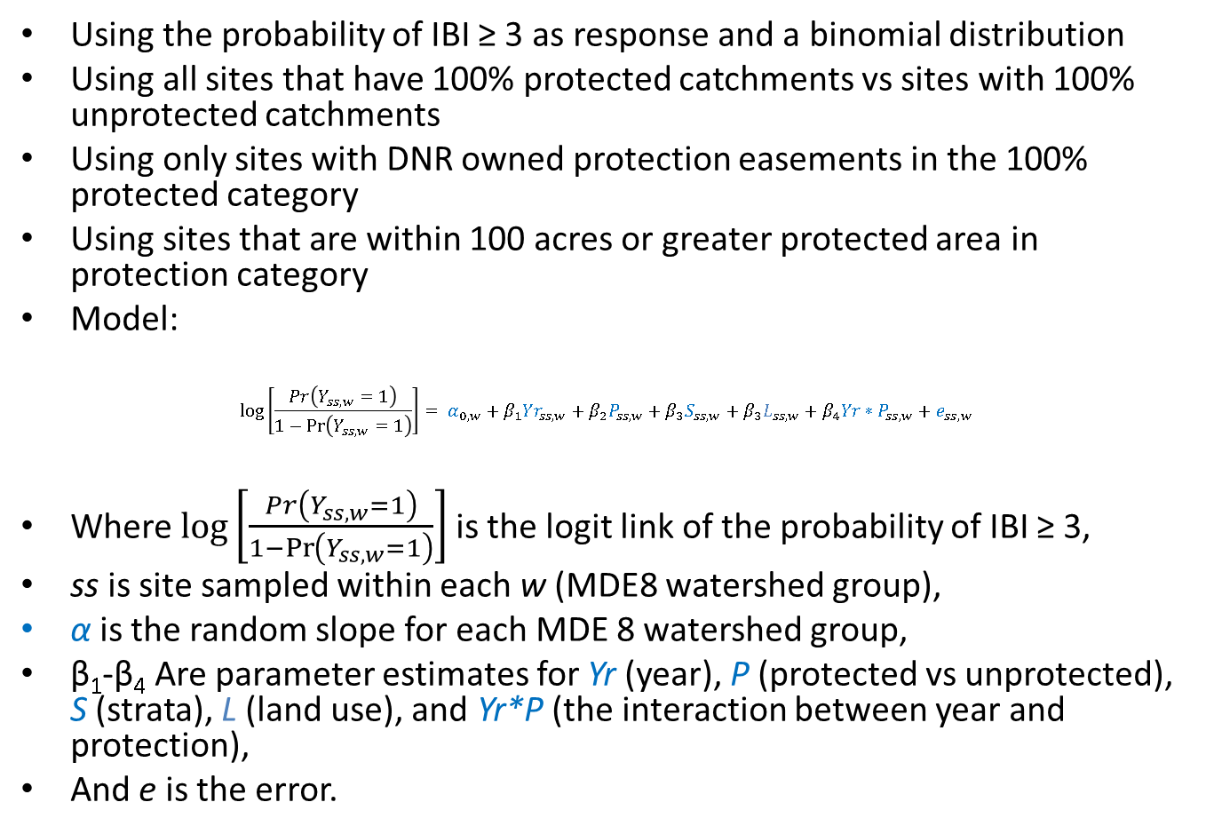
Logistic Regression Mixed Model

Slide 13
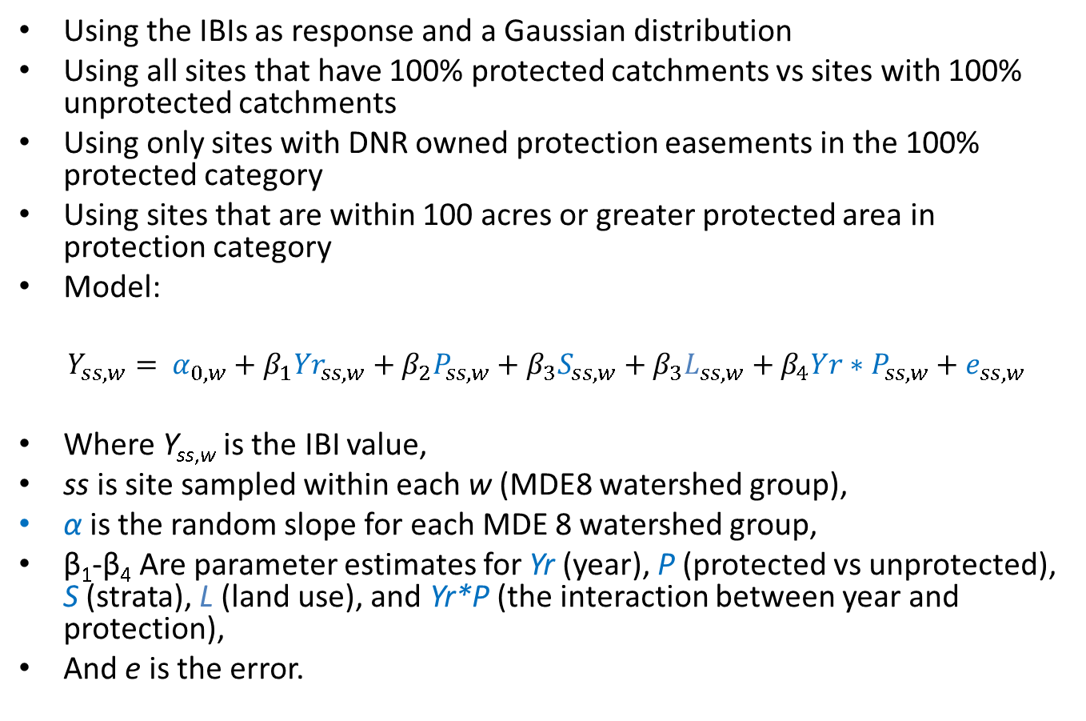
Generalized Linear Mixed Model

Slide 14
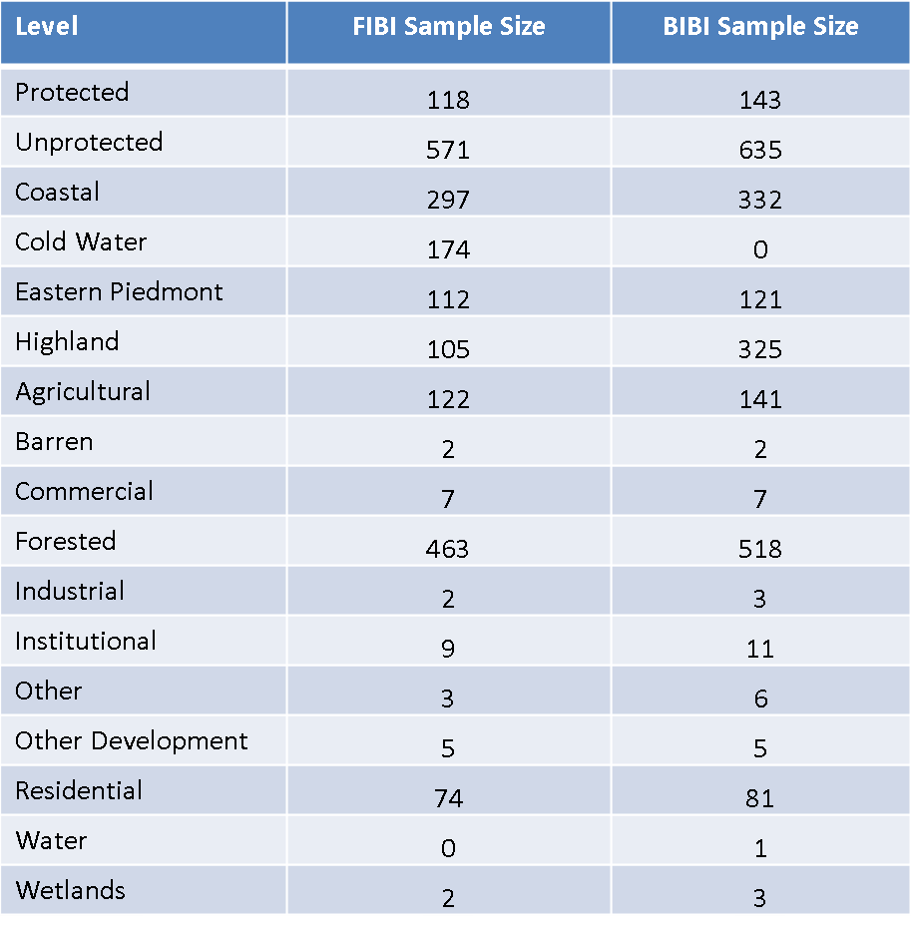
Sample Size (all sites)

Slide 15
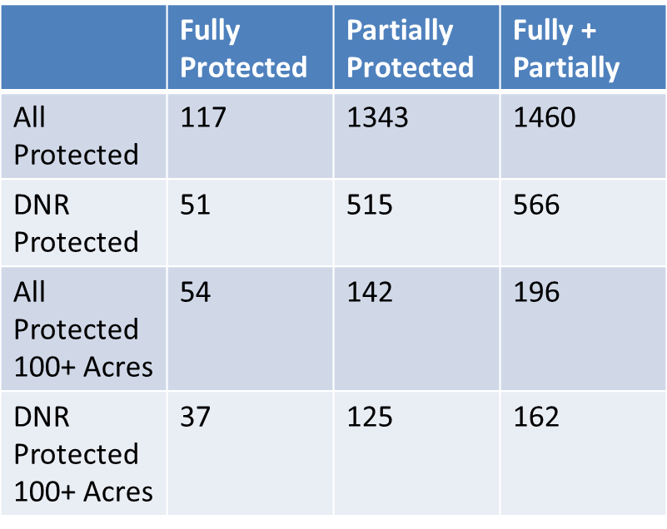
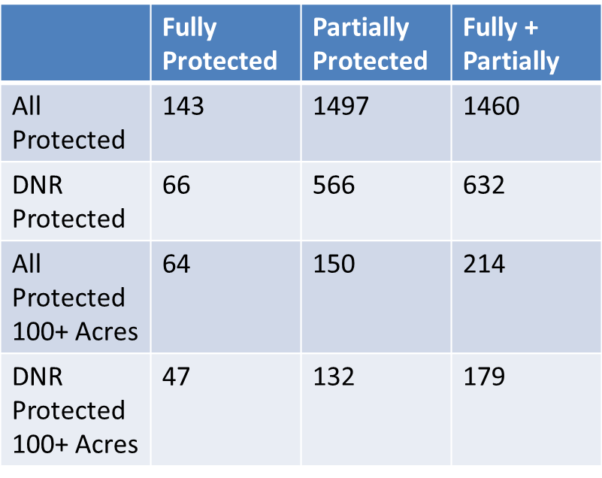
Sample Size (tested classes)

Slide 16
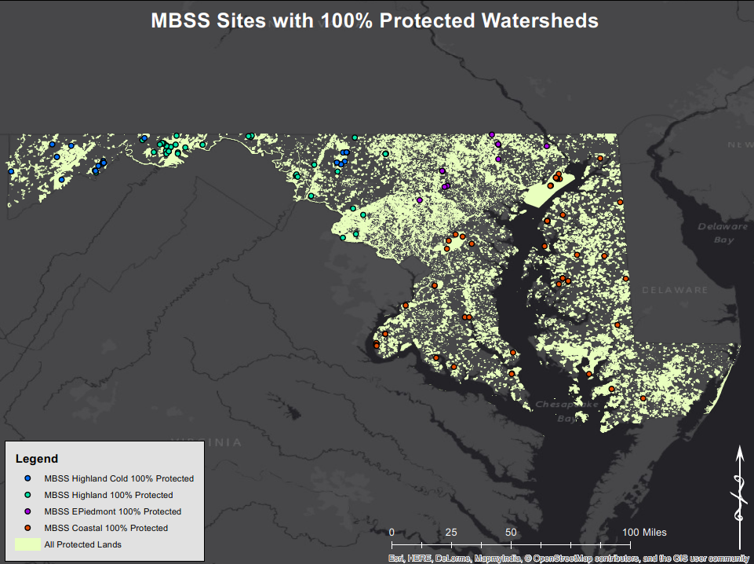
Sites on Protected Lands

Slide 17
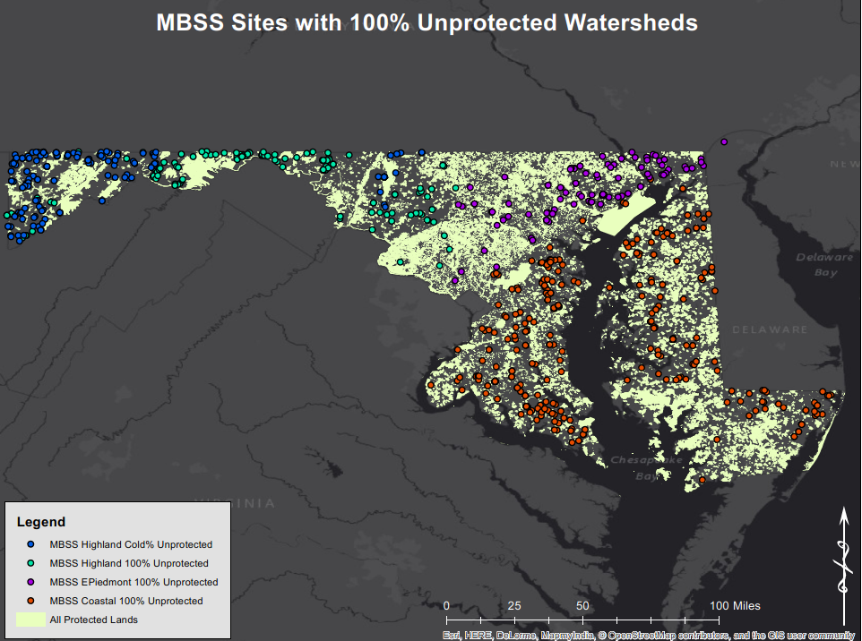
Sites on Unprotected Lands

Slide 18
Hypotheses
Are protected areas always healthy?
Is stream condition better with type of protection?
  Size
  Management
  Length of time protected
Is more protected land in a watershed better?
  Especially well-managed lands

Slide 19
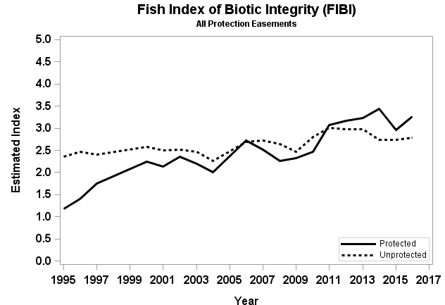
Protected areas are not always better

Slide 20
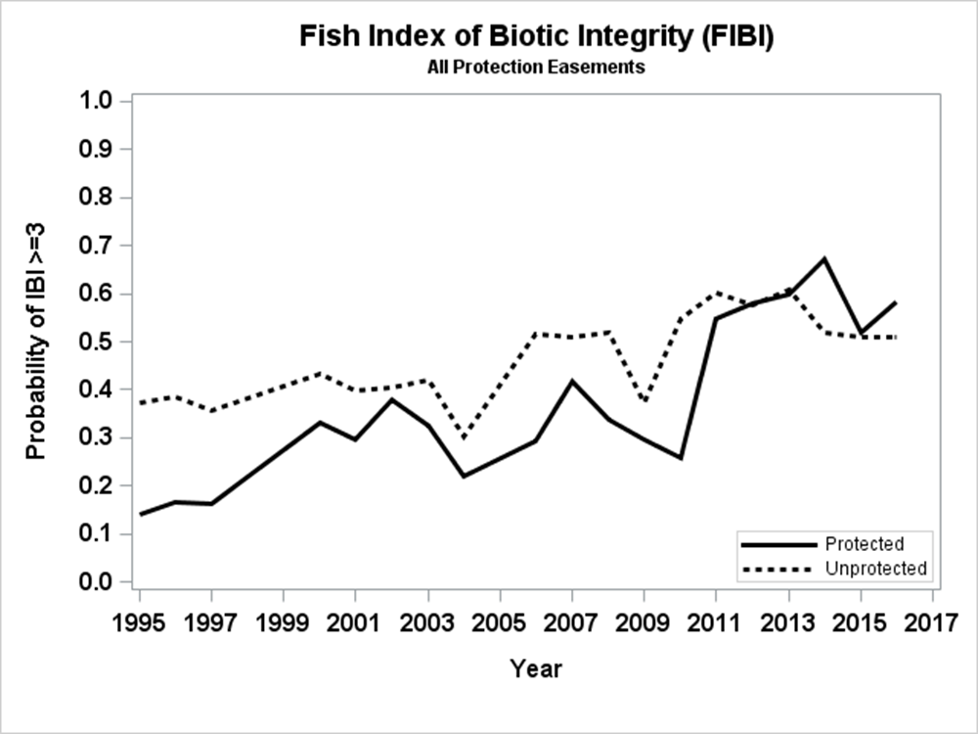
Protected areas are not always better

Slide 21
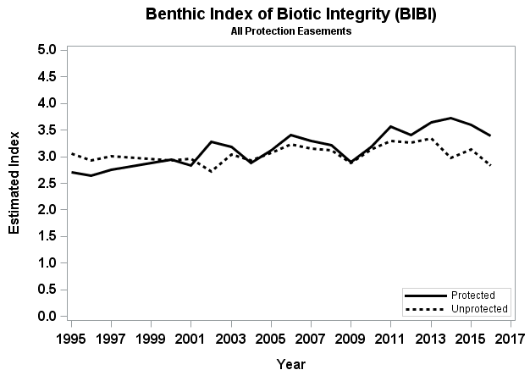
Protected areas are not always better

Slide 22
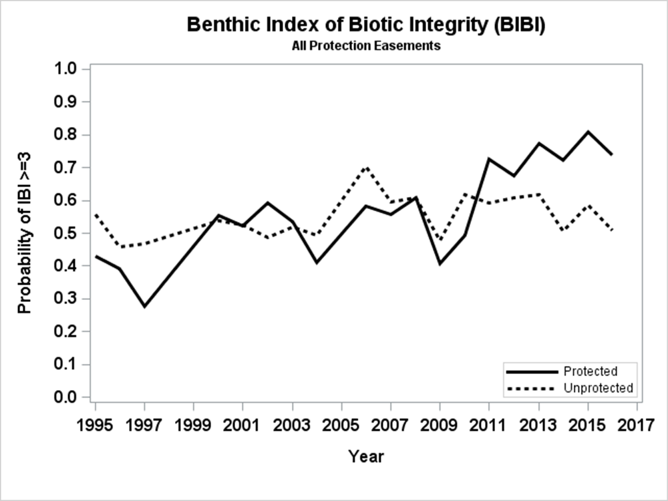
Protected areas are not always better

Slide 23
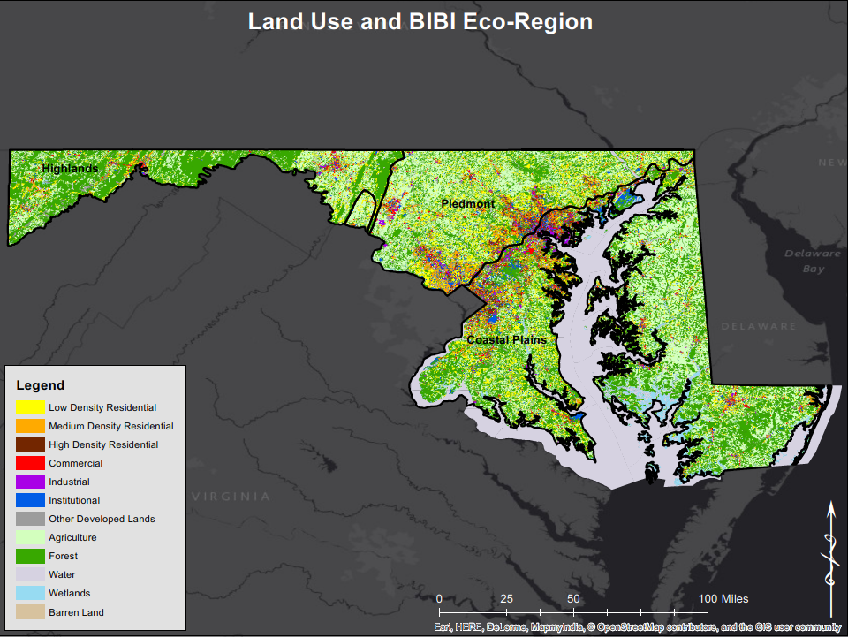
Land use

Slide 24
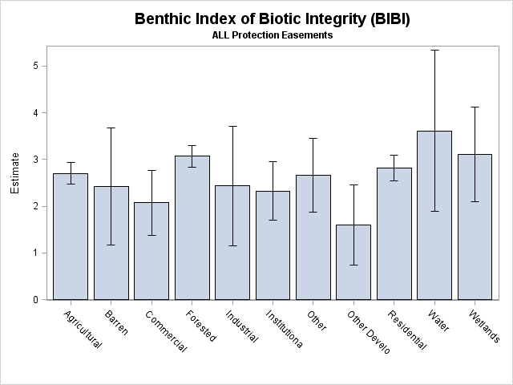
Land use matters

Slide 25
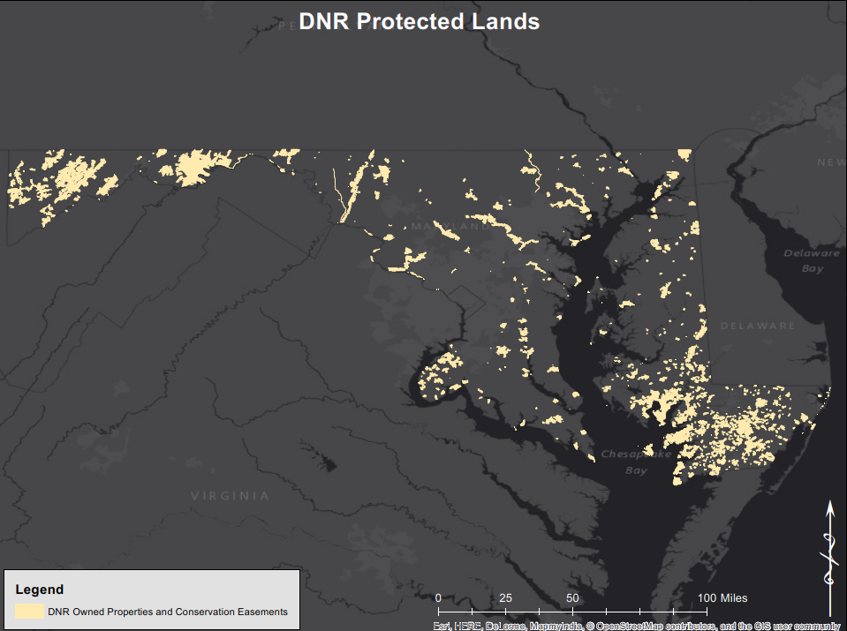
DNR sites

Slide 26
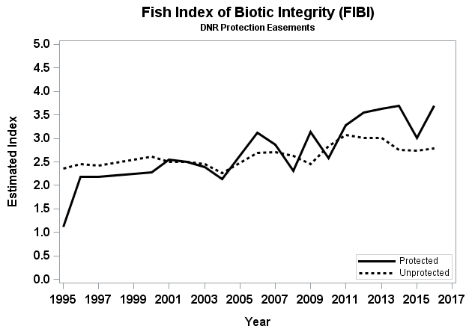
DNR sites are better

Slide 27
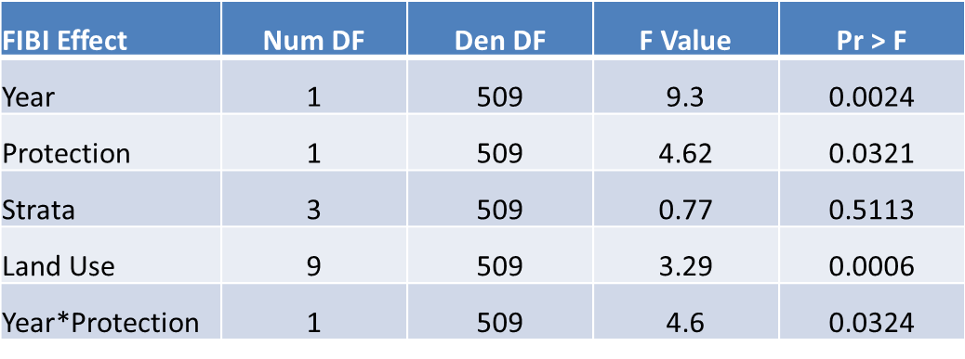
DNR sites are better

Slide 28
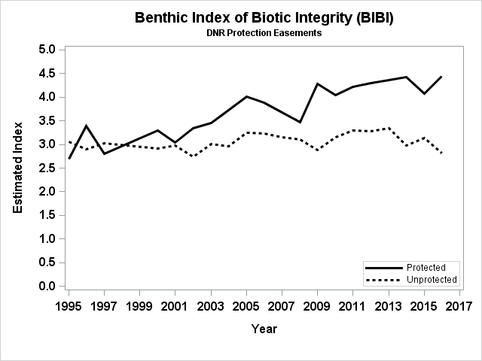
DNR sites are better

Slide 29
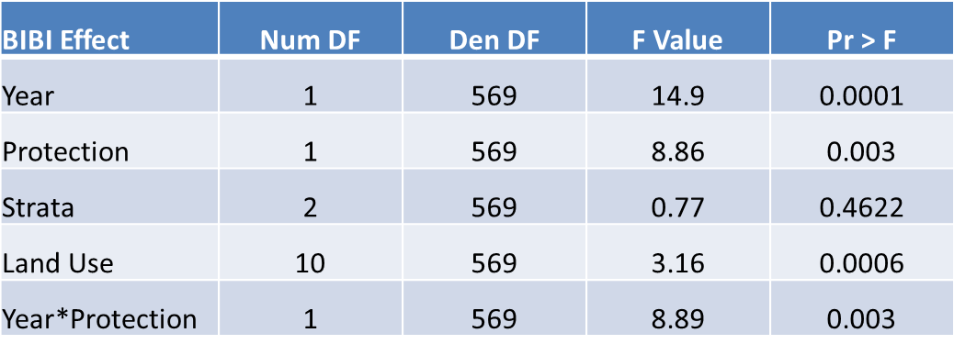
DNR sites are better

Slide 30
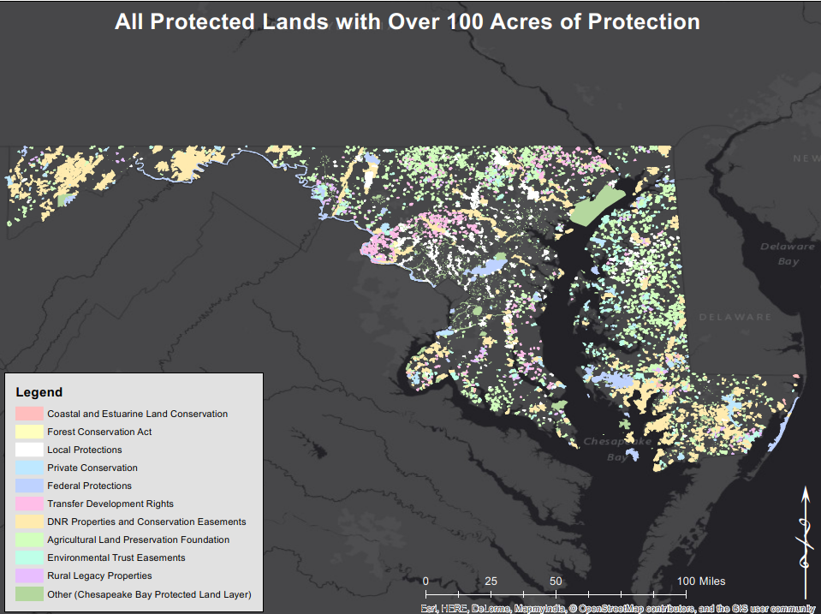
Large sites

Slide 31
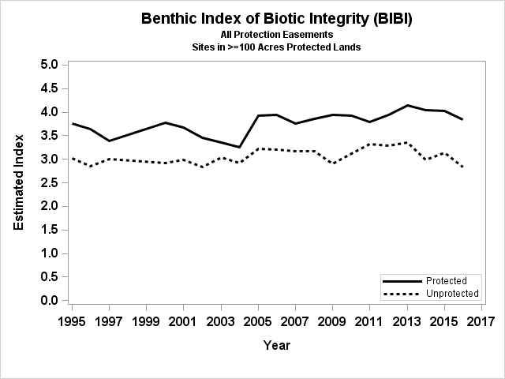
Large sites are better

Slide 32
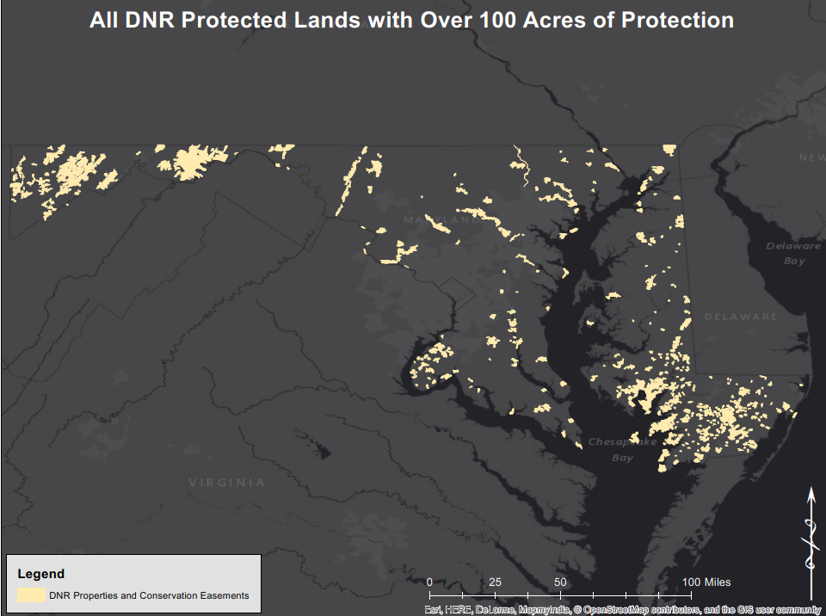
Large DNR Sites

Slide 33
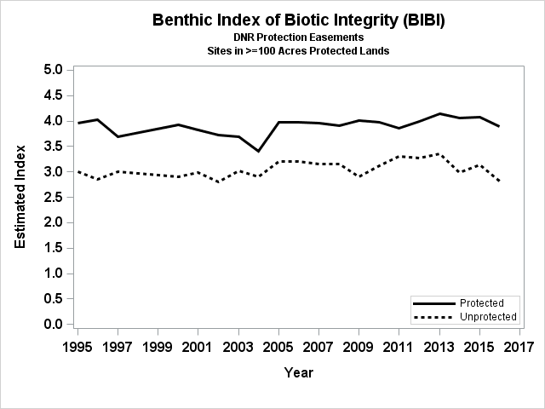
Large DNR sites are better

Slide 34
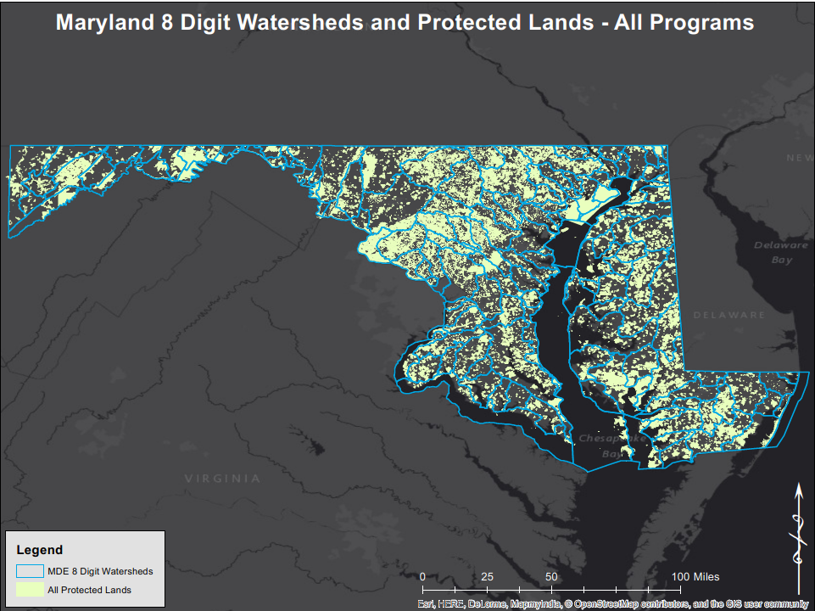
Protecting Watersheds
MD8
average
90 mi²

Slide 35
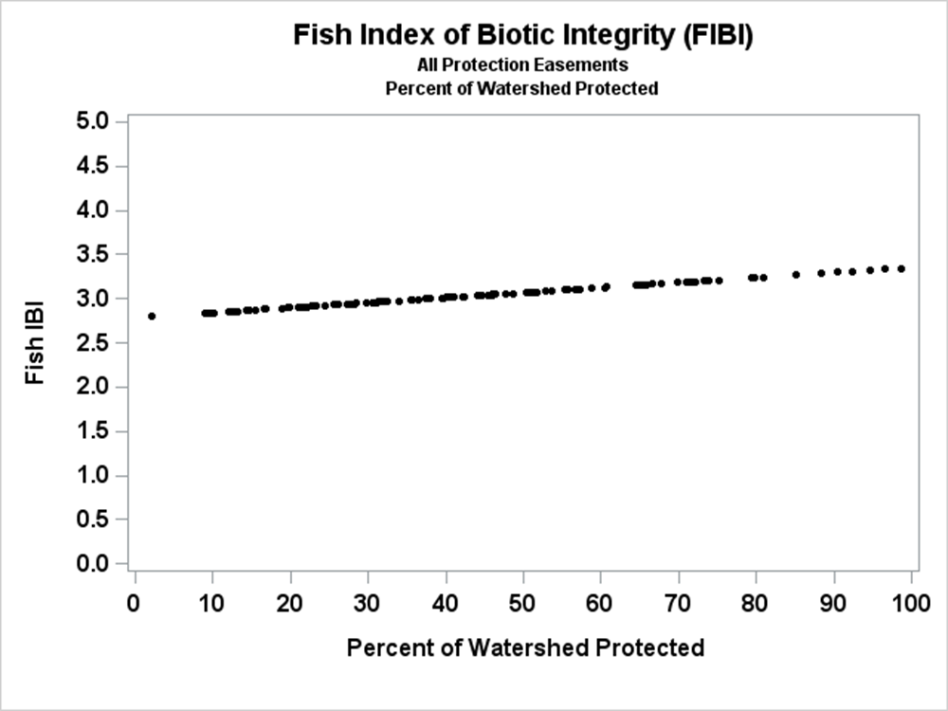
Percent of watershed protected

Slide 36
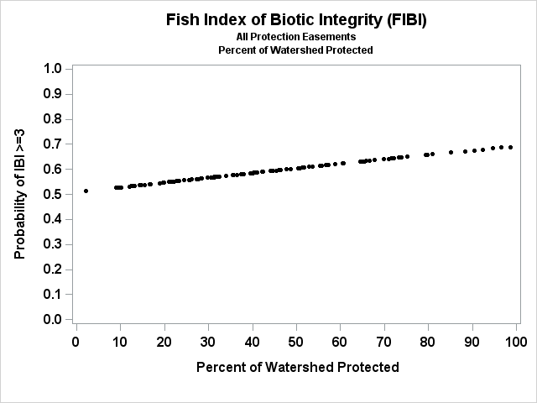
Percent of watershed protected

Slide 37
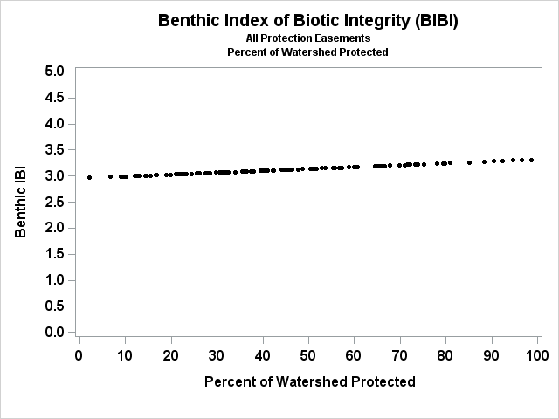
Percent of watershed protected

Slide 38
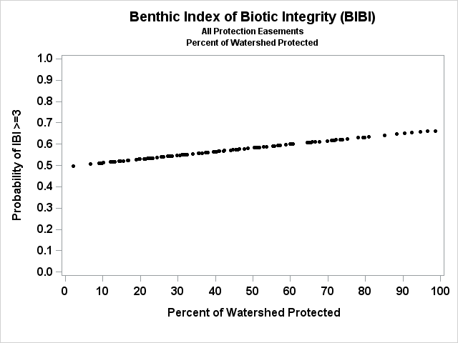
Percent of watershed protected

Slide 39
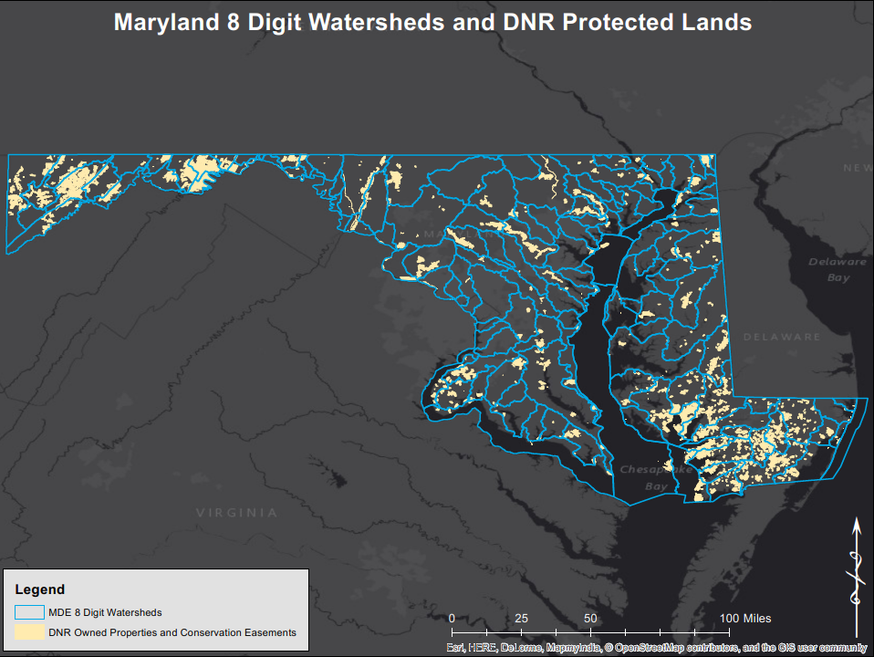
Protecting Watersheds

Slide 40
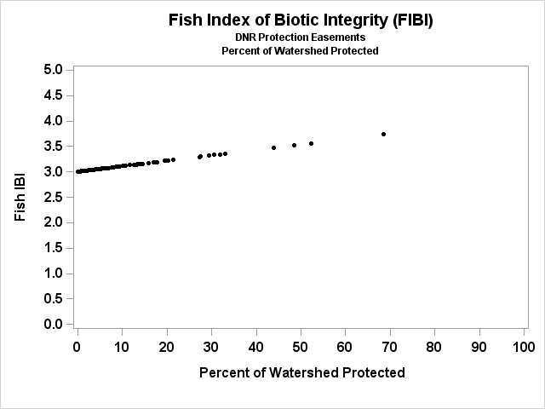

Percent of watershed DNR protected

Slide 41
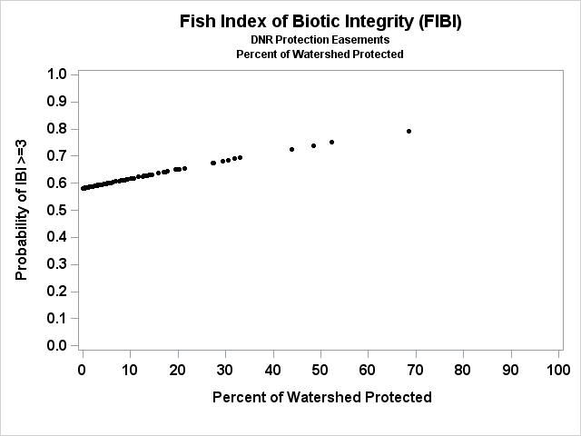
Percent of watershed DNR protected

Slide 42
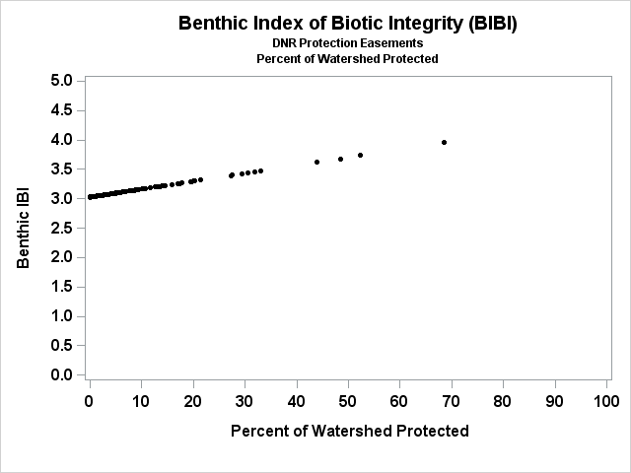
Percent of watershed DNR protected

Slide 43
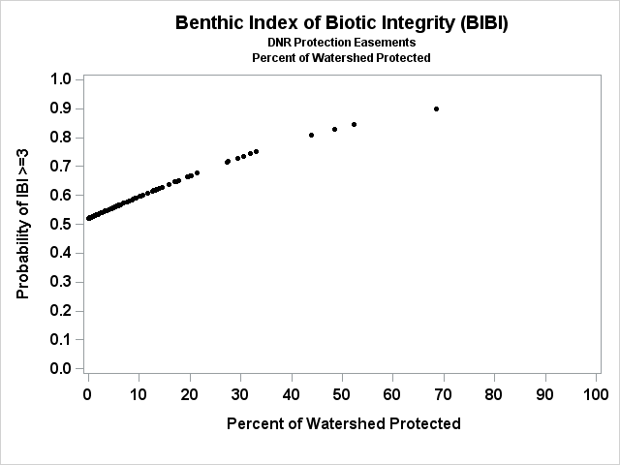
Percent of watershed DNR protected

Slide 44
Conclusions
Not all protected areas are created equal
  Management, size, and time protected matter
Truly protected streams and watersheds are in better condition
Preserving healthy watersheds and “green infrastructure networks” provide ecosystem benefits over time

