Slide 1

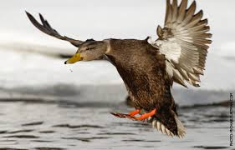
QUARTERLY PROGRESS MEETING – November 2020 Chesapeake Bay Program
Black Duck
Ben Lewis
Virginia Department of Wildlife Resources
Chair, Black Duck Action Team
Notes:
Find photos on our Flickr site: https://www.flickr.com/photos/29388462@N06/sets/
You can also browse photos by category on our website: http://www.chesapeakebay.net/photos

Slide 2
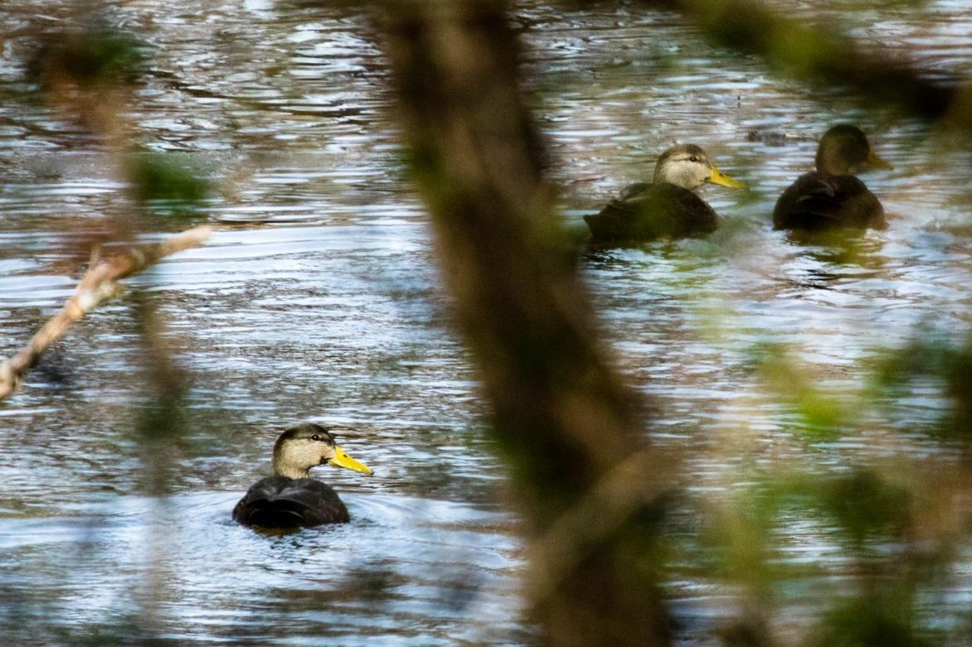
Through the Chesapeake Bay Watershed Agreement, the Chesapeake Bay Program has committed to…
Goal: Vital Habitats (Black Duck)
Outcome: By 2025, restore, enhance and preserve wetland habitats that support a wintering population of 100,000 black ducks, a species representative of the health of tidal marshes across the watershed. Refine population targets through 2025 based on best available science.
Notes:
INSTRUCTIONS:
Add the title of your goal and the language of your outcome from the 2014 Agreement (copy and paste).
Add a relevant photo (if it all fits).
If desired, talking points could include more contextual information, e.g. the importance of the outcome and the historic trends that led to the establishment of the specific target.

Slide 3
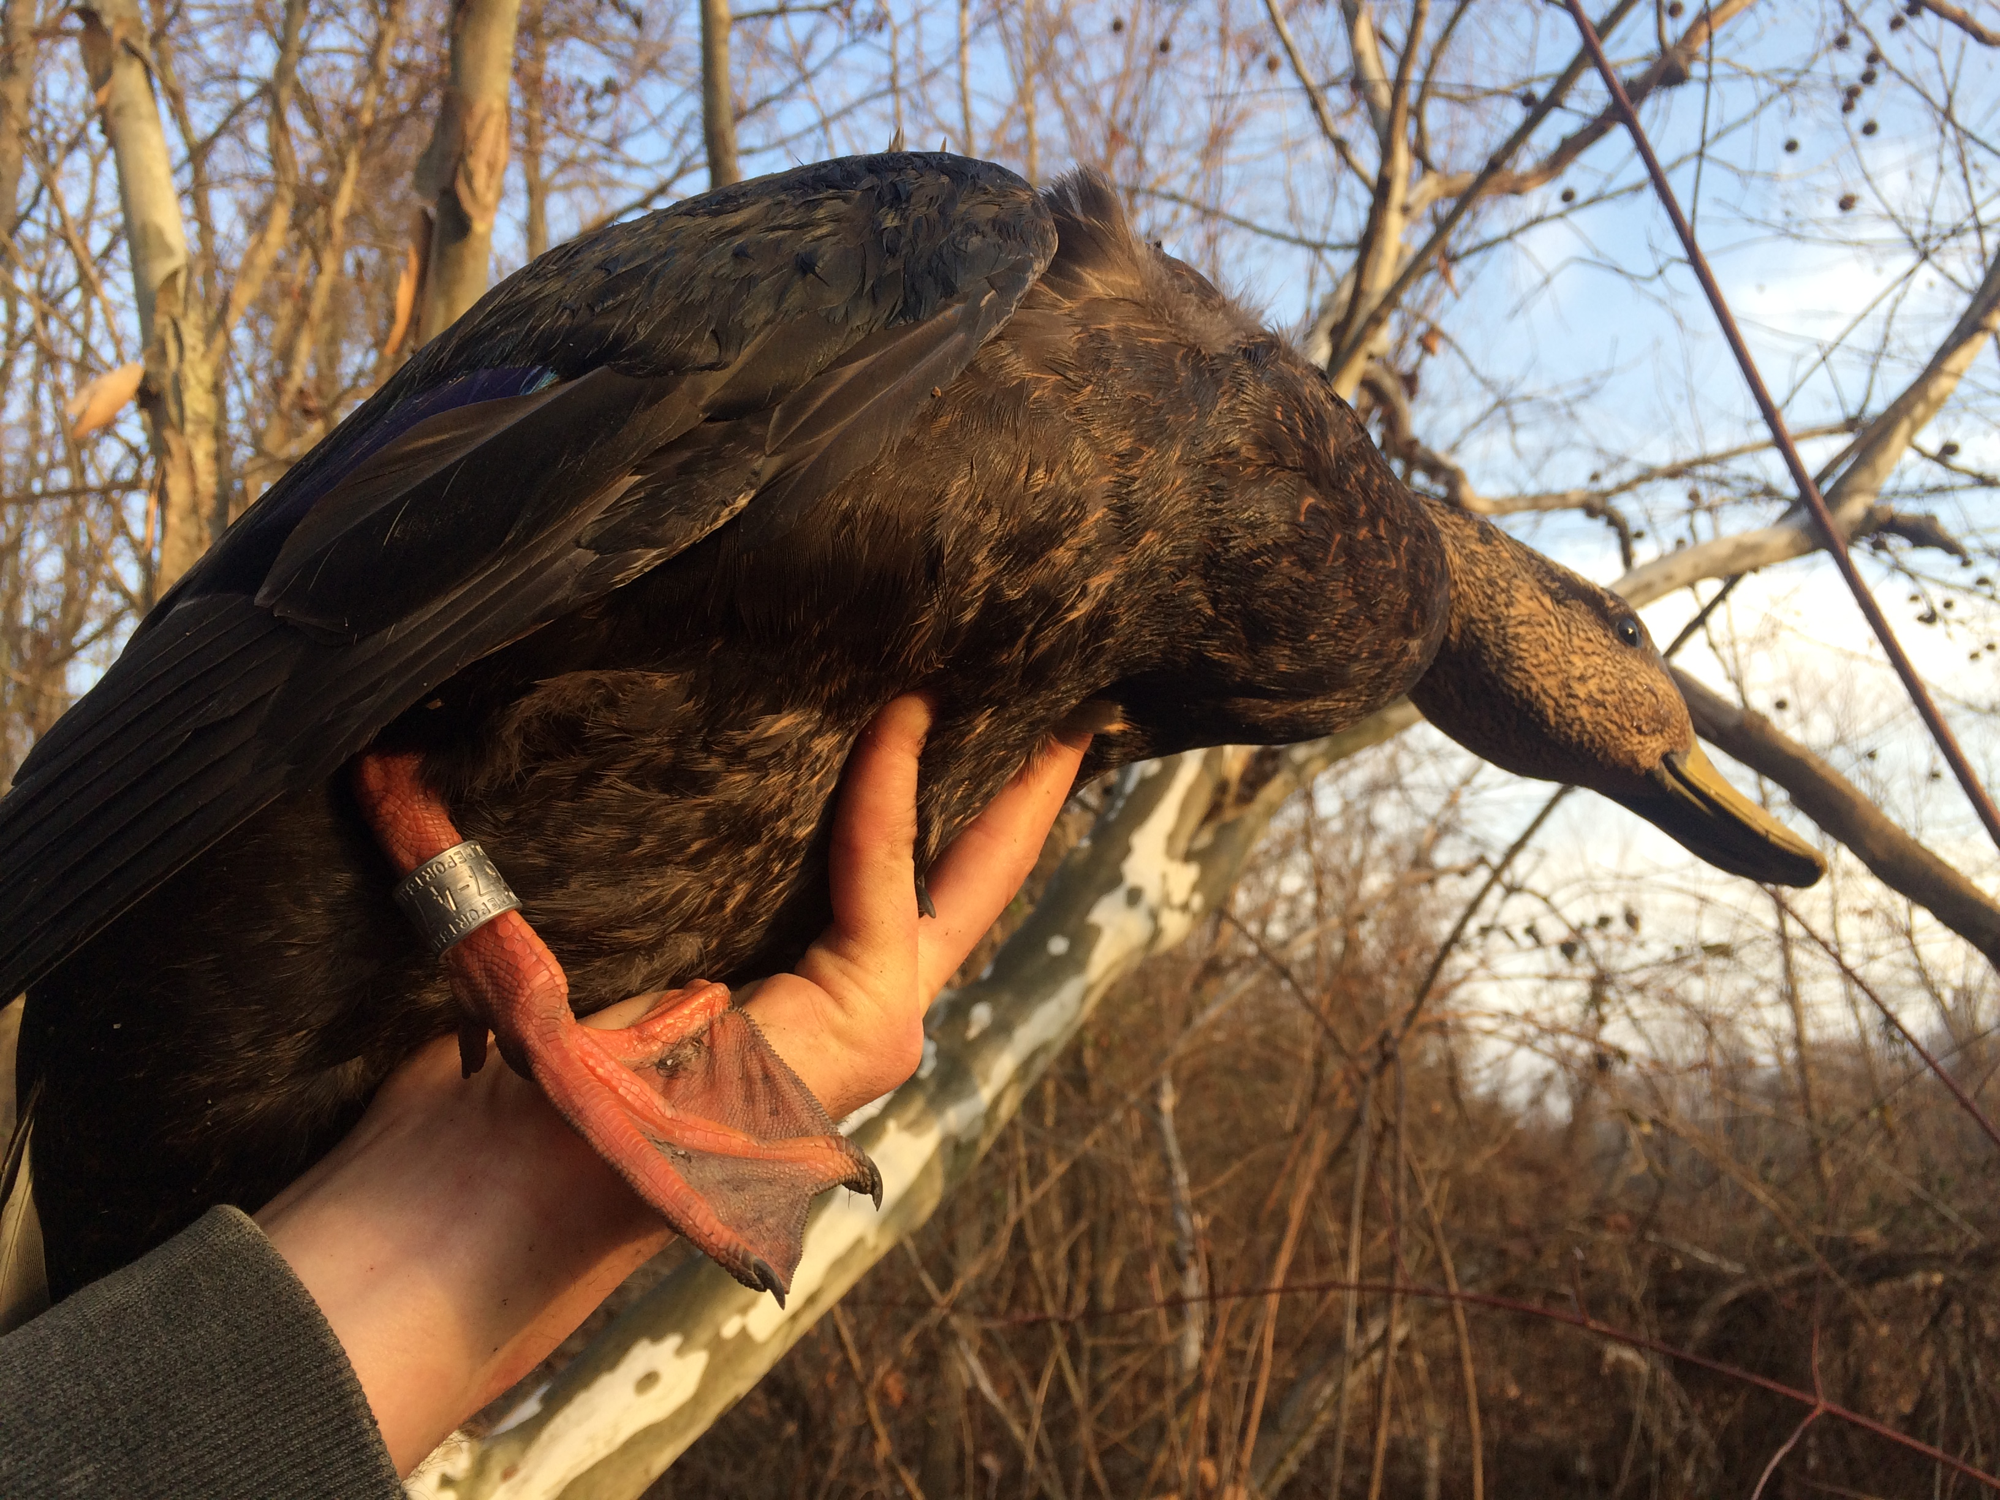
Black Ducks and the Chesapeake
Historically the primary dabbling duck in the Chesapeake Bay
Chesapeake Bay critical wintering area
Experienced drastic decline with a recent population stabilization
Important indicator species of the health of the Chesapeake Bay
Notes:
INSTRUCTIONS: This slide should briefly summarize your answer to narrative analysis question #1.
FROM NARRATIVE ANALYSIS (FOR YOUR REFERENCE ONLY):
“1. Examine your red/yellow/green analysis of your management actions. What lessons have you learned over the past two years of implementation?
Summarize what you have learned about what worked and what didn’t. For example, have you identified additional factors to consider or filled an information gap?”

Slide 4
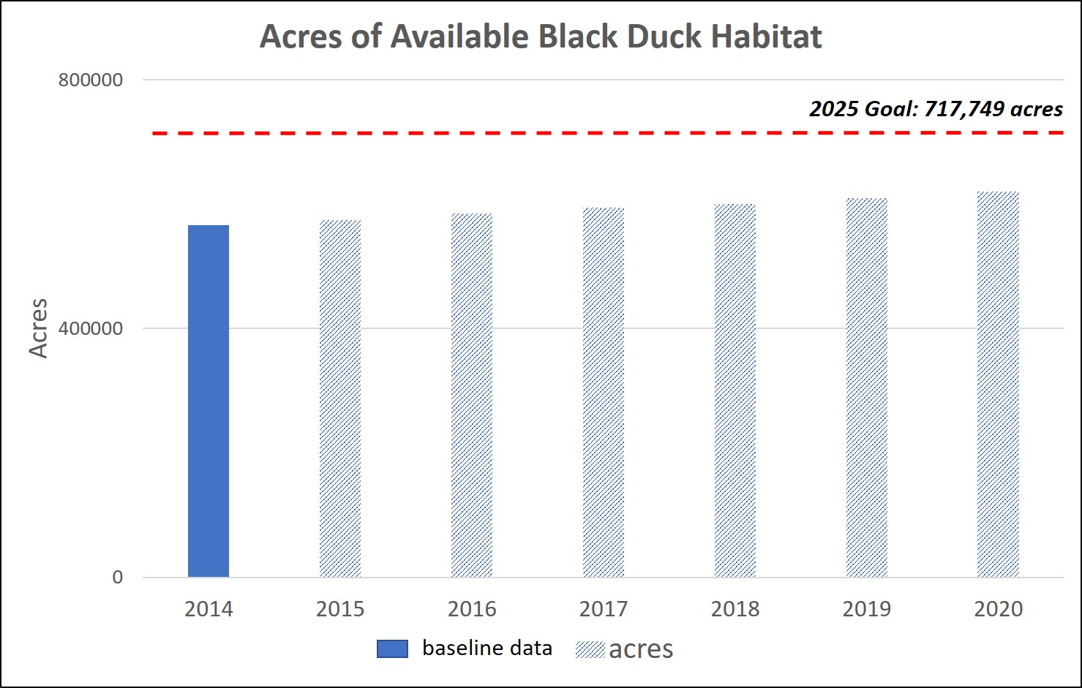
What is our Expected and Actual Progress?
2014 Baseline: 566,477 acres
2025 Goal: 717,749 acres
Restoration goal: 151,272 additional acres
*based on results from the Decision Support Tool (DST)*
Notes:
INSTRUCTIONS: Copy and paste the graph or chart you used to answer narrative analysis question #2. The editable graph from the Narrative Analysis template has been included here for your reference.
FROM NARRATIVE ANALYSIS (FOR YOUR REFERENCE ONLY):
“2. Regardless of how successful your short-term progress has been over the past two years, indicate whether we are making progress at a rate that is necessary to achieve the outcome you are working toward.
Use the editable graph or your own chart to illustrate your progress. Explain any gap(s) between our actual progress and our anticipated trajectory.”

Slide 5
Learn What have we learned in the last two years?
L
Notes:
INSTRUCTIONS: This slide is a transition slide and does not need to be modified.

Slide 6
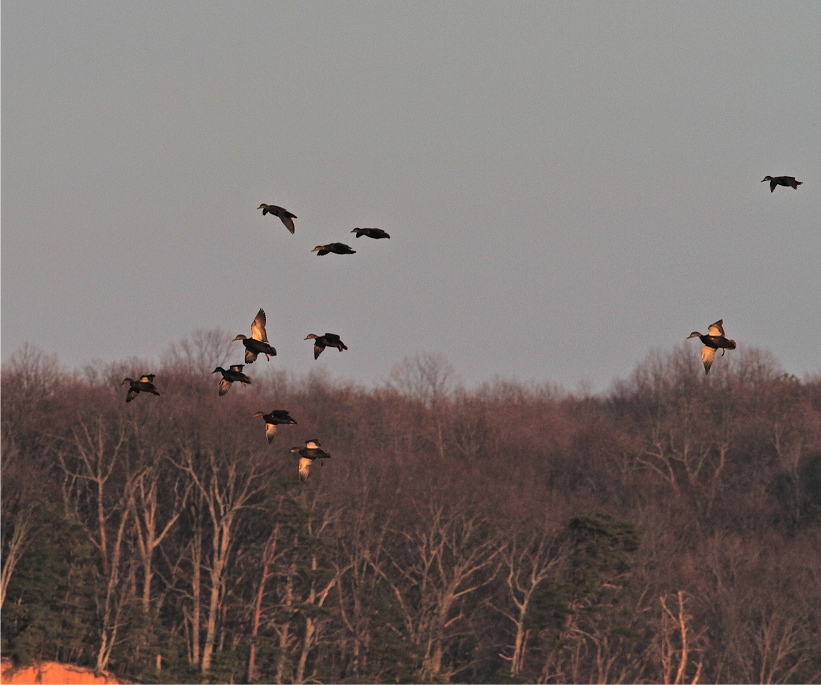
Successes and Challenges
Most actions have been completed, are on track, or are ongoing
Current factors affecting progress are still accurate
Development of DST is biggest success
Biggest obstacle tracking of wetland
restoration acres towards outcome
Notes:
INSTRUCTIONS: This slide should briefly summarize your answer to narrative analysis question #1.
FROM NARRATIVE ANALYSIS (FOR YOUR REFERENCE ONLY):
“1. Examine your red/yellow/green analysis of your management actions. What lessons have you learned over the past two years of implementation?
Summarize what you have learned about what worked and what didn’t. For example, have you identified additional factors to consider or filled an information gap?”

Slide 7
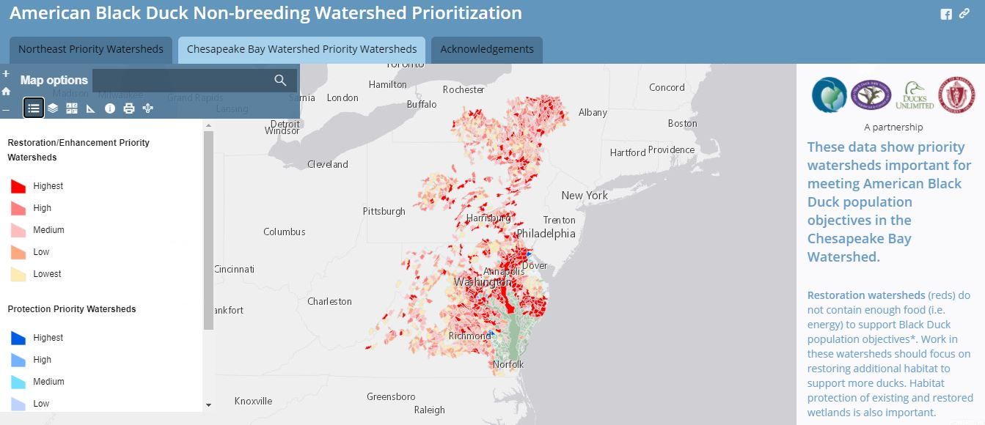
Successes and Challenges
Black Duck Decision Support Tool (DST) was a successful project that fills the info. gap of knowing which areas are highest priority for restoration and conservation
New available science related to the DST is informing an update to the model and will affect the restoration goal when completed
Notes:
Success and challenges, continued

Slide 8
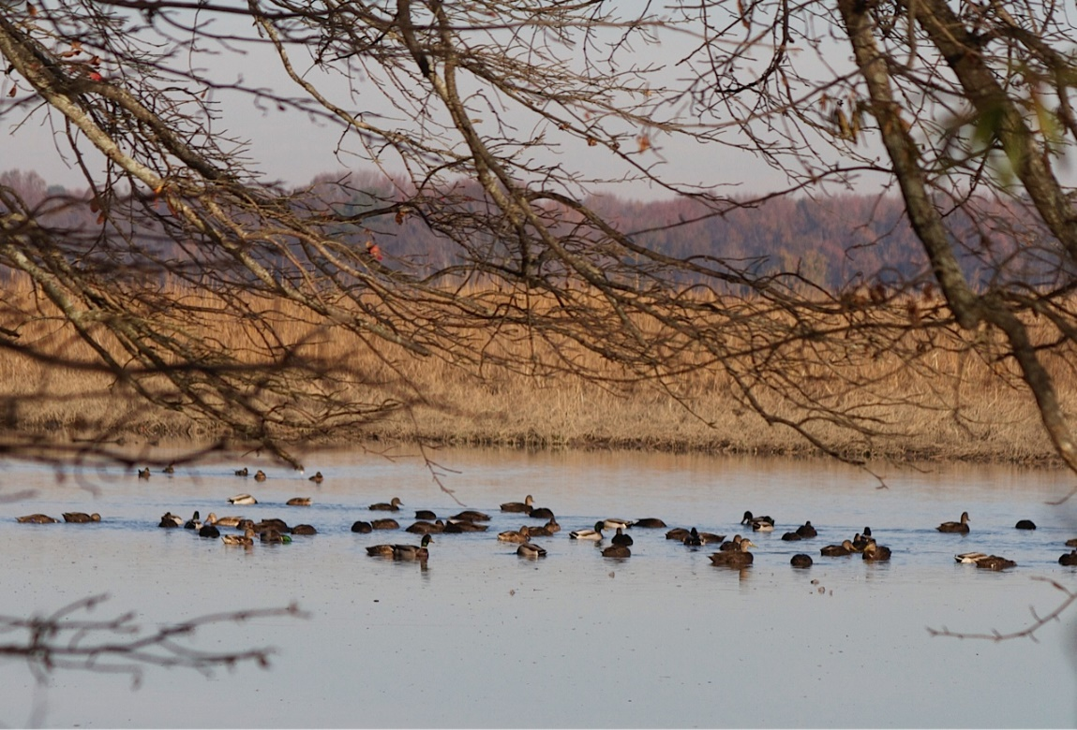
Challenges
Biggest obstacle: tracking of restoration acres toward the outcome
Overlap of project partners (double counting)
Types of projects (Restoration/Enhancement)
Project boundaries are not clear cut
Turnover of staff implementing projects
Common theme with Wetland Workgroup
Notes:
INSTRUCTIONS: This slide should briefly summarize your answer to narrative analysis question #1.
FROM NARRATIVE ANALYSIS (FOR YOUR REFERENCE ONLY):
“1. Examine your red/yellow/green analysis of your management actions. What lessons have you learned over the past two years of implementation?
Summarize what you have learned about what worked and what didn’t. For example, have you identified additional factors to consider or filled an information gap?”

Slide 9
On the Horizon
Scientific: The update to the DST is currently underway and is expected to be complete in 1-2 years.
Updates:
1) a new NWI layer
2) Impacts of Climate Change
3) changes to the model that will more accurately calculate the restoration goal
Will likely lead to a change in the number of acres that are needed to support a population of 100,000 black ducks, which impacts the outcome.
Notes:
INSTRUCTIONS: This slide should briefly summarize your answer to narrative analysis question #3.
FROM NARRATIVE ANALYSIS (FOR YOUR REFERENCE ONLY):
“3. What scientific, fiscal and policy-related developments will influence your work over the next two years?
This may include information learned at the previous biennial SRS meeting or more specific information about your outcome such as an increase or decrease in funding, new programs that address gaps, and new scientific data or research. Describe how these developments are likely to impact your recommended measure(s) of progress, the factors you believe impact your ability to succeed, and newly created or filled gaps. These changes should be reflected in the first three columns of your revised logic and action plan after your quarterly progress meeting.”

Slide 10
Adapt How does all of this impact our work?
A
Notes:
INSTRUCTIONS: This slide is a transition slide and does not need to be modified.

Slide 11
Based on what we learned, we plan to …
Continue ongoing habitat restoration work
Improve our tracking of habitat restoration so we can accurately track progress towards the outcome
Work with the Indicators Team at the Bay Program to develop this indicator
Notes:
INSTRUCTIONS: This slide should briefly summarize your answer to narrative analysis question #4. As a reminder, question four refers back to the first three questions in the Narrative Analysis.
FROM NARRATIVE ANALYSIS (FOR YOUR REFERENCE ONLY):
“4. Based on your response to the questions above, how will your work change over the next two years?
Describe the adaptations that will be necessary to more efficiently achieve your outcome and explain how these changes will lead you to adjust your management strategy or the actions described in column four of your logic and action plan. Changes that the workgroup, GIT or Management Board consider significant should be reflected in your management strategy.”

Slide 12
Help How can the Management Board lead the Program to adapt?
H
Notes:
INSTRUCTIONS: This slide is a transition slide and does not need to be modified.

Slide 13
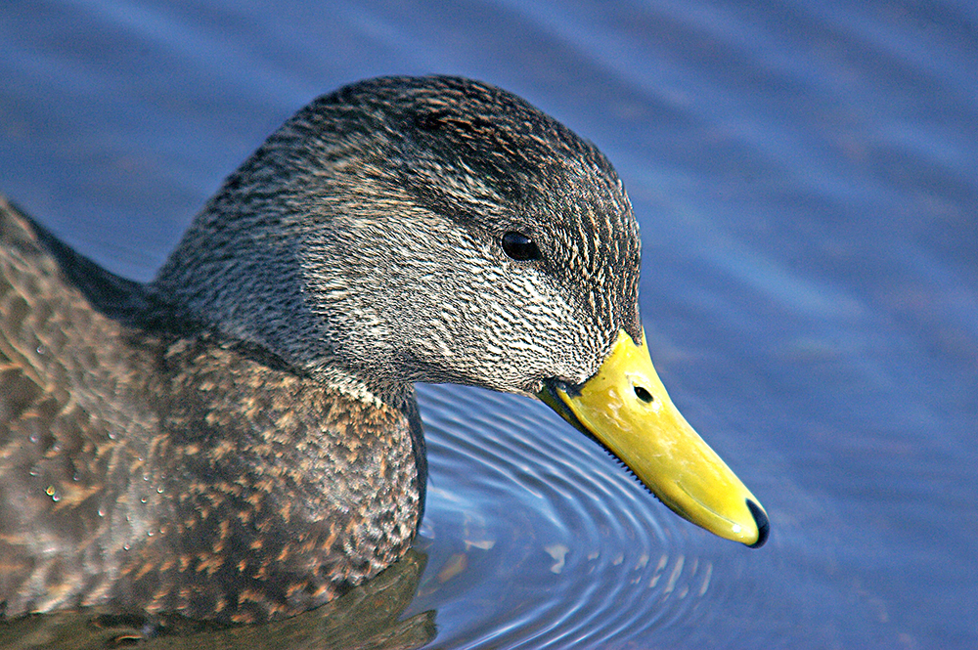
How You Can Help
Unsure what our progress is due to data collection challenges
Biggest challenge is development of indicator
Notes:
INSTRUCTIONS: This slide is intended to provide context for your presentation.
Summarize your progress and preview your needs without going into detail on either point. If you don’t have a request, identify a few key points you want the to convey to the Management Board.
Replace the provided picture with your own or one selected from the sources identified on the first slide.

Slide 14
Help Needed
Support and coordination in tracking the acres of restored wetlands (both tidal and non-tidal habitat)
Reaching out to partners individually to collect the last 5 years of wetland restoration data has had little success
MB could help coordinate this data collection by instituting a formal data call or by encouraging the partners in their respective jurisdictions to provide their restoration numbers each year
Notes:
INSTRUCTIONS: This slide should briefly summarize your answer to narrative analysis question #5.
FROM NARRATIVE ANALYSIS (FOR YOUR REFERENCE ONLY):
“5. What, if any, actions can the Management Board take to help ensure success in achieving your outcome?
Please be as specific as possible. Do you need direct action by the Management Board? Or can the Management Board direct or facilitate action through other groups? Can you describe efforts the workgroup has already taken to address this issue? If this need is not met, how will progress toward your outcome be affected? This assistance may include support from within a Management Board member’s jurisdiction or agency.”

Slide 15
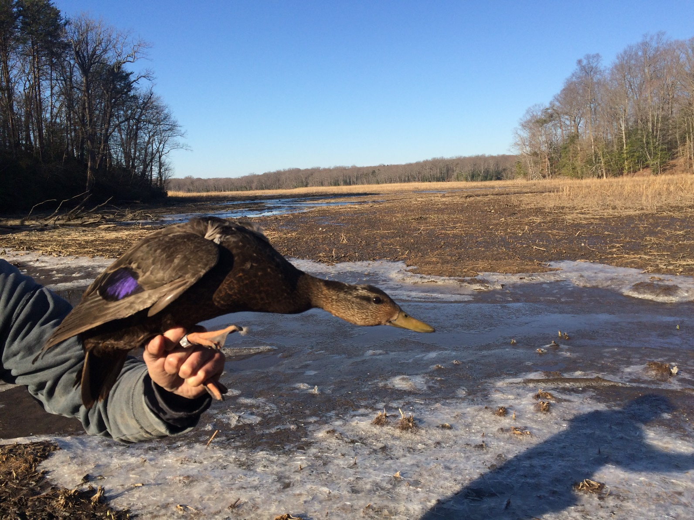
QUARTERLY PROGRESS MEETING Chesapeake Bay Program
Discussion
Presentation template by SlidesCarnival.
Notes:
[time for discussion at the end of the presentation, before the next outcome presentation]

