Slide 1
Concepts and Timeline for Developing a CBP Biennial Strategy Review System
(DRAFT) October 31, 2016 (DRAFT)

Slide 2
Biennial Strategy Review System
Why is it needed?
Fulfill 2014 Chesapeake Bay Watershed Agreement (Agreement) commitment to biennially re-evaluate and update management strategies. PSC is required to report on implementation to the Executive Council.
Support PSC charge to use the Decision Framework to adaptively manage (later re-affirmed in the Agreement).
Establish consistent method for identifying changes needed to implement adaptive management as articulated through the Agreement.
Utilize the Indicators Framework to track progress toward outcomes, to understand what factors influence outcome achievement, and whether the program did what it said it would do.
Support evolving partnership needs related to accountability, transparency, and decision-support identified through stakeholder research.
Promote core values such as flexibility, trust, open conversation, efficiency, predictability, collaboration, and solution-finding.

Slide 3
How partners are working
ALL goals, outcomes and strategies derived from the CBP Goal Teams –
issue experts & stakeholders from across the jurisdictions / watershed.
GOAL
CBP’s Executive Council (EC)
agreed to
Watershed Agreement
GOALS & initial OUTCOMES
OUTCOME
OUTCOME
CBP’s Principals’ Staff Committee (PSC) tracks OUTCOMES ,
ensuring they are measureable & achievable; adapting as needed
OUTCOME
Mgmt
Strategy
CBP’s Management Board (MB) to manage and track the STRATEGIES, adapting them as necessary over time for success
Mgmt
Strategy
Mgmt
Strategy
Biennial Workplan
Biennial Workplan
Biennial Workplan
Notes:
So first lets look at the process incorporated in the new Agreement
New Watershed Agreement includes the overarching GOALS & initial OUTCOMES
Management strategies called for in the new watershed agreement –
Things that are not changing much and allow for the accountability called for by the public
Management Strategies are called for in the Agreement but can be updated every couple of years to provide flexibility for science to impact direction
2 year workplans provide more detail for accountability but only for 2 years at a time/Flexibility

Slide 4
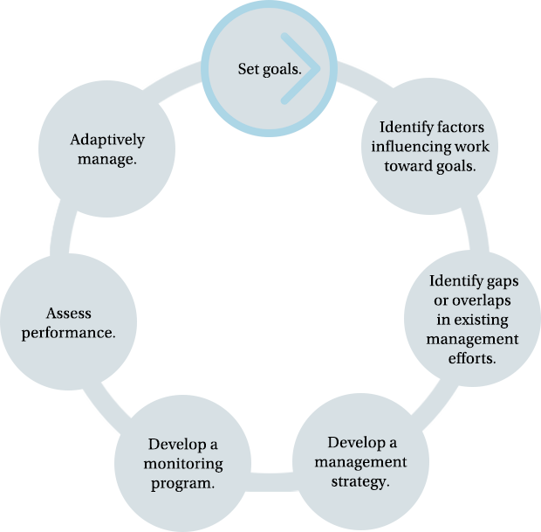
Biennial Strategy Review System
How do we do it?
What are we doing?
Management strategies/
biennial workplans
What are we learning?
Case studies, priority areas
Planned two-year schedule
Regular meetings designed to accomplish specific objectives
Work-planning/in-depth discussions distributed throughout the year
Management Board decision-makers provided with robust information to learn how to do it better
Clearly defined process and outputs.
What are our available resources?
Budget and Finance
Have we done what we said we would do?
Is it having the expected effect?
Do we need to modify our approach to promote future success?
Biennial Strategy Review
How well are we doing?
Measuring and Monitoring

Slide 5
The Timeline
Date | Action
August 2, 2016 | Present draft options to GIT 6. Solicit input for revisions.
August 30, 2016 | Present revised draft options to GIT Chairs. Present during GIT Chairs meeting, have Chairs review and comment.
September 6, 2016 | GIT 6 members review comments from GIT Chairs and modify options as needed.
September 14, 2016 | STAC members review and comment.
September 15, 2016 | Present revised draft options to the Management Board for review and discussion.
October 18, 2016 | Revise and edit the draft Strategy Review System to incorporate Management Board suggestions at full-day GIT6 meeting.
November 1, 2016 | GIT 6 continues development of strategy review system at monthly meeting.
December 6, 2016 | GIT 6 continues development of strategy review system at monthly meeting.
November 17, 2016 | Present recommended draft to the Management Board, as time permits.
December 2016 | Present final draft of Strategy Review System to Management Board for approval and implementation.

Slide 6

Biennial Strategy Review Meetings
Time-sensitive Topics
Goal Implementation Teams Progress Sessions – Review management strategy and work plan progress highlighting successes, challenges and obstacles. Provide rationale for any planned shifts in strategies and workplans. Receive input and problem solving support from Management Board, including Advisory Committee chairs.
GIT Progress MB Sessions
Interim Management Board Meetings – As needed, follow-up on issues identified in GIT Progress Sessions, new issues related to challenges or strategy shifts, other business.
Biennial Review Meeting – High-level retrospective program-wide review to celebrate our successes and identify important stories. Discuss developments in environmental (monitoring, science) and economic (available resources) conditions, and results of program evaluations (e.g., Independent Evaluator). Identify science needs and future focus for GIT Progress meetings, and summarize recommendations to be reported to the PSC.
2-Day Biennial Review
Principals’ Staff Committee – Provide input on any significant shifts in strategy and approval of changes, with public input, resulting from the Biennial Review to prepare for PSC report on implementation progress to the Executive Council.
PSC
EC
Executive Council – Concurrence and partner commitment to significant strategy shifts and discussion and approval of changes, if necessary.

Slide 7
Meeting Content Standardization
Simplifying Our Work
Standard, easy to use templates would support developing:
  Pre-brief background papers
  Goal Implementation Team progress session presentation
  Materials for Interim Management Board meetings on issues that arise between progress meetings
Templates would include a standard series of questions to focus the reviews, such as:
  What are the major accomplishments?
  What are the barriers?
    Proposed solutions
    Needed resources

Slide 8

Option 1
2-day Biennial Review
EC
PSC
PSC
2017
2018
Jan.
Feb.
Mar.
Apr.
May
Jun.
Jul.
Aug.
Sep.
Oct.
Nov.
Dec.
Jan.
Feb.
Mar.
Apr.
Healthy Watersheds
- Healthy Watersheds
- Protected Lands
- Stream Health/Brook Tr.
- Tree Canopy
- Fish Habitat
Stewardship
- Citizen Stewardship
- Local Leadership
- Public Access
- Diversity
Crabs/Eco Snapshot
- Bl. Crab Abundance
- Bl. Crab Mgmt.
- SAV
Connected Bay System
- Forage Fish
- Fish Passage
- Oysters
- Land Use Options
Change & Resiliency
- Wetlands
- Black Duck
- Climate Resiliency
EC
2-day Biennial Review
EC
PSC
2018
2019
May
Jun.
Jul.
Aug.
Sep.
Oct.
Nov.
Dec.
Jan.
Feb.
Mar.
Apr.
May
Jun.
Jul.
Aug.
Categories: Integrated Outcomes (tied to release of indicators)
Healthy Watersheds (GIT: 1, 2, 4, 5)
Water Quality (GIT: 3, 4)
Crabs as Ecosystem Snapshot (GIT: 1, 2)
Connected Bay System (GIT: 1, 2, 4)
Change & Resiliency (GIT: 2, CRWG)
Culture of Stewardship (GIT: 5, 6)
Taking Action on Toxics (GIT: 3, 4)
Next Generation of Stewards (GIT: 5)
Water Quality
- 2017/25 WIPs
- Standards Attain.
- Land Use Methods
- Forest Buffers
Action on Toxics
- Toxics Policy/Prevnt.
- Toxics Research
Next Gen Stewards
- Stud. Env. Literacy
- Env. Lit. Planning
- Sust. Schools
Healthy Watersheds
- Healthy Watersheds
- Protected Lands
- Stream Health
- Tree Canopy
- Fish Habitat

Slide 9
Option 2
2-day Biennial Review
EC
PSC
PSC
2017
2018
Jan.
Feb.
Mar.
Apr.
May
Jun.
Jul.
Aug.
Sep.
Oct.
Nov.
Dec.
Jan.
Feb.
Mar.
Apr.
Water Quality
- 2017/25 WIPs
- Standards Attain.
Tidal Organisms
- Bl. Crab Abundance
- Bl. Crab Mgmt.
- SAV
- Oysters
Stewardship
- Citizen Stewardship
- Public Access
- Diversity
Local Action
Local Leadership
Land Use Options
Land Use Meth./Metrics
Fish Habitat
Change & Resiliency
- Wetlands
- Black Duck
- Climate Monitoring
- Climate Adaptation
- Tree Canopy
EC
2-day Biennial Review
EC
PSC
2018
2019
May
Jun.
Jul.
Aug.
Sep.
Oct.
Nov.
Dec.
Jan.
Feb.
Mar.
Apr.
May
Jun.
Jul.
Aug.
Categories: Integrated Outcomes (tied to release of indicators)
Water Quality (GIT: 3)
Tidal Organisms (GIT: 1,2)
Stewardship (GIT: 5)
Local Action (GIT: 1, 4, 6)
Change & Resiliency (GIT: 2, CRWG)
Action on Toxics (GIT: 1, 3)
Next Generation Stewards (GIT: 5)
Headwater Story (GIT: 2, 4, 5)
Action on Toxics
- Toxics Policy/Prevnt.
Toxics Research
Forage Fish
Next Gen Stewards
- Stud. Env. Literacy
- Env. Lit. Planning
- Sustainable Schools
Headwater Story
- Healthy Watersheds
Protected Lands
Stream Health
Brook Trout
Fish Passage
Forest Buffers
Water Quality
- 2017/25 WIPs
- Standards Attain.

Slide 10
Recommended Model
Cross-Outcome/Indicator Themes
Encourages most cross-outcome/cross-GIT collaboration
Planned around cross-outcome story lines and logic yielding key opportunity for meaningful strategy changes (if needed)
Tied to indicators data release ensuring timely information
Facilitates more robust discussion with fewer outcomes/meeting
GITs have chance to present multiple times through the year on different outcomes

