Slide 1
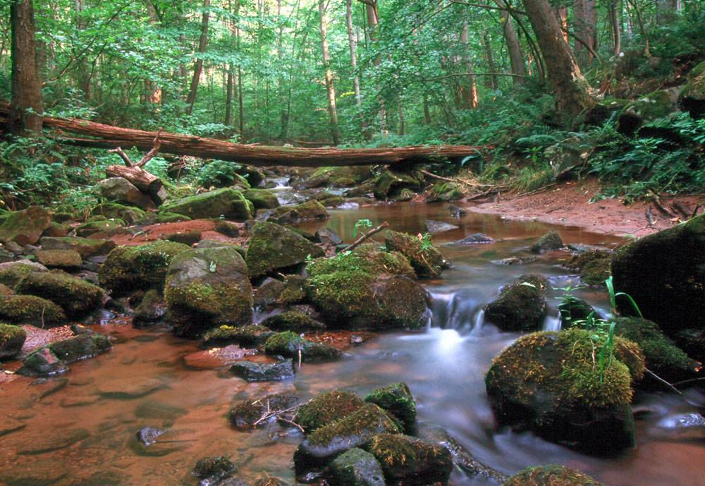

Streams & Riparian Buffers:
How They Work
&
Why They’re Important
Notes:
Story from copresenting with Dr. Bob Munson (managing microbes in rumen), Steve Groff (managing microbes in soil),
I’m here to talk about managing microbes in streams.
I find farmers are interested in how things work – part of being a manager is knowing how things work. Part of enjoying working with the land is figuring out how it works and how to work with it. I hope you’ll enjoy the info.
Also introduced talk as how to diversify your farm to be paid for producing clean water vs. milk or grain or beef etc. – CREP = payment for services.
Stroud WRC
~dozen PhD researchers, 25+ technicians
Study how streams work for ~ 4 decades
Research on 6 continents
Located in Avondale, PA
I’m newbie – watershed restoration program

Slide 2
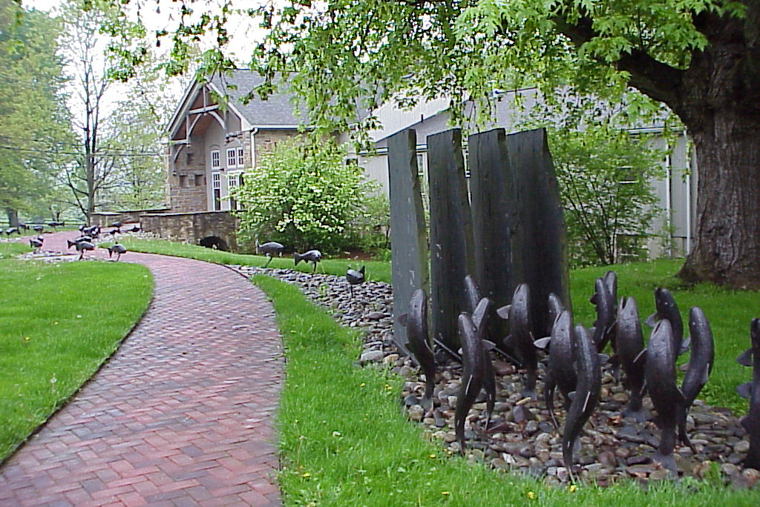
STROUD™ WATER RESEARCH CENTER
Independent not-for-profit
Research and Environmental Education Center
Notes:
2

Slide 3
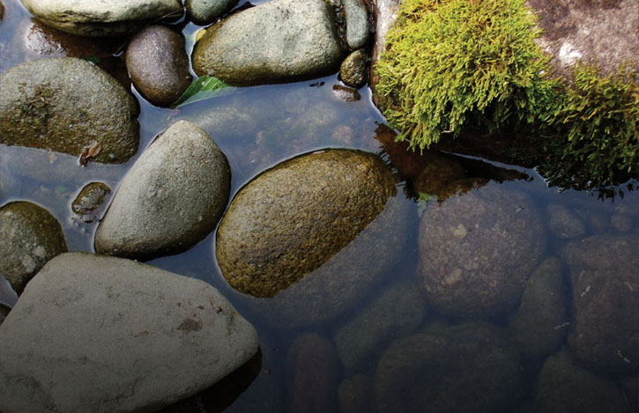
Mission
STROUD™ WATER RESEARCH CENTER
Photo: Marissa Morton
To advance global knowledge and stewardship of fresh water through research and education
Notes:
3

Slide 4
Chesapeake Bay
Forest Buffer Commitments
295,000 acres by 2025
Roughly 900 miles per year
2017 Six State Buffer Output:
Approximately 70 miles
Notes:
Field BMPs, crop rotations
Managing to minimize soil loss
Not just new work but renovating old
Old ones fill with sed if doing their job

Slide 5
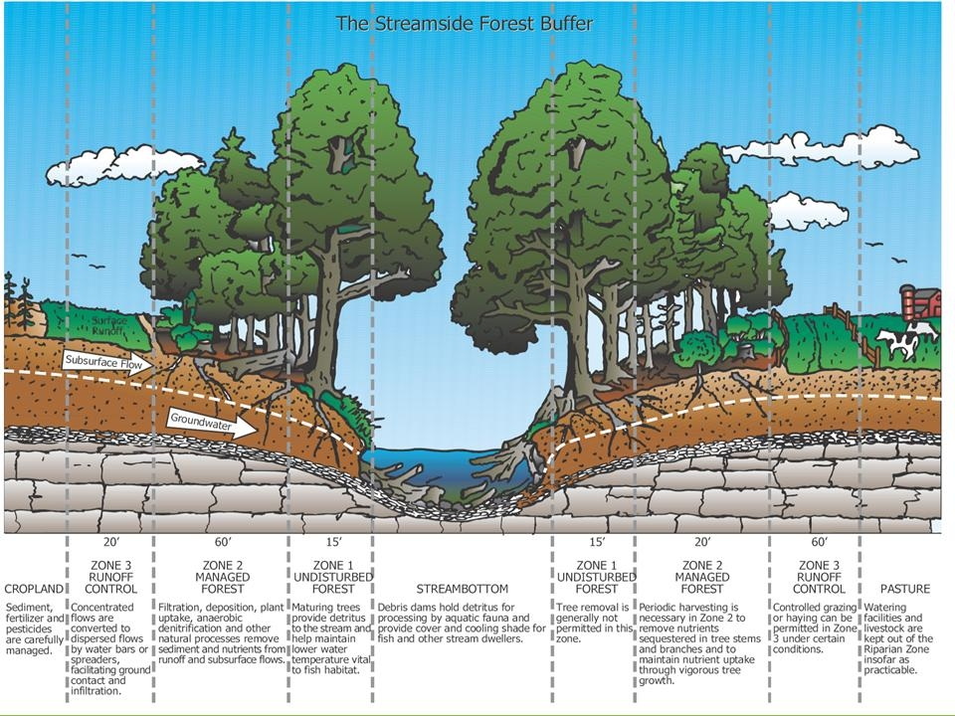


Forest Buffers as Filters
Notes:
Schematic of that space. What we call a riparian forest buffer. The important thing is that if we want to have functional streams, we really cant separate the stream from the forest.
This slide represents the things we’ve known for a long time. the role of the forest as a filter for things coming from the landscape. Note the flow.
This is how the buffer gets valued in most of our policys and in our pollution modelling.
But this is only part of the story
5

Slide 6
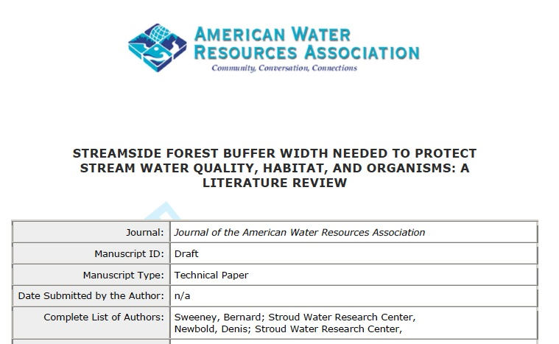
Bernard W. Sweeney and J. Denis Newbold
Stroud Water Research Center
Avondale, PA

Slide 7
64% for first 33 ft…… 84% for 100 ft
Sediment Trapping Efficiency
Mm
m
Buffer Width (m)

Slide 8
64% for first 33 ft…… 84% for 100 ft
Mm
m
Sediment Trapping Efficiency
The 20% more @ 100 ft
are the fine silts and clays!!!
<---------->
Buffer Width (m)

Slide 9
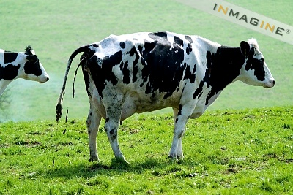
http://www.inmagine.com/imb034/imb0340459-photo

Slide 10
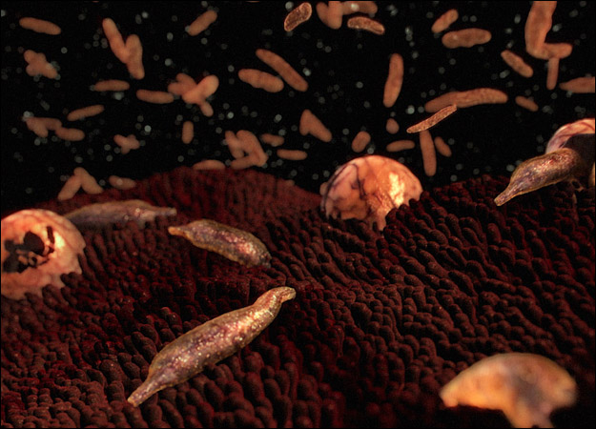
Cryptosporidium spores
(“Crypto”)
http://animal.discovery.com/invertebrates/monsters-inside-me/cryptosporidiosis-cryptosporidium-hominis/

Slide 11
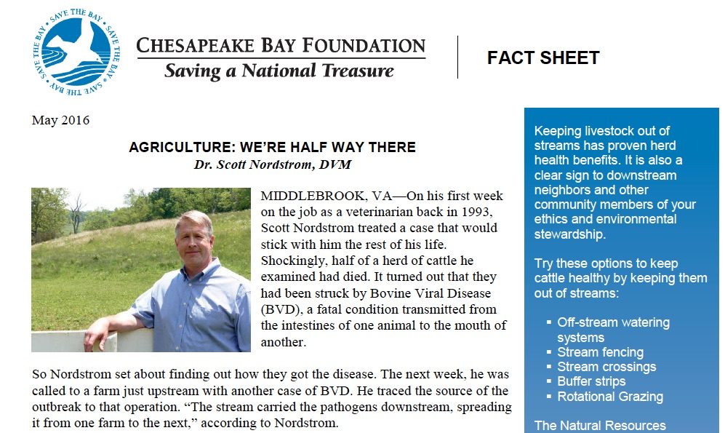
“Clearly, at least fifty percent
of all cattle diseases in the
Chesapeake Bay watershed
are transmitted through the
fecal-oral pathway,”
Several of the big cattle diseases are carried by water
(BVD, E.coli, Cryptosporidium, Salmonella, leptospirosis, and mastitis).

Slide 12
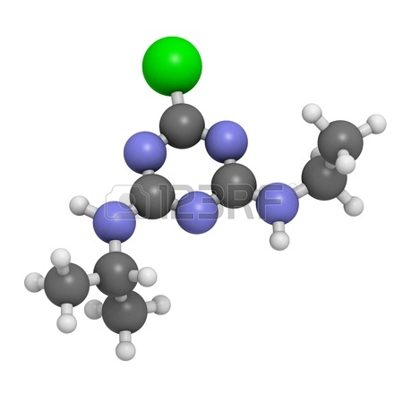
Pesticides (e.g., Atrazine)

Slide 13
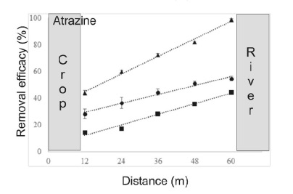
Trees
Shrubs
Grass
Aguiar Jr., T. R., F. R. Bortolozo, F. A. Hansel, K. Rasera, and M. T. Ferreira. 2016. Riparian buffer zones as pesticide filters of no-till crops. Environ Sci Pollut Res 22:10618–10626.

Slide 14
Questions on the Role of Forest Buffers
Should we focus forest buffers based on landscape position, i.e.. in flowpaths?
What if concentrated flows move directly through a buffer?
What if we do an outstanding job managing the upland? Why bother with a buffer? The potential of a Soil Health focus?

Slide 15
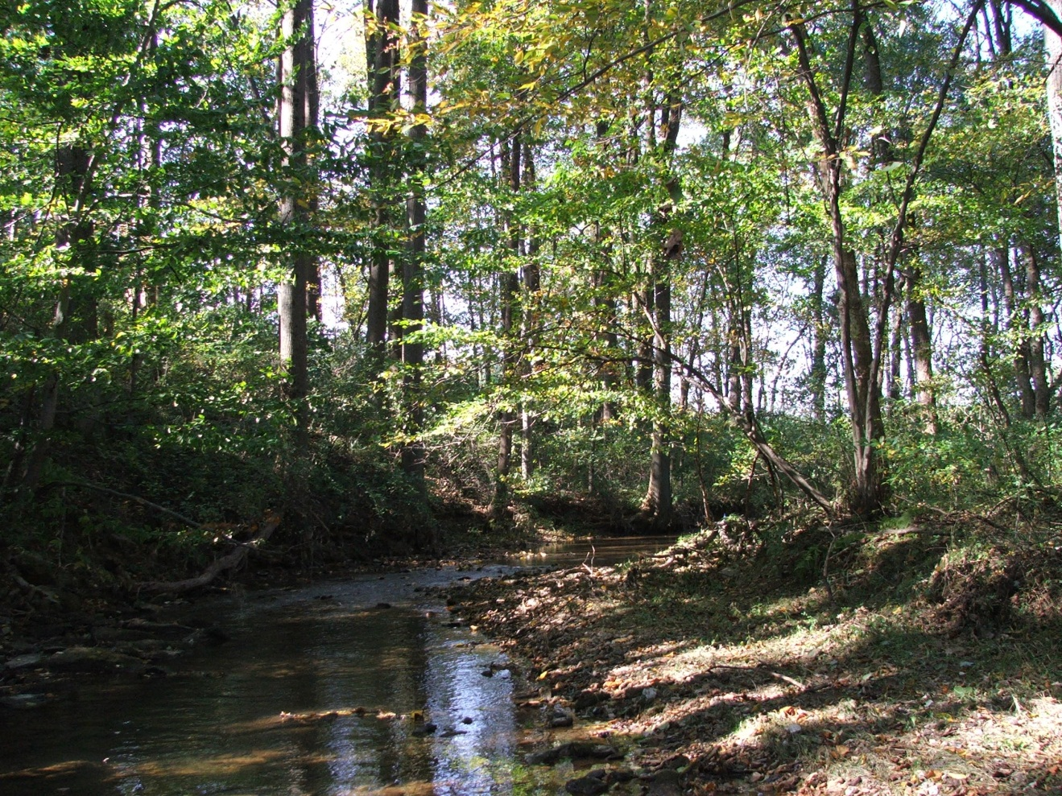

The Rest of The Story

Slide 16
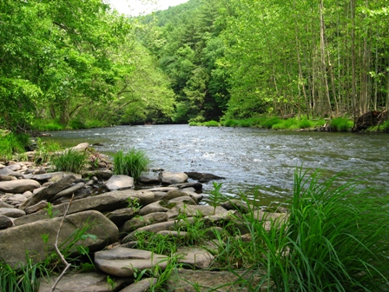
Forest Buffers provide
In-Stream services
forested streams…
remove 2 to 9x more nitrogen pollution
have 2 to 5x more biological activity
Notes:
Research done here at stroud and published in 2004, makes it clear that perhaps most of the work these forested streams do for us is actually in the channel of a healthy stream.
Forested streams are free pollution treatment systems. They process xs nutrients N & P. They break down organic compounds that get into the stream.
How does that work???

Slide 17
2-4x more stream bottom area
better conditions for biofilm
more and preferred foods
shading provides cooler temperatures
Notes:
Research done here at stroud and published in 2004, makes it clear that perhaps most of the work these forested streams do for us is actually in the channel of a healthy stream.
Forested streams are free pollution treatment systems. They process xs nutrients N & P. They break down organic compounds that get into the stream.
How does that work???

Slide 18
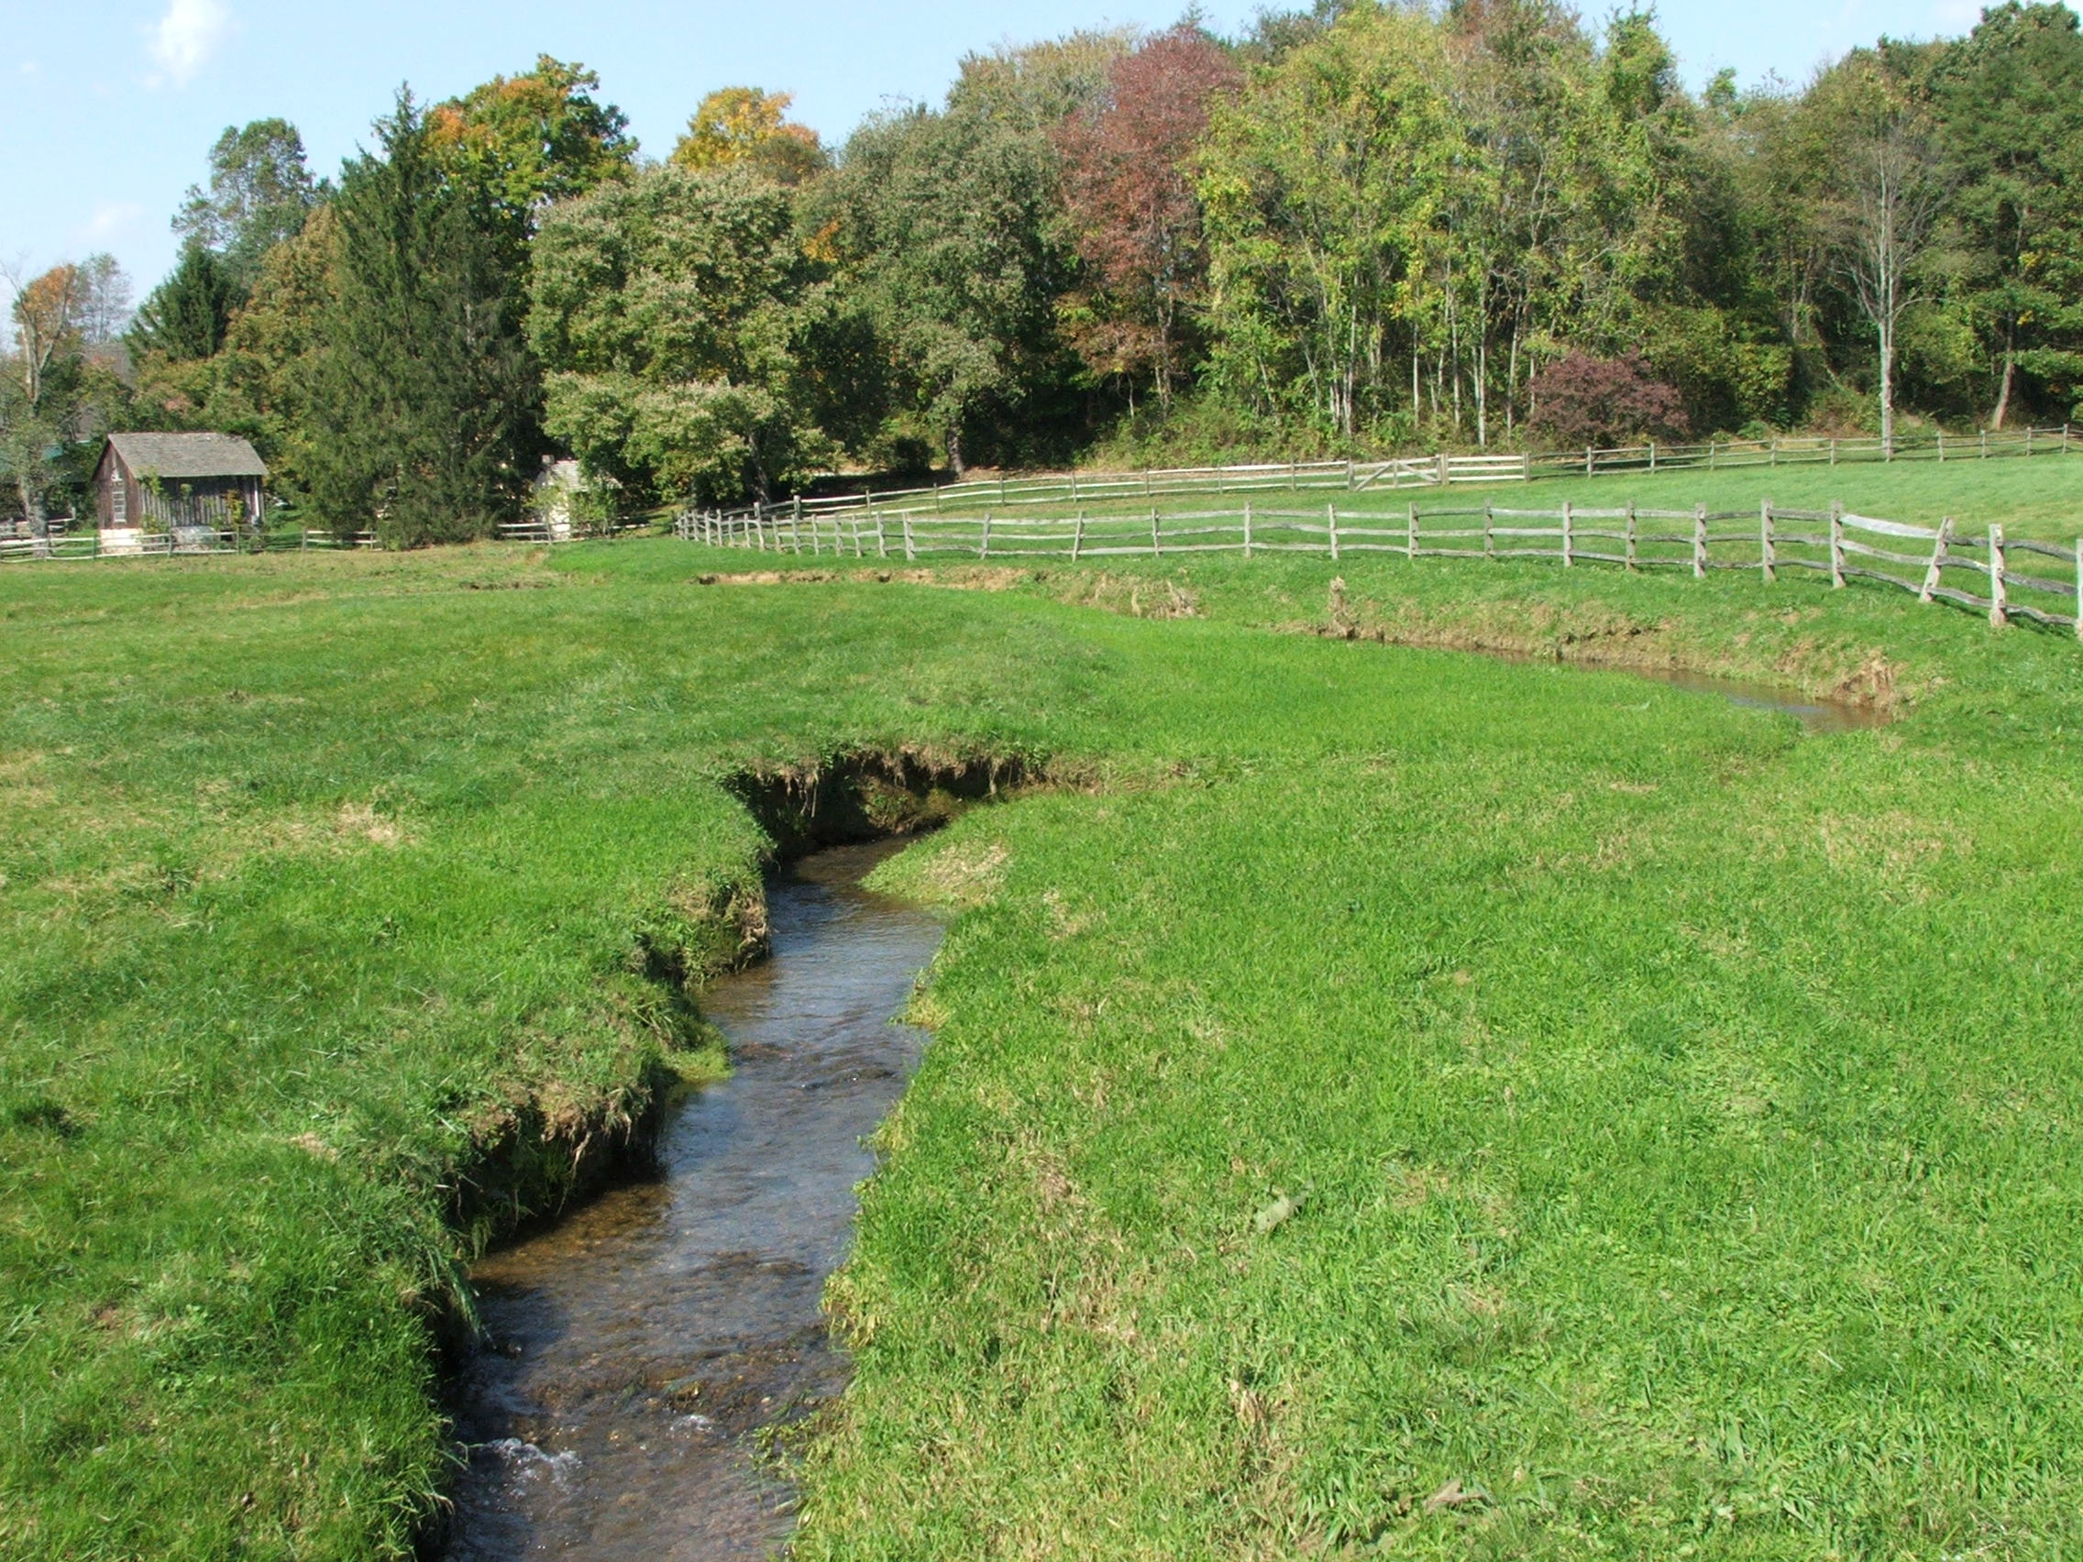
Notes:
Same stream just upstream of last photo

Slide 19
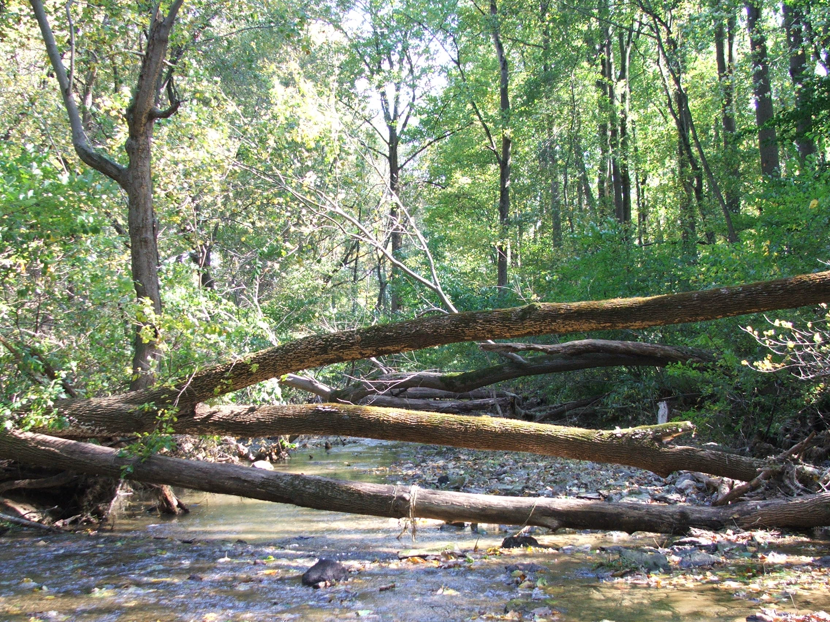
Notes:
Wider stream = more habitat area. Narrowing caused by grass is very evident where pastures meet forest (unless overgrazing reduces grass and allows stream widening)
Look for this yourself.

Slide 20
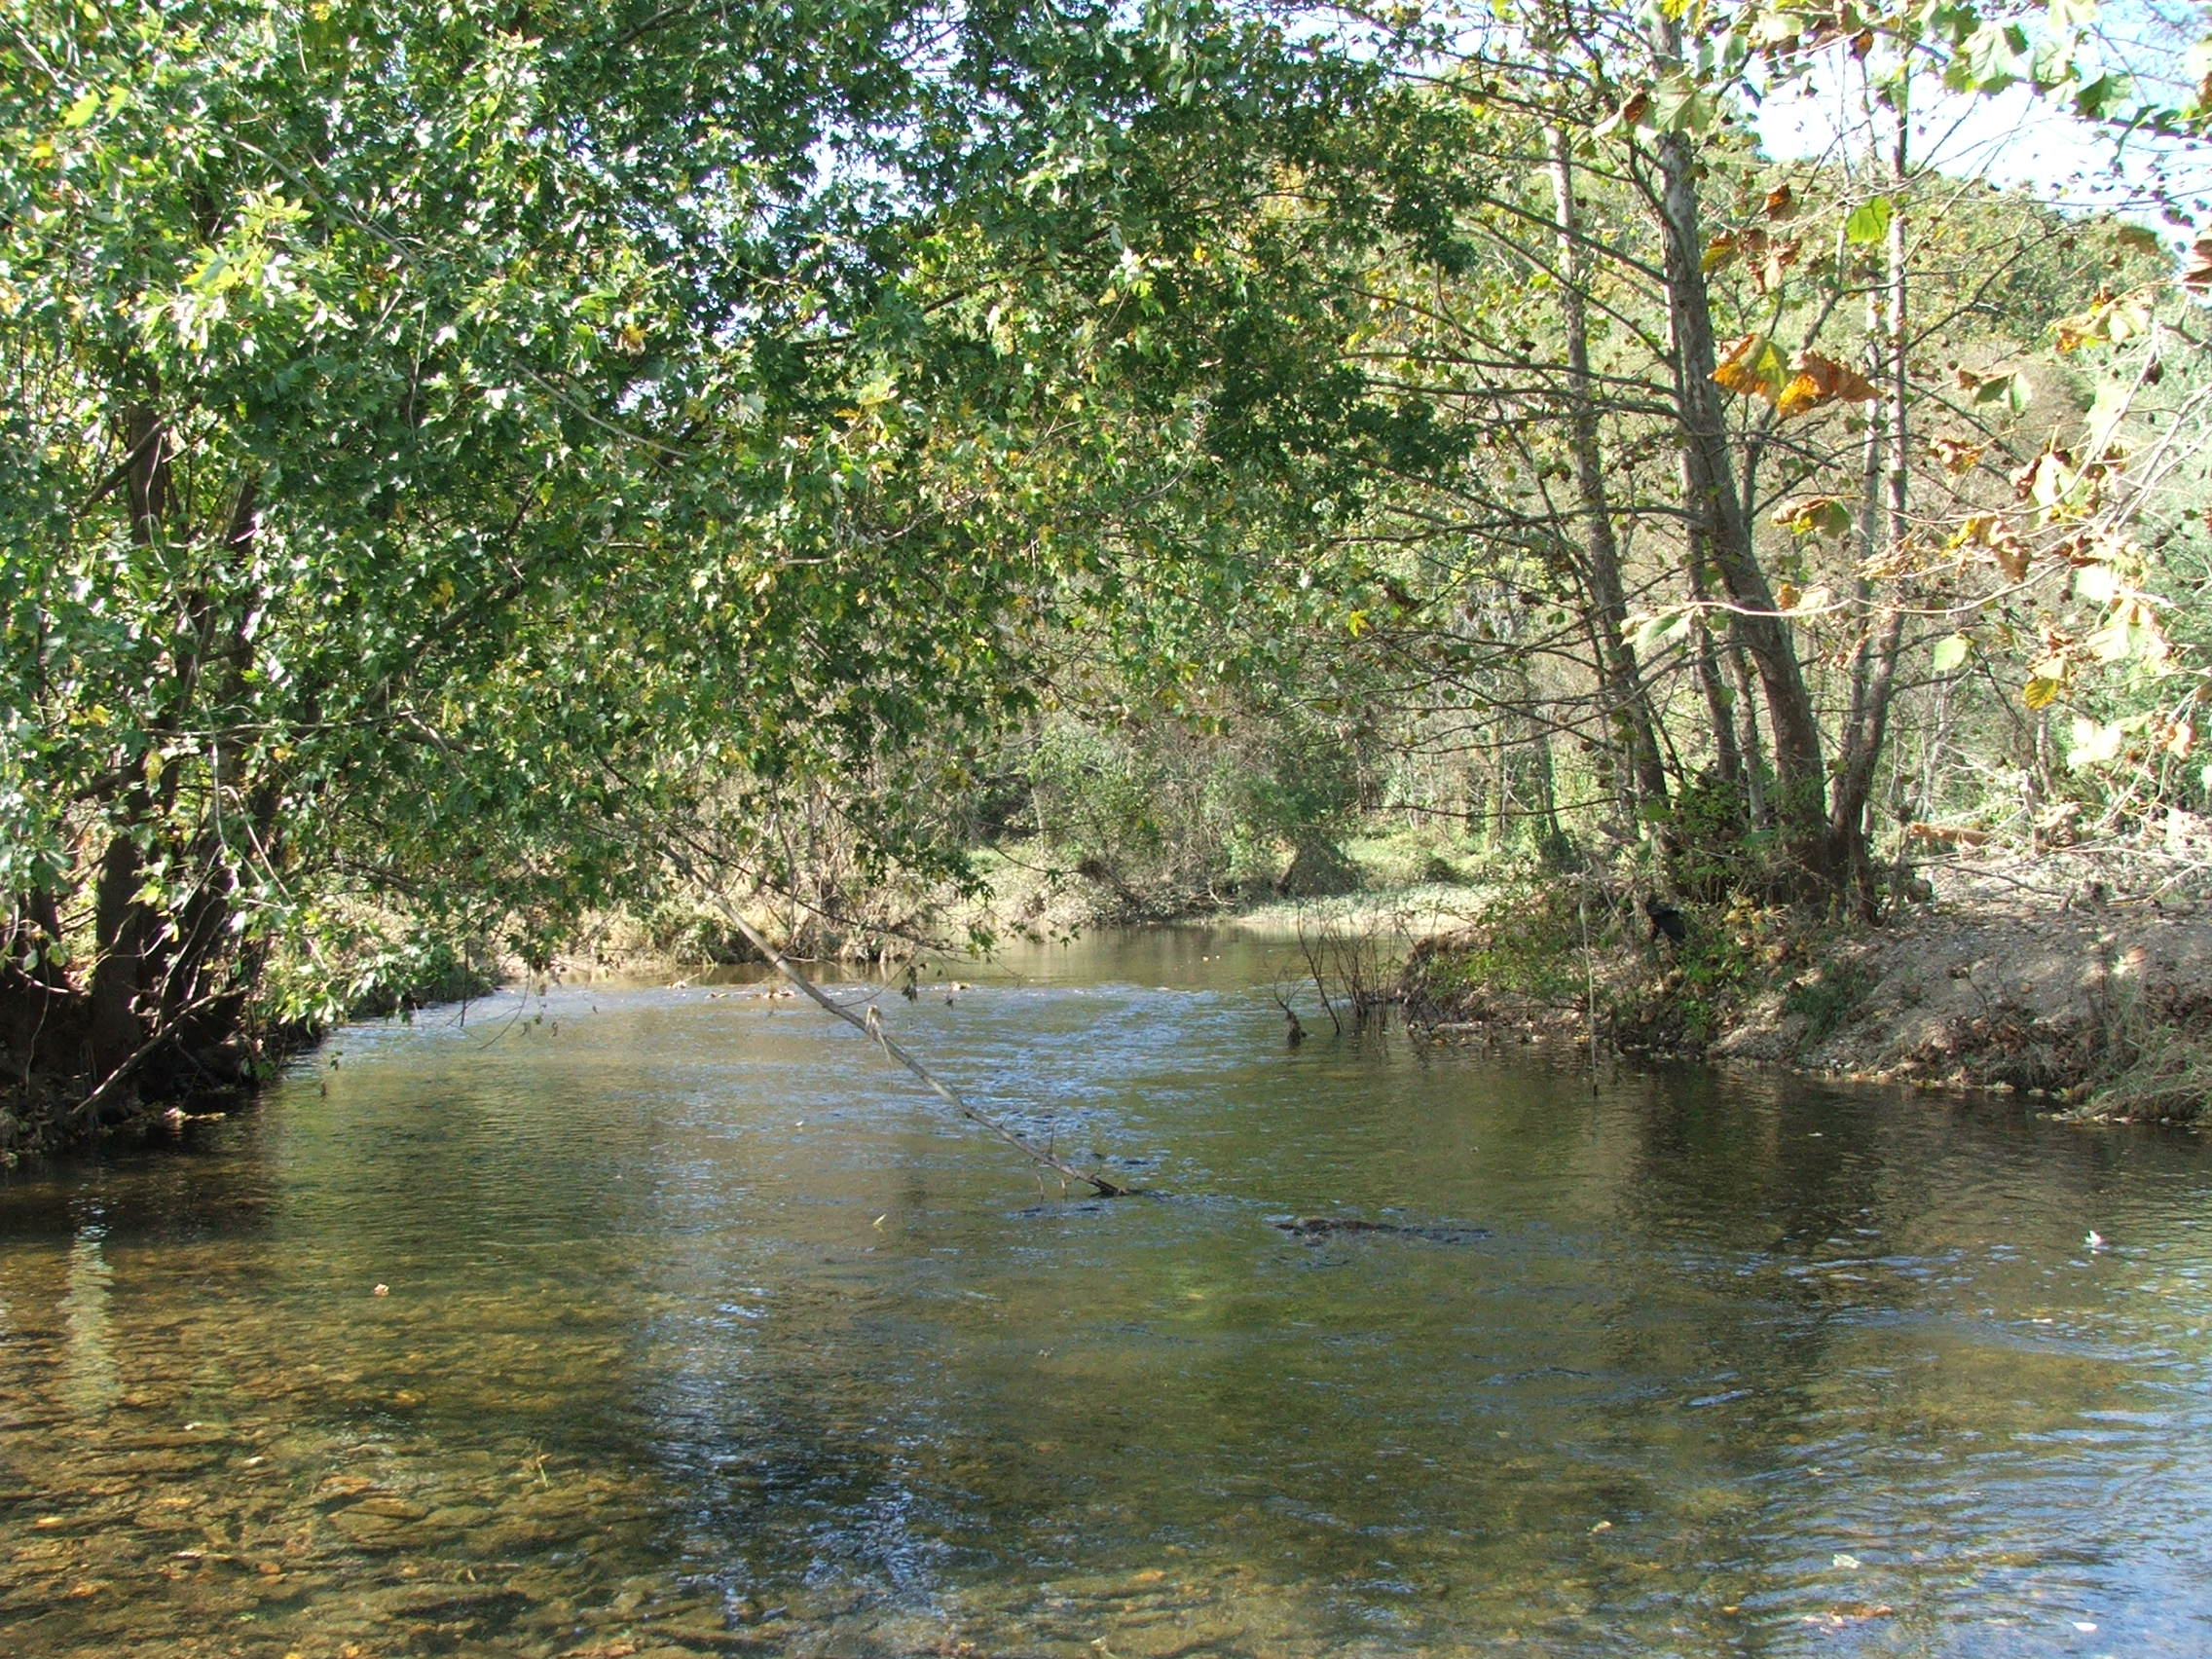
How Streams Work

Slide 21
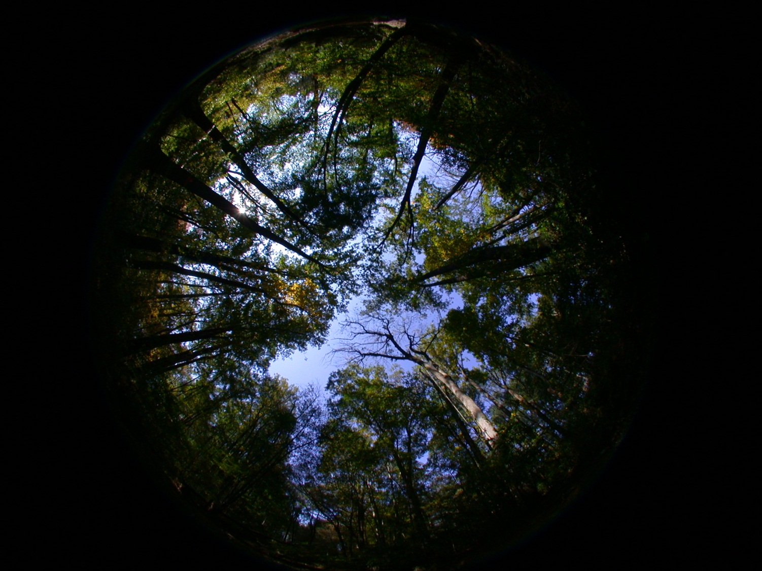
The Hidden Energy of Streams
Notes:
Most ecosystems rely on photosynthesis to fuel the system
Where are these green plants in streams???

Slide 22
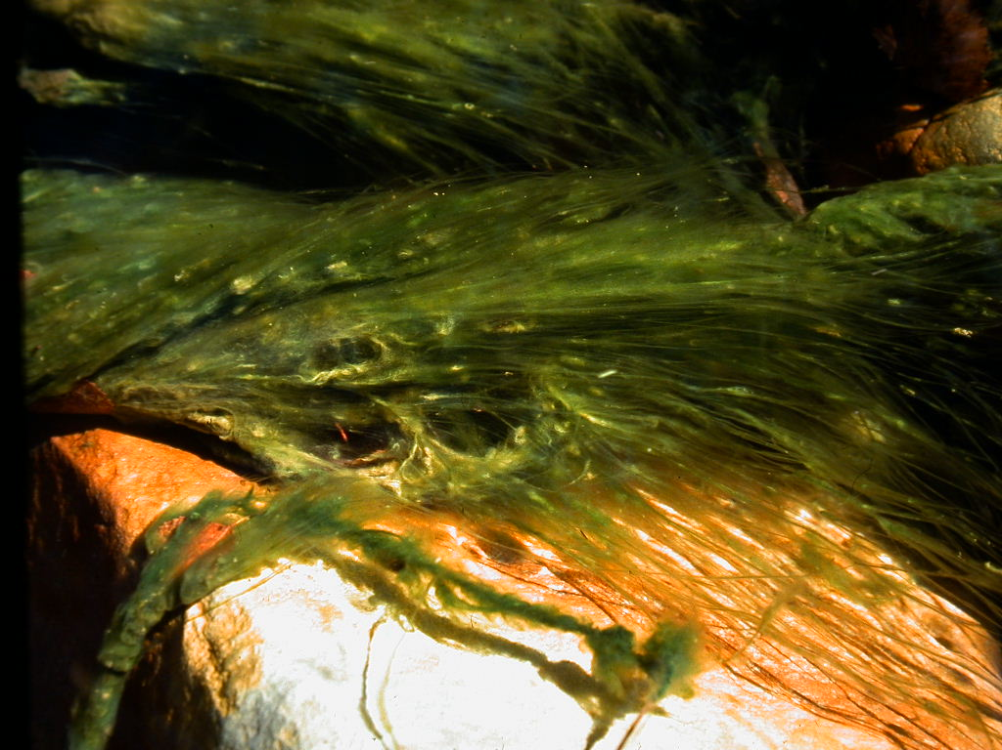
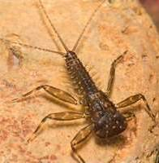
Filamentous algae
Notes:
Side tests – mayfly success on filamentous algae (rare algae in forests since it requires high light levels)
Mayflies fed only filamentous starved. Mayflies fed only multiflora rose (non-native) died. Repeated test – same results. Toxic?

Slide 23
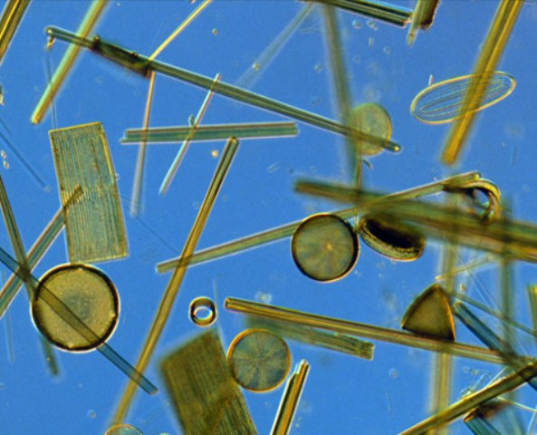
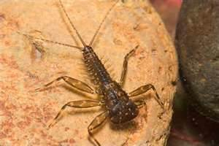
Diatoms
Need shady conditions to thrive
A preferred food for scrapers
Small % of food energy in stream
Notes:
Diatoms are microscopic aquatic algae.
need low light levels
A rock in shade: 50+ species, 10,000+ individuals. Scrapers adapted to eat this
Diatoms: small fraction of food energy. Diatoms: high value food – but low total % of food
So where in the stream is the food? Trick question – its not in the stream.
Hint tree leaves intercept > 90% of sunlight hitting a forest

Slide 24
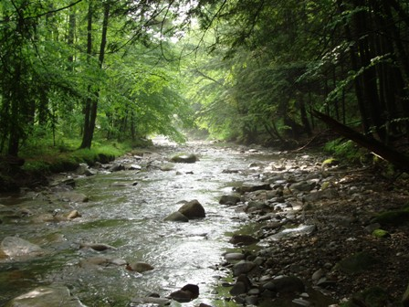
Tree leaves feed streams
Leaves, twigs, pollen: solid carbon
Streams collect ~5x more than other areas
Only ~1/3 of stream’s energy
Notes:
If you said tree leaves, you’re close (leaves that fall in streams are not the MAIN energy source)
The producers that feed streams aren’t IN the streams – it’s the trees along the streams
obvious sources: leaves, twigs, logs.
This is silage for the stream.
As wet (= sticky) depressions, streams get ~ 5x leaf accumulation vs. forest floor.
But… add diatoms + leaves, twigs, pollen, solid carbon – you still only have 1/3 of total energy for stream life
Where’s the 2/3??

Slide 25
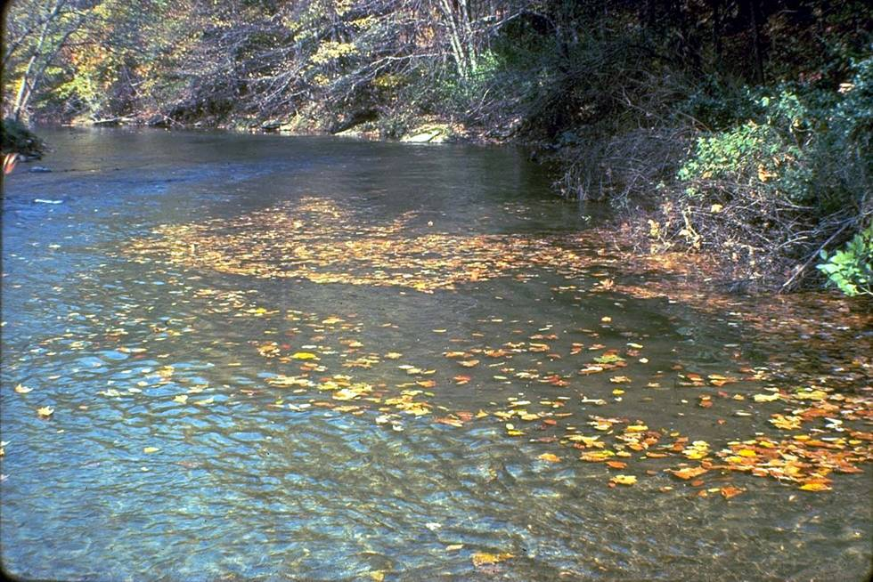

Slide 26
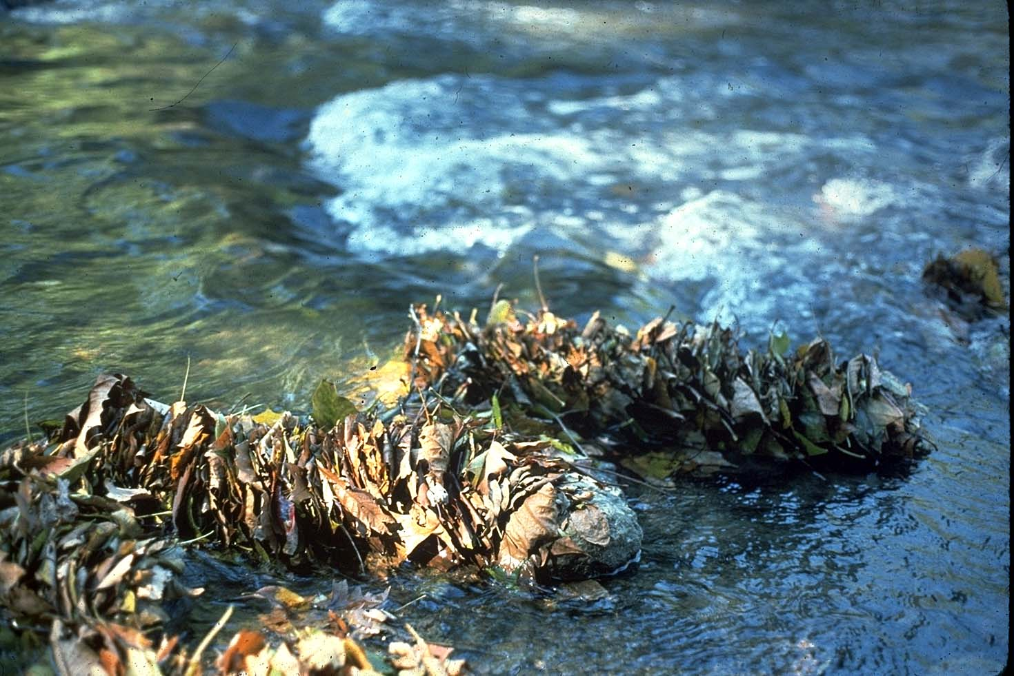

Slide 27
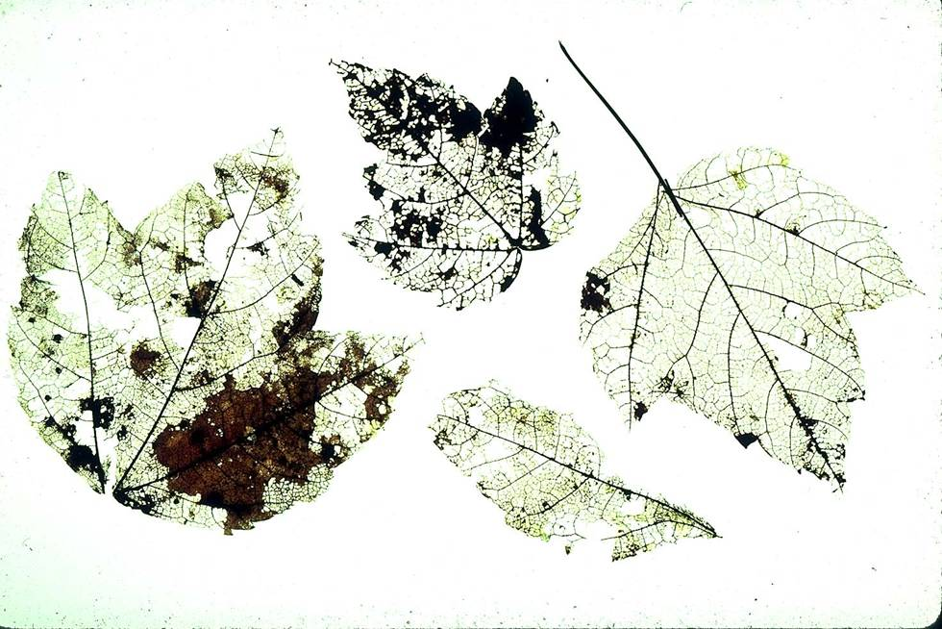

Slide 28
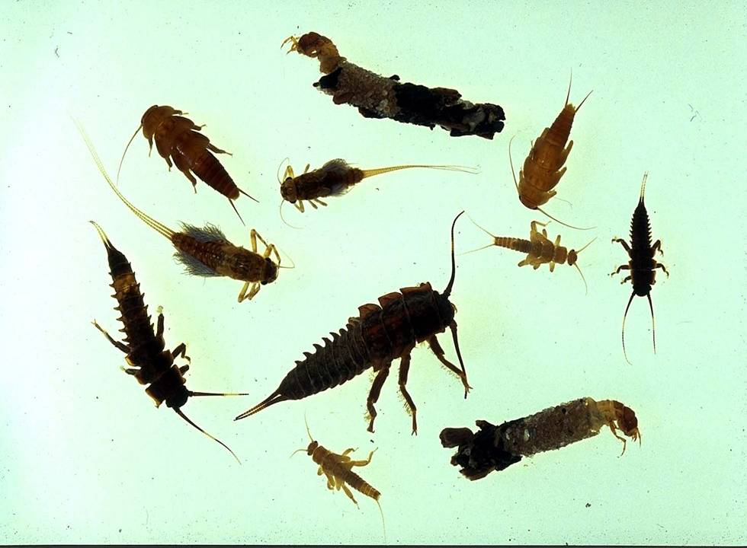
Without Trees ….these are missing

Slide 29
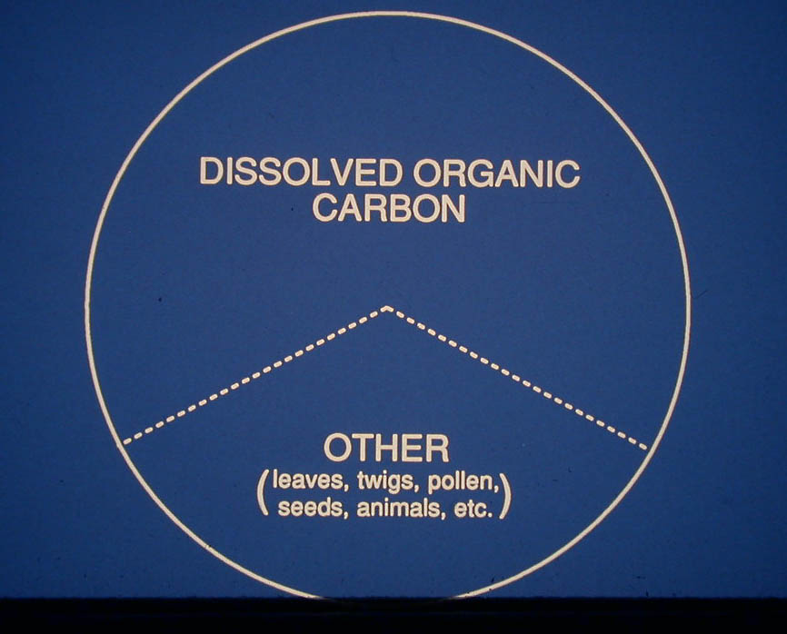
Watershed Tea

Slide 30
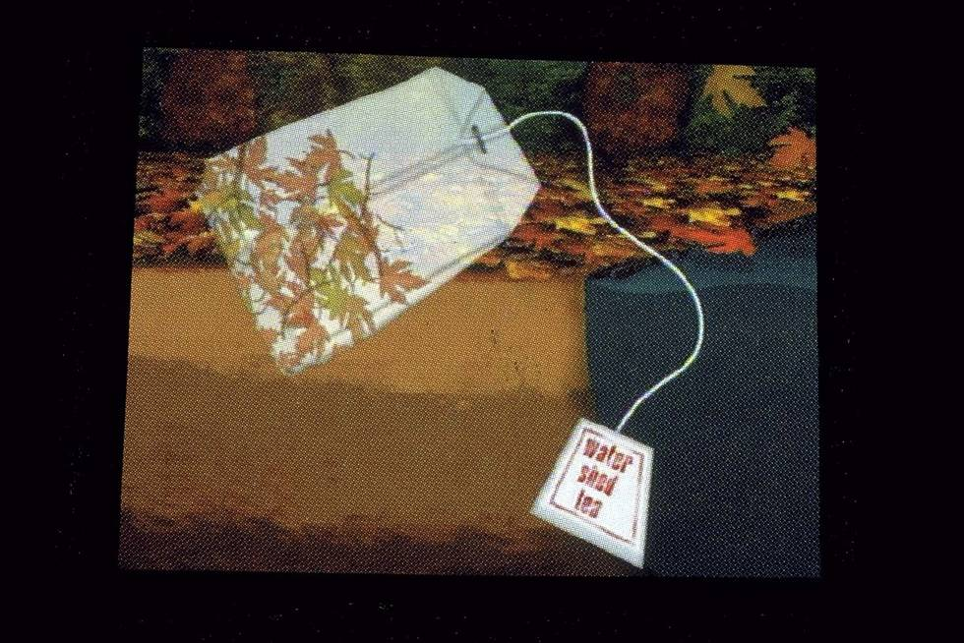

Slide 31

“Watershed Tea”
dissolved organic carbon
~ 2/3 of a stream’s food supply
Notes:
The big surprise: ~ 2/3 of energy for healthy streams is watershed tea – dissolved organic carbon from forests
The typical tea we drink is food leached from leaves of tea trees: carbohydrates, proteins, amino acids, etc..
Watershed tea is same – from forested, not tea bags.
Streams drink watershed tea. Bacteria turn into biomass, fed upon by the rest of the system.
This is NOT obvious and typically is overlooked. Energy matters. How productive would a factory be if workers lost 2/3 of food supply?
Point: Trees are key to a stream food web. 1) leaves 2) shade so diatoms can grow 3) biggy: dissolved organic carbon – watershed tea.
Insight: How far from a stream can a tree feed a stream? As far away as water carries DOM from that tree to the stream via groundwater.
I’m reminding you of what you know: trees are good for streams. Hopefully providing details to flesh out this idea.

Slide 32
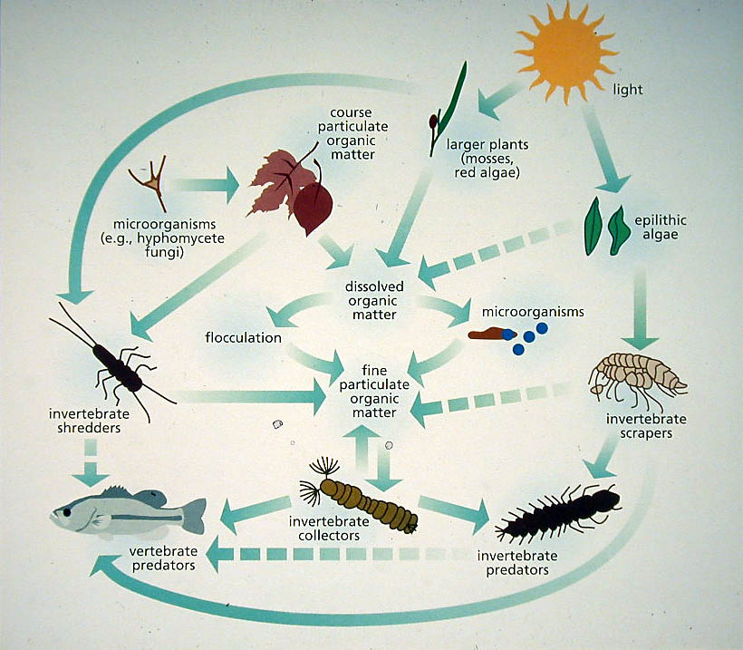

Slide 33
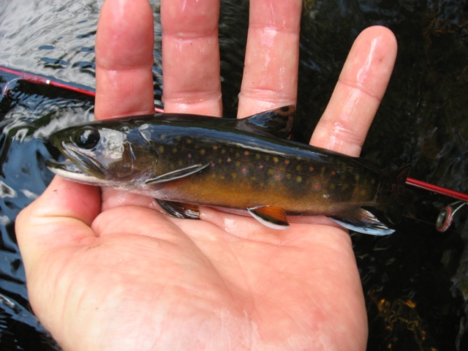
Fish grow on trees
Notes:
There’s much more to stream health than energy: temperature, cover, channel stability, healthy substrates, healthy PROCESSES. Too complicated to cover all in detail, so turn to a proxy:
Brook trout are an indicator of stream health. How strongly correlated are brook trout and trees?
Trout Unlimited staff: Critical breakpoint: 68% forest cover.
EBTJV huge data set Georgia Maine:
only 6% of watersheds with good brookie populations have <68% forest cover
Stroud staff: the singular best predictor of stream health is the % forest cover in the watershed.

Slide 34
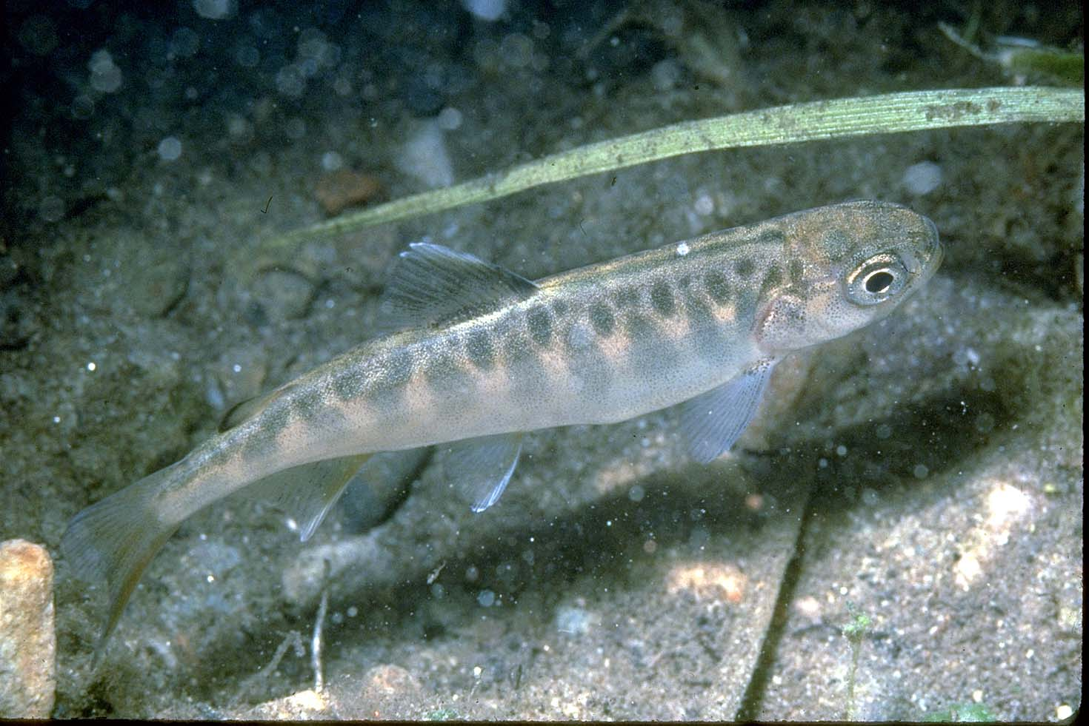
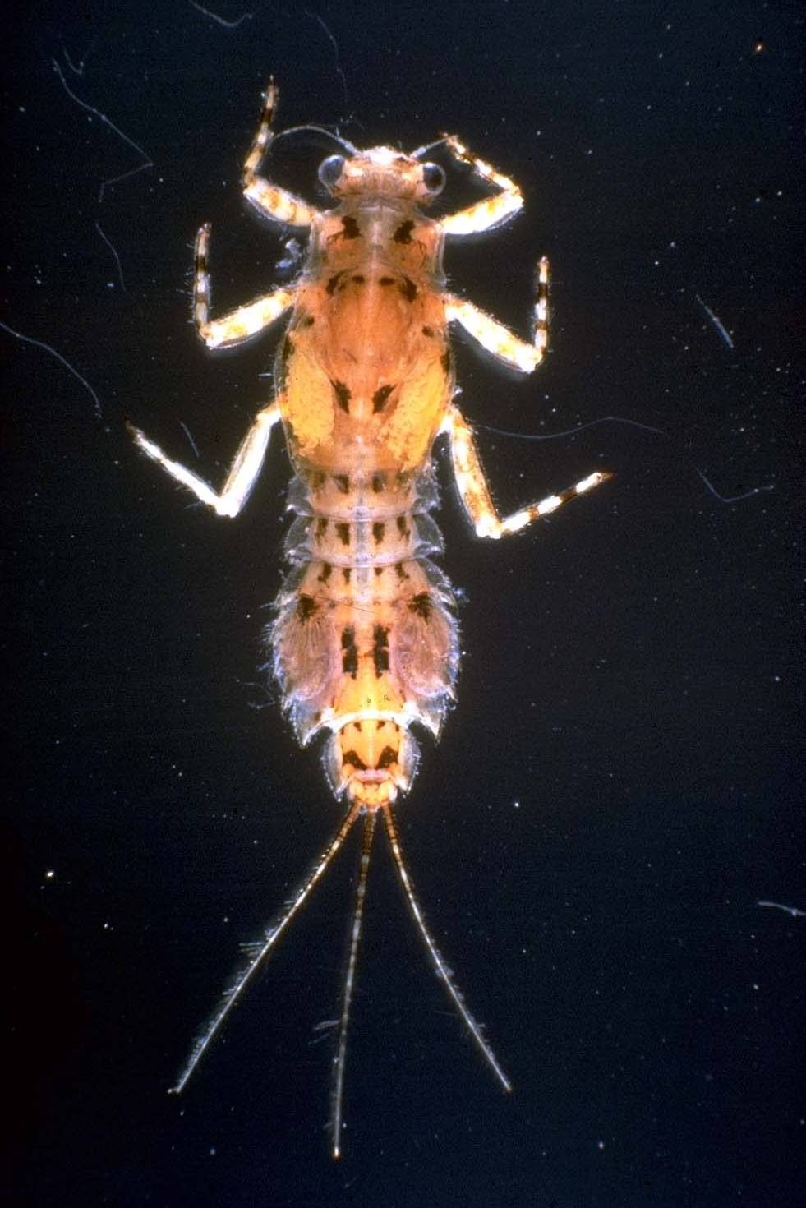
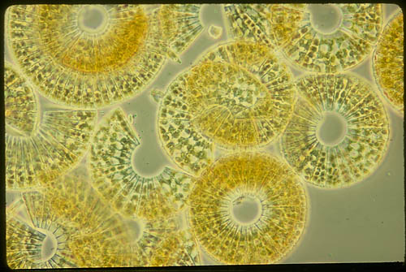
Forested streams have more natural temperature regime
“cooler in summer, warmer in winter”

Slide 35
Mayfly:
Eurylophella
verisimilis

Slide 36
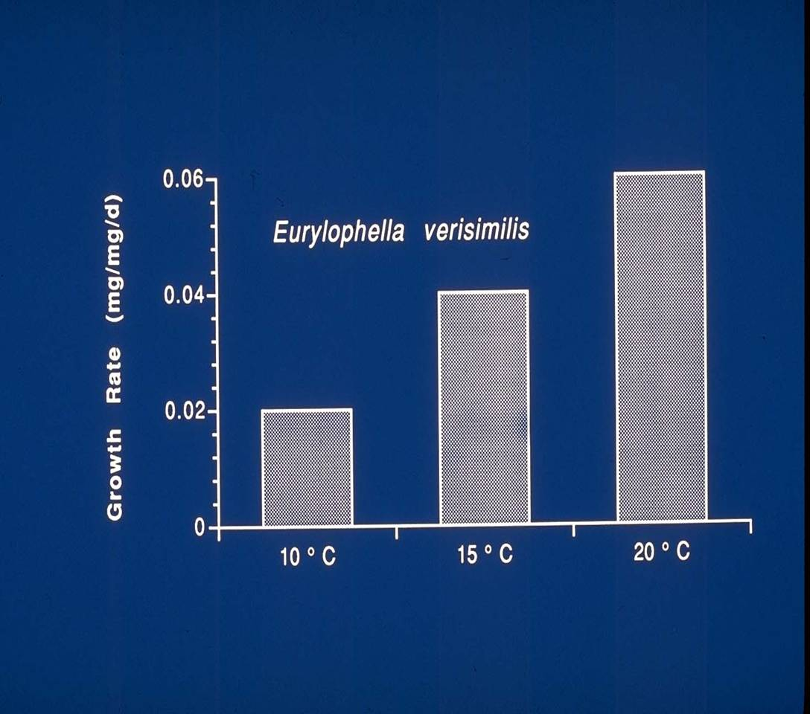
50 F 59 F 68 F

Slide 37

Cold Water Species
“live on the edge”

Slide 38
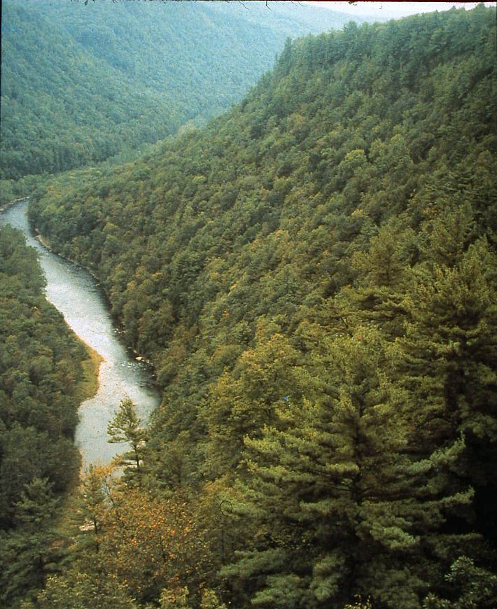
For 1000’s of years ….most small streams were shaded and never went above 68 F

Slide 39
A stream’s “ecosystem” is on the bottom

Slide 40
Forested Streams:
remove 2 to 9x more nitrogen pollution
have 2 to 5x more biological activity
2-4x more stream bottom area
better conditions for biofilm
Notes:
Research done here at stroud and published in 2004, makes it clear that perhaps most of the work these forested streams do for us is actually in the channel of a healthy stream.
Forested streams are free pollution treatment systems. They process xs nutrients N & P. They break down organic compounds that get into the stream.
How does that work???

Slide 41

Notes:
Wider stream = more habitat area. Narrowing caused by grass is very evident where pastures meet forest (unless overgrazing reduces grass and allows stream widening)
Look for this yourself.

Slide 42

Wider streams have more bottom (ecosystem)
per unit length
Forested
Deforested (grass)

Slide 43
Notes:
43

Slide 44
Addressing Stream Impairment
Our Regulatory Process Lists our Streams as Impaired for Sediment, Phosphorous, Pathogens, Etc., BUT….
We Assess Impairment Biologically. What else is important for the Ecosystem?
Temperature
Habitat
Hydrology
Ecosystem Function
Notes:
44

Slide 45
Chesapeake Bay
Forest Buffer Commitments
295,000 acres by 2025
Roughly 900 miles per year
2017 Six State Buffer Output:
Approximately 70 miles
Notes:
Field BMPs, crop rotations
Managing to minimize soil loss
Not just new work but renovating old
Old ones fill with sed if doing their job

Slide 46
Forest Buffer Programs
CREP
All The Rest
Notes:
Field BMPs, crop rotations
Managing to minimize soil loss
Not just new work but renovating old
Old ones fill with sed if doing their job

Slide 47
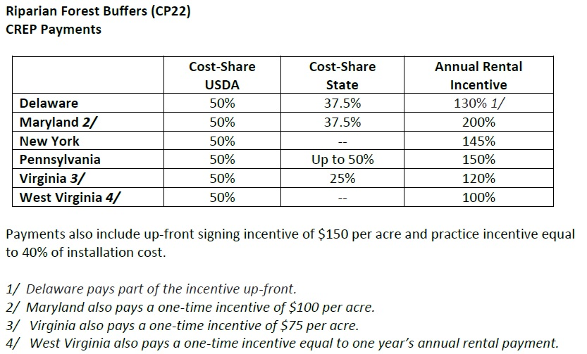
Conservation Reserve Enhancement Program
CREP
Began in Maryland in 1997, Pennsylvania and Virginia followed
Each State’s CREP program is unique
Notes:
Field BMPs, crop rotations
Managing to minimize soil loss
Not just new work but renovating old
Old ones fill with sed if doing their job

Slide 48
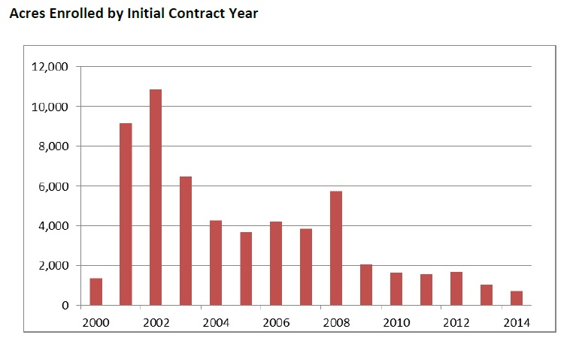
The Problem
Notes:
Field BMPs, crop rotations
Managing to minimize soil loss
Not just new work but renovating old
Old ones fill with sed if doing their job

Slide 49
Why:
We “picked the low hanging fruit”
Early problems with survival soured landowners
Incentives haven’t kept pace with inflation
Inadequate resources for maintenance
Lack of interest/support from Agencies
Perhaps, given the value to society, we should require this practice for access to taxpayer funds for other practices – (just Matt’s crazy opinion)
Notes:
Field BMPs, crop rotations
Managing to minimize soil loss
Not just new work but renovating old
Old ones fill with sed if doing their job

Slide 50
What Do We Do Now?
Fix CREP?
Farm Bill?
New State CREP Agreements?
Invest State Funds outside of CREP?
Incorporate New Ideas?
Multi-Function Buffers?
Notes:
Field BMPs, crop rotations
Managing to minimize soil loss
Not just new work but renovating old
Old ones fill with sed if doing their job

Slide 51
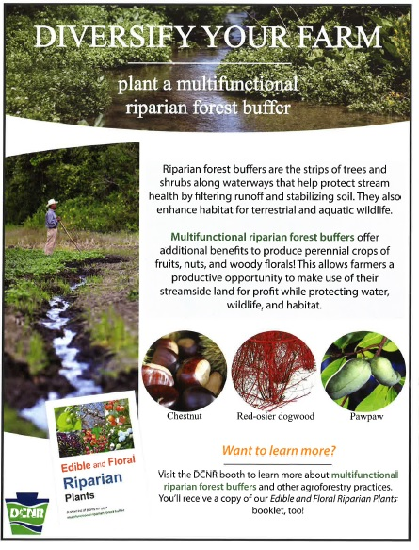
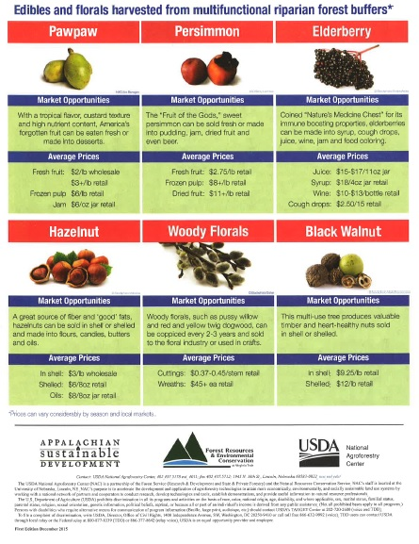
Notes:
Field BMPs, crop rotations
Managing to minimize soil loss
Not just new work but renovating old
Old ones fill with sed if doing their job

Slide 52
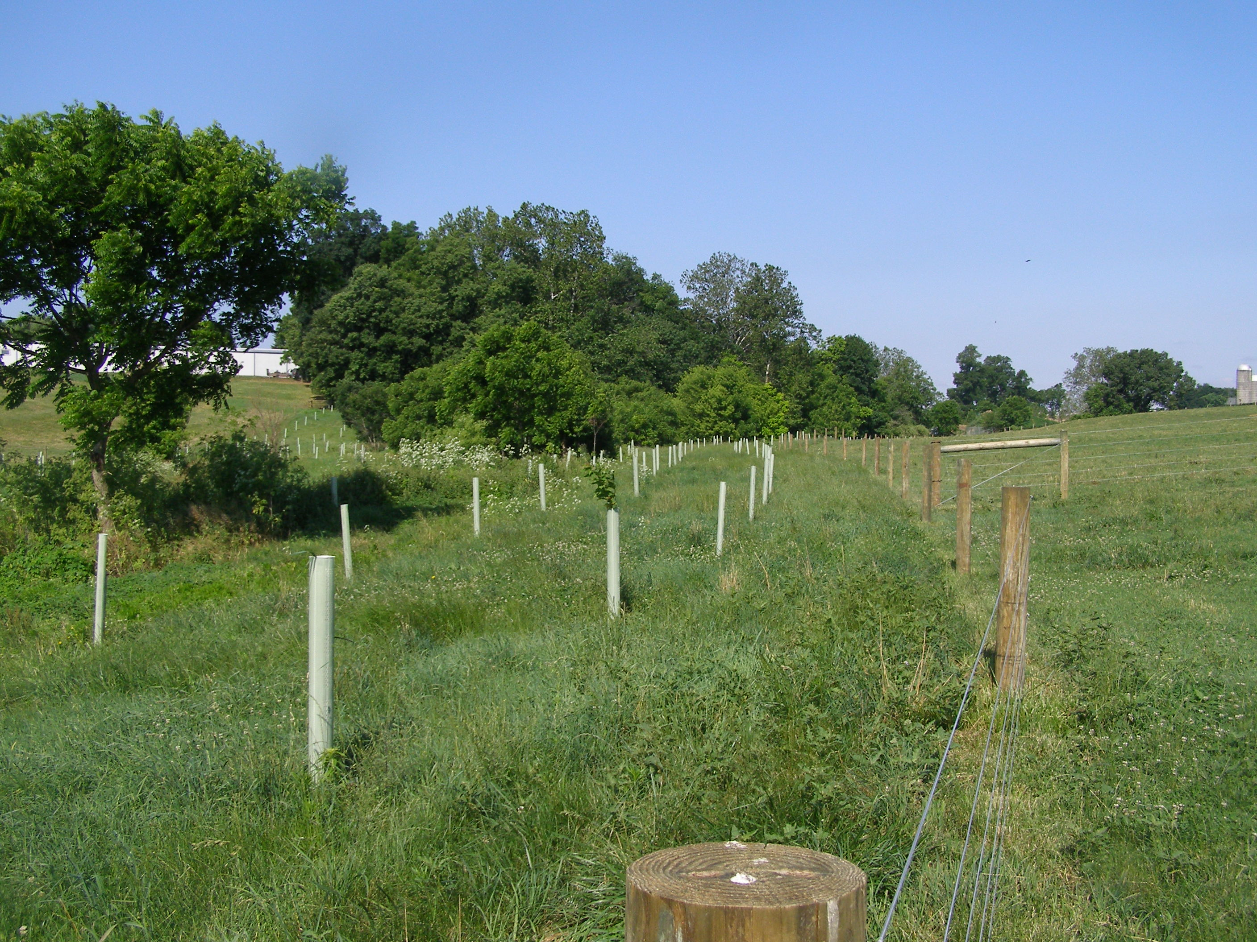

Notes:
CREP builds fences, plants trees, and creates alternative water supplies, stabilized stream crossings, and it provides a maintenance structure.
52

Slide 53
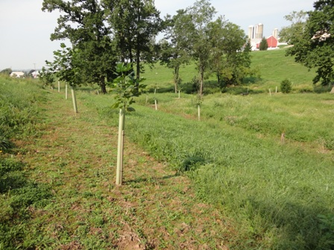
Notes:
We have some great success stories.
53

Slide 54
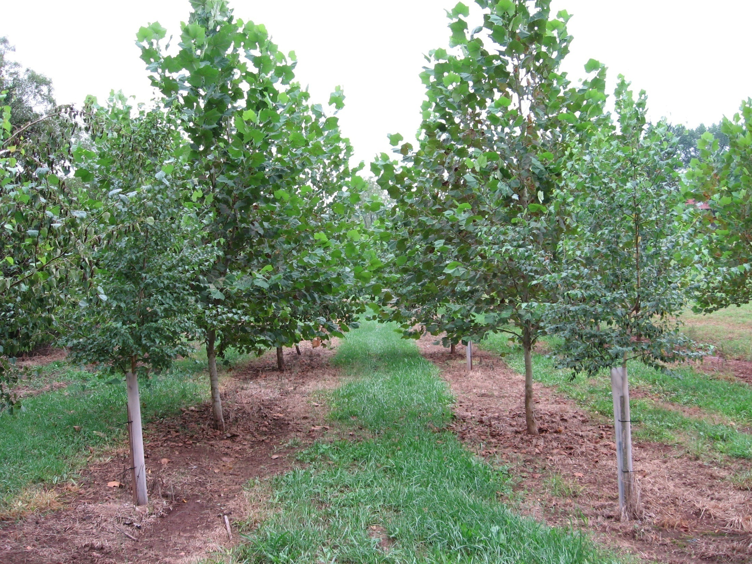
Notes:
This is a 4 year old buffer. Now the maintenance can be reduced and the buffer can begin to fend for itself.

Slide 55
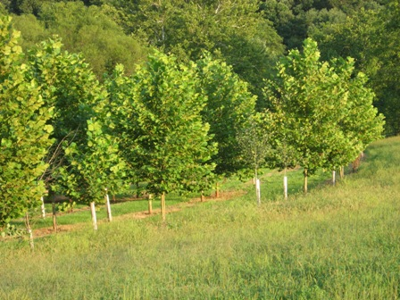
Our Mission
Notes:
55

Slide 56
Matthew J. Ehrhart
Director of Watershed Restoration
Stroud Water Research Center
mehrhart@stroudcenter.org
610 268 2153 ext 308
Notes:
56

