Slide 1
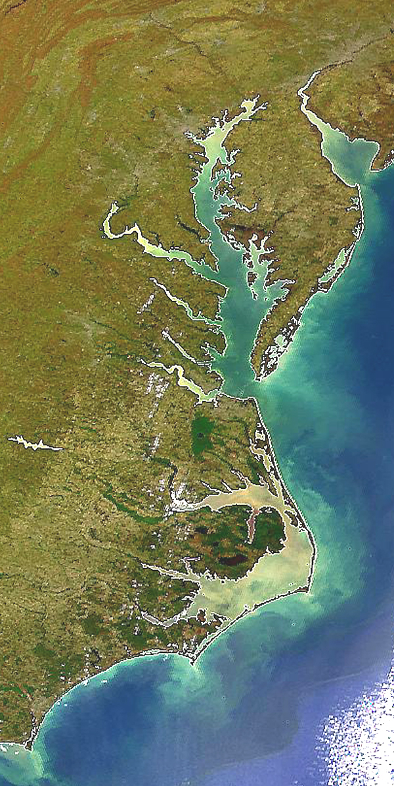

Federal Facility
Planning Targets for
Watershed Implementation Plans III
Jeff Sweeney
Environmental Protection Agency
Chesapeake Bay Program Office
jsweeney@chesapeakebay.net
410-267-9844
DC-Federal Facilities Webinar
May 24, 2018

Slide 2

Chesapeake Bay
Impairments
Dissolved Oxygen
Chlorophyll a
Water Clarity
(SAV Abundance)

Slide 3
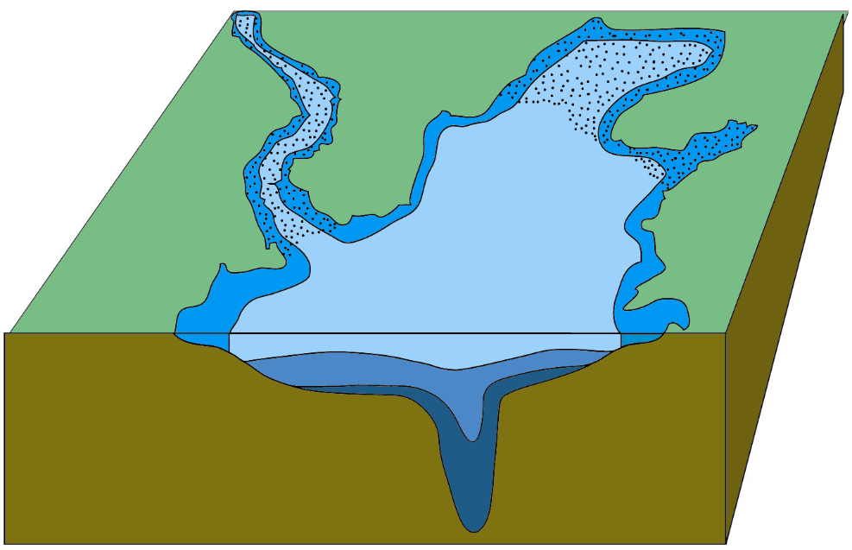
Chesapeake Bay TMDL
Water Quality Standards
Oxygen Requirements (mg/L) of Bay Species
Shallow-Water
Bay Grass Use
Migratory Fish
Spawning and
Nursery Use
Open-Water
Habitat
Open-Water
Habitat
Deep-Water
Seasonal Fish and
Shellfish Use
Deep-Channel
Seasonal
Refuge Use

Slide 4
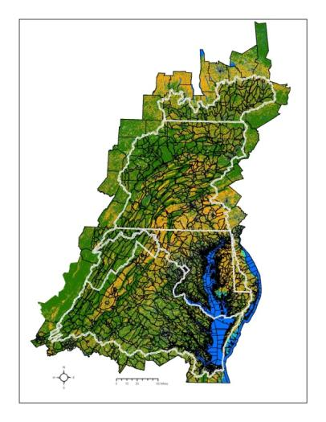
Planning Targets
Nitrogen, Phosphorus and Sediment Loading Caps
Carrying Capacity of the Bay:
~200 million lbs. Nitrogen/year
14.2 million lbs. Phosphorus/year

Slide 5
Planning Targets
Nitrogen, Phosphorus and Sediment Loading Caps
Some rules of equity:
Those who pollute more
should do more
Those that have a greater influence on attaining water quality standards should have a greater level of effort

Slide 6
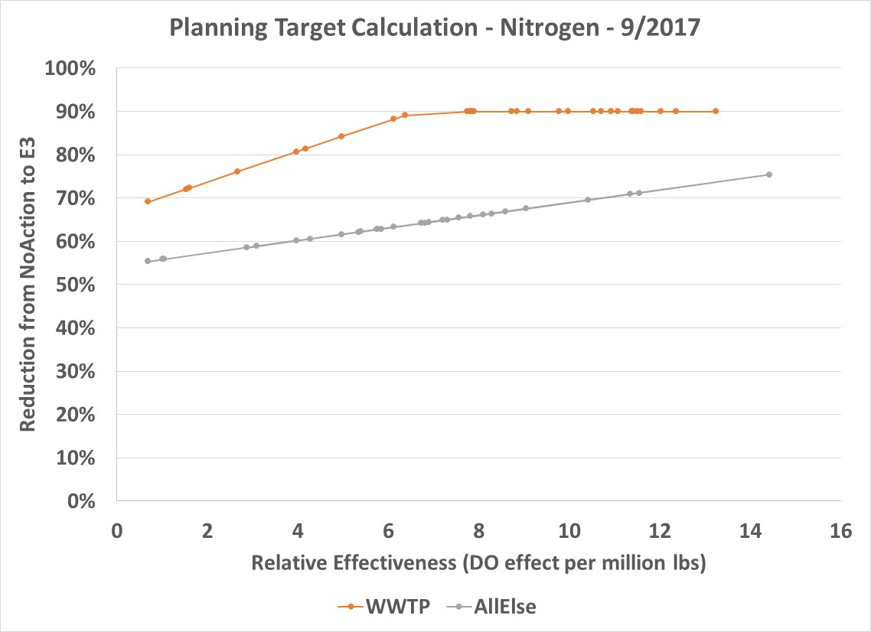
Planning Target Methodology
“Hockey Stick”
Those who
pollute more
should do more
At the end, Planning Targets do not specify loading goals for any particular source. That is jurisdictions’ responsibility through their WIPs.
Those that have a greater influence on attaining water quality standards should have a greater level of effort

Slide 7
Planning Target Methodology
Defining the Controllable Loads
No-Action
E3 (Everything, Everywhere, by Everyone)
  No-Action and E3 are one component of the Planning Target calculations
  Equity rule = Major river basins that contribute the most to the Bay water quality problems must do the most to resolve those problems (on a pound-per-pound basis)
The difference between No-Action and E3 loads is defined as the “controllable” loads.

Slide 8
Planning Target Methodology
E3 Model Scenario
The E3 scenario is an estimate of the application of management actions . . . with theoretical maximum levels of managed controls on all pollutant load sources.
There are no cost and few physical limitations to implementing BMPs in the E3 scenario.
Generally, E3 implementation levels and their associated reductions in nutrients and sediment could not be achieved for many practices, programs and control technologies when considering physical limitations and participation levels.

Slide 9
E3 Scenario
Urban, Forestry & Septic BMP Implementation Levels
Urban, Forestry & Septic
Phase 6 BMP | E3 Implementation Level
Stormwater Management - New Development | 100% of new development has Runoff Reduction BMPs sized for 2.0 inch Impervious area
Stormwater Management - Retrofits | Runoff Reduction Retrofits sized to treat 1.5 inch Impervious area for 75% of each urban land use type (accommodates physical limitations)
Stormwater Management Composite | 100% of area that can be managed through these techniques
Erosion & Sediment Control | 100% of construction sites are treated to ESC Level 3 and have high-risk Urban Nutrient Management plans
Urban Nutrient Management | 100% eligible Pervious Cover has Urban Nutrient Management Plan implementation which is split 20% High Risk and 80% Low Risk
Forest Buffers | Turfgrass (no canopy) within 10m of all streams and rivers that's unbuffered (from high-resolution land cover); CB watershed-wide average = 4% of turfgrass area
Shoreline Erosion Control | Included with Forest Buffers on turfgrass (no canopy) within 10m of tidal waters that are unbuffered (from high-resolution land cover)
Urban Tree Canopy | No net loss of tree canopy
Street Cleaning | 100% of Transport Impervious Cover swept using SCP-1
Advanced Grey Infrastructure Nutrient Discovery Program & Storm Drain Clean Outs | 5% of Urban N and P load removed due to both credits
Urban Stream Restoration | 5% of urban stream miles are restored at the default Stream Restoration value; Applied to 1st to 5th order streams using the NHD+ 24K resolution dataset
Septic Connections | 10% of septic systems connected to wastewater treatment facilities
Septic Denitrification Enhanced | 100% of systems remaining after connections
Resource BMPs | E3 Implementation Level
Forest Harvesting BMP | 100% of Harvested Forest area
Forest Conservation | No net loss of true forest
DiploidOysters3 | MD = 112 M oysters; VA = 280 M oysters

Slide 10
Planning Target Methodology
Nitrogen Loads, CB Watershed-wide

Slide 11
Planning Target Methodology
Nitrogen Loads, CB Watershed-wide

Slide 12
Planning Target Methodology
Nitrogen Loads, CB Watershed-wide
No-Action – E3

Slide 13
Planning Target Methodology
“Hockey Stick”

Slide 14
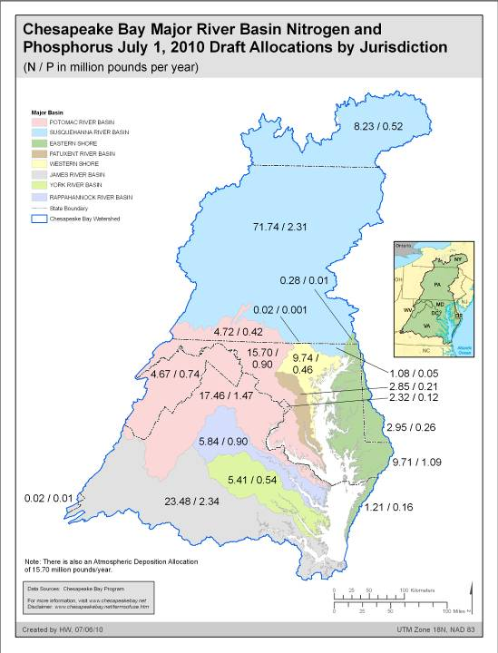
Planning Targets
Nitrogen, Phosphorus and Sediment Loading Caps
Once equitable planning targets were agreed to, jurisdictions developed Watershed Implementation Plans (WIPs) to meet those loading caps

Slide 15
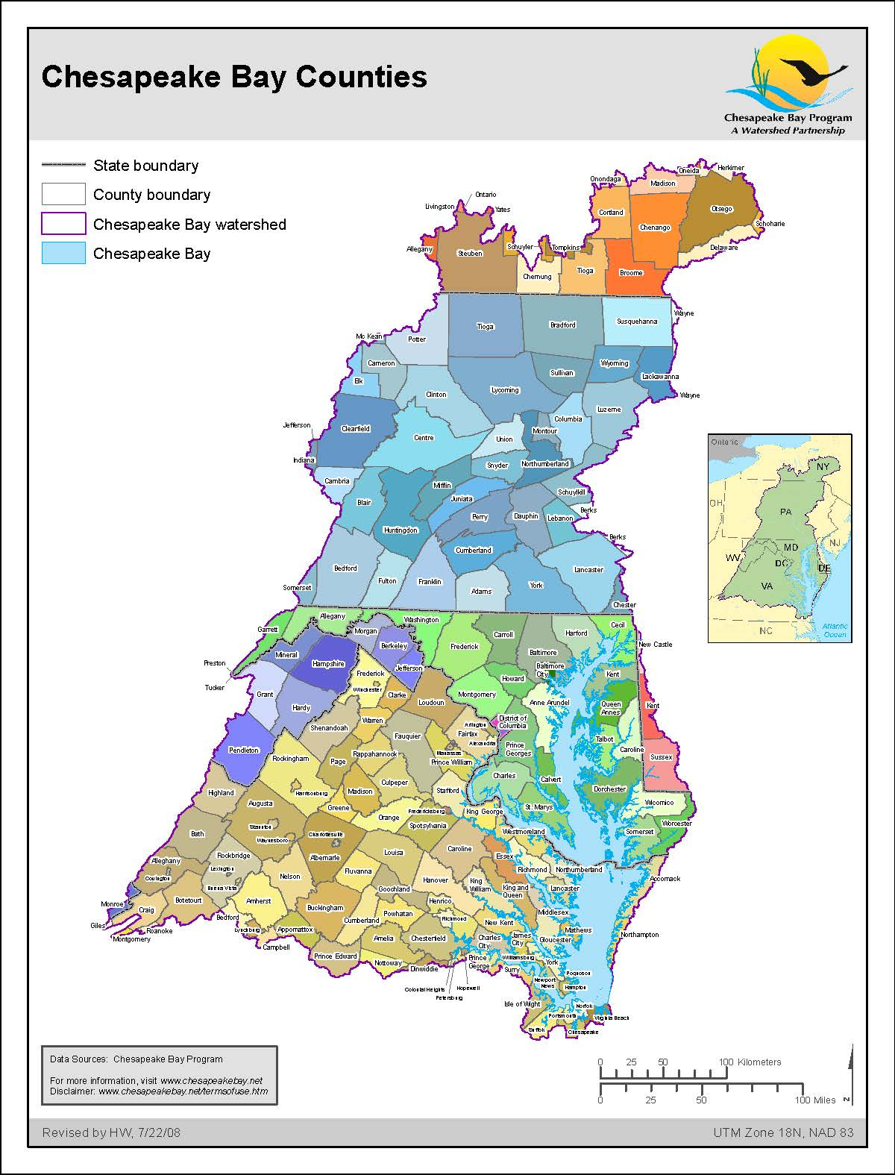
Planning Targets
for Federal Facilities and DC
– Example
Use the same concept of equity:
Those areas that contribute the most to the Bay water quality problems must do the most to resolve those problems.
The difference between No-Action and E3 loads is defined as the “controllable” loads.

Slide 16
Federal Facility
Planning Targets and WIPs
Planning targets should be equitable among federal agencies and the rest of DC outside the facility boundaries.
At the end, Planning Targets need to make sense among DC, the facilities, and among sources.
There should be reasonable assurance the targets can be achieved.

Slide 17
Planning Target Methodology for DC + Federal Facilities
Wastewater loads in the WIPs have already been established through NPDES permits
The influence of a change in loads on attaining CB water quality standards is essentially the same anywhere in the District

Slide 18
Federal Facility
Planning Targets and WIPs
Federal partners:
  DOD
  ARS
  FS
  FWS
  GSA
  NASA
  NPS
  SI
  Other Federal
Reported implementation covers the period
1985 – 2017
Watershed Implementation Plans will be developed for year 2025

Slide 19
Federal Facility
Preliminary Federal Facility Planning Targets

Slide 20
Chesapeake Assessment Scenario Tool
(CAST)
Jeff Sweeney
Environmental Protection Agency
Chesapeake Bay Program Office
jsweeney@chesapeakebay.net
410-267-9844
DC-Federal Facilities Webinar
May 24, 2018

Slide 21
Chesapeake Assessment Scenario Tool: https://cast.chesapeakebay.net/
The complex becomes simple with CAST.
Users select a geographic area, add and remove implementation, and get estimated N, P and SED reductions; and costs in minutes.

Slide 22
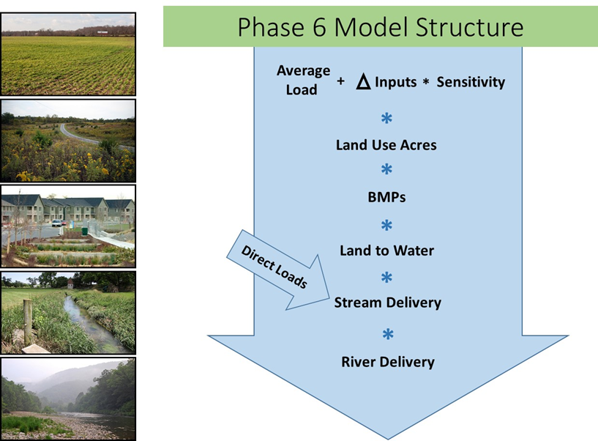
Chesapeake Assessment Scenario Tool
CAST = Watershed Model

Slide 23
CAST
Goals
Quantify the impacts of various management actions; scenario development is iterative
Guarantees calculations are consistent and replicable; creates transparency
Integrates data in a uniform format for WIPs and Milestones
Accommodates many simultaneous users
  Online with private log in
  Private and public scenarios
  Users can share scenarios with other specified users
  Local scenarios can be merged for a larger area, e.g., DC

Slide 24
CAST
Sources and Loads
Loads are calculated for all sources in the watershed
  Urban, including MS4s (Phase I & II municipalities) + non-regulated
  Agriculture, including CAFOs
  Wastewater, significant + non-significant facilities, municipal + industrial.
  Natural
Identifies the BMPs that give the greatest load reductions
Specifies the extent these BMPs are to be implemented

Slide 25
CAST
Sources and Loads
Outputs include the acres of each BMP and the loads of N, P, and sediment
Estimates cost of each “what-if” management scenarios

Slide 26
CAST
Urban/Developed Land Use Classifications
Impervious Roads
Paved and unpaved roads and bridges
Impervious Non-Roads
Buildings, driveways, sidewalks, parking lots, runways, some private roads, railroads and rail right-of-ways, and barren lands within industrial, transitional (early stages of construction), and warehousing land uses
Turfgrass
Herbaceous and barren lands that have been altered through compaction, removal of organic material, and/or fertilization. These include all herbaceous and barren lands within road right-of-ways and residential, commercial, recreational, and other turf-dominated land uses (e.g., cemeteries, shopping centers) and a portion of herbaceous and barren lands within federal facilities, parks, institutional campuses, and large developed parcels.
Tree Canopy over Impervious Surfaces
Trees over roads and non-road impervious surfaces.
Tree Canopy over Turfgrass
Trees within 30’-80’ of non-road impervious surfaces where the understory is assumed to be turf grass or otherwise altered through compaction, removal of surface organic material, and/or fertilization.

Slide 27
CAST
Urban/Developed Land Use Classifications
Overlays – Used to divide the land uses into subcategories relevant to management and BMPs
Federal Facilities
All federally owned/managed properties
Municipal Separate Storm Sewer Systems (MS4)
Areas with Phase I or Phase II stormwater permits; typically drain into municipally owned/operated storm sewer drainage networks within the 2010 Census urban areas
Combined Sewer Service Areas
Areas served by centralized combined wastewater/stormwater treatment systems

Slide 28
CAST
BMPs
300+ unique practice names available for reporting through NEIEN
  About 50 unique BMP names available for conservation plans alone
These lump into 200⁺ more-inclusive BMP categories across the agricultural, urban, septic, and natural sectors

Slide 29
Federal Facility BMP Implementation
BMP Types Reported
BMP Name
Stormwater Performance Standard-Runoff Reduction
Stormwater Performance Standard-Stormwater Treatment
Wet Ponds and Wetlands
Dry Detention Ponds and Hydrodynamic Structures
Dry Extended Detention Ponds
Filtering Practices
Infiltration Practices, no underdrain
Bioretention/Raingardens, underdrain
Bioswale
Permeable Pavement
Vegetated Open Channels, no underdrain
Nutrient Management Plan
Erosion and Sediment Control Level 1
Impervious Surface Reduction
Forest Buffer
Tree Planting - Canopy
Forest Planting
Mechanical Broom Technology - 1 pass/4 weeks
Separation of stormwater and sewer systems
Forest Harvesting Practices
Urban Stream Restoration
Urban Shoreline Management

Slide 30
Urban BMP Implementation

Slide 31
Urban BMP Implementation

Slide 32
Urban BMP Implementation

Slide 33
Links to Resources
Midpoint Assessment Website: https://mpa.chesapeakebay.net/
WQGIT web page: http://www.chesapeakebay.net/groups/group/water_quality_goal_implementation_team
Chesapeake Assessment Scenario Tool: https://cast.chesapeakebay.net/
Chesapeake Progress / Water Quality: http://www.chesapeakeprogress.com/clean-water#water-quality

Slide 34
Chesapeake Bay Watershed Nitrogen Loads
(Phase 5.3.2 Model)

Slide 35
Chesapeake Bay Watershed Nitrogen Loads
(Phase 5.3.2 Model)

Slide 36
Chesapeake Bay Watershed Nitrogen Loads
(Phase 5.3.2 Model)

Slide 37
Chesapeake Bay Watershed Nitrogen Loads
(Phase 5.3.2 Model)
Jurisdictions’ WIPs defined source load reductions

Slide 38
Chesapeake Bay Watershed Nitrogen Loads
(Phase 5.3.2 Model)
2017 60% Interim Target

Slide 39
Chesapeake Bay Watershed Nitrogen Loads
(Phase 5.3.2 Model)

Slide 40
Chesapeake Bay Watershed Nitrogen Loads
(Phase 5.3.2 Model)
2017 60% Interim Target

Slide 41
2017 Progress Load Review
Chesapeake Bay Watershed
For 2017, the goal is to achieve 60% of the planned 2009-2025 load reductions
2017 Nitrogen is at 36% of this goal
  The only source meeting the 60% target is wastewater
2017 Phosphorus is at 86% = better than the target
  Agriculture and wastewater have achieved mid-point goals
2017 Sediment is at 66% of its goal

Slide 42
Where did the load reductions come from?
(Phase 5.3.2 Model)

Slide 43
Where will future reductions come from?
(Phase 5.3.2 Model, WIP II)

Slide 44
Where will future reductions come from?
(Phase 5.3.2 Model, WIP II)

