Slide 1

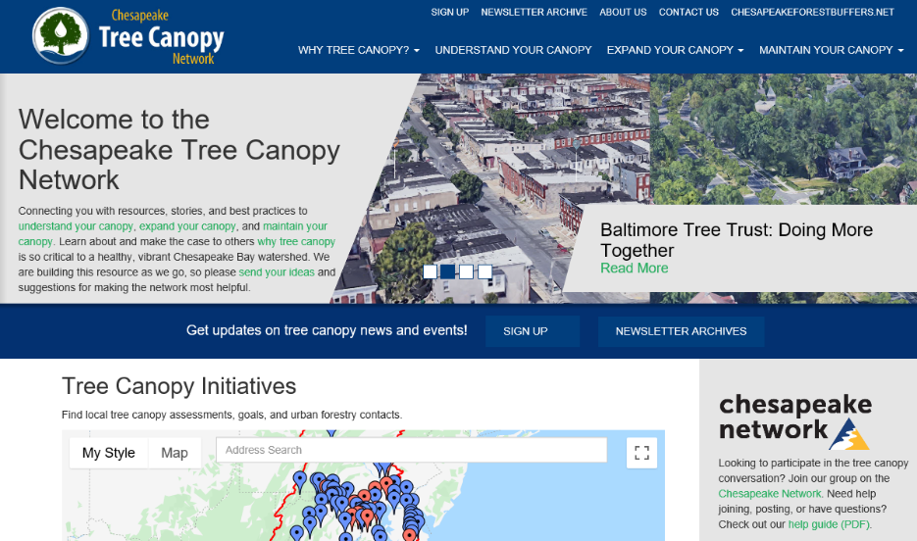
QUARTERLY PROGRESS MEETING – February 2021 Chesapeake Bay Program
Tree Canopy
Julie Mawhorter
Forestry Workgroup,
Tree Canopy Coordinator
USDA Forest Service
julie.mawhorter@usda.gov
Notes:
Find photos on our Flickr site: https://www.flickr.com/photos/29388462@N06/sets/
You can also browse photos by category on our website: http://www.chesapeakebay.net/photos

Slide 2
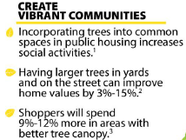

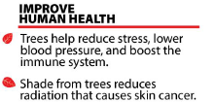
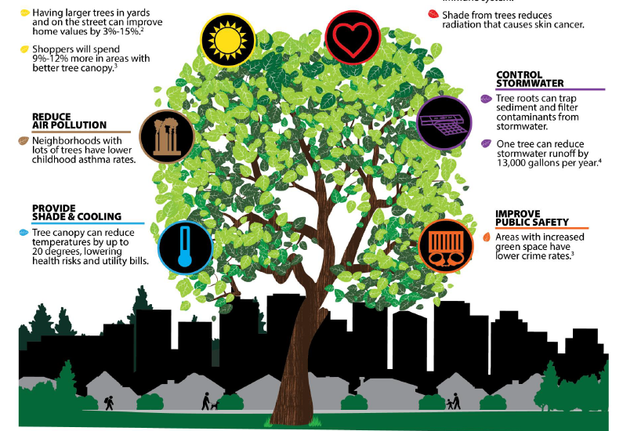
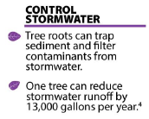



Source:
Chesapeake Forest Restoration Strategy

Slide 3
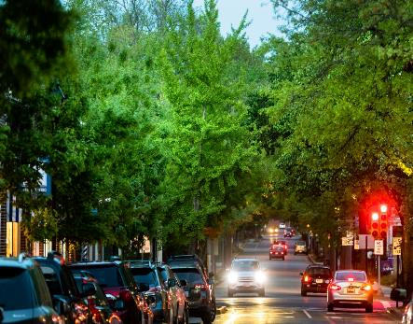
Through the Chesapeake Bay Watershed Agreement, the Chesapeake Bay Program has committed to…
Goal: Vital Habitats
Outcome: Tree Canopy
Continually increase urban tree canopy capacity to provide air quality, water quality and habitat benefits throughout the watershed. Expand urban tree canopy by 2,400 acres by 2025.
Relevant Photo
Notes:
Remind re community tree canopy from rural to urban – lots of opportunity in yards, open space, etc not just urban

Slide 4
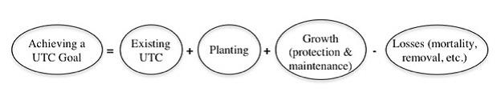
It’s not just about planting…
Tree Canopy Indicator has 2 components:
1) States report three urban tree planting BMPs annually for TMDL
2) Long term progress analyzed through CBP Land Cover updates (2021)
Notes:
Key element of the goal set is that it is intended to reflect a net gain in tree canopy by 2025. We know there are many forces at play on the landscape causing us to lose canopy – so in order to actually grow our canopy we need to do more than just plant a lot of trees. We need quality tree plantings that are maintained over time, and most importantly we need to protect the canopy we have and try to minimize the losses.

Slide 5
What is our Expected and Actual Progress?
Acres Planted: 5525
(MD: 4875)
Net Gain Target: 2400 Acres
Loss: ?? Acres
Ph3 WIP Target:
72,230 acres
Notes:
INSTRUCTIONS: Copy and paste the graph or chart you used to answer narrative analysis question #2. The editable graph from the Narrative Analysis template has been included here for your reference.
FROM NARRATIVE ANALYSIS (FOR YOUR REFERENCE ONLY):
“2. Regardless of how successful your short-term progress has been over the past two years, indicate whether we are making progress at a rate that is necessary to achieve the outcome you are working toward.
Use the editable graph or your own chart to illustrate your progress. Explain any gap(s) between our actual progress and our anticipated trajectory.”

Slide 6
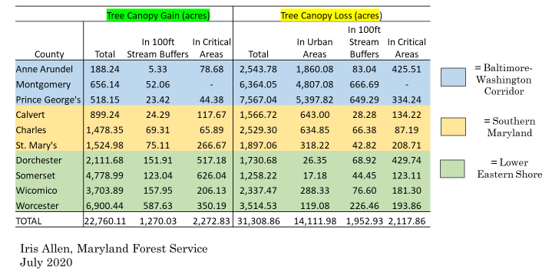
In some areas, we are losing ground…
Notes:
INSTRUCTIONS: Copy and paste the graph or chart you used to answer narrative analysis question #2. The editable graph from the Narrative Analysis template has been included here for your reference.
FROM NARRATIVE ANALYSIS (FOR YOUR REFERENCE ONLY):
“2. Regardless of how successful your short-term progress has been over the past two years, indicate whether we are making progress at a rate that is necessary to achieve the outcome you are working toward.
Use the editable graph or your own chart to illustrate your progress. Explain any gap(s) between our actual progress and our anticipated trajectory.”

Slide 7
Learn What have we learned in the last two years?
L
Notes:
INSTRUCTIONS: This slide is a transition slide and does not need to be modified.

Slide 8
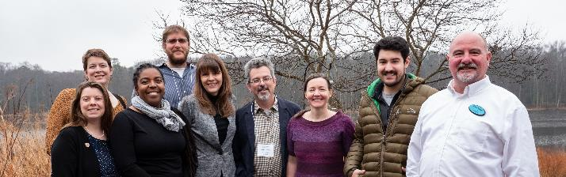
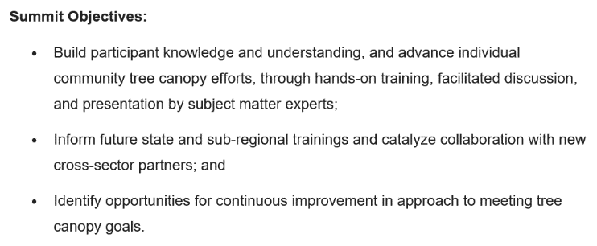
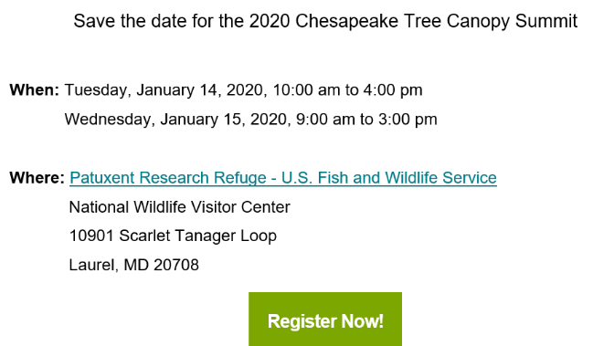
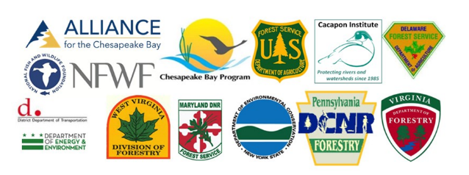
Successes – Summit 2.0
Notes:
INSTRUCTIONS: This slide should briefly summarize your answer to narrative analysis question #1.
FROM NARRATIVE ANALYSIS (FOR YOUR REFERENCE ONLY):
“1. Examine your red/yellow/green analysis of your management actions. What lessons have you learned over the past two years of implementation?
Summarize what you have learned about what worked and what didn’t. For example, have you identified additional factors to consider or filled an information gap?”

Slide 9
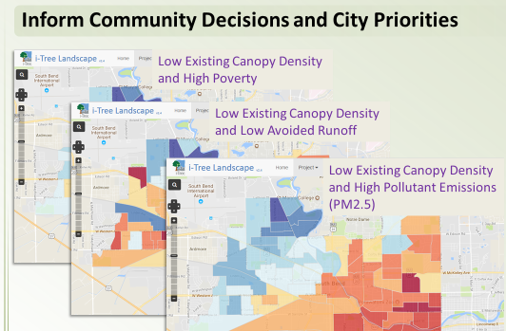
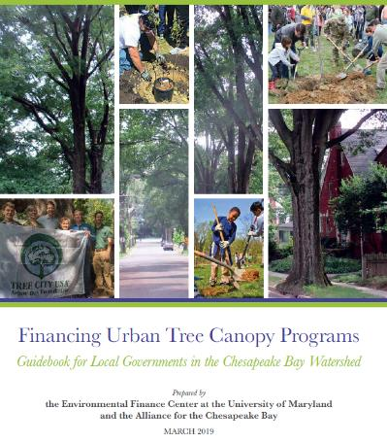
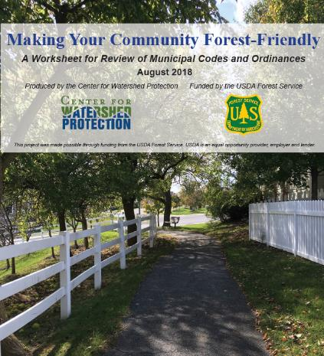

Successes – Summit 2.0
INCREASE
Technical Capacity & Knowledge
BOLSTER
Funding & Partnership
STRENGTHEN
Policy & Ordinances
EXPAND
Community Outreach & Education
Notes:
INSTRUCTIONS: This slide should briefly summarize your answer to narrative analysis question #1.
FROM NARRATIVE ANALYSIS (FOR YOUR REFERENCE ONLY):
“1. Examine your red/yellow/green analysis of your management actions. What lessons have you learned over the past two years of implementation?
Summarize what you have learned about what worked and what didn’t. For example, have you identified additional factors to consider or filled an information gap?”

Slide 10

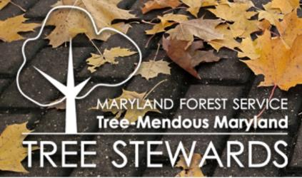
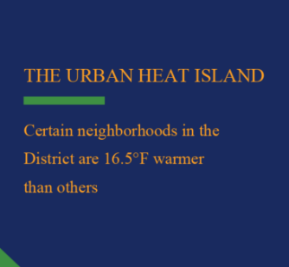
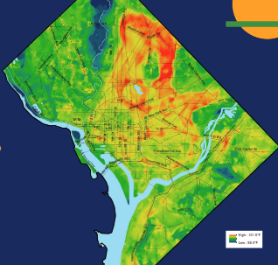

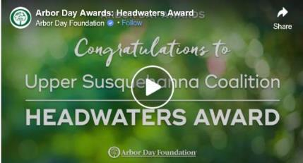
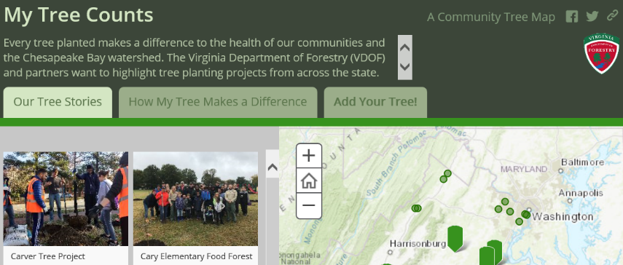
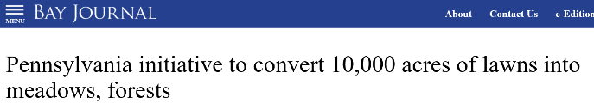
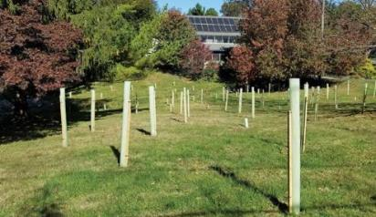
Successes – States
ACTION 1.1 Implement state programs and grants to incentivize tree canopy progress
Notes:
INSTRUCTIONS: This slide should briefly summarize your answer to narrative analysis question #1.
FROM NARRATIVE ANALYSIS (FOR YOUR REFERENCE ONLY):
“1. Examine your red/yellow/green analysis of your management actions. What lessons have you learned over the past two years of implementation?
Summarize what you have learned about what worked and what didn’t. For example, have you identified additional factors to consider or filled an information gap?”

Slide 11
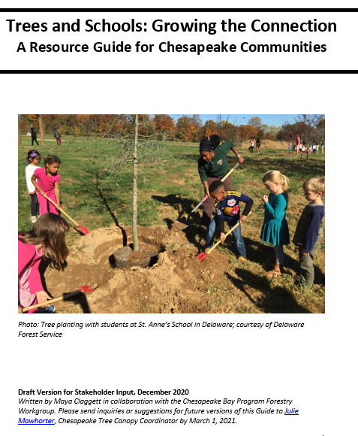
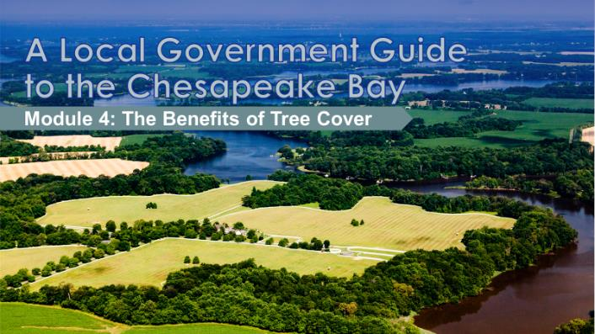
Successes – Cross Outcome
Environmental Literacy
Local Leadership
https://chesapeaketrees.net/category/schools/
Notes:
INSTRUCTIONS: This slide should briefly summarize your answer to narrative analysis question #1.
FROM NARRATIVE ANALYSIS (FOR YOUR REFERENCE ONLY):
“1. Examine your red/yellow/green analysis of your management actions. What lessons have you learned over the past two years of implementation?
Summarize what you have learned about what worked and what didn’t. For example, have you identified additional factors to consider or filled an information gap?”

Slide 12
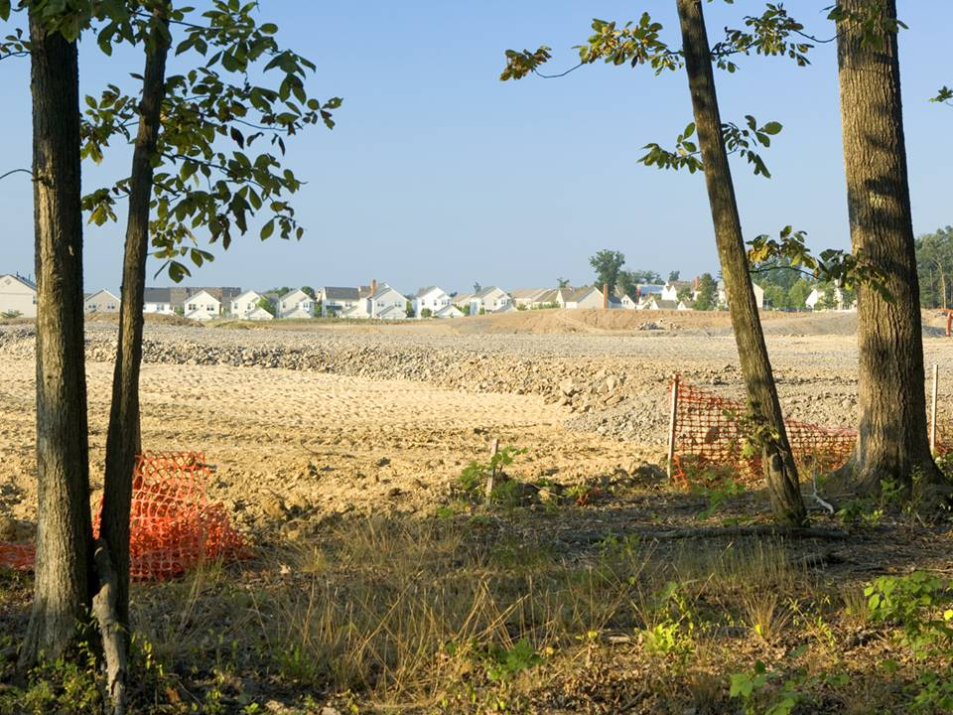


COVID IMPACTS
- Delays, budgets, priorities
Delayed workplan action:
Funding & Policy Roundtable
Many drivers of loss (development, storms, pests)
Weak or nonexistent local ordinances and staffing
Inadequate or patchy funding
People take trees for granted and sometimes focus on negatives
Notes:
Planting only takes you so far; policy impacting how to maintain existing canopy is the big missing piece; not under the purview of those doing the planting

Slide 13
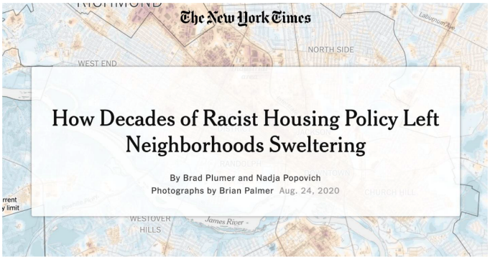
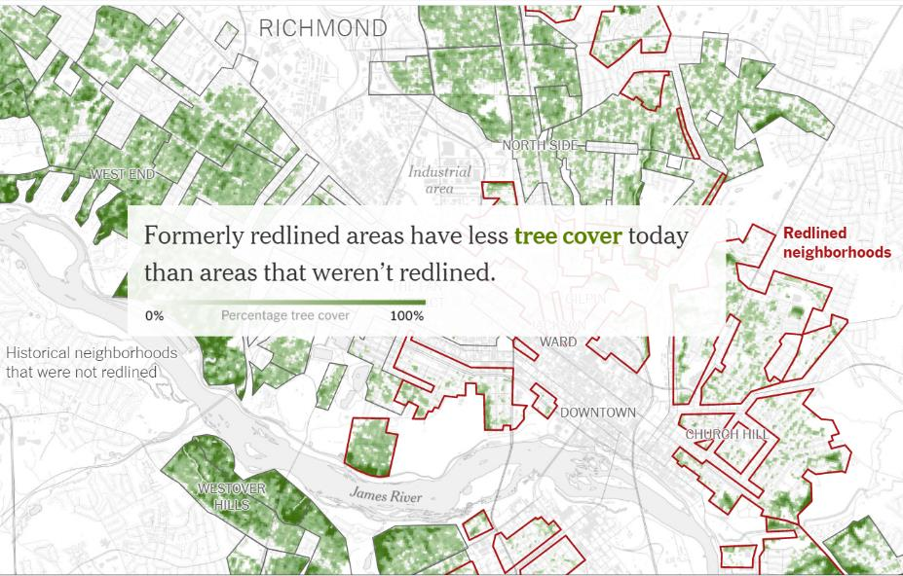

Challenges & Lessons Learned
Learn more: Heat, Health & Trees Session, Chesapeake Watershed Forum;
https://www.nytimes.com/interactive/2020/08/24/climate/racism-redlining-cities-global-warming.html
Notes:
INSTRUCTIONS: This slide should briefly summarize your answer to narrative analysis question #1.
FROM NARRATIVE ANALYSIS (FOR YOUR REFERENCE ONLY):
“1. Examine your red/yellow/green analysis of your management actions. What lessons have you learned over the past two years of implementation?
Summarize what you have learned about what worked and what didn’t. For example, have you identified additional factors to consider or filled an information gap?”

Slide 14
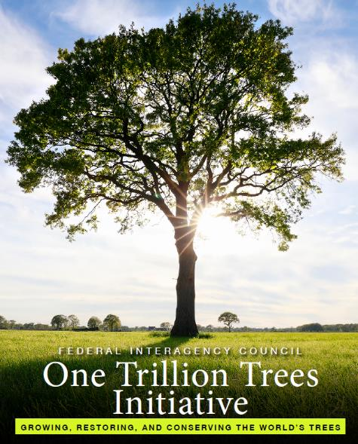
On the Horizon
New Land Cover Data & Analysis (2021)
CBP DEIJ Strategy and Tree Equity Focus
Continued COVID Impacts
Climate Initiatives focused on trees
(e.g. Trillion Trees)
Notes:
INSTRUCTIONS: This slide should briefly summarize your answer to narrative analysis question #3.
FROM NARRATIVE ANALYSIS (FOR YOUR REFERENCE ONLY):
“3. What scientific, fiscal and policy-related developments will influence your work over the next two years?
This may include information learned at the previous biennial SRS meeting or more specific information about your outcome such as an increase or decrease in funding, new programs that address gaps, and new scientific data or research. Describe how these developments are likely to impact your recommended measure(s) of progress, the factors you believe impact your ability to succeed, and newly created or filled gaps. These changes should be reflected in the first three columns of your revised logic and action plan after your quarterly progress meeting.”

Slide 15
Adapt How does all of this impact our work?
A
Notes:
INSTRUCTIONS: This slide is a transition slide and does not need to be modified.

Slide 16
Based on what we learned, we plan to …
1. Develop and share data, tools & best practices for Tree Equity
2. Assess and Communicate Tree Canopy Status & Change to Stakeholders
Bay-wide Summary Report and Local Fact Sheets
3. COVID- Continue virtual opportunities and plan for 2022 Summit
4. Continue partnership work around priority issues and needs
Funding & Policy Roundtable
Collaboration-Local Leadership, Communications, Stormwater, Schools
Notes:
INSTRUCTIONS: This slide should briefly summarize your answer to narrative analysis question #4. As a reminder, question four refers back to the first three questions in the Narrative Analysis.
FROM NARRATIVE ANALYSIS (FOR YOUR REFERENCE ONLY):
“4. Based on your response to the questions above, how will your work change over the next two years?
Describe the adaptations that will be necessary to more efficiently achieve your outcome and explain how these changes will lead you to adjust your management strategy or the actions described in column four of your logic and action plan. Changes that the workgroup, GIT or Management Board consider significant should be reflected in your management strategy.”

Slide 17
Help How can the Management Board lead the Program to adapt?
H
Notes:
INSTRUCTIONS: This slide is a transition slide and does not need to be modified.

Slide 18
Help Needed
Prioritize CBP DEIJ Implementation Plan efforts to grow investments in communities, with tree equity as a focus
Continue and grow the support for critical state urban and community forestry programs, through leveraging available programs and policies
Request: in each state, MB member(s) work with State Tree Canopy Lead to document existing programs/policies that could help maintain and expand tree canopy
(e.g. water quality, climate, health, community development, workforce)
Participate in the Funding & Policy Roundtable and next Summit
Notes:
INSTRUCTIONS: This slide should briefly summarize your answer to narrative analysis question #5.
FROM NARRATIVE ANALYSIS (FOR YOUR REFERENCE ONLY):
“5. What, if any, actions can the Management Board take to help ensure success in achieving your outcome?
Please be as specific as possible. Do you need direct action by the Management Board? Or can the Management Board direct or facilitate action through other groups? Can you describe efforts the workgroup has already taken to address this issue? If this need is not met, how will progress toward your outcome be affected? This assistance may include support from within a Management Board member’s jurisdiction or agency.”

Slide 19
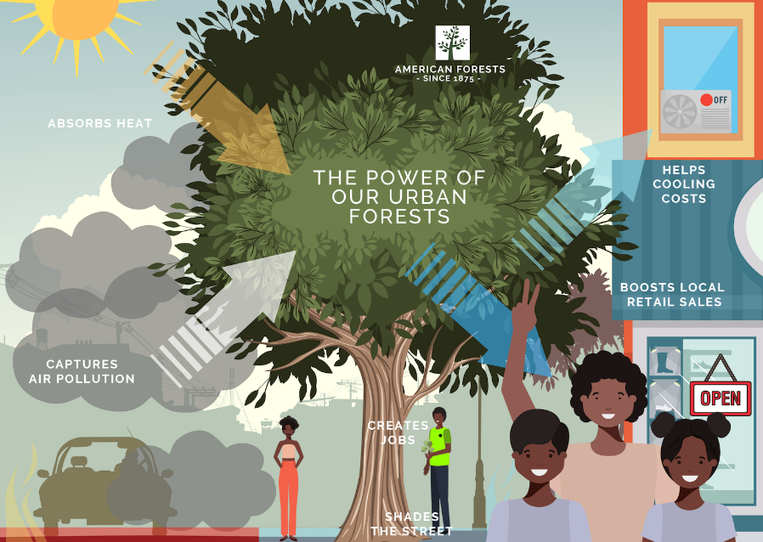
QUARTERLY PROGRESS MEETING Chesapeake Bay Program
Discussion
To learn more or engage with our Strategy/ Workplan development, please reach out!
Julie Mawhorter, julie.mawhorter@usda.gov.
Notes:
[time for discussion at the end of the presentation, before the next outcome presentation]

