Slide 1
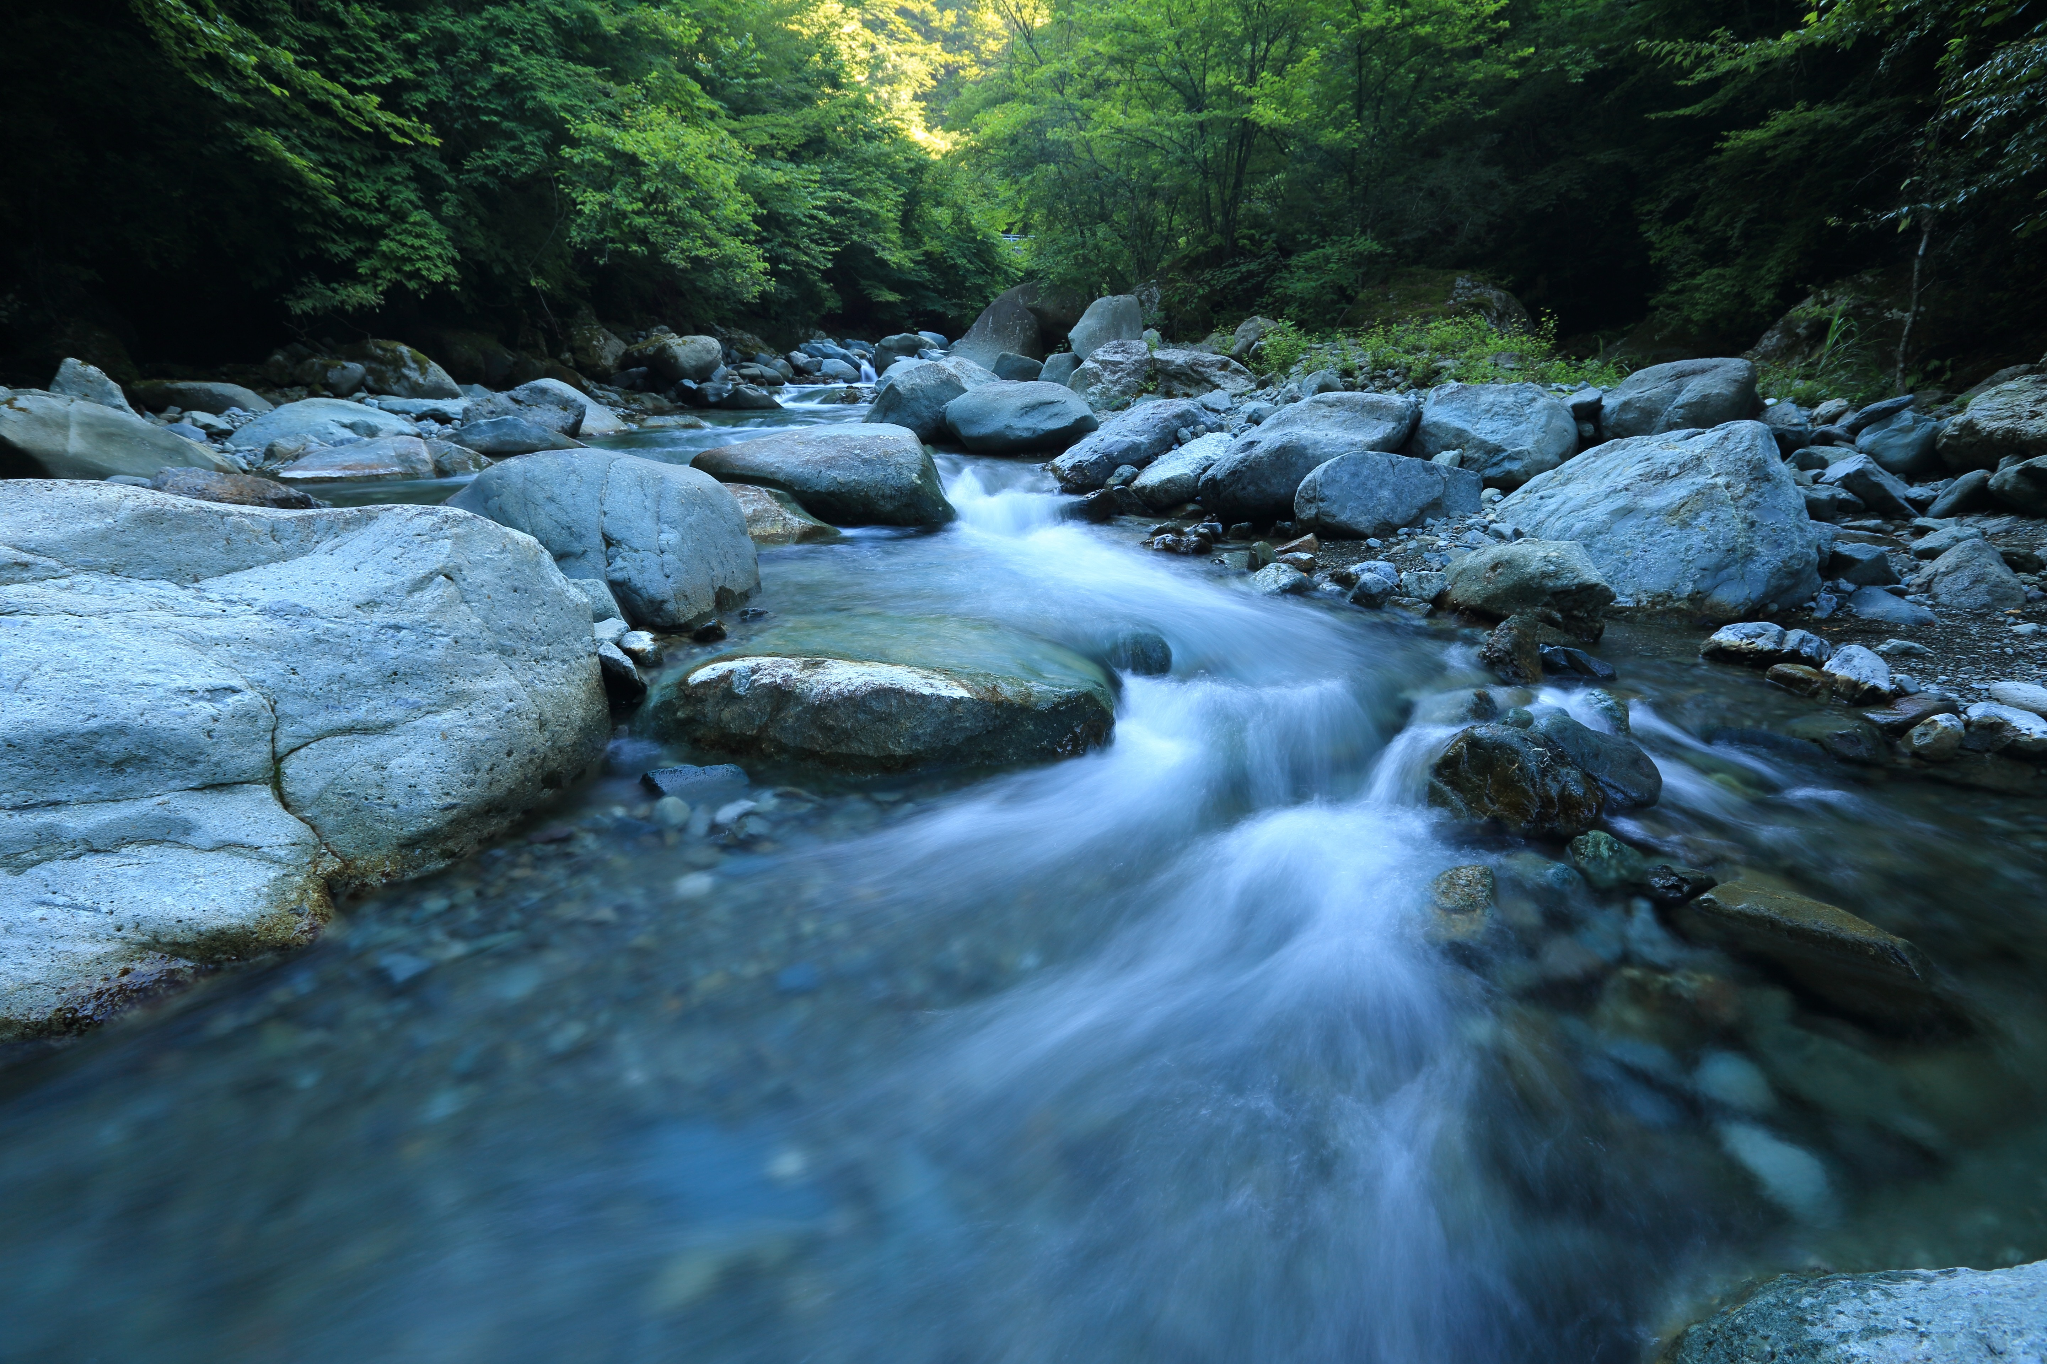

CAC Meeting, Sept 18, 2019
Jenna Mitchell, PA State Director
Alliance for the Chesapeake Bay
Notes:
Lindsay – I will introduce the project – explain the role each of the partners is taking during the project and the number of farms that are impacted.

Slide 2
Jenna Mitchell, PA State Director
Alliance for the Chesapeake Bay
Notes:
Lindsay – I will introduce the project – explain the role each of the partners is taking during the project and the number of farms that are impacted.

Slide 3
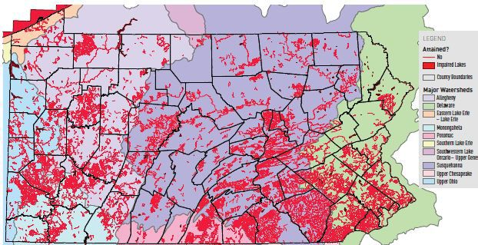
Stream health PA is troubling

Slide 4

What does it mean to be impaired?
A stream is considered impaired when it is no longer safely drinkable, fishable, or swimmable and has lost 70% of its original aquatic life.

Slide 5
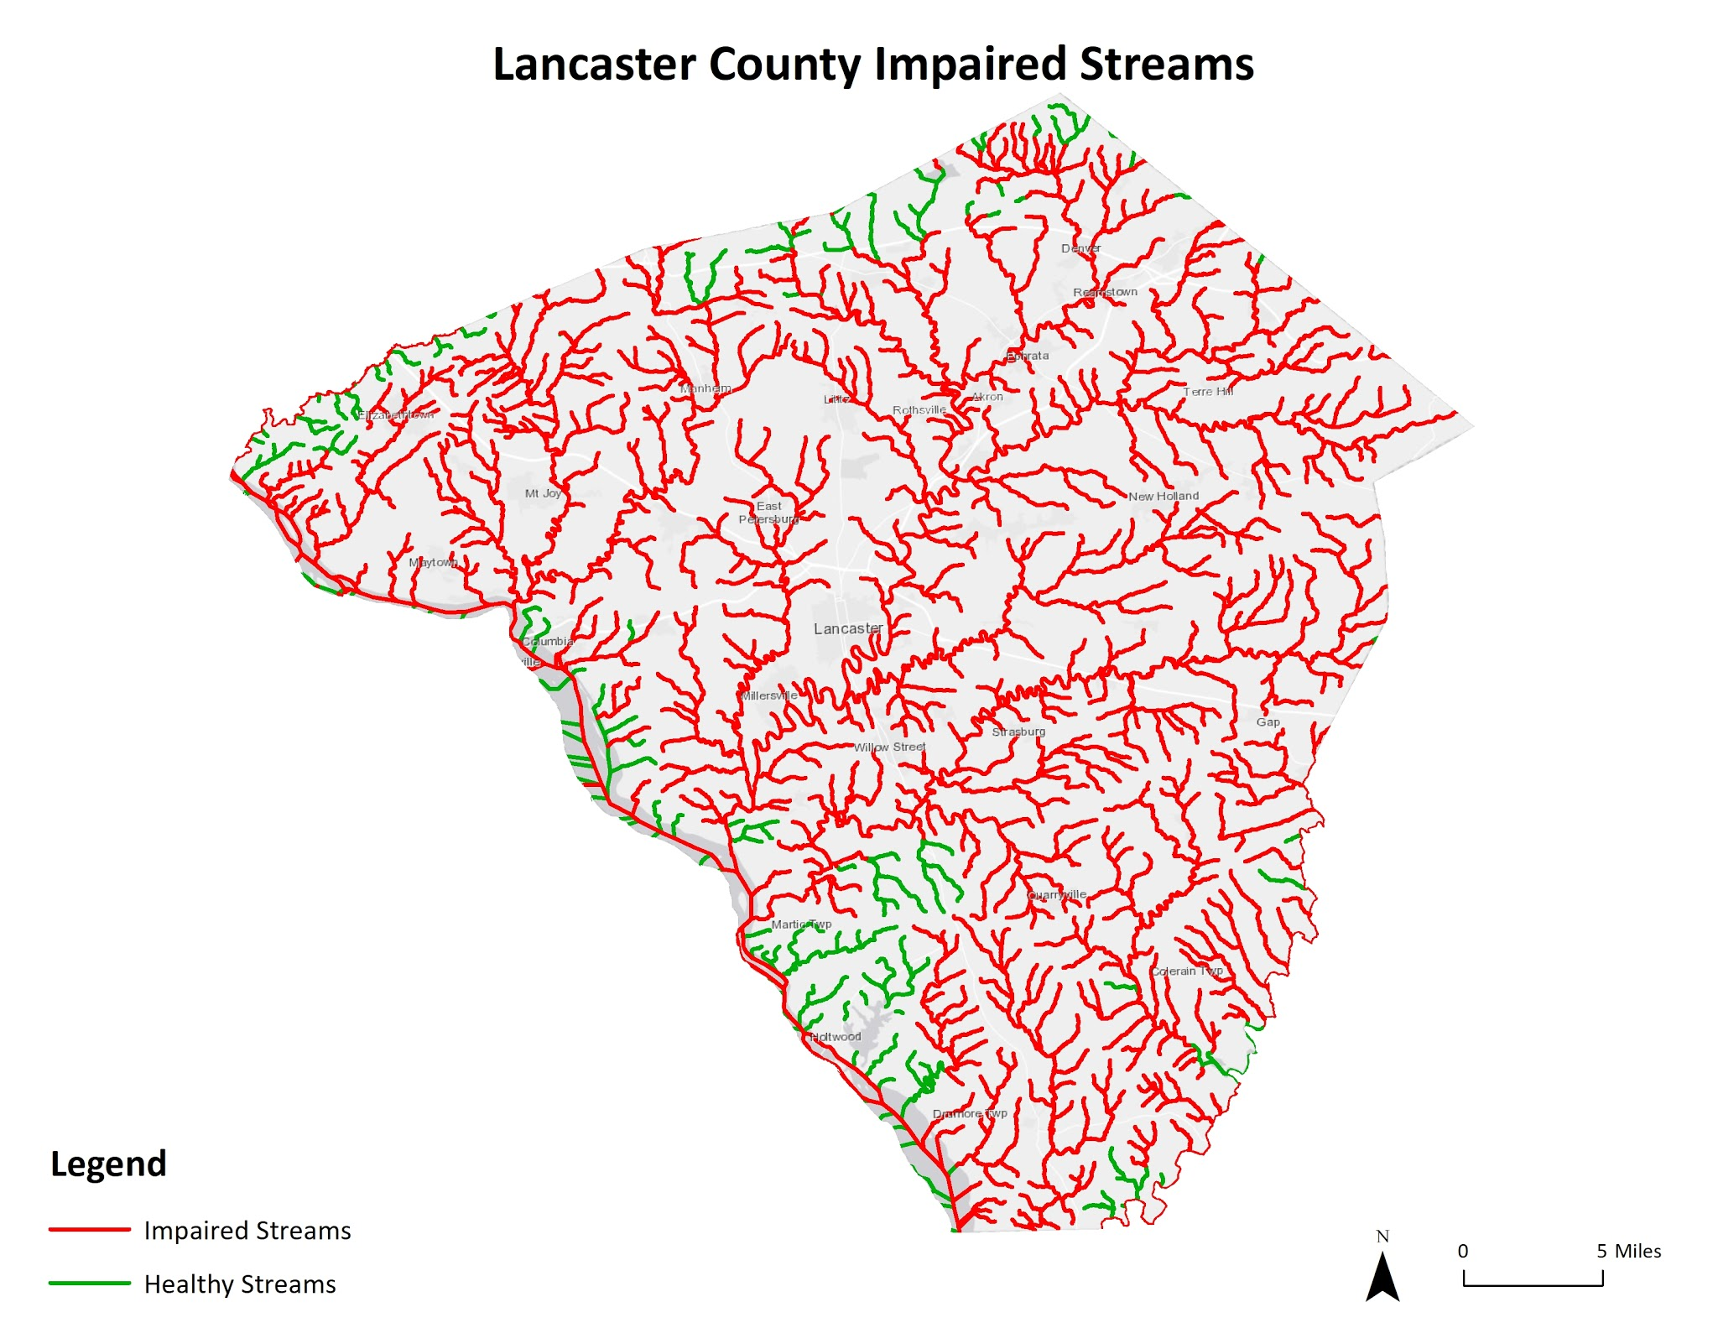
The majority of Lancaster’s streams are impaired

Slide 6
Since 1972, it has been a Pennsylvania state requirement that all agriculture operations have a Conservation Plan
It is estimated that only 50% of farms in Lancaster County have a Conservation Plan

Slide 7
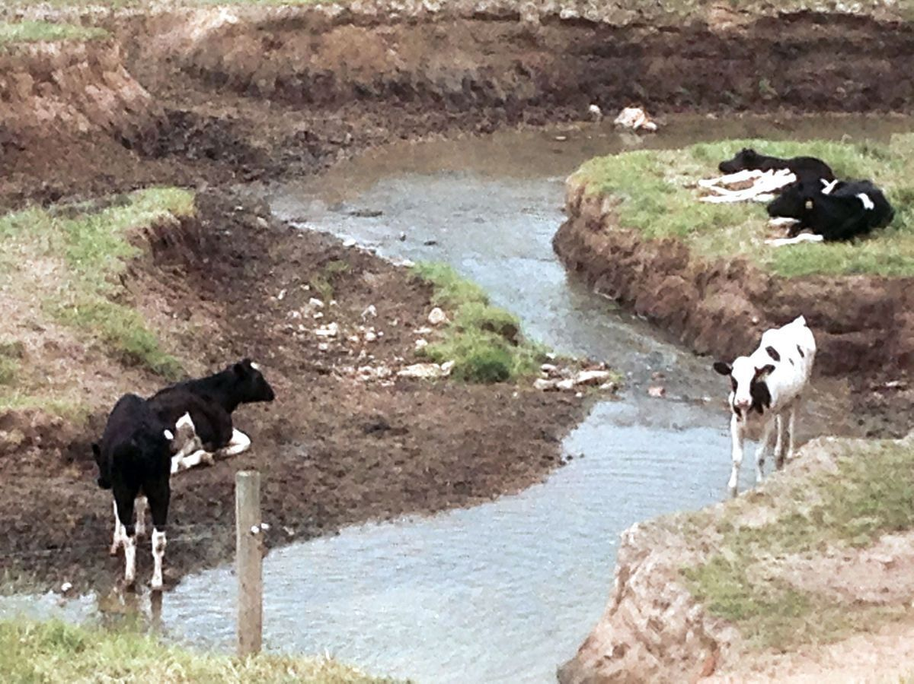
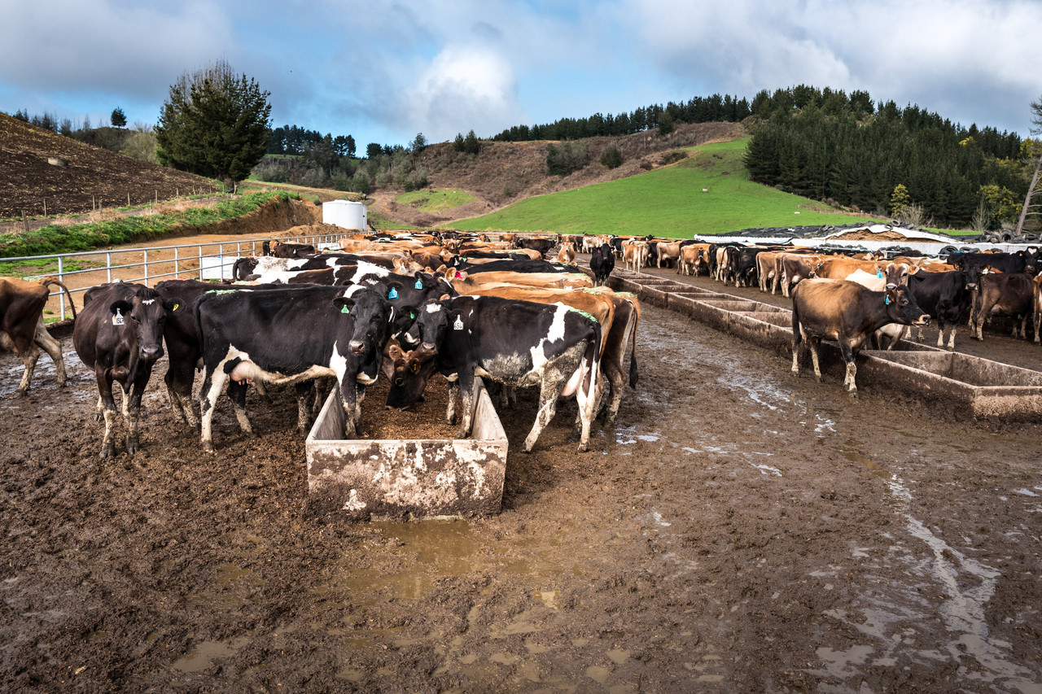
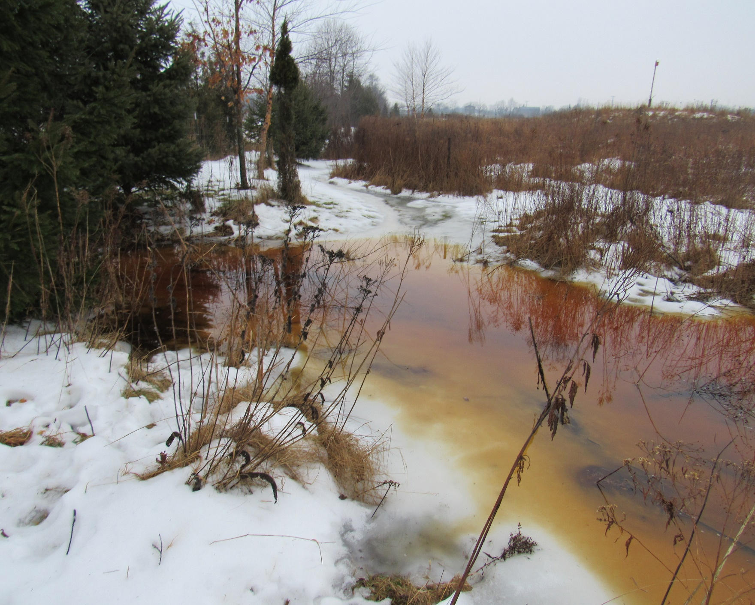
OPPORTUNITY FOR TURKEY HILL AND MDVA TO MAKE A SERIOUS IMPACT

Slide 8
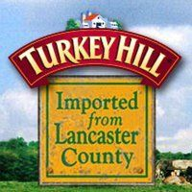
TURKEY HILL DAIRY
Founded and Headquartered in Lancaster County since 1931
Almost all employees live in Lancaster County
Distributes milk locally, ice cream nationally

Slide 9

TIMING WAS PERFECT
Turkey Hill was rebidding their contract with their co-op at the exact time they were considering their impact in Lancaster County

Slide 10
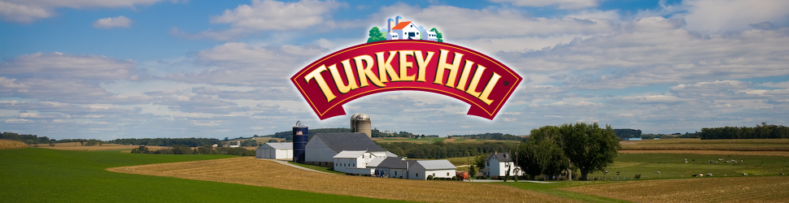
THE TURKEY HILL CLEAN WATER PARTNERSHIP
Turkey Hill has asked MDVA to support all of the farmers providing milk to Turkey Hill to receive a conservation plan and reach compliance with on-the-ground BMPs

Slide 11

THE TURKEY HILL CLEAN WATER PARTNERSHIP
Once all farmers have obtained a conservation plan, Turkey Hill will pay the farmers a premium for the new added “quality” of their milk

Slide 12
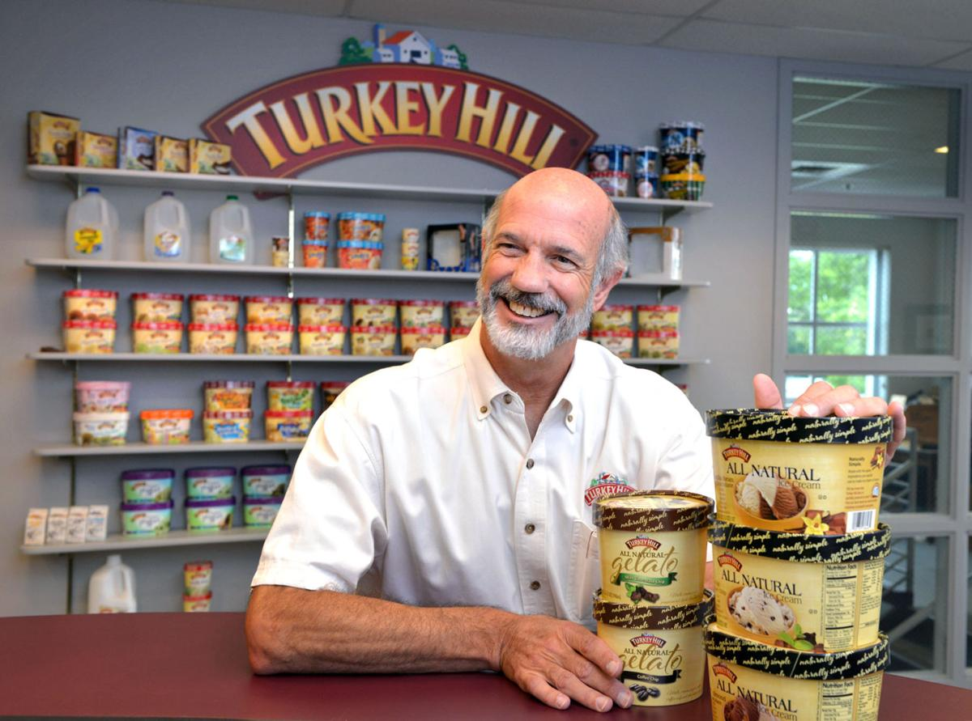
TURKEY HILL’S MOTIVATION
Clean & Clear water for Lancaster County
  For their employees
  For all residents
Eliminate the need for increased regulation of Lancaster County Farms
Make their consumers happy – Turkey Hill is a national company and the Bay is a national treasure

Slide 13

FUNDING FOR PILOT EFFORT
The Alliance received a Conservation Innovation Grant (CIG) from NRCS as seed money to jumpstart project
Goal of grant is to prove that leadership within the private sector can motivate an acceleration of the implementation of conservation practices

Slide 14



HOW IS THE PARTNERSHIP WORKING?
MDVA Field staff assesses farmers’ conservation level during their standard dairy inspection
  Uses this data to build database of producers
Alliance visits with each farmer to explain initiative and options for support
  Then connects farmer to NRCS office or private consultant for assistance

Slide 15
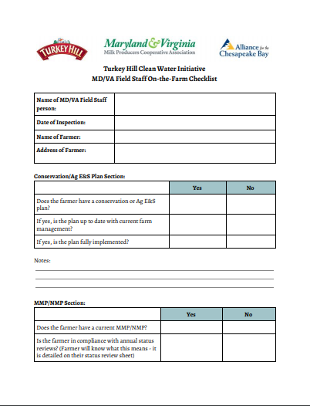
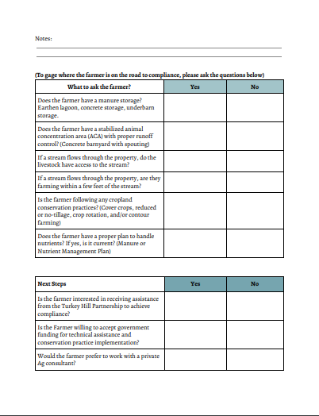


Slide 16
Producer Demographics
136 MDVA farmers serving Turkey Hill Dairy
Located in Lancaster, York, Adams, Cumberland, Lebanon, Luzerne, Franklin, Northumberland, an Berks Counties

Slide 17
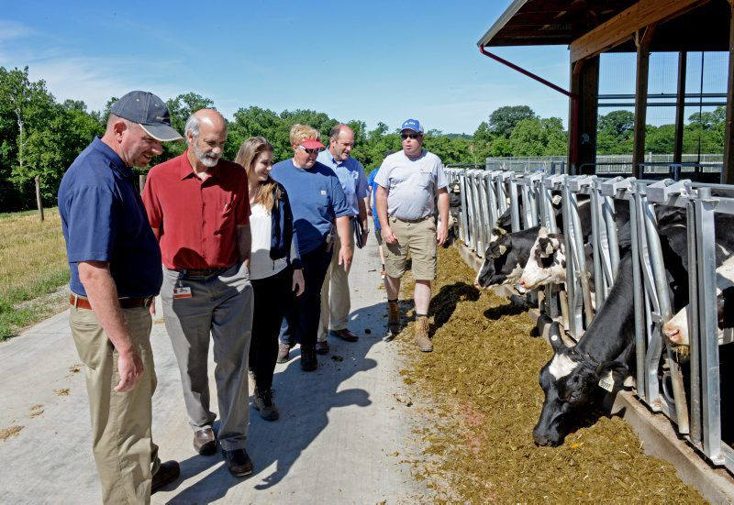
PRODUCER RESULTS
About 25% of them did not have an Ag E&S plan or Cons plan
ALMOST ALL farmers are supportive of this approach and appreciate Turkey Hill’s interest and investment

Slide 18
Current and Future Funding
Project was created through NRCS Conservation Innovation Grant: $460,000
National Fish and Wildlife Foundation: $1,000,000
Will work with NRCS to utilize EQIP funds for farmers
Alliance utilizes general funding pots (DNCR, DEP Growing Greener) for farmers as well

Slide 19

Creative Marketing
Local Marketing Firm, NXT Creative developing a marketing strategies for Turkey Hill and MDVA to share the initiative with their consumers and clients

Slide 20
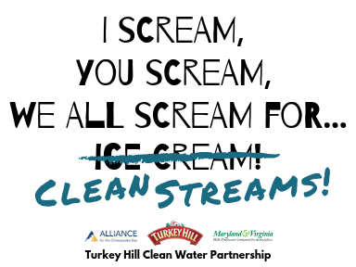

Slide 21

Implementation Strategy
Chesapeake Conservancy prioritized all farmers based off of their potential impact to stream health including:
  Headquarters proximity to stream
  upland land use
  Soil type
  Slope
  Existence of Riparian buffer

Slide 22

PARTNERSHIP IMMEDIATE GOALS
Begin implementation with volunteer farmers to showcase project
Offer support to highly prioritized farmers – continue support until all farmers are compliant

Slide 23
Model Replication
Non-profit
Corporate Customer
Agriculture Cooperative

Slide 24


NEXT STEPS….
Focus efforts on implementation of conservation practices
Apply for more funding to grow partnership
Bring other businesses to the table

Slide 25





QUESTIONS?
Jenna Mitchell, PA State Director
37 East Orange Street Suite 302 Lancaster, PA 17602
Office (717) 517-8698
Cell Phone (717) 405-9687
jmitchell@allianceforthebay.org

Slide 26
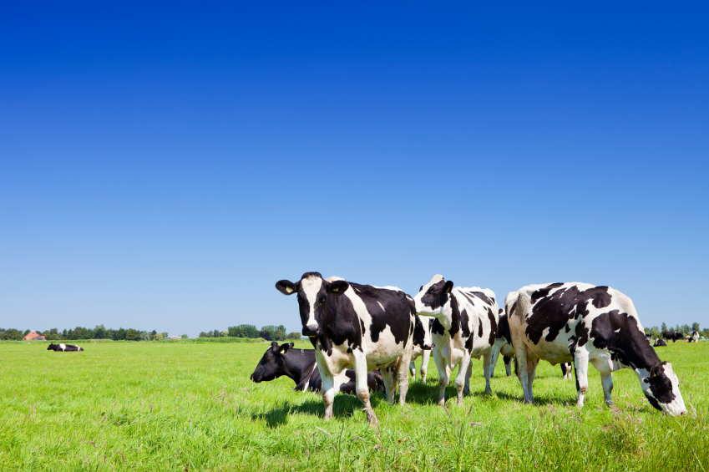

THANK YOU!

