Slide 1

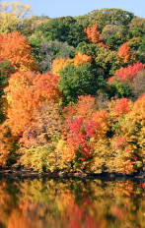

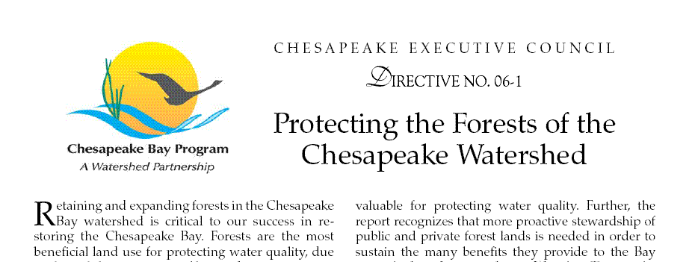
Update on Chesapeake Urban Tree Canopy Management Strategy
Urban Stormwater Workgroup, Dec. 16, 2014
Julie Mawhorter
Mid-Atlantic Urban & Community Forestry Coordinator
jmawhorter@fs.fed.us

Slide 2
Overview
Overview of UTC Goal and Management Strategy
Highlights from Chesapeake UTC Summit
Question: How to better integrate urban tree protection and planting into stormwater programs and WIP goals?

Slide 3
Where we’ve been…
2003 Chesapeake Executive Council Directive
…WE FURTHER RECOGNIZE THAT URBAN TREE CANOPY COVER offers stormwater control and water quality benefits for municipalities in the Chesapeake Bay watershed…
By 2010, work with at least 5 local jurisdictions in each state to complete an assessment of urban forests, adopt a local goal to increase urban tree canopy cover and encourage measures to attain the established goals…
And in 2007 Forest Conservation Directive…
By 2020, accelerate reforestation and conservation in urban and suburban areas, by increasing the number of communities with commitments to tree canopy expansion goals to 120.

Slide 4
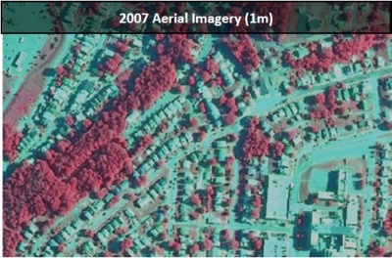
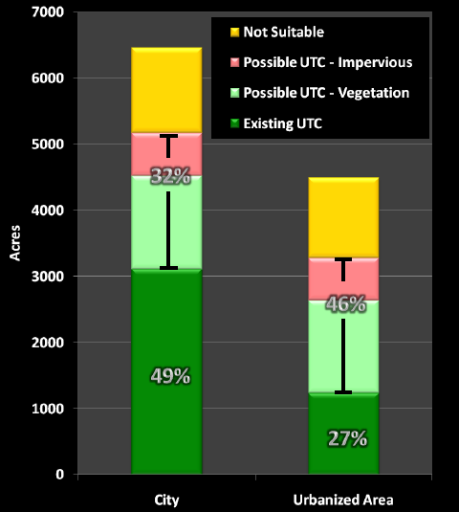
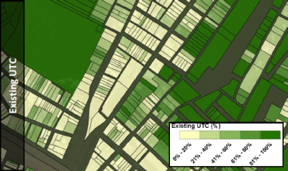
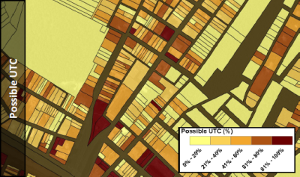
Progress: UTC Assessments
(Cumberland, MD, J. O’Neil-Dunne)

Slide 5
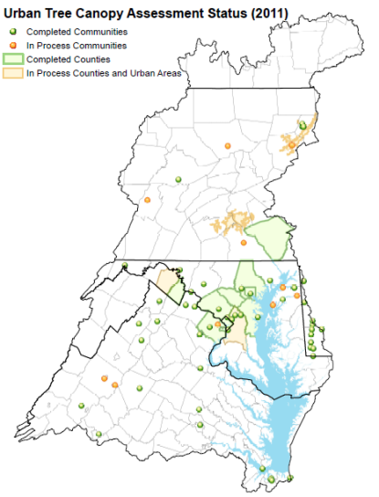
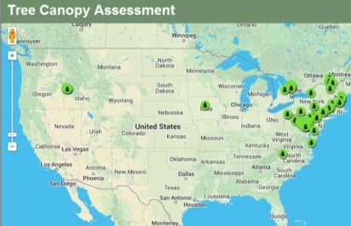
UTC Assessments in the Chesapeake Bay Watershed
~ 70 localities and 9 counties complete
Recent statewide UTC assessment in Maryland

Slide 6
Progress: UTC Goals
5 Counties and ~40 Cities/Towns have set UTC Goals
EXAMPLES – UTC GOALS

Slide 7
Progress: On the ground?
??? ???
Assess →Set Goal → Plan → Implement → Monitor
We don’t have good information on actions taken and progress made in protecting and expanding urban tree canopy.

Slide 8
NEW Chesapeake Bay Agreement
June 2014
TREE CANOPY OUTCOME
Continually increase urban tree canopy capacity to provide air quality, water quality and habitat benefits throughout the watershed.
Expand urban tree canopy by 2,400 acres by 2025.
Must be 2,400 acres net gain, after accounting for canopy losses
For reporting, 1 acre = 100 trees planted
Tracked using tree planting data submitted to Chesapeake Bay model, cross-checked with periodic canopy assessments

Slide 9
Preliminary State UTC Targets
State | Annual Target (New Acres) | 2025 Target (New Acres)
Delaware | 5 | 60
DC | 40 | 480
Maryland | 45 | 540
New York | 5 | 60
Pennsylvania | 60 | 720
Virginia | 40 | 480
West Virginia | 10 | 120
TOTAL | 205 | 2460

Slide 10
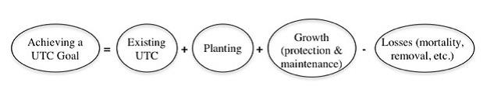
Factors Influencing ability to meet goal
Development
Storms
Pests/Disease
Natural Mortality
Utility Clearing
Funding/Partnerships
Policies/Ordinances
Community Outreach/Buy-in
Knowledge/Tools/Technical Capacity

Slide 11
Chesapeake TMDL – Credit for Trees?
YES!!!
Urban Tree Planting is a credited Best Management Practice (BMP) for the Chesapeake Bay TMDL
On average, urban tree planting gets credit for reducing pollutant loading from around 12 lb/acre/year total nitrogen to 4 lb/acre/year (varies by location in watershed)
A new Urban Tree Canopy land use layer is being developed to better credit existing tree canopy in the Chesapeake Bay model
These tree canopy credits/values are currently under review by an Expert Panel

Slide 12
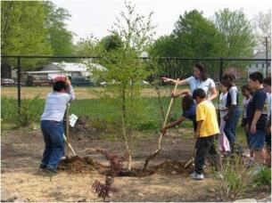
Chesapeake TMDL – Credit for Trees?
Some states included urban tree planting targets in their TMDL Watershed Implementation Plans (20,000 new acres by 2025!!!)
However, very little urban tree planting has been reported to date, since 2009 (exception: DC)
Need to develop good tracking and reporting mechanisms for local governments to get credit for urban tree canopy expansion

Slide 13
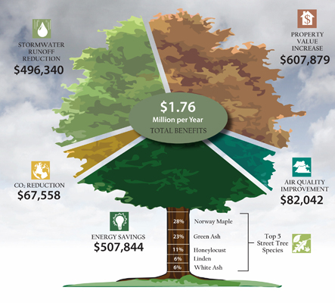
But, Beyond the tmdl…
VERY cost-effective bmp for achieving many goals

Slide 14
Chesapeake Urban Tree Canopy Summit Highlights
Held October 14-15 in Linthicum, MD
80+ local, state, federal, and nongovernmental participants from across watershed
Meeting summary report and recorded presentations are posted online:
http://forests.allianceforthebay.org/what-were-doing/forest-restoration/urban-tree-canopy-summit-proceedings/

Slide 15

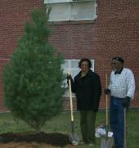
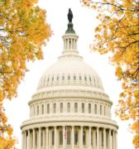
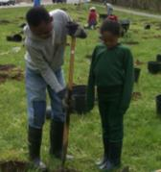

District of Columbia
Urban Tree Canopy Goals
Chesapeake UTC Summit
October 14, 2014
Chesapeake Bay 2-year Milestone: 4,150 trees planted per year
MS4 Permit: Annually plant a net 4,150 trees in the MS4 area of DC
UTC Plan: 40% Tree Canopy
Sustainable DC Plan: 40% Tree Canopy by 2032

Slide 16
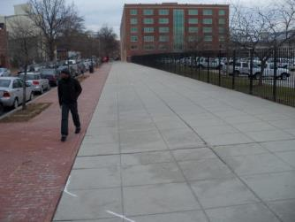
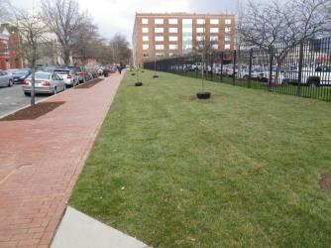
How the District Achieves its UTC Goals
District Lands
UFA street tree planting
DDOT GI guidelines
Planting Plans for parks and schools
Maintenance of existing trees
  Pruning
  Impervious surface removal
  Pervious paving
  Vertical mulching

Slide 17
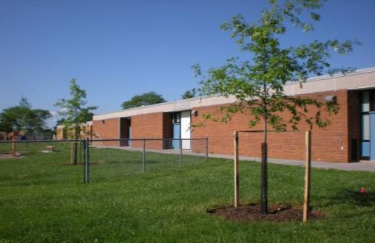

Chesapeake UTC Summit
October 14, 2014
Integrating UTC into Water Quality Goals
Baltimore County’s Watershed Implementation Plan …. and more
Donald C. Outen, AICP
Natural Resource Manager
Baltimore County EPS
410-887-3981
douten@baltimorecountymd.gov
MD Sustainable Forestry Council
Sustainable Forests Roundtable
www.LinkedIn.com/in/DonOuten

Slide 18
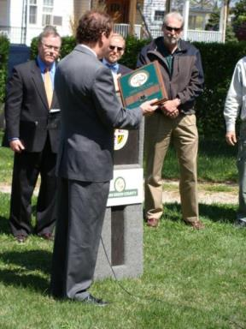
Baltimore County Tree Canopy & WIP Planting Goals
In April 2013, County Executive Kamenetz announced tree canopy goals:
By 2025, achieve and maintain:
  50% tree canopy County-wide & for the 3 drinking water reservoir watersheds
  40% tree canopy within the URDL & each of the 30 Census-Designated Places
Our County Phase II WIP planting target is 1,500 acres, or 120 acres/year for 13 years (2013-2025)
  40 ac/year for citizen-initiated projects
  80 ac/year for EPS contractual planting
2007 Canopy Cover:
(1 m NAIP)
48.7% County-wide
38.4% urban/URDL
5,060 ac. total gap

Slide 19
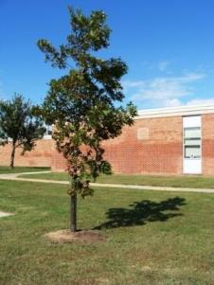
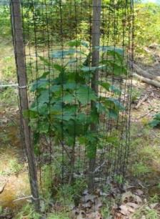
How Will We Plant 1,500 Acres by 2025?
urban and rural areas, public and private land
grants, stormwater remediation fees (“rain tax”), leverage capital & operating budgets
used stormwater fees to hire 2 staff and secure 6 on-call contractors; $666,000/yr for projects
project types:
  “Cool Trees” Energy Efficiency grant
  MD Governor’s Stream Restoration Challenge grant
  CBT Green Streets, Jobs, Towns grant
  Citizen projects (Policy & Guidelines process)
  BigTrees Sales
  Urban managed grounds (business & institutional)
  Community street tree projects
  BCPS CLIPs
  County open lands
  Rural easements and larger properties
  Rural residential “turf-to-trees”

Slide 20
More Bang for the “green” Buck: Integrating Green Infrastructure and utc into Existing capital Projects
Chesapeake UTC Summit
October 14, 2014

Slide 21
UTC Management Strategy:
Next Steps
Early “Discussion Draft” Management Strategy is posted on CBP website; processing input from Dec. 3 Forestry Workgroup strategy session
January – flesh out Draft Strategy get input on state level actions
Feb. 4 – next Forestry Workgroup meeting 10-3, final input on Public Draft Strategy
Release Public Draft Strategy (Feb-Mar)
Revise and Complete Final Strategy (May-June)

Slide 22
Management Strategy:
Participating Jurisdictions
EVERYONE – progress will be driven by local government and partner efforts
State urban forestry coordinators will gather input on state-specific strategy actions in January
Jurisdiction | Lead Agency/contact
Delaware | Delaware Forest Service Kyle Hoyd, kyle.hoyd@state.de.us Kesha Braunskill, kesha.braunskill@state.de.us
District of Columbia | DDOT Urban Forestry Administration John Thomas, john.pthomas@dc.gov District Dept. of Environment Steve Saari, steve.saari@dc.gov
Maryland | Maryland DNR Forest Service Marian Honeczy, marian.honeczy@maryland.gov
New York | NYSDEC, Div. Lands and Forests Mary Kramarchyk, mary.kramarchyk@dec.ny.gov
Pennsylvania | PA-DCNR Bureau of Forestry Rachel Reyna, rreyna@pa.gov
Virginia | VA Dept. of Forestry Barbara White, Barbara.White@dof.virginia.gov
West Virginia | Cacapon Institute (CB UTC Coordinator) Frank Rodgers, frodgers@cacaponinstitute.org WV Div. of Forestry Herb Peddicord, Herb.F.Peddicord@wv.gov

Slide 23
Urban Stormwater Workgroup Input
How can we better integrate urban tree canopy goals into state and local stormwater programs?
What kinds of information/tools/technical assistance will be most useful to the network of stormwater practitioners?
Other ideas?
Please send input on posted Early Draft UTC Management Strategy to jmawhorter@fs.fed.us and consider joining Feb. 4 Forestry Workgroup

