Slide 1

USGS/SHWG Stressor summary project update
Rosemary Fanelli, Matt Cashman, and Aaron Porter
U.S. Geological Survey
May 15, 2020

Slide 2

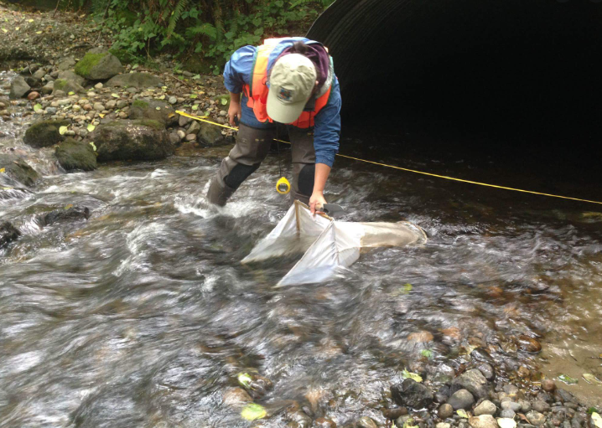
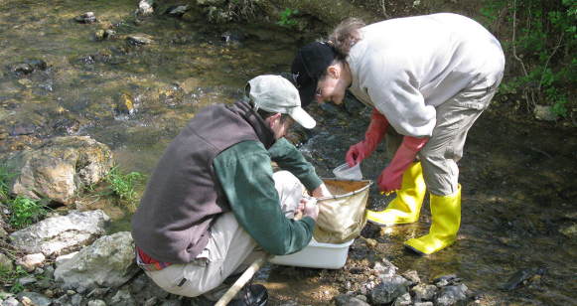
Extracting key information from selected literature
General paper information
Author, title, journal, etc.
General study design
Field-based study vs flume or mesocosm
Multiple or single stressor
Methodology
How response variable was measured (IBI, %EPT)
How stressor(s) were quantified
Key findings
Identified dominant stressor
Thresholds for detectable changes in stream health
Qualitative measures of changes in stream health
Study constraints/limitations

Slide 3
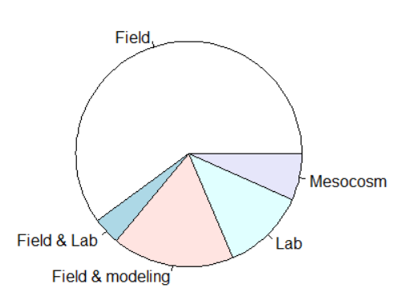
Summarize and synthesize results
Number of studies summarized so far = 75
Number of journals/sources covered = ~38
Hydrobiologia (10)
JNABS/Freshwater Science (8)
Ecological Indicators (5)
Freshwater Biology (5)
STOTEN (5)
Environmental Pollution (3)
Types of studies
Most field, some field & modeling and lab
60%
12%
17%
Provisional results, for feedback only
Notes:
Predicted conditions using stressor data

Slide 4
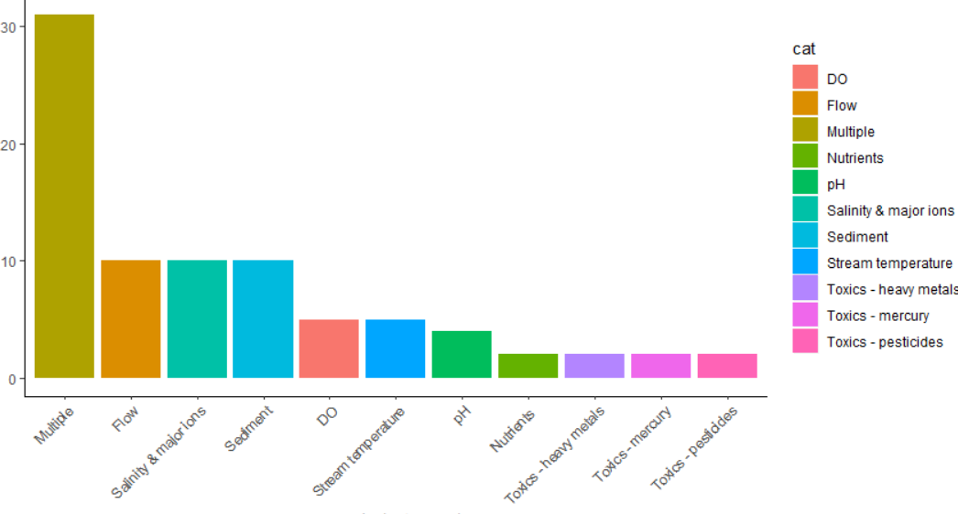
What types of stressors were measured?
41% examined 3 or more stressors
13% examined flow, salinity, and sediment individually
Few toxic field studies
Stressor
Number of papers
Provisional results, for feedback only

Slide 5
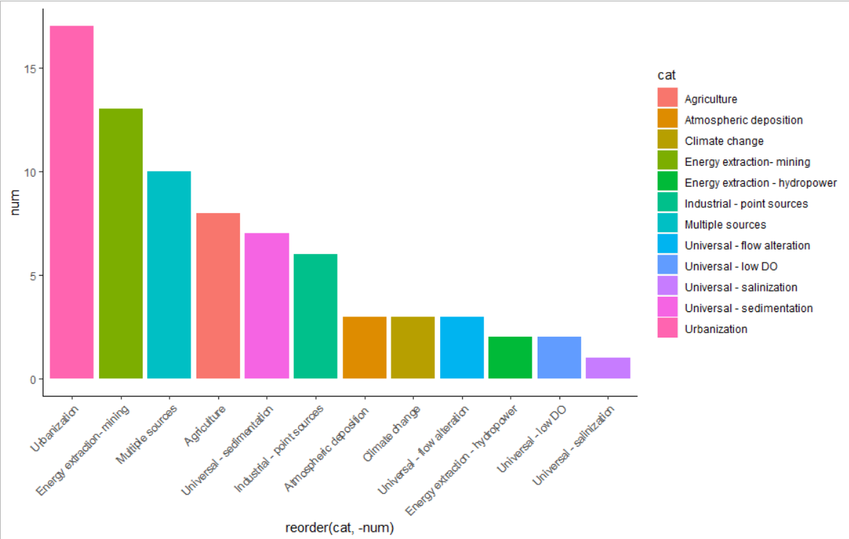
Where do the stressors originate?
Out of 75 papers:
23% urbanization
17% mining
13% multiple
10% agriculture
13 papers did not have defined “source”
Driver/source
Number of papers
Provisional results, for feedback only

Slide 6
Where do the stressors originate?
Out of 75 papers:
23% urbanization
17% mining
13% multiple
10% agriculture
13 papers did not have defined “source”
Driver/source
Number of papers
Provisional results, for feedback only

Slide 7
Urban studies
17 studies identified urbanization as major driver
13 studies examined multiple stressors
1 study examined flow alteration
3 studies examined salinity (2 of 3 had lab component)
2 studies examined sediment
Types of urbanization
Most leveraged rural/forest-urban gradients
Highway construction
Military base development
Many biological response metrics
Abundance, total taxa richness, EPT richness, EPT-H richness, % EPT taxa, MD BIBI, Shannon diversity, FFG, evenness metrics, NMDS ordination scores, O/E ratios, etc.
Provisional results, for feedback only

Slide 8
Urban studies- multiple stressor
Type of study: spatial urban gradient in 9 major metropolitan areas (25-30 sites in each MA)
Stressors measured: Flow alteration, temp, W/D ratios, percent fines, ions, nutrients, toxics
Bio response: observed vs expected (O/E) taxa and NMDS scores
Statistical approach for comparing stressors: single and multiple regression model comparisons
Which stressor was most important: HOCs (toxics) and hydrology
Summed AICc weights
Bryant and Carlisle 2012 (Freshwater Science)
Notes:
HOC= hydrophobic organic contaminates, PAHs (polycyclic aromatic hydrocarbons)

Slide 9
Urban studies- multiple stressor
Type of study: spatial urban gradient of 75 sites in SE united States
Stressors measured: Flow alteration, temp, habitat metrics, ions, nutrients, toxics
Bio response: EPTR-H richness, O/E taxa, total taxa richness
Statistical approach for comparing stressors: boosted regression trees
Which stressor was most important: hydrology, toxics (pesticides), and dissolved oxygen
Waite et al. 2019 (STOTEN)

Slide 10
Agricultural studies
8 studies identified agriculture as main driver
5 examined multiple stressors simultaneously
2 were pesticide lab/mesocosm studies
1 study compared 2 stressors simultaneously (sediment and velocity)
Different agricultural types and intensity
Pasture/cattle grazing
row crops
Wide range of biological responses
macroinvert abundance, diversity, richness, biomass, multimetric indices of biological integrity, survival and growth, etc.
Provisional results, for feedback only

Slide 11
Ag studies-multiple stressor
Type of study: sites spanning cattle density gradient
Stressors measured: flow, water quality (no nutrients), habitat, food sources
Biological response: Whole community, % taxa, % sensitive taxa, etc.
Statistical approach for comparing stressors: Multivariate statistical analyses (CCA), regression model comparison
Which stressor was most important: physical habitat (percent fines, substrate homogeneity)
Braccia and Voshell 2006
(Hydrobiologia)

Slide 12
Ag studies-multiple stressor
Type of study: 98 sites spanning row crop gradient (12 were designated urban)
Stressors measured: flow, water quality, toxics, habitat, temperature
Biological response: multi-metric index
Statistical approach for comparing stressors: structural equation modeling
Which stressor was most important: pesticides, ammonia, channel erosion (all negative effects)
Schmidt et al. 2019 (Environmental Science and Technology)

Slide 13
Next steps
Continue summarizing studies
Test out different ways to summarize data
Sources/sectors have multiple stressors
Stressors can originate from multiple sources
Further standardizing information collection during paper reviews
Categorize biological responses (reference-based, richness, etc.)
Target specific literature to cover gaps (e.g., more agriculture, climate change, stream temperature studies needed)

Slide 14
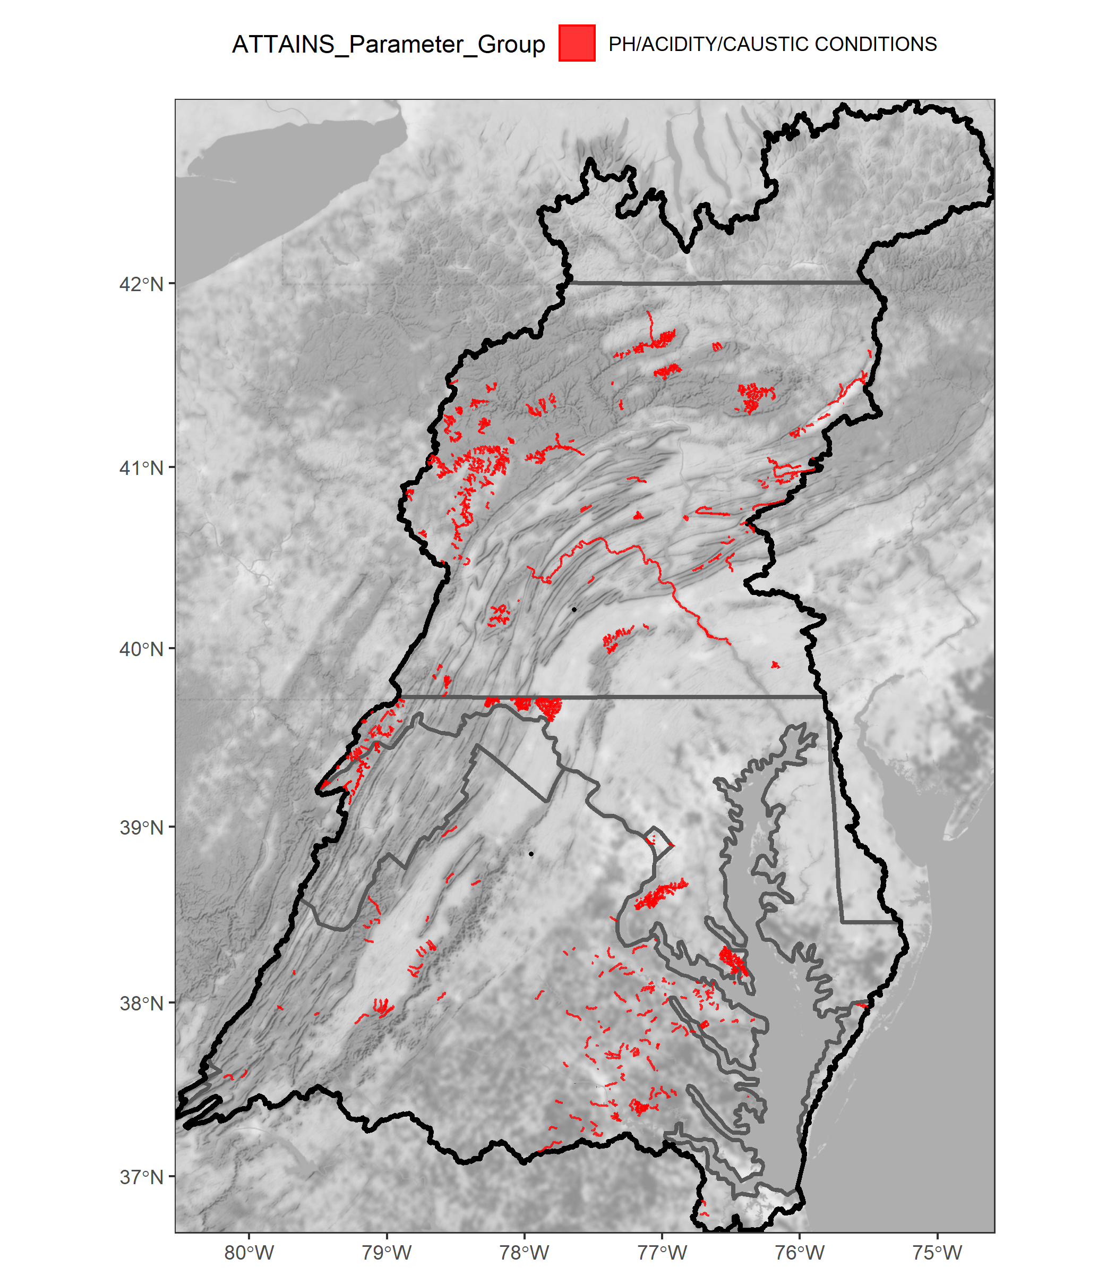
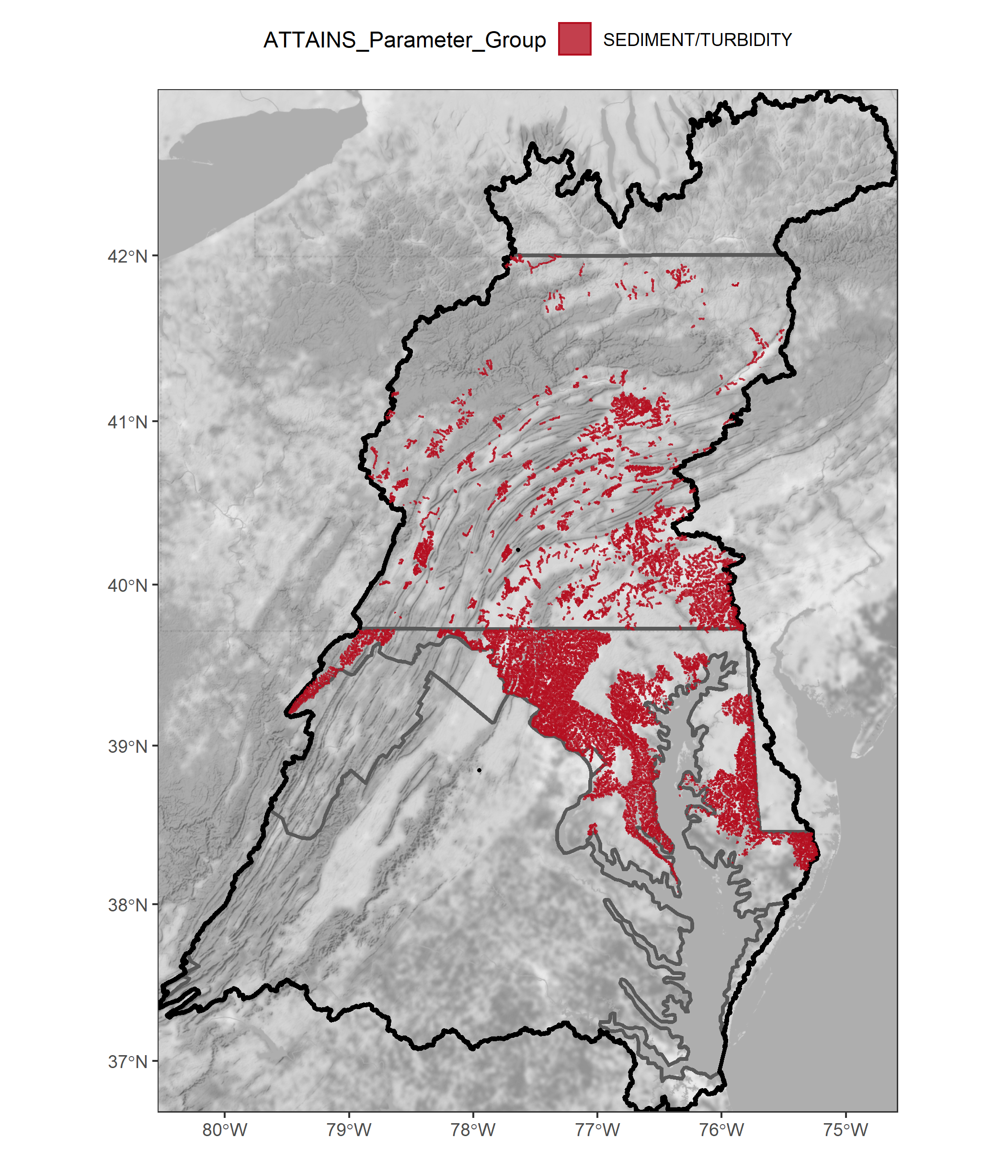
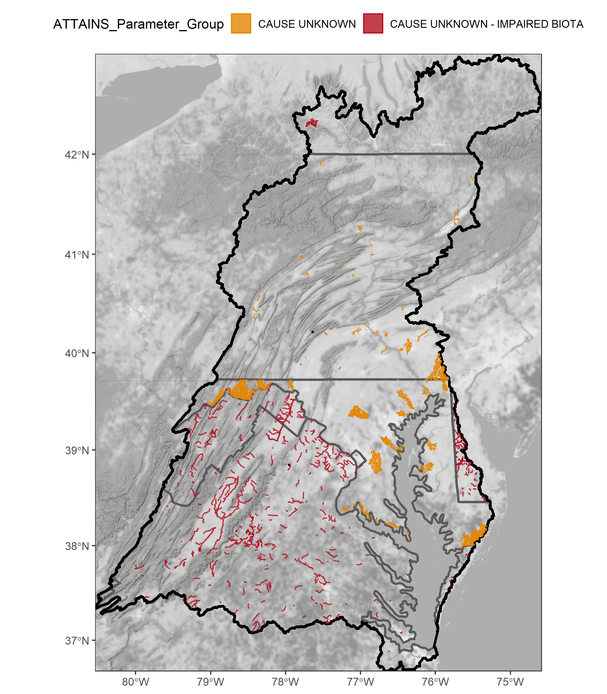
EPA ATTAINS – Impairment Analysis
What in-stream stressors and landscape causes are most important according to impairment listings?
Using most recent EPA ATTAINS data
Focus on Ecological Life Use Group
Other groups include: Fish Consumption, Recreation, Water Supply
Impairment “parameters” grouped into larger EPA categories
i.e. stressor groups
State-level differences obvious
Provisional results, for feedback only

Slide 15
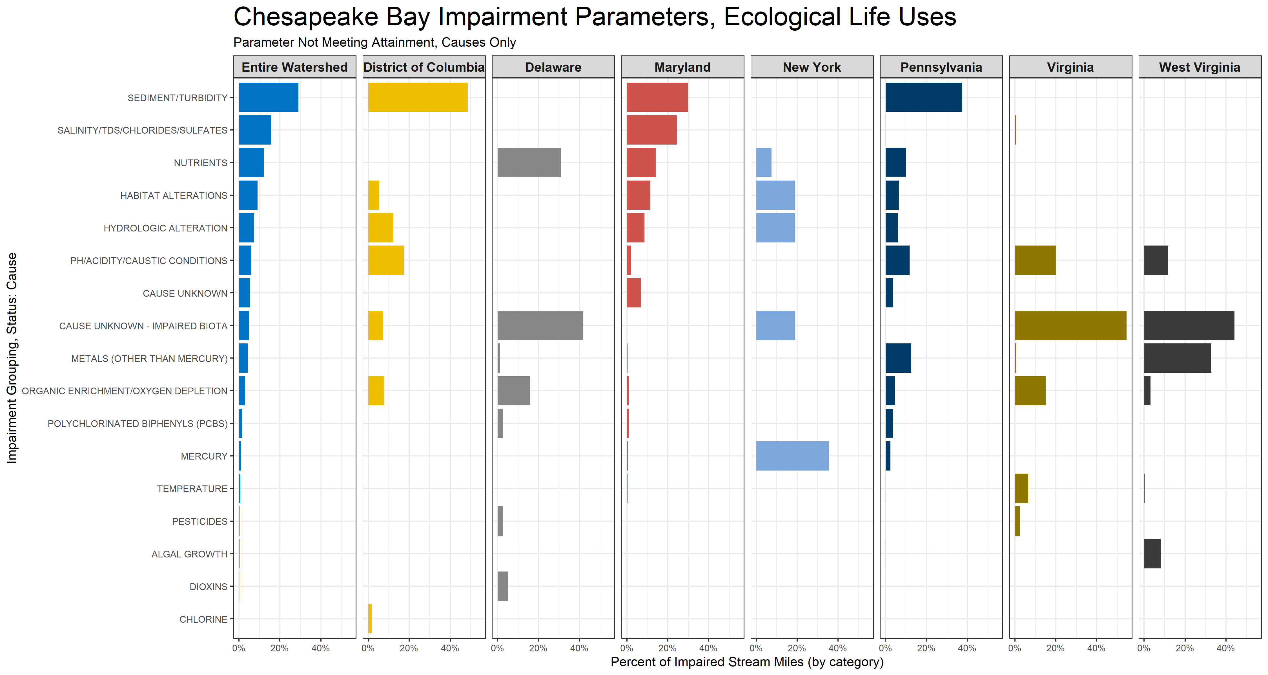
EPA ATTAINS – Most Frequent Parameters
Use: Ecological Life
Parameter: Not Attaining
“Cause” only
Ranked by stream miles listed in ATTAINS
Provisional results, for feedback only

Slide 16
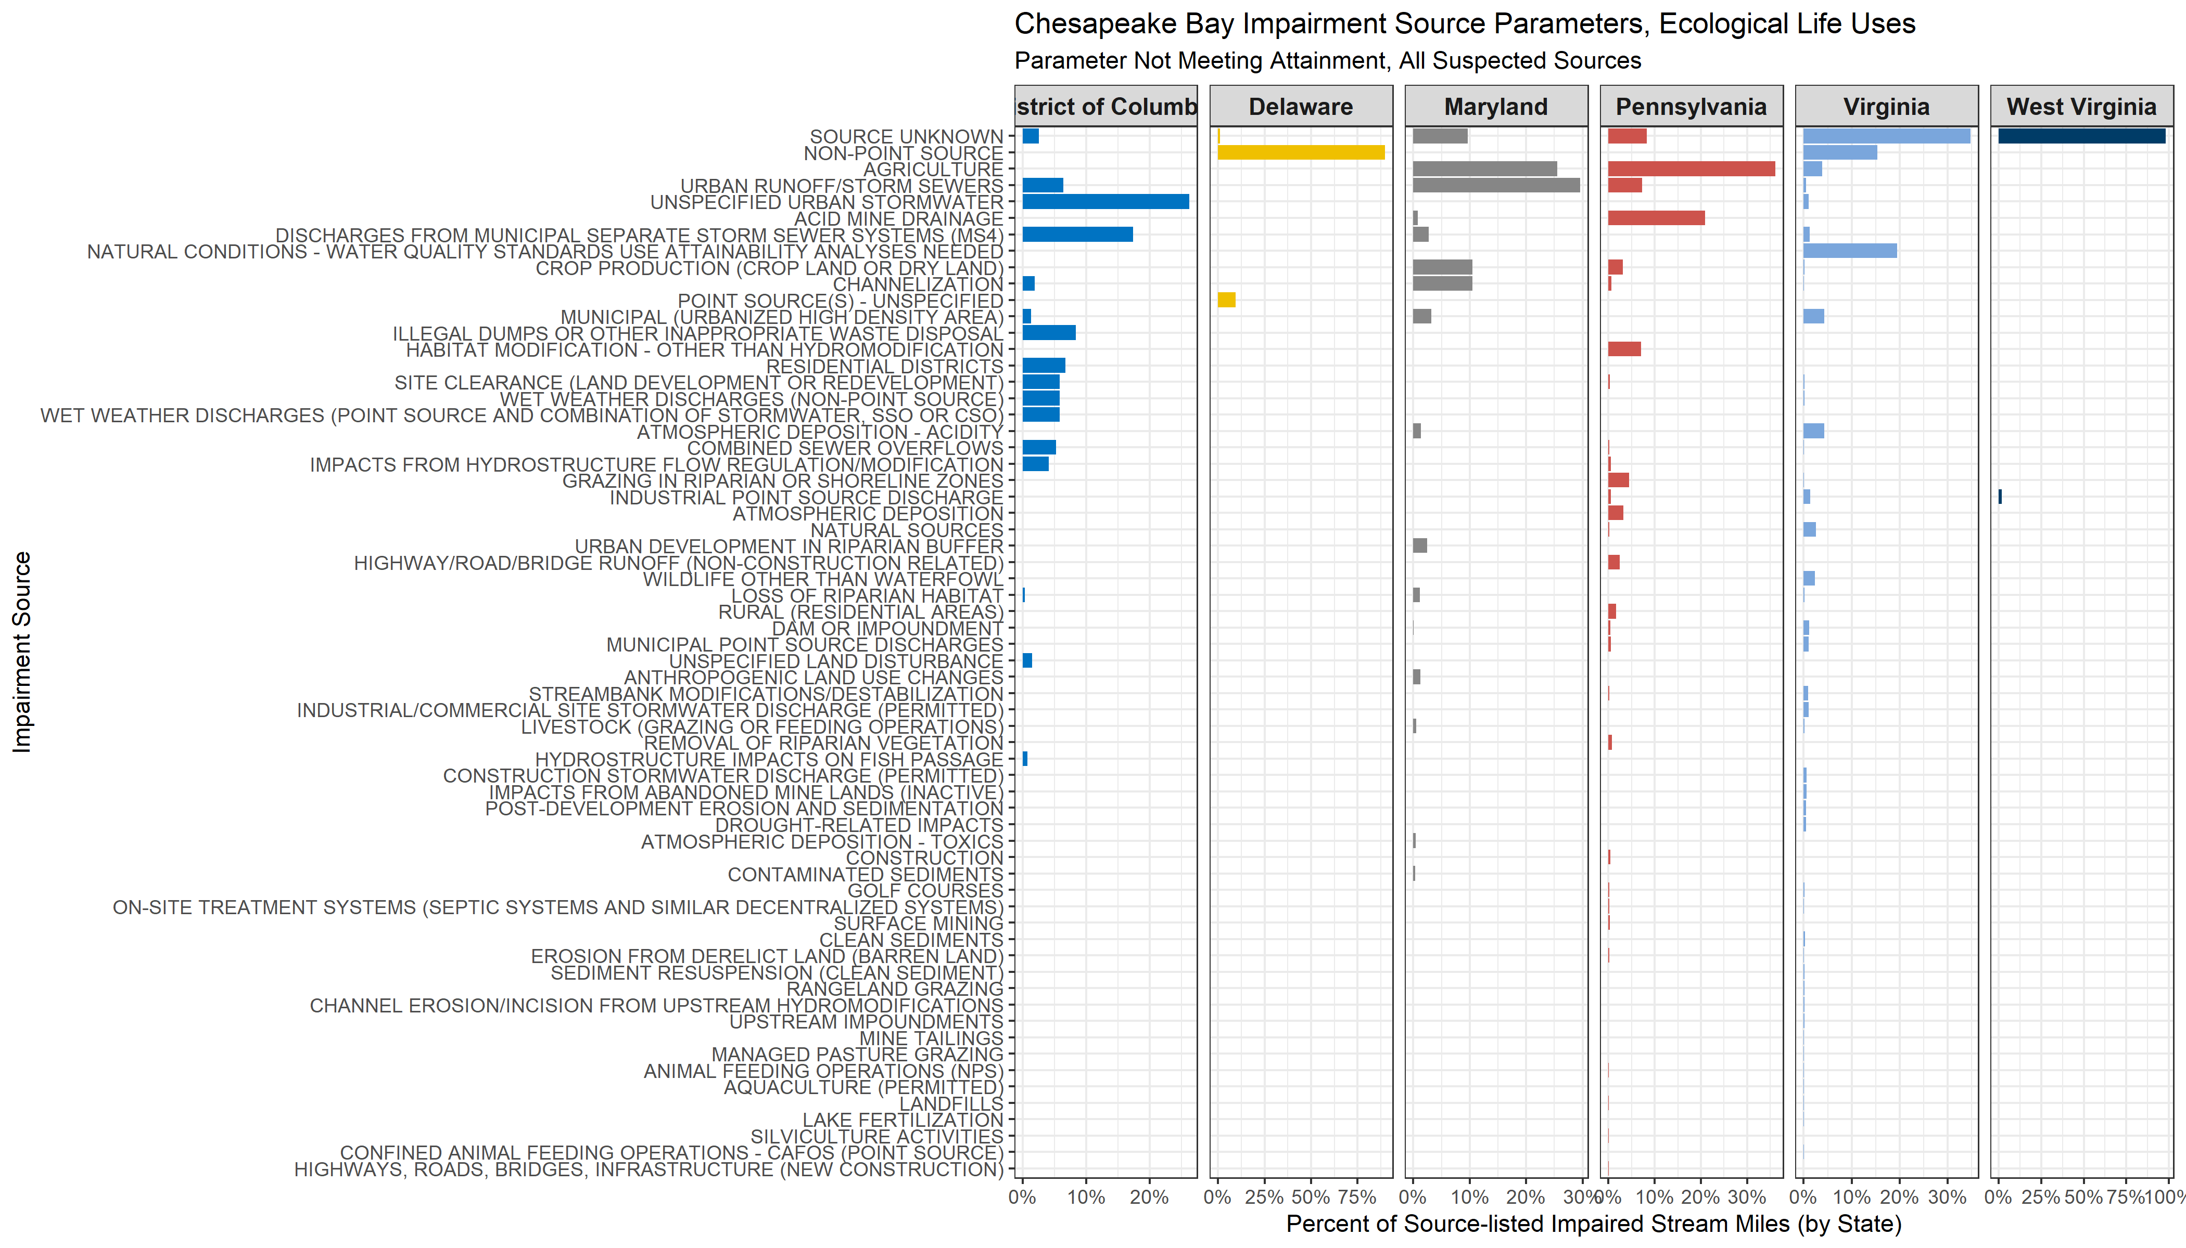
EPA ATTAINS – Suspected “Source”
Many state differences
Provisional results, for feedback only

Slide 17
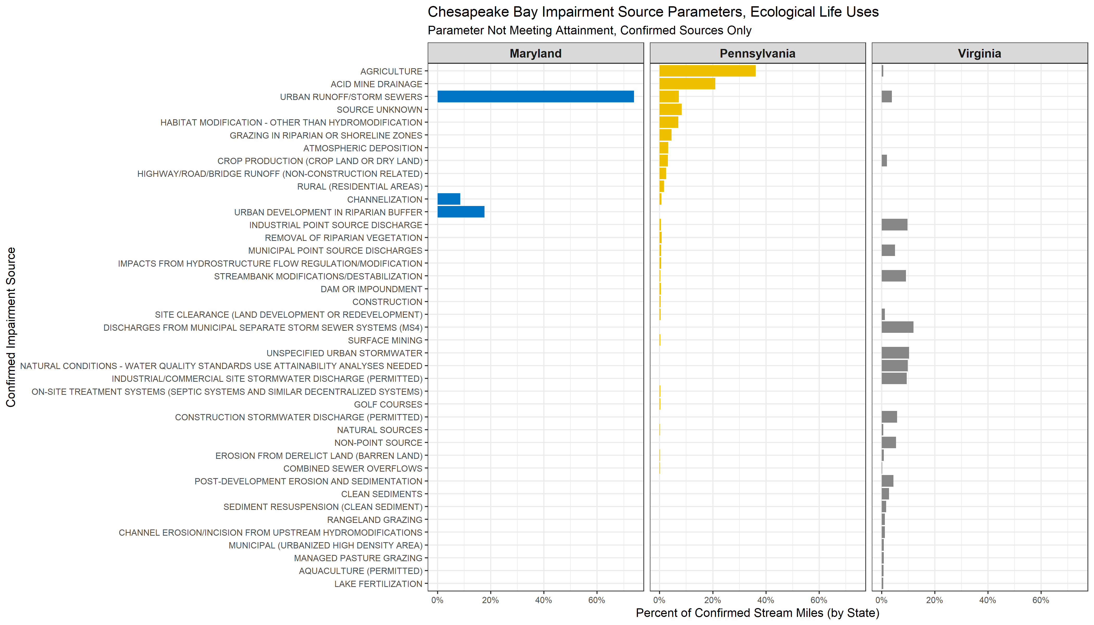
EPA ATTAINS – Confirmed “Source”
Many state differences
Provisional results, for feedback only

Slide 18
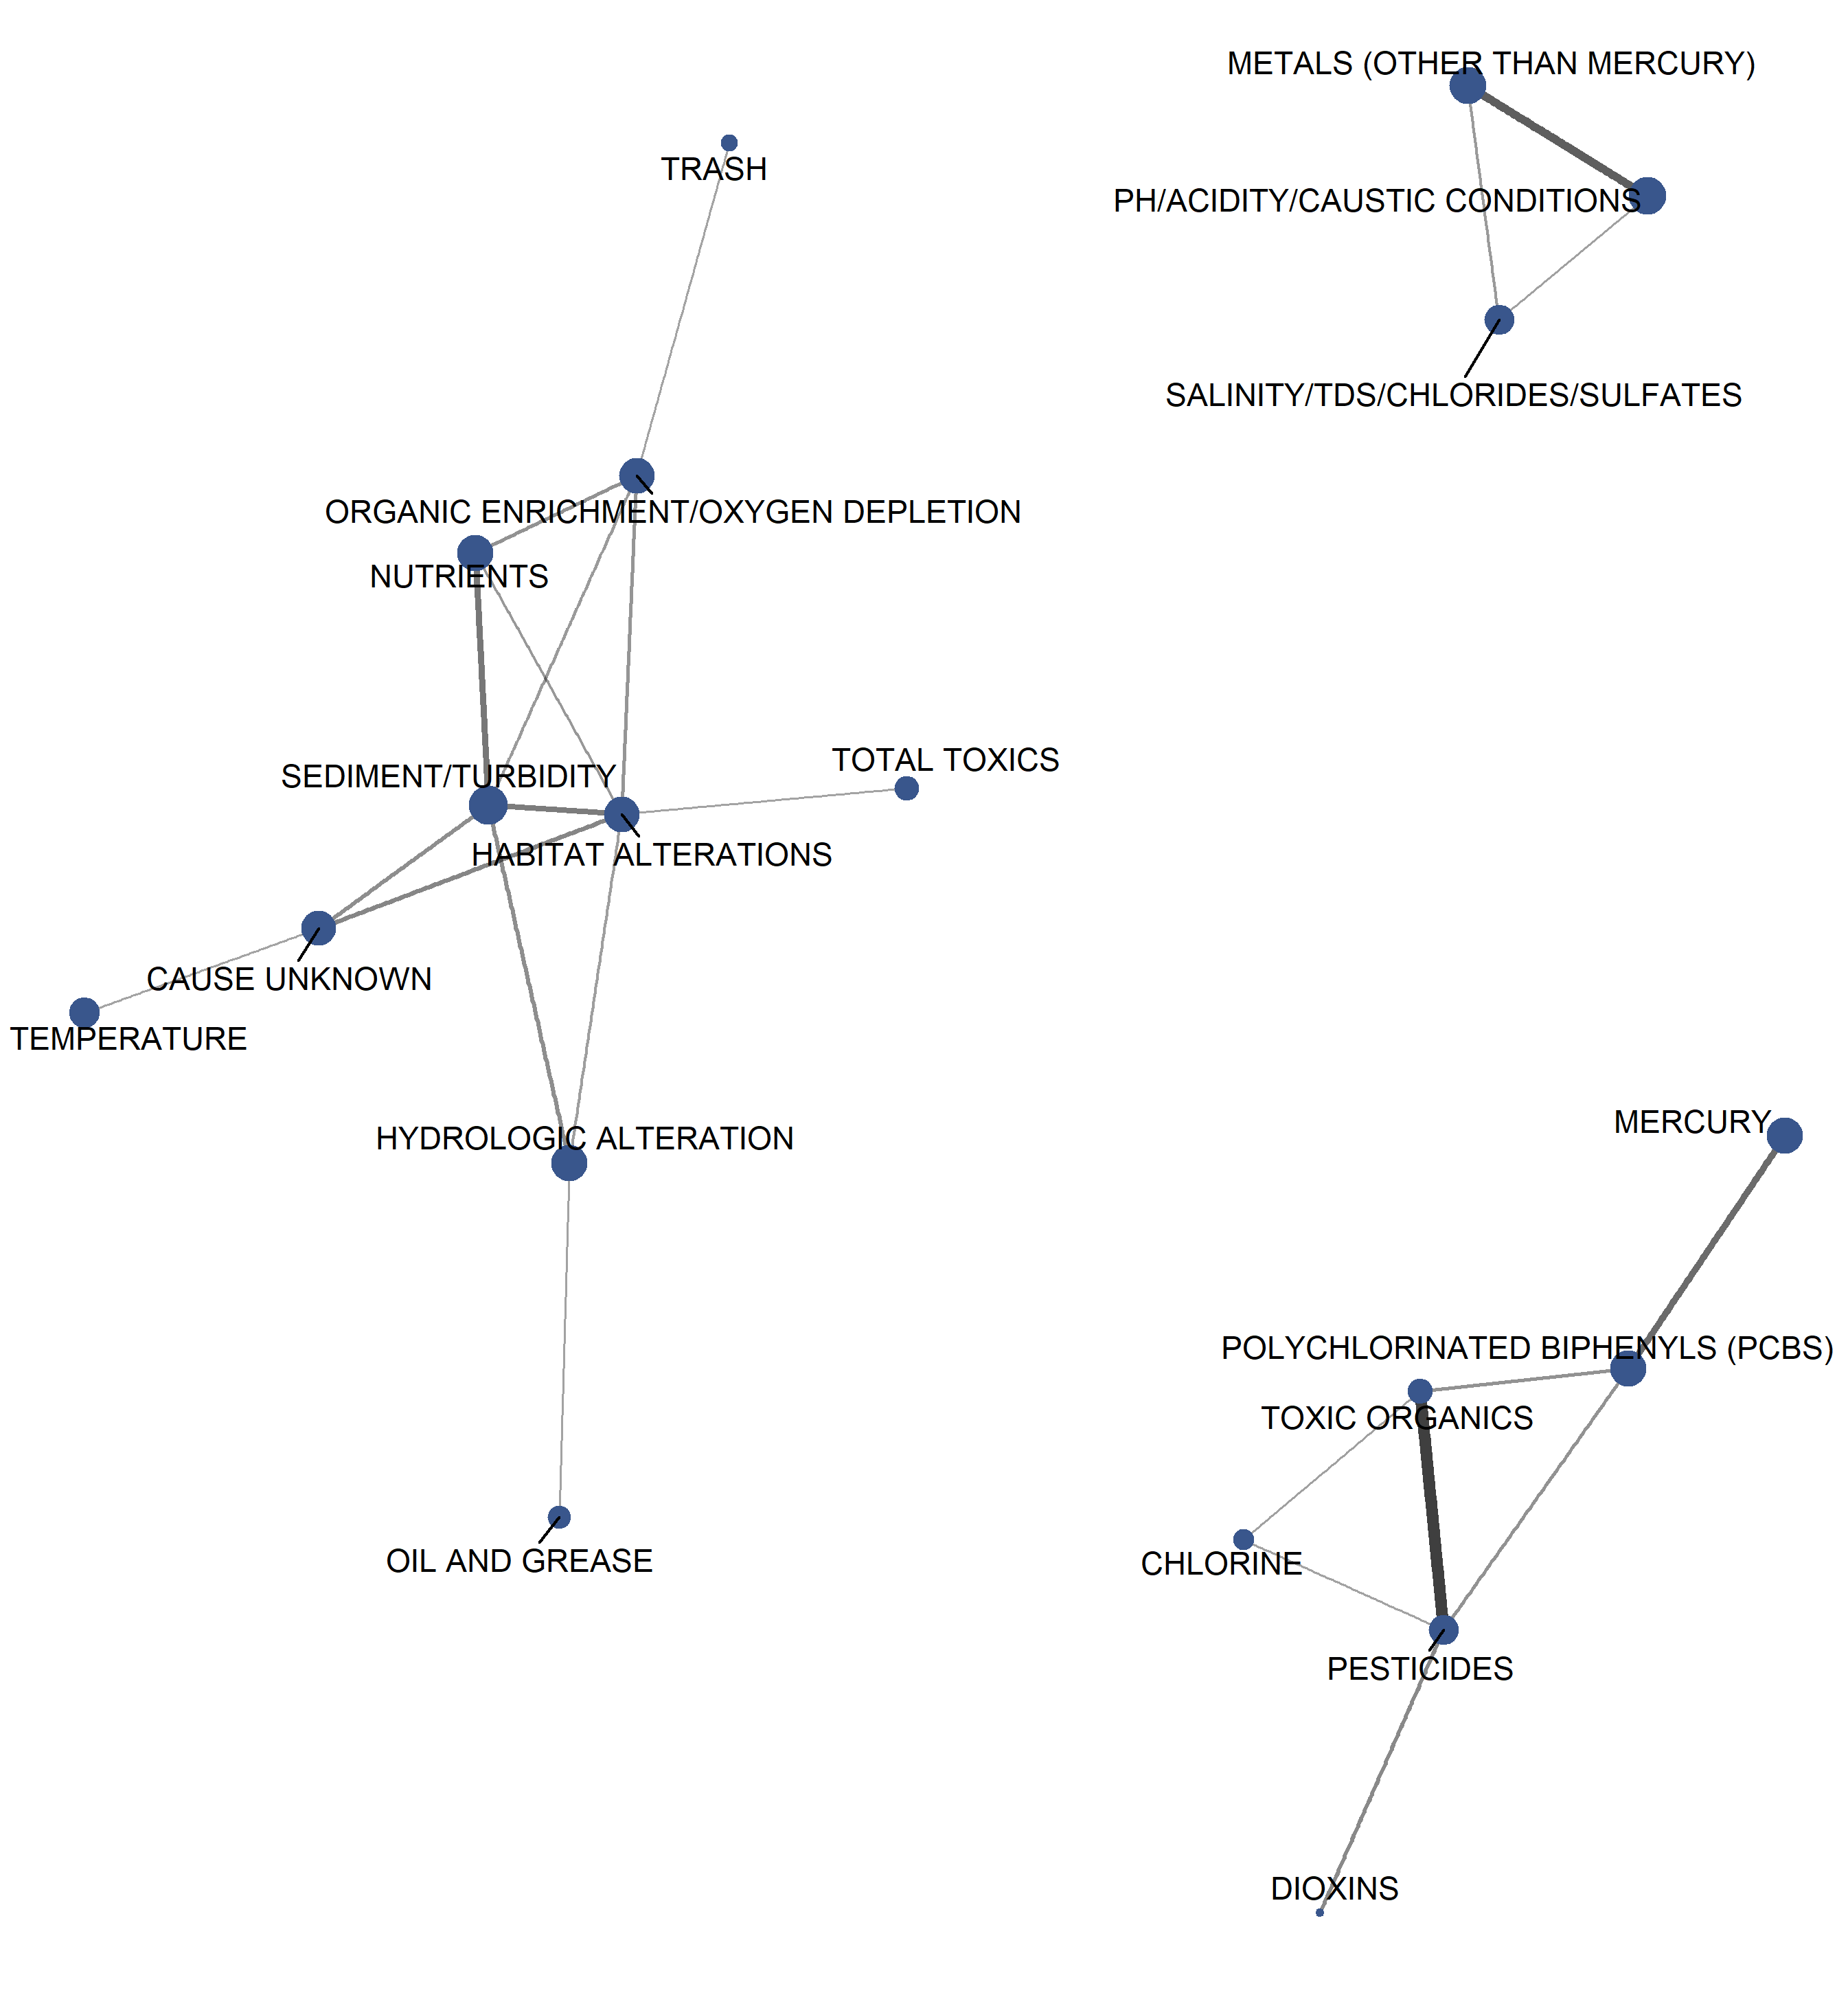
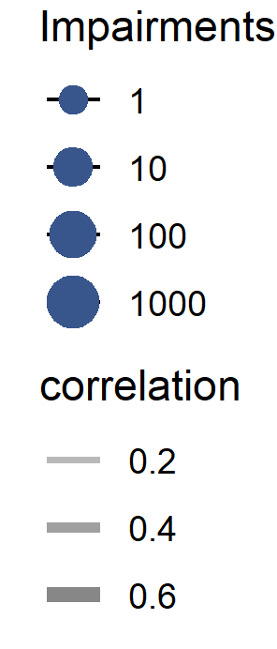
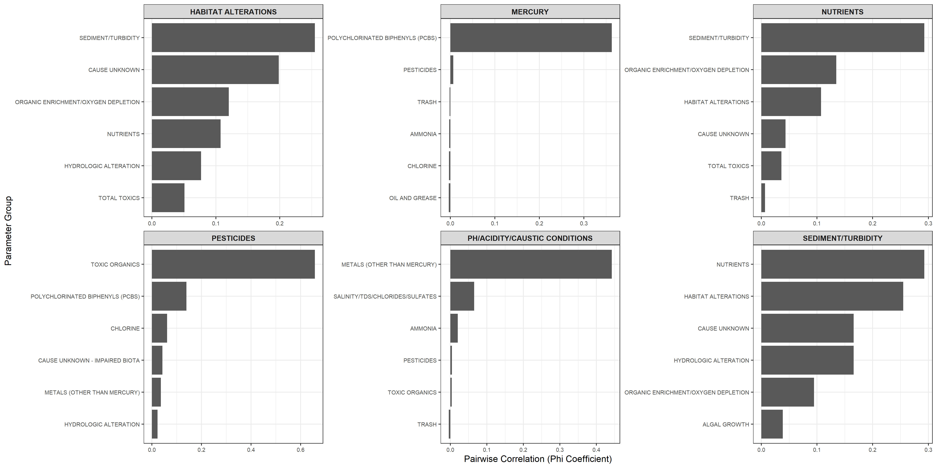
EPA ATTAINS – Parameter Networks
Network analysis of co-occurring impairment parameter on same assessment unit across uses
Clusters of correlated stressors
Identifying multi-stressor groupings
Provisional results, for feedback only

Slide 19
EPA ATTAINS – Current takeaways
In ATTAINS, the top 4 “Stressor” groupings (by mile)
Sediment/Turbidity
Salinity/TDS/Chlorides/Sulfates
Nutrients
Habitat Alterations
Network analysis of co-occurring stressor impairments identifies multi-stressor clusters related to
Sediment/Nutrients/Habitat
Contaminants
Metals/Acidity
There are large state-by-state differences, in stressors, sources, and way data is stored in ATTAINS
Work-in-progress to harmonize data
Missing data for some listed Virginia streams
Provisional results, for feedback only

