Slide 1
RFB Outreach and Technical Assistance A Brief, Historical^{(?)} Context in the Chesapeake
Outreach – publications, “chicken dinner circuit”, posters, ads, website, etc
Early focus on CREP – a post-2018 Farm Bill report coming out in April
Pilot projects, Collaborations, Supporting Initiatives, Workshops
Tracking – ongoing, evolving

Slide 2
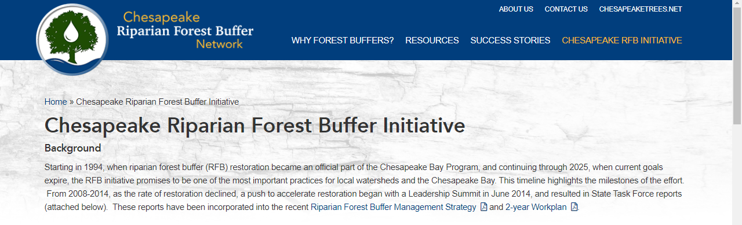
2014 RFB Initiative chesapeakeforestbuffers.net

Slide 3
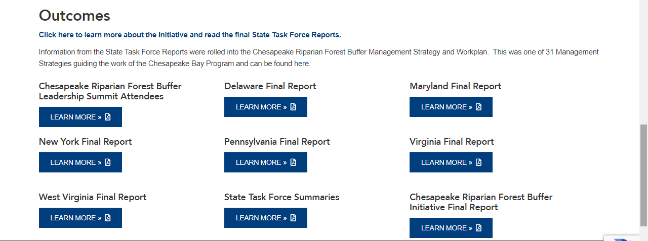
2014 RFB Initiative chesapeakeforestbuffers.net

Slide 4
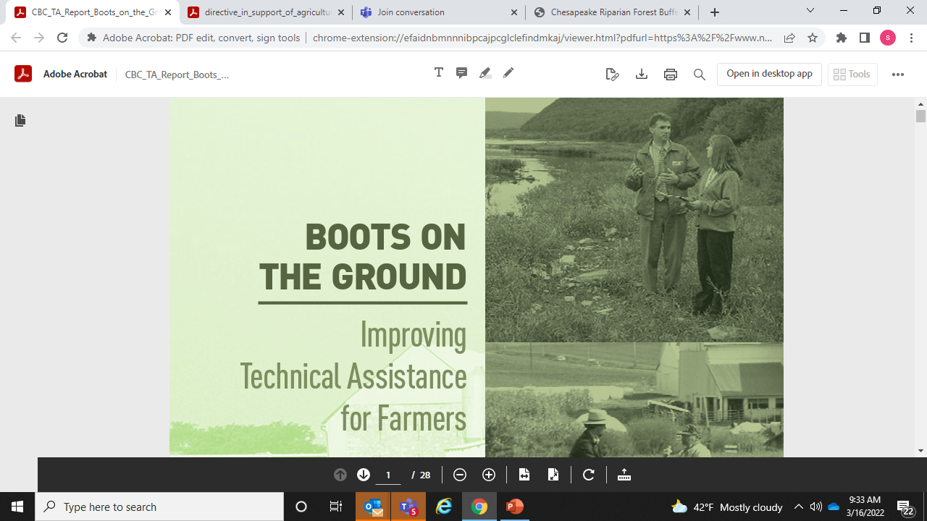
Chesapeake Bay Commission Report, 2017

Slide 5
Diversify and expand the network of public, private and non-profit providers of technical and financial assistance to ensure that on-farm support is available to meet the agricultural sector load reductions. Expand technical assistance capacity through the use of cooperative agreements and other tools that combine federal, state, local and private resources to target priority agricultural resource concerns.
From CBP’s 2018 Technical Assistance Directive

Slide 6
From CBP’s 2018 Technical Assistance Directive
Enhance and coordinate critical agricultural conservation programs to ensure they offer the flexibility and capacity needed to incentivize farmers to install practices, including riparian forest buffers, to help meet the goals of the Bay TMDL.
Enhance the job climate for government technical assistance professionals by exploring how to make training and certification more streamlined and accessible, along with the development of two-year certification programs, innovative technology training forums and education loan assistance programs.

