Slide 1

QUARTERLY PROGRESS MEETING – November 2020 Chesapeake Bay Program
Wetlands
Pamela Mason,
CCRM/VIMS
WWG Co-chair
Notes:
Find photos on our Flickr site: https://www.flickr.com/photos/29388462@N06/sets/
You can also browse photos by category on our website: http://www.chesapeakebay.net/photos

Slide 2
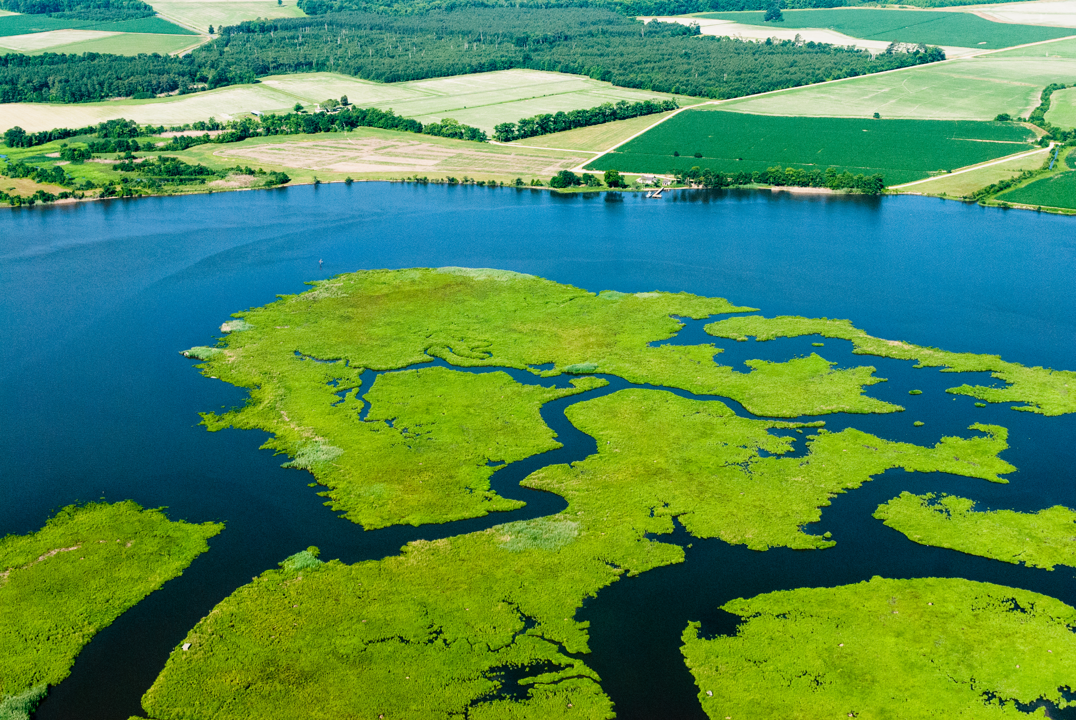
Through the Chesapeake Bay Watershed Agreement, the Chesapeake Bay Program has committed to…
Goal: Vital Habitats (WETLANDS)
Outcome:
Continually increase the capacity of wetlands to provide water quality and habitat benefits throughout the watershed. Create or reestablish 85,000 acres of tidal and non-tidal wetlands and enhance function of an additional 150,000 acres of degraded wetlands by 2025. These activities may occur in any land use (including urban), but primarily occur in agricultural or natural landscapes.
Relevant Photo
Notes:
INSTRUCTIONS:
Add the title of your goal and the language of your outcome from the 2014 Agreement (copy and paste).
Add a relevant photo (if it all fits).
If desired, talking points could include more contextual information, e.g. the importance of the outcome and the historic trends that led to the establishment of the specific target.

Slide 3
What is our Expected and Actual Progress?
Lack confidence- Accounting for TMDL not wetland areal extent
No Tidal Wetlands included (looking at shoreline management data)
Almost no Enhancement due to issues with NEIEN
Goal: 85,000
Notes:
INSTRUCTIONS: Copy and paste the graph or chart you used to answer narrative analysis question #2. The editable graph from the Narrative Analysis template has been included here for your reference.
FROM NARRATIVE ANALYSIS (FOR YOUR REFERENCE ONLY):
“2. Regardless of how successful your short-term progress has been over the past two years, indicate whether we are making progress at a rate that is necessary to achieve the outcome you are working toward.
Use the editable graph or your own chart to illustrate your progress. Explain any gap(s) between our actual progress and our anticipated trajectory.”

Slide 4
Wetland Restoration + Creation 1985–2019 + 2025 WIP Goals

Slide 5
Wetland Enhancement/ Rehabilitation 1985–2019 + 2025 WIP Goals

Slide 6
What is our Expected and Actual Progress?
Goal came from WIP 1. Jurisdictions may not be as committed or over-estimated possible achievement.
Wetlands are tracked because they are BMPs- not for wetlands sake.
No Tidal Wetlands included. Tracking process lacking
Lack confidence in the data
No Enhancement data due to issues with reporting in NEIEN
Notes:
INSTRUCTIONS: Copy and paste the graph or chart you used to answer narrative analysis question #2. The editable graph from the Narrative Analysis template has been included here for your reference.
FROM NARRATIVE ANALYSIS (FOR YOUR REFERENCE ONLY):
“2. Regardless of how successful your short-term progress has been over the past two years, indicate whether we are making progress at a rate that is necessary to achieve the outcome you are working toward.
Use the editable graph or your own chart to illustrate your progress. Explain any gap(s) between our actual progress and our anticipated trajectory.”

Slide 7
Learn What have we learned in the last two years?
L
Notes:
INSTRUCTIONS: This slide is a transition slide and does not need to be modified.

Slide 8
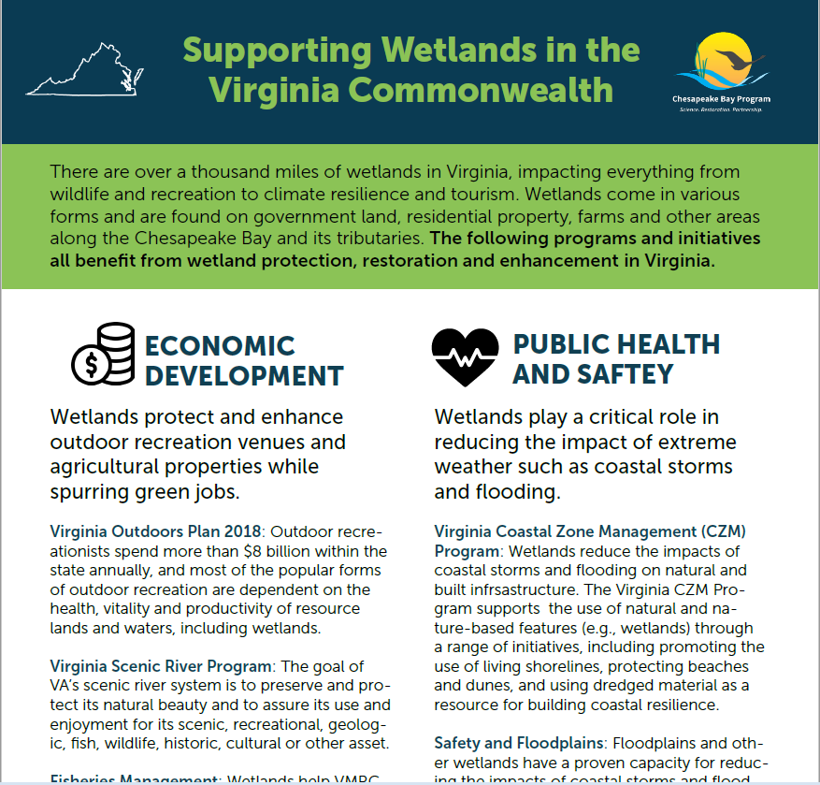
Successes and Challenges
Good engagement from WWG members
Increased interest in wetlands goal work
Improved communications and cross GIT/ WG engagement
Wetland Benefits fact sheets
Notes:
INSTRUCTIONS: This slide should briefly summarize your answer to narrative analysis question #1.
FROM NARRATIVE ANALYSIS (FOR YOUR REFERENCE ONLY):
“1. Examine your red/yellow/green analysis of your management actions. What lessons have you learned over the past two years of implementation?
Summarize what you have learned about what worked and what didn’t. For example, have you identified additional factors to consider or filled an information gap?”

Slide 9
Successes and Challenges
Concerns over data accuracy
Concerns regarding perverse consequences of wetland BMPs as incentives for projects other than wetlands
Need continued focus on communications efforts
Notes:
INSTRUCTIONS: This slide should briefly summarize your answer to narrative analysis question #1.
FROM NARRATIVE ANALYSIS (FOR YOUR REFERENCE ONLY):
“1. Examine your red/yellow/green analysis of your management actions. What lessons have you learned over the past two years of implementation?
Summarize what you have learned about what worked and what didn’t. For example, have you identified additional factors to consider or filled an information gap?”

Slide 10
On the Horizon
Potential effects of COVID on Federal, State and NGO budgets decreasing funding
FEMA policies on Natural and Nature Based Features
State policies on wetlands and buffers (Virginia new living shorelines law and climate inclusion in CBPA and VDOT policy)
Use co-benefits (flood, habitats, open space, ecotourism) as restoration/ enhancement incentives
Climate impacts on non-tidal and tidal wetlands
Research on climate impacts
Notes:
INSTRUCTIONS: This slide should briefly summarize your answer to narrative analysis question #3.
FROM NARRATIVE ANALYSIS (FOR YOUR REFERENCE ONLY):
“3. What scientific, fiscal and policy-related developments will influence your work over the next two years?
This may include information learned at the previous biennial SRS meeting or more specific information about your outcome such as an increase or decrease in funding, new programs that address gaps, and new scientific data or research. Describe how these developments are likely to impact your recommended measure(s) of progress, the factors you believe impact your ability to succeed, and newly created or filled gaps. These changes should be reflected in the first three columns of your revised logic and action plan after your quarterly progress meeting.”

Slide 11
Adapt How does all of this impact our work?
A
Notes:
INSTRUCTIONS: This slide is a transition slide and does not need to be modified.

Slide 12
Based on what we learned, we plan to …
One year since Logic and Action plan revision
No adaptations since last November
Continue to focus on current actions
Notes:
INSTRUCTIONS: This slide should briefly summarize your answer to narrative analysis question #4. As a reminder, question four refers back to the first three questions in the Narrative Analysis.
FROM NARRATIVE ANALYSIS (FOR YOUR REFERENCE ONLY):
“4. Based on your response to the questions above, how will your work change over the next two years?
Describe the adaptations that will be necessary to more efficiently achieve your outcome and explain how these changes will lead you to adjust your management strategy or the actions described in column four of your logic and action plan. Changes that the workgroup, GIT or Management Board consider significant should be reflected in your management strategy.”

Slide 13
Based on what we learned, we plan to …
Commit to increased communications via formal presentations (2 per meeting)
Shared meetings and cross-sector engagement: Fish habitat WG, Climate Resilience WG, Buffers. Working on Black Duck engagement
Pursue collaborative STAC workshop on BMP accounting and perverse incentives
Notes:
INSTRUCTIONS: This slide should briefly summarize your answer to narrative analysis question #4. As a reminder, question four refers back to the first three questions in the Narrative Analysis.
FROM NARRATIVE ANALYSIS (FOR YOUR REFERENCE ONLY):
“4. Based on your response to the questions above, how will your work change over the next two years?
Describe the adaptations that will be necessary to more efficiently achieve your outcome and explain how these changes will lead you to adjust your management strategy or the actions described in column four of your logic and action plan. Changes that the workgroup, GIT or Management Board consider significant should be reflected in your management strategy.”

Slide 14
Help How can the Management Board lead the Program to adapt?
H
Notes:
INSTRUCTIONS: This slide is a transition slide and does not need to be modified.

Slide 15
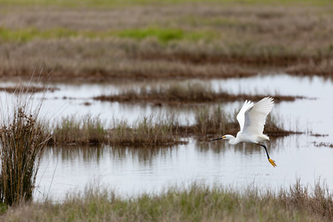
How You Can Help
Goal is off-track
Not surprising given challenges
Need increased commitment in funding and personnel time to advance wetlands restoration, creation and enhancement
Notes:
INSTRUCTIONS: This slide is intended to provide context for your presentation.
Summarize your progress and preview your needs without going into detail on either point. If you don’t have a request, identify a few key points you want the to convey to the Management Board.
Replace the provided picture with your own or one selected from the sources identified on the first slide.

Slide 16
Help Needed
Direct collaboration among the state agencies (reg and non-reg) on wetland data. If there is an annual data call, then there needs to be more support and collaboration to ensure accuracy. Assign/ commit/ finance personnel.
Notes:
INSTRUCTIONS: This slide should briefly summarize your answer to narrative analysis question #5.
FROM NARRATIVE ANALYSIS (FOR YOUR REFERENCE ONLY):
“5. What, if any, actions can the Management Board take to help ensure success in achieving your outcome?
Please be as specific as possible. Do you need direct action by the Management Board? Or can the Management Board direct or facilitate action through other groups? Can you describe efforts the workgroup has already taken to address this issue? If this need is not met, how will progress toward your outcome be affected? This assistance may include support from within a Management Board member’s jurisdiction or agency.”

Slide 17
QUARTERLY PROGRESS MEETING Chesapeake Bay Program
Discussion
Presentation template by SlidesCarnival.
Notes:
[time for discussion at the end of the presentation, before the next outcome presentation]

